Slide 1
Analysis of Korea-4GSR NC-HHC
2025-03-28, Pohang, South Korea
Young Min Park
Division of Advanced Nuclear Engineering (DANE), POSTECH

Slide 2
Index
Robinson instability with HHC
Theory
Analysis
Near Flat Potential
High Q cavity
Passive cavity
2

Slide 3
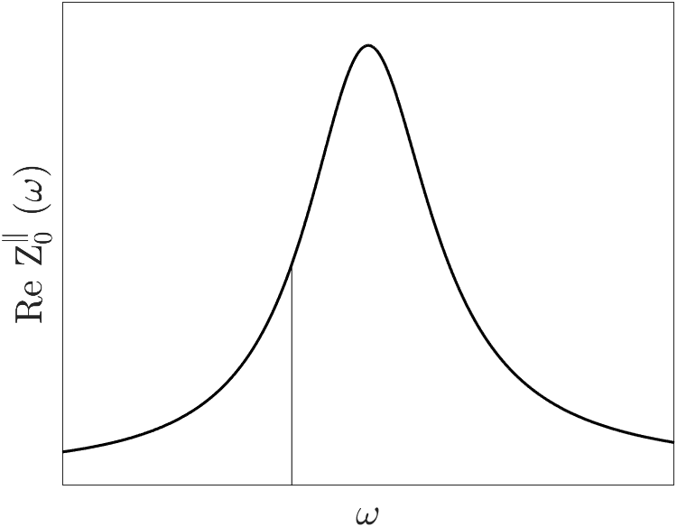
Robinson instability with HHC
$$ω_{r}$$
$$τ^{−1}=\frac{eαI}{4πE_{0}ν_{s}}\left\{\sum_{p=0}^{∞}{Re\left[\left(\left(pM+μ\right)ω_{0}+ω_{s}\right)Z\left(\left(pM+μ\right)ω_{0}+ω_{s}\right)\right]−\sum_{p=0}^{∞}{Re\left[\left(\left(pM−μ\right)ω_{0}−ω_{s}\right)Z\left(\left(pM−μ\right)ω_{0}−ω_{s}\right)\right]}}\right\}≈\frac{eαI}{4πE_{0}ν_{s}}\left\{Re\left[\left(\left(h+μ\right)ω_{0}+ω_{s}\right)Z\left(\left(h+μ\right)ω_{0}+ω_{s}\right)\right]−Re\left[\left(\left(h−μ\right)ω_{0}−ω_{s}\right)Z\left(\left(h−μ\right)ω_{0}−ω_{s}\right)\right]\right\}$$
$$μ=1$$
$$μ=0$$
$ω_{s}:$ synchrotron frequency,$μ:$ multibunch mode, $ω_{0}:$ revolution frequency, $ν_{s}$: synchrotron tune
Off-momentum particles have different frequencies $→$ Different energy loss due to cavity impedance $→$ Results in either amplitude growth or damping, depending on $tan ψ$ or $ω_{r}−ω_{rf}$
$$ω_{s}$$
$$ω_{0}$$
$$ω_{rf}$$
Considering both the main RF and the harmonic cavity, impedance $Z$ is given by :
$$Z=Z_{main}+Z_{HHC}=\frac{R_{s,main}}{1+iQ_{L,main}\left(\frac{ω_{r,main}}{ω}−\frac{ω}{ω_{r,main}}\right)}+\frac{R_{s,HHC}}{1+iQ_{L,HHC}\left(\frac{ω_{r,HHC}}{ω}−\frac{ω}{ω_{r,HHC}}\right)}$$
The tuning angle $ψ$ of the harmonic cavity is typically larger than 0 $→$ Growth condition
3

Slide 4
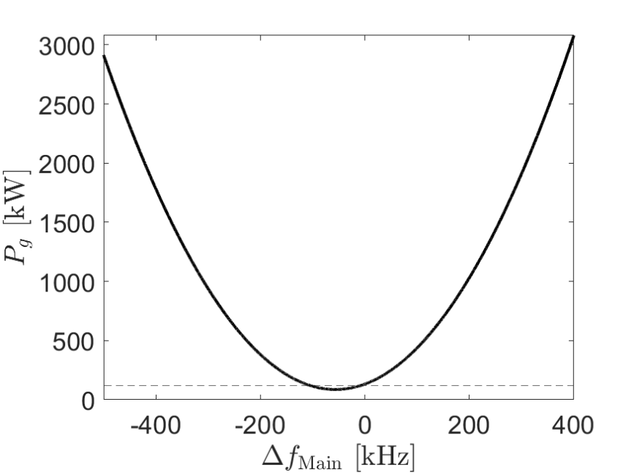
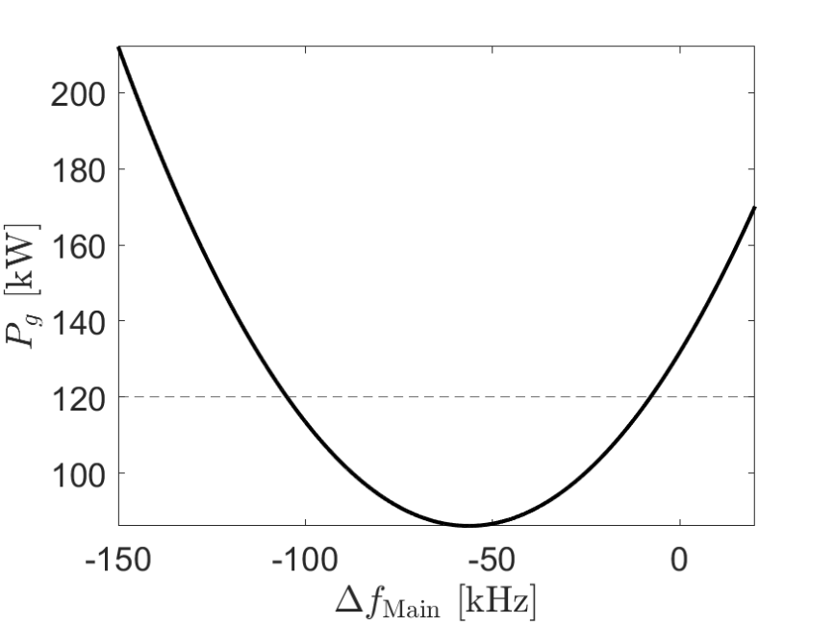
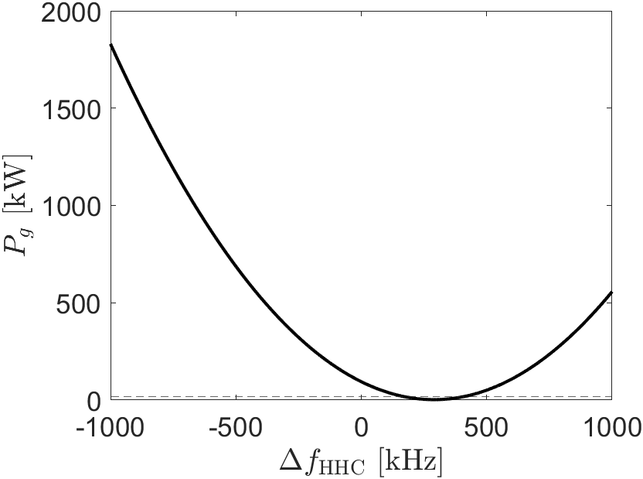
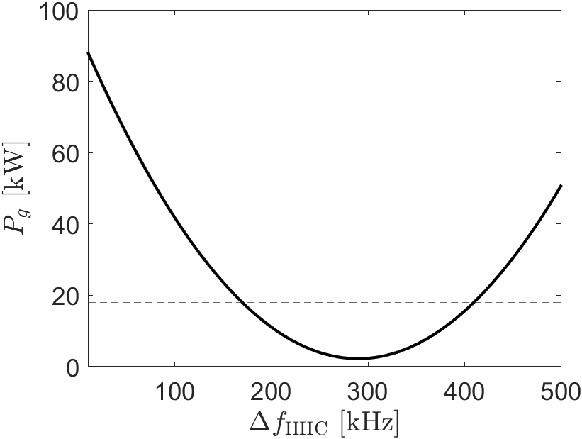
Analysis
Single cavity required generator power depending on tuning frequency
Main RF cavity
Coupling beta ($β)=4.$58
Beam current = 400 mA
Number of cavity = 12
Max. Coupler
Higher harmonic cavity (HHC)
Coupling beta ($β)=1$
Beam current = 400 mA
Number of cavity = 7
SSPA power
$$Q=14000, \frac{R}{Q}=86⋅7=219 Ω, β=1$$
4

Slide 5
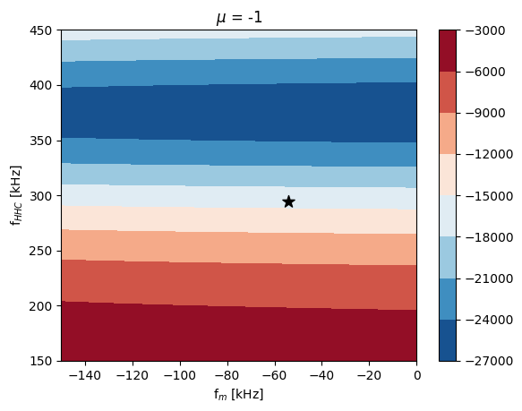
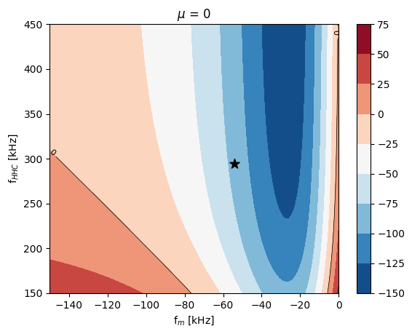
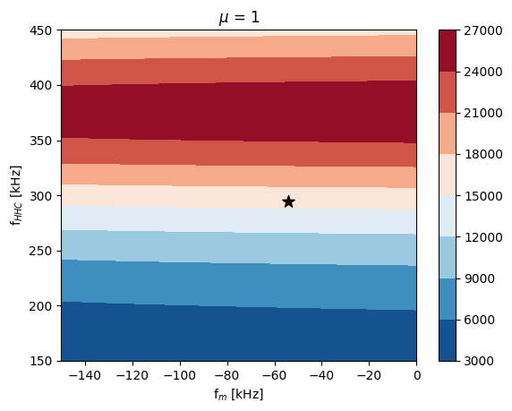
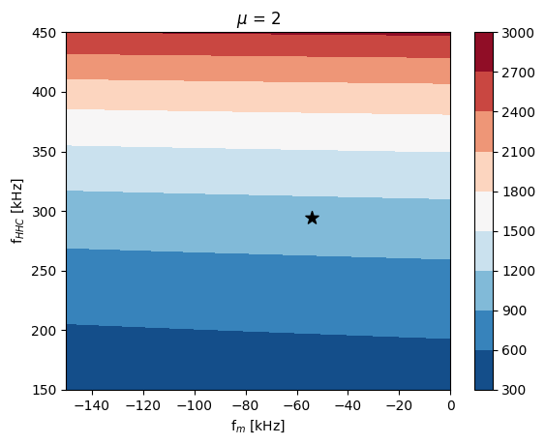
Analysis
AC Robinson instability growth rate with different mode number ($μ$)
Name | Main RF | HHC
Total voltage | 4.24 MV | 1.22 MV
Phase | 147.33 degree | 347.93 degree
Number of cavity | 12 | 7
$β$ (Coupling beta) | 4.58 | 1
$Δf_{opt}$ (Optimal detuning freq.) | -54.23 kHz | 294.19 kHz
Feasible operation detuning freq. range | -104.5 ~ -8.3 kHz | 171 ~ 407 kHz
Beam current | 400 mA
Longitudinal damping rate | 147.5 $s^{−1}$
Ideal bunch lengthening factor | 4
STABLE!!
STABLE!!
Here, all analytical calculations were assumed uniform filling with 1332 bunches (No gap)
Black dots in figures indicate optimal detuning frequencies
$μ$is AC Robinson instability mode number
There is no stable solution in feasible operation detuning frequency ranges due to $μ$ = 1, 2, 3, … .
UNSTABLE!!
UNSTABLE!!
5

Slide 6
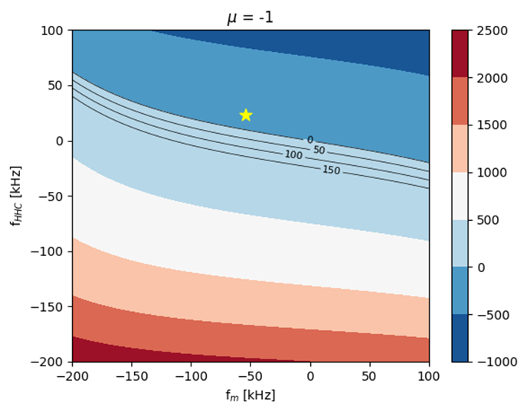
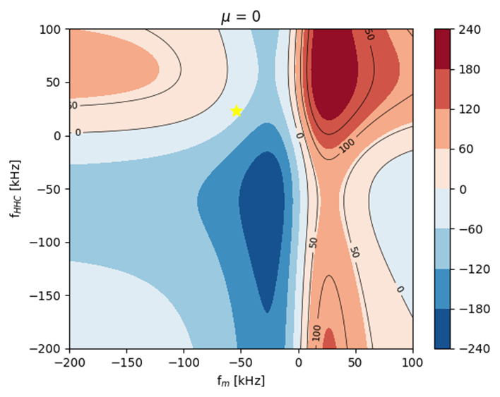
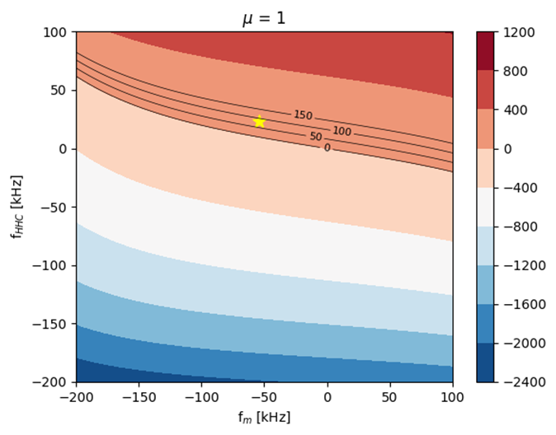
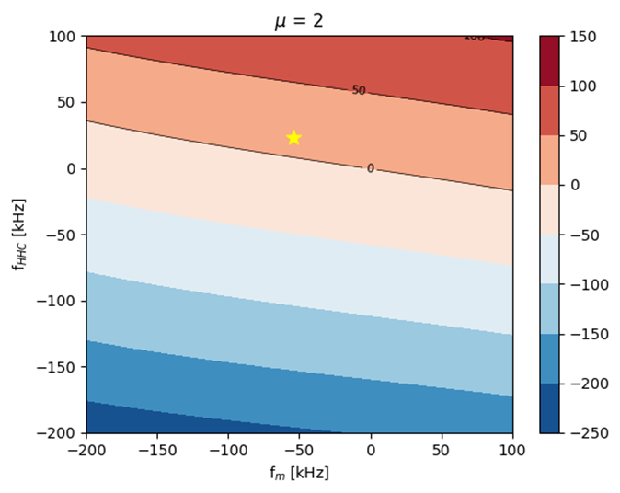
Analysis
AC Robinson instability growth rate with different mode number ($μ$)
Name | Main RF | HHC
Total voltage | 4.24 MV | 1.22 MV
Phase | 147.33 degree | 347.93 degree
Number of cavity | 12 | 7
$β$ (Coupling beta) | 4.58 | 1
$Δf_{s}$ (Selected detuning freq.) | -54.23 kHz | 25 kHz
Required generator power | 86 kW | 79.2 kW
Beam current | 400 mA
Longitudinal damping rate | 147.5 $s^{−1}$
Ideal bunch lengthening factor | 4
STABLE!!
STABLE!!
With 7 HHC, AC Robinson instability can be avoided with its detuning ~ 25 kHz
Analytical estimations show the instability will be stable at the selected detuning frequencies.
However, it requires HHC generator power of ~ 80 kW.
STABLE!!
STABLE!!
6

Slide 7
Analysis
The main causes of Robinson instability:
A high total shunt impedance due to the use of many cavities to achieve high cavity voltage.
A large detuning frequency, required by the low quality factor, which happens to be close to the revolution frequency.
To mitigate these issues, the following approaches can be considered:
Employ a near-flat potential condition instead of the optimal flat potential condition.
Use a harmonic cavity with a higher quality factor than the ALBA-type cavity.
Use a passive harmonic cavity.
7

Slide 8
Index
Robinson instability with HHC
Theory
Analysis
Near Flat Potential
High Q cavity
Passive cavity
8

Slide 9
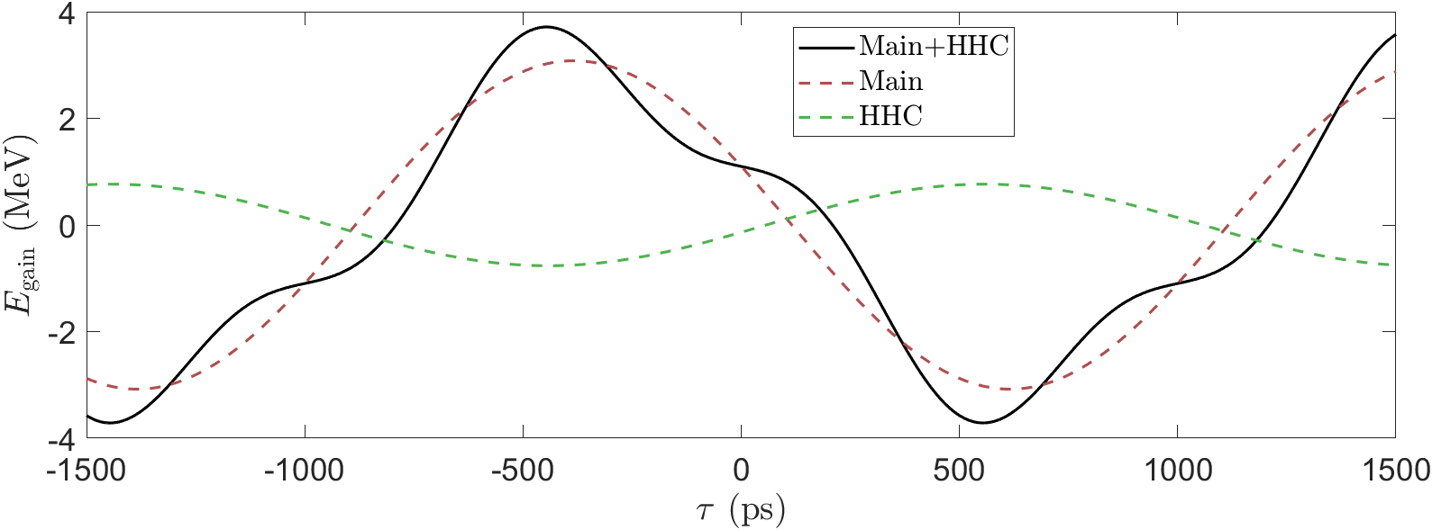
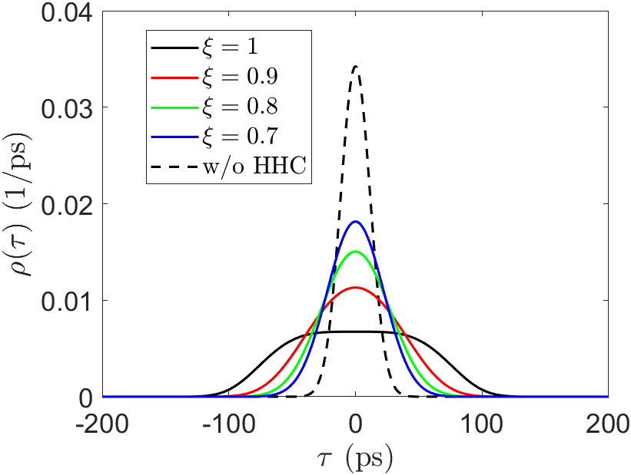
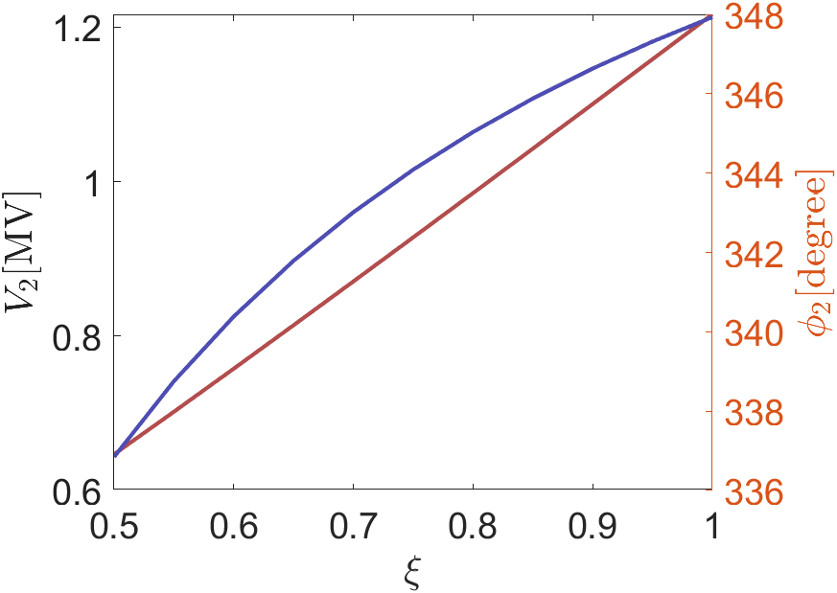
Near flat potential
Near Flat Potential
$$V\left(0\right)=U_{0}/e \\ V^{′}\left(0\right)=ω_{rf}V_{1}\cos\left(φ_{1}\right)\left(1−ξ\right) \\ V^{′′\left(0\right)}=0 \\ ξ=−\frac{mV_{2}\cos{φ_{2}}}{V_{1}\cos{φ_{1}}}$$
Not flat at $τ=0$
$ξ<1$ Lower bunch lengthening Can reduce number of cavity
Parameter to Achieve NFP
$$φ_{1}=\sin^{−1}\left(\frac{m^{2}}{m^{2}−1}\frac{U_{0}}{eV_{1}}\right) \\ φ_{2}=−\tan^{−1}\left(\frac{\tan{φ_{1}}}{mξ}\right) \\ V_{2}=\frac{V_{1}\sin{φ_{1}}}{m^{2}\sin{φ_{2}}}$$
$$BL=4.08$$
$$BL=2.85$$
$$BL=2.23$$
$$BL=1.86$$
9

Slide 10
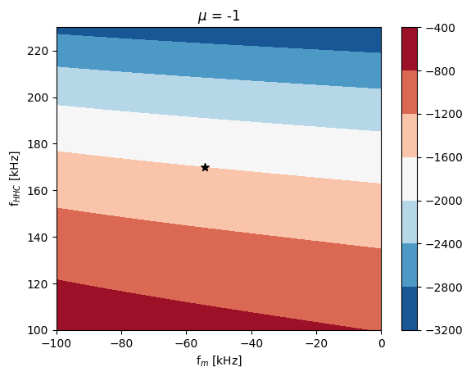
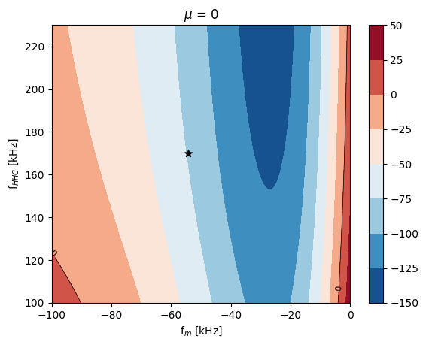
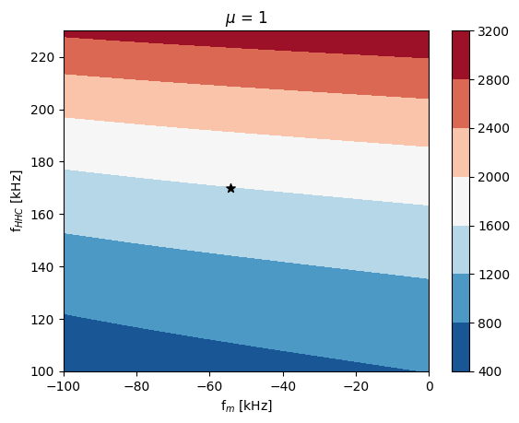
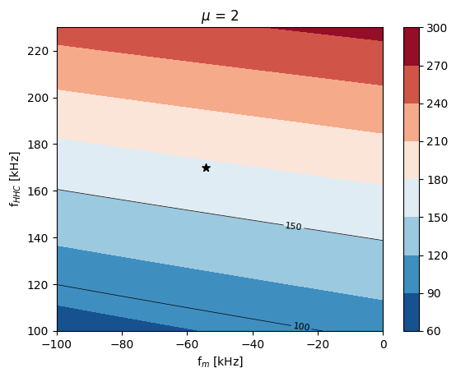
Near flat potential
AC Robinson instability growth rate with different mode number ($μ$)
Name | Main RF | HHC
Total voltage | 4.24 MV | 0.87 MV
Phase | 147.33 degree | 343.01 degree
Number of cavity | 12 | 3
$β$ (Coupling beta) | 4.58 | 1
$Δf_{opt}$ (Optimal detuning freq.) | -54.23 kHz | 169.89 kHz
Feasible operation detuning freq. range | -104.5 ~ -8.3 kHz | 110.7 ~ 229.1 kHz
Beam current | 400 mA
Longitudinal damping rate | 147.5 $s^{−1}$
Bunch lengthening factor | $$1.86$$
STABLE!!
STABLE!!
$$ξ=0.7 case$$
Due to the lower detuning frequency and total shunt impedance, growth rate can be reduced.
But still $μ=1,2$ instability occurs, because of the large value of $Δf_{HHC}$.
Additionally, we considered that a bunch lengthening factor of 1.86 would not be useful.
UNSTABLE!!
UNSTABLE!!
10

Slide 11
Index
Robinson instability with HHC
Theory
Analysis
Near Flat Potential
High Q cavity
Passive cavity
11

Slide 12
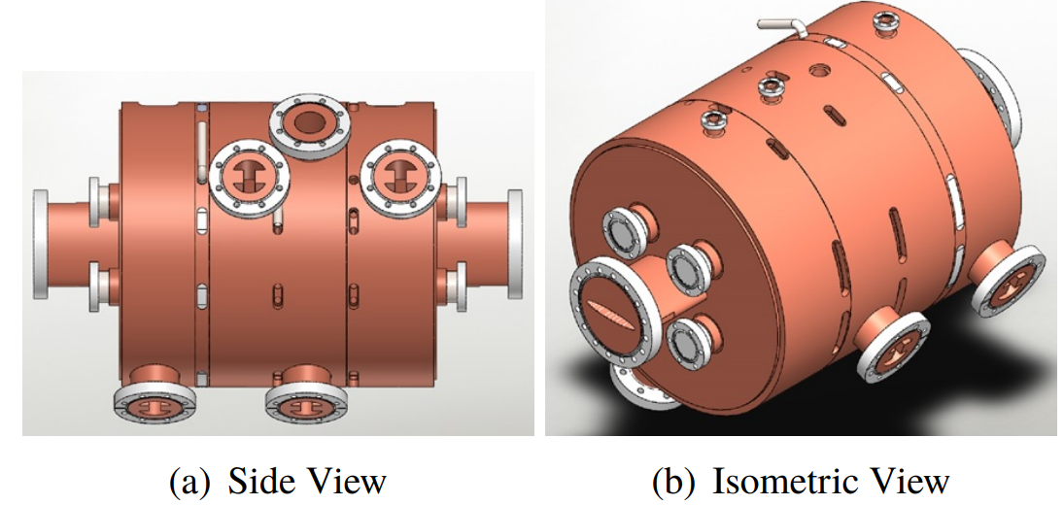
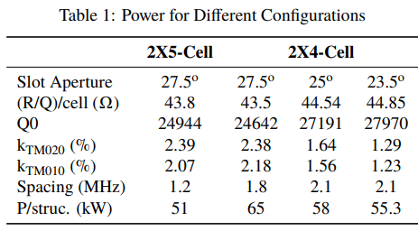
High Q cavity
A. D’Elia et al., “Design of 4th Harmonic RF Cavities for ESRF-EBS”, IPAC2021, (2021)
In the case of ESRF-EBS, the cavity exhibits a higher quality factor compared to the ALBA type, which is expected to help reduce the detuning frequency.
Although the HHC in ESRF-EBS operates at 1.41 GHz, which is different from the 1.5 GHz in our design, we do same analysis on the 4GSR lattice using only the cavity parameters.
2X5-CELL with $Q=24944, total \frac{R}{Q}=43.8⋅5=219 Ω, β=1$
2X4-CELL with $Q=27191, total \frac{R}{Q}=44.85⋅4=179.4 Ω, β=1$
12

Slide 13
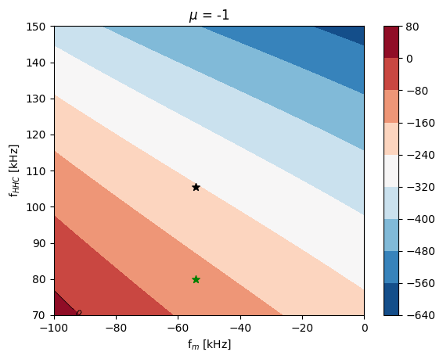
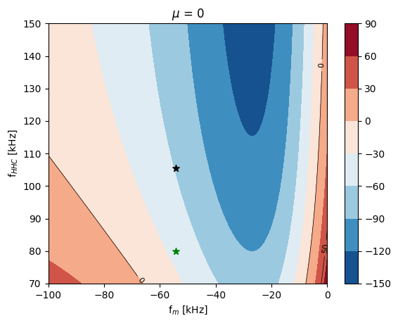
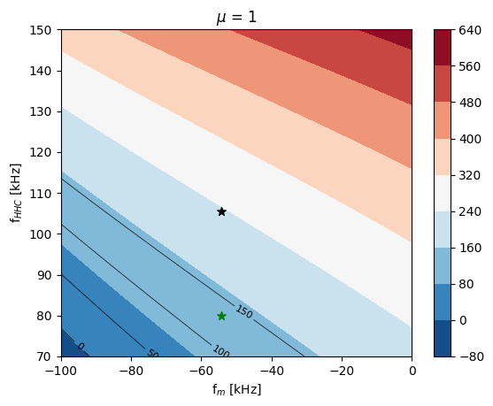
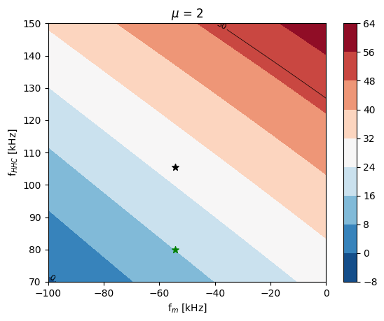
High Q cavity
AC Robinson instability growth rate with different mode number ($μ$)
Name | Main RF | HHC
Total voltage | 4.24 MV | 1.22 MV
Phase | 147.33 degree | 347.93 degree
Number of cavity | 12 | 5
$β$ (Coupling beta) | 4.58 | 1
$Δf_{opt}$ (Optimal detuning freq.) | -54.23 kHz | 105.54 kHz
Feasible operation detuning freq. range | -104.5 ~ -8.3 kHz | 70.1 ~ 141.0 kHz
Beam current | 400 mA
Longitudinal damping rate | 147.5 $s^{−1}$
Ideal bunch lengthening factor | 4
STABLE!!
STABLE!!
$$Q=24944, \frac{R}{Q}=43.8⋅5=219 Ω, β=1$$
The high Q of the HHC allows for a reduction in the optimal detuning frequency.
This plays a significant role in mitigating both 𝜇=1 and 𝜇=2 instabilities.
The black dot $→$ optimal points.
The green dot $→$ a location within the feasible detuning range where the 𝜇=1 instability does not occur.
STABLE!!
STABLE!!
Detuned point
$$(f_{HHC}=80 kHz)$$
Optimal point
13

Slide 14
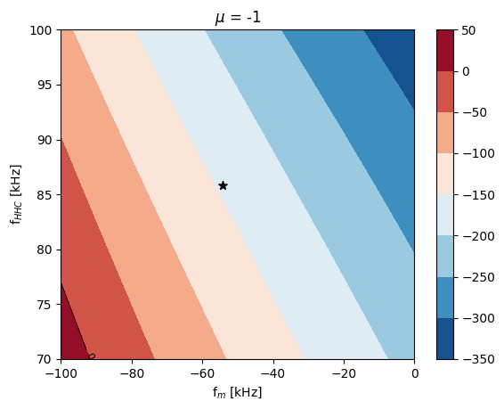
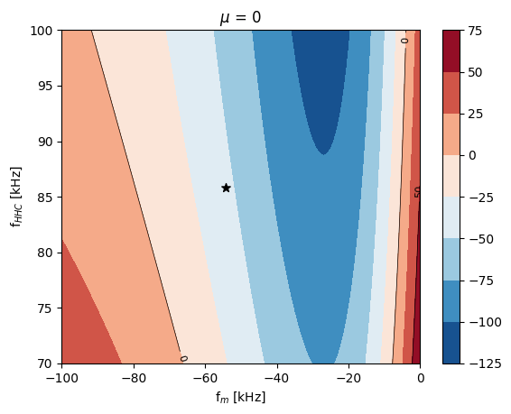
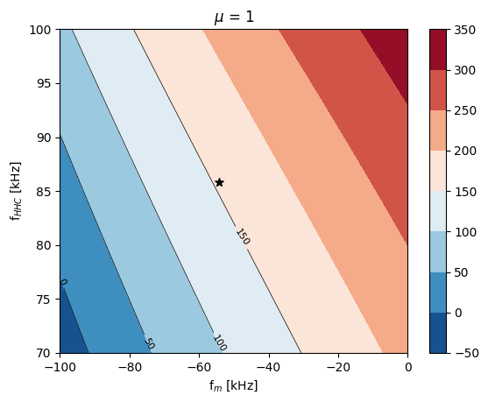
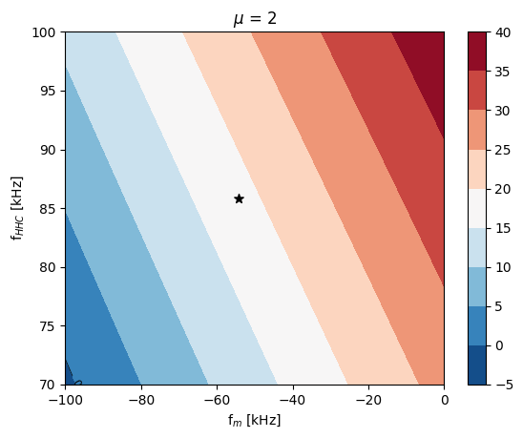
High Q cavity
AC Robinson instability growth rate with different mode number ($μ$)
Name | Main RF | HHC
Total voltage | 4.24 MV | 1.22 MV
Phase | 147.33 degree | 347.93 degree
Number of cavity | 12 | 4
$β$ (Coupling beta) | 4.58 | 1
$Δf_{opt}$ (Optimal detuning freq.) | -54.23 kHz | 85.86 kHz
Feasible operation detuning freq. range | -104.5 ~ -8.3 kHz | 70.4 ~ 101.3 kHz
Beam current | 400 mA
Longitudinal damping rate | 147.5 $s^{−1}$
Ideal bunch lengthening factor | 4
STABLE!!
STABLE!!
$$Q=27191, \frac{R}{Q}=43.85⋅4=179.4 Ω, β=1$$
Due to its higher quality factor the optimal detuning frequency is more reduced.
The growth rate from the μ=1 instability is found to be comparable to the longitudinal damping rate.
We need 17 kW of generator power per cavity, this is considered achievable with SSPA.
STABLE!!
STABLE!!
14

Slide 15
Index
Robinson instability with HHC
Theory
Analysis
Near Flat Potential
High Q cavity
Passive cavity
15

Slide 16
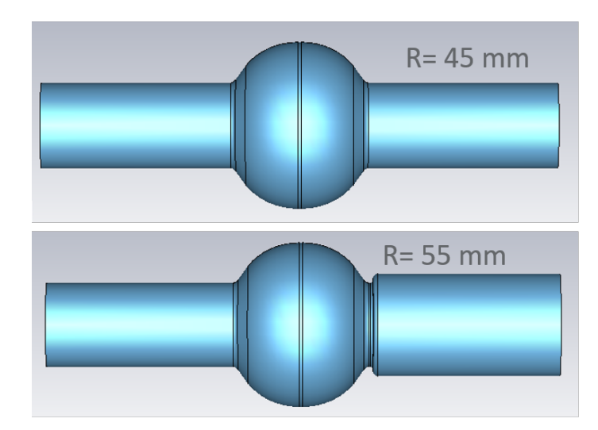
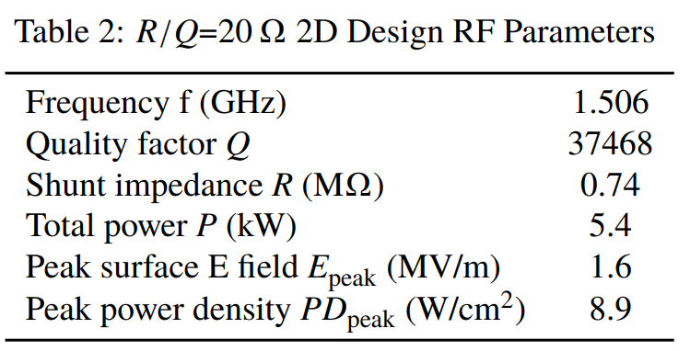
Passive cavity
The voltage of Passive Harmonic Cavity induced by wake field of rf-cavity.
$$V\left(τ\right)=−Ne\sum_{l=−∞}^{∞}{\int_{−∞}^{∞}{dτ^{′}ρ\left(τ^{′}\right)W_{0}^{′}\left(τ−τ^{′}+lT_{1}\right)}}≈−2I_{avg}R_{s}\cos{ψ}\cos\left(hω_{0}τ+ψ\right)$$
$N:$ number of electrons in a one bunch, $T_{1}:$ bunch spacing, $I_{avg}:$ average current, $ψ:$ tuning angle
Once installed, the flat potential condition is satisfied only at a specific beam current, and not at other operating points.
Since it is not externally coupled, the quality factor is higher than that of an active cavity, meaning that a large detuning frequency is not required.
$R_{s}=7.27 MΩ, ψ=77.93°$ for flat potential at $I=400 mA$
16

Slide 17
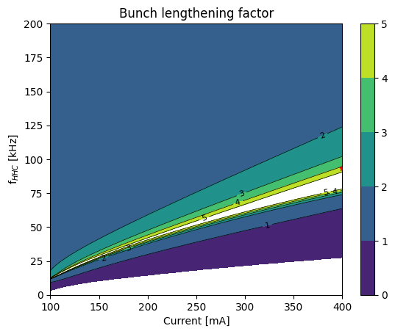
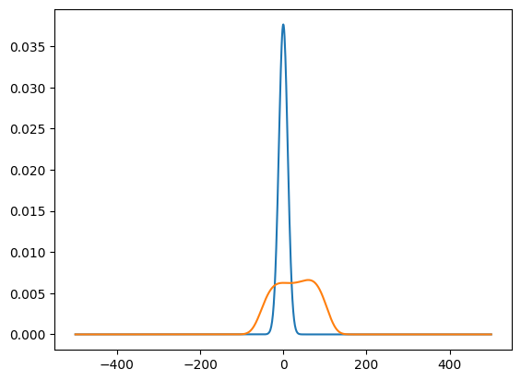
Passive cavity
Bunch lengthening factor with different currents
Name | Main RF | HHC
Total voltage | 4.24 MV | 1.22 MV
Phase | 147.33 degree | 347.93 degree
Number of cavity | 12 | 5
Beam current | 100 mA - 400 mA
Longitudinal damping rate | 147.5 $s^{−1}$
$$Q=37468, \frac{R}{Q}=194 Ω, N_{cav}=10$$
Due to the high quality factor, only a small detuning frequency is required.
The detuning of the harmonic cavity (HHC) must be adjusted depending on the beam current.
Although a perfectly flat potential cannot be achieved, the resulting potential approximately satisfies the near-flat-potential (NFP) condition.
$$I=200 mA,$$
$$Δf_{HHC}=43.3 kHz$$
$$I=300 mA,$$
$$Δf_{HHC}=68.4 kHz$$
$$I=400 mA,$$
$$Δf_{HHC}=93.5 kHz$$
17

Slide 18
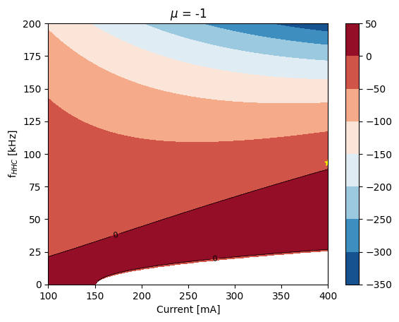
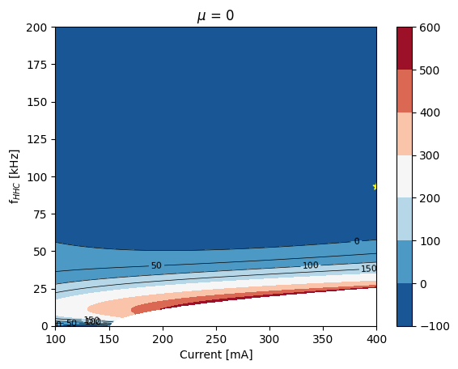
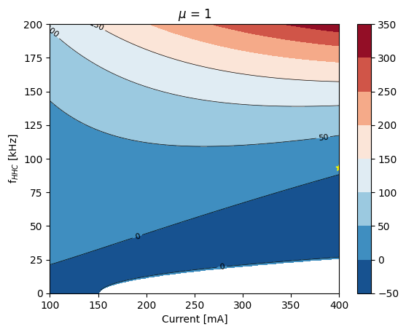
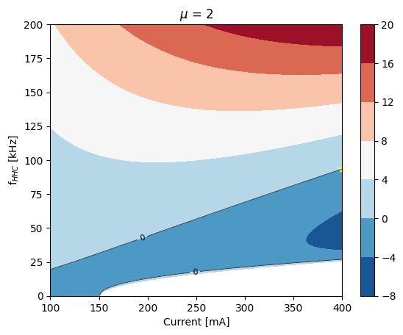
Passive cavity
AC Robinson instability growth rate with different mode number ($μ$)
Name | Main RF | HHC
Total voltage | 4.24 MV | 1.22 MV
Phase | 147.33 degree | 347.93 degree
Number of cavity | 12 | 5
Beam current | 100 mA - 400 mA
Longitudinal damping rate | 147.5 $s^{−1}$
STABLE!!
STABLE!!
$$Q=37468, \frac{R}{Q}=194 Ω, N_{cav}=10$$
Since the growth rates of the μ=1\mu = 1μ=1 and μ=2\mu = 2μ=2 instabilities are smaller than the damping rate, the beam can remain stable.
Reducing the total shunt impedance (i.e., num of cavities) allows for a lower detuned frequency, which could be a more effective approach to mitigating the instability.
STABLE!!
STABLE!!
18

Slide 19
Thank you for your attention!
19

Slide 20
Appendix. HHC in 4GSR
Institute | Mode | Active/Passive | NC/SC | Freq. (GHz) | Q, R/Q
MAX-IV(1) | 3 | Passive | NC | 0.3 | 21600, 109.25
ESRF-EBS(2,study) | 4 | Active | NC | 1.41 | 29735, 86.8
SIRIUS(3,plan) | 3 | Passive | SC | 1.5 | $$2×{10}^{8}, 90$$
APS-U(4,plan) | 4 | Passive | SC | 1.41 | $$2×{10}^{10}, 104$$
PETRA-IV(5,study) | 3 | Active | NC | 1.5 | $$23247, 99$$
SOLEIL-II(6,7,study) | 3/4 | Passive Passive Active | SC NC NC | 1.06/1.41 | $${10}^{8},45$$ $$27000, 88.8$$ $$27000, 88.8$$
HEPS(8) | 3 | Active | SC | 0.5 | $${10}^{9}, 93.5$$
Diamond-II(9, study) | 3 | Passive | SC | 1.5 | $${2⋅10}^{8}, 88.4$$
ALS-U(10, study) | 3 | Passive | NC | 1.5 | 37468, 20(study)
ALBA-II (11, study) | 3 | Active | NC | 1.5 | 14000, 86
20

