Slide 1


JKPS 250321
Multiobjective Bayesian optimization for online accelerator tuning
Minseo Jeong
21, Mar 2025

Slide 2
JKPS 250321
Index
Background
Multi-objective Bayesian Optimization(MOBO)
Optimization of AWA photoinjector
2

Slide 3
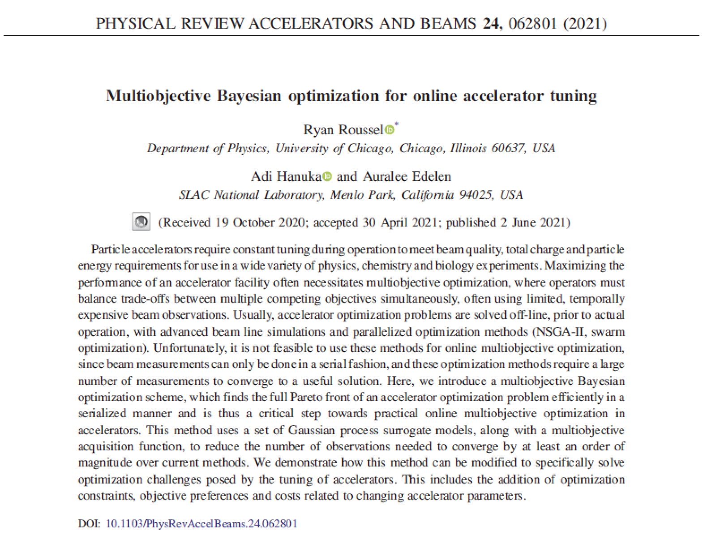
JKPS 250321
Background
3

Slide 4
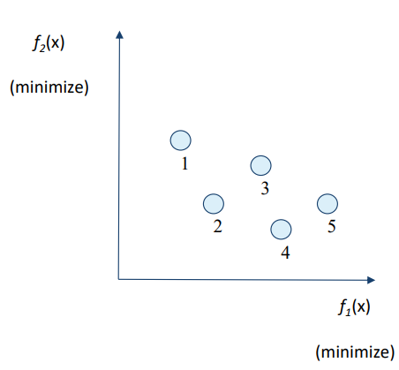
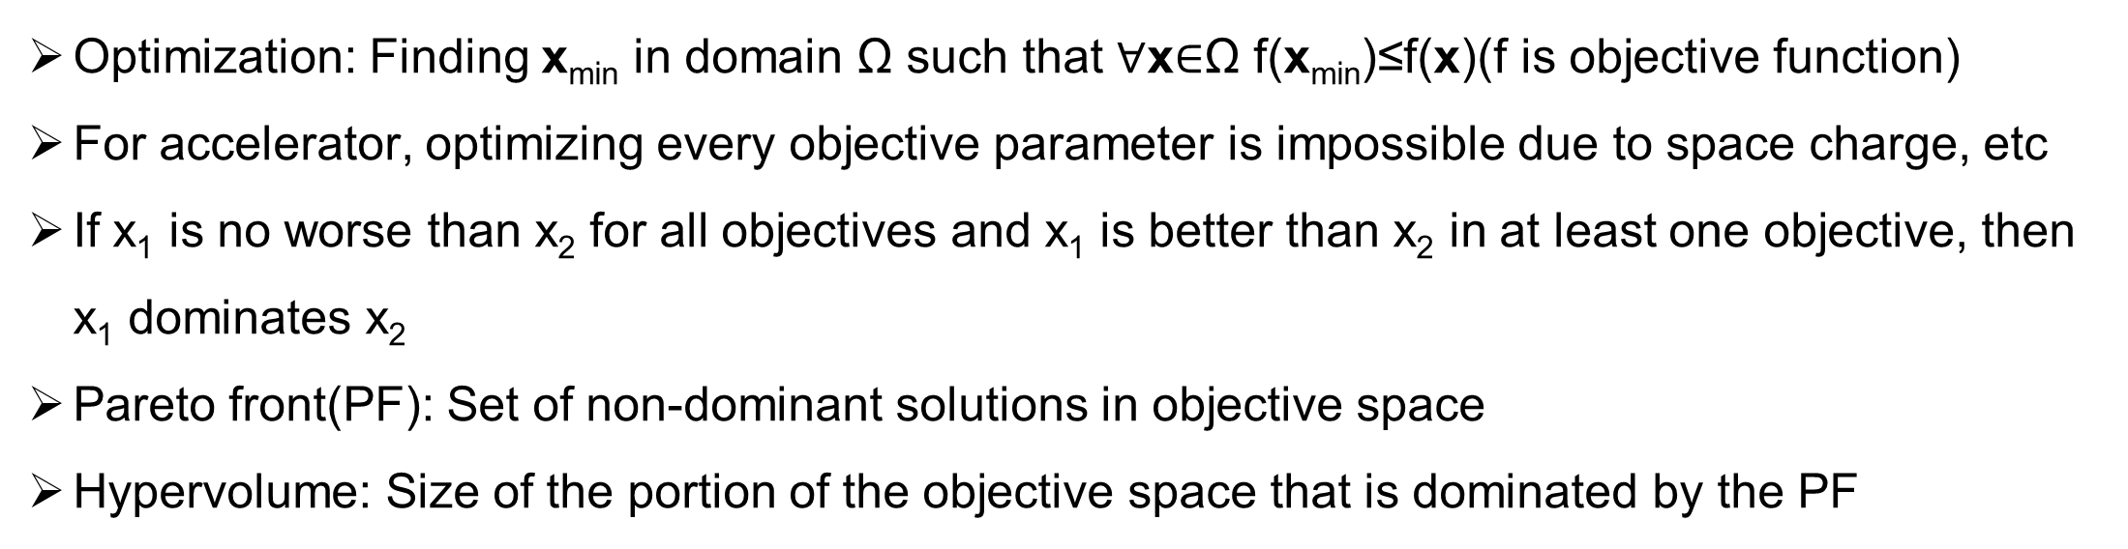
JKPS 250321
Optimization
Optimization: Finding x_{min} in domain Ω such that $∀$x$∈$Ω f(x_{min})≤f(x)(f is objective function)
For accelerator, optimizing every objective parameter is impossible due to space charge, etc
If x₁ is no worse than x₂ for all objectives and x₁ is better than x₂ in at least one objective, then x₁ dominates x₂
Pareto front(PF): Set of non-dominant solutions in objective space
Hypervolume: Size of the portion of the objective space that is dominated by the PF
4

Slide 5
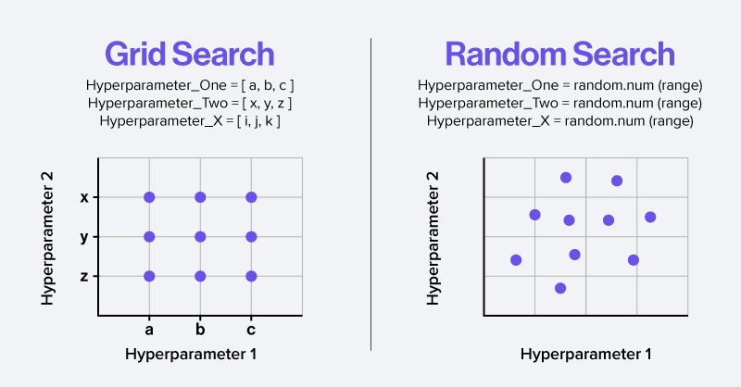
JKPS 250321
Optimization
Grid search: Evaluates f at points separated by a fixed step in each direction
- takes long time
Random search: Evaluates f at randomly chosen points
- does not guarantee the best solution
5

Slide 6
JKPS 250321
Optimization
Evolutionary algorithm: An optimization algorithm based on evolutionary operators, such as recombination and mutation
Y. Li et al. Phys. Rev. Accel. Beams 21. (2018).
6

Slide 7
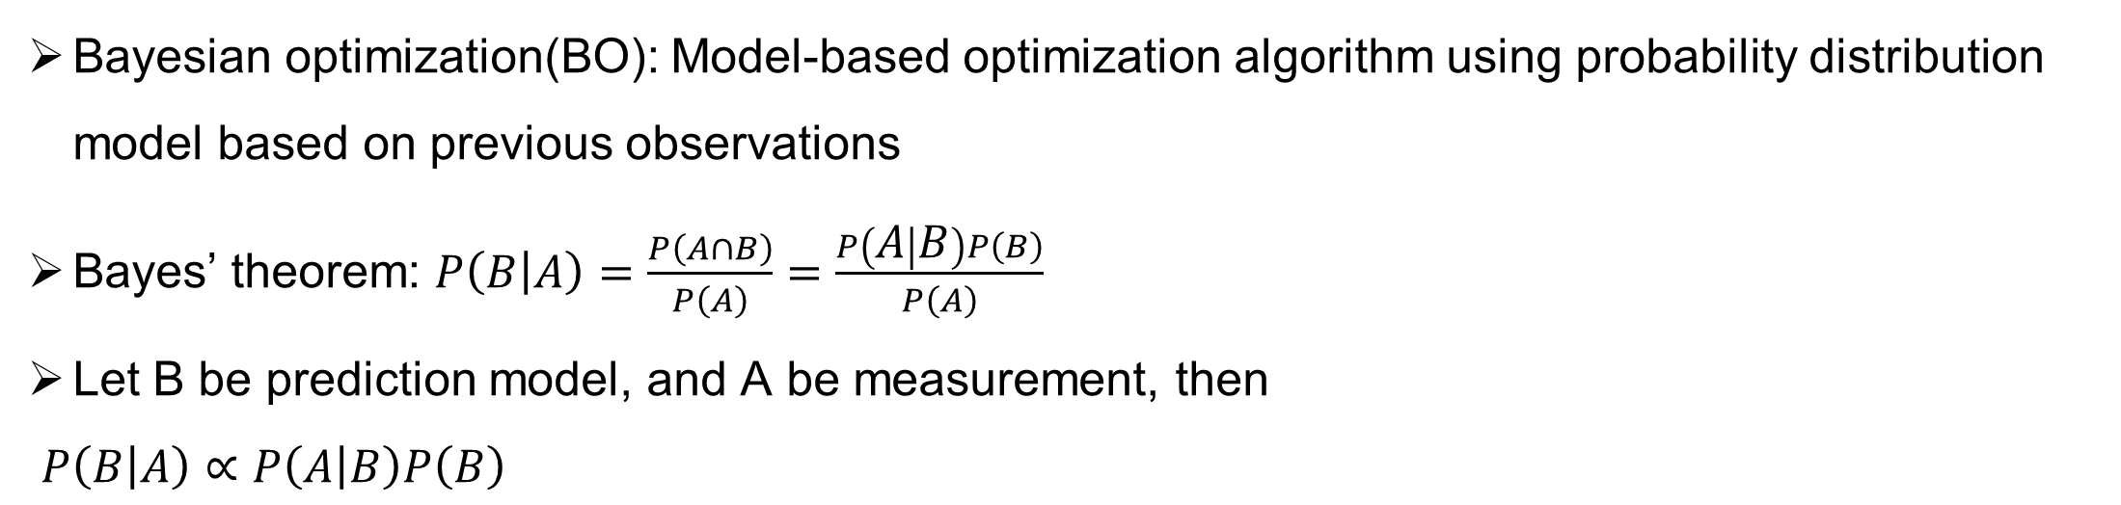
JKPS 250321
Optimization
Bayesian optimization(BO): Model-based optimization algorithm using probability distribution model based on previous observations
Bayes’ theorem: $P\left(B | A\right)=\frac{P\left(A∩B\right)}{P\left(A\right)}=\frac{P\left(A | B\right)P\left(B\right)}{P\left(A\right)}$
Let B be prediction model, and A be measurement, then
$P\left(B | A\right)∝P\left(A | B\right)P\left(B\right)$
posterior
likelihood
prior
7

Slide 8
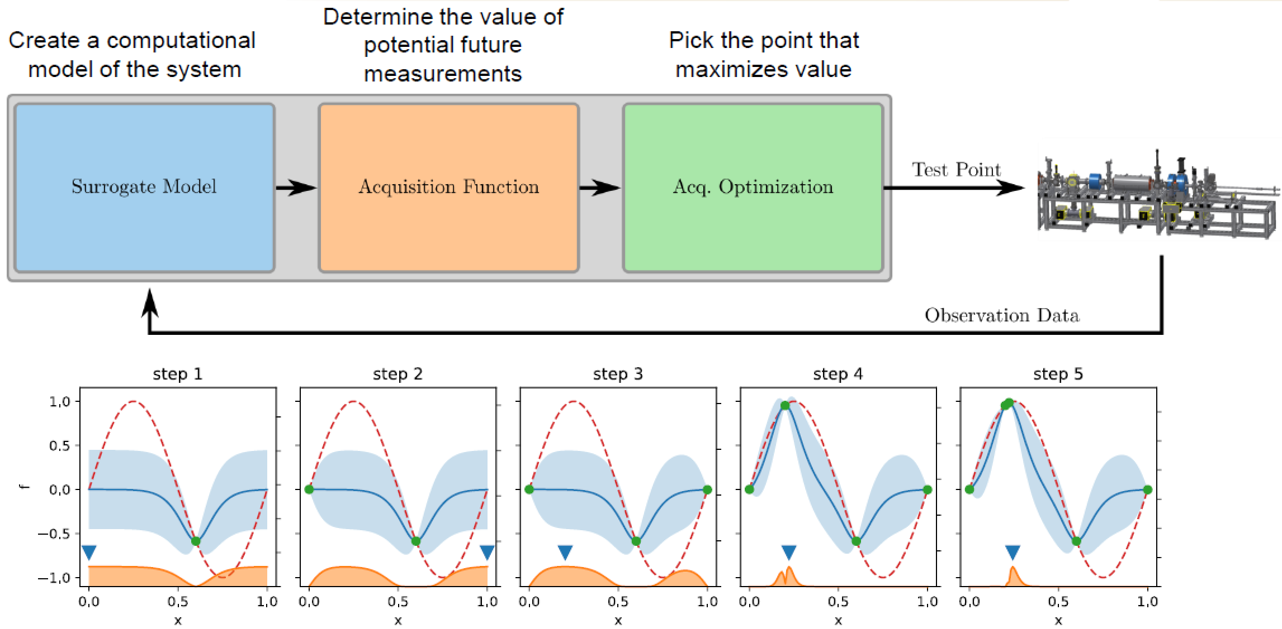
JKPS 250321
Multi-objective Bayesian Optimization
R. Roussel et al. Phys. Rev. Accel. Beams 27. (2024).
8

Slide 9
JKPS 250321
Multi-objective Bayesian Optimization
Advantage: Sample efficient, robust to noise, incorporation of prior information
- Efficient when objective function is expensive to evaluate
Disadvantage: Computational complexity(O(n³)), assumption of smoothness, inefficient if objective function is simple and cheap to evaluate
- Unable to use in high dimensional (10~20) space
9

Slide 10
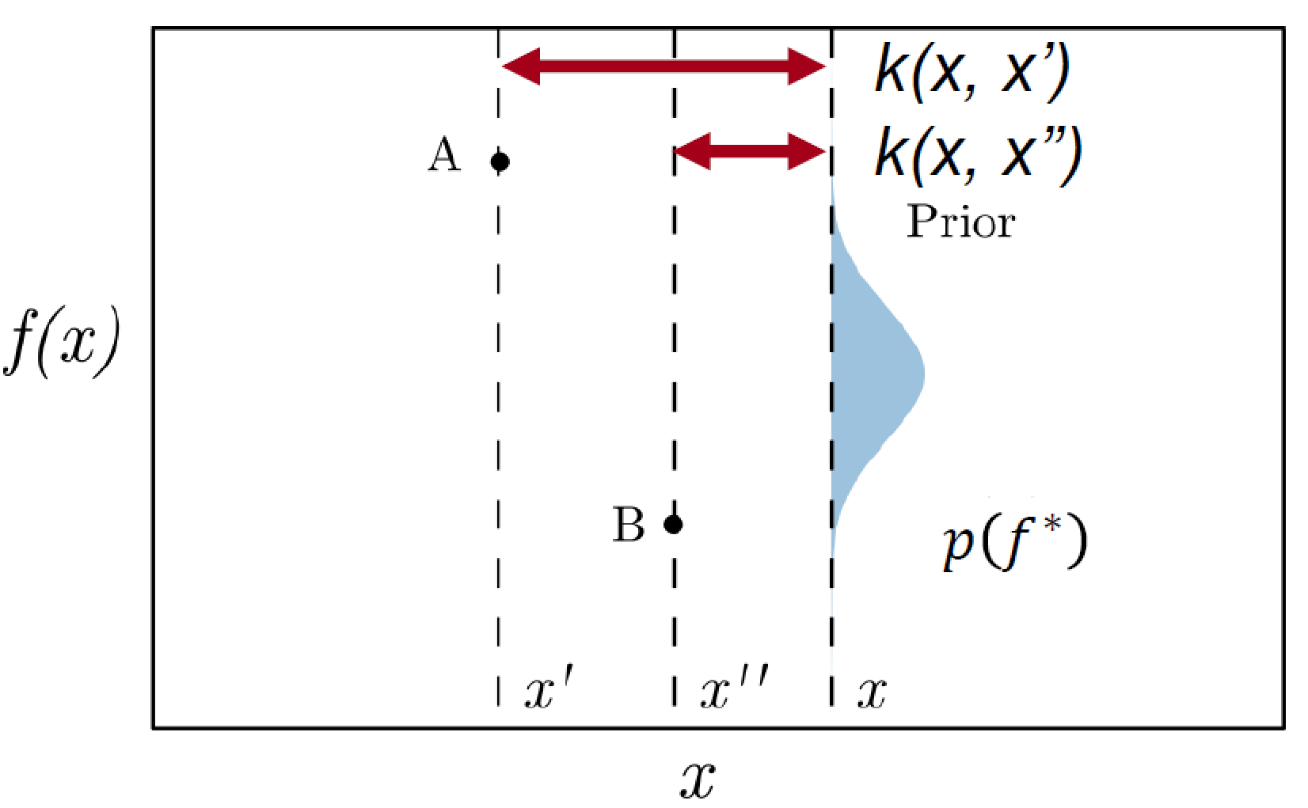
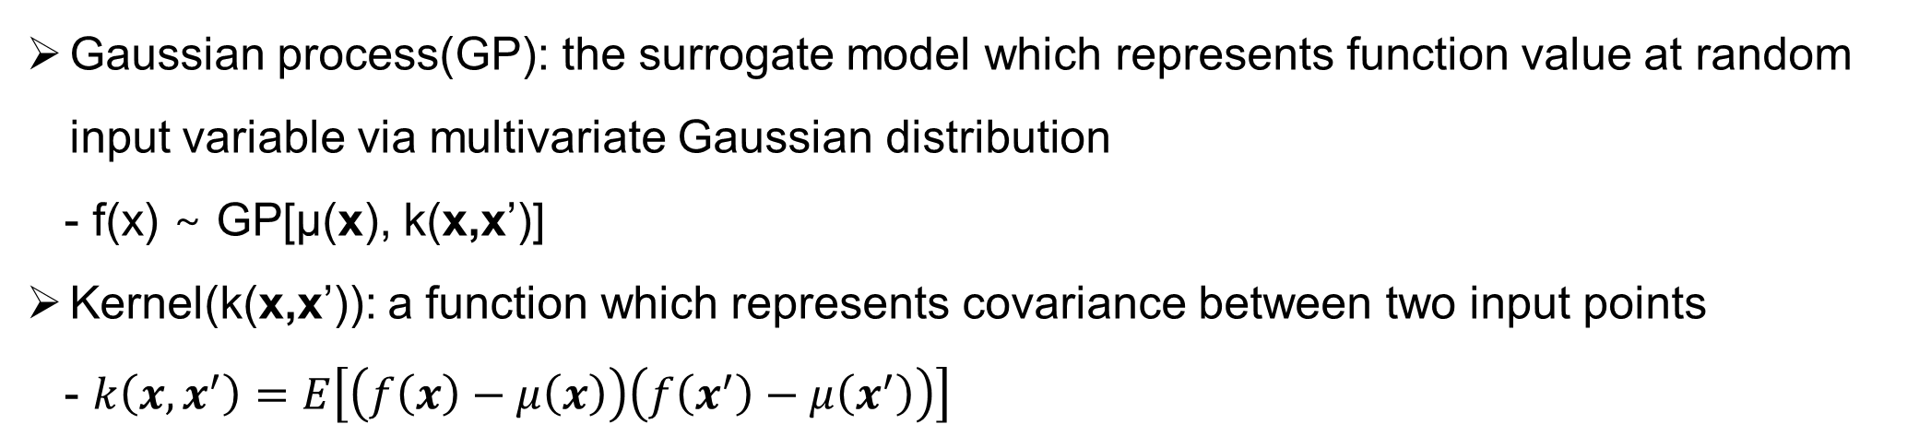
JKPS 250321
Multi-objective Bayesian Optimization
Gaussian process(GP): the surrogate model which represents function value at random input variable via multivariate Gaussian distribution
- f(x) ∼ GP[μ(x), k(x,x’)]
Kernel(k(x,x’)): a function which represents covariance between two input points
- $k\left(x,x^{′}\right)=E\left[\left(f\left(x\right)−μ\left(x\right)\right)\left(f\left(x^{′}\right)−μ\left(x^{′}\right)\right)\right]$
10

Slide 11
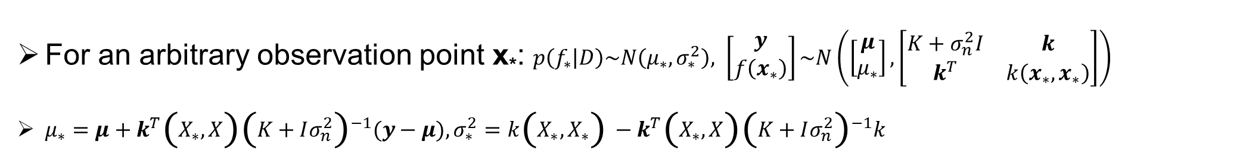
JKPS 250321
Multi-objective Bayesian Optimization
For an arbitrary observation point x*: $p\left(f_{∗} | D\right)\sim N\left(μ_{∗}, σ_{∗}^{2}\right), \left[\begin{matrix}y \\ f\left(x_{∗}\right)\end{matrix}\right]\sim N\left(\left[\begin{matrix}μ \\ μ_{∗}\end{matrix}\right], \left[\begin{matrix}K+σ_{n}^{2}I & k \\ k^{T} & k\left(x_{∗},x_{∗}\right)\end{matrix}\right]\right)$
$μ_{∗}=μ+k^{T}\left(X_{∗},X\right){\left(K+Iσ_{n}^{2}\right)}^{−1}(y−μ), σ_{∗}^{2}=k\left(X_{∗},X_{∗}\right)−k^{T}\left(X_{∗},X\right){\left(K+Iσ_{n}^{2}\right)}^{−1}k$
11

Slide 12
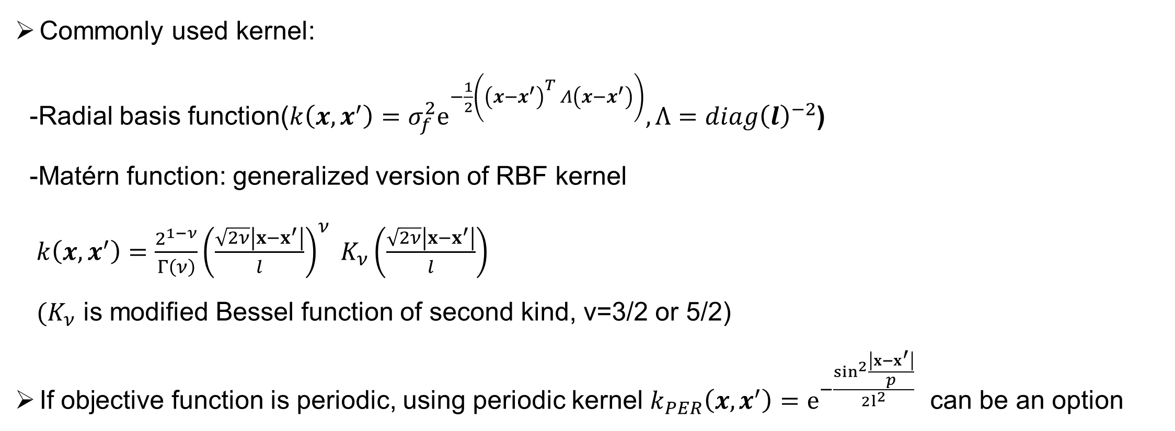
JKPS 250321
Multi-objective Bayesian Optimization
Commonly used kernel:
-Radial basis function($k\left(x,x^{′}\right)=σ_{f}^{2}e^{−\frac{1}{2}\left({\left(x−x^{′}\right)}^{T} Λ\left(x−x^{′}\right)\right)}, Λ=diag{\left(l\right)}^{−2}$)
-Matérn function: generalized version of RBF kernel
$k\left(x,x^{′}\right)=\frac{2^{1−ν}}{Γ\left(ν\right)}{\left(\frac{\sqrt{2ν}\left|x−x^{′}\right|}{l}\right)}^{ν} K_{ν}\left(\frac{\sqrt{2ν}\left|x−x^{′}\right|}{l}\right)$
$(K_{ν}$ is modified Bessel function of second kind, ν=3/2 or 5/2)
If objective function is periodic, using periodic kernel $k_{PER}\left(x,x^{′}\right)=e^{−\frac{\sin^{2}{\frac{\left|x−x^{′}\right|}{p}}}{2l^{2}}}$ can be an option
12

Slide 13
JKPS 250321
Multi-objective Bayesian Optimization
Length scale hyperparameter l should be optimized by maximizing marginal log-likelihood(MLL)
- log p(y|X, θ)= −y^{T}K⁻¹ _{y}y/2-log |K_{y}| −n/2 log 2π
R. Roussel et al. Phys. Rev. Accel. Beams 27. (2024).
13
Notes:
θ is the set of GP model hyperparameters
The first term is the data fit term which is maximized when model predictions accurately predict experimental data.
The second term describes model complexity and is maximized given the simplest model,
The final term is a normalization constant based on the number of training points in the dataset.

Slide 14
JKPS 250321
Multi-objective Bayesian Optimization
Acquisition function: the function that determines which input point to measure next
Exploitation: focuses on the vicinity of current best measurement points
Exploration: focuses on unexplored region
14

Slide 15
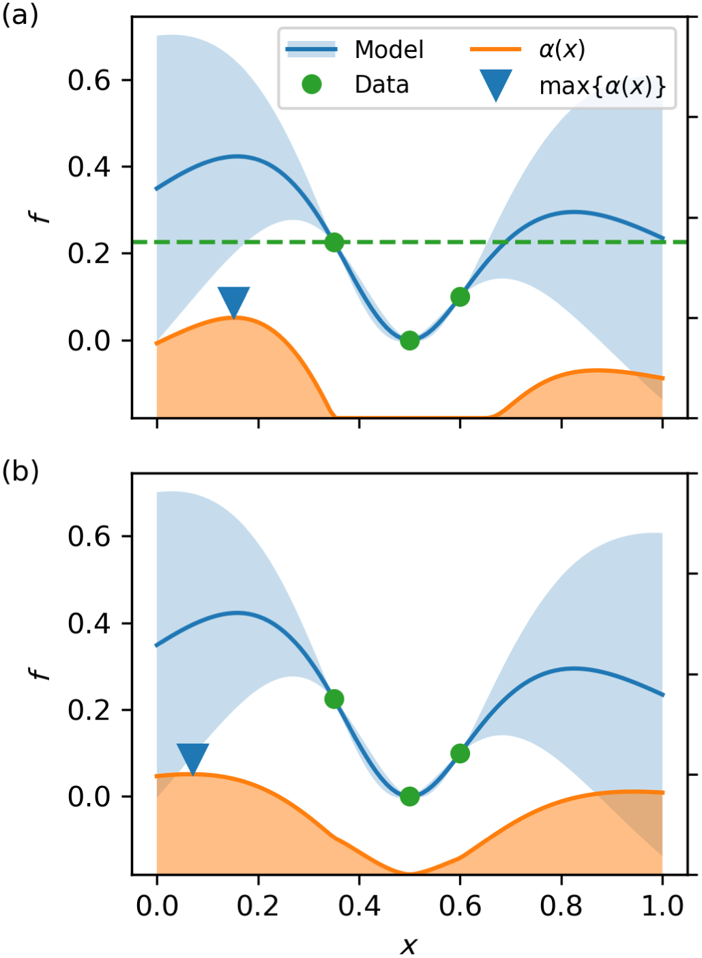
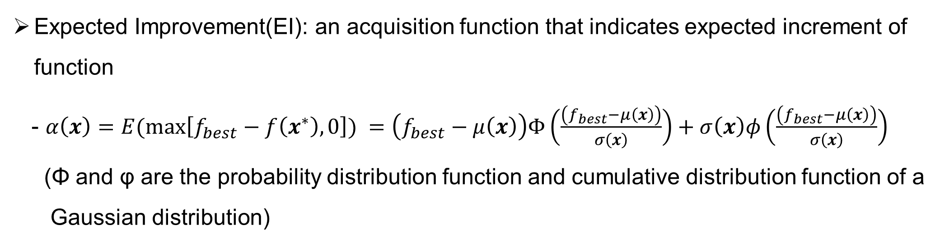
JKPS 250321
Multi-objective Bayesian Optimization
Expected Improvement(EI): an acquisition function that indicates expected increment of function
- $α\left(x\right)=E(\max\left[f_{best}−f\left(x^{∗}\right),0\right]) =\left(f_{best}−μ\left(x\right)\right)Φ\left(\frac{\left(f_{best}−μ\left(x\right)\right)}{σ\left(x\right)}\right)+σ\left(x\right)φ\left(\frac{\left(f_{best}−μ\left(x\right)\right)}{σ\left(x\right)}\right)$
(Φ and φ are the probability distribution function and cumulative distribution function of a
Gaussian distribution)
R. Roussel et al. Phys. Rev. Accel. Beams 27. (2024).
15

Slide 16
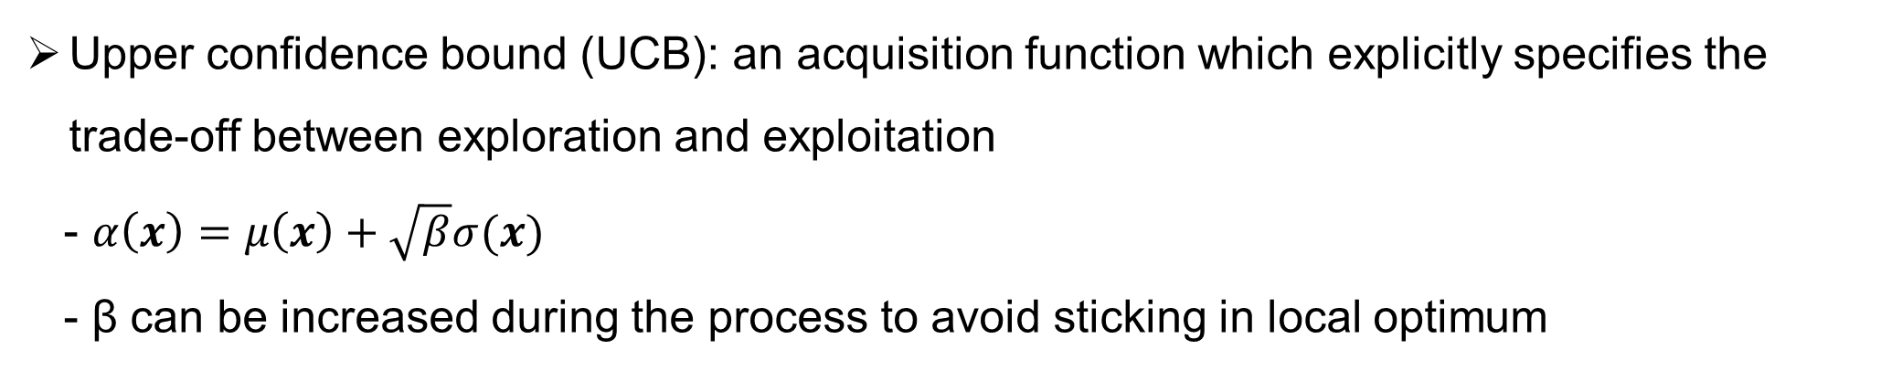
JKPS 250321
Multi-objective Bayesian Optimization
Upper confidence bound (UCB): an acquisition function which explicitly specifies the trade-off between exploration and exploitation
- $α\left(x\right)=μ\left(x\right)+\sqrt{β}σ(x)$
- β can be increased during the process to avoid sticking in local optimum
16

Slide 17
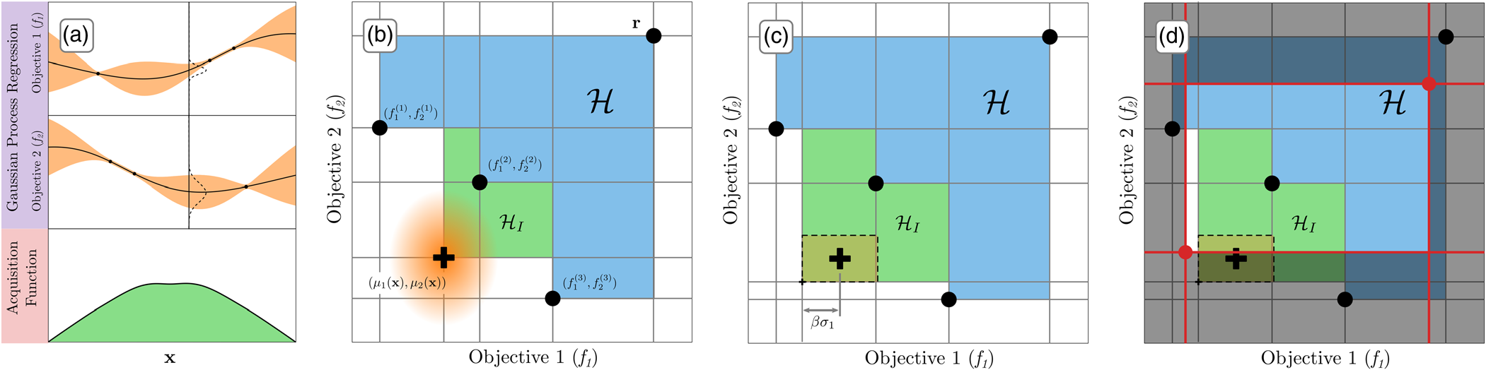
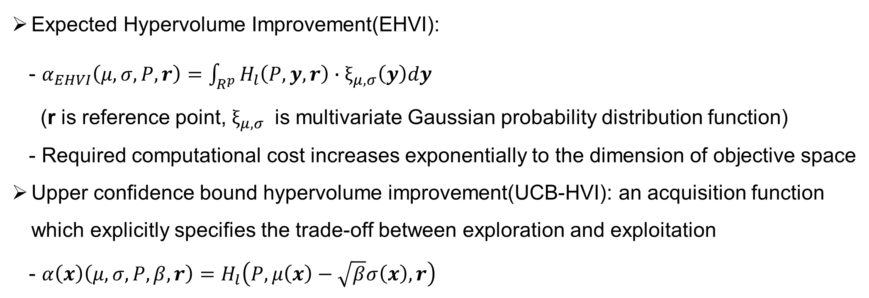
JKPS 250321
Multi-objective Bayesian Optimization
Expected Hypervolume Improvement(EHVI):
- $α_{EHVI}\left(μ,σ, P, r\right)=\int_{R^{p}}{H_{l}\left(P,y,r\right)∙ξ_{μ,σ}\left(y\right)dy}$
(r is reference point, $ξ_{μ,σ}$ is multivariate Gaussian probability distribution function)
- Required computational cost increases exponentially to the dimension of objective space
Upper confidence bound hypervolume improvement(UCB-HVI): an acquisition function which explicitly specifies the trade-off between exploration and exploitation
- $α\left(x\right)\left(μ,σ, P,β, r\right)=H_{l}\left(P,μ\left(x\right)−\sqrt{β}σ\left(x\right),r\right)$
17

Slide 18
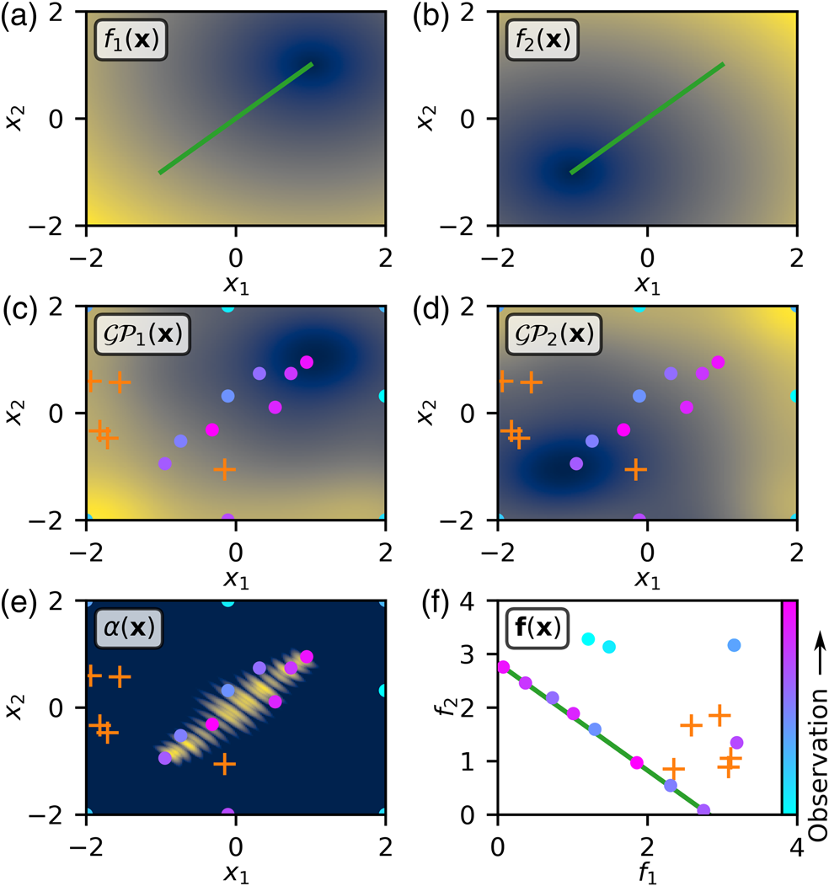
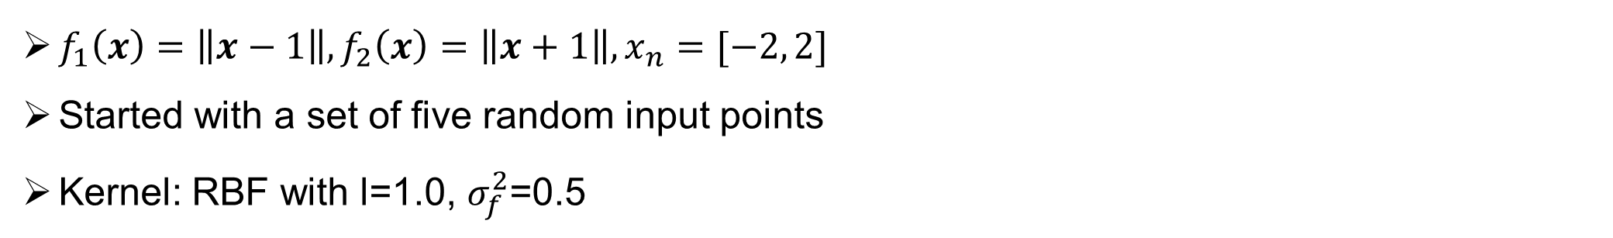
JKPS 250321
Multi-objective Bayesian Optimization
$f_{1}\left(x\right)=\left\|x−1\right\|, f_{2}\left(x\right)=\left\|x+1\right\|, x_{n}=[−2, 2]$
Started with a set of five random input points
Kernel: RBF with l=1.0, $σ_{f}^{2}$=0.5
18

Slide 19
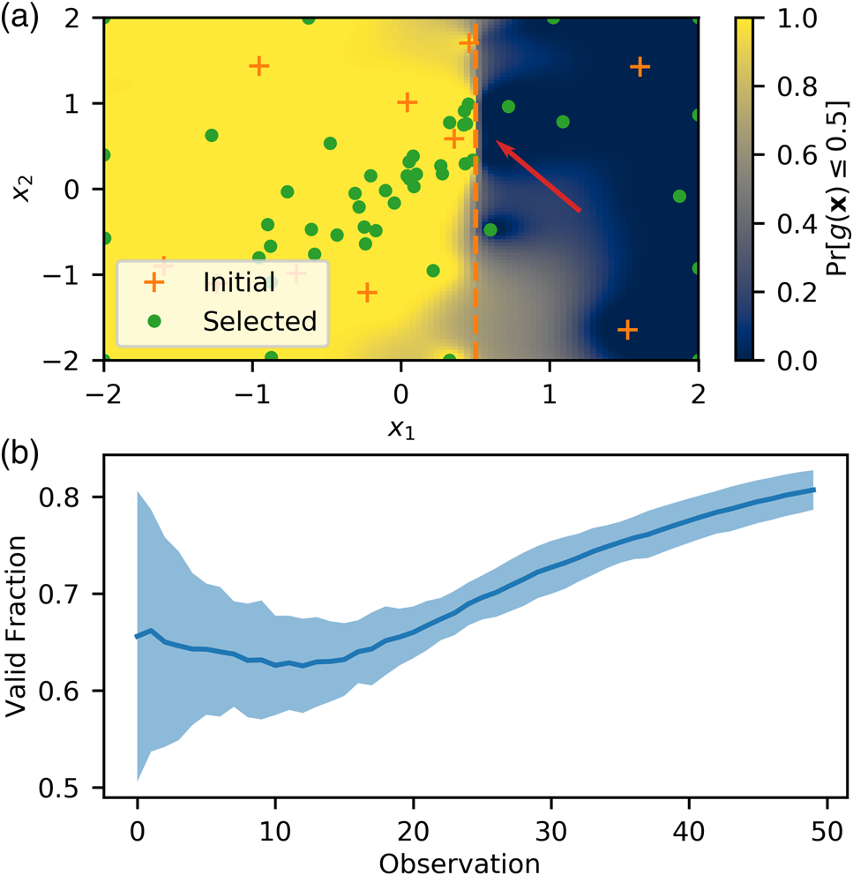
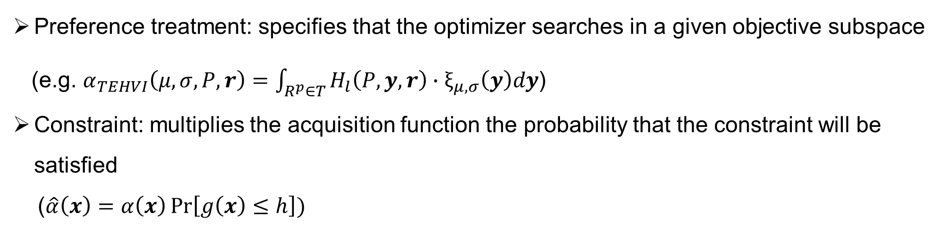
JKPS 250321
Multi-objective Bayesian Optimization
Preference treatment: specifies that the optimizer searches in a given objective subspace
(e.g. $α_{TEHVI}\left(μ,σ, P, r\right)=\int_{R^{p}∈T}{H_{l}\left(P,y,r\right)∙ξ_{μ,σ}\left(y\right)dy}$)
Constraint: multiplies the acquisition function the probability that the constraint will be satisfied
($\hat{α}\left(x\right)=α\left(x\right)\operatorname{Pr}\left[g\left(x\right)≤h\right])$
19

Slide 20
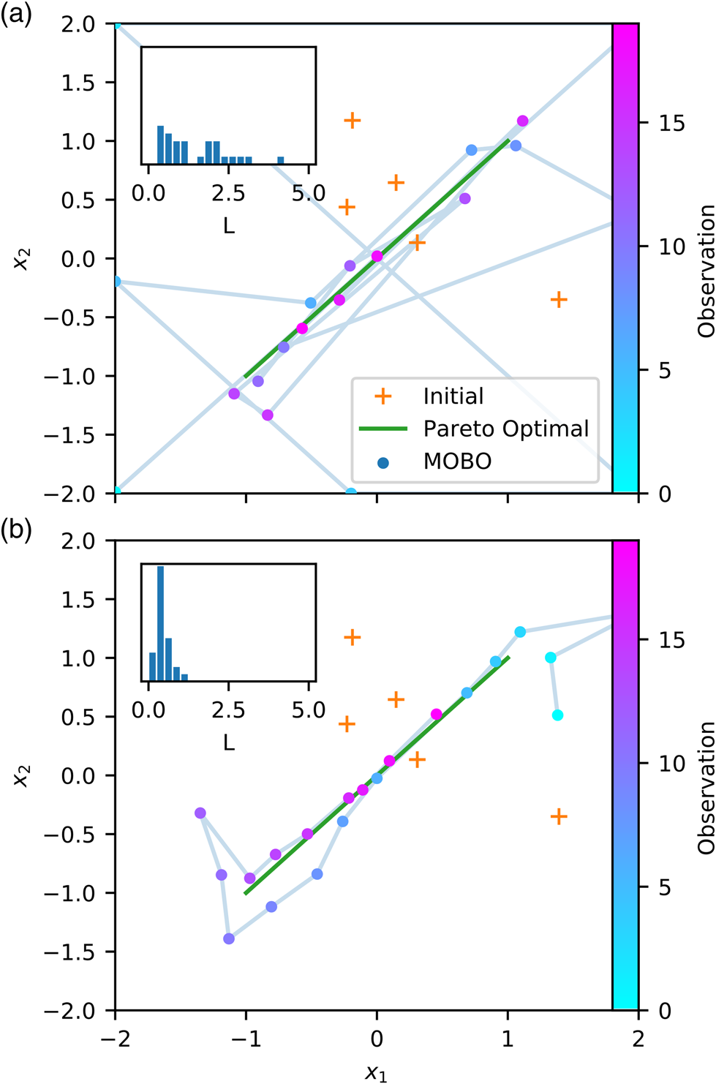
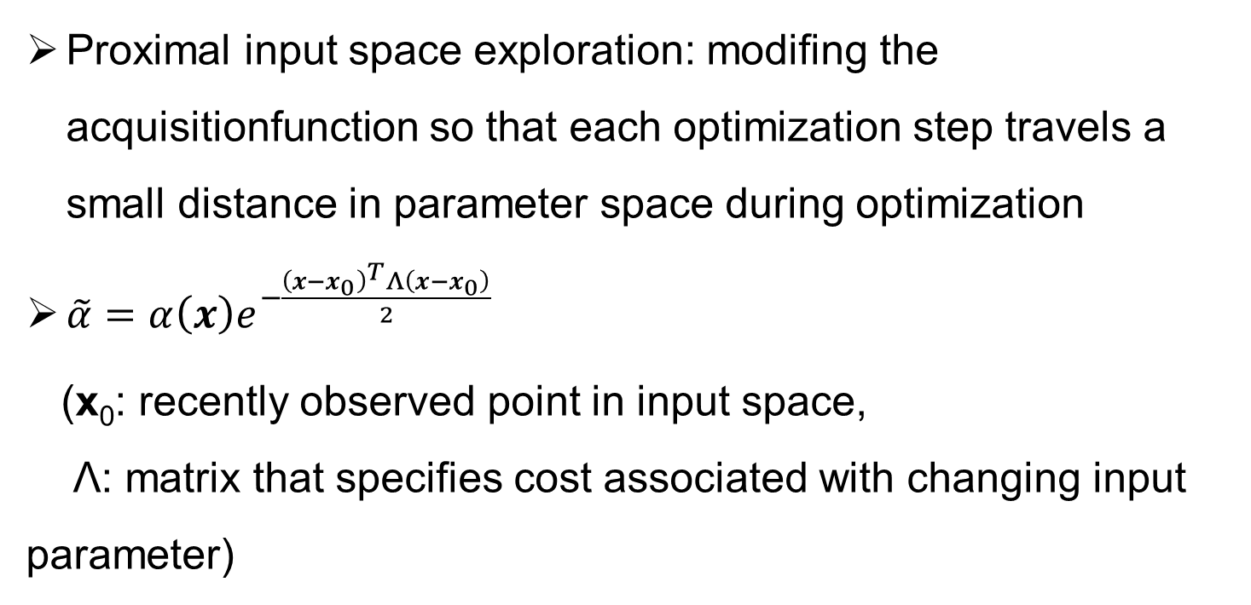
JKPS 250321
Multi-objective Bayesian Optimization
Proximal input space exploration: modifing the acquisitionfunction so that each optimization step travels a small distance in parameter space during optimization
$\tilde{α}=α\left(x\right)e^{−\frac{{\left(x−x_{0}\right)}^{T}Λ\left(x−x_{0}\right)}{2}}$
(x₀: recently observed point in input space,
Λ: matrix that specifies cost associated with changing input parameter)
20

Slide 21
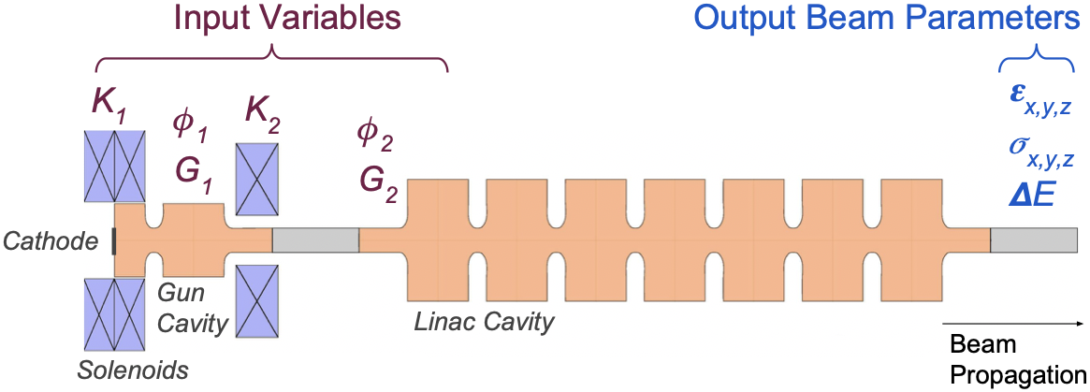
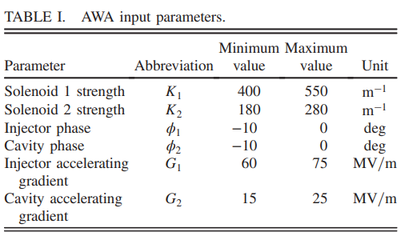
JKPS 250321
Optimization of AWA Photoinjector
Parameters of AWA photoinjector(photogun+one RF cavity) was optimized
A. Edelen et al., Phys. Rev. Accel. Beams 23, 044601 (2020)
21

Slide 22
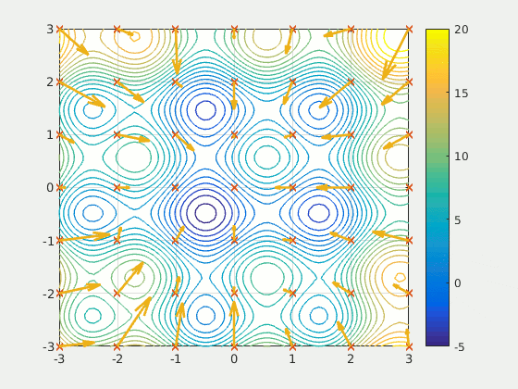
JKPS 250321
Optimization of AWA Photoinjector
Kernel: RBF with initial hyperparameter vector l
- Hyperparameter optimization is done by maximizing the log marginal likelihood of the GP model with the gradient based Adam optimization algorithm, with 5000 iterations and a learning rate of 0.001
- l is updated with period of 10 turns
Acquisition function: UCB-HVI with β=0.01
Method of maximizing the acquisition function : particle swarm optimization
22
Notes:
PSO: 각각의 입자들이 가진 정보와 종합적인 정보를 종합하여 각각의 입자의 다음 위치를 선정
-계산량이 많지만, 전체적으로는 global optimum에 수렴 가능

Slide 23
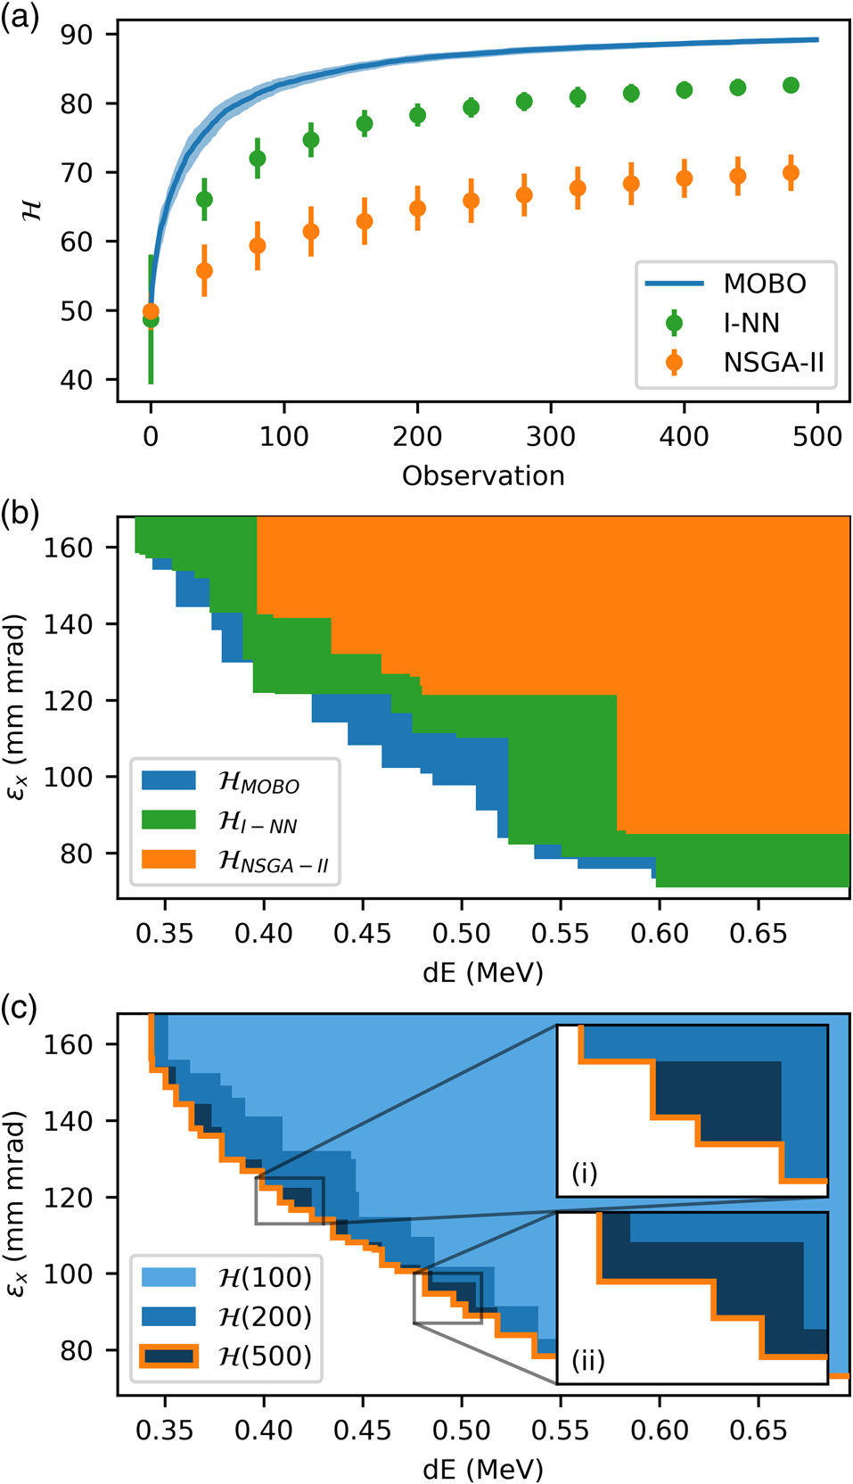
JKPS 250321
Optimization of AWA Photoinjector
MOBO was 35 times more efficient than NSGA-II
Took 45 min to optimize
Since neither NSGA-II nor I-NN includes a direct calculation of the hypervolume increase for each proposed observation point, hypervolume generated by MOBO is larger than others
23

Slide 24
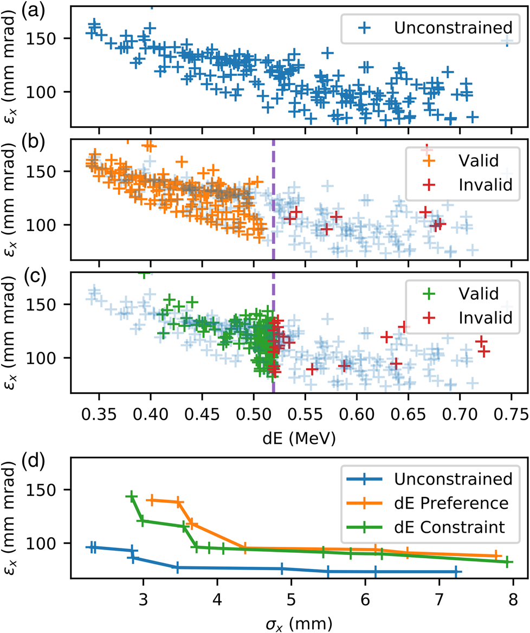
JKPS 250321
Optimization of AWA Photoinjector
Preference/constraint of dE<0.52MeV was set
(b) MOBO with an optimization preference of dE < 0.52 MeV.
(c) MOBO with an inequality constraint of dE < 0.52 MeV
24

Slide 25
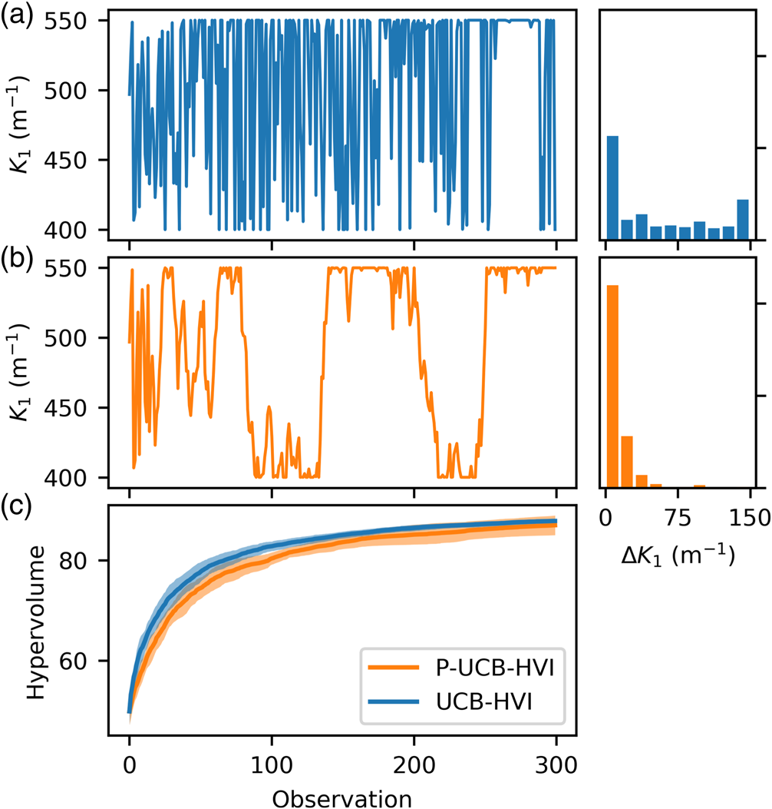
JKPS 250321
Optimization of AWA Photoinjector
Proximal optimization with Λ=4I was demonstrated
Change of K₁ parameter is mirrored in each of the other five input parameters
25

Slide 26
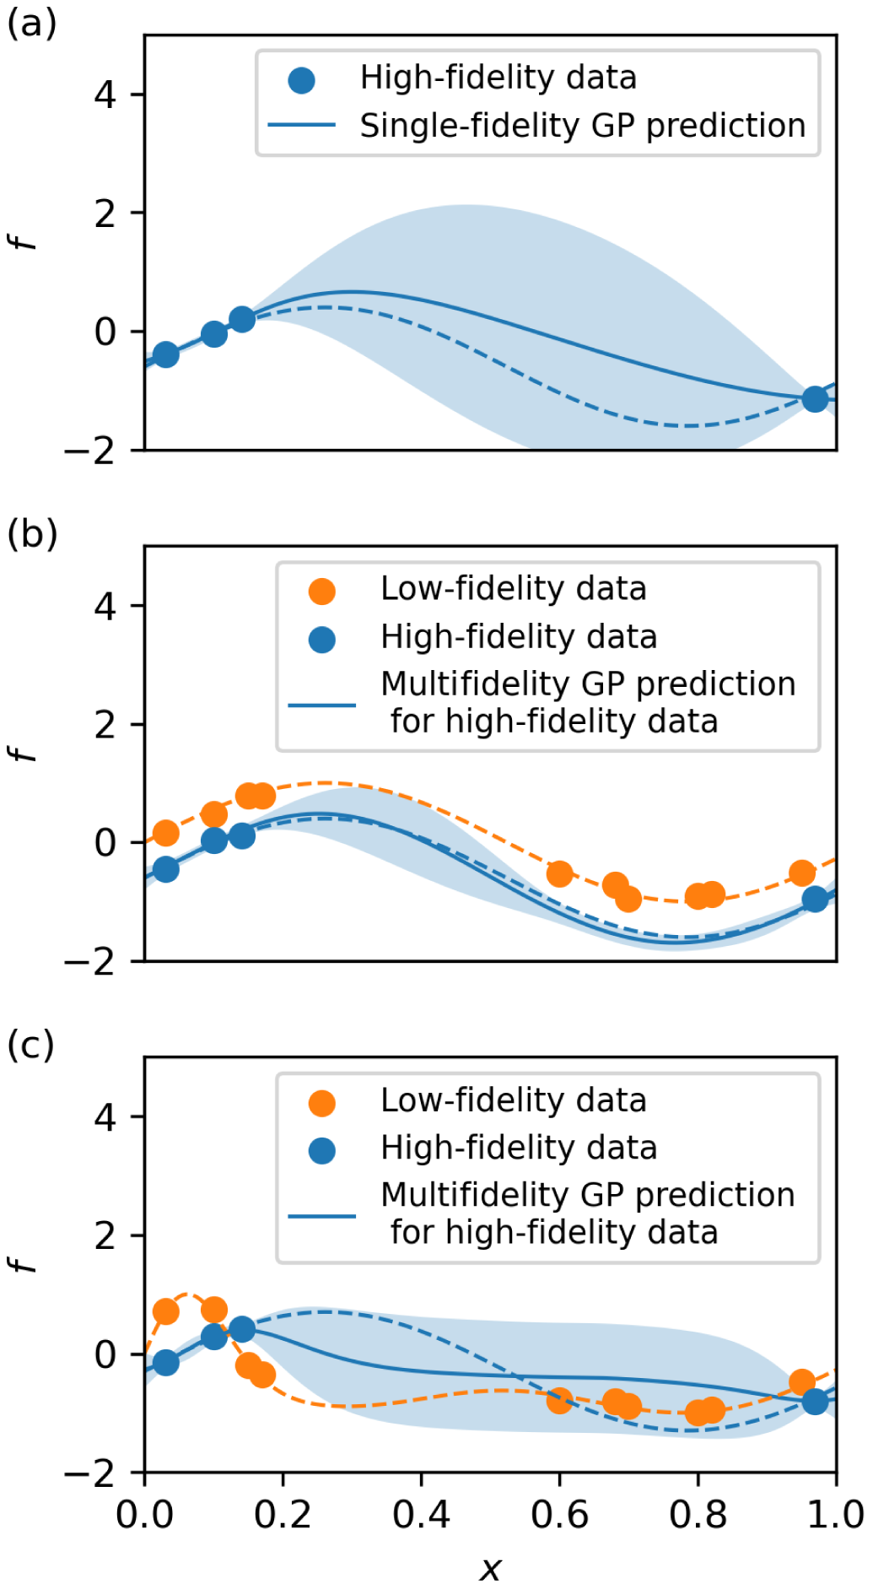
JKPS 250321
Conclusion
MOBO is ideal tool for online multiobjective accelerator optimization
MOBO can be repeated periodically to monitor changes in machine performance over time
Advanced method can be applied in MOBO in order to reduce optimization time
(e.g. q-EHVI, multi-fidelity modeling, trust-region Bayesian optimization(TuRBO)
26

Slide 27
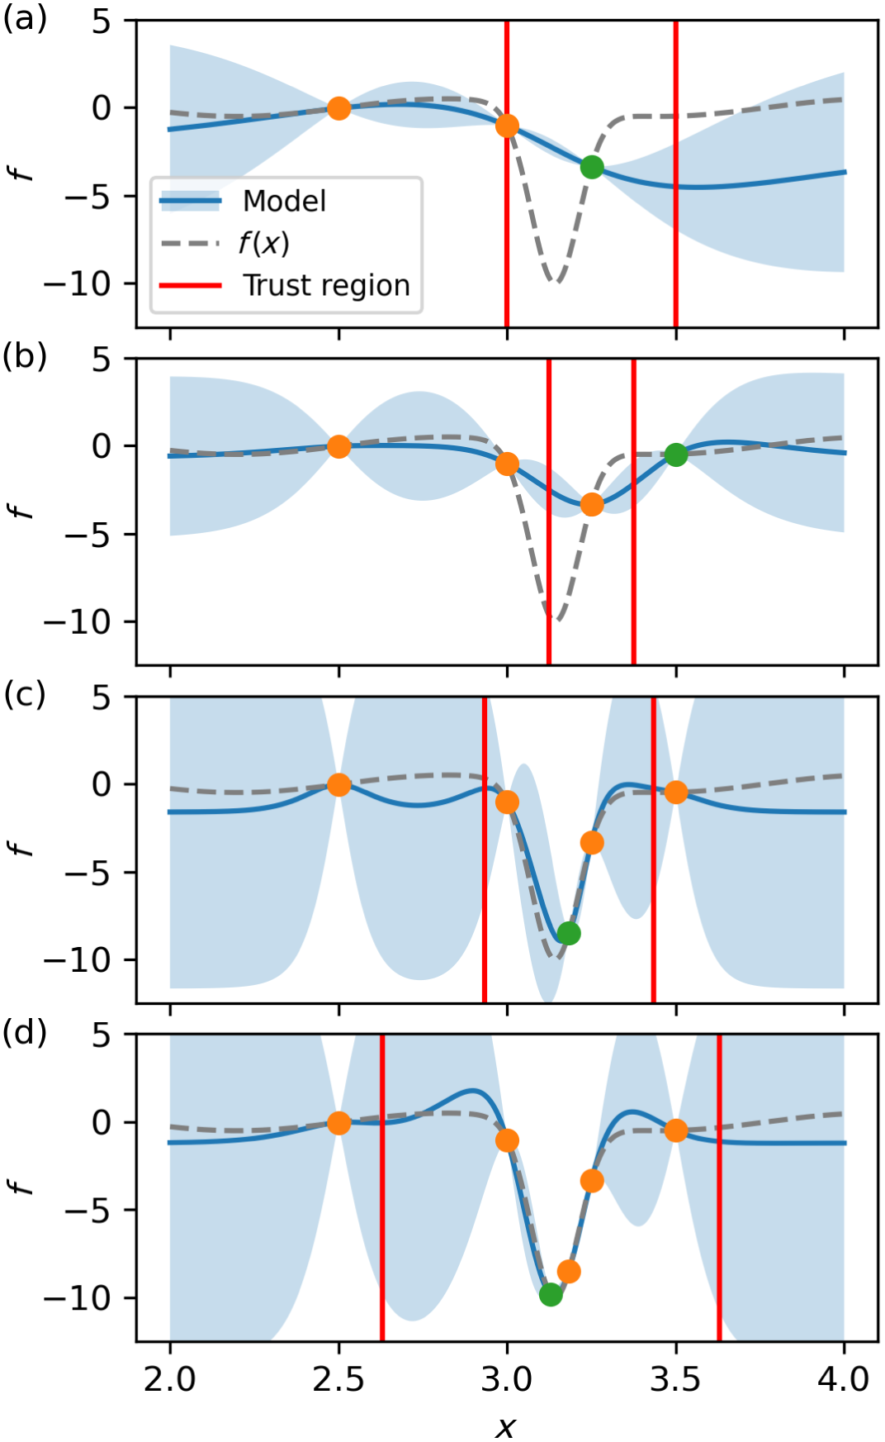
JKPS 250321
Conclusion
MOBO is ideal tool for online multiobjective accelerator optimization
MOBO can be repeated periodically to monitor changes in machine performance over time
Advanced method can be applied in MOBO in order to reduce optimization time
(e.g. q-EHVI, multi-fidelity modeling, trust-region Bayesian optimization(TuRBO)
27

Slide 28
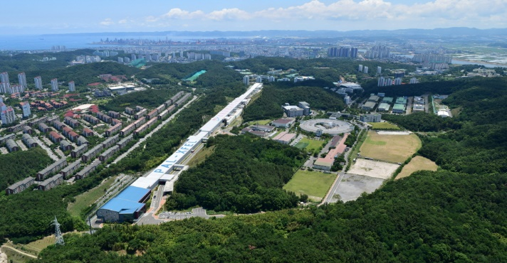


JKPS 250321
Thank you!

