Slide 1
Machine Learning for prognostics and optimization of particle accelerators
Machine Learning at Spallation Neutron Source (SNS), Oak Ridge National Lab (ORNL)
Kishansingh Rajput
Collaborators: W. Blokland, A. Zhukov, D. Winder, M. Schram, P. Ramuhalli, C. Peters, R. Vilalta, Y. Alanazi, A. Kasparian, D. Brown, C. Long, B. Cathey, D. Winder, M. Edwards, C. Elliott, G. Gallimore, M. Bryan, C. Pappas, K. Ruisard, J. Rye, S. Thomas, X. Zhao, G. Milanovich, J. Walden, S. Cousineau
This work was supported by the DOE Office of Science, United States under Grant No. DE-SC0009915 (Office of Basic Energy Sciences, Scientific User Facilities program).

Slide 2
Outline
Overview of Machine Learning at SNS for Prognostics and Optimization
  Infrastructure
  Beam Loss Optimization
  Target System Anomaly Reporting and Feedback
  Errant Beam Prediction using Machine Learning
    Sensors and Data Collection
    Data Curation
    Beam Configuration and drift in the data
    Conditional ML Models
    Continual Learning and UQ
Conclusion, Future Direction, and References

Slide 3
Overview

Slide 4
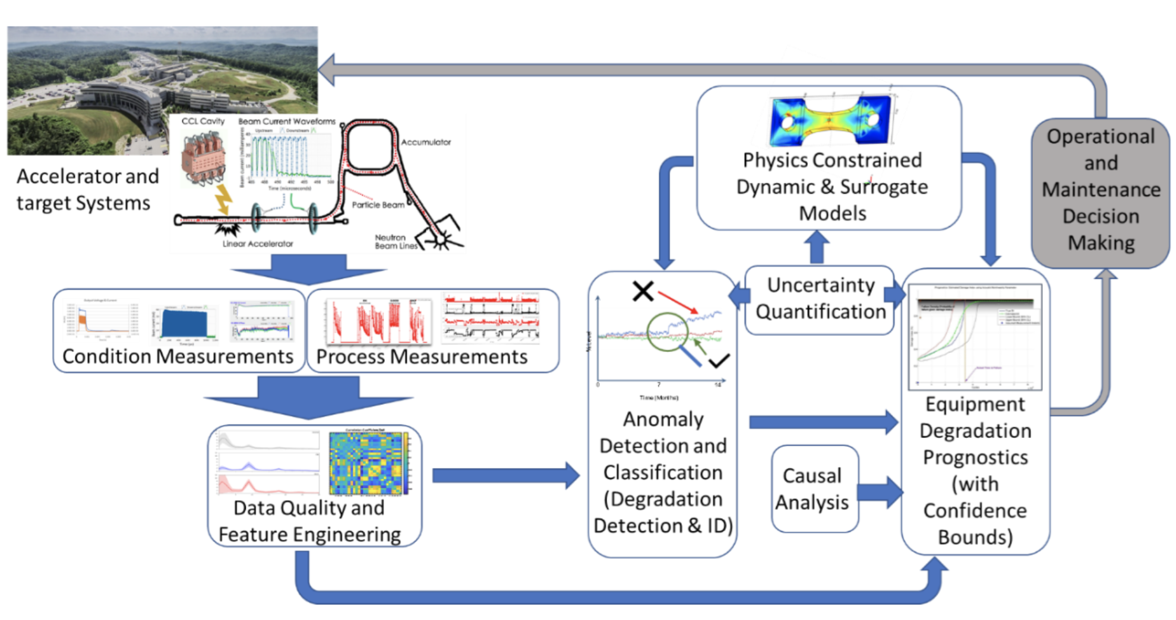
Overview
Spallation Neutron Source (SNS) accelerator at Oak Ridge National Lab delivers 1.4 MW of a 1 GeV pulsed beam at 60 Hz (1.3 MW of 2.8 GeV after recent upgrade)
Ongoing work on anomaly prediction, reporting and feedback system for errant beams and target systems using Machine Learning (ML) algorithms to reduce downtime
ML based controls algorithms are being explored for beam loss tuning optimization
Infrastructures to support long term ML lifecycles deployment are being developed

Slide 5
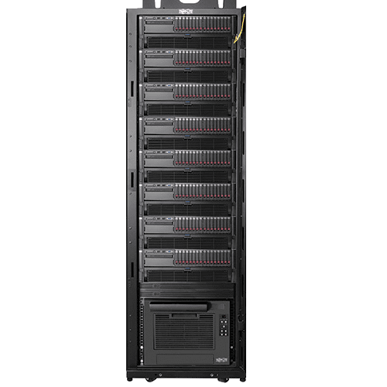

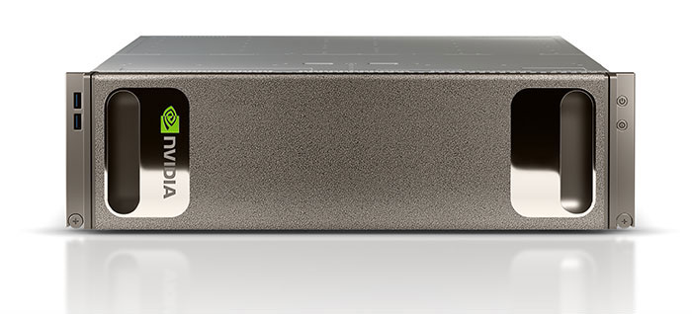
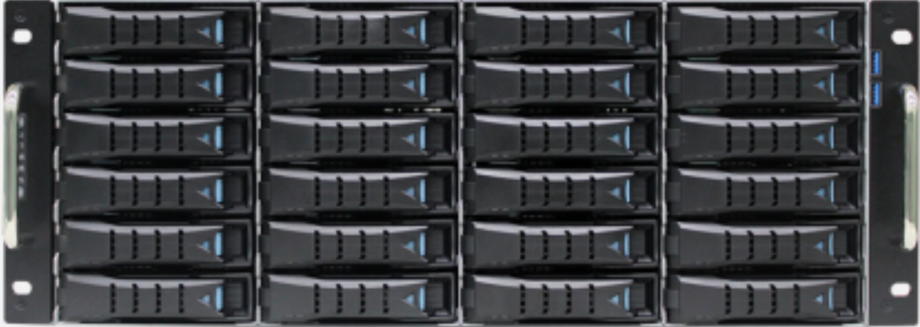
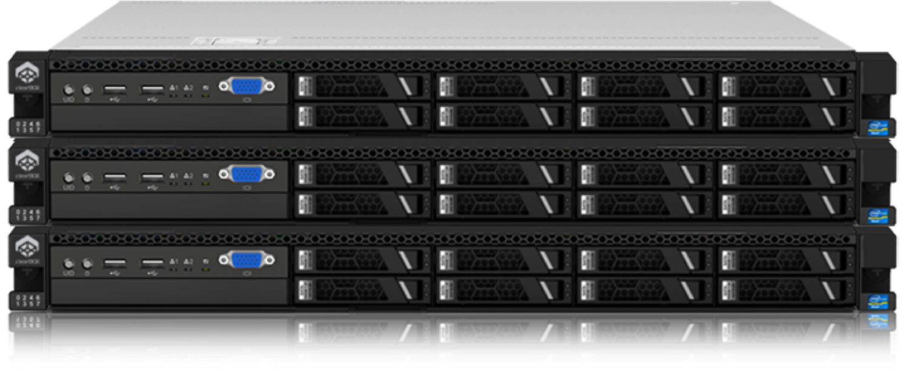
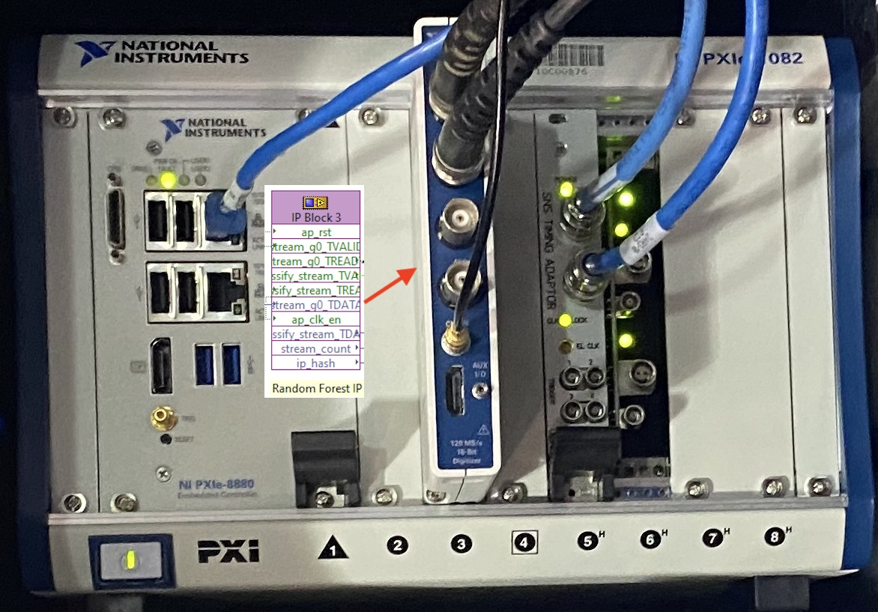
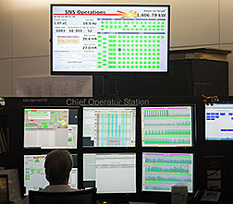

Infrastructure
DGX
GitLab
GitLab
Code repository
Actions
  Verify new code
  Deploy
Storage
Acquired Data
Data
SNS Servers
Train and test model
Store data
ORNL Servers
GitLab
Icarus
New Model
New Model
Abort
Inference Results
Data Acquisition
Acquire data
Model inference
Abort beam
Edge computer
Data compression and buffer
Real-time Model inference
Display results
Operator
View results
Operate models
Developer
Scripts
GUIs
MLFlow

Slide 6
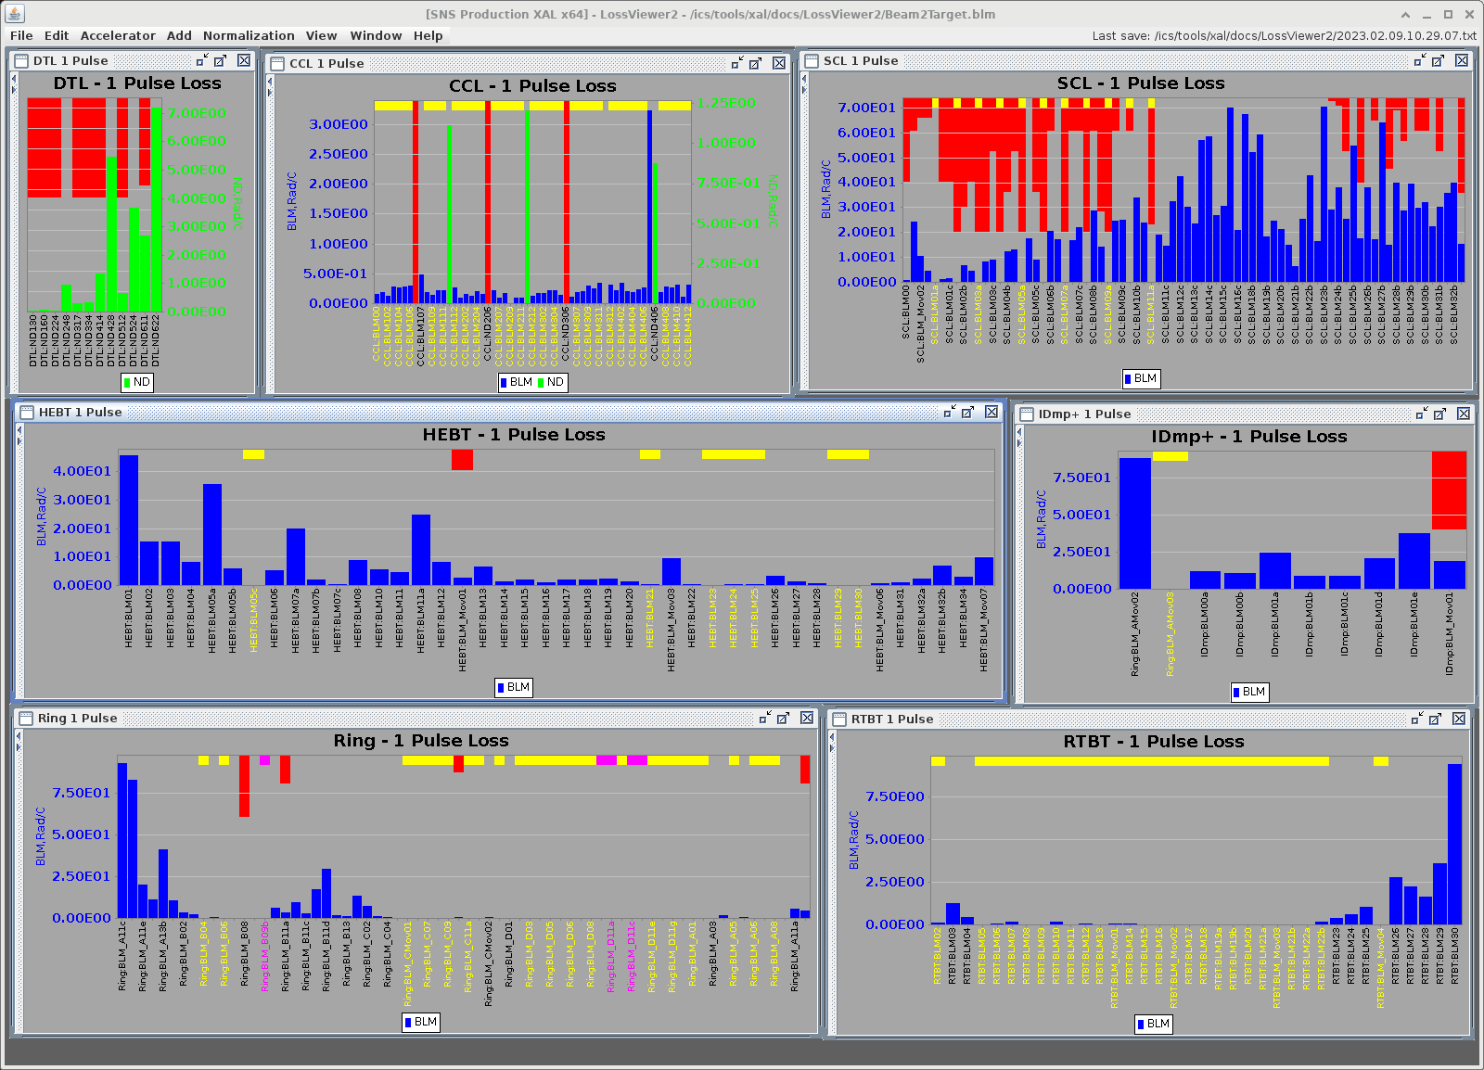
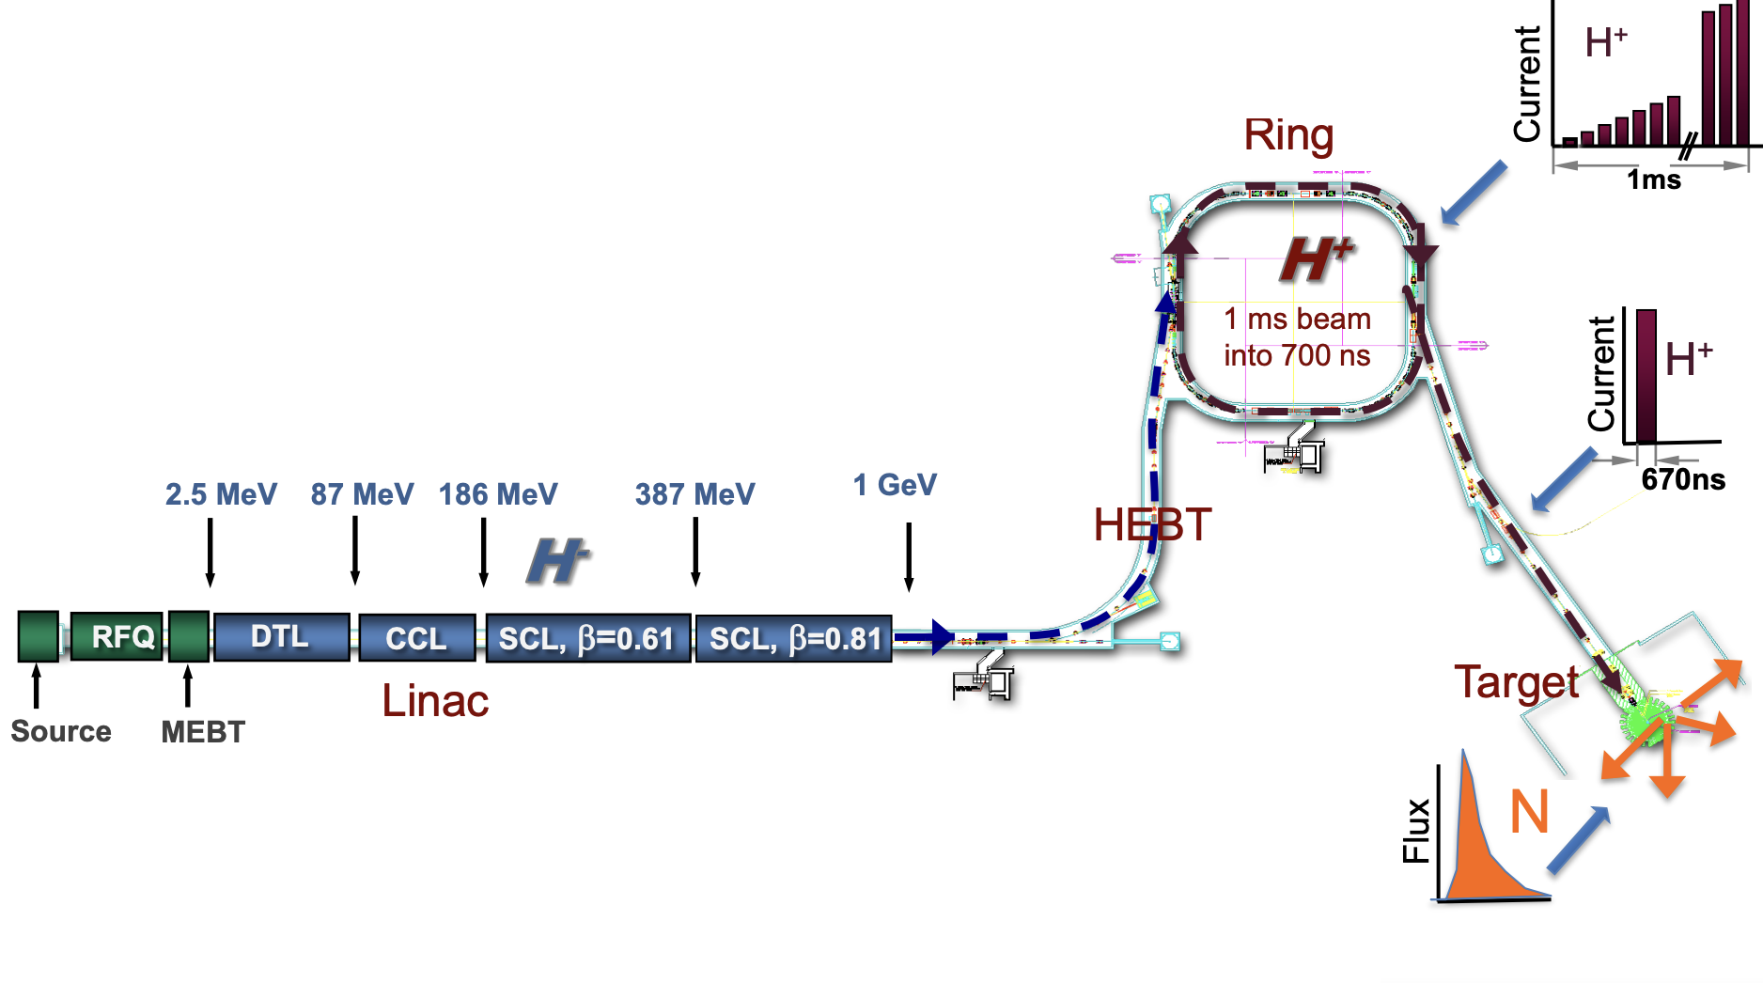
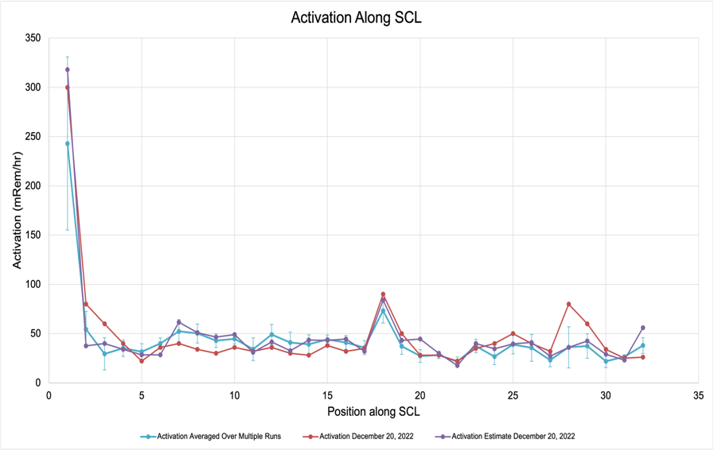
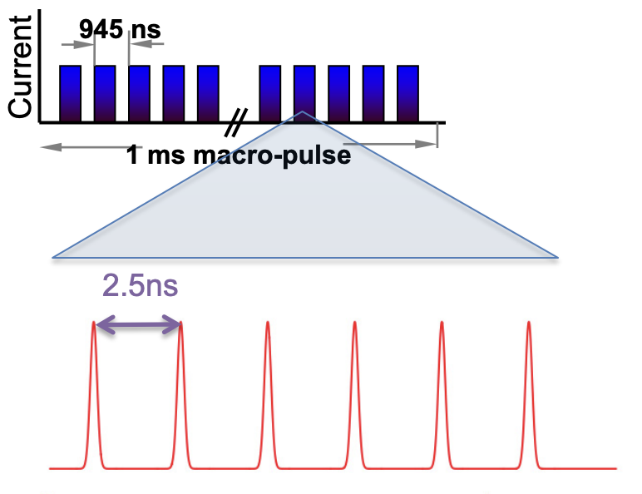
Beam loss Optimization
Measured beam losses lead to activation
Goal: Reduce beam losses
Timescale: Minutes, 1GB/year
Sensors and Actuators: > 100 Loss monitors
and magnets
Approach: Reinforcement Learning;
Use virtual accelerator and safety limits
to test safety of algorithms
Loss monitor
sees 1 ms
Example of beamline activation due to losses
AP physics model
works with one bunch,
doesn’t have halo details
Talk - From Physics Study to Operations by Carrie Elliott

Slide 7
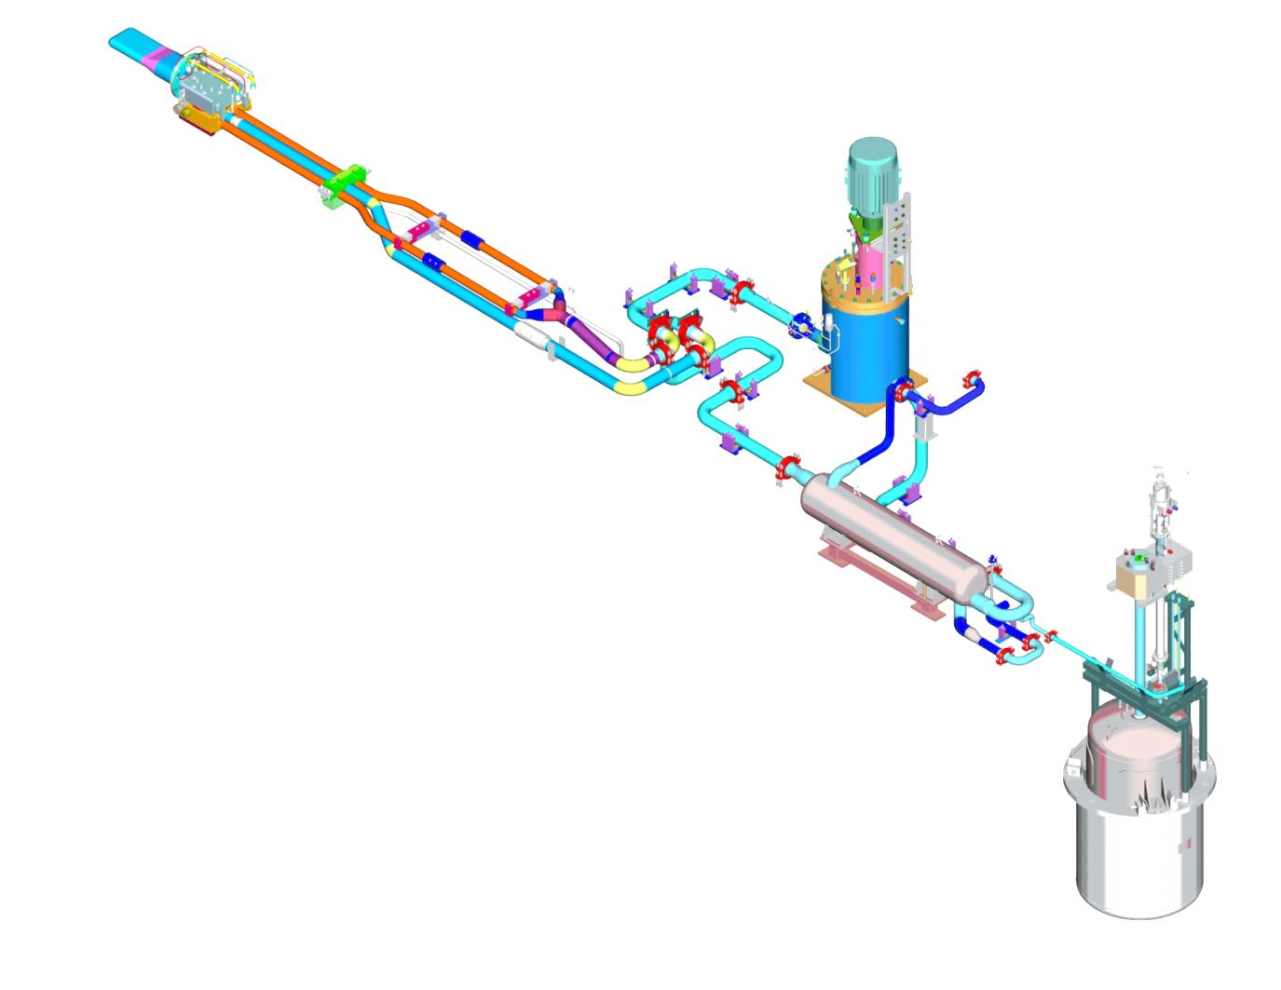
Target System Anomaly Prediction
Goal: Reduce downtime due to target
Timescale: Minutes
Sensors and Actuators: Flow, Pressure, Temperature and PID controllers’ valve and motors
Approach: Use archived and real-time data to train for anomalies, generate reports and alert for anomalies
Hg Pump Motor
Target
Module
Supply Pipes (3)
Hg Pump Tank
Return Pipe (1)
Transfer Valve
Heat Exchanger
Operates with ~1400 L of liquid mercury
  ~20 tons of mercury
  Mercury circulates through the loop about once a minute
  4 slpm of helium gas injected at the target module
Set it and forget it
  Loop is intended to run at a constant pump speed and gas flow rate
Mercury Storage Tank

Slide 8
Outline
Overview of Machine Learning at SNS for Prognostics and Optimization
  Infrastructure
  Beam Loss Optimization
  Target System Anomaly Reporting and Feedback
  Errant Beam Prediction using Machine Learning
    Sensors and Data Collection
    Data Curation
    Beam Configuration and drift in the data
    Conditional ML Models
    Continual Learning and UQ
Conclusion, Future Direction, and References

Slide 9
Errant Beam Prediction
Goal: Predict and prevent Errant beam pulses
Timescales: µsecs to 15 ms, stream: +100Mb/s
Sensors and Actuators: 1x Current Monitor and 30+ Beam Position Monitors
Approach: Use continual learning ML (Siamese and VAE) models to detect precursor and abort beam (FP must be very low <0.2%)
Beam Configuration
ML Model
Anomaly Prediction,
Uncertainty
ML Model
DCM
BPM data
Latent
Representation
BPM
MPS anomaly Labels
Clustering
Fault Classification

Slide 10
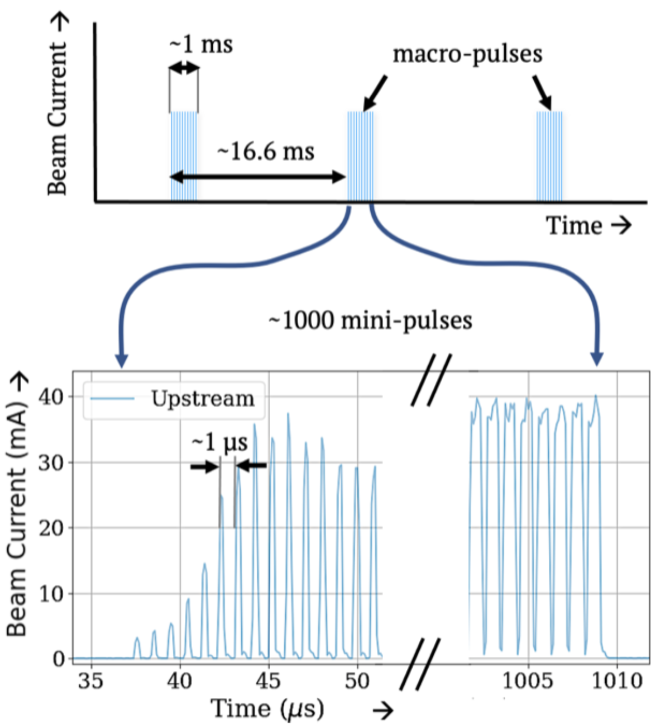
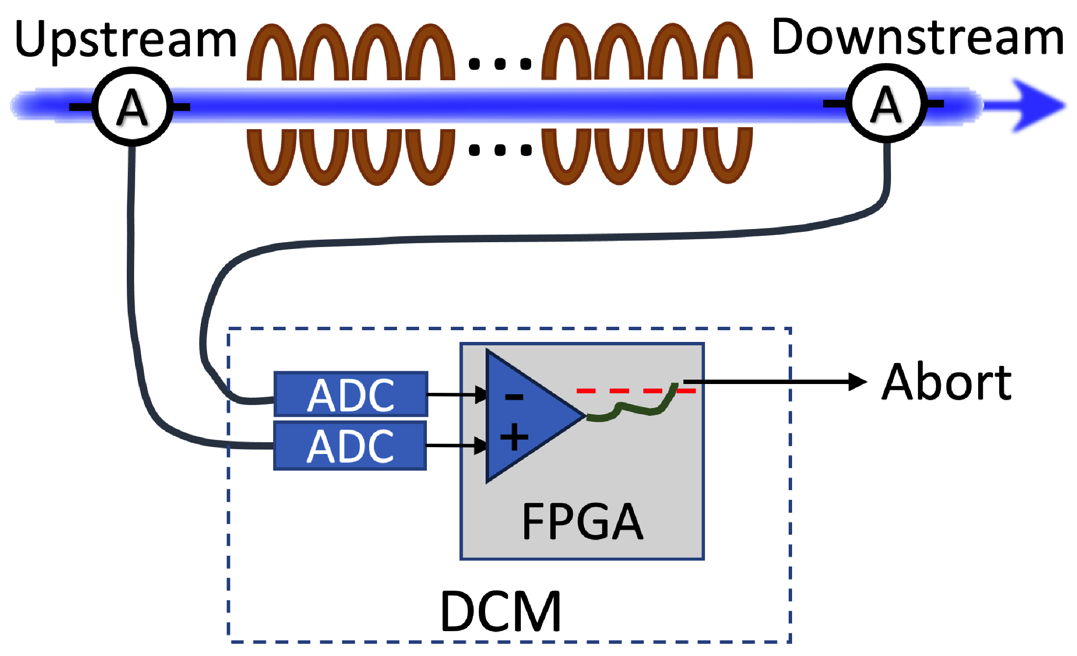

Sensors and Data Collection
SNS employs a DCM to protect the Super Conducting Linac (SCL)
Continuously monitors upstream and downstream beam current waveforms to detect any loss
FPGA and dedicated communication line with Machine Protection System (MPS)
DCM can be programmed to store all the beam current waveforms
Previous studies showed precursors are present in pre-fault data to indicate upcoming fault
In addition, beam configuration settings are also store associated with these waveforms
We are also looking into possibility of using Beam Position Monitor (BPM) data together with DCM data to improve the accuracy further

Slide 11
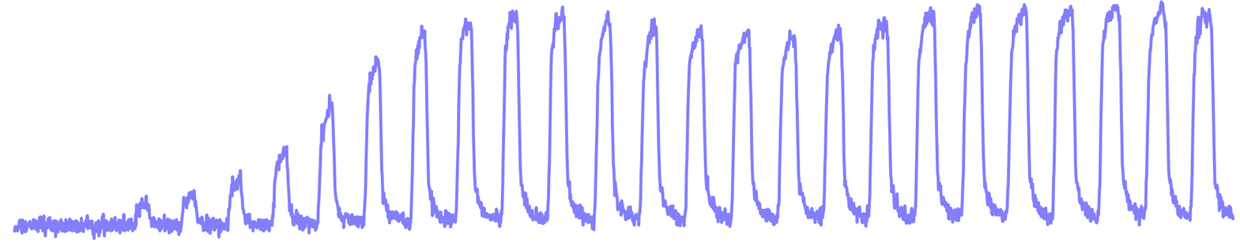
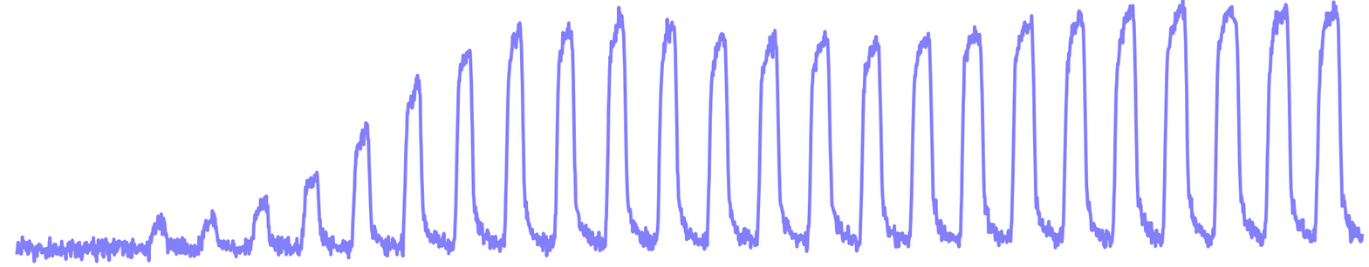
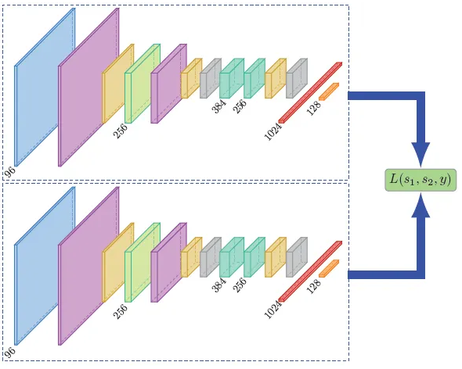
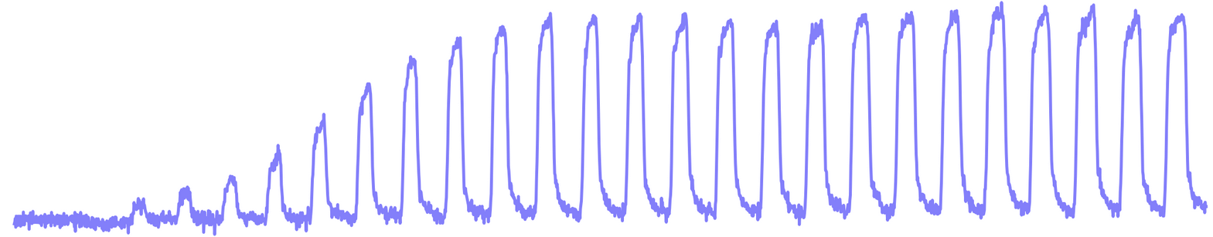
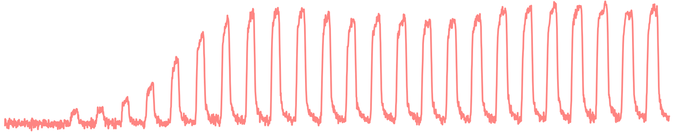
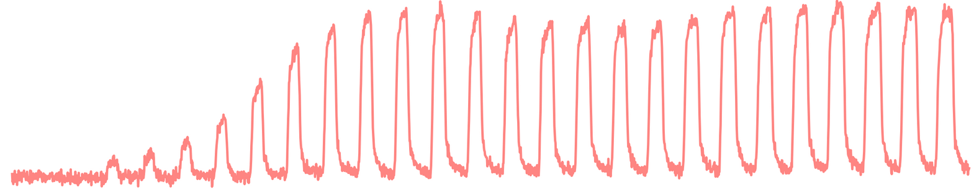
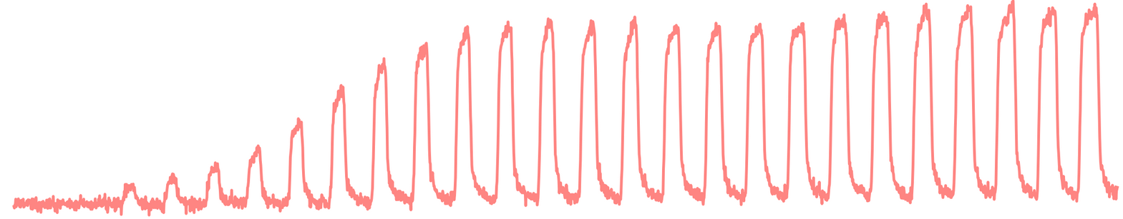
Data Curation
Pre-cursors in the normal (pre-fault) beam current data
Enables prediction of faults (Prediction not detection!)
Label normal data immediately before fault as 1
All other normal data instances labeled as 0
Normal
Preceding fault
Fault
(Not used)
Marked as anomaly in training data
Marked as normal (including all the preceding samples until previous fault)
Reference Normal Pulses
Input to Siamese Model
Different Combinations of Normal to Normal (labeled 0) and Normal to “Before” pulses (labeled 1)
1
Pre-fault Pulses
0
Shared weights and biases
0
1
Siamese Model

Slide 12
Data Drift
Drift due to measurable parameters
Beam configuration are tuned continuously
Changes in the config parameter → changes distribution of the beam current waveforms
Drift due to non-measurable parameters
Machine degradation, aging, maintenance, Equipment replacement etc. cause data distribution to change
Different colors represent different beam configuration settings

Slide 13
ML Models
Similarity based models can correctly classify unseen anomalies. Ex Siamese model, AE, VAE etc.
Siamese Neural Network (SNN), and VAE to predict anomalies
SNN learns twin embedding models to transform inputs into a latent space
Distance measures are applied at latent space to compute the similarity
Beam Config
Do we account for drifts due to known parameters?
Beam configurations as Conditional input
Conditional SNN (CSNN) and Conditional VAE (CVAE)
Potentially learn any cross-correlations between beam current data from different configs
MLP
Concatenate
Can the model adapt to distribution drifts due to non-measurable parameters?
- Work in progress to leverage developments in Continual Learning domain
(GPA)

Slide 14
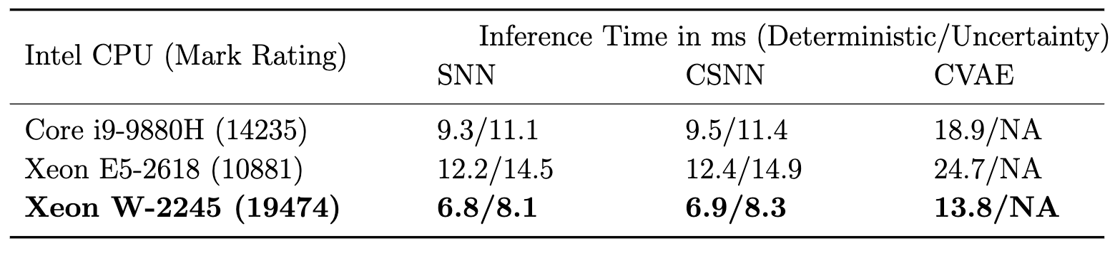
Results
Evaluation Metric
Total downtime should not be increased by false alarms
Maximum number of possible anomalies should be predicted before they occur
Goal: Maximize True Positive Rate (TPR) while keeping False Positive Rate (FPR) below 0.1%
CSNN vs CVAE vs SNN
Model architectures were selected after a HPO and NAS
10 Trials to provide statistically robust comparison
CSNN outperforms both SNN and CVAE
CVAE has 10 times more learnable parameters than CSNN
Inference Time

Slide 15
Continual Learning
Data
Predictions
Sensors
Model performance degrades when data distribution changes
Defining Triggers for model re-training is challenging
Sudden drifts due to config changes → include new config data in training set
Gradual drifts due to non-measurable parameters → Continual Learning
Model performance based triggers are most valued
When aborted – no information whether it was right!
Uncertainty Quantification can help defining re-training triggers
  Distance aware uncertainty goes up → Model is less confident as data is out of distribution
Catastrophic forgetting is a big issue to address
Inference and Feedback setup
Logging and Monitoring
Model Re-training Triggers
Data Preparation
Offline Model Training and Evaluation
Deployed Model
Continual Learning setup in the outer loop

Slide 16
Conclusion
Machine Learning is being deployed at SNS accelerator for anomaly prediction and optimization
Conditional Siamese Models and Conditional VAEs are deployed to predict errant beams
Beam Current Waveforms are used to predict upcoming anomalies
Conditional Siamese Model outperforms
  Conditional VAE Siamese Models
  Siamese model trained on single beam configuration data
Data drifts due to both measurable (beam config) and non-measurable (machine degradation, equipment replacement etc.) parameters
Model performance degrades when data drifts
Continual Learning is being explored to tackle data drifts
Open to Collaboration
Principle Investigators
Willem Blokland (Blokland@ornl.gov)
Malachi Schram (schram@jlab.org)
Use case lead
Anomaly Prediction and Continual Learning
Kishan Rajput (Kishan@jlab.org)

Slide 17
References
K. Rajput, M. Schram, W. Blokland, Y. Alanazi, P. Ramuhalli, A. Zhukov, C. Peters, R. Vilalta, “Robust Errant Beam Prognostics with Conditional Modeling for Particle Accelerators” Machine Learning: Science and Technology, Available: https://iopscience.iop.org/article/10.1088/2632-2153/ad2e18
W. Blokland, K. Rajput, M. Schram, T. Jeske, P. Ramuhalli, C. Peters, Y. Yucesan, A. Zhukov,”Uncertainty aware anomaly detection to predict errant beam pulses in the Oak Ridge Spallation Neutron Source accelerator,” Physical Review Accelerators and Beams, vol 25, p.122802, Dec 2022. Available: https://doi.org/10.1103/PhysRevAccelBeams.25. 122802
Yasir Alanazi, Malachi Schram, Kishansingh Rajput, Steven Goldenberg, Lasitha Vidyaratne, Chris Pappas, Majdi I. Radaideh, Dan Lu, Pradeep Ramuhalli, Sarah Cousineau, Multi-module-based CVAE to predict HVCM faults in the SNS accelerator, Machine Learning with Applications,Volume 13,2023,100484,ISSN 2666-8270, https://doi.org/10.1016/j.mlwa.2023.100484. (https://www.sciencedirect.com/science/article/pii/S2666827023000373)
Kishansingh* Rajput, Malachi Schram, Karthik Somayaji, Publication date 2022/12, Conference NeurIPS Machine Learning and the Physical Sciences workshop, https://arxiv.org/abs/2309.14502
S. Goldenberg, M. Schram, K. Rajput, T. Britton, C. Pappas, D. Lu, J. Walden, M. Radaideh, C. Cousineau, S. Harave, “Distance Preserving Machine Learning for Uncertainty Aware Accelerator Capacitance Predictions”, Under review at Machine Learning with Applications, Available at: https://arxiv.org/abs/2307.02367
M. I. Radaideh, C. Pappas, J. Walden, D. Lu, L. Vidyaratne, T. Britton, K. Rajput, M. Schram, S. Cousineau, ”Time series anomaly detection in power electronics signals with recurrent and ConvLSTM autoencoders,” Digital Signal Processing, vol 130, p. 103704, Oct 2022. Available: https://doi.org/10.1016/j.dsp.2022.103704
C. Pappas, D. Lu, M. Schram, D. Vrabie, ”Machine Learning for Improved Availability of the SNS Klystron High Voltage Converter Modulators,” Proceedings of the 12th Inter- national Particle Accelerator Conference, 2021. Available: https://doi.org/10.18429/ jacow-ipac2021-thpab252
M. I. Radaideh, C. Pappas, P. Ramuhalli, Sarah Cousineau, ”Application of Convolutional and Feedforward Neural Networks for Fault Detection in Particle Accelerator Power Systems,” Annual Conference of the PHM Society, vol 14, Oct 2022. Available: https://doi. org/10.36001/phmconf.2022.v14i1.3270
M. I. Radaideh, H. Tran, L. Lin, H. Jiang, D. Winder, S. Gorti, G. Zhang, J. Mach, S. Cousineau, ”Model calibration of the liquid mercury spallation target using evolutionary neural networks and sparse polynomial expansions,” Nuclear Instruments and Methods in Physics Research Section B: Beam Interactions with Materials and Atoms, vol 525, pp. 41- 54, Aug 2022. Available: https://doi.org/10.1016/j.nimb.2022.06.001
L. Lin, S. Gorti, J. Mach, H. Tran, D. Winder, ”Application of Machine Learning to Pre- dict the Response of the Liquid Mercury Target at the Spallation Neutron Source,” Proceedings of the 12th International Particle Accelerator Conference, 2021. Available: https: //doi.org/10.18429/JACoW-IPAC2021-WEPAB292
M. I. Radaideh, L. Lin, H. Jiang, S. Cousineau, ”Bayesian inverse uncertainty quantification of the physical model parameters for the spallation neutron source first target station,” Re- sults in Physics, vol 36, p. 105414, May 2022. Available: https://doi.org/10.1016/j. rinp.2022.105414
L. Lin, M. I. Radaideh, H. Tran, D. Winder, ”Benchmarking and Exploring Parameter Space of the 2-Phase Bubble Tracking Model for Liquid Mercury Target Simulation,” North American Particle Accelerator Conference (NAPAC), vol 14, Aug 2022. Available: https: //doi.org/10.18429/jacow-napac2022-wepa37
M. I. Radaideh, C. Pappas, D. Lu, J. Walden, S. Cousineau, T. Britton, K. Rajput, L. Vid- yaratne, M. Schram, ”Progress on Machine Learning for the SNS High Voltage Converter Modulators,” North American Particle Accelerator Conference (NAPAC), vol 14, Aug 2022. Available: https://doi.org/10.18429/jacow-napac2022-wepa38
M. I. Radaideh, C. Pappas, S. Cousineau, ”Real electronic signal data from particle accelerator power systems for machine learning anomaly detection,” Data in Brief, vol 43, p. 108473, Aug 2022. Available: https://doi.org/10.1016/j.dib.2022.108473
M. Rescic, R. Seviour, W. Blokland, “Predicting particle accelerator failures using binary classifiers”, Available at: https://pure.hud.ac.uk/ws/portalfiles/portal/18999491/paper_4.pdf

