Slide 1
ML Methods for Noise Reduction in Industrial LLRF Systems
This material is based upon work supported by the U.S. Department of Energy, Office of Science, Office of Accelerator R&D and Production award number DE-SC0023641
M. Henderson, J. Edelen, J. Einstein-Curtis, C. Hall (RadiaSoft LLC) J. Diaz Cruz, A. Edelen (SLAC)

Slide 2
Outline
Motivation & background
Problem motivation
Industrial application areas
Noise reduction approach
Overview
Noise analysis
Kalman filtering
Convolutional autoencoders
Variational autoencoders
Results & discussion

Slide 3
Background & motivation
The value of noise reduction in industrial applications

Slide 4
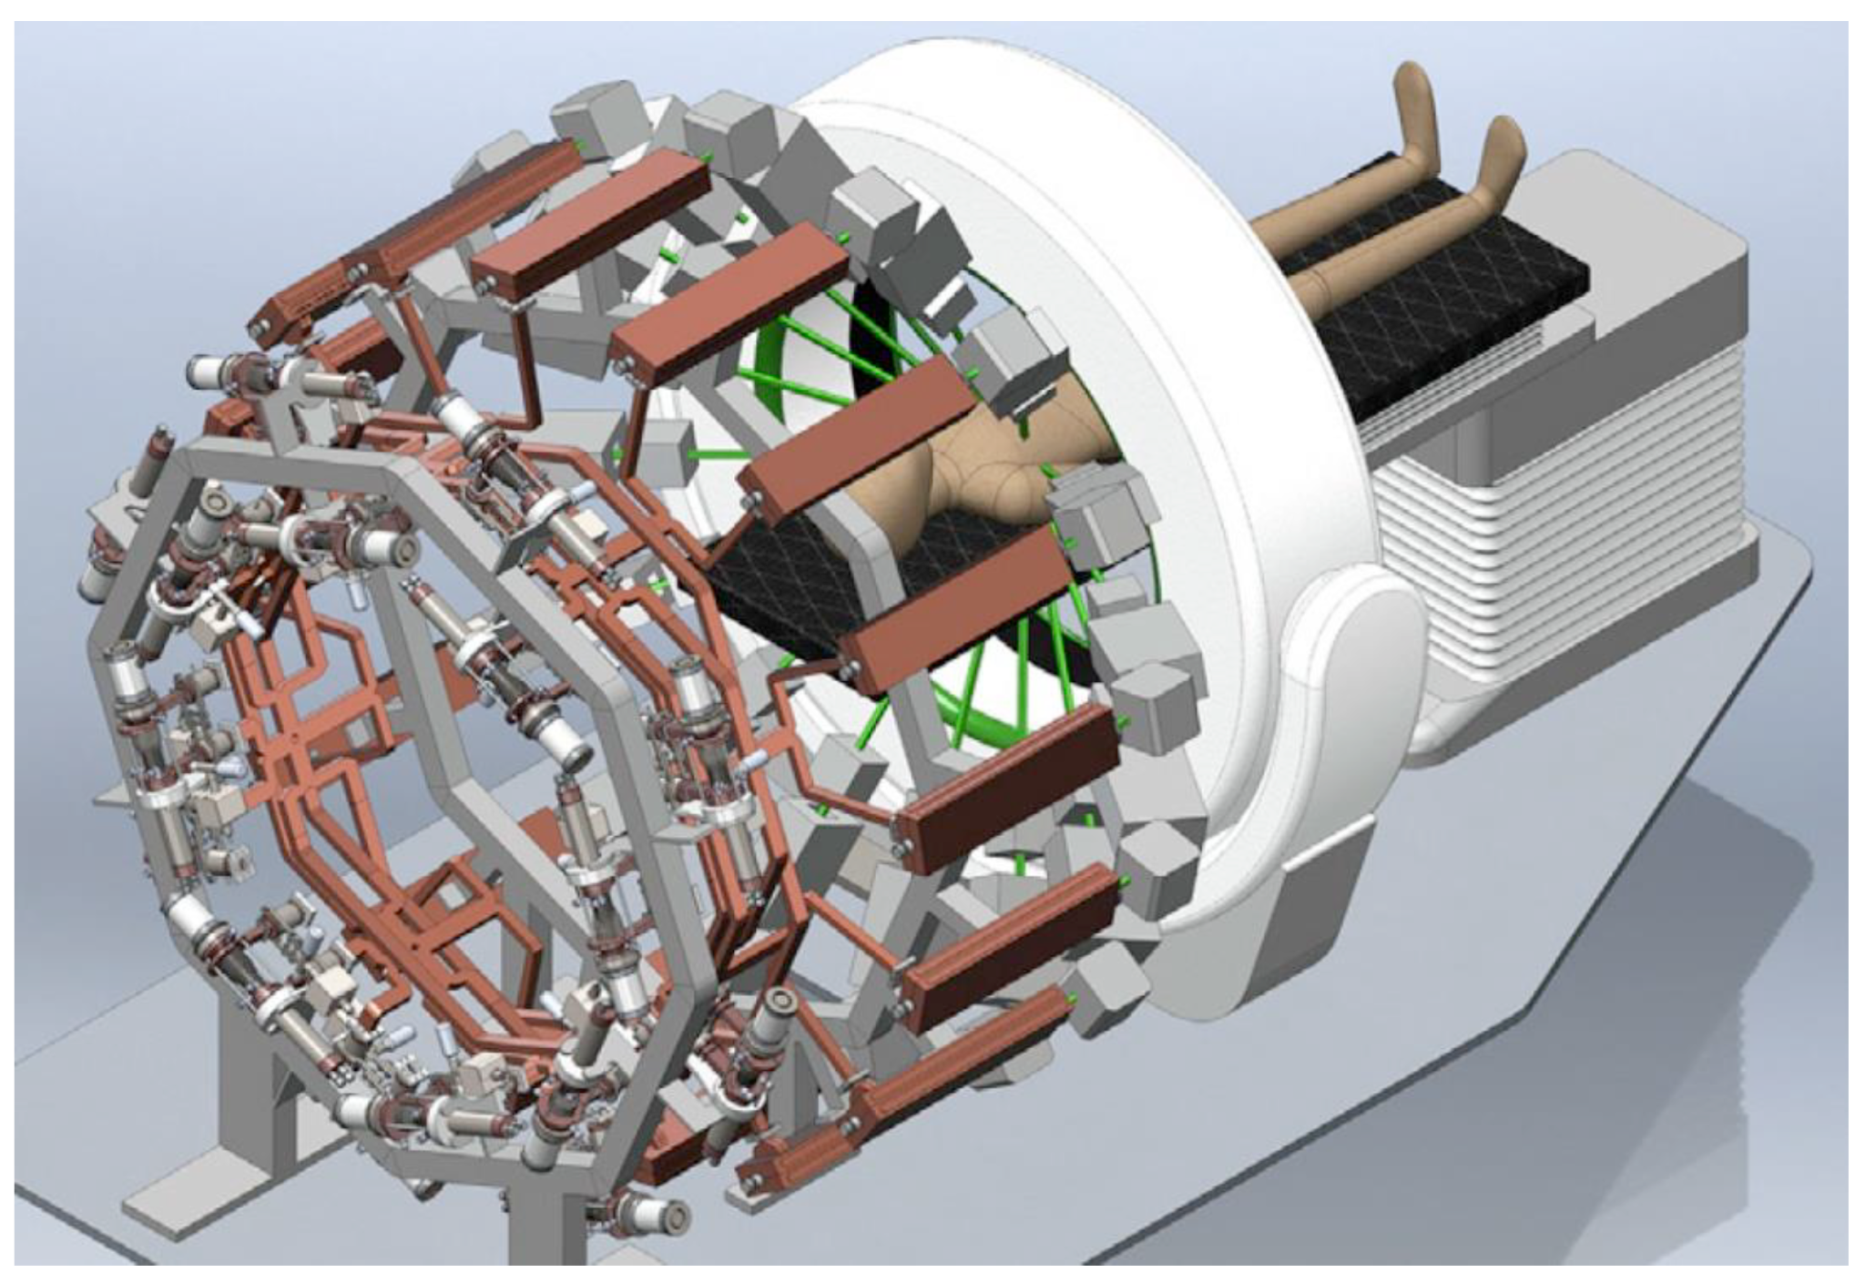
Motivation
Industrial vs. research operations
Less controlled environments
Mass-produced equipment
Noisier electronic (e.g. RF) systems
Growing demand for finely-tuned controls
Highly targeted radiotherapy
Sterilization (medical, agricultural, etc.)
Promising solutions via machine learning (ML)
Noise reduction & controls
PHASER flash radiotherapy system

Slide 5
Industrial Application Areas
Security & Defense
Imaging
Medical Therapies
Manufacturing
Sterilization
Polymer treatment
Directed energy testing
Electron microscopy
Proton therapy
Medical devices
Industrial curing
𝛾-ray sources
Electron therapy
Food & water
Single effects
Ion implantation
X-ray sources
X-ray therapy
Waste water
Welding
All rapidly increasing in complexity
High-energy multi-cavity designs
Distributed RF generation

Slide 6
Noise reduction approach
Noise analysis & methods for removal

Slide 7
Noise Reduction Overview
Noise analysis techniques
Noise power spectra
Integrated noise statistics
Analytic approaches
Shifting Gaussian smoothing window
Standard Kalman filter
ML approaches
Standard & variational autoencoders (AE & RAE)
Convolutional autoencoder (CAE)
Variational recurrent autoencoder (VRAE)

Slide 8
Noise Analysis
Original $\left(X_{0}\right)$ & noisy $\left(X\right)$ state data available via simulation
Predict noiseless states $(\hat{X}≈X_{0})$ from noisy data
$$X\left(t\right)=X_{0}\left(t\right)+w_{t}, \hat{X}\left(t\right)=f\left(X\right), N\left(t\right)=\hat{X}−X_{0}, w_{t}\sim 𝒩\left(0, σ_{N}\right)$$
Noise error power spectra & integrated noise
$$N\left(ω\right)=\int{N\left(t\right)e^{−iωt} dt}, N_{int}\left(ω\right)=\int_{0}^{ω}{N\left(ω^{′}\right) dω^{′}}$$
Average integrated noise
Used for computing statistics over sample sets
$${\overline{N}}_{int}=\int{N\left(ω\right) dω}$$
(for ONE sample set)

Slide 9
Kalman Filtering
Dynamical estimation technique
Linear state & measurement dynamics (for standard KF)
$x_{t+1}=Fx_{t}+Gu_{t}+w_{t}$
$y_{t}=Hx_{t}+Mu_{t}+v_{t}$
Predict true states from noisy measurements
A priori updates follow known dynamics
State estimate: ${\hat{x}}_{k}^{−}=F{\hat{x}}_{k−1}^{+}+G{\vec{u}}_{k−1}$
Error covariance: $P_{k}^{−}=FP_{k−1}^{+}F^{T}+Q$
Information (Kalman) gain: $K_{k}=P_{k}^{−}H^{T}{\left(HP_{k}^{−}H^{T}+R\right)}^{−1}$
A posteriori updates follow Bayes’ rule
State estimate: ${\hat{x}}_{k}^{+}={\hat{x}}_{k}^{−}+K_{k}\left({\vec{y}}_{k}−H{\hat{x}}_{k}^{−}\right)$
Estimation error covariance: $P_{k}^{+}=\left(I−K_{k}H\right)P_{k}^{−}$
RF State, Controls, & Measurements
$$x_{t}=\left[\begin{matrix}Re\left(V_{t}\right) \\ Im\left(V_{t}\right)\end{matrix}\right], u_{t}=\left[\begin{matrix}Re\left(I_{fwd}\right) \\ Im\left(I_{fwd}\right)\end{matrix}\right], y_{t}=\left[\begin{matrix}Re\left(V_{t}\right) \\ Im\left(V_{t}\right) \\ Re\left(V_{r}\right) \\ Im\left(V_{r}\right)\end{matrix}\right]$$
RF Dynamics Matrices
$$F=\left[\begin{matrix}−ω_{1/2} & −Δω \\ Δω & −ω_{1/2}\end{matrix}\right], G=\frac{R_{L}ω_{1/2}}{m}\left[\begin{matrix}1 & 0 \\ 0 & 1\end{matrix}\right]$$
$$H=\left[\begin{matrix}1 & 0 \\ 0 & 1 \\ 1/m & 0 \\ 0 & 1/m\end{matrix}\right], M=−\frac{Z_{0}}{2}\left[\begin{matrix}0 & 0 \\ 0 & 0 \\ 1 & 0 \\ 0 & 1\end{matrix}\right]$$

Slide 10
Convolutional Autoencoders
Convolutions condense 1D sequences into latent vectors
Filters learn translation-invariant features (similar to UNet)
Pooling layers for down-sampling
Transpose convolutions for up-sampling
Parameterized architecture
Latent dimension
Number of filters per convolution
Convolutional kernel sizes
1D Convolutions
Noisy Sequence
Denoised Sequence
Max Pooling
Up-Convolution
Contraction
Extract features from sequence
Flatten
Reshape
Expansion
Expand features into sequence
Dense Layers

Slide 11
Variational Autoencoders
Condenses/expands 1D sequences into/from stochastic latent space
Encoder/decoder can be deep neural-network (DNNs), LSTM cells, etc.
Latent space distribution given by mean vector & covariance diagonals
KL divergence loss enforces smooth latent distributions
Attractive option for denoising RF signals
Previous success on BPM data
Another reason
Reconstruction Loss
$$L_{recon}={\left\|X −\hat{X}\right\|}^{2}$$
KL Divergence Loss
$$L_{KL}=\sum_{i}{σ_{i}^{2}+μ_{i}^{2}−\log\left(σ_{i}\right)−\frac{1}{2}}$$
(Assuming $p\sim 𝒩\left(\vec{μ}, Σ\right)$)
$$X\left(t\right)$$
Condense sequence
$$p\left(\vec{z}\right)$$
Sample latent space
(”Reparameterization Trick”)
Expand sample
$$\hat{X}\left(t\right)$$
Encoder
Decoder
$$\vec{μ}$$
$$\vec{z}\sim 𝒩\left(\vec{μ}, Σ\right)$$
$$\vec{σ}$$
$$\left(\vec{σ}≡diag\left(Σ\right)\right)$$

Slide 12
Results & discussion
Denoised signals & integrated noise statistics

Slide 13
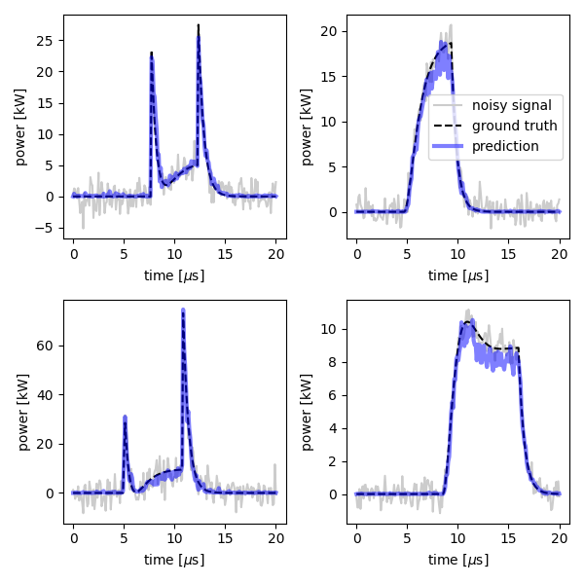
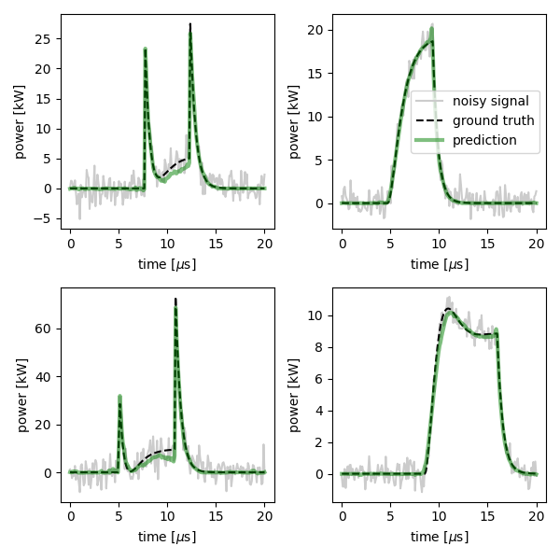
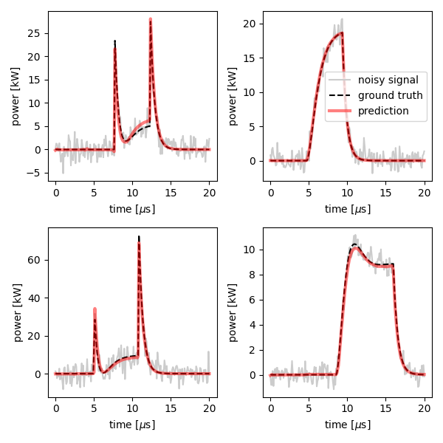
Denoised Signals
Kalman Filter
Convolutional Autoencoder
Variational Recurrent Autoencoder

Slide 14
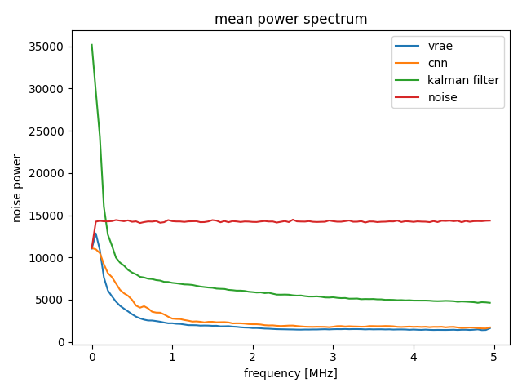
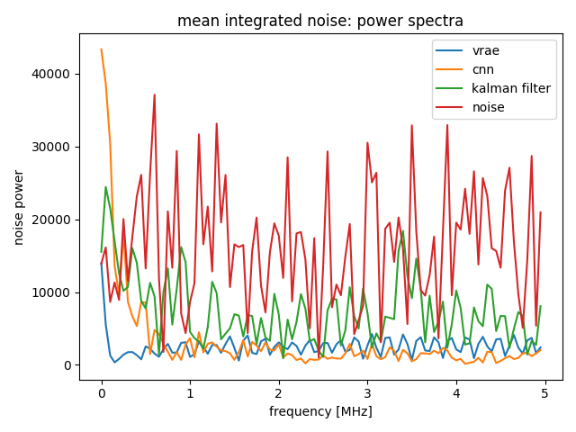
Noise Power Analysis
Single example with median $N_{int}$

Slide 15
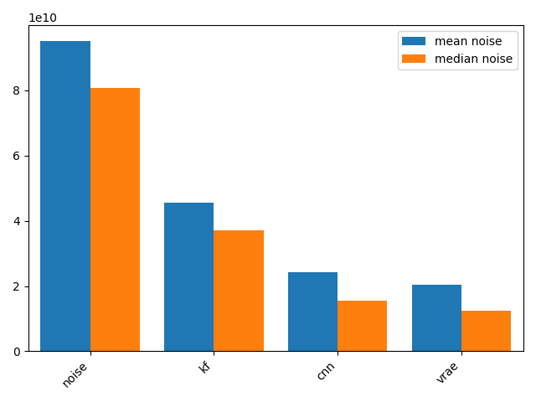
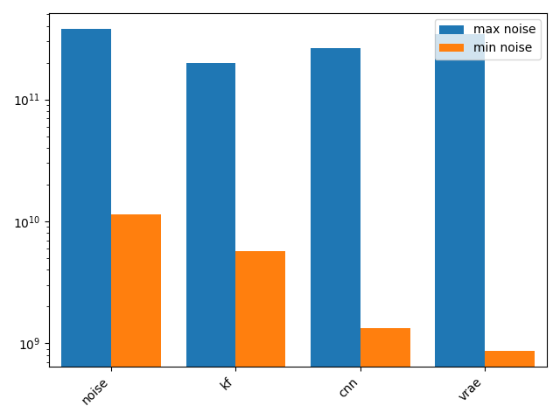
Integrated Noise Statistics

Slide 16
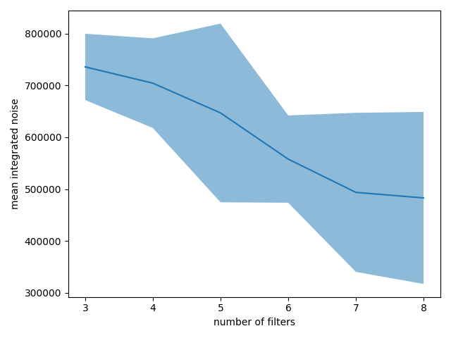
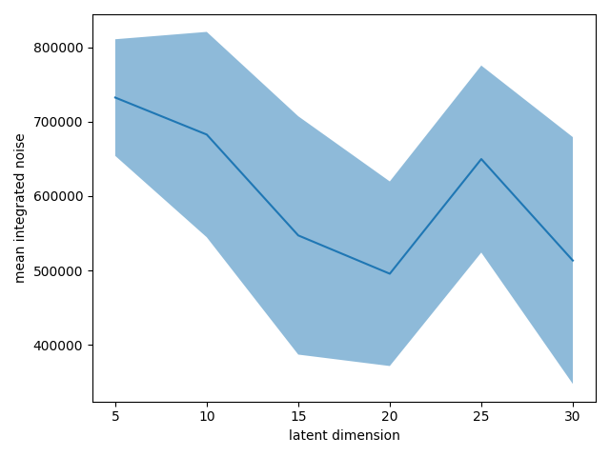
Integrated Noise & Hyperparameter Tuning (CAE)

Slide 17
Discussion
All approaches achieved noise reduction
Signal reconstruction with errors inside noise bounds
“Best” result depends on requirements of application
KF: worst mean, median, & minimum noise, but best maximum noise
VRAE: best mean, median & minimum noise, but worst maximum noise
CNN: similarly good mean & median to VRAE, lower maximum noise
Hyperparameter tuning via noise statistics continues
Tuning for additional models (other than CAE)
Automated hyperparameter scans

Slide 18
Government Disclaimer
This report was prepared as an account of work sponsored by an agency of the United States Government. Neither the United States Government nor any agency thereof, nor any of their employees, makes any warranty, express or implied, or assumes any legal liability or responsibility for the accuracy, completeness, or usefulness of any information, apparatus, product, or process disclosed, or represents that its use would not infringe privately owned rights. Reference herein to any specific commercial product, process, or service by trade name, trademark, manufacturer, or otherwise does not necessarily constitute or imply its endorsement, recommendation, or favoring by the United States Government or any agency thereof. The views and opinions of authors expressed herein do not necessarily state or reflect those of the United States Government or any agency thereof.

