Slide 1
An open-source MLOps pipeline for Particle Accelerators
Gopika Bhardwaj
4th ICFA Beam Dynamics Mini-Workshop on Machine Learning for Particle Accelerators
Mar 6, 2024

Slide 2
Introduction
MLOps is the standardization and streamlining of the ML development lifecycle.
MLOps is required to address the challenges and risks associated with large-scale machine learning projects such as
Changing data dependencies
Varying operations needs
Reproducibility
Making machine learning tools accessible to other accelerator operations departments.

Slide 3
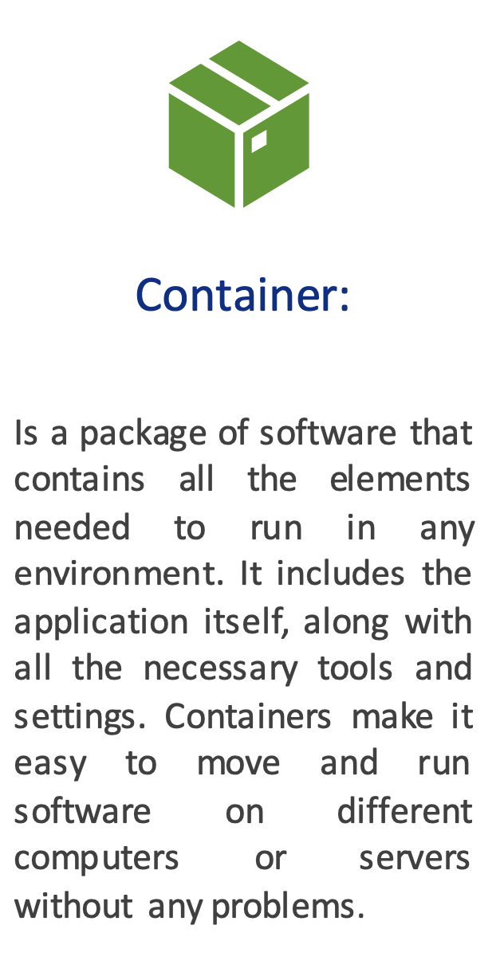
Key Concepts

Slide 4
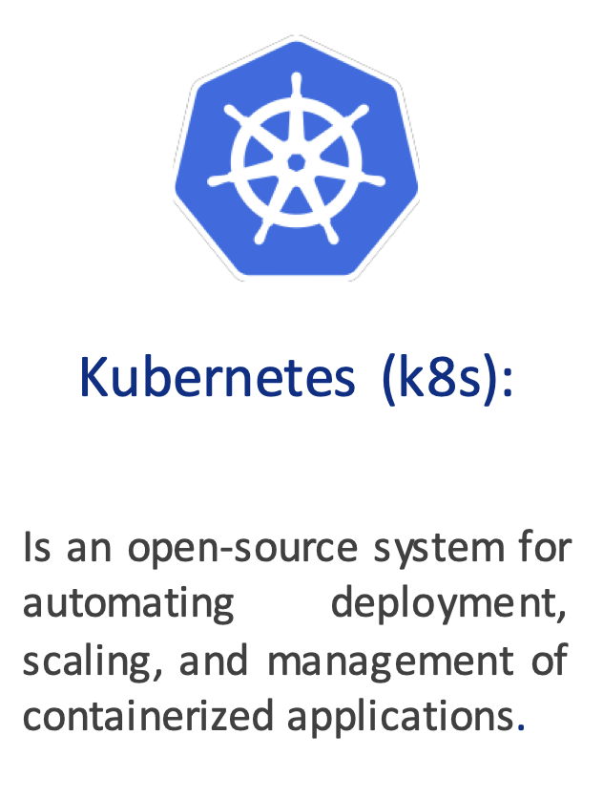
Key Concepts

Slide 5
Key Concepts
Docker is an open platform for developing, shipping, and running applications. Docker enables you to separate your application from your infrastructure so you can deliver software quickly.

Slide 6
Key Concepts
Docker is an open platform for developing, shipping, and running applications. Docker enables you to separate your application from your infrastructure so you can deliver software quickly.
Helm is a package manager for Kubernetes and a Helm chart is a package that contains all the necessary resources to deploy an application to a Kubernetes cluster

Slide 7
Infrastructure: the Elastic Analysis Facility
“The infrastructure and services that provide integrated data, software and computational resources to execute one or more elements of an analysis workflow. These resources are shared among members of a virtual organization and supported by that organization.”

Slide 8
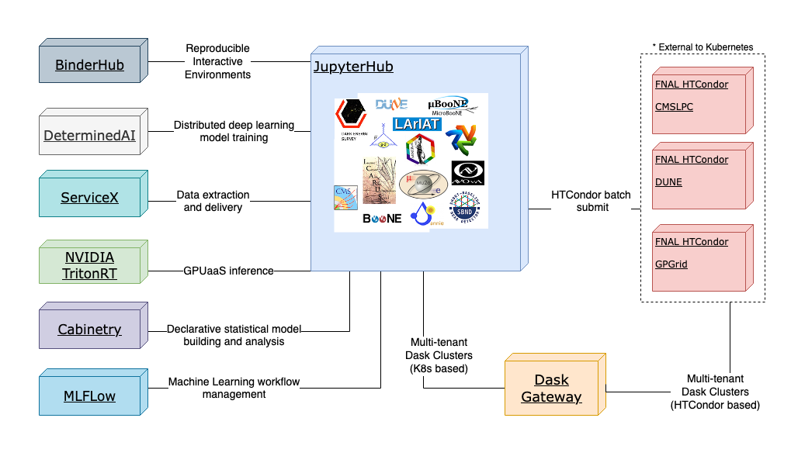
Infrastructure: the Elastic Analysis Facility
“The infrastructure and services that provide integrated data, software and computational resources to execute one or more elements of an analysis workflow. These resources are shared among members of a virtual organization and supported by that organization.”
Monitoring
Storage

Slide 9
Infrastructure: the Elastic Analysis Facility
What is an Analysis Facility? “The infrastructure and services that provide integrated data, software and computational resources to execute one or more elements of an analysis workflow. These resources are shared among members of a virtual organization and supported by that organization.”
Monitoring
Storage
EAF is an interactive analysis facility serving CMS, Neutrinos/Muon experiments, Accelerator science and Astro physics groups collaborating at Fermilab.
Facility is open to all Fermi services account users onsite or connected to the Fermi network via VPN or SOCKS proxy.
A homogeneous deployment layer in Kubernetes facilitates the use and access to a pool of large, specialized software and hardware.
Link to Documentation - https://eafjupyter.readthedocs.io/en/latest/

Slide 10
MLOps Process Diagram
DATA
MANAGEMENT
1. Request a data filter from data stream.
2. Decide on a definition of a dataset train/validation/test
3. Version control(VC) data.
4. Label data, VC again.

Slide 11
AD Data
Notes:
Directly export from here
Or use python code – acsys-python

Slide 12
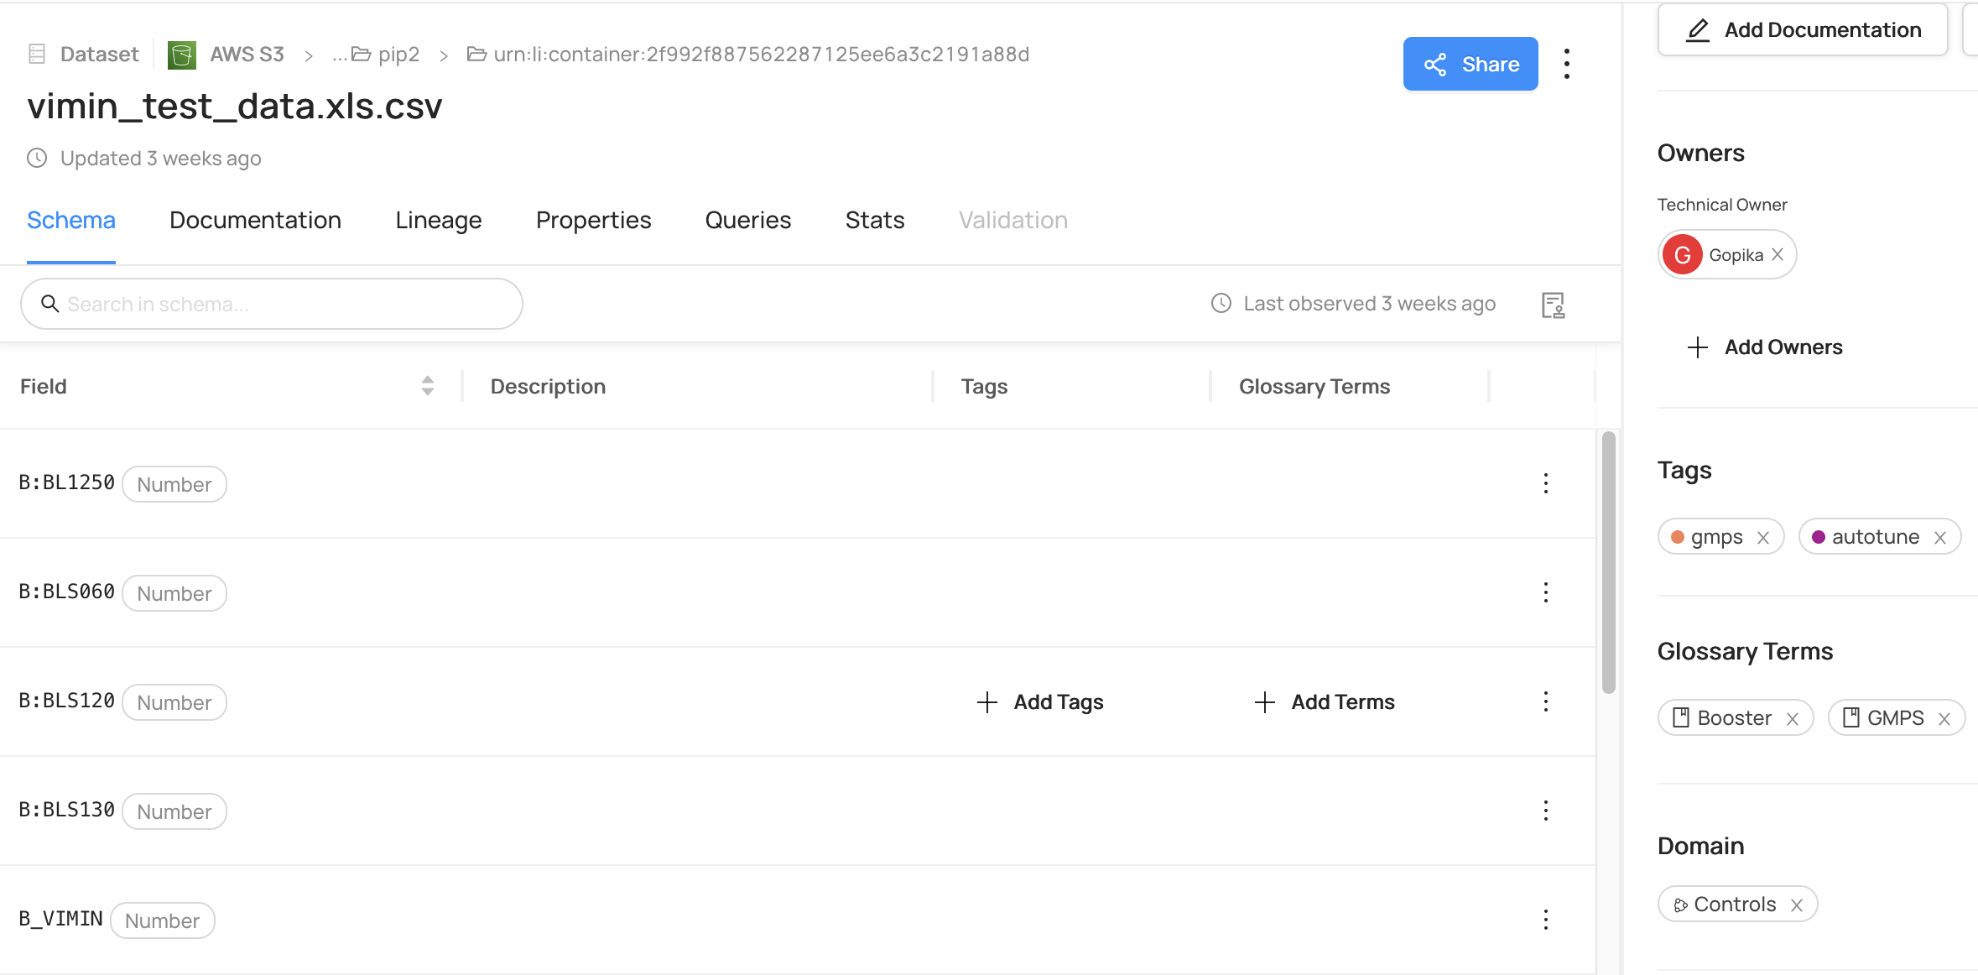
Data Management
DataHub is a modern data catalog built to enable end-to-end data discovery, data observability, and data governance. Link - https://datahubproject.io
Features – Ingestion, Domains, Business Glossary, Tags
Notes:
Ingestion - DataHub supports creating, configuring, scheduling, & executing batch metadata ingestion using the DataHub user interface.
Domains - DataHub supports grouping data assets into logical collections called Domains. Domains are curated, top-level folders or categories where related assets can be explicitly grouped.
Business Glossary – Datahub helps organize data assets using a shared vocabulary by providing a framework for defining a standardized set of data concepts and then associating them with the physical assets that exist within your data ecosystem.
Tags - Tags are informal, loosely controlled labels that help in search & discovery. Tags can help help you in Querying - tagging a dataset with a phrase that a co-worker can use to query the same dataset and Mapping assets to a category or group of your choice
Many Sources –
VIMIN is the minimum current set point for the gradient magnet power supply (GMPS) 15 Hz sinusoidal curve. VIMIN setting determines the radial position that the beam will oscillate around horizontally. Changes are needed to keep up with
–Linac beam energy
–Gallery/rack temperatures
–Beam intensity/rep rate changes
–Orbit tuning
–Misc beam condition changes

Slide 13
MLOps Process Diagram
DATA
MANAGEMENT
1. Request a data filter from data stream.
2. Decide on a definition of a dataset train/validation/test
3. Version control(VC) data.
4. Label data, VC again.
MODEL DEVELOPMENT
5. Choose metrics to optimize.
6. Prep data and VC code and derivative datasets.
7. Model Trials
Model choice
Train
Tune
Test Result(VC)
8. Save all model assets

Slide 14
MLFlow
MLFlow is an open-source platform designed to manage the complete machine learning lifecycle.
Link - https://mlflow.org/
It has 4 components -
Notes:
MLflow Tracking - An engineer will use this feature the most. It allows experiments to be recorded and queried. It also keeps track of the code, data, configuration and results for each experiment.
MLflow Projects - Allows experiments to be reproduced by packaging the code into a platform agnostic format.
MLflow Models - Deploys machine learning models to an environment where they can be served.
MLflow Model Registry - Allows for the storage, annotation, discovery, and management of models in a central repository.

Slide 15
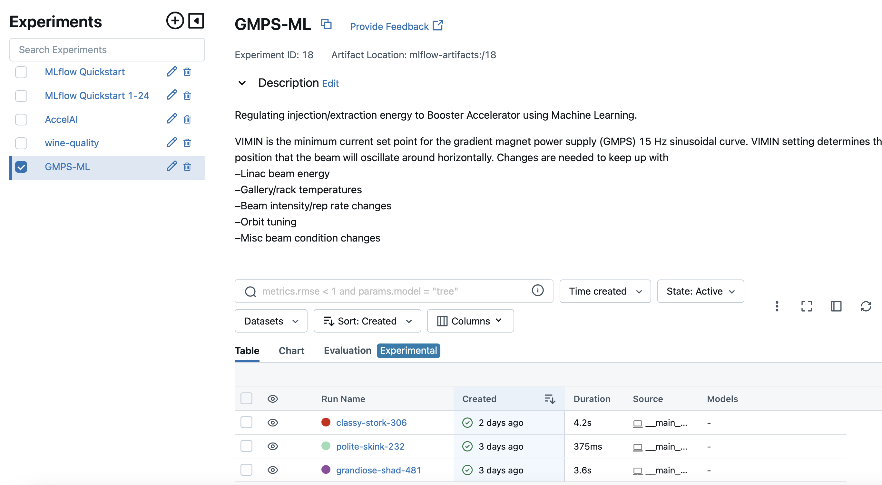
MLFlow Tracking
We use MLflow Tracking to keep track of the code, data, configuration and results for each experiment.
Notes:
MLflow Tracking - An engineer will use this feature the most. It allows experiments to be recorded and queried. It also keeps track of the code, data, configuration and results for each experiment.
MLflow Projects - Allows experiments to be reproduced by packaging the code into a platform agnostic format.
MLflow Models - Deploys machine learning models to an environment where they can be served.
MLflow Model Registry - Allows for the storage, annotation, discovery, and management of models in a central repository.

Slide 16
Tracking Parameters and Metrics

Slide 17
Storing Artifacts

Slide 18
MLFlow Tracking UI

Slide 19
How to implement MLFlow in ML code -

Slide 20
How to implement MLFlow in ML code -

Slide 21
How to implement MLFlow in ML code -

Slide 22
How to implement MLFlow in ML code -

Slide 23
How to implement MLFlow in ML code -

Slide 24
How to implement MLFlow in ML code -

Slide 25
How to implement MLFlow in ML code -

Slide 26
MLOps Process Diagram
DATA
MANAGEMENT
1. Request a data filter from data stream.
2. Decide on a definition of a dataset train/validation/test
3. Version control(VC) data.
4. Label data, VC again.
MODEL DEVELOPMENT
5. Choose metrics to optimize.
6. Prep data and VC code and derivative datasets.
7. Model Trials
Model choice
Train
Tune
Test Result(VC)
8. Save all model assets
MODEL DEPLOYMENT
9. Prepare transforms for live data to model.
10. Choose thresholds for monitoring
Live input data
Prediction/ Performance
11. Enter model registry
12. Test deployment

Slide 27
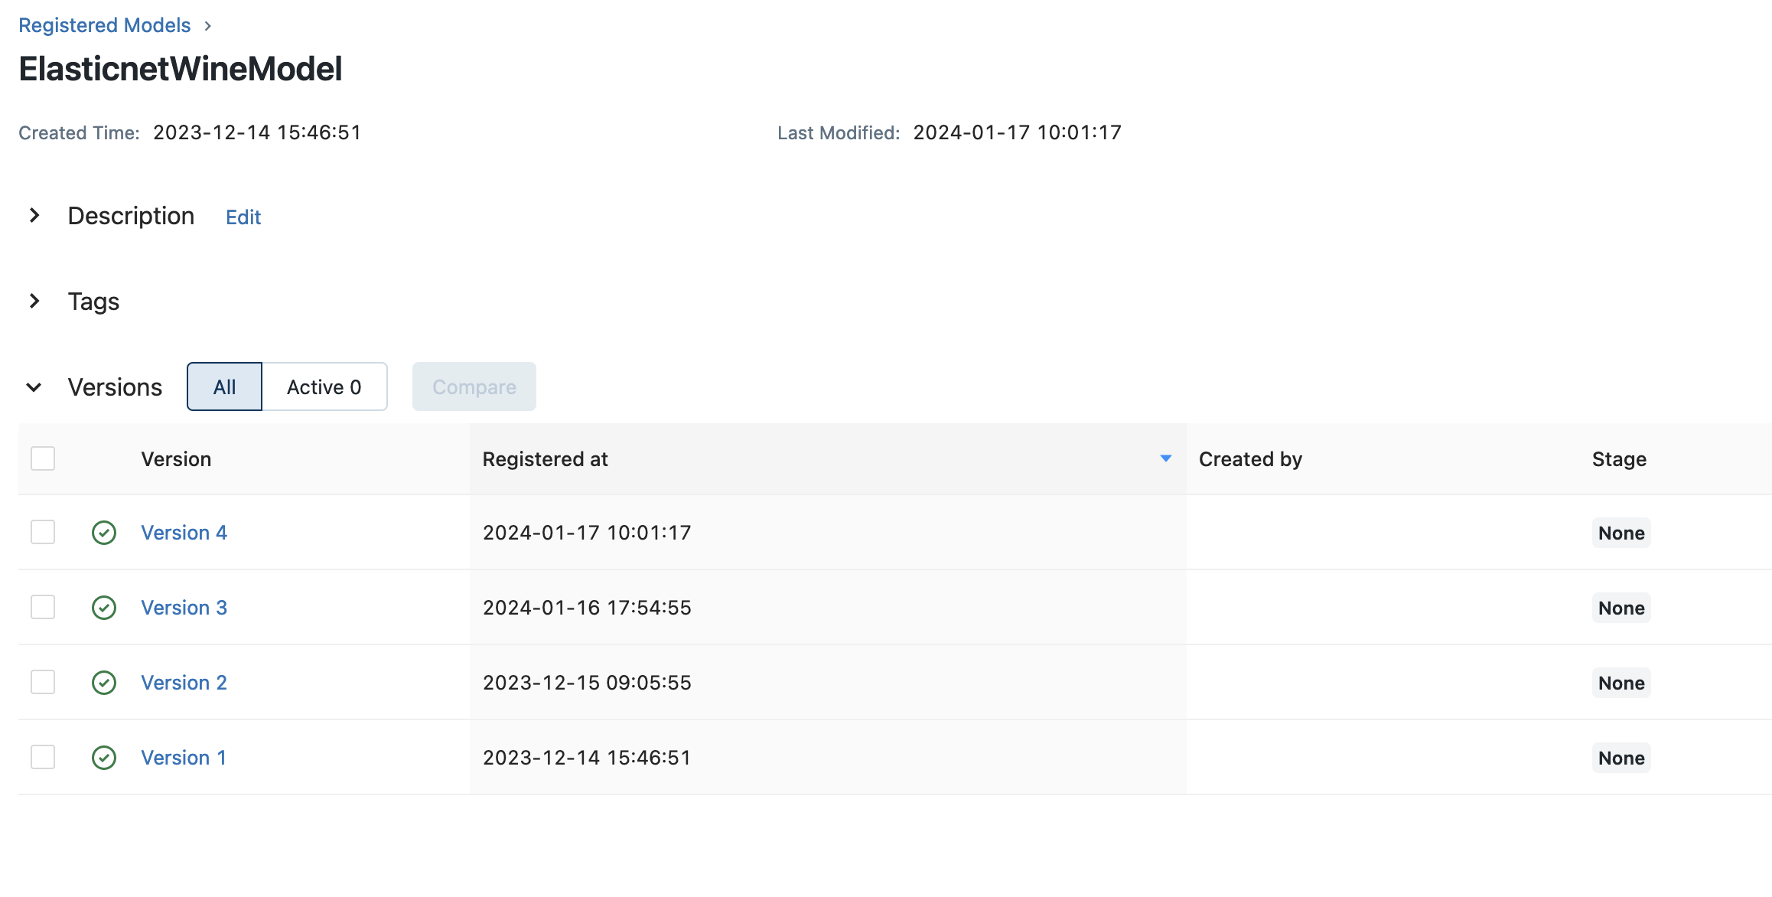
MLFlow Model Registry
We use MLflow Model Registry for the storage, annotation, discovery, and management of models in a central repository.
Notes:
MLflow Tracking - An engineer will use this feature the most. It allows experiments to be recorded and queried. It also keeps track of the code, data, configuration and results for each experiment.
MLflow Projects - Allows experiments to be reproduced by packaging the code into a platform agnostic format.
MLflow Models - Deploys machine learning models to an environment where they can be served.
MLflow Model Registry - Allows for the storage, annotation, discovery, and management of models in a central repository.

Slide 28
MLOps Process Diagram
DATA
MANAGEMENT
1. Request a data filter from data stream.
2. Decide on a definition of a dataset train/validation/test
3. Version control(VC) data.
4. Label data, VC again.
MODEL DEVELOPMENT
5. Choose metrics to optimize.
6. Prep data and VC code and derivative datasets.
7. Model Trials
Model choice
Train
Tune
Test Result(VC)
8. Save all model assets
MODEL DEPLOYMENT
9. Prepare transforms for live data to model.
10. Choose thresholds for monitoring
Live input data
Prediction/ Performance
11. Enter model registry
12. Test deployment
SYSTEM OPERATIONS
13. Respond to alarms:
Adjust thresholds,
adjust model weights
Replace and retire

Slide 29
For serving models – we use MLflow Models
MLFlow Models

Slide 30
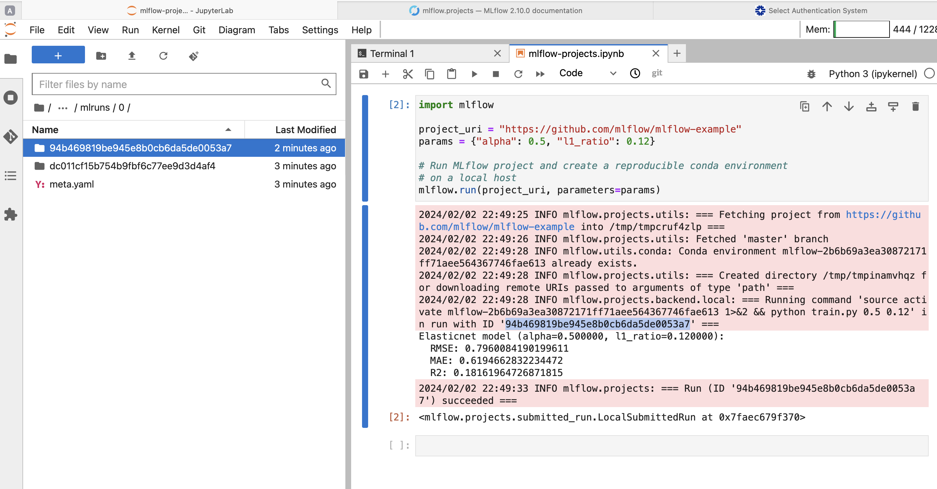
MLFlow Projects
We use MLflow Projects for reproducing models in a platform-agnostic format.
Notes:
MLflow Tracking - An engineer will use this feature the most. It allows experiments to be recorded and queried. It also keeps track of the code, data, configuration and results for each experiment.
MLflow Projects - Allows experiments to be reproduced by packaging the code into a platform agnostic format.
MLflow Models - Deploys machine learning models to an environment where they can be served.
MLflow Model Registry - Allows for the storage, annotation, discovery, and management of models in a central repository.

Slide 31
MLOps Process Diagram
✅ DATA
MANAGEMENT
✅ Request a data filter from data stream
ACSYS-PY
✅ Decide on a definition of a dataset train/validation/test
70:10:20
✅ Version control(VC) data
✅ Label data, VC again
DATAHUB
MODEL DEVELOPMENT
✅ Choose metrics to optimize.
✅ Prep data and VC code and derivative datasets.
✅ Model Trials
Model choice
Train
Tune
Test Result(VC)
✅ Save all model assets
MLFLOW
MODEL DEPLOYMENT
9. Prepare transforms for live data to model.
10. Choose thresholds for monitoring
Live input data
Prediction/ Performance
✅ Enter model registry
✅ Test deployment
MLFLOW
SYSTEM OPERATIONS
13. Respond to alarms:
Adjust thresholds,
adjust model weights,
Replace and retire

Slide 32
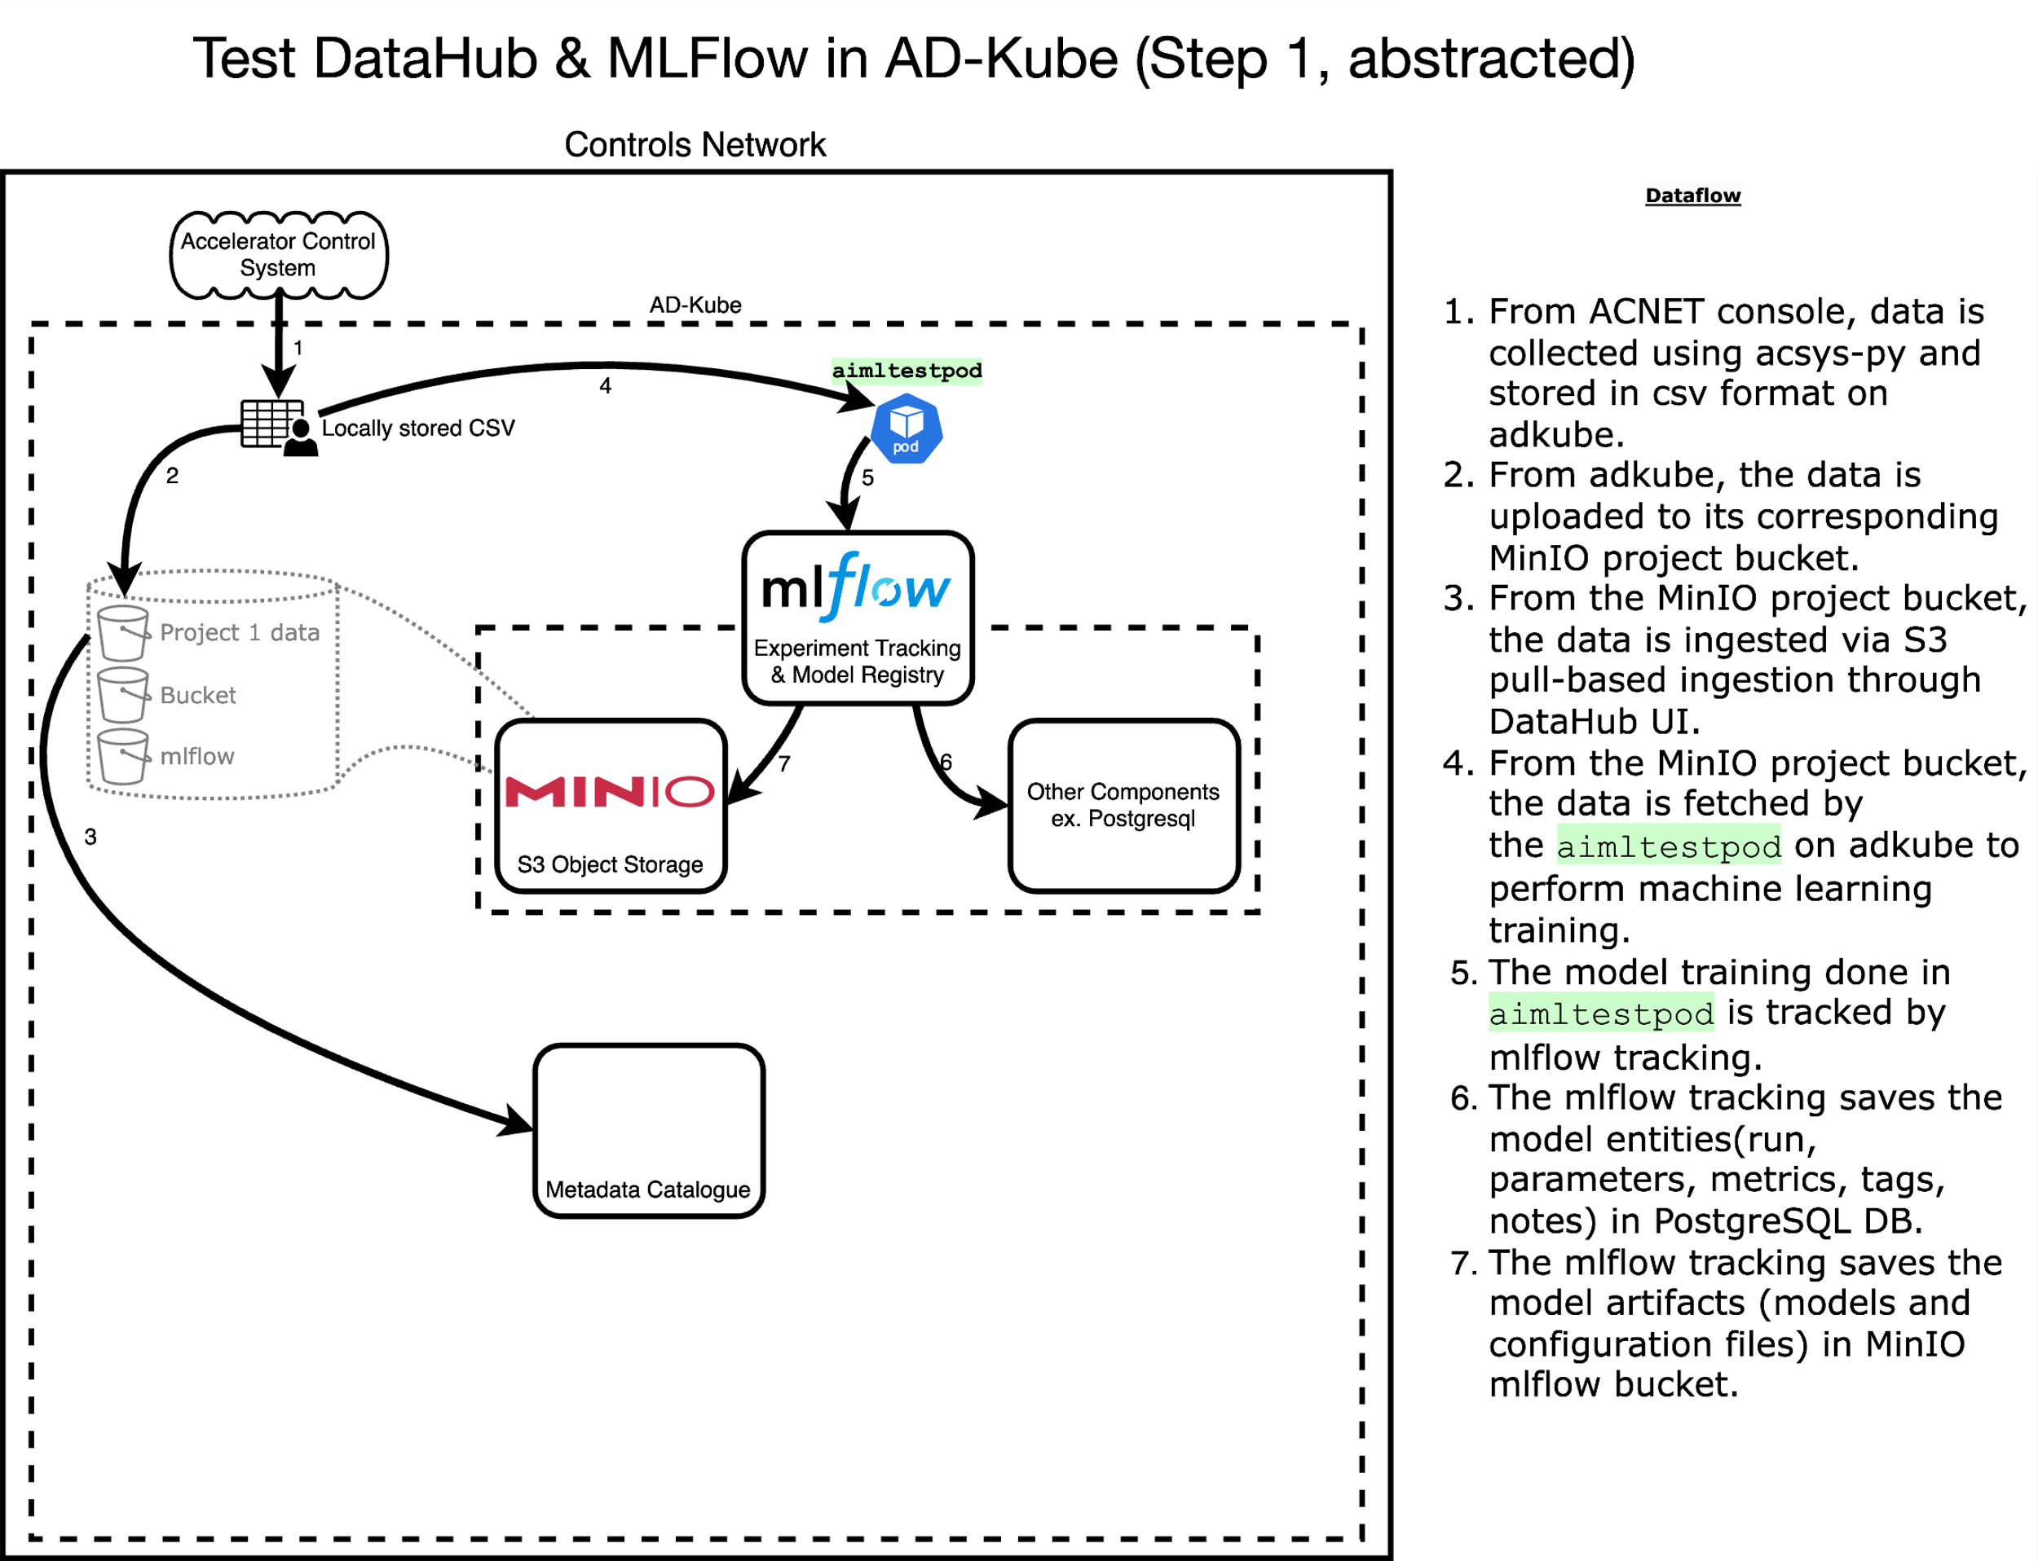
Initial Implementation

Slide 33
Initial Implementation

Slide 34
Initial Implementation

Slide 35
Initial Implementation

Slide 36
Initial Implementation
x

Slide 37
Initial Implementation

Slide 38
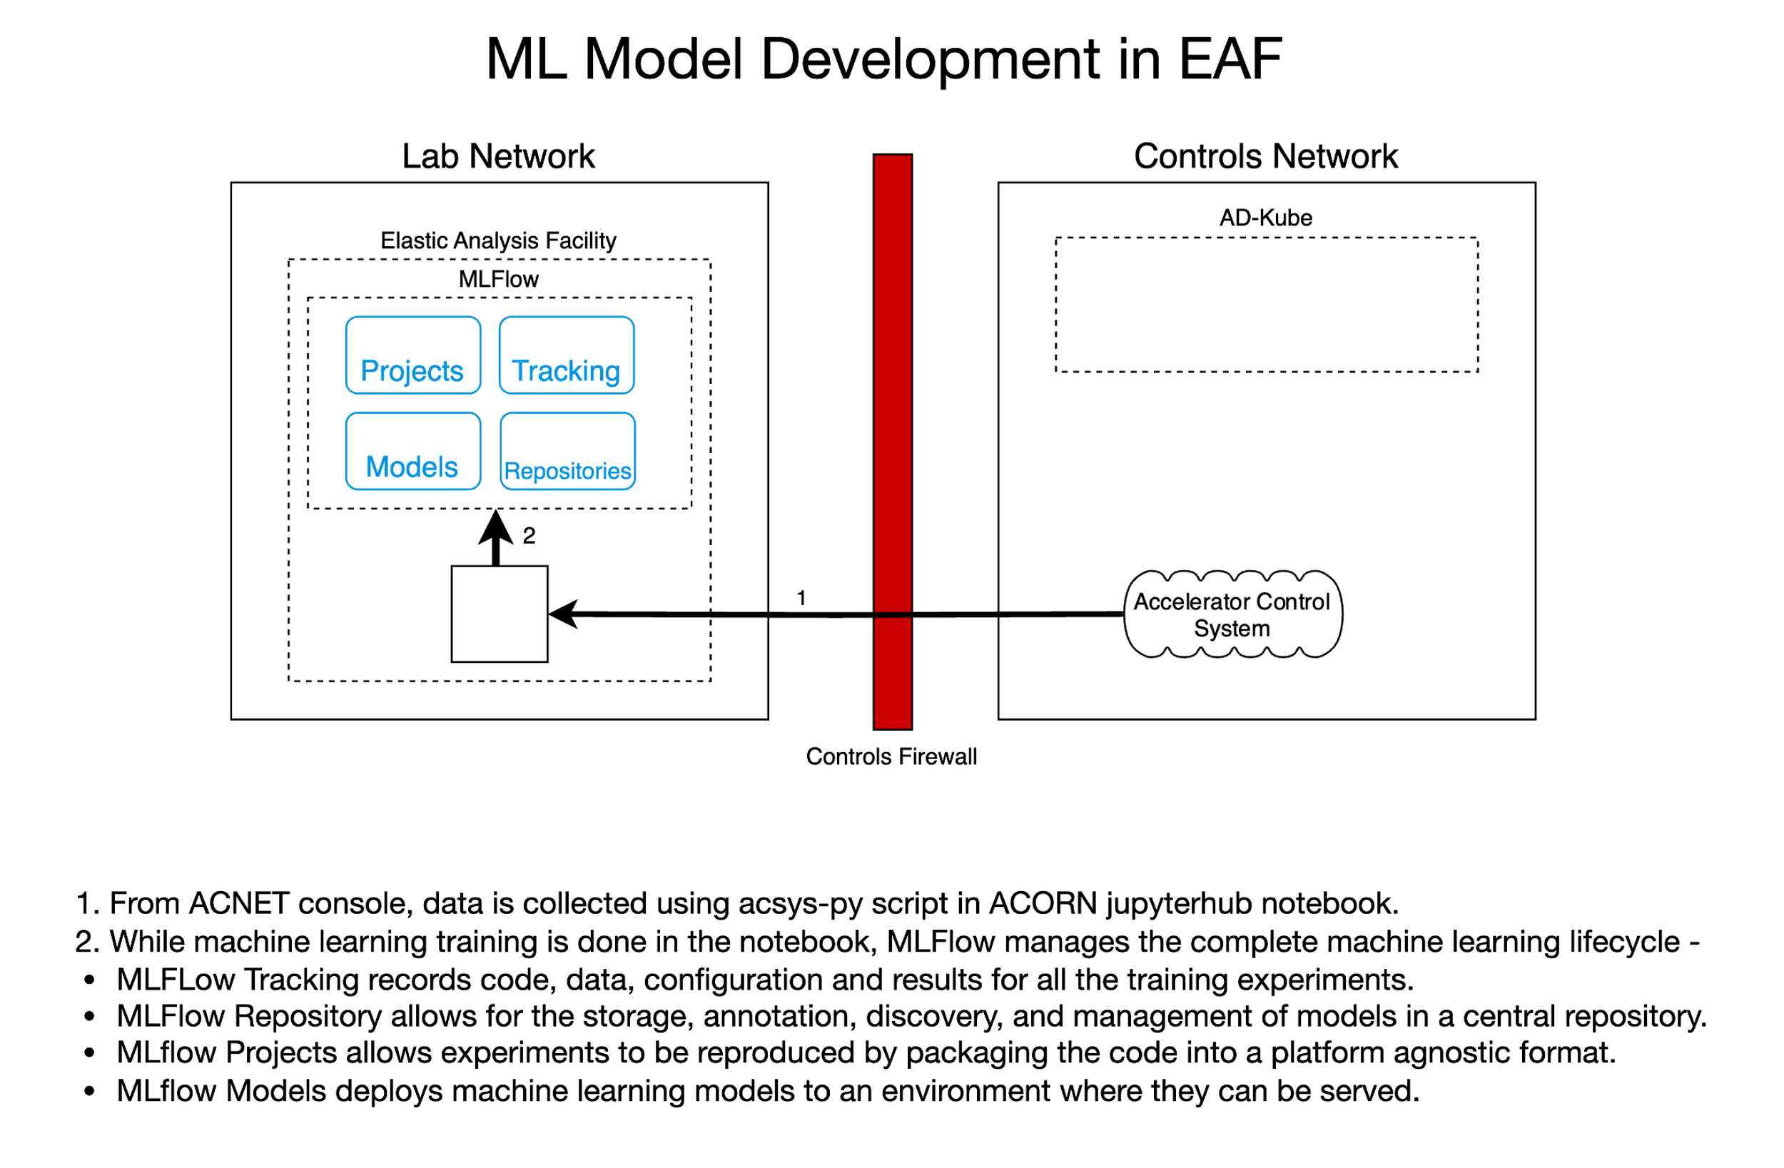
Current Implementation
x

Slide 39
Future Implementation
x
Lab Network
x
MinIO S3

Slide 40
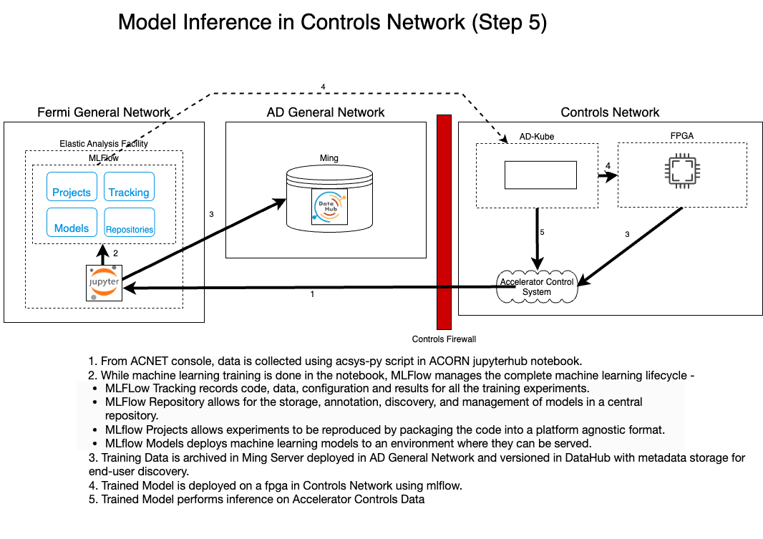
Fast Control
x
x
x
MinIO S3
x
x
x

Slide 41
Summary
We are evaluating following open-source tools –
DataHub for Data Management
MLFlow for Model Lifecycle Management
MinIO S3 for Data Storage
We have been successful in building an MLOps prototype pipeline and
We expect to deploy a demo project for automating adjusting the injection/extraction energy of the Booster accelerator using Machine Learning.
We are thoroughly documenting this process and hoping to publish so we can help others implement parts of this pipeline.
Notes:
intend to release a helm chart so these tools can be configured for MLOps for Particle Accelerators readily.

Slide 42
Thank you!
Gopika Bhardwaj, AI Researcher I, gopikab@fnal.gov
Any questions?

Slide 43
Dependencies

Slide 44
Backup – In depth Diagram

Slide 45
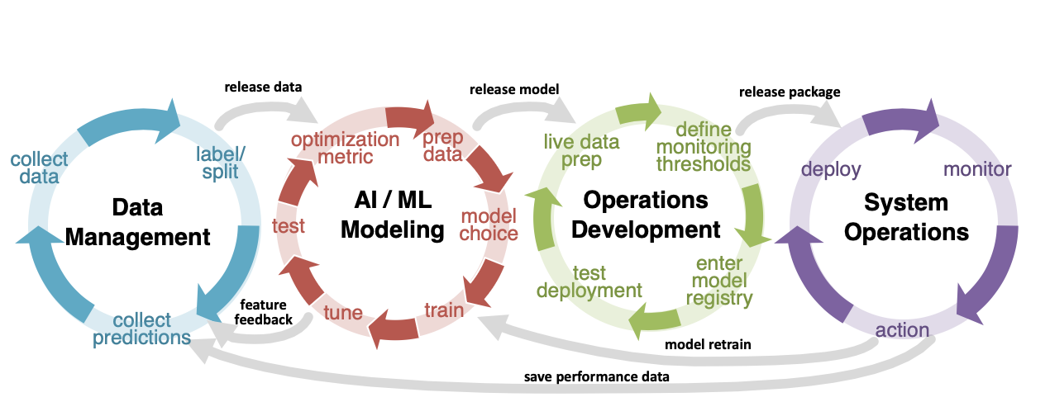
MLOps Process Diagram
Standardized data logger & filter.
Standardized format.
Interface for ML Engineer
Dataset Management System
Versioning
Track derivative datasets
Metadata
Use Common Tools
Model Development System
MLFlow / hyper p. tune
VC: model with references to env., data, results
Interfaces for ML Engineer:
Getting “live data”
Setting “actions”
Monitoring input,
model inference
Model Registry:
All data, env., model,
and performance assets
Server with proper specifications
Monitoring services
Control services
(Logging services)
Automate deployment of model assets from Model Registry

