Slide 1
The L-Cape Project
B. Schupbach
4th ICFA Beam Dynamics Mini-Workshop on Machine Learning for Particle Accelerators
March 2024, 5th – 8th
Notes:
Good Morning everyone thanks for joining me, my name is Brian Schupbach and I'm an engineer in the Proton Source group at Fermilab located just outside of Chicago.
I’d like share some details about our ongoing efforts to apply machine learning in the domain of accelerator operations.

Slide 2
Agenda
Background
Methods
Issues/Constraints
Conclusion

Slide 3
Introduction
Notes:
For those that may be unfamiliar FNAL accelerator complex consists of…
The Proton Source department is tasked with maintaining and operating the Pre-Acc H- Ion source, the Linac (400MeV), and the Booster (8GeV) proton synchrotron. Our discussion here will focus on the Pre-Acc and Linac.

Slide 4
Linac
Upstream (5 MW 7835 RCA triodes @ 201 MHz)
Downstream (12 MW L3 Klystron @ 805 MHz)
15 Hz duty cycle, 500 usec pulse width, ~10 - 60 usec beam width
~50 - 60 mA H- source intensity
~20 - 30 mA at Linac output
Notes:
The Pre-Acc consists of an H- plasma source, a 750 KeV radio frequency quadrupole accelerating cavity and associated medium energy beam line. The 400 MeV Linac consists of 5 Alvarez drift tube accelerating cavities powered by 5 MW triode vacuum tubes and 7 side-coupled accelerating cavities powered by 12 MW klystrons.
As such, many of these systems are composed of other systems such as vacuum (turbo and ion pumps), low conductivity closed loop water cooling, regulated quad/trim power supplies, and associated diagnostics & controls. Each of which is operated in a specific range dictated by the requirements for stable beam operations. It's our goal to operate these machines in a manner which minimizes their radiation footprint and downtime due to system failures.

Slide 5
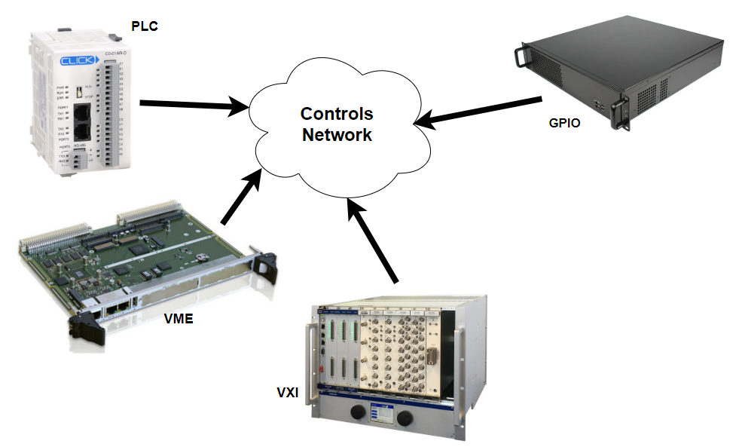
DAQ Landscape
Many sources for machine data in Linac (varying timescales, 1 us to 1 s)
Notes:
The Linac is a 40+ year old machine and has accumulated a variety of hardware that produce data streams of various shapes and sizes in a range of timescales.
These Front-End’s provide the mechanisms to monitor and control the accelerator components and play a key role in the success of any machine learning project.

Slide 6
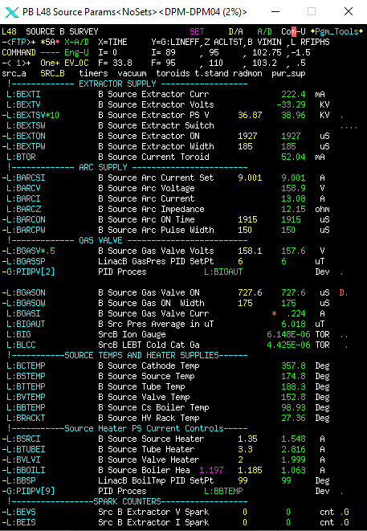
Accelerator Control Network (ACNET)
Custom broadcast messaging protocol
Front-Ends handle/filter client requests
MinimalObjectOrientedComs, (C/C++)
provides a set of common functionality
Central db for device properties and config
maps devices to channels and ids to FE node
Over 200,000 devices
Java software stack developed in early 2000’s
orchestrates client jobs to read/write
DataAcquisitionEngines and OpenAccessClients
RabbitMQ Framework added in late 2000’s
Message based using RabbitMQ
deployed on commodity servers
rmq
DAE’s
mooc
Notes:
These systems are monitored and controlled via the Accelerator Control Network (ACNET). A bespoke server/client message protocol that predates many if not all the familiar or modern messaging protocols such as MQTT, AVRO, and the like. Clients request data from the daq Front-Ends who handle the hardware specifics via MOOC. This is the main abstraction layer for ACNET and is centered around the idea of a device.
There are over 200,000 accelerator "devices" in total providing access to a wide array of analog and digital data in the form of singular values like temperature, waveforms, and digital status.

Slide 7
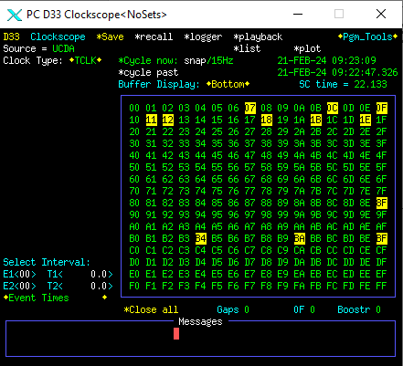
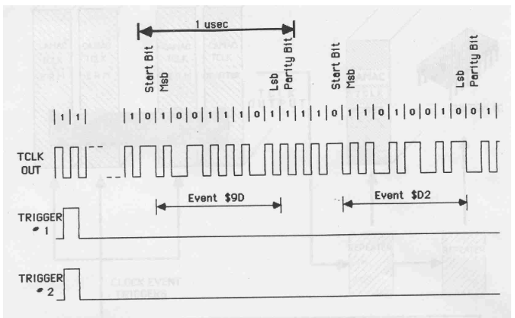
Tevatron Clk (TClk)
10 MHz Manchester encoded serial link
orchestrate machine sequences to ~1000 nsec
ramp power supplies
arm/trigger data acquisition
respond to beam aborts etc…
256 unique events machine specific
Notes:
For synchronization purposes there exits a dedicated copper or fiber link (10 MHz serial) developed for the collider, Tevatron Clock (TClk) to stream 256 dedicated events that are used to coordinate various systems and front-end tasks with respect to time and each other.
For example, when to ramp a set of power supplies or to arm/trigger data acquisition. The important thing to note with TClk is that it is synchronized with the natural resonance frequency of the gradient magnet power supplies of the 8 GeV Booster proton synchrotron.

Slide 8
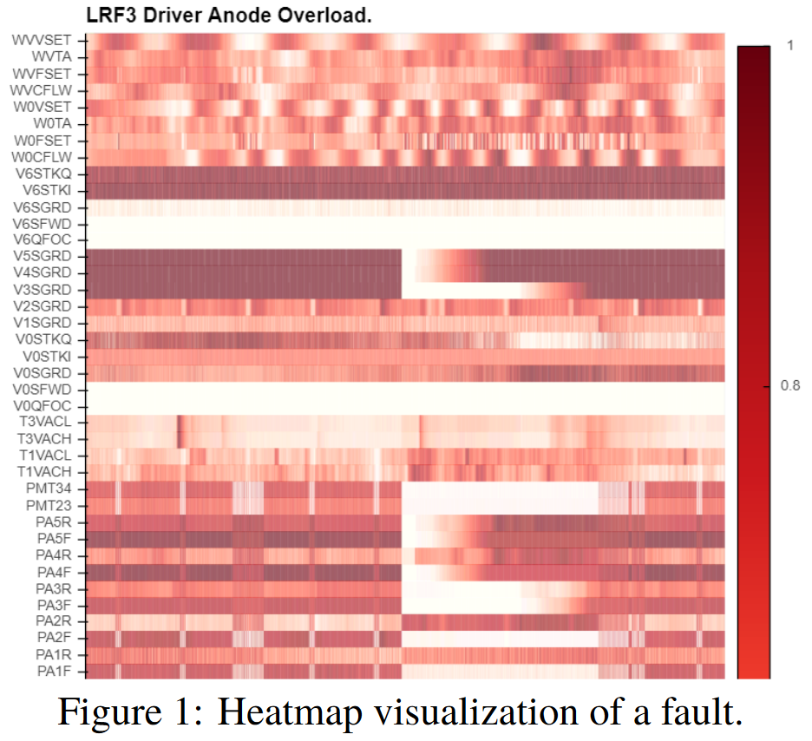
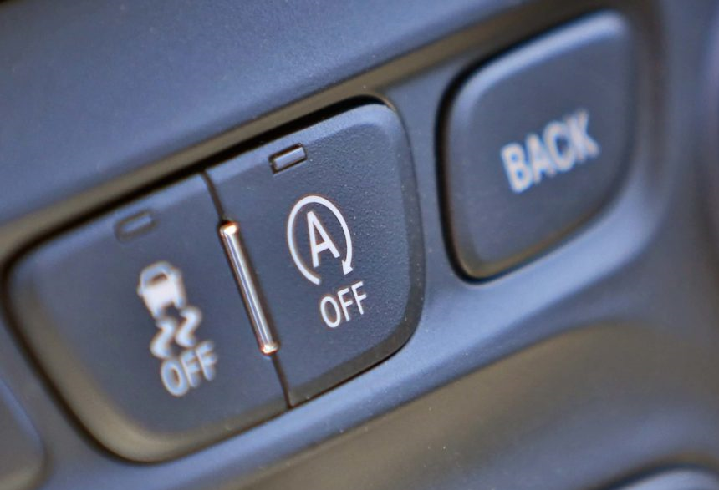
Linac Condition Anomaly Prediction of Emergence (L-Cape)
develop a machine learning model to assist in labeling the various system faults by pattern matching real-time accelerator data using the existing controls system
accurate and consistent predictions of system failures enable staff to make informed decisions about how to operate the other machines in the complex
for reasonable amounts of expected downtime put the complex in a more efficient operating mode
appropriate actions may include inhibiting
dipole bend bus power supplies
HLRF amplifiers & bias supplies
reducing RF gradient voltages
Notes:
The goal of L-Cape specifically is to develop a machine learning model that will alert MCR Staff of, and assist in labeling, the various system faults by pattern matching real-time accelerator data using the existing controls system.
Having an accurate and consistent idea of pending system failure allows MCR staff to make informed decisions about how to operate the other machines in the complex.
Of the many constraints will be not modifying the existing controls system in any way. This is due in part to funding scope and our desire to minimize any operational side effects.
If the Linac is expected to be down for a reasonable amount of time, actions can be taken to put the complex in a more efficient operating mode.
For example, it does not make sense to ramp the 12,000 Amp dipole bend bus power supplies in the 120 GeV synchrotron which are a dominant contributor to our overall electricity bill.
This mindset can be applied to other high power pulsed devices in the complex such as the Booster High Level RF (amplifiers and bias supplies) or any remaining Linac RF stations which have not been inhibited due to failure.

Slide 9
Basic Idea
Get the data, process it, interpret it
Rinse and repeat
Data flow must be as reliable and consistent as possible
https://inspirehep.net/files/f49576cf957d0d032273cf92aaa0061f
Notes:
The basic idea here is of course familiar and we have ~2800 devices for which we want to read the value of on every linac cycle which is every 66 ms.

Slide 10
Data Collection
Java based daemon service which provides
cli interface for local status and control
REST api
embedded websocket server for client UI
ACNET settings
Collects data at 15 Hz on a TClk event
timestamps should be synchronous to 66 ms
JSON stream as output
sent to python buffer via pub/sub for processing and model input
resulting anomaly scores are returned UI, round trip ~2-3 sec
Notes:
Our approach to the data collection process began with a desire to develop a long running process that would make the appropriate ACNET level requests for the devices we believe may play a role in foreshadowing the most common system faults in the Linac.
I set to work on a multi-threaded approach which partitions the list of devices into some number of dmq reading jobs. The response for each device request is then put into a thread safe key value store which acts like a buffer of sorts, whenever a complete list of device requests has been fulfilled, the request, timestamps, and values of the request are serialized and sent to a separate python process responsible for running the model.
The outputs of the model are then returned to this java process, forwarded to ACNET as device settings, and the dashboard user client for visualization purposes.

Slide 11
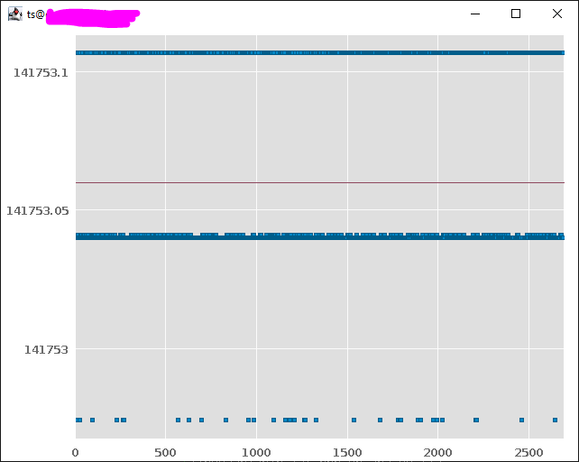
Data Collection cont.
Timestamps, Y-axis in [ns], for ~2700 devices, X-axis
no way to prioritize requests at the front-end
nor is there any way to start all Jobs on the “same” event
+ 1 (15 Hz tick)
- 1 (15 Hz tick)
Notes:
This is an example of one frame of data for the entire device list, time increases on the Y-axis. You can see that we end up receiving timestamps that correspond to 3 different 15 Hz ticks or Linac cycles suggesting that we should find a way to correlate or sort the incoming data by timestamp. The variation in timestamps can be due to network effects, request priority, and fluctuations in timestamp generation. Each Front-End handles this differently.

Slide 12
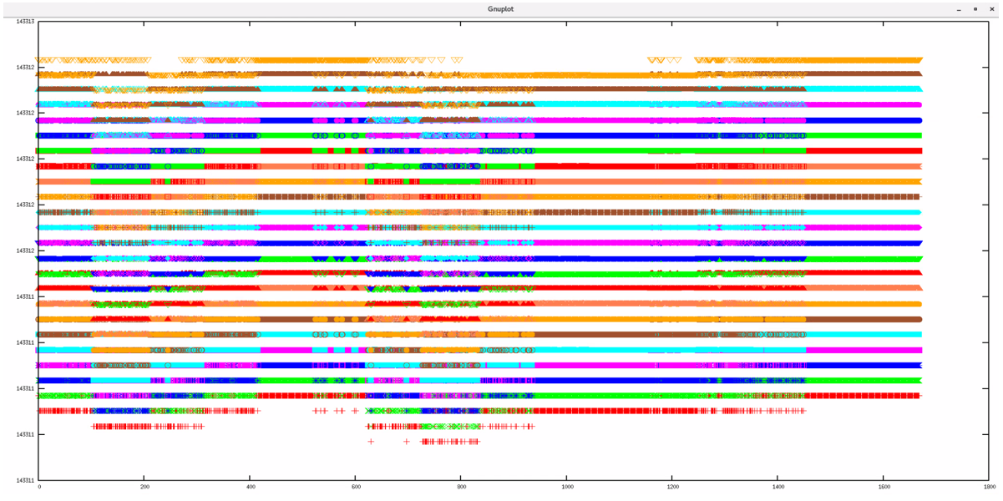
Data Collection cont.
stacking the previous plot of timestamps on top of each other
after n 15 Hz ticks, we can get a value for each request on the “same” event
computationally expensive to buffer and sort, unstable (room for improvement here)
Notes:
If we stack up the previous frame one after the other, after a few ticks each row will have a similar timestamp for each device. The difficulty here is that the distribution of timestamps will shift and you have to wait an additional n 15 Hz ticks for everything to re-stabilize.

Slide 13
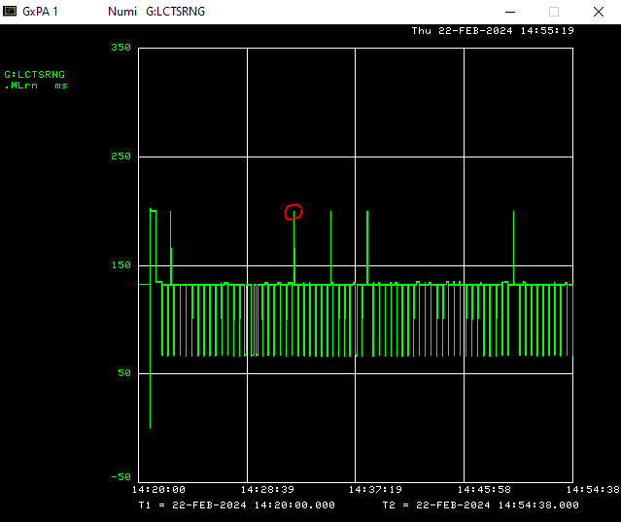
Data Collection cont.
(max – min) as a function of time
Notes:
There are moments where all the timestamps correspond to a unique Linac cycle. It only takes one device to show up late to the party which could be any one device on the list. Just going to go with it, don’t let perfect be the enemy of the good!

Slide 14
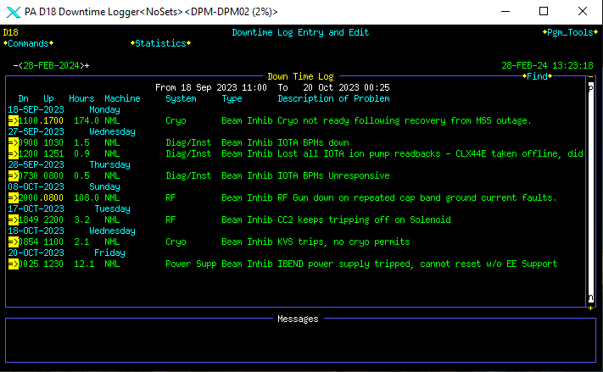
Labels
MCR staff manually enter downtime
system category and duration
overlayed with machine data during model training
Notes:
Before jumping into the details of the model architecture I'd like to take a moment and describe how we collected and labeled the data used to train the model. Our controls system includes a "datalogger" interface for archiving and retrieving data to and from persistent storage.
Regarding historical data, the basic idea is that there are long running process' that request and write device data to relational database tables at specified rates (1 Hz, 15 Hz), and on specific TClk events ($15, $0F).
These loggers can then be queried for data within some time window. Ordinarily these dataloggers only store 2 weeks worth of 15 Hz data which is the duty cycle of the Linac. A python script was developed to query the db at periodic intervals, process and then persist the required training data in HDF5 files.
As a convenient result of operating the complex MCR staff routinely hand label machine downtime. These labels are aggregated in the "downtime logger" (another relational database) for each machine. Each entry includes a timestamp, duration, and a categorical description related to the system at fault, such as vacuum pressure or Anode PS overvoltage. These downtime entries are then used by machine specialists to augment traditional operational statistics and performance metrics.

Slide 15
Methods
Took a data driven approach to the following
computational effort to train and infer
false positives
lookback and lookforward windows
LSTM-AE (anomaly score for each device)
TADGAN (refined approach for individual score)
Temporal Fusion Transformer (beam permit predictor maps to system-level anomaly score)
Notes:
Our approach to developing and implementing a model began with simple statistics and thresholding. This provided a convenient base from which to compare more complicated algorithms.
Subsequent models were compared by the amount of computational effort to train and run the model as well as the number of false positives or accuracy in finding and determining faults.
Thresholding was by far the simplest approach taken, had the best training/inference times, and was the least performant wrt fault positives.
I suspect normalizing the data and applying some naive threshold for significant events does not handle noise in the input sequences very well and lead to an increased number of false positives. Not much time was invested in this approach and only served to establish a baseline for which to make comparisons.

Slide 16
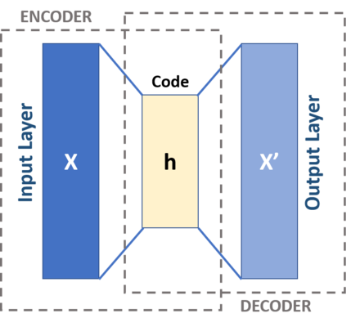
LSTM-AutoEncoder
unsupervised anomaly detection for each device
aggregate to system-level anomaly score and apply threshold
parallelizable, handles multiple input frequencies, and does not correlate devices
time
LSTM-AE
$$∑$$
Anomaly Score
LSTM-AE
all devices
Figures: Milan Jain
Notes:
For our next model, researchers developed a Long-Short Term Memory Auto Encoder which transforms the input sequences into the latent space and then tries to reconstruct the input sequence providing unsupervised anomaly detection for each device.
These unique anomaly scores are then aggregated to construct a system-level anomaly score for which some threshold is applied to indicate some sort of system fault. This algorithm is parallelizable and can handle potential variations in input frequencies well. One drawback is that it does not make any conclusions about how the devices are correlated to each other. Another drawback is the increased time to run the model despite the relatively short training time. Recall for this approach was ~80%, plenty of room for improvement.

Slide 17
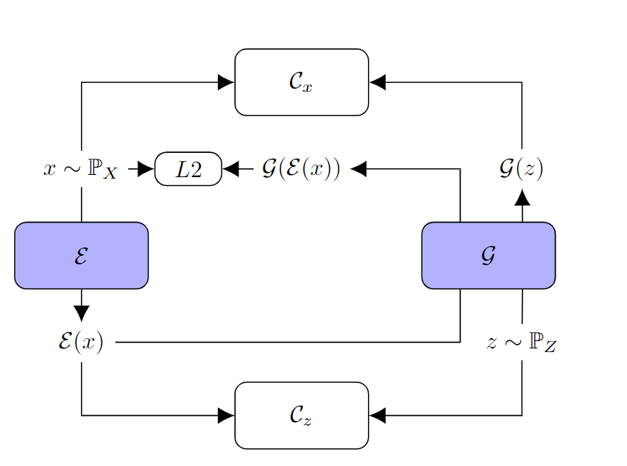
TadGAN: Timeseries Anomaly Detection using Generative Adversarial Network
E maps time seqs into latent space while G reconstructs those same time seqs
C measures the quality of the latent mapping from which an anomaly score is derived
a threshold is applied to the aggregate system-level anomaly score
time
TADGAN
Frequency-1
$$∑$$
Anomaly Score
TADGAN
Frequency-n
Figures: Milan Jain
Notes:
The encoder E maps the input time series sequences into the latent space, while Generator G serves as a Decoder that transforms the latent space into the reconstructed time series.
The critic Cx distinguishes between real-time series sequences from X and the generated time series sequences from G(z), and Critic Cz measures the quality of the mapping into the latent space.
In this model, one TADGAN is trained per frequency, and the frequency-level anomaly scores are combined to get a system-level anomaly score.

Slide 18
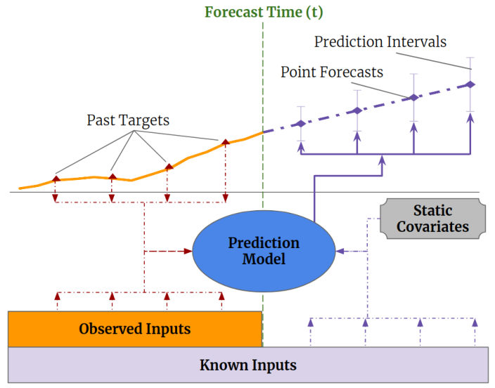
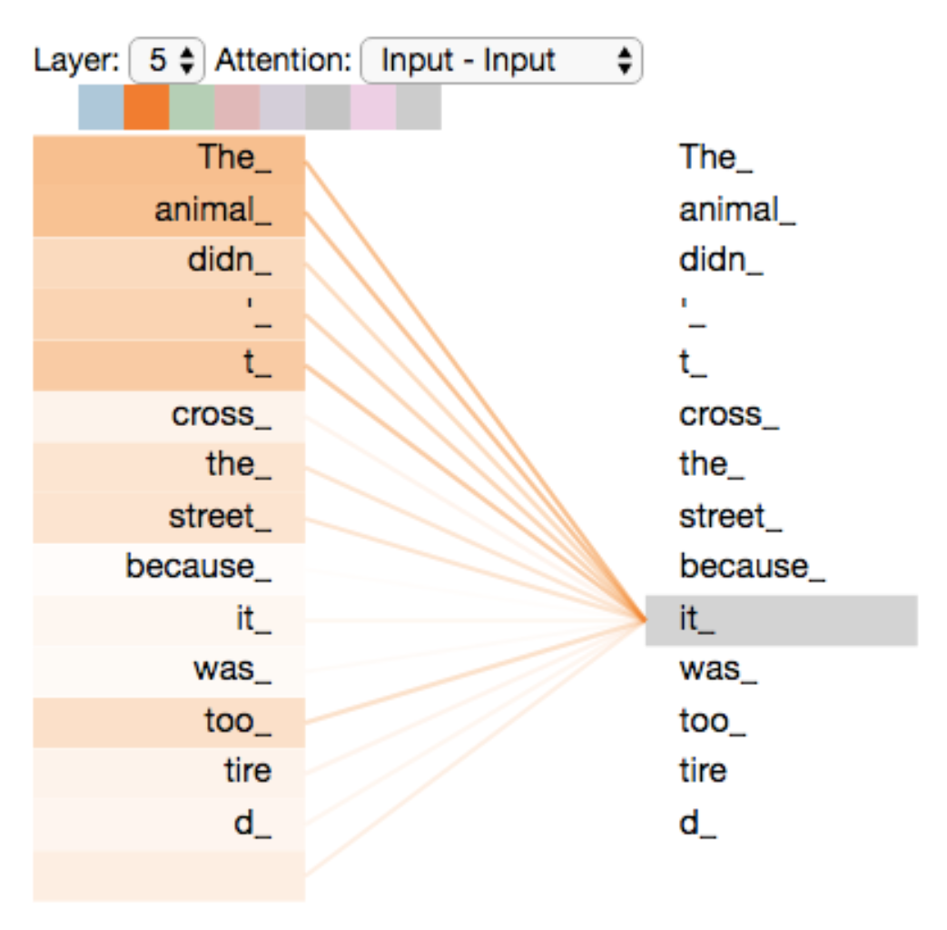
TFT: Temporal Fusion Transformer
supervised anomaly detection to predict beam permits
self-attention used to detect the presence of significant events and sequence dependencies
computationally expensive to train
look back
look forward
TFT
all devices
bit permits
Figures: Milan Jain
Notes:
To enable some predictive abilities we explored using supervised anomaly detection which exploits the upstream and downstream beam permits. These are saved as device parameters that we can monitor directly.
The transformer talk on Monday provided a good starting point for understanding this blackbox but the idea here is to use device data from the last 60 seconds to predict beam permits for the next 30 seconds. From what I understand this is possible by capturing temporal dependencies at different time scales using a combination of the LSTM Sequence-to-Sequence and the Transformer’s Self-Attention mechanism.

Slide 19
Comparing
Training Setup: NVIDIA A100 GPU (1), FP32, 16 CPU Cores
train on 2 months of data test on 6 months
batch size: 1024 (~15 min); Look Back: 1 min; Look Forward: 30 sec
training time and inference time measured for one batch of data
Notes:
Really want to get the inference time down to somewhere between 1-3 seconds. Might be difficult and were open to exploring more ideas on how to get there.

Slide 20
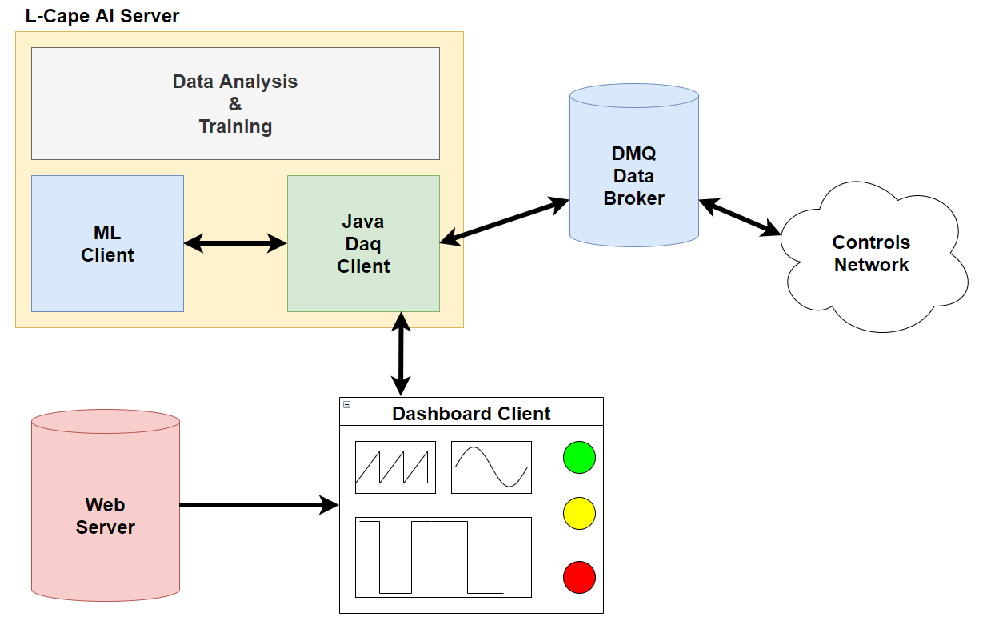
Overview
All the pieces together

Slide 21
Dashboard UI
Notes:
One of, if not the most important goals, was to develop some sort of dashboard or client user interface that MCR staff could use to determine if the inference process was collecting data and calculating anomaly scores properly.
We wanted this to have a modern look and feel so developing for the web seemed like the most reasonable thing to do.
Java plays well in this space and is performant enough for our needs when taking into account that we can collect data faster than we can process it using the dmq framework.

Slide 22
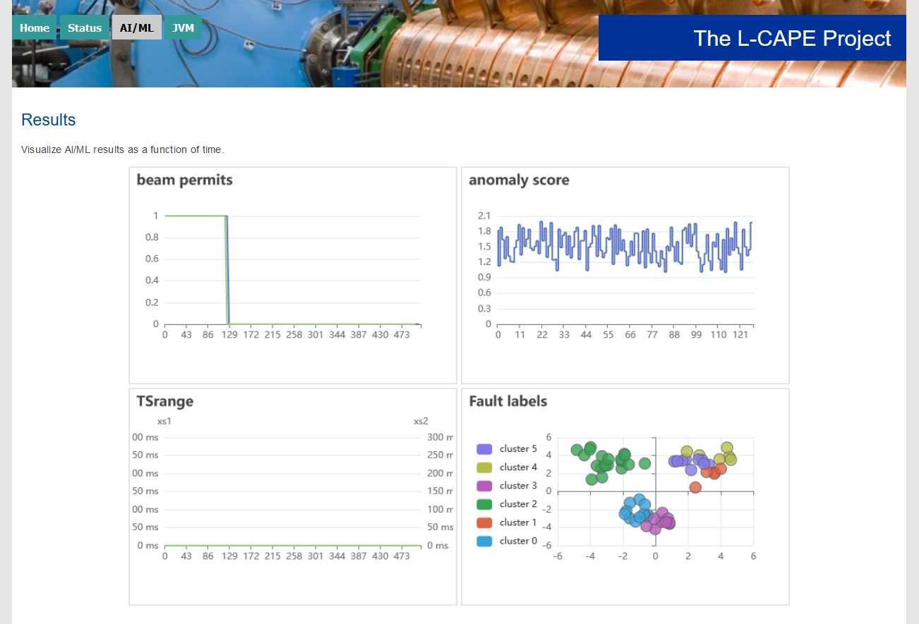
UI cont.

Slide 23
UI cont.
Notes:
System resources as a canary for the data pipeline, JVM stats should be fairly stable all things being equal. When many of the Front-Ends begin to lag buffers overflow and heap allocations occur. At some we run out of memory and the process crashes.

Slide 24
Issues
FE issues
PLC too busy to service requests, just can’t keep up
LLRF memory leaks, requires reboot, impacts operations
inconsistent generation of timestamps, suboptimal, 10’s us to 1 s
network delays
Big Saves
saves machine wide readings/settings and dumps them to DB
initiated by Ops 0100-0400 hrs
no way to prioritize our requests, so we lose

Slide 25
Moving Forward
collect training data with real-time Java client
save data stream to DataFrames and write to Snappy file
as compared to the acnet dataloggers
sequential consistency difficult (data locality)
add device settings as inputs
compare Operator settings to anomaly scores
informed thresholding?
beam returned in late January
continue development on applying labels to detected faults
has been some work on using UMAP to help categorize labels

Slide 26
References
https://inspirehep.net/files/f49576cf957d0d032273cf92aaa0061f NAPAC22
https://arxiv.org/pdf/2009.07769.pdf TadGAN
https://arxiv.org/pdf/2001.08317.pdf Deep Xfmr
https://arxiv.org/pdf/1912.09363.pdf TFT
https://www-bd.fnal.gov/controls/micro_p/mooc_front_ends.html
https://www-bd.fnal.gov/controls/java
https://beamdocs.fnal.gov/AD/DocDB/0038/003860/001/dmq.pdf
https://science.osti.gov/-/media/grants/pdf/foas/2021/SC_FOA_0002490.pdf FOA

Slide 27
Acknowledgements and Special Thanks
Pacific Northwest National Laboratory
Jan Strube
Milan Jain
Fermi National Accelerator Laboratory
William Pellico
Kiyomi Seya
Jason St. John
Kyle Hazelwood
AD Controls Dept
Beau Harrison
Kevin Cahill
Andre Petrov

