Slide 1
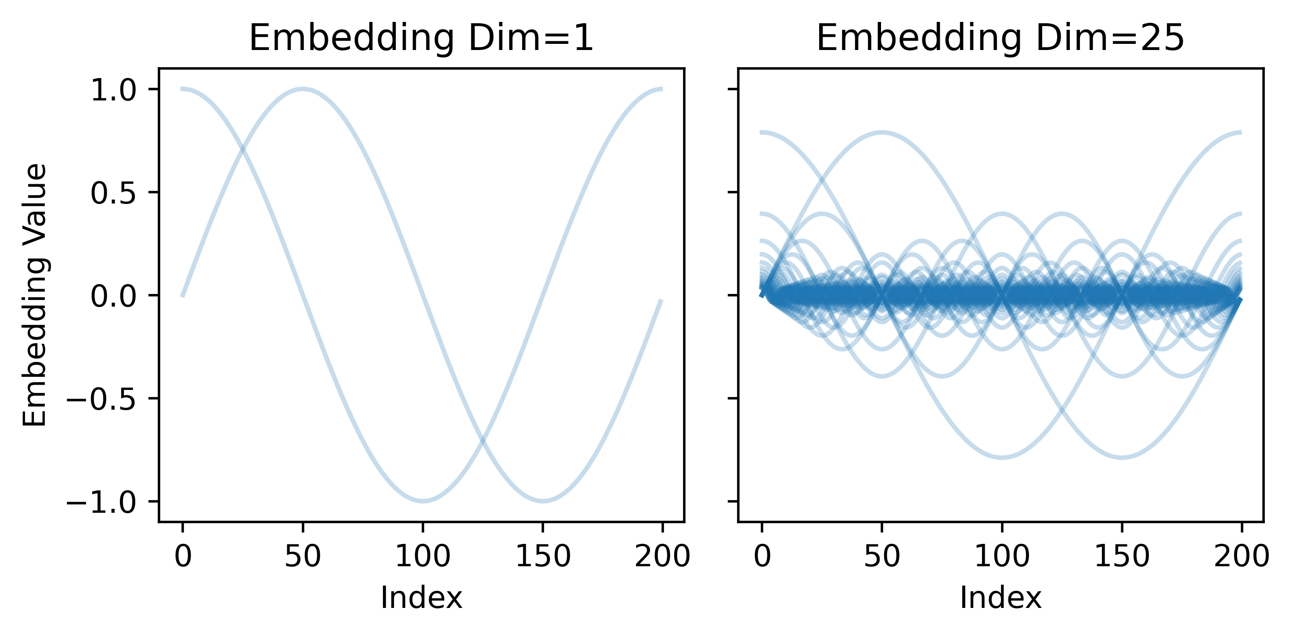
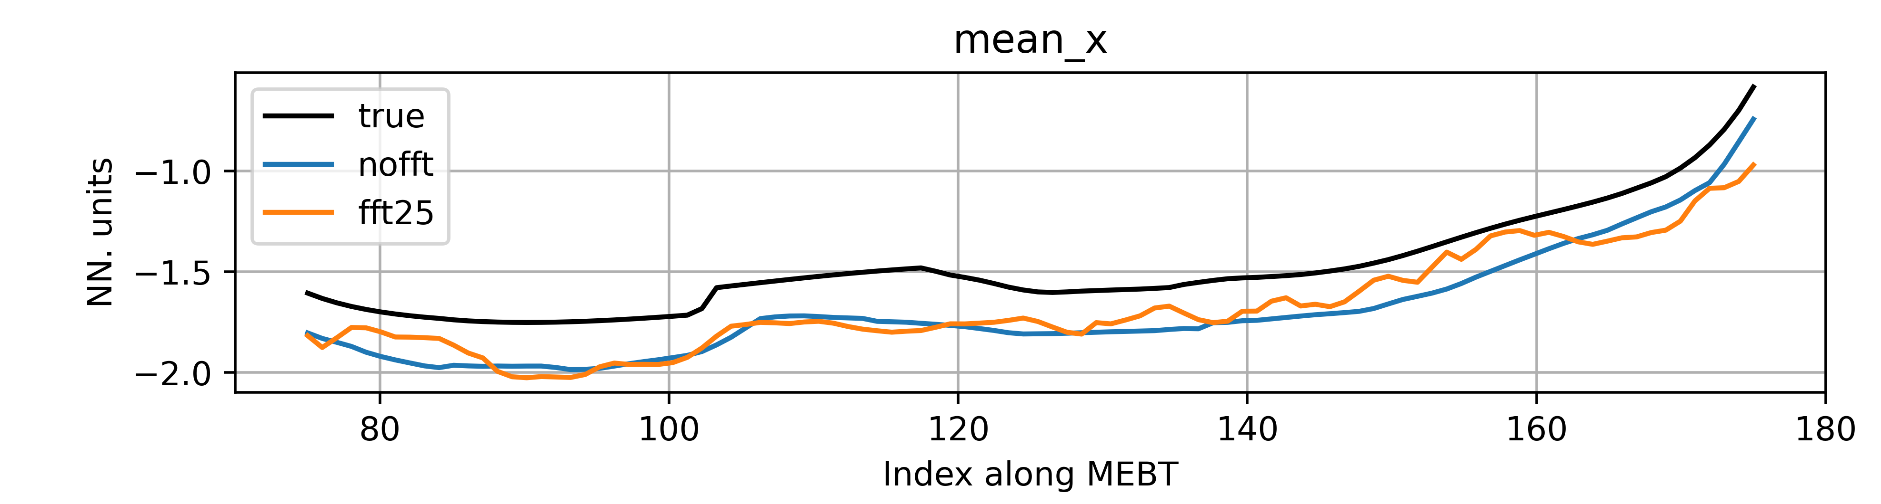
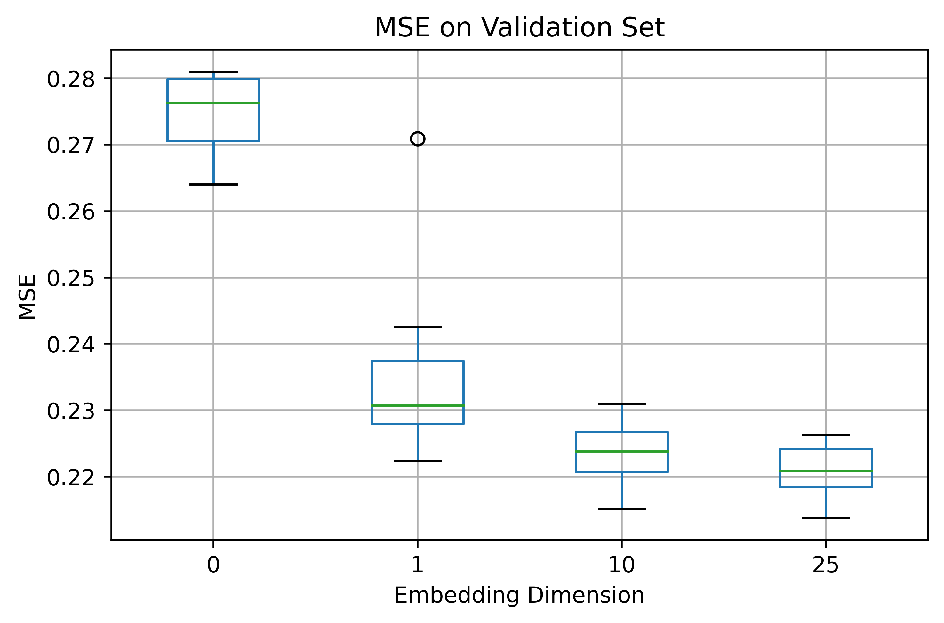
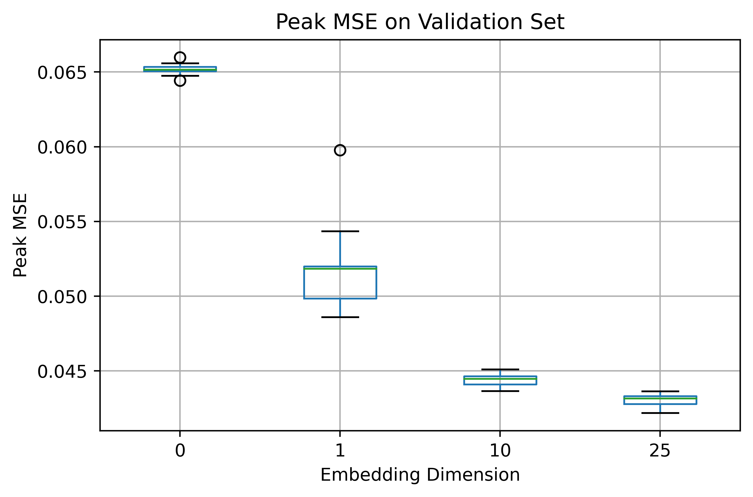
Improving Surrogate Model Performance for Sparse Outputs in the Spatial Domain
Kathryn Baker¹ , Susmita Basak², Jaehoon Cha²
ISIS Neutron and Muon Source, STFC, Harwell Campus, Oxfordshire, OX11 0QX, UK
Scientific Machine Learning, STFC, Harwell Campus, Oxfordshire, OX11 0QX, UK
Introduction
Discussion
Neural networks are rapidly being adopted as surrogate models for computationally expensive physics simulations. However, one of their prominent weaknesses is their ability to reproduce sparse or ‘step’ functions. Functions such as these are common within particle tracking codes, which often produce loss patterns that highlight where beam is lost for a set of control parameters.
It is important to be able to predict these patterns accurately, as the cumulative sum of these losses is a common objective for optimising performance of a component as well as an important radiation safety consideration.
Having shown promise for improving the resolution quality in the field of computer vision, this work investigates whether Fourier Feature (FF) mappings can be leveraged in traditional neural networks (NNs) for improving their ability to predict sparse functions. We take a model of the ISIS Medium Energy Beam Transport (MEBT) as a case study.
Figure 3: Use of FF mappings with embedding dimension m=25 produces outputs that match the beam loss profile more closely.
The ideal case for the loss patterns is where we are able to match the loss profile exactly. Using FF mappings reduced the cumulative error in the loss predictions, as well as the magnitude of the errors at each predicted peak, as shown in figure 3 and table 1.
Fourier Feature Embeddings
 | Error at Peaks (%) | Cumulative Error (%) | Cumulative Error (Above True) (%) | Cumulative Error (Below True) (%)
No FFT | 5.346 ± 2.0e+01 | -14.148 ± 5.3e+01 | 19.669 ± 5.4e+01 | 3.330 ± 2.5e+00
FFT 25 | 0.713 ± 1.7e+00 | 1.985 ± 4.3e+00 | 3.681 ± 3.0e+00 | 3.184 ± 2.5e+00
$$γ\left(x\right)={\left[\cos\left(2πBx\right),\sin\left(2πBx\right)\right]}^{T}$$
Equation 1: Fourier Feature mapping, where $B ∈ R^{m×d}$, with $m$ being the embedding dimension
Table 1: Using Fourier Features improves performance of the peak prediction for the sparse outputs, reducing the magnitude of the error in the final cumulative loss as well as the error in the peak maximums
The 1D z-coordinate of the 200 discrete positions along MEBT is fed into the FF mapping (eq. 1) and concatenated with the machine parameters before being passed to the NN.
Figure 1: Visual representation of Fourier Feature mappings with $m=$1 and $m=25$
The mean error between the prediction in the cumulative loss and the difference in the loss at each peak is lower and also shows a smaller standard deviation when FFs are used (table 1). This suggests that they make the model’s prediction of the loss peaks more stable.
Results
However, it was noted that using high dimensionality FFs adds an additional high frequency component to the predictions, which in the case of the smoother, continuous beam descriptors is considered non-physical. Methods to mitigate against this impact (shown in fig. 4) will form the basis of future work.
NN models that take the concatenated machine settings and FF mappings (of increasing dimension) of the z-coordinate were trained to predict 12 beam descriptors along the ISIS MEBT. Quantile regression was used as a loss function to achieve uncertainty quantification with Adam as an optimiser.
Peak reconstruction error was used to evaluate the ability of the models to reconstruct the sparse functions. It uses the difference between sequential values in the array and finds the mean squared error between that of the ground truth and the prediction.
Figure 4: Visual representation of high frequency component added to outputs by high dimensional FF mappings.
Results in figure 2 show that increasing the dimensionality of the FF embedding improves the overall performance of the models for both MSE and the peak reconstruction error.
Conclusions
Use of FFs as additional inputs to neural networks can increase overall performance on sparse 1D spatial predictions. This work has also shown that they can reduce the variance in the predicted outputs for these functions, making the model predictions more stable. Fourier features are therefore suitable for use in fields where surrogate modelling of sparse or step functions is required, for example predicting the loss patterns across components in beam dynamics simulations.
Acknowledgements
Figure 2: Increasing the Embedding Dimension of the Fourier Features improves performance across both MSE and Peak Reconstruction. Dimension 0 represents a model where Fourier features are not added.
The authors would like to thank both the Scientific Machine Learning group at STFC and the Low Energy Beams group at ISIS for their support, feedback and guidance throughout this work.

