Slide 1
From Physics Study to Operations: The Road to Production ML-Driven Beam Loss Optimization
C. Elliott, W. Blokland, D. Brown, B. Cathey, G. Gallimore, A. Kasparian*, B. Maldonado Puente, C. Peters,
K. Rajput*, K. Ruisard, J. Rye, M. Schram*, A. Shishlo,
S. Thomas, A. Zhukov

Slide 2
Motivation
Spallation Neutron Source Facility
Impact of Beam Loss on SNS
Operator Perspective
Automated Beam Loss Tuning (ABLT)
Beam Loss Optimization(BLO)
DOE Grant Information
BLO Use-Case
Deployment Plan
Software Integration
CER Upgrades
Future Plans

Slide 3
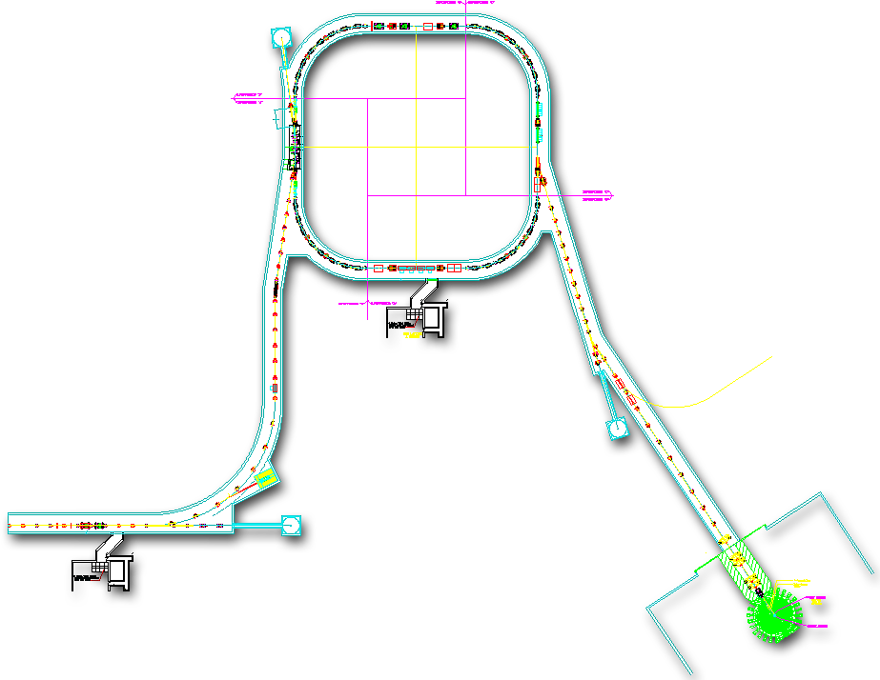
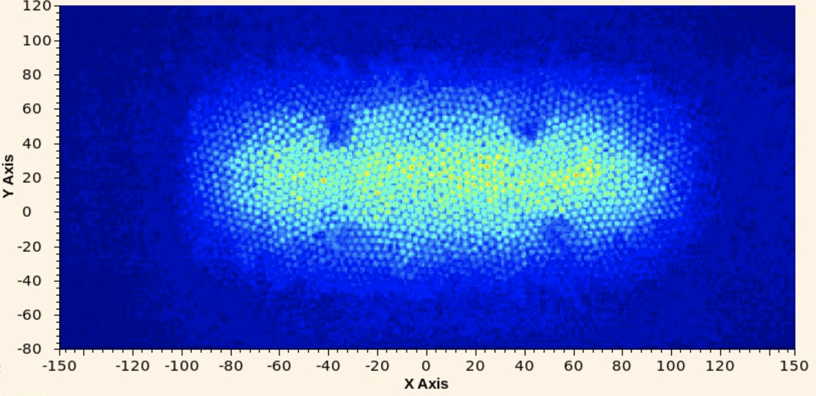
Most Intense Pulsed Neutron Source in the World
The Spallation Neutron Source (SNS)
1.3 GeV, 2.8 MW, 60 Hz
Normal & superconducting Linac accelerates H-
Accumulator ring and carbon foil strip H- to p+
1000:1 pulse compression from Linac to Target
Neutron production (NP) for users 4600 hrs/yr
Waste Beam Dump
+
RING
Electron Stripping
RTBT
HEBT
-
-
-
-
-
-
-
+
+
+
LINAC
FRONT END
+
+
+
+
+
+
-
-
-
-
-
-
-
Liquid Hg Target

Slide 4
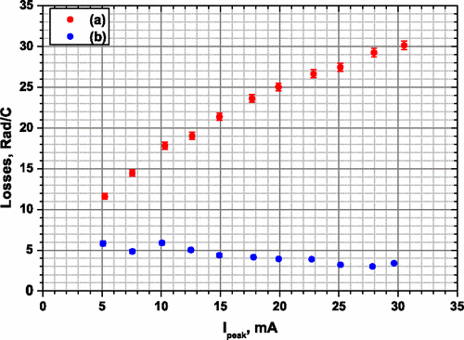
SNS Design Didn’t Match Observations
Designed for 0 loss in Superconducting Linac (SCL)
Large aperture
High vacuum
Unexpected H- beam loss mechanisms observed
Intrabeam stripping: inelastic scattering of H-
IBST occurs when ϵ is small
Reduce quad gradients from design
https://doi.org/10.1103/PhysRevLett.108.114801
H−
P+
(Shishlo et.al)
Normalized Loss
Peak Current

Slide 5
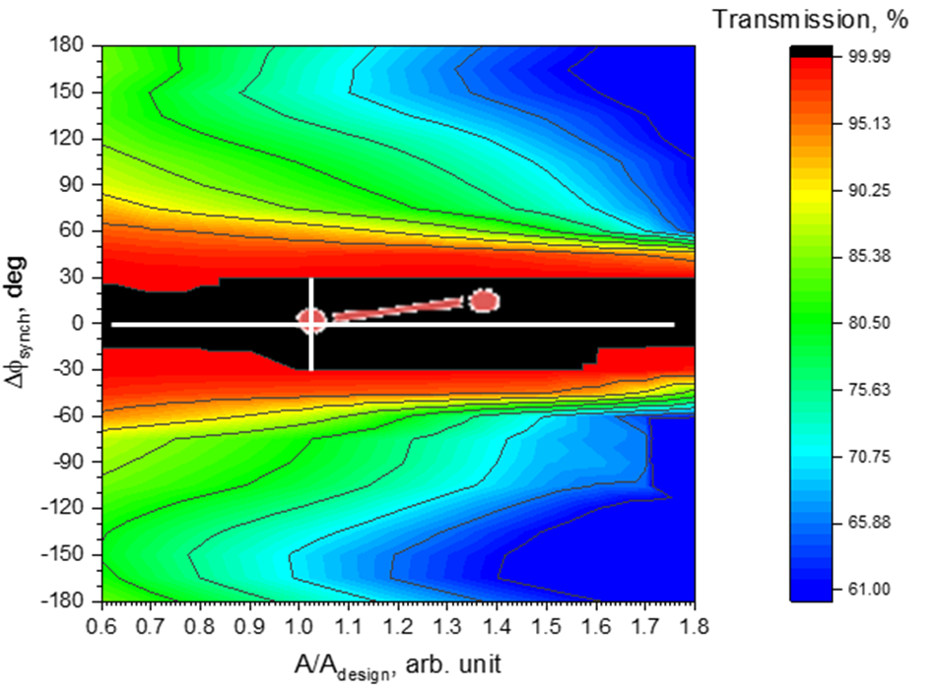
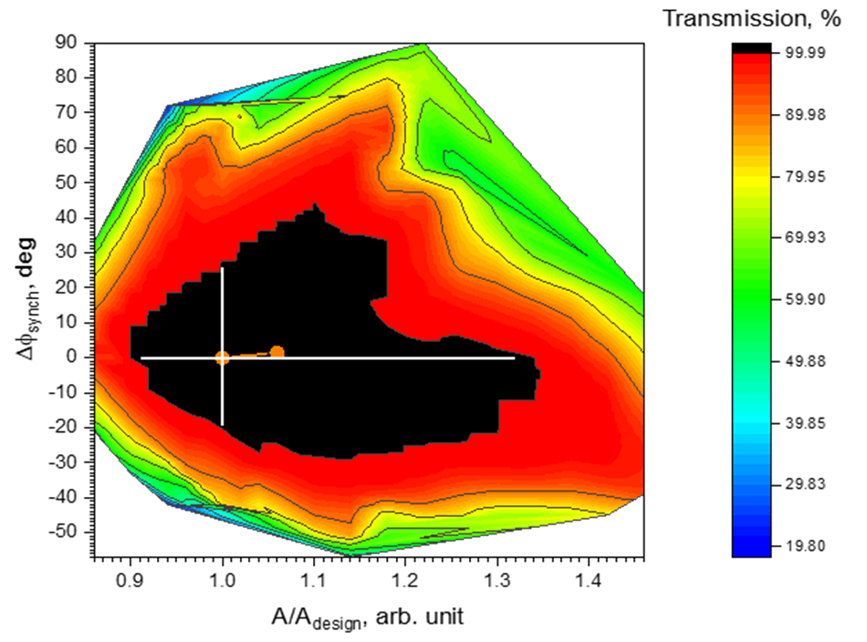
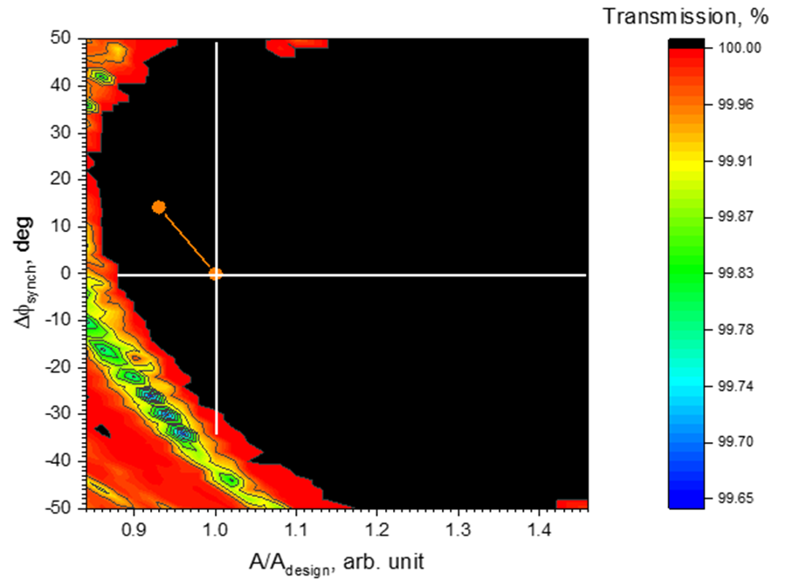
Simulated Transmission through Warm Linac
Simulation shows both the design and final settings have no loss.
Model isn’t accurate enough to predict losses seen
Black region is not lossless in reality, but we can explore it
MEBT1
DTL1
CCL1
(B. Cathey, A. Shishlo)
Simulation of Each cavity Phase & Amplitude 2D Scan
We changed amplitudes and phases 14 cavities one by one
For each cavity, all downstream ones were tuned according to design
100,000 macro-particles at the MEBT entrance with design Twiss
Transmission was simulated to the end of warm linac

Slide 6
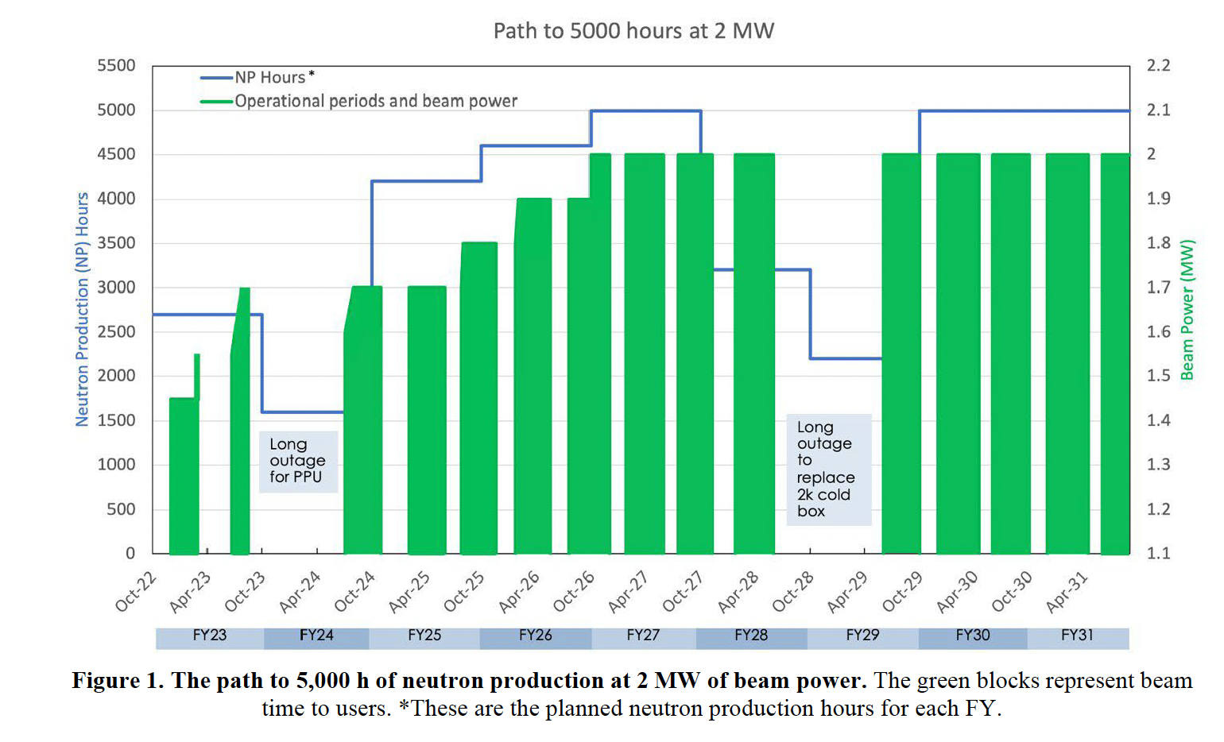
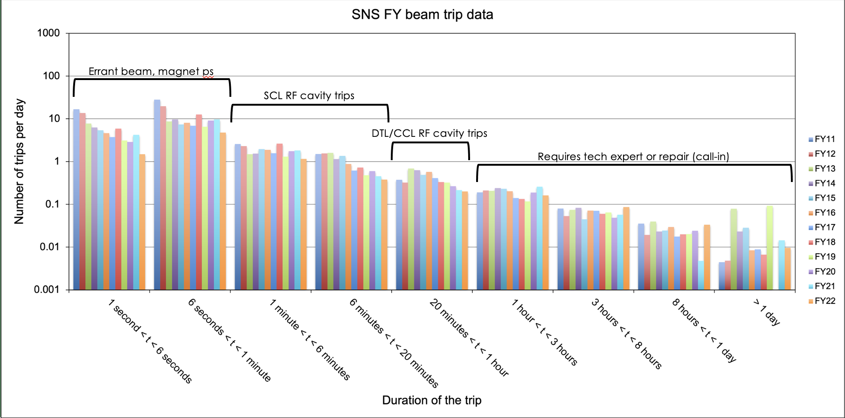
How Did We Adapt?
Beam Power Operating Hours
H- beam loss activation
DR > 1 Rem/hr : must maintain positive access control
Longer cooldown times
Must address continuous loss, prompt loss
Mitigated through:
Scraping and collimation
Equipment modifications
Hand Tuning
Tracking faults
Frequency per day
Trip Length

Slide 7
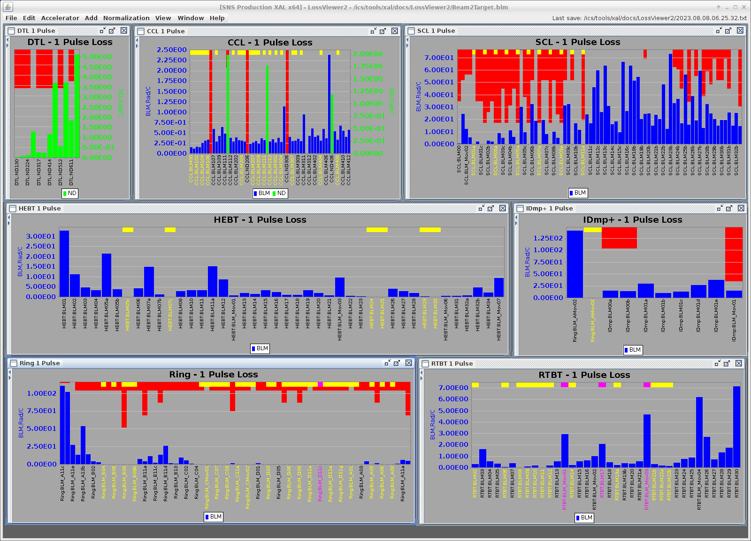
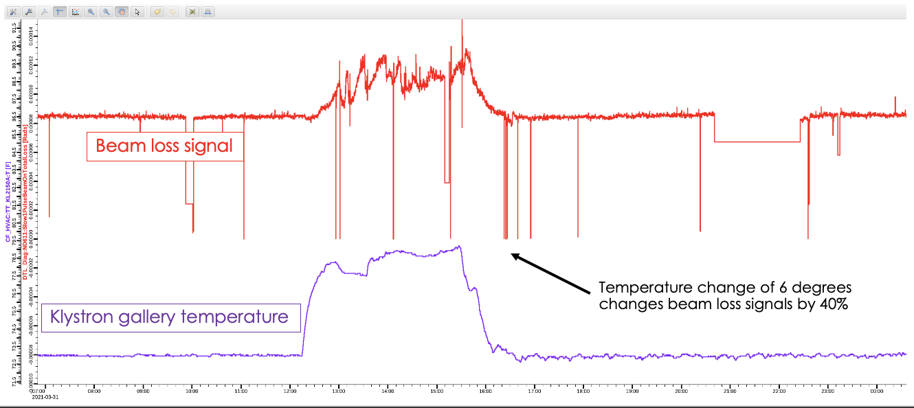
Operations Impact
Want loss profile that is:
Well-below trip limits
Minimize spurious trips
Free up operators for other duties
Robust to “drift”
Due to humidity, equipment, etc.
Reduce daily hand-tuning
Resilient to power ramp-up in coming years (2 MW by 2027)

Slide 8
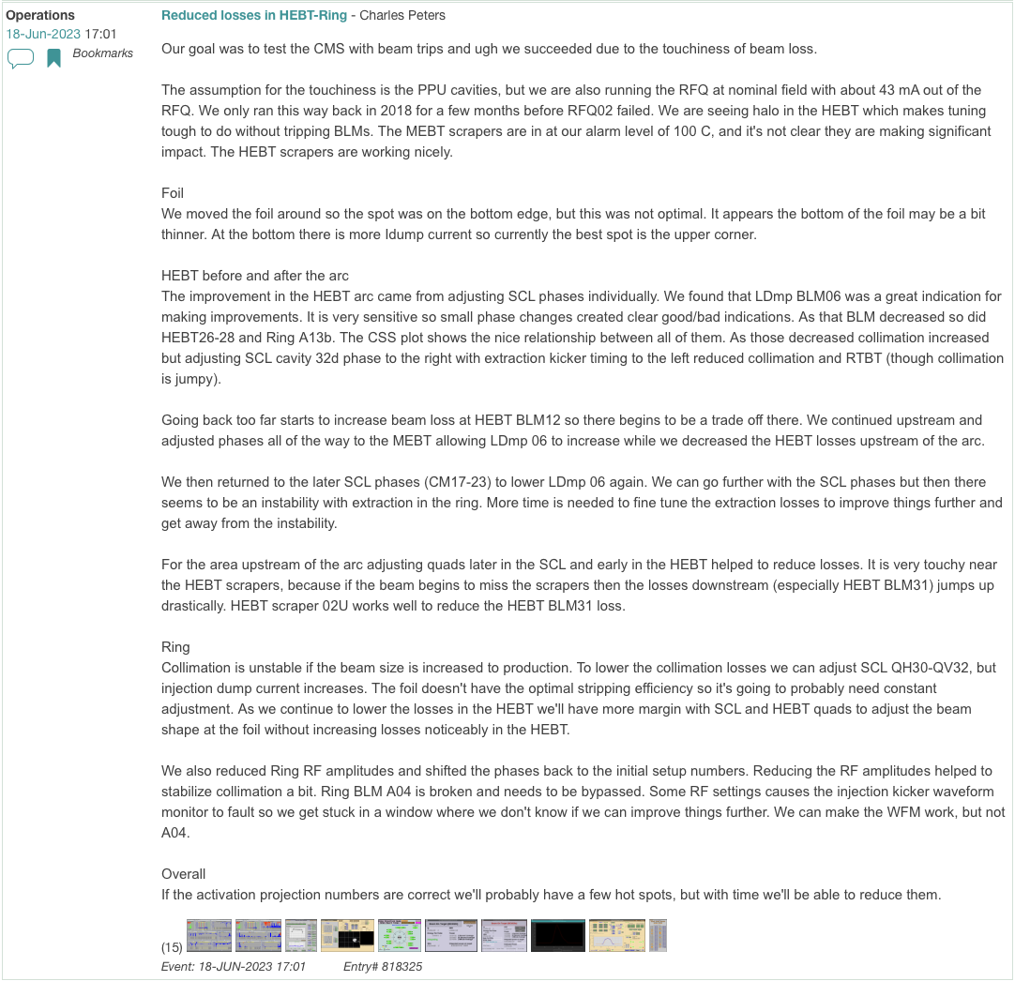
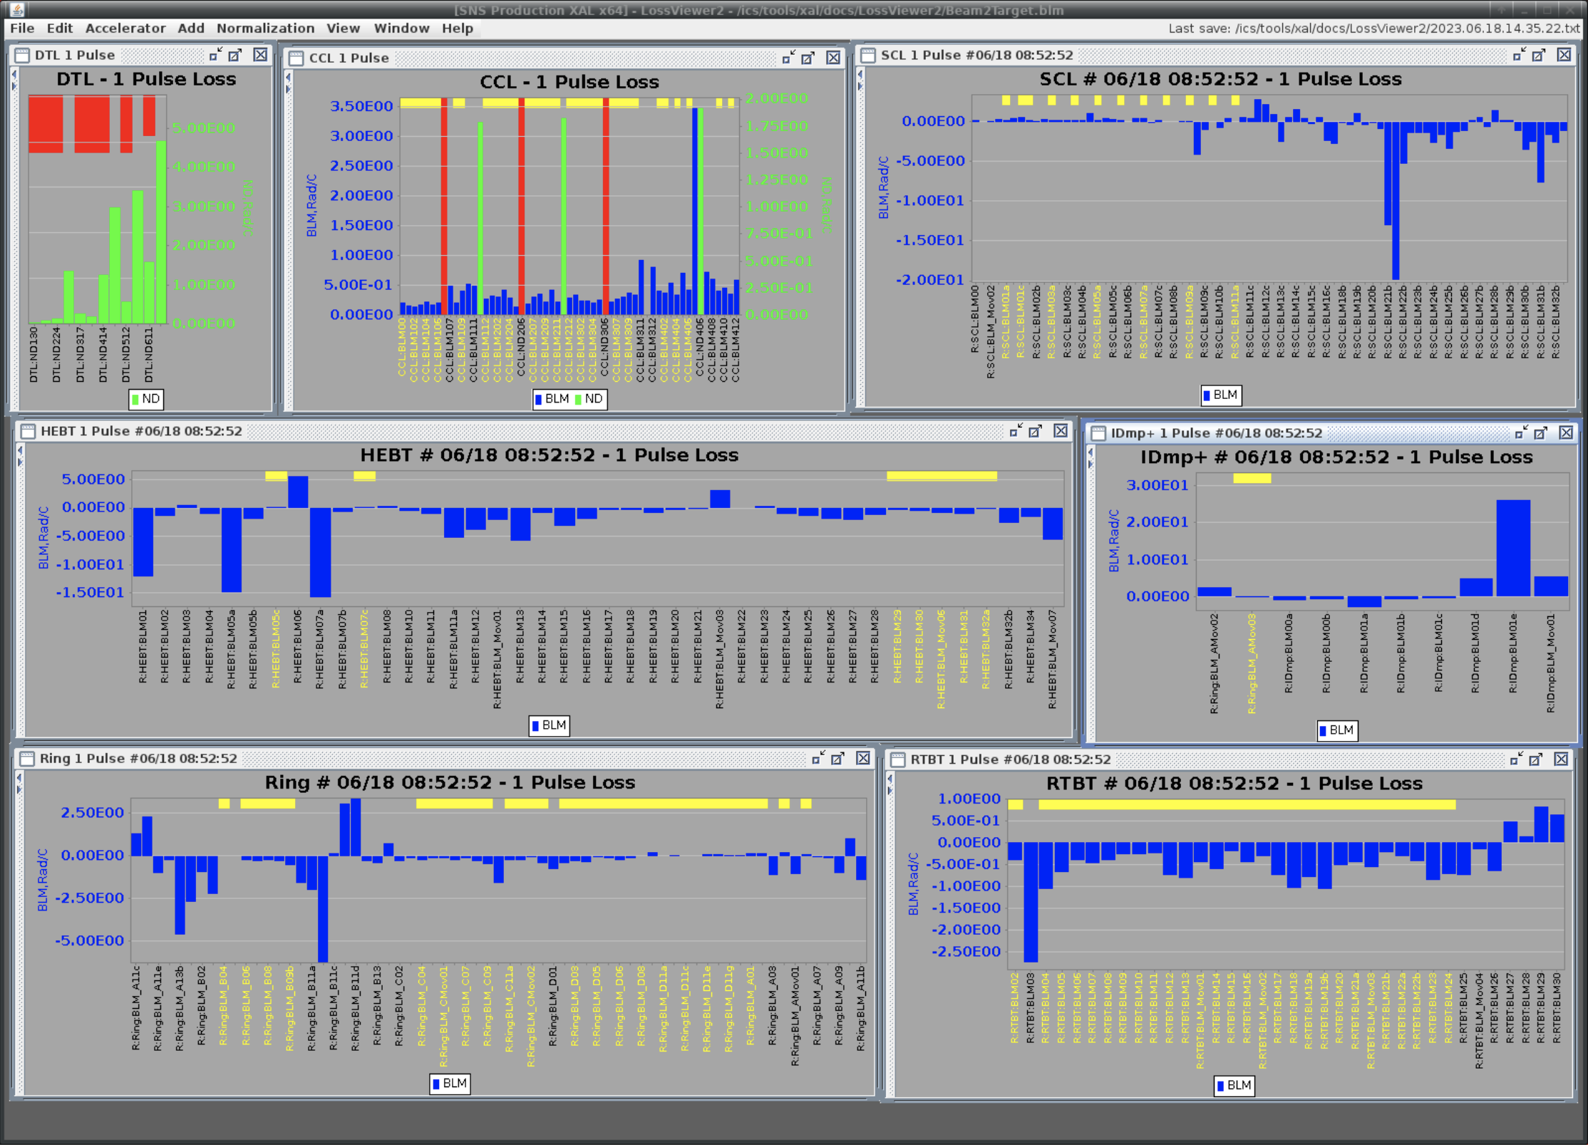
Hand Tuning is an Art
Time-consuming nature introduces human error
Cannot be easily taught

Slide 9
Automated Beam Loss Tuning (Pre-ML) in Python
Optimize & Maintain Low Losses
Constraints to Run During NP
Metric: Loss data, expected activation data (correlated to loss signal using historical survey data)
Actuators: Shift RF cavity settings and quadrupole magnet currents
Save explored settings & diagnostic readbacks to HDF5 file
Current Monitors (BCM), RMS H and V beam profiles upstream of Target, Position Monitors (BPM) in the HEBT, Humidity
Orbit correction happening in parallel
Op. Constraints: beam current & centering on injection dump, beam size and centering on target, power on target, beam orbit and trajectory into Ring
Safety Constraints: safe windows, step sizes from experts; save as defaults
Terminates if violating user-defined BLM limits
Terminate for unexplained Machine Protection System (MPS) faults
Lock one instance of script running at one time
Approval from ACCC to run at 60 Hz for 24 hrs (08/14/2023); No trips!
Real-Time Optimization during NP – safeguards are critical!
Notes:
Organize left side into “goals” and “constraints”

Slide 10
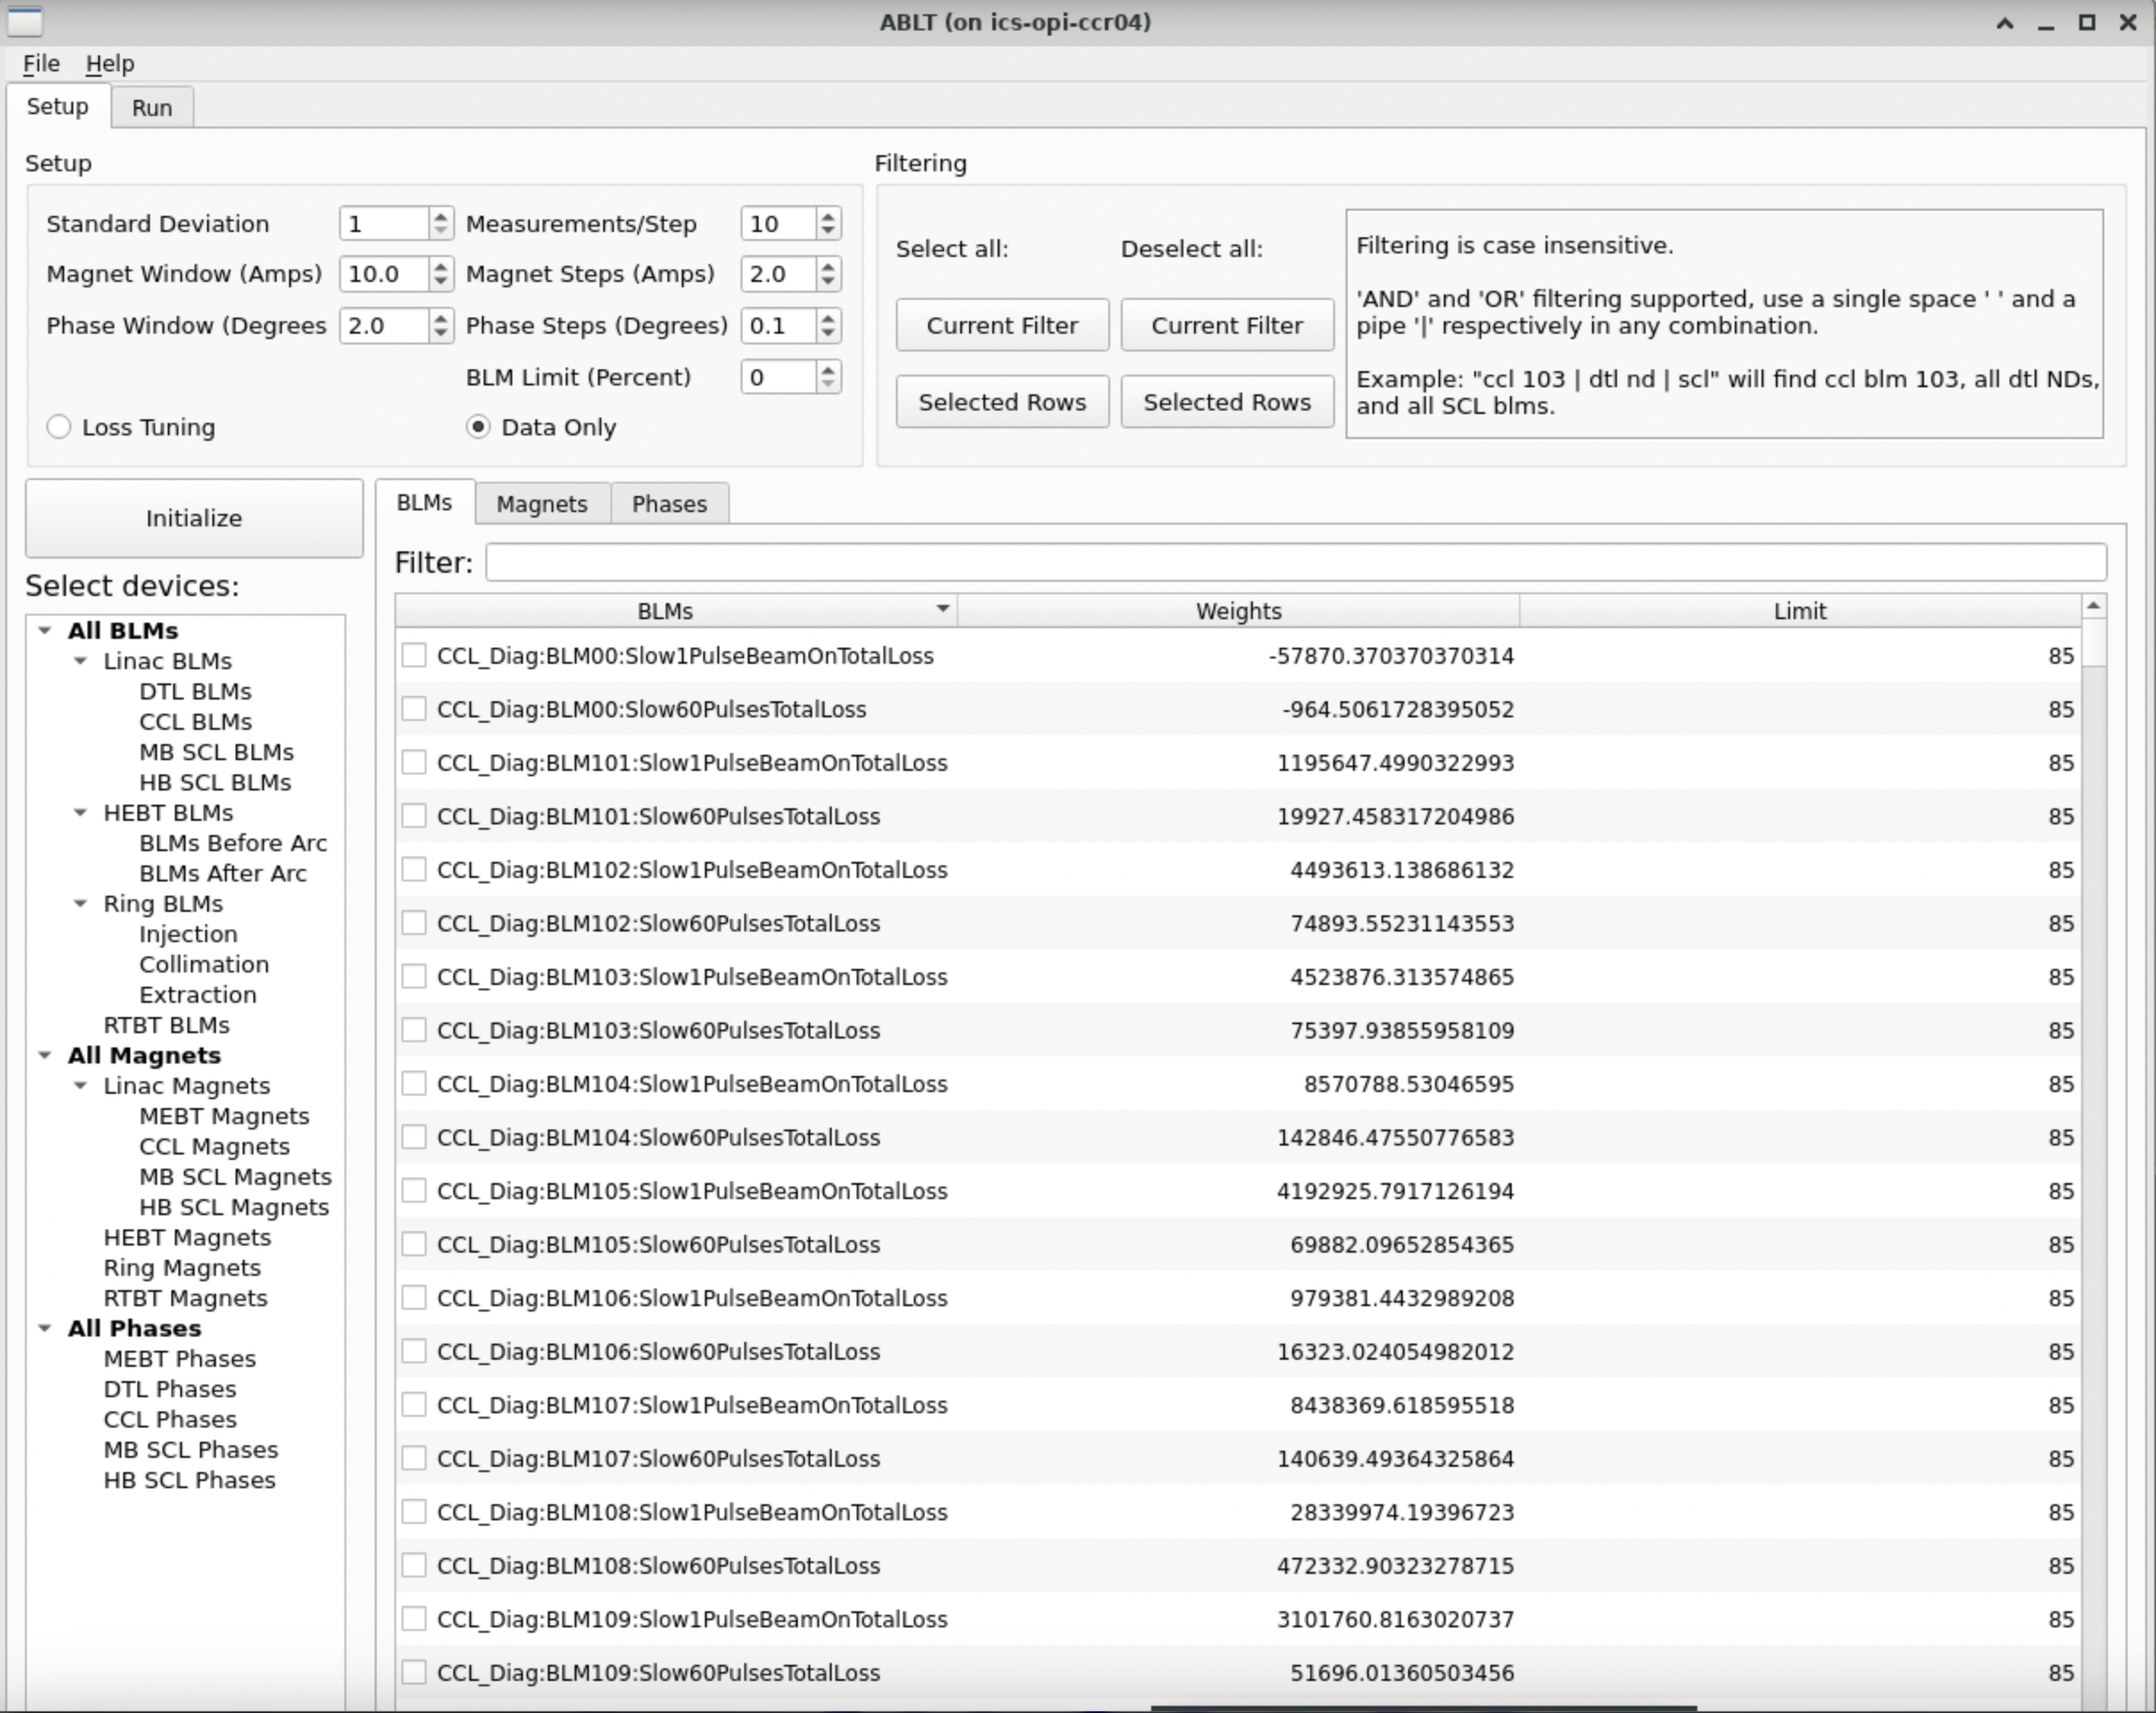
Automated Beam Loss Tuning
Estimated Activation
(J. Rye)

Slide 11
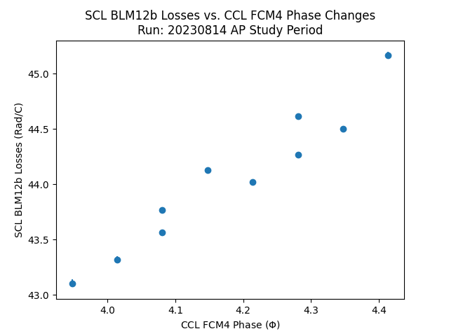
Data Analysis, 1D Scans
RF Phase Changing
Beam Loss Monitor
(S. Thomas)

Slide 12
Motivation
Spallation Neutron Source Facility
Impact of Beam Loss on SNS
Operator Perspective
Automated Beam Loss Tuning (ABLT)
Beam Loss Optimization(BLO)
DOE Grant Information
BLO Use-Case
Deployment Plan
Software Integration
CER Upgrades
Future Plans

Slide 13
“Machine Learning for Improvement in Accelerator and Target Performance” Renewed for up to 3 years
ORNL PI: Willem Blokland and JLAB PI: Malachi Schram
This is a continuation of previous grant, and the focus is now to bring ML into operations as opposed to offline analysis
Three use-cases:
Beam Loss Optimization: Automatically minimize beam losses in real-time
Target Anomaly Detection: Warn for anomalies and generate reports
Errant Beam: Predict and prevent errant beam pulses
(K. Rajput: “Machine Learning to Improve Accelerator Operations at SNS”)
(W. Blokland)

Slide 14
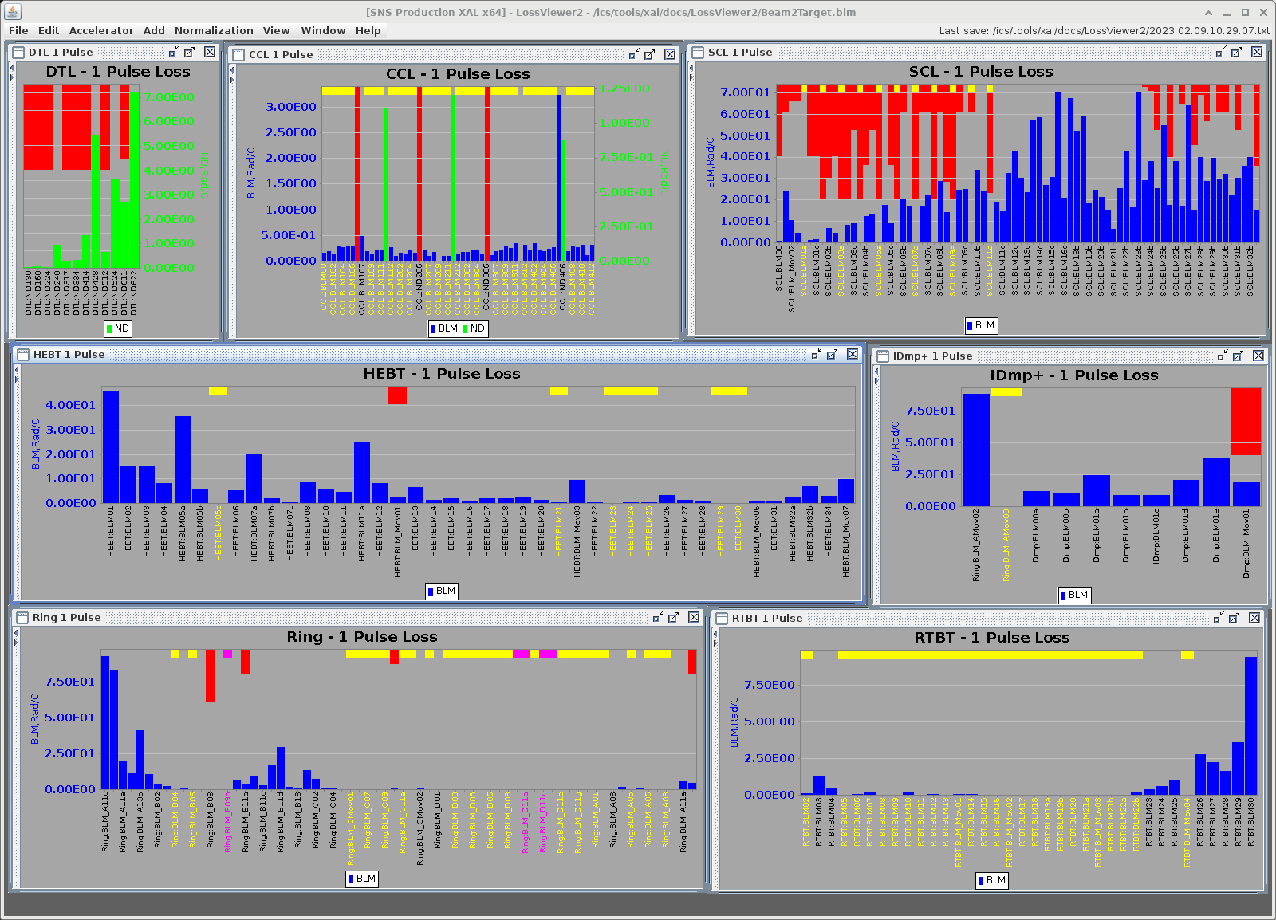
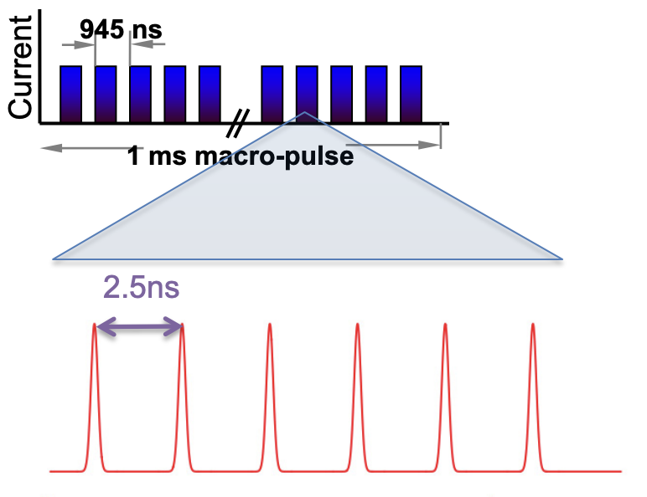
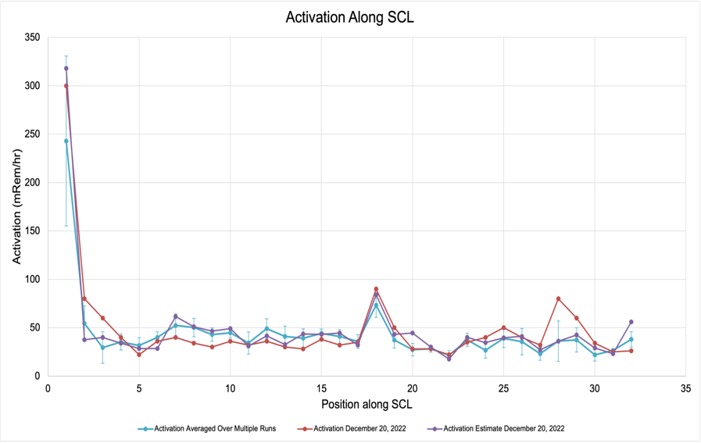
BLO Use Case
(W. Blokland)
Lead: Alexander Zhukov
Goal: Reduce beam losses using Reinforcement Learning
Sensors: 267 Loss Monitors
Actuators: 111 RF Cavities, 335 Magnets
Approach: Use virtual accelerator and safety limits to test safety of algorithms
Metrics: Reduce tune-up time by 50% Reduce activation < 100 mRem/h
Loss monitors see 1 ms pulse
Activation (mRem/hr)
AP physics model works with one bunch, doesn’t have halo details
Position Along SCL

Slide 15
Tools
List of Tools
Tool | Description
Python | Used for Virtual Accelerator (VA) and ScanEngine
PyORBIT3 | Particle-In-Cell accelerator physics code
EPICS | Used for VA and ScanEngine
HDF5 | Scan file format
SciOptControlToolkit (Jefferson Lab) | ML Side; Specific techniques/methods to come
(A. Zhukov)

Slide 16
Software Integration – Configuration 1
ScanEngine
SciOptControl Toolkit
Proxy Server with safe limits
Virtual
Accelerator
Safe stepping, monitoring BLMs from ABLT
Proxy
Use
Test interaction between proxy server and control policy safely using VA

Slide 17
Software Integration – Configuration 2
Use
Bypass proxy server to scale up training
ScanEngine
SciOptControl
Toolkit
PyORBIT/Virtual
Accelerator
Control policy
SciOptControlToolkit
Virtual Accelerator

Slide 18
Software Integration – Production Configuration
Use:
In NP on accelerator network
Need to define administrative boundaries for new approvals
ScanEngine
SciOptControl Toolkit
Proxy Server with safe limits
SNS

Slide 19
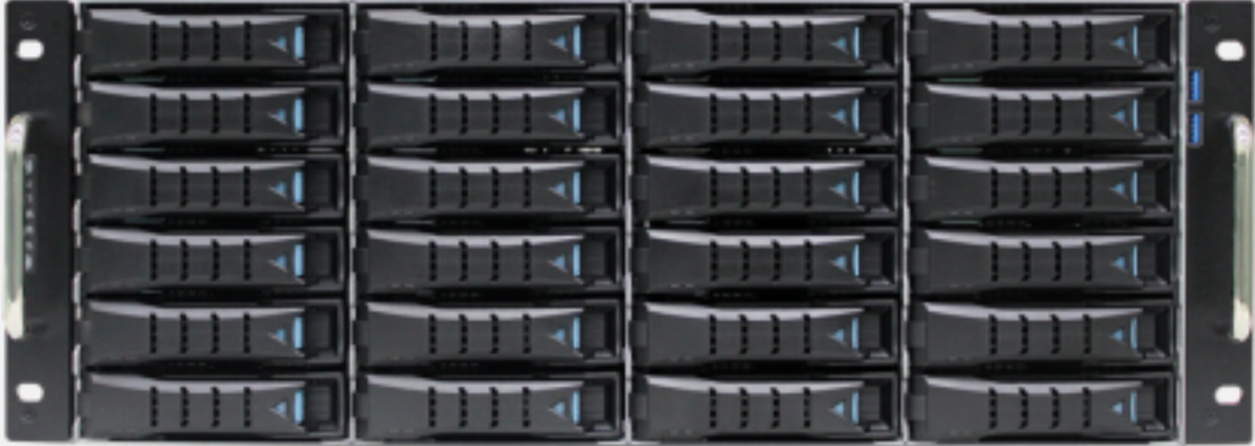
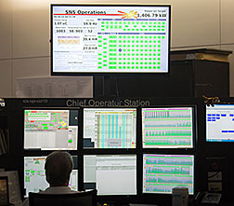
Infrastructure Overview
ML Server
GitLab
GitLab
Code repository
Actions
Verify new code
Deploy
Storage
Data
SNS Servers
Train and test model
Store data
ORNL Servers
GitLab
Icarus
SNS / VA
New Model
Proxy Server
New Model
SciOptControlToolkit
Inference Results
Data Acquisition
Acquire data
Model inference
Edge computer
Data compression and buffer
Real-time Model inference
Display results
Operator
View results
Operate models
Stop / Pause
Rollback to previous model
Developer
Scripts
GUIs
MLFlow
(W. Blokland)

Slide 20
Deliverables
Deliverable | When
VA Environment | Spring 2024
IPAC paper/poster on VA | Spring-Summer 2024
Software framework to run safe scan during production | Summer 2024
Preliminary quantitative data with comparison of different techniques for reduced number of setpoints (10 knobs, 26 BLMs) | Spring 2025
VA to include some loss modeling (From AP or empirical findings) | Spring 2025
Expansion of parameter space to full SCL | Winter 2026
Working Automated procedure that reduces loss during production | Summer 2026
Publication ML Based Adaptive Accelerator Beam Loss Tuning | Fall 2026
(A. Zhukov)

Slide 21
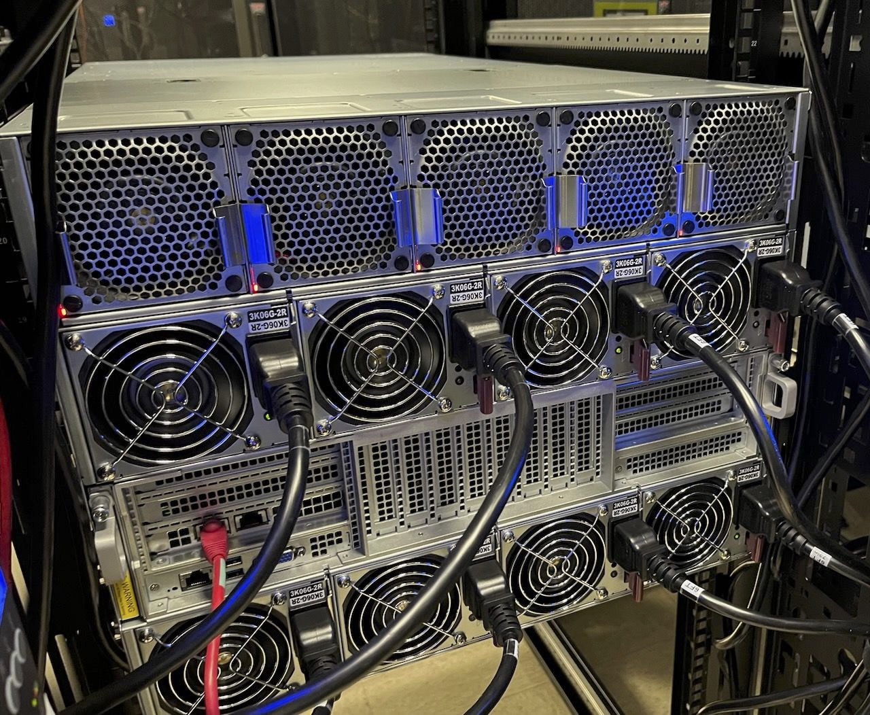
Hardware Installation Progress
8 Nvidia GPUs purchased and delivered
Modifications to central equipment room to support
(2) 208V, three-phase, 60A receptacle circuits to rack 04CER01, and new 60A 3 pole breakers to support circuits
Near completion

Slide 22
Moving Forward into FY24B
Clean up integration code / Running example
Proxy server integration
Test on ICS, small subset, during Accelerator Physics study (low power)
Test on ICS, small subset, at 60 Hz full power
In the next three years….
Compare ML techniques to find best for our usecase
Incorporate loss-modeling into Virtual Accelerator
Expand to full parameter space
Deploy working CCR tool

Slide 23
Acknowledgements
BLO Team for their invaluable input and contributions,
Accelerator Physicists for their work studying beam dynamics,
ORNL, JLab, and DOE for supporting this project,
supportive management for this opportunity,
the Scientific and Local Organizing Committees for ICFA 2024.
Thank you! 정말 고마워요

Slide 24
References
First Observation of Intrabeam Stripping of Negative Hydrogen in a Superconducting Linear Accelerator (A. Shishlo, J. Galambos, A. Aleksandrov, V. Lebedev, and M. Plum, Phys. Rev. Lett. 108, 114801 12 March 2012)
ML Physics Presentation for BLO Use Case (B. Cathey, A. Shishlo, Machine Learning Kick-off Meeting, 9 Nov 2023)
BLO Use Case Overview (S. Zhukov, Machine Learning Kick-off Meeting, 9 Nov 2023)

Slide 25
Additional Slides
ABLT
Analysis
ScanEngine
More Physics Slides
More Details on BLO Use Case

Slide 26
Design vs. Production Settings in RF Cavities
Cavity | Design φ_{synch} deg | Real φ_{synch} deg | A_{RF}/A_{RF Design} %
MEBT 1 | -90.0 | -100.6 | 145
MEBT 2 | -90.0 | -85.6 | 131
MEBT 3 | -90.0 | -103.5 | 132
MEBT 4 | -90.0 | -91.6 | 129
DTL 1 | -45.0 | -43.6 | 106
DTL 2 | -33.4 | -44.4 | 103
DTL 3 | -32.4 | -19.6 | 99
DTL 4 | -31.7 | -30.7 | 101
DTL 5 | -31.7 | -25.2 | 92
DTL 6 | -34.0 | -34.4 | 97
CCL 1 | -30.9 | -16.7 | 93
CCL 2 | -30.8 | -21.6 | 95
CCL 3 | -30.7 | -23.9 | 98
CCL 4 | -29.3 | -18.3 | 93
RF Cavities are initially designed using the model with no beam loss
Operators then change the cavity settings to minimize beam loss
These final settings can be far from the design settings
Models aren’t predicting this beam loss
(B. Cathey, A. Shishlo)
Data on Feb. 7, 2021, 1.4 MW

Slide 27
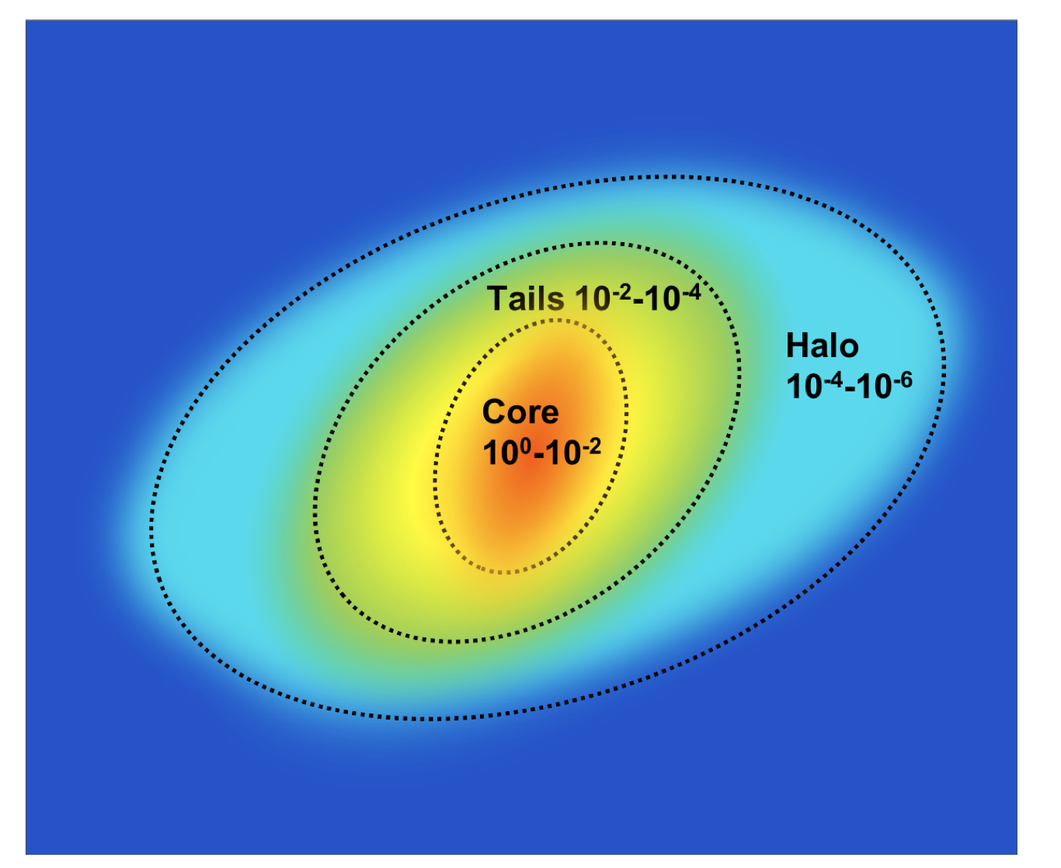
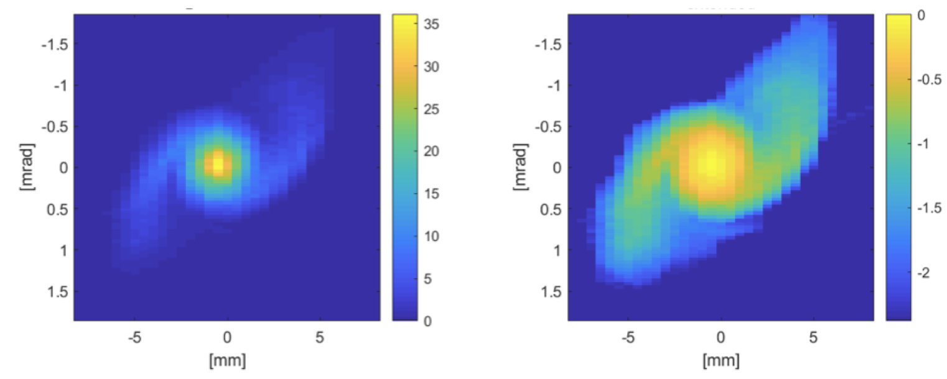
Beam Halo
(B. Cathey, A. Shishlo)
Beam Halo is defined as particles far outside of the main beam
Not well defined
Formed from space-charge self forces
Current models fail to predict its formation
Halo Twiss can be significantly different from core Twiss
The Beam Test Facility at SNS is currently looking into this
Horizontal phase space at the SNS Linac exit showing beam halo
A. Aleksandrov, S. Cousineau, and K. Ruisard, “Understanding beam distributions in hadron linacs in the presence of space charge”

Slide 28
Data In
Input Details
Sensor | Type | Repeatability | Storage
Beam Loss Monitors | timeseries, 60 pulse array | Yes | Scan files on BIGMAC
Beam Position Monitors | 60 pulse array, average scalars | Yes | Files on errant-beam
Slow environmental parameters: temperature etc. | scalars |  | EPICS archiver
(A. Zhukov)

Slide 29
Tools
List of Tools
Tool | Description
Python | Used for VA and scanning script
PyORBIT3 | PIC accelerator physics code
EPICS | Used for VA and scanning script
HDF5 | Scan file format
ML | Specific techniques/methods to come
(A. Zhukov)

Slide 30
Model and Dynamics
Dynamics
Do you have | Yes/No | If yes, explain | If no, what is missing | Comments
Physics model | Yes but | There are accelerator physics models | Losses are not explained by it | Might not use it
Record relevant settings | Yes | Beam configuration settings are saved | There might be other relevant events that change data | Concept/data Drift
Simulation Model | Yes | Virtual Accelerator based on PyORBIT3 (PIC code) | Can not model loss data | Will be used for testing scanning procedures
Stable | Yes | BLM and BPM data are stable
Disturbances | No?
How to optimize
Tuning Procedure | Yes | Manual | Smart automation not affecting production
(A. Zhukov)

Slide 31
Objectives and approaches
List of objectives and approaches
Objective | Approach
Identify critical control variables for loss minimization | Online (during scan) correlation analysis
Determine the duration of scan allowing the model to learn and guide subsequent tuning
Determine what percentage of loss reduction is achievable
(A. Zhukov)

Slide 32
Challenges
Need to run in production for relevant data
Safe non-intrusive operations required
List of Challenges
Challenge | Approach | Backup
Administrative Control | Framework controlling all changes to machine independent from ML algorithm | None
Reasonable trade-offs while relaxing constraints | Revisiting limits in SCL with all parties involved | Operate within existing unnecessary tight limits
Unstable performance (especially for tuning phase)
Quantification of the results
(A. Zhukov)

Slide 33
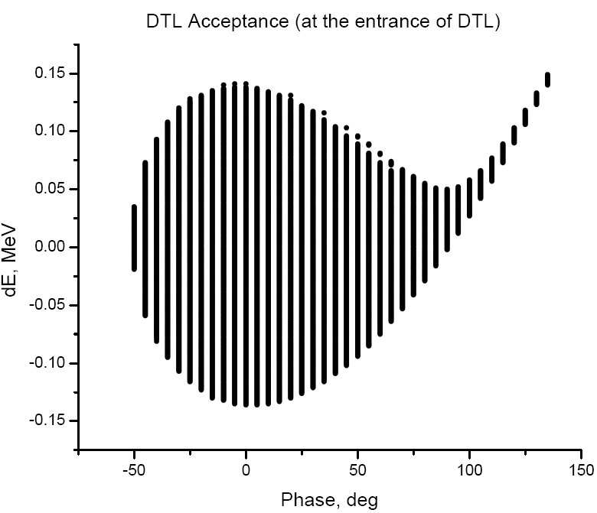
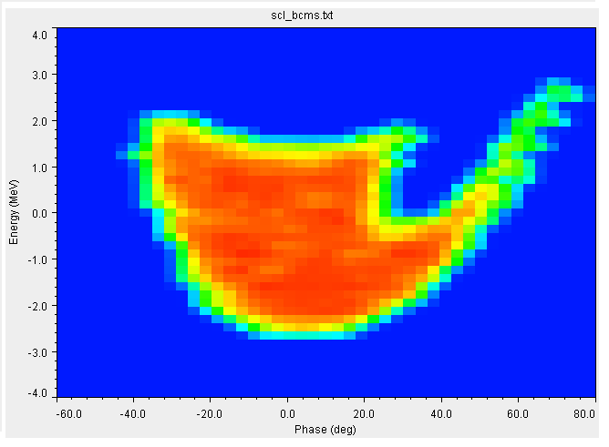
BLO Overview
Timeline
Tasks
Action Items
Notes
Results
Deliverables
Kick-off
Framework development
Virtual accelerator
Objectives
Approaches
Plan
Final
ML methods comparison
Control Room Integration
Develop VA
Test with VA
??
Full scale tool running in CCR
Report
Test with AP beam
Test with production beam
??
NIM publication
Virtual Accelerator Environment
Year 1
Year 1
Software framework
Technique Comparison
Year 2
VA loss modeling
Year 2
Full parameter space
Working CCR tool
Year 3
Year 3
Publication: NIM
Highlight Slide
(S. Zhukov)

