Slide 1
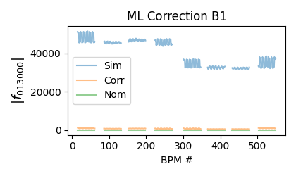
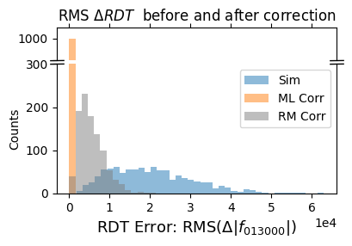
Supervised learning for nonlinear corrections
in the LHC
Current state of nonlinear commissioning in the LHC time consuming and iterative
Can ML be used to correct multiple order errors at once using resonance driving terms (RDTs)?
Set | R2 | MAE [σ]
Train | 0.904 | 0.157
Test | 0.883 | 0.173
Using MADNG to generate up to 30k RDT samples with random errors 82 times faster than PTC!
Quadratic polynomial regression allows to model nonlinearities and collinearity in the variables
Performance yields better results than a traditional response matrix method for simultaneous correction of RDTs

