Slide 1
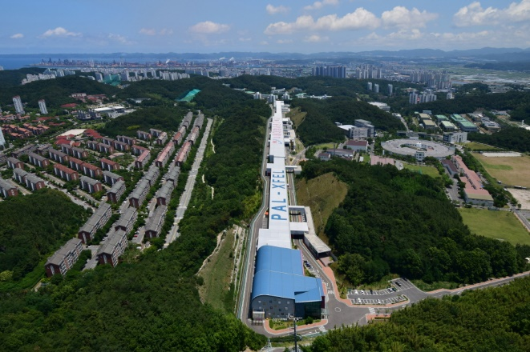
Updates of Korea-4GSR impedance modeling and instability studies
Updates of Korea-4GSR impedance modeling and instability studies
Jimin Seok
on behalf of 4GSR Beam Dynamics Group
Pohang Accelerator Laboratory, POSTECH
2024.11.14

Slide 2
Updates of Korea-4GSR impedance modeling and instability studies
Outline
Overview of Korea-4GSR storage ring
Korea-4GSR impedance modeling status
Beam coupling impedance
Korea-4GSR impedance budget
Storage ring instability study
Single bunch instability
Multi bunch instability
Conclusions

Slide 3
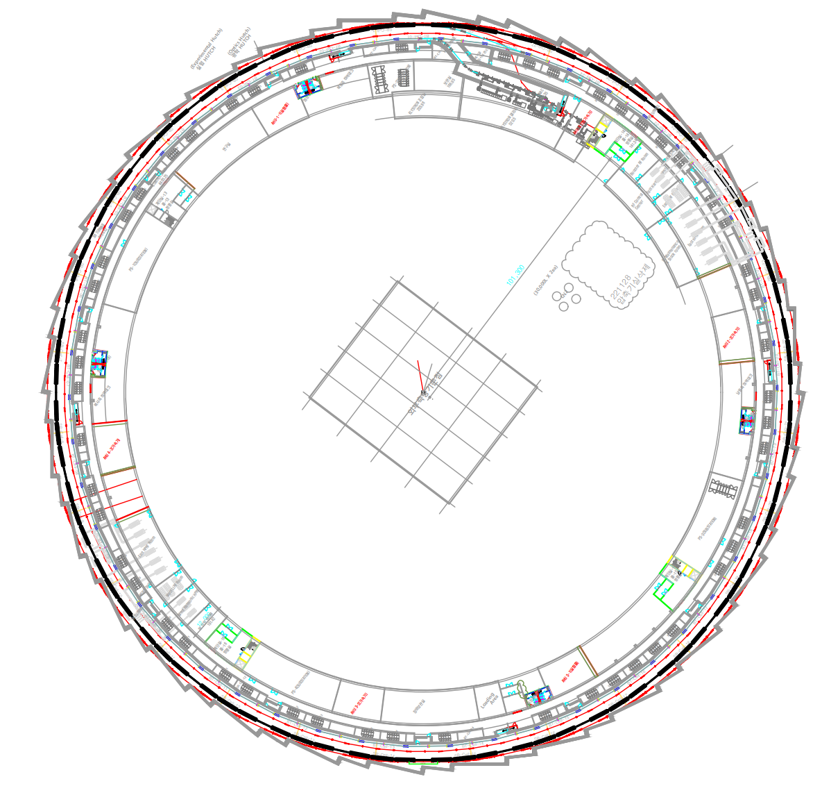
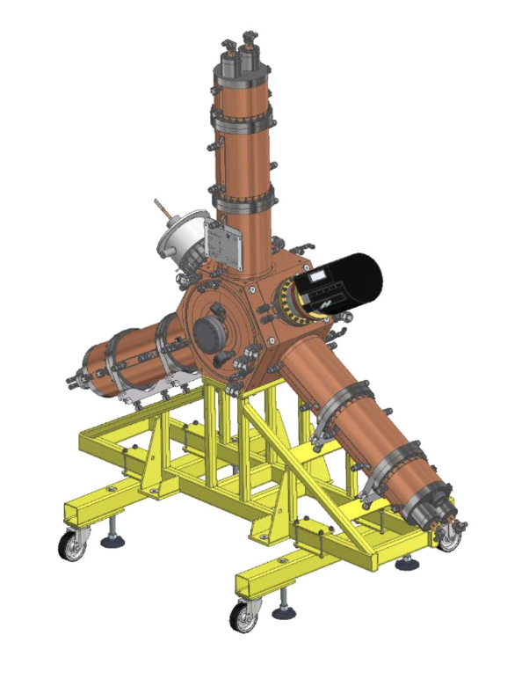
Updates of Korea-4GSR impedance modeling and instability studies
Overview of Korea-4GSR
Injection section
Storage ring main parameters
Parameter | Value
Energy | 4 GeV
Circumference | 799.30 m
Harmonic number | 1332
Natual emittance | 62.2 pm
Tunes $Q_{x}, Q_{y}$ | 68.1, 23.2
Momentum compaction factor | 7.78E-05
Natural Chromaticities $ξ_{nx},ξ_{ny}$ | -112.15, -85.33
Chromaticities $ξ_{x},ξ_{y}$ | 5.82, 3.48
Damping times $τ_{x}, τ_{y}, τ_{z}$ (No IDs) | 10.5 ms, 19.4 ms, 16.8 ms
Energy spread | 0.126%
Bunch length (without HCAV*) | 3.6 mm
Bunch length (with HCAV) | 14.8 mm
RF voltage (No IDs) | 3.08 MV
SR RF main RF cavity
200 MeV linac
Racetrack
EU type normal conducting HOM damped RF cavity, 500 MHz
High-beta section

Slide 4
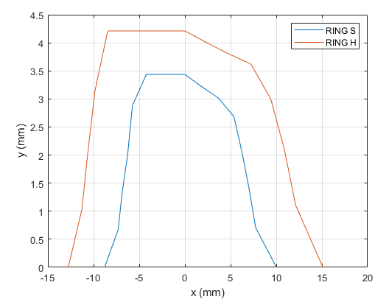
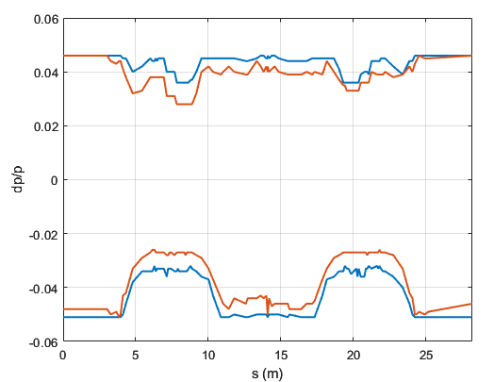
Updates of Korea-4GSR impedance modeling and instability studies
Overview of Korea-4GSR
Hybrid 7 Bend Achromat
Quad
Dipole quad (reverse bend)
Sextupole (includes skew quad)
Octupole
bending
RING_S : Ring with full periodic 28-cell (no high-beta straight)
RING_H : Ring with 26 ID straights + 2 high-beta straights (28 identical arcs)
LGBM
LGBM
2 T center bend
RING_H has larger DA as much as ~ 1.45.
RING_H has smaller MA which result in 27% decrease of Touschek lifetime.
Korea-4GSR lifetime
Beta functions at the center of ID SS:
($β_{x}$, $β_{y}$) = (6.33 m, 2.84 m)
Beta functions at the center of High-beta SS:
($β_{x}$, $β_{y}$) = (15.90 m, 4.45 m)
The ring is composed of 28 H7BA cells (28 identical arcs, 26 ID SS + 2 high-beta SS).
-I transform between dispersion bumps cancels dominant resonance driving terms within a cell.
Though the ring has 2-fold geometric symmetry, it has 28-cell symmetry in terms of on-momentum phase advance ( $Δφ_{x, A}$ = $Δφ_{x, B}$ and $Δφ_{y, A}$ = $Δφ_{y, B}$ ).

Slide 5
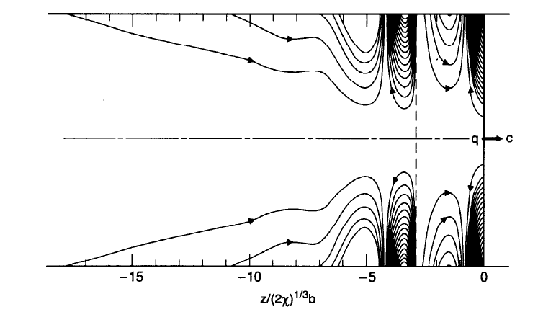
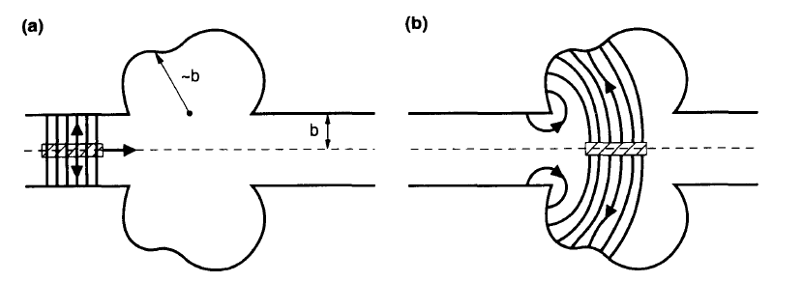
Updates of Korea-4GSR impedance modeling and instability studies
Beam coupling impedance
Coulomb field of charged particle
Pancake shape
$$v$$
$$v$$
$$v=0$$
$$γ≫1$$
$$v≈c$$
Resistive wall impedance
Geometric impedance
Ref. A. Chao, “Physics of collective beam instabilities in high energy accelerators”
s [m]

Slide 6
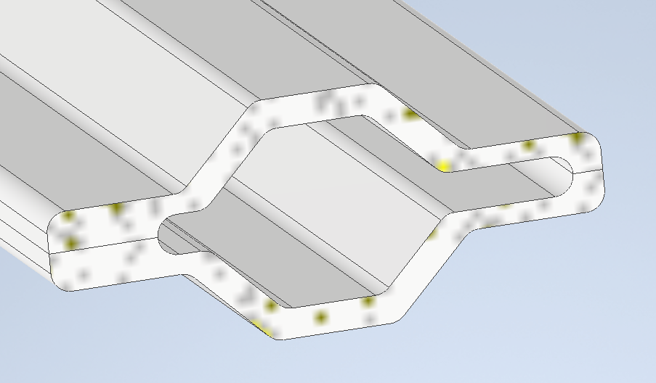
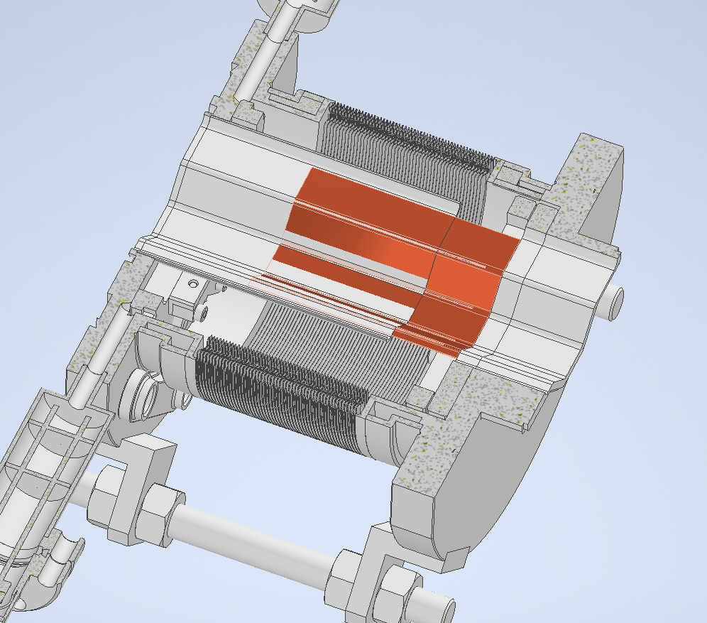
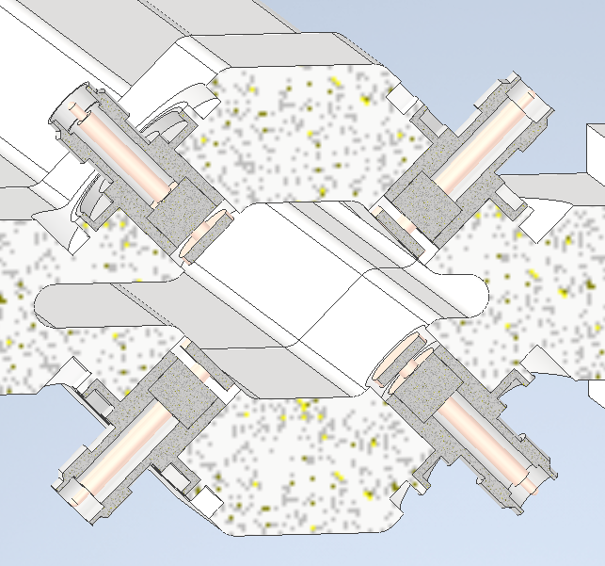
Updates of Korea-4GSR impedance modeling and instability studies
Korea-4GSR impedance modeling
Geometric impedance
Resistive wall impedance
Korea-4GSR chamber cross section
LGBM chamber
Bellows
BPM
Material: Aluminum or stainless steel
Parameter | Length (m) | Number
Arc section | 20.11 | 28
ID section | 7.92 | 26
High beta section | 12.69 | 2
In-vacuum undulator (IVU) | 3.4 | 20
Elliptical polarized undulator (EPU) | 3.6 | 4
Center bend | 0.186 | 28
Sum | 651
Geometric Impedance Calculation with GdfidL Simulation Tool.
Components with changes in cross-sectional shape were simulated.
Bunch length of 1 mm was used for pseudo wake function.
Distinguishing Vacuum Chambers by Cross-Section Shape and Materials.
The resistive wall impedance was modeled using ImpedanceWake2D, with approximate chamber dimensions used for the calculations.

Slide 7
Updates of Korea-4GSR impedance modeling and instability studies
Korea-4GSR impedance modeling
Korea-4GSR single component’s loss, kick factors and effective impedances at bunch length of 3.6 mm
Components | Number | $k_{z}$ (V/pC) | $k_{x}$ (V/pC/m) | $k_{y}$ (V/pC/m) | $${\left|\frac{Z_{∥} }{n}\right|}_{eff} \left(mΩ\right)$$
RW (IVU open/close) | 1 | 15.85/17.06 | 3476 | 8124/18555 | 248.89/260.93
Main RF cavity | 10 | 1.22 | 7.55 | 7.55 | 5.142
BPM | 178 | 29.01E-3 | 4.78 | 4.78 | 0.16
Bellows | 196 | 3.51E-3 | 0.60 | 1.70 | 0.04
BPM bellows | 84 | 33.32E-3 | 13.28 | 0.09 | 0.23
Gate valve | 80 | 0.20E-3 | 0.38 | 0.61 | 0.02
Pumping tee | 84 | 0.56E-3 | 1.67 | -0.79 | 0.02
LGBM chamber | 56 | 33.85E-3 | 18.45 | -7.26 | 0.22
IVU open/close | 19 | 0.87E-3/1.72E-3 | -0.79/-12.66 | 2.99/238.35 | 0.04/0.69
flange | 700 | 0.05E-3 | 0.33 | 0.82 | 0.02
LF kicker | 1 | 1.67 | 107.85 | 114.98 | 5.38
HF kicker | 1 | 0.21 | -16.04 | 16.04 | 0.65
VF kicker | 1 | 0.21 | 16.04 | -16.04 | 0.65
Transitions | 28 | 4.27E-3 | -2.18 | 46.82 | 0.36
RF components | 1 | 0.13 | 9.54 | 7.18 | 1.28
Total |  | 41.1/42.28 | 7111/6886 | 11031/25934 | 404.35/428.74
LF, HF, and VF represent the longitudinal, horizontal and vertical feedback kickers, respectively.
Assumptions include 19 in-vacuum undulators and 5 elliptically polarized undulators.
Certain components, such as transitions and injection section, are missing in the current model.

Slide 8
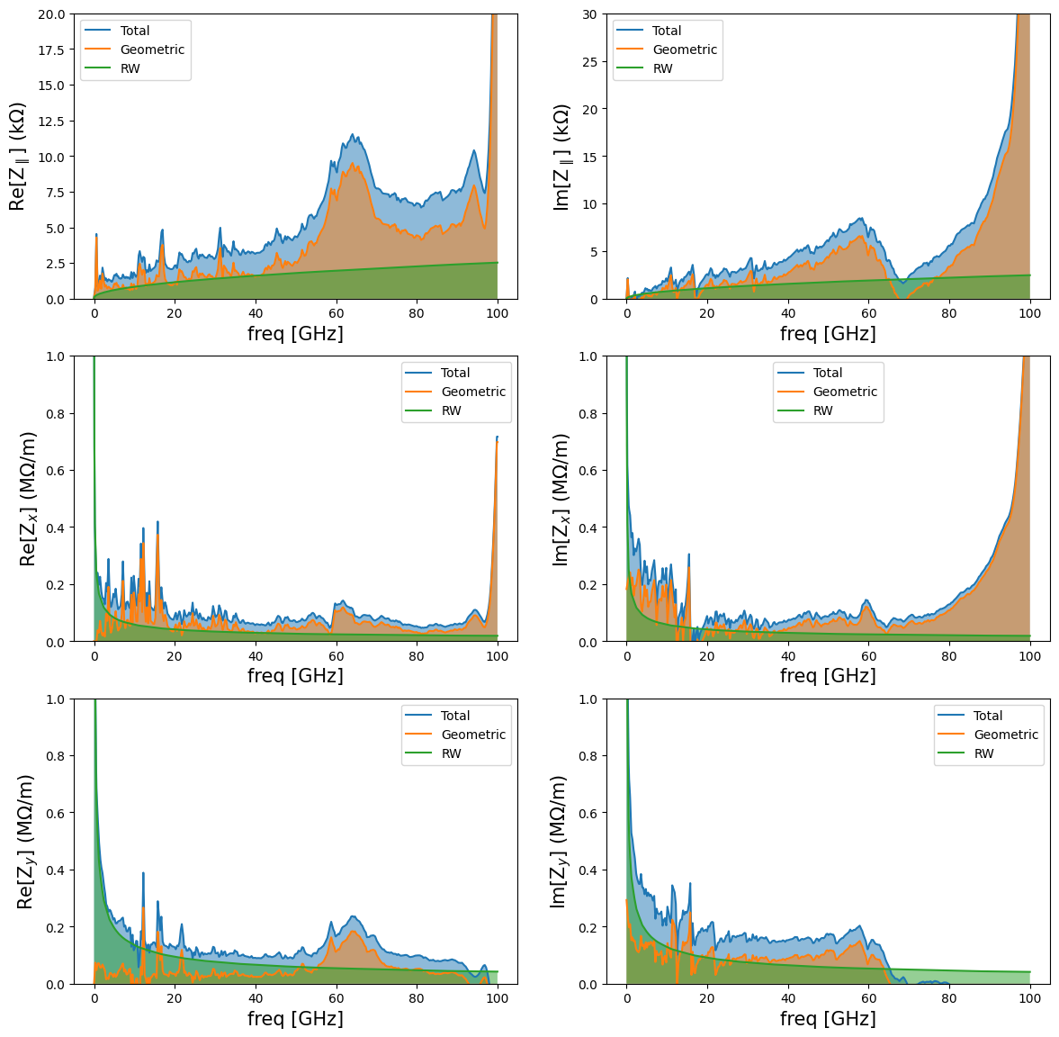
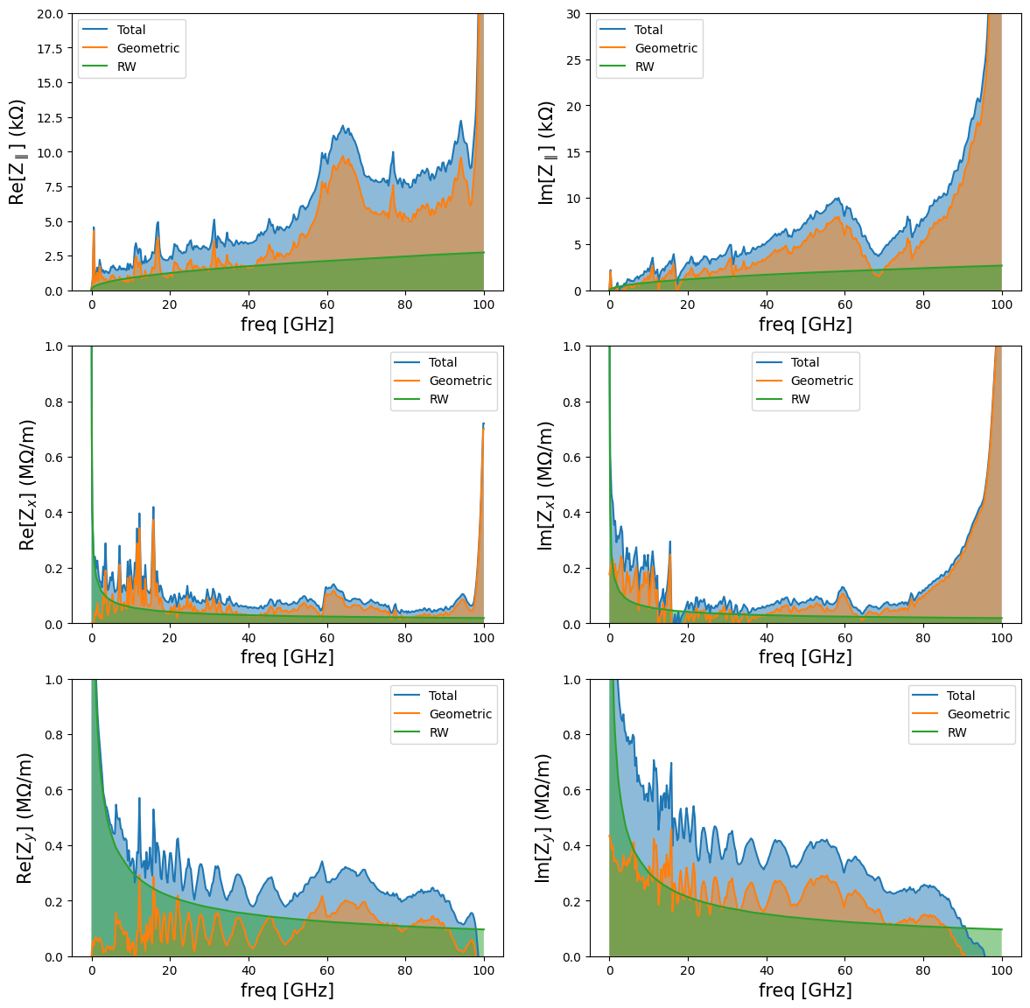
Updates of Korea-4GSR impedance modeling and instability studies
Korea-4GSR impedance modeling
19 IVUs open
19 IVUs close

Slide 9
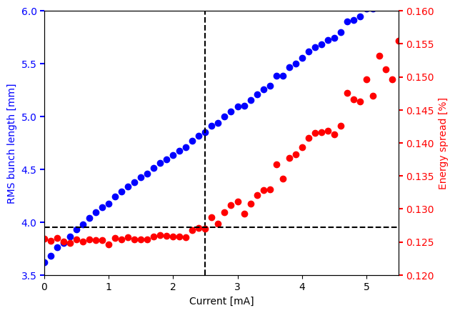
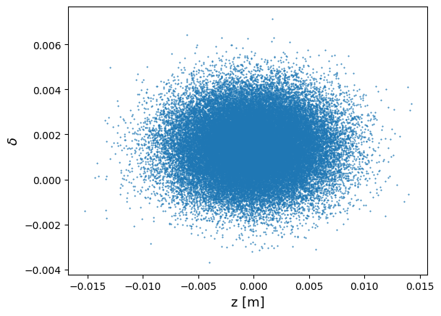
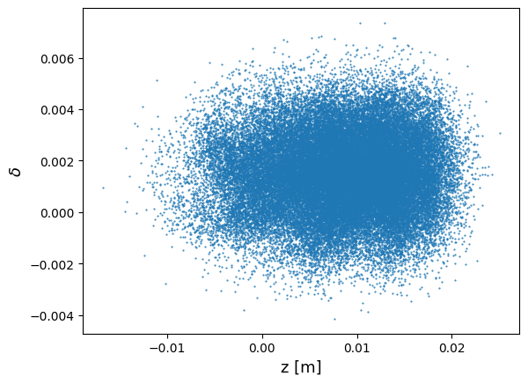
Updates of Korea-4GSR impedance modeling and instability studies
Microwave instability
PyAT tracking result
Microwave instability occurs when high-frequency impedance (wavelengths on the order of a few centimeters) causes turbulence in the beam.
This instability increases the beam energy spread and emittance.
The threshold for microwave instability can be estimated using the Boussard criterion.
Keil-Schnell-Boussard criterion
$E_{0}$ beam energy
$σ_{z}$ bunch length
$σ_{δ}$ energy spread
$N_{0}$ Number of particles in bunch
$c$ speed of light
$${\left|\frac{Z_{∥}}{n}\right|}_{eff}<{\left(2π\right)}^{\frac{3}{2}}\frac{E_{0}\left|η_{p}\right|σ_{z}σ_{δ}^{2}}{e^{2}N_{0}c}$$
Korea-4GSR theoretical MW threshold current: 0.1 mA
I= 0 mA
I= 3 mA
2.4 mA
Theoretical estimations were based on conservative conditions.
Numerical tracking was performed with 50,000 particles over 100,000 turns.
The microwave instability simulation included only longitudinal impedance (transverse impedance was not considered).
The threshold current for microwave instability was identified when the increase in energy spread exceeded 1%.

Slide 10
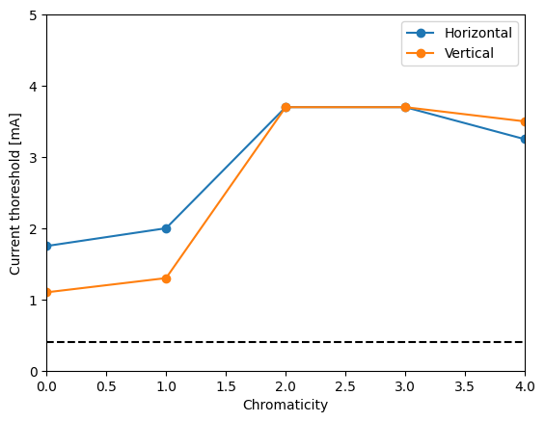
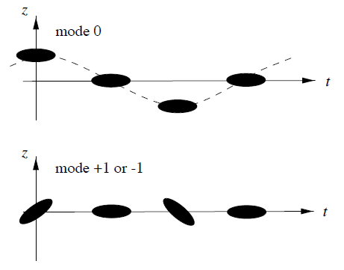
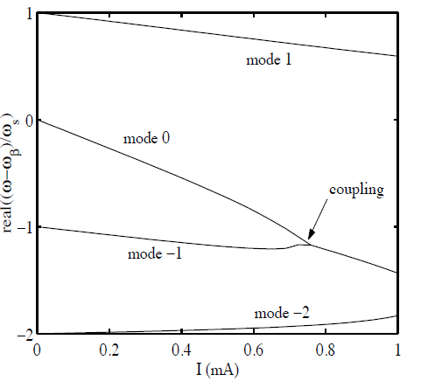
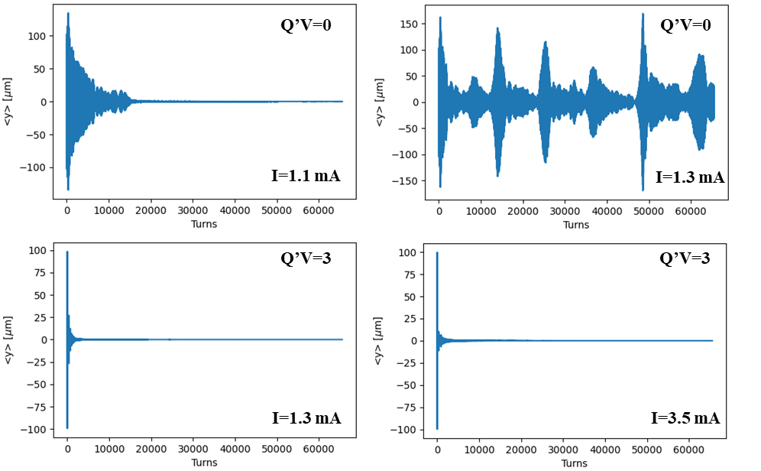
Updates of Korea-4GSR impedance modeling and instability studies
Transverse mode coupling instability
Transverse broad-band impedance (short-range wakefield) induces head-tail instability.
As the single-bunch current increases, modes of head-tail instability can couple, leading to transverse mode coupling instability (TMCI).
TMCI limits the bunch current in the transverse direction.
Adjusting chromaticity can raise the threshold current for the onset of this instability.
Vertical centroid motions
Analytical TMCI threshold @ zero chromaticity
$$I_{th}=\frac{4\sqrt{π}α_{c}Eσ_{δ}}{e}\frac{1}{βIm{\left(Z_{⊥}\right)}_{eff}}$$
 | Analytical threshold current | Threshold current from tracking
Horizontal | 1.37 mA | 1.75 mA
Vertical | 1.17 mA | 1.10 mA
TMCI tracking includes longitudinal, transverse impedance, 50k particles and 60k turns.
TMCI threshold was found that beam size start to change or loss the particle .

Slide 11
Updates of Korea-4GSR impedance modeling and instability studies
RW induced coupled bunch mode instability
Resistive wall induced coupled bunch mode instability @ zero chromaticity
Horizontal plane
Vertical plane IVU open
Vertical plane IVU close
Analytical results
Theoretical analysis comes from a well-known equation
$$Ω_{μ}−ω_{β}=−i\frac{4π}{Z_{0}}\frac{n_{b}N_{b}r_{0}ω_{0}c}{8πγ_{0}ν_{⊥}}\sum_{p=−∞}^{∞}{Z_{⊥}\left\{ω_{β}+\left(μ−n_{b}p\right)ω_{0}\right\},}$$
Imaginary part of frequency shift gives a growth rate
To determine the growth rate from numerical tracking data, singular value decomposition (SVD) was applied. The growth rate was then obtained by fitting to the time vector.
$$X=U∙W∙V^{T}$$
Turn by turn bunches position data (size of $n_{turn}×n_{bunch})$
$$\sum_{n=1}^{n_{turn}}{u_{k}\left(n\right)u_{l}\left(n\right)=δ_{kl}}$$
Tracking results
$$x\left(n,b\right)=\sum_{k=1}^{n_{bunch}}{λ_{k}u_{k}\left(n\right)v_{k}(b)}$$
$$\sum_{n=1}^{n_{turn}}{v_{k}\left(b\right)v_{l}\left(b\right)=δ_{kl}}$$
Time pattern
Spatial pattern
 | Horizontal | Vertical (IVUs open) | Vertical (IVUs close)
Analytical growth rate | 614.7 1/s | 4004.1 1/s | 6877.9 1/s
Tracking growth rate | 1522.6 1/s | 3945.83 1/s | 6006.5 1/s
Damping rate | 95.4 1/s | 51.5 1/s | 138.7 1/s
Tracking current threshold | 25 mA | 5.2 mA | 9.3 mA
Bunch number: 1332
Current: 400 mA

Slide 12
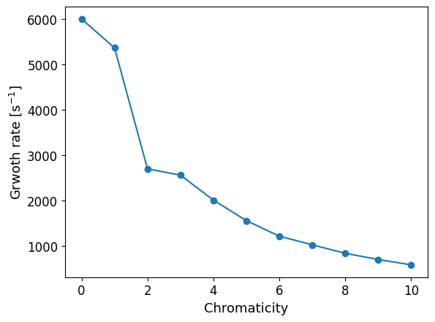
Updates of Korea-4GSR impedance modeling and instability studies
RW induced coupled bunch mode instability
Bunch number: 1332
Current: 400 mA
IVU close, vertical plane
Similar to TMCI, chromaticity can increase the CBMI threshold current.

Slide 13
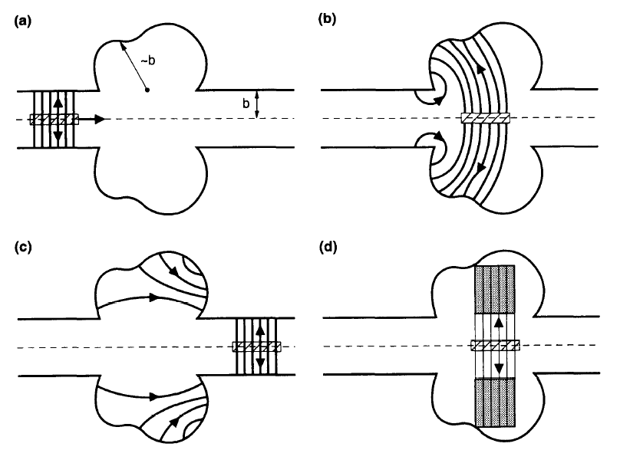
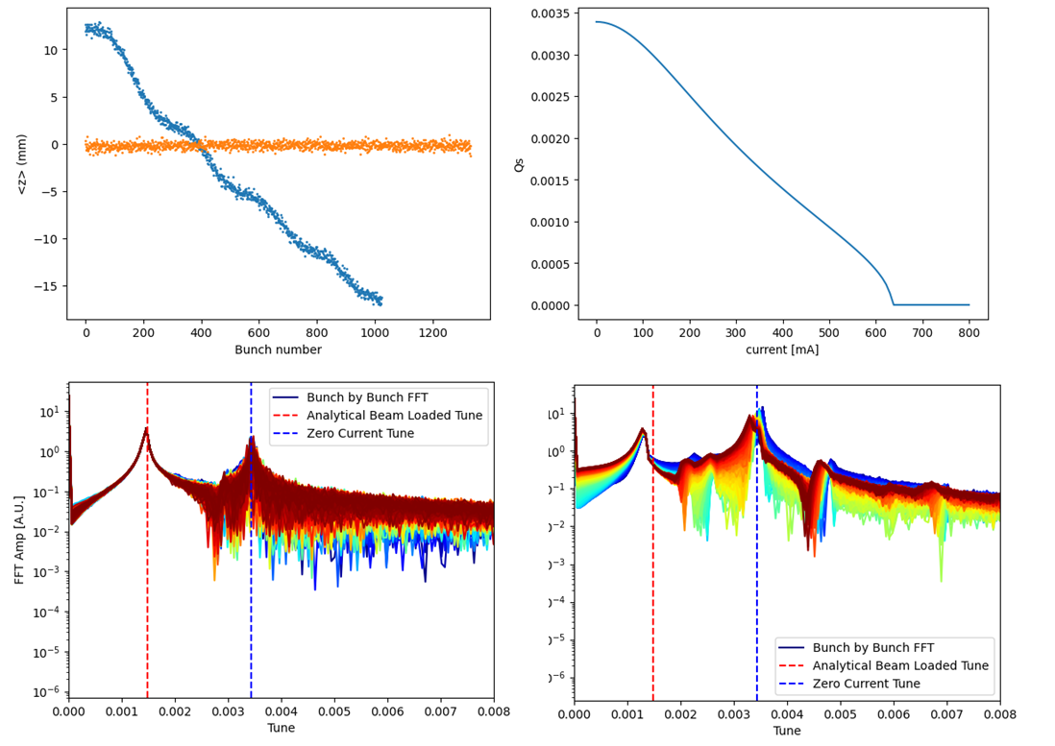
Updates of Korea-4GSR impedance modeling and instability studies
Main RF beam-loading
Longitudinal position shift
Analytical synchrotron tune shift
Uniform filling (nb=1332)
Transient filling (nb=1024)
As a beam traverses a cavity structure, it loses energy, which causes energy to oscillate within the cavity.
Subsequent beams will either lose or gain energy depending on the phase of the field.
Analytical synchrotron tune shift
Detuning angle
$$ω_{s}=\sqrt{ω_{s0}^{2}+Kω_{rf}\sin{2ψ}}$$
Uniform filling (nb=1332) bunch by bunch synchrotron tune
Transient filling (nb=1024) bunch by bunch synchrotron tune
Unperturbed synchrotron tune
Loaded quality factor
13

Slide 14
Updates of Korea-4GSR impedance modeling and instability studies
Conclusions
The Korea-4GSR impedance modeling remains an ongoing process, with significant progress achieved in calculating various components.
Approximately 20% of the weighted impedance has been simulated, particularly focusing on single bunch instability.
Findings suggest that a single bunch current of 2–3 mA can operate without single bunch instability.
Resistive wall (RW) induced coupled bunch instability analysis shows that increasing chromaticity can effectively raise the threshold current, mitigating instability.
Studies on transient beam-loading in the RF cavity indicate areas for further examination.
Continued efforts in impedance modeling and instability analysis are essential to support the successful Korea-4GSR project.

Slide 15
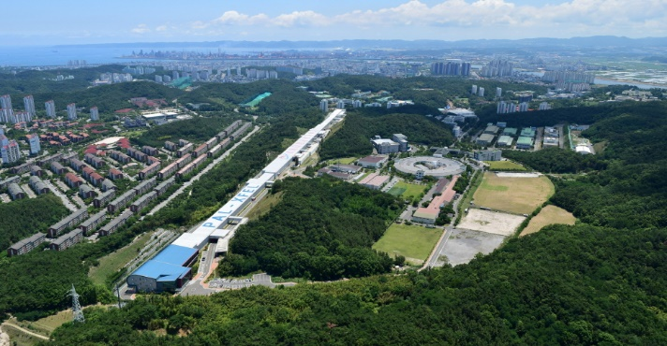
Low Emittance Rings Workshop 2024
Thank you for your attention

