Slide 1




Transient superhydrophilic surface modification of polyimide by metal ion beam irradiation
Sunmog Yeo
2024. 11. 14
Langmuir (2024) 40, 12200-12206
Korea Atomic Energy Research Institute (KAERI)

Slide 2

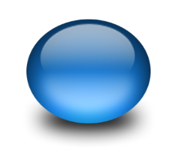
Contents
1
1
Background
2
Experimental set up
3
Results and discussion
4
Summary

Slide 3
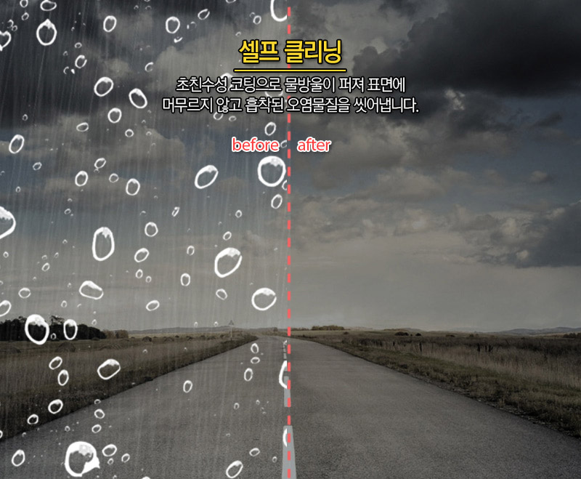

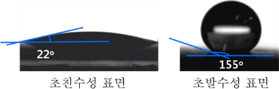
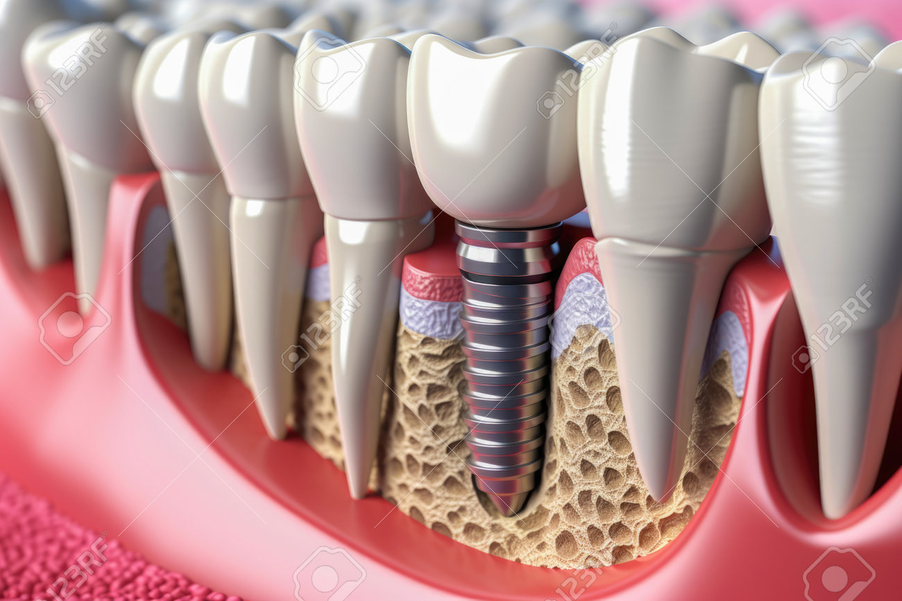
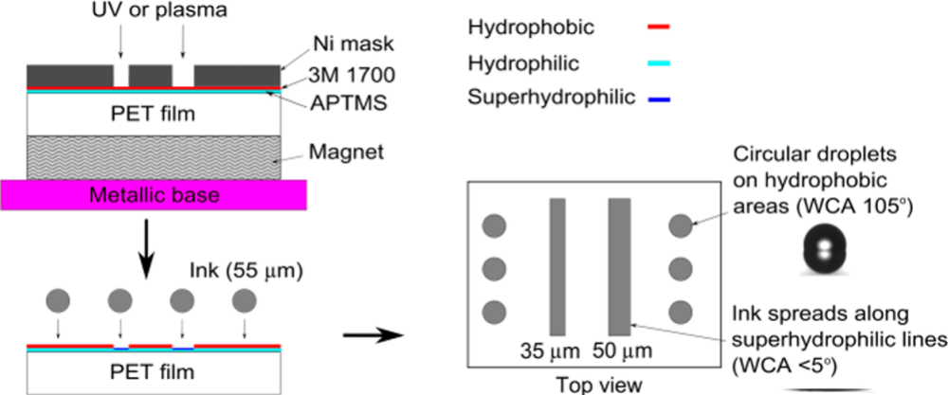
Background
@ Superhydrophilic surface
Superhydrophilic
Superhydrophobic
Superhydrophilic application
1) Self-Cleaning
2) Anti-fogging
3) Biomedical Application : implant materials
Funshop 제공
4) Ink printing
…. etc
ACS applied Materials and Interface. Vol 6 (2014) 4011
Patterned surface with controllable wettability for inkjet printing of flexible printed electronics
Notes:
열교환효율 향상 → 쿨링시스템 적용,

Slide 4
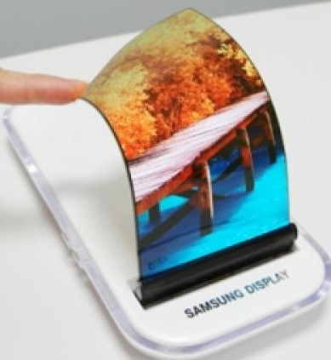
Background
@ Flexible display panel substrate
Necessary condition for the flexible display substrate
Flexibility and durability
Excellent dimensional stability (humidity, temperature)
Lightweight
Transparency and optical properties (reflectivity, refractivity)
Electrical properties (Insulator, low permittivity)
Thermal stability (low thermal expansion coefficient)
Chemical stability (resistance for harsh chemical process)
etc..
What are the good canditators?
Polyimide (PI), Polyethylene Terephthalate (PET),
Polycarbonate (PC), Polymethyl methacrylate (PMMA)
Notes:
열교환효율 향상 → 쿨링시스템 적용,

Slide 5
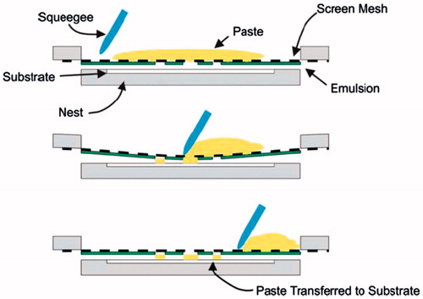
Background
@ Electrode formation processes on the flexible display substrate
PVD (Physicial Vapor Deposition) : E-Beam evaporation, sputtering
CVD (Chemical Vapor Deposition)
Inkjet printing, Screen Printing
(Cheap, easy → Industrial application)
etc..
In order to enhance adhesion between substrates and ink (or paste), surface treatments should be done, especially, superhydrophilic surface treatments.
Notes:
열교환효율 향상 → 쿨링시스템 적용,

Slide 6
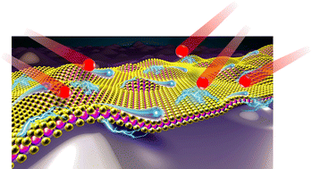
Background
@ Motivation
  In order to make superhydrophilic surface of polyimide, various surface treatments have been applied such as chemical treatments, plasma treatments, etc.
  The chemical treatments, however, produces a lot of detrimental wastes to the environment.
  Surface treatments by Ion beam irradiation are environmental friendly tools and generate no detrimental wastes
  Is there anyway to achieve superhydrophilic surface without detrimental wastes?

Slide 7
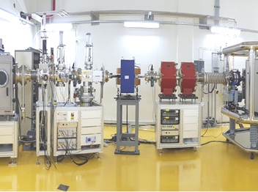
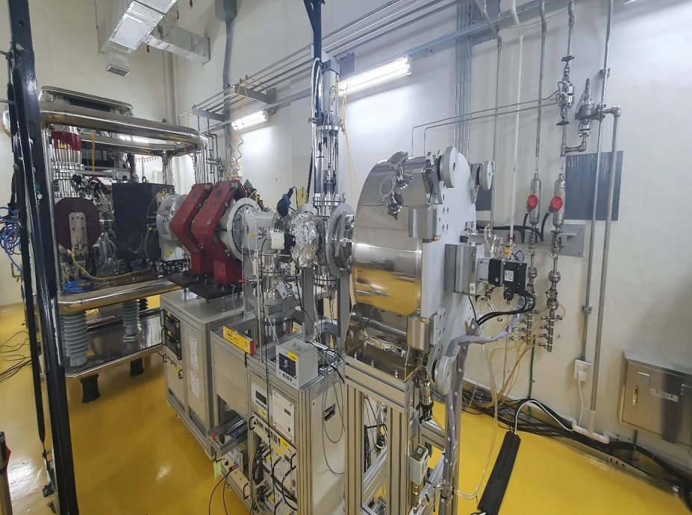
Experimental set up
@ Ion implanter operated by KAERI (Korea Atomic Energy Research Institute)
Gas implanter
Ion source : DuoPIGatron
Energy range : 20 ~ 200 keV
Ion species : H⁺, He⁺, N⁺, O⁺, Ne⁺, Ar⁺, Kr⁺, etc.
Metal implanter
Ion source : Bernas type ion source
Energy range : 20 ~ 150 keV
Ion species : Mg⁺, Ti⁺, Cr⁺, Fe⁺, Co⁺, Ni, Cu⁺, etc.
양성자과학연구단 홈페이지 : www.komac.re.kr

Slide 8
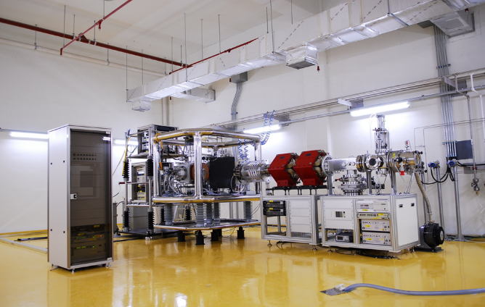
Experimental set up
Metal ion implanter
Mass separation
magnet
Scanner
Target
Chamber
MQD
Energy : 20 ~ 140 keV
Peak current : ~ 1 mA
Irradiation area : ~ 100 mm-φ
Possible ion species :
Co, Fe, Cu, Cr, Mg, Ti, Ag etc
Burnace
ion source
Faraday cup
Acceleration
tube

Slide 9
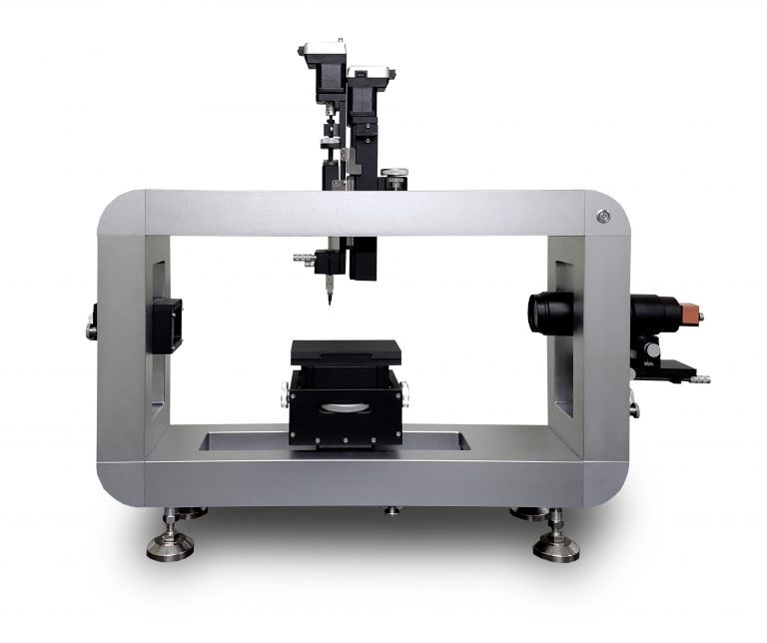
Experimental set up
@ Contact angle Measurement
For the contact angle measurements, we used a drop of water.
SEO (Model : Phonix-MTT)

Slide 10
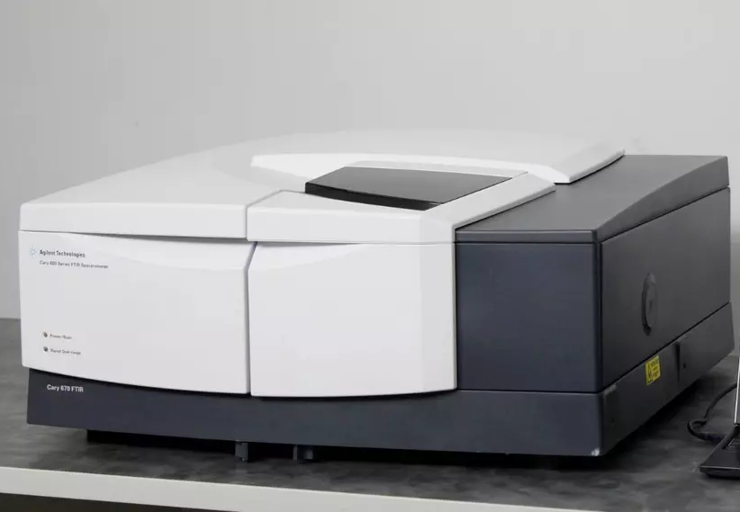
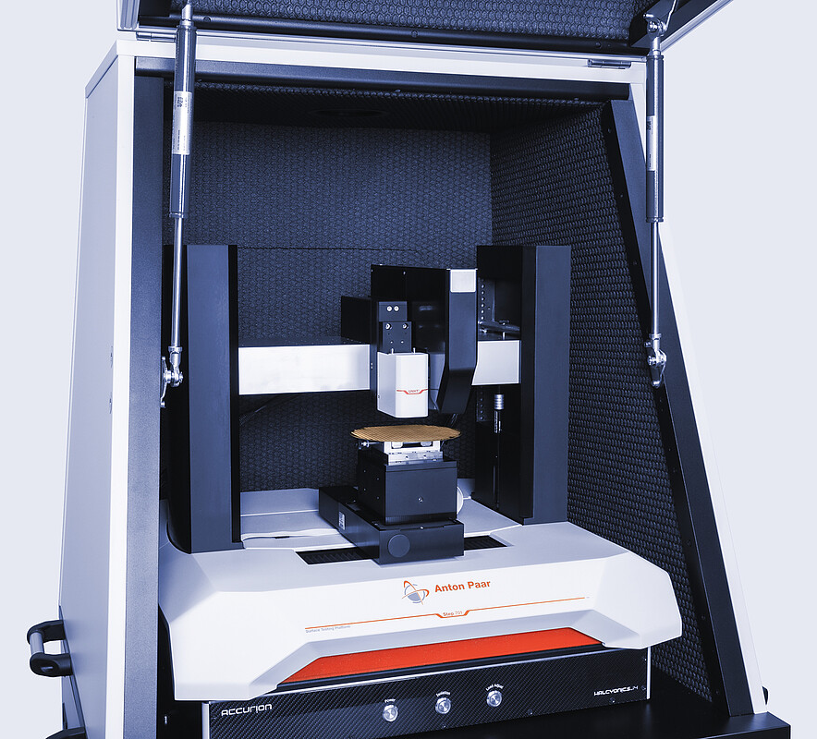
Experimental set up
@ Surface analysis equipment
FTIR
Agilent (Model : Cary 660 IR)
Surface bonding characterization
Nano-indenter
CPX-UNHT
Surface hardness, elastic modulus
Surface morphology → AFM

Slide 11
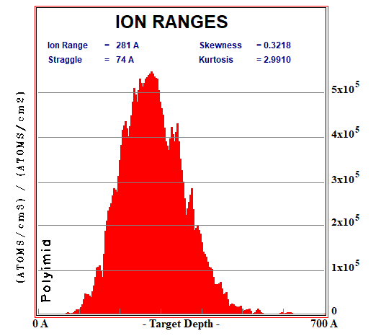
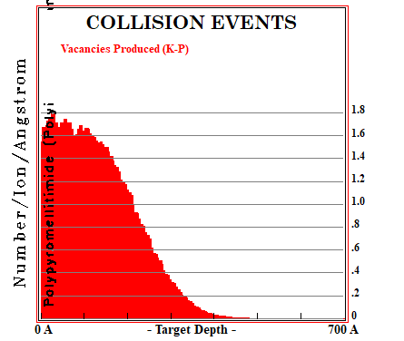
Results and discussion
@ SRIM simulation for metal ion beam irradiation (Cu⁺, Ti⁺)
Ion beam irradiation condition
Energy : 20 keV
Ion species : Cu⁺

Slide 12
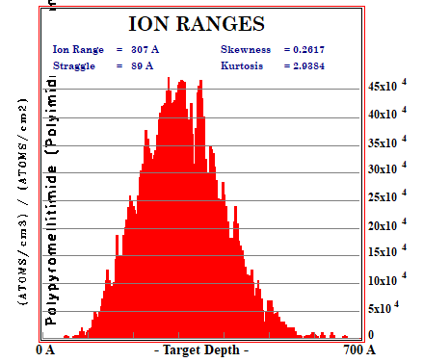
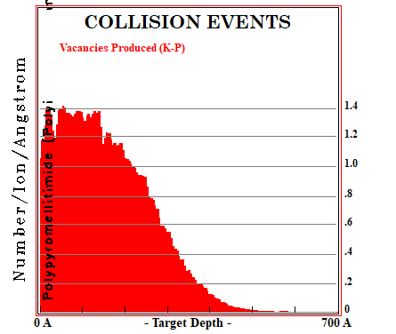
Results and discussion
@ SRIM simulation for metal ion beam irradiation (Cu⁺, Ti⁺)
Ion beam irradiation condition
Energy : 20 keV
Ion species : Ti⁺

Slide 13
Results and discussion
@ Surface morphology change by metal ion beam irradiation (Cu⁺)
Change ion beam current density
(a)
Pristine
(b)
0.5 μA/cm²
(c)
1.5 μA/cm²
(d)
2.0 μA/cm²

Slide 14
Results and discussion
@ Surface morphology change by metal ion beam irradiation (Ti⁺)
Change ion beam current density
(a)
0.3 μA/cm²
(b)
0.5 μA/cm²
(c)
0.7 μA/cm²
(d)
0.9 μA/cm²

Slide 15
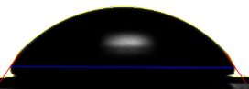
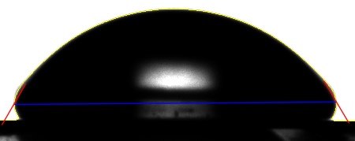
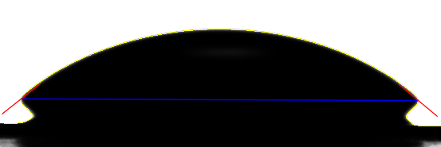
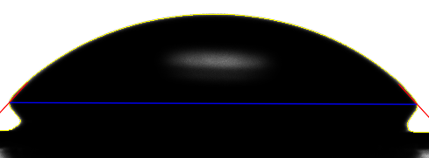
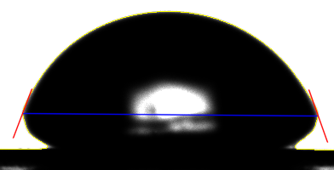
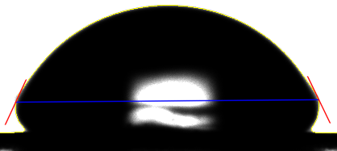
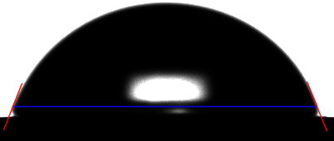
Results and discussion
@ Contact angle change by metal ion beam irradiation (Cu⁺)
Pristine PI
56.9º
current density : 0.5 μA/cm².
4 min : 38.3º
6 min : 47.3º
12 min : 60.8º
60 min : 65.7º
3 h: 70.2º
8 day : 71.3º

Slide 16
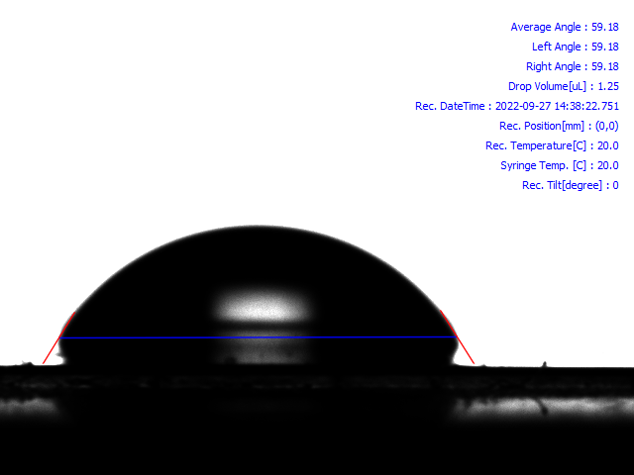
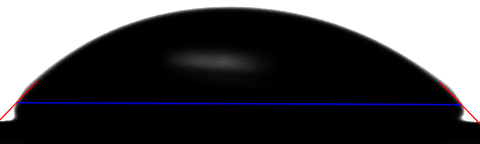
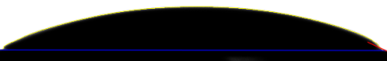
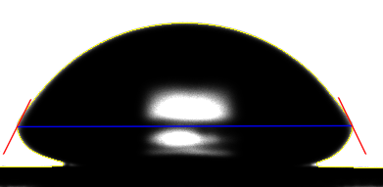
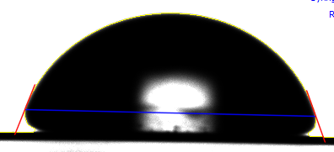
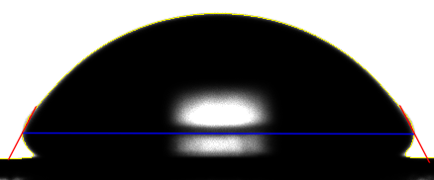
Results and discussion
@ Contact angle change by metal ion beam irradiation (Cu⁺)
Pristine PI
56.9º
current density : 1.0 μA/cm².
4 min : 23.4º
6 min : 46.4º
16 min : 59.1º
60 min : 63.6º
1 day : 64.5º
8 day : 70.6º

Slide 17
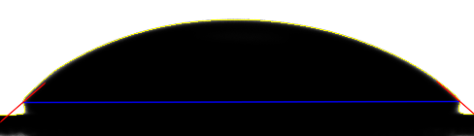
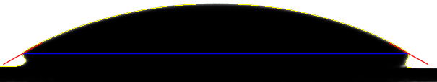
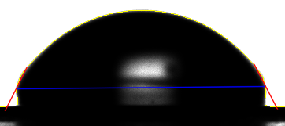
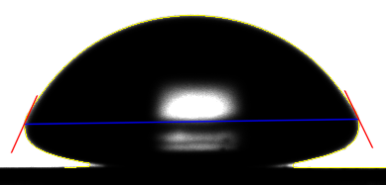
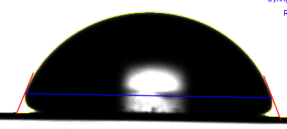
Results and discussion
@ Contact angle change by metal ion beam irradiation (Cu⁺)
Pristine PI
56.9º
current density : 1.5 μA/cm².
4 min : 22.8º
6 min : 40.6º
16 min : 59.1º
3 h : 64.4º
1 day : 66.2º
8 day : 69.7º

Slide 18
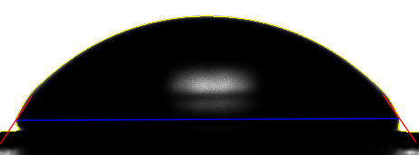
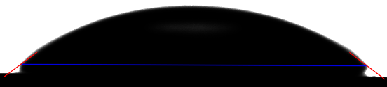
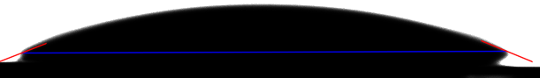
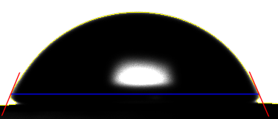
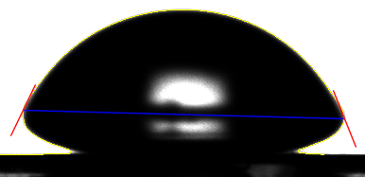
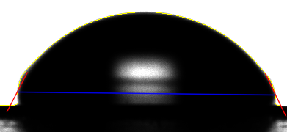
Results and discussion
@ Contact angle change by metal ion beam irradiation (Cu⁺)
Pristine PI
56.9º
current density : 2.0 μA/cm².
4 min : 20.5º
6 min : 37.1º
16 min : 57.1º
3 h : 64.0º
1 day : 66.2º
8 day : 67.3º

Slide 19
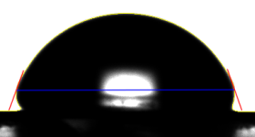
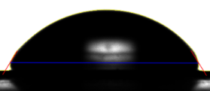
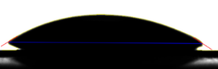
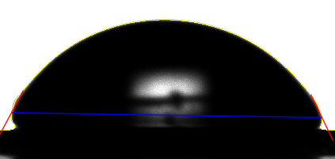
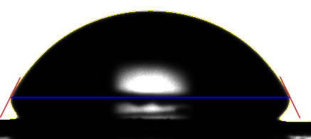
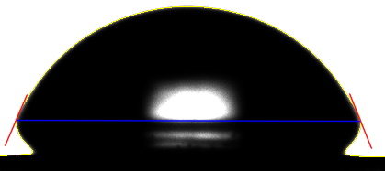
Results and discussion
@ Contact angle change by metal ion beam irradiation (Ti⁺)
Pristine PI
56.9º
current density : 1.3 μA/cm².
5 min : 30.98º
12 min : 58.88º
30 min : 70.73º
0.5 μA/cm²: 64.1 º
0.7 μA/cm² : 64.6 º
0.9 μA/cm² : 68.7 º

Slide 20
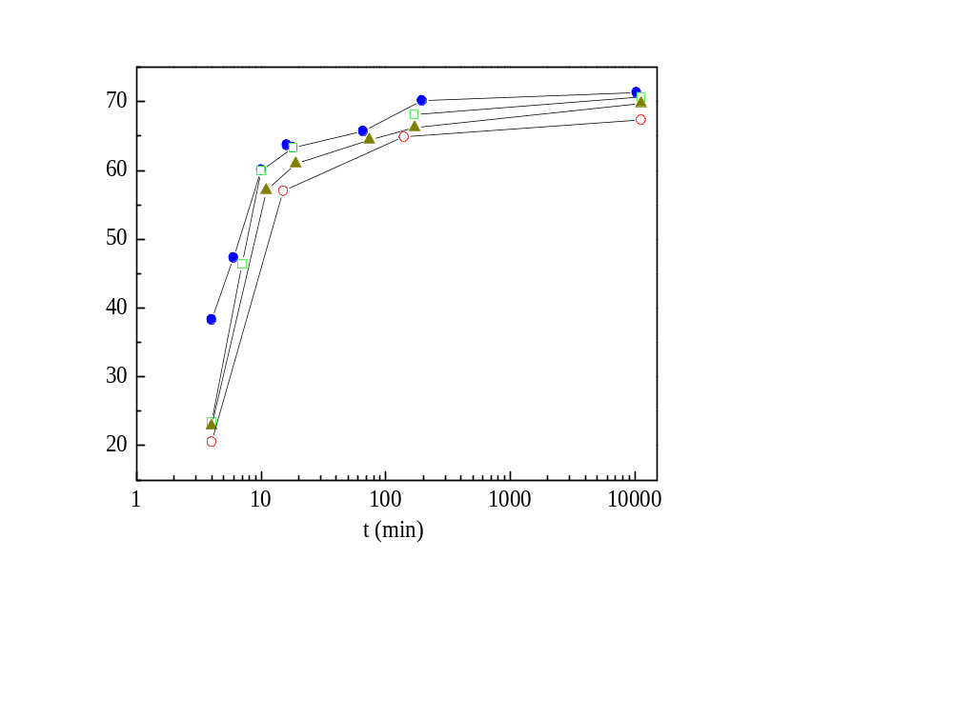
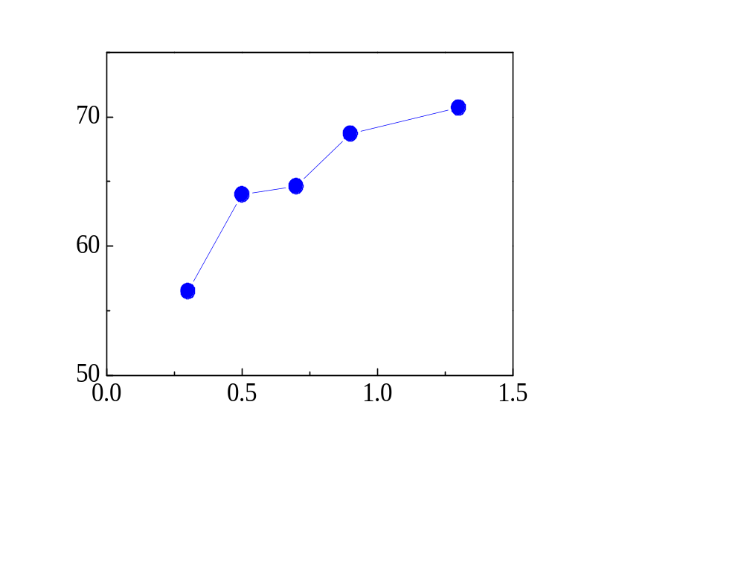


Results and discussion
@ Contact angle change by metal ion beam irradiation (Ti⁺)
Cu irradiation
● 0.5 μA/cm²
□ 1.0 μA/cm²
▲ 1.5 μA/cm²
○ 2.0 μA/cm²
Long time after Ti irradiation
Contact Angle (◦)
Contact Angle (◦)
Current density(μA/cm²)

Slide 21

Results and discussion
@ Mechanical properties by metal ion beam irradiation
Triangle : Cu
Circle : Ti.
Surface Hardness (GPa)
Elastic Modulus (GPa)
Current density(μA/cm²)

Slide 22


Result and discussion
Absorbance FTIR Spectrum for polyimide
C=O
Symmetric stretching
C-N
Stretching
Cu 20 keV
J = 0.5 μA/cm²
2 min
4 min
6 min
8 min
12 min
2 min
4 min
6 min
8 min
12 min
Large absorbance indicates that the specific bonds exists a lot in the materials.
For J = 0.5 μA/cm², 2 min after irradiation displays the lower absorbance suggesting that the amount of C=O symmetric stretching bonds are small.
In other words, C=O bonds at 1720 cm⁻¹ are restored by time.

Slide 23


Results and discussion
@ FTIR spectrum analysis
Cu 20 keV
J = 2.0 μA/cm²
C=O
Symmetric stretching
C-N
Stretching
2 min
4 min
6 min
8 min
12 min
pristine
Absorbance peaks indicate the presence of corresponding vibration modes in materials.
Metal ion beam breaks some C=O symmetric stretching mode and C-N stretching mode.
The incomplete bonds cause the high surface energy which arise superhydrophilic surface.
Absorbance (a. u)
Absorbance (a. u)
Wavenumber (cm⁻¹)

Slide 24
Summary
Superhydrophilic surface is very useful to our lives.
Ion beam irradiation is an environmental friendly surface treatment tool so that the surface treatment for the polyimide is a good application materials.
By using ion beam irradiation, superhydrophilic surface of polyimide can be obtained.
The FTIR spectrum analysis reveals that ion beam irradiation produces high surface energy states by breaking C=O and C-N bond temporarily and the bonds are recovered after all.
Even though ion beam irradiation affects surface properties of polyimide, the mechanical properties of polyimide are similar.

Slide 25
Thank you for your attention !!

