Slide 1
Weekly Lab Meeting
20232308 Youngmin Park
2024-08-07

Slide 2
INDEX
01
USPAS
02
Wake
03
My Research
Overview
Hands on Training
Extra
Review
Wake field
Wake function
Wake potential
Convention
Summary
1 Page Overview

Slide 3
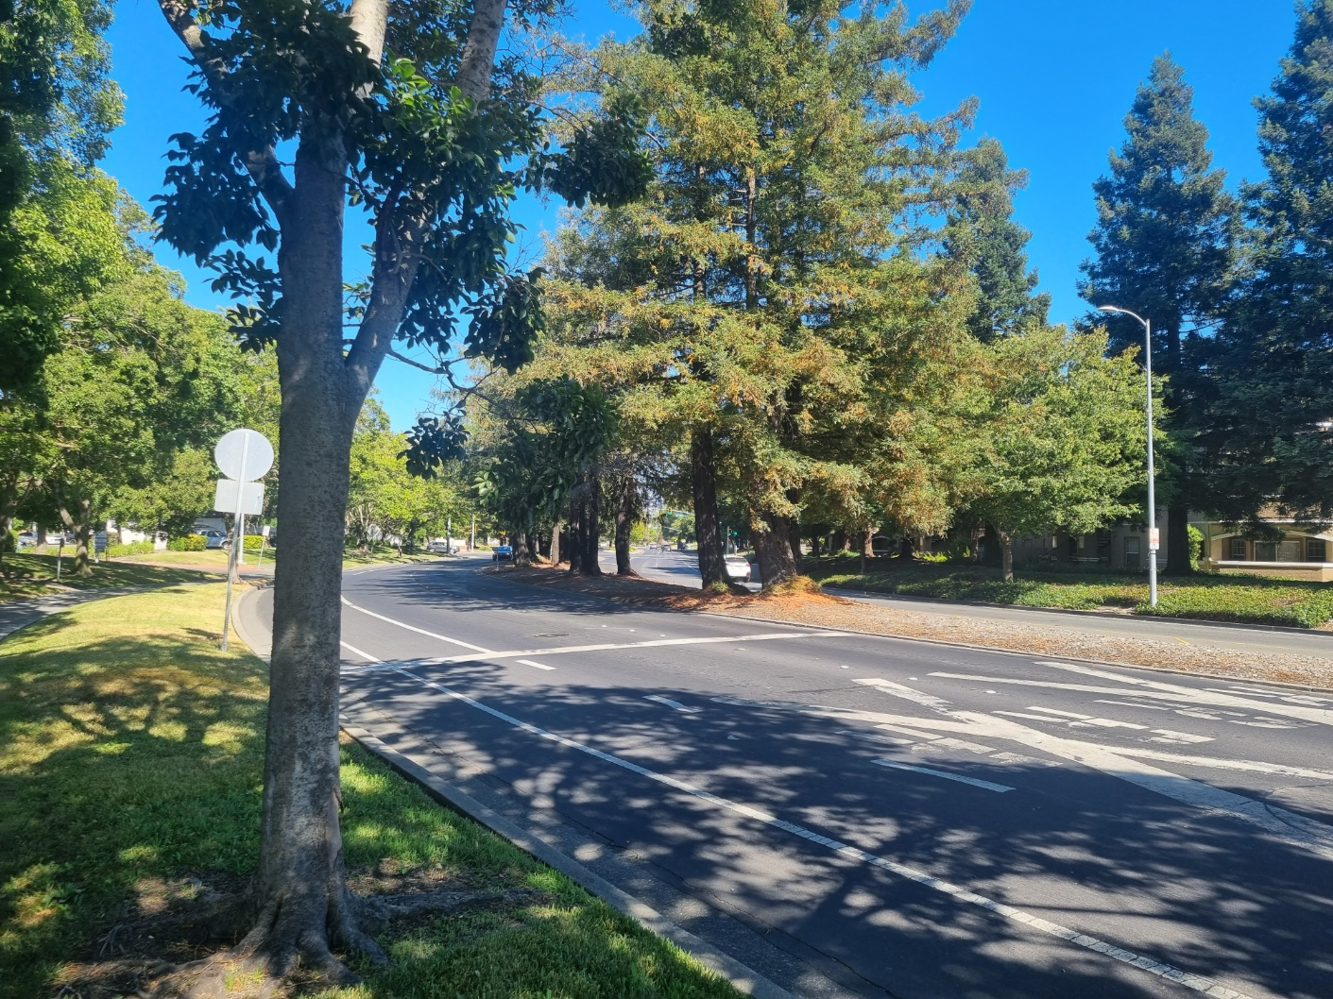
USPAS
Overview
Date: 2024.07.14(Sun)~2024.07.28(Sun)
Location: Sonoma County, California
Course: Fundamentals of Accelerator Physics and Technology with Simulations and Measurement lab
Grade: Hw. 35%-Labs. 35%-Final. 30%

Slide 4
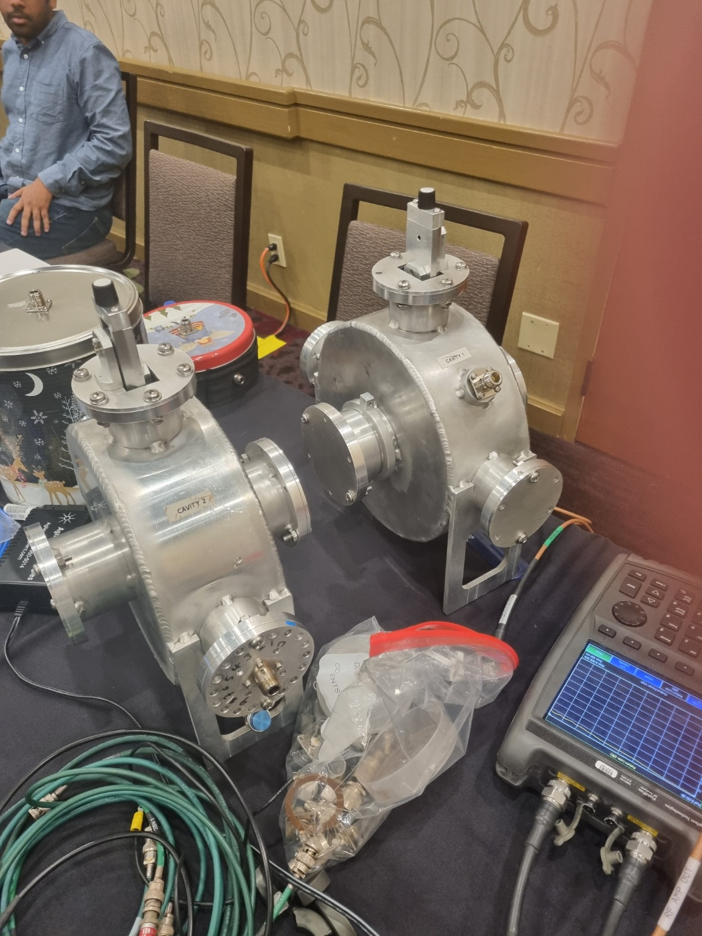
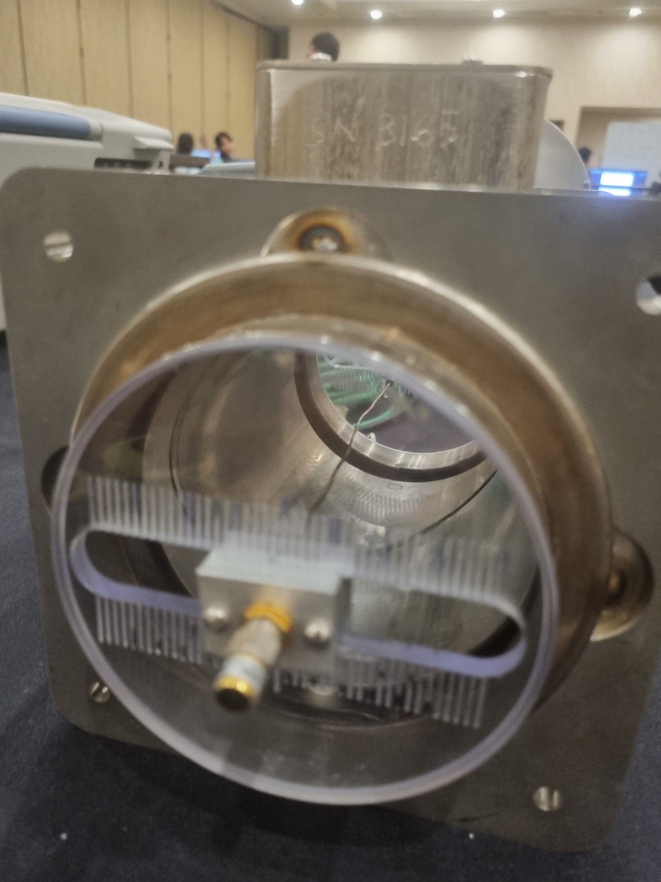
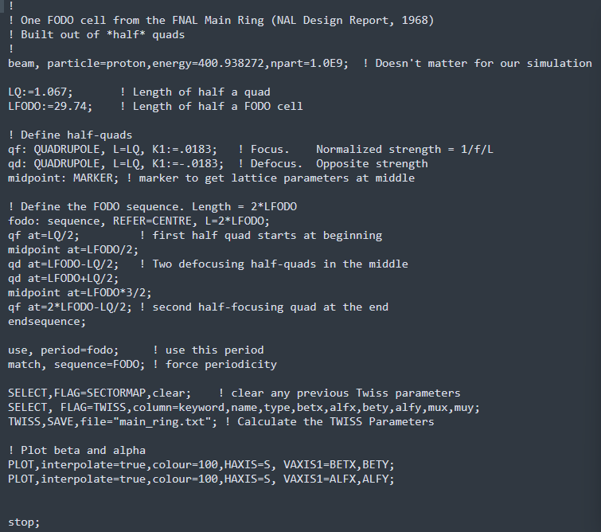
USPAS
Hands on Training
Measurements
Simulations
Dipole
Quadrupole
RF-Cavity
Instrumentation(Diagnostic)
Transverse Dynamics
Longitudinal Dynamics
Quadrupole Focusing
Off momentum particle
(+MAD-X)

Slide 5
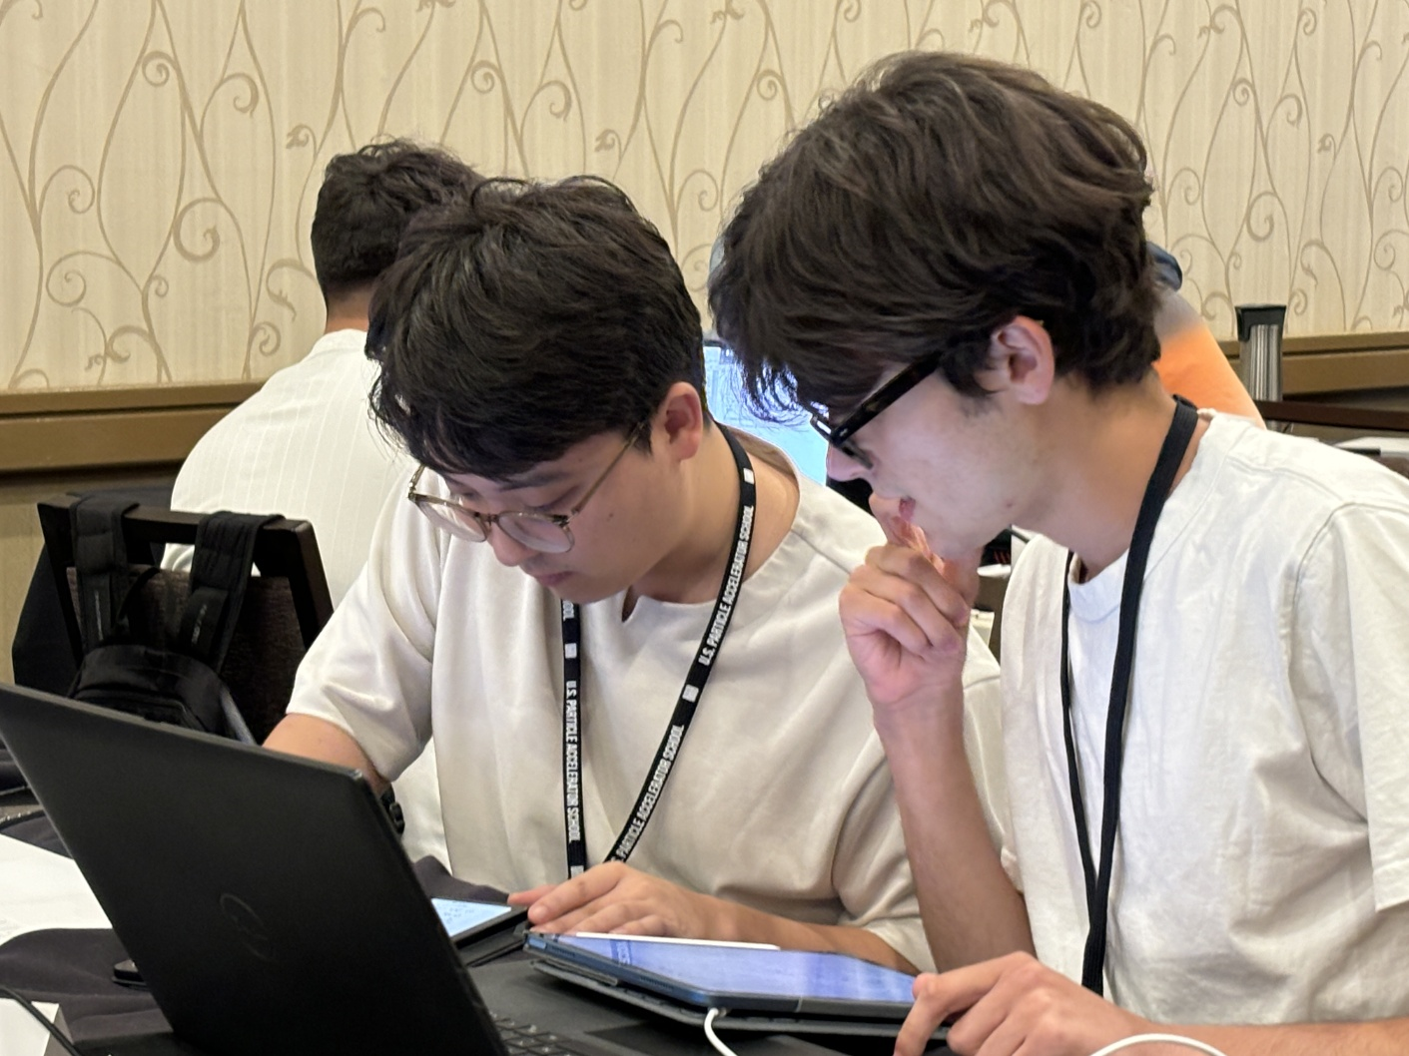
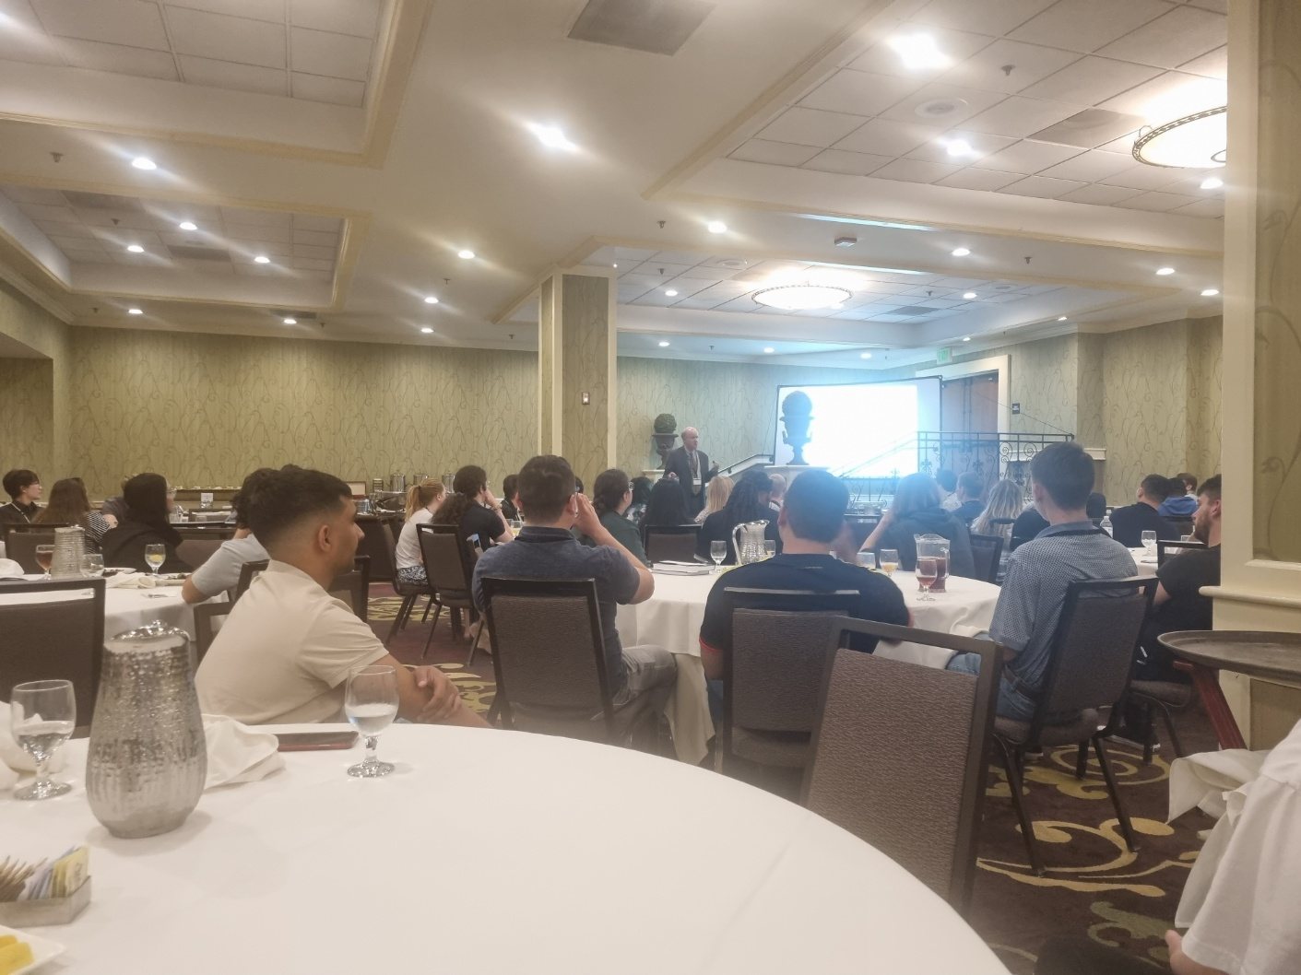
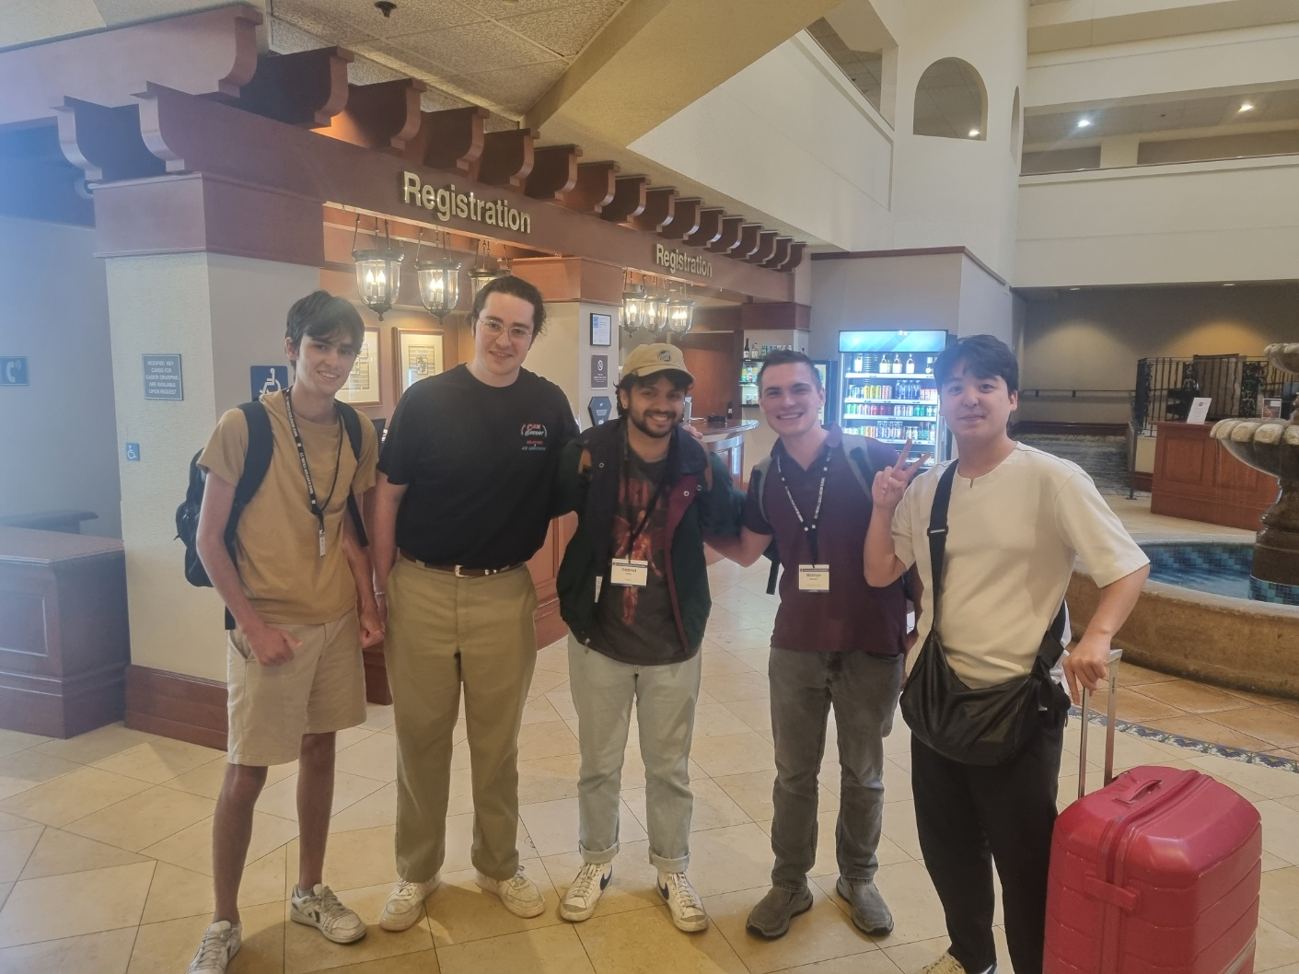
USPAS
Extra
Hw
Dinner
Make a friends

Slide 6
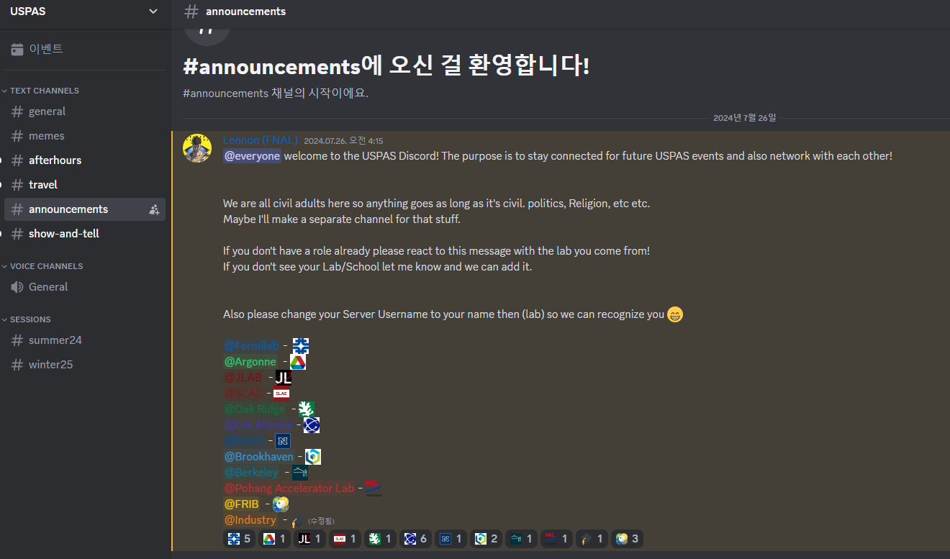
USPAS
Review
The combination of theoretical work with hands-on experiments and simulations in the lab has provided a valuable experience.
Interacting with people from various labs gave me the opportunity to learn not only about synchrotron but also about other types of accelerators such as colliders, proton accelerators and cyclotrons, thereby broadening my knowledge.
I believe this school will be very beneficial for students, and I would love to participate again if given the chance. I am especially interested in attending courses on RF-cavity or Collective effect, should they be available.

Slide 7
Wake
Wake field
Electro magnetic fields induced by the beam are refereed to as wake fields due to the fact that they are left mainly behind the traveling charge. – L.Palumbo, CERN. LNF-94/041
$$b$$
E&B
$$c$$
$$c$$
$$q$$
$$q_{front}$$

Slide 8
Wake
Wake field
Wake fields effects can be longitudinal or transverse
Longitudinal wakes(${\vec{E}}_{s}$) affect energy of beam particles or bunch distribution.
Transverse wakes(${\vec{E}}_{⊥}, {\vec{B}}_{⊥}$) affect beam particle’s transverse momentum.
$$y$$
Transverse force $q\left({\vec{E}}_{⊥}+c\left(\hat{s}×{\vec{B}}_{⊥}\right)\right)$
$$x$$
$$q$$
$$q_{front}$$
$$s$$
Longitudinal force $q{\vec{E}}_{s}$
Both wake fields significantly affect the stability of the beam and must always be considered!!

Slide 9
Wake
Wake function
The wake field is a function of $s$ and $t.$
It can be simply represented using the combined variable $z=s−ct$.
$z$represents the distance from the leading particle.
$$b$$
$$E_{1}\left(s_{1},t\right)$$
$$E_{2}\left(s_{2},t\right)$$
$$ct_{1}$$
$$ct_{2}$$
$$c$$
$$c$$
$$q$$
$$q_{front}$$
$$ΔU\left(z\right)=q\int_{−\frac{L}{2}}^{\frac{L}{2}}{E_{s}\left(s,t=\frac{s−z}{c}\right)ds}$$
$ΔU\left(z\right)$ is the energy gained by the trailing particle, which is a distance $z$ away from the leading particle, while passing through a structure of length $L$.
$$W_{∥}\left(z\right)=−\frac{ΔU\left(z\right)}{qq_{front}}=−\frac{1}{q_{front}}\int_{−\frac{L}{2}}^{\frac{L}{2}}{E_{s}\left(s,t=\frac{s−z}{c}\right)ds}$$

Slide 10
Wake
Wake function
The same calculation can be performed in the transverse direction as well.
$$\vec{M}\left(z\right)=q\int_{−\frac{L}{2}}^{\frac{L}{2}}{\left({\vec{E}}_{⊥}\left(s,t\right)+c\left(\hat{s}×{\vec{B}}_{⊥}(s,t)\right)\right)ds}$$
$\vec{M}\left(z\right)$is the transverse momentum kick by the trailing particle, which is a distance $z$ away from the leading particle, while passing through a structure of length $L$.
Both wake functions become zero for $z>0$ due to causality. (only the super-relativistic case)
$$W_{⊥}\left(z\right)=−\frac{Δ\vec{M}\left(z\right)}{qq_{front}}=−\frac{1}{q_{front}}\int_{−\frac{L}{2}}^{\frac{L}{2}}{\left({\vec{E}}_{⊥}\left(s,t\right)+c\left(\hat{s}×{\vec{B}}_{⊥}(s,t)\right)\right)ds}$$

Slide 11
Wake
Wake potential
Generally, an electron bunch has a finite distribution rather than being a point charge, and the potential experienced by a trailing particle is represented as a convolution with this distribution.
$$b$$
$$λ\left(z\right)$$
$$c$$
$$c$$
$$q$$
$$q_{front}$$
$$𝒲_{∥}\left(z\right)=\frac{1}{q_{front}}\int_{z}^{∞}{λ\left(z′\right)W_{∥}\left(z−z′\right)dz′}$$
$$𝒲_{⊥}\left(z\right)=\frac{1}{q_{front}}\int_{z}^{∞}{λ\left(z^{′}\right)W_{⊥}\left(z−z^{′}\right)dz′}$$
$λ\left(z′\right)→q_{front}δ\left(z\right), 𝒲_{∥}\left(z\right)=W_{∥}\left(z\right)→$delta-function wake potential or Green’s function

Slide 12
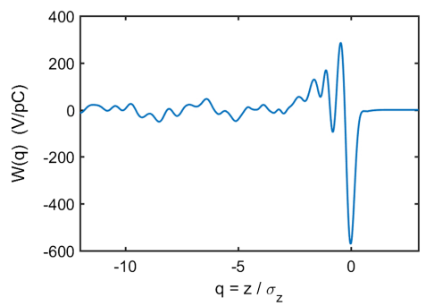
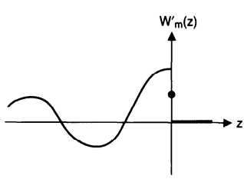
Wake
Convention
01
02
03
Zotter-Kheifets
L.Palumbo
K.Bane
A.Wolski
A.Chao
Simulation
Only sign changed
Causality changed
L.Palumbo,Wake Fields and Impedance, CERN. LNF-94/041
A.Chao, Physics of Collective Beam Instabilities in High Energy Accelerator, ISBN 0-471-55184-8
R.Warnock,Numerical solution of the Haissinski equation for the equilibrium state of a stored electron beam, PRAB 21,(2018).

Slide 13
Wake
Convention
Zotter-Kheifets
A.Chao
$W^{∥}\left(z\right)=0$ if $z>0$
$W^{∥}\left(z\right)=0$ if $z<0$
$$Z^{∥}\left(ω\right)=\int_{−∞}^{∞}{\frac{dz}{c}W^{∥}\left(z\right)e^{−\frac{iωz}{c}}}$$
$$W^{∥}\left(z\right)=\frac{1}{2π}\int_{−∞}^{∞}{dω}Z^{∥}\left(ω\right)e^{\frac{iωz}{c}}$$
$$Z^{∥}\left(ω\right)=\int_{−∞}^{∞}{\frac{dz}{c}W^{∥}\left(z\right)e^{−\frac{iωz}{c}}}$$
$$W^{∥}\left(z\right)=\frac{1}{2π}\int_{−∞}^{∞}{dω}Z^{∥}\left(ω\right)e^{\frac{iωz}{c}}$$
$$ReZ^{∥}\left(ω\right)=−\frac{1}{π}P.V. \int_{−∞}^{∞}{dω^{′}\frac{ImZ^{∥}\left(ω\right)}{ω−ω^{′}}}$$
$$ImZ^{∥}\left(ω\right)=\frac{1}{π}P.V. \int_{−∞}^{∞}{dω^{′}\frac{ReZ^{∥}\left(ω\right)}{ω−ω^{′}}}$$
$$ReZ^{∥}\left(ω\right)=\frac{1}{π}P.V. \int_{−∞}^{∞}{dω^{′}\frac{ImZ^{∥}\left(ω\right)}{ω−ω^{′}}}$$
$$ImZ^{∥}\left(ω\right)=−\frac{1}{π}P.V. \int_{−∞}^{∞}{dω^{′}\frac{ReZ^{∥}\left(ω\right)}{ω−ω^{′}}}$$
Ex) RLC Resonator
$$Z^{∥}\left(ω\right)=\frac{R_{s}}{1+iQ\left(\frac{ω}{ω_{r}}−\frac{ω_{r}}{ω}\right)}$$
$$Z^{∥}\left(ω\right)=\frac{R_{s}}{1+iQ\left(\frac{ω_{r}}{ω}−\frac{ω}{ω_{r}}\right)}$$

Slide 14
Wake
Summary
The definition of the wake function can vary between books and papers.
The sign of wake functions can change depending on whether energy is lost or gained.
The Causality of wake functions can change depending on whether the distance is considered positive or negative.
If causality changes, the relationship with transform of the impedance will also changed. This ultimately affects the sign of the imaginary part of the impedance.
Different notations are used for wake functions and wake potential:
Some books use “wake potential” instead of “wake function” (e.g., K. Bane.)
In some cases, “wake potential” refers to the energy without dividing by the charge(e.g., A.Chao, A.Wolski)
Other papers refer to “wake potential” as “bunch-wake potential” (e.g., Demin Zhou, Theories derived from Haissinski equation and their applications to electron storage rings)
Many different notations are currently in use.

Slide 15
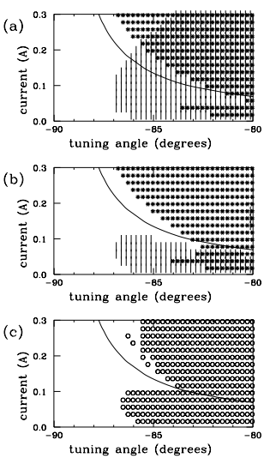
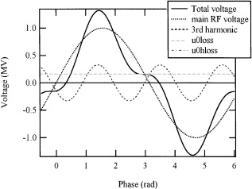
My Research
Robinson instability with 3rd Harmonic Cavity
Robinson instability: The phenomenon of damping or growth in the longitudinal direction due to the wake field generated by the beam from the previous turn passes through the RF-cavity.
$$Ω−ω_{s}=−i\frac{Nr_{0}η}{2γT_{0}^{2}ω_{s}}\left[\sum_{p=−∞}^{∞}{pω_{0}Z^{∥}\left(pω_{0}\right)−\left(pω_{0}+ω_{s}\right)Z^{∥}\left(pω_{0}+ω_{s}\right)}\right]$$
$$ω_{s}→synchrotron frequency, N→number of particles, r_{0}→classical radius of electron,$$
$$γ=lorentz factor, η→slippage factor, T_{0}→revoltuion period, ω_{0}→revolution frequency.$$
RA Bosch, “Robinson instability with a Higher-Harmonic Cavity”, PARB,(2001)

Slide 16
Thank you!
I’m really happy to work with you!!

