Slide 1
How to Apply for Long-term Stay in PAL
Minseo Jeong

Slide 2
Index
Apply for long-term stay
Apply for access to controlled area in PAL

Slide 3
Apply for Long-term Stay in PAL
Submit long-term stay approval request and required documents(memo, certificate of enrollment) to person in charge of lab
-Ask Yuri Kim in PAL general affairs & human resources team for the forms of long-term stay approval request and memo
-Term of long-term stay is at most a year
Ask administration office of your major to send official document for dispatch student
-When you send an e-mail to administration office, you need to specify your name, academic advisor, and your purpose for long-term stay

Slide 4
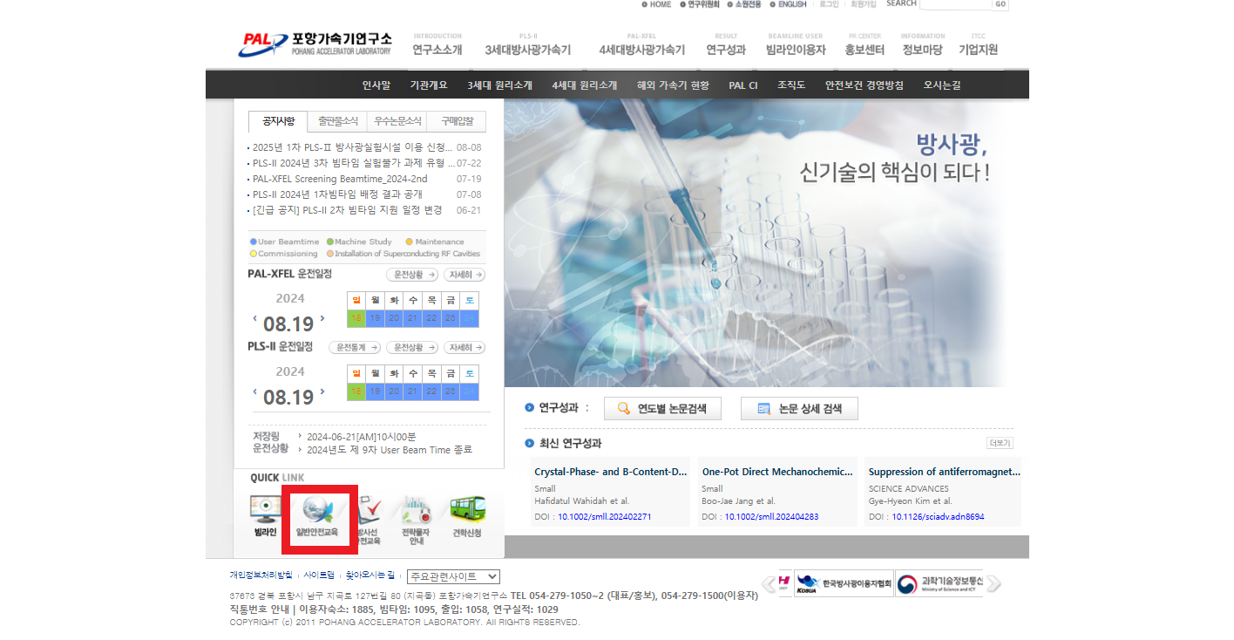
Apply for Long-term Stay in PAL
After approval of long-term stay, you must take laboratory ordinary safety education in PAL homepage(https://pal.postech.ac.kr/)
Submit certificate of laboratory safety education to the person in charge in PAL utility&safety team

Slide 5
Apply for Long-term Stay in PAL
Researchers of PAL should take laboratory safety education depending on their research field
-Can be replaced by submitting certificate of laboratory safety education of POSTECH

Slide 6
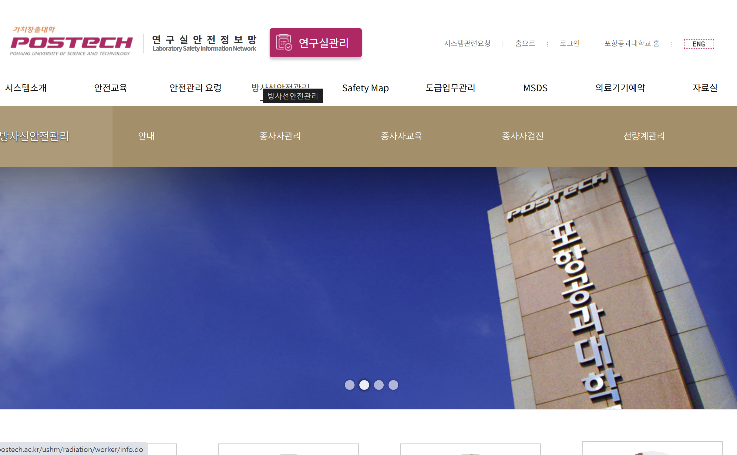
Registration for Radiation Worker in POSTECH
POSTECH laboratory safety information network (https://posafety.postech.ac.kr/ushm/main/home.do)
Radiation safety>Employee management>Application
After printing radiation worker application, you have to get signature of academic advisor and submit it to safety management

Slide 7
Registration for Radiation Worker in POSTECH -Medical Checkup
Receive medical checkup at the first floor of health improvement center in Pohang St.Mary’s Hospital
-Reception must be done before 4 p.m. on weekdays
-It takes 1~2 weeks to receive medical certificate
You must notify them that you came for “POSTECH radiation worker checkup”
Submit medical certificate to safety management

Slide 8
Registration for Radiation Worker in POSTECH -Safety Education
Basic education: Korea Foundation of Nuclear Safety (https://edu.kofons.or.kr/front/main/index.do)
Apply for education>
-offline education>type: basic education(radiation worker), new(ordinary)(new)
-e-learning>basic education>regular course (ordinary-3 hrs) (existing worker)
Click cancel for the payment>send email to safety management
>payment by safety management

Slide 9
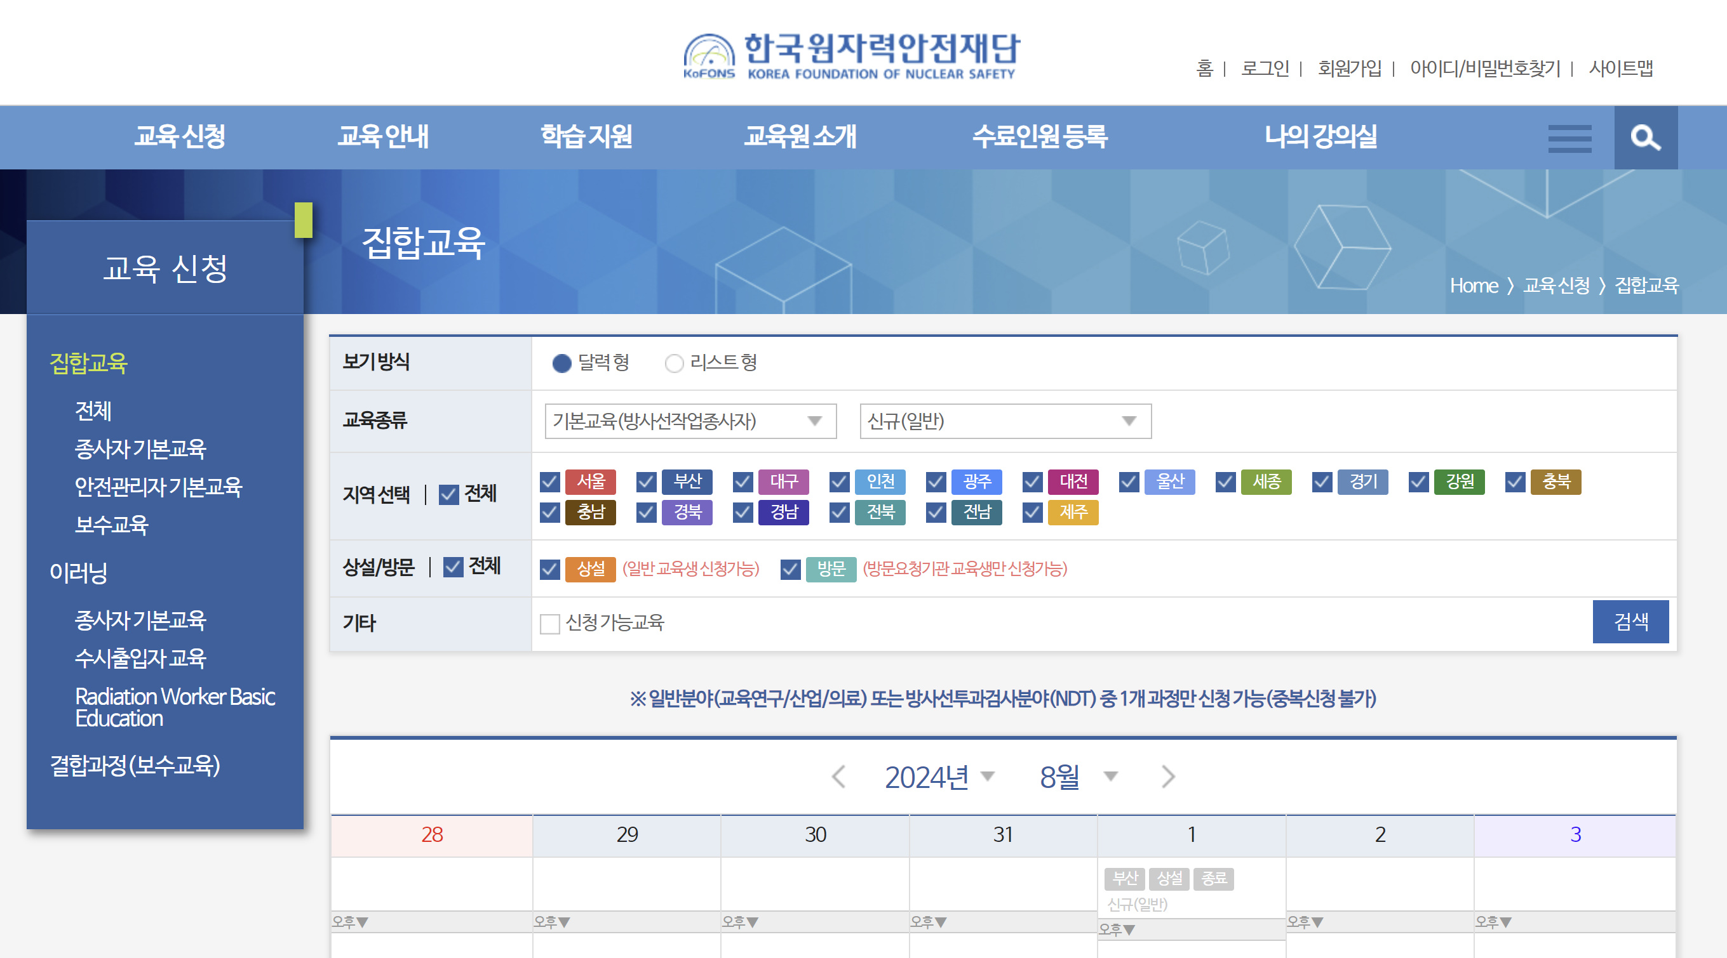
Registration for Radiation Worker in POSTECH -Safety Edutation
Application for basic education(New radiation worker)

Slide 10
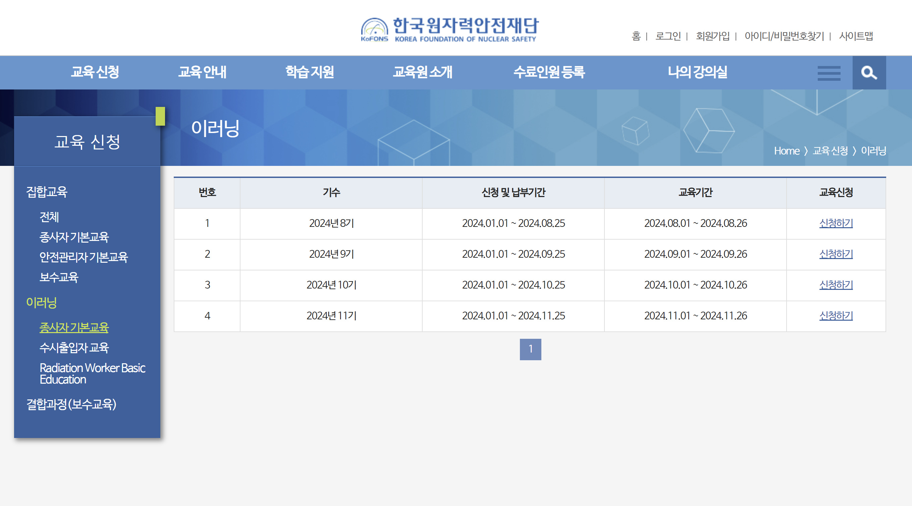
Registration for Radiation Worker in POSTECH -Safety Edutation
Application for basic education(Existing radiation worker)

Slide 11
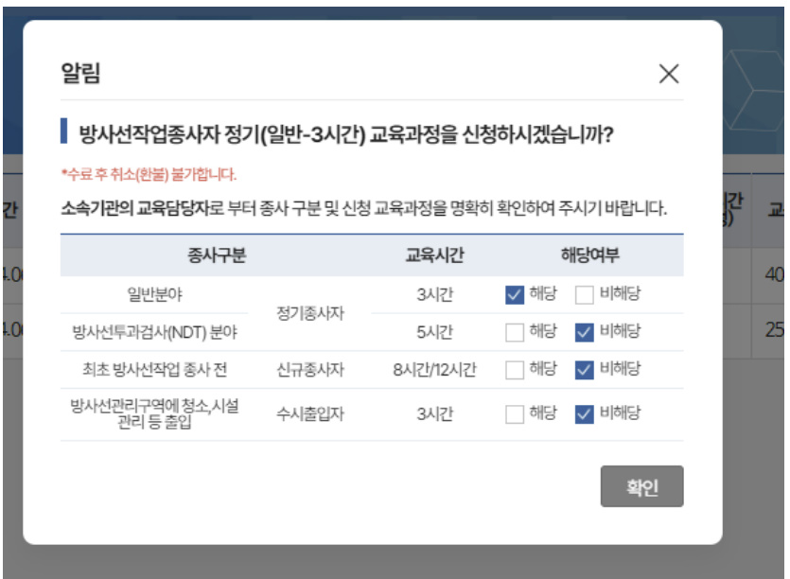
Registration for Radiation Worker in POSTECH -Safety Edutation
Application for basic education(Existing radiation worker)

Slide 12
Registration for Radiation Worker in POSTECH -Safety Edutation

Slide 13
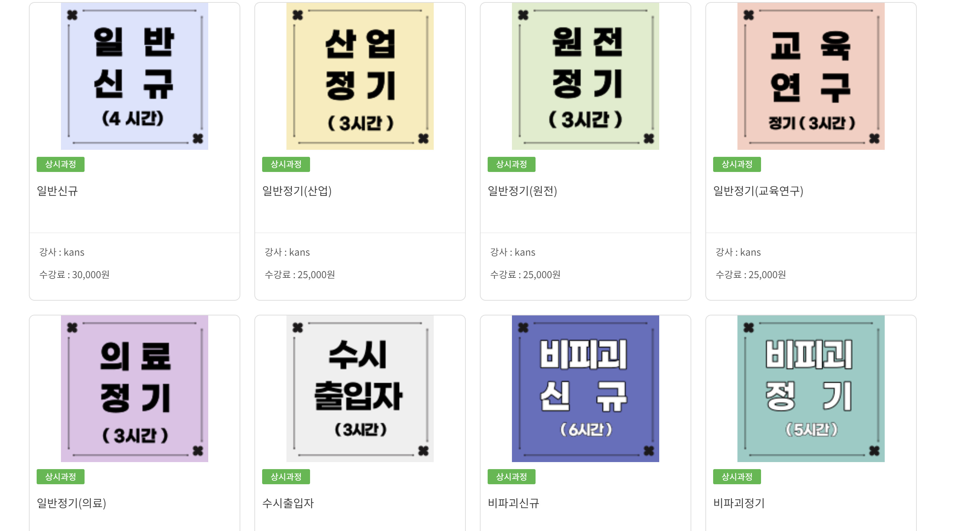
Registration for Radiation Worker in POSTECH -Safety Edutation
Office education: Korea association of nuclear ∙ radiation safety (https://www.kanselearning.kr/userMain/goUserMain?lang=ko)
New(new worker)/regular(education and research)(Existing worker)
Deposit without bankbook>progress to payment>send email to safety management>payment by safety management

Slide 14
Registration for Radiation Worker in POSTECH -Safety Edutation

Slide 15
Registration for Radiation Worker in POSTECH -Safety Edutation

Slide 16
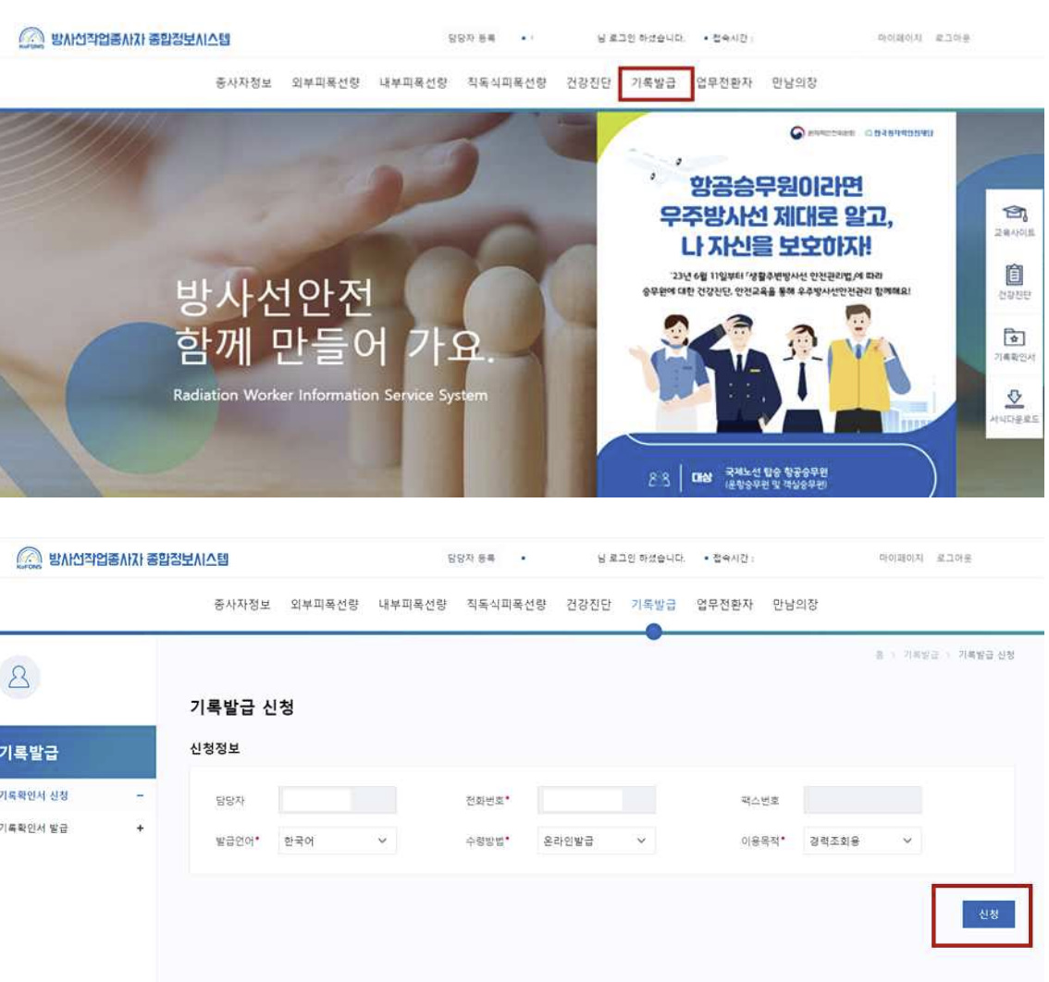
Registration for Radiation Worker in POSTECH –Record Confirmation(optional)
If you have registered as radiation worker before, you must submit radiation worker record confirmation to safety management
Radiation worker integrated information system (rawis.kofons.or.kr)>login>issue the record>For checking career

Slide 17
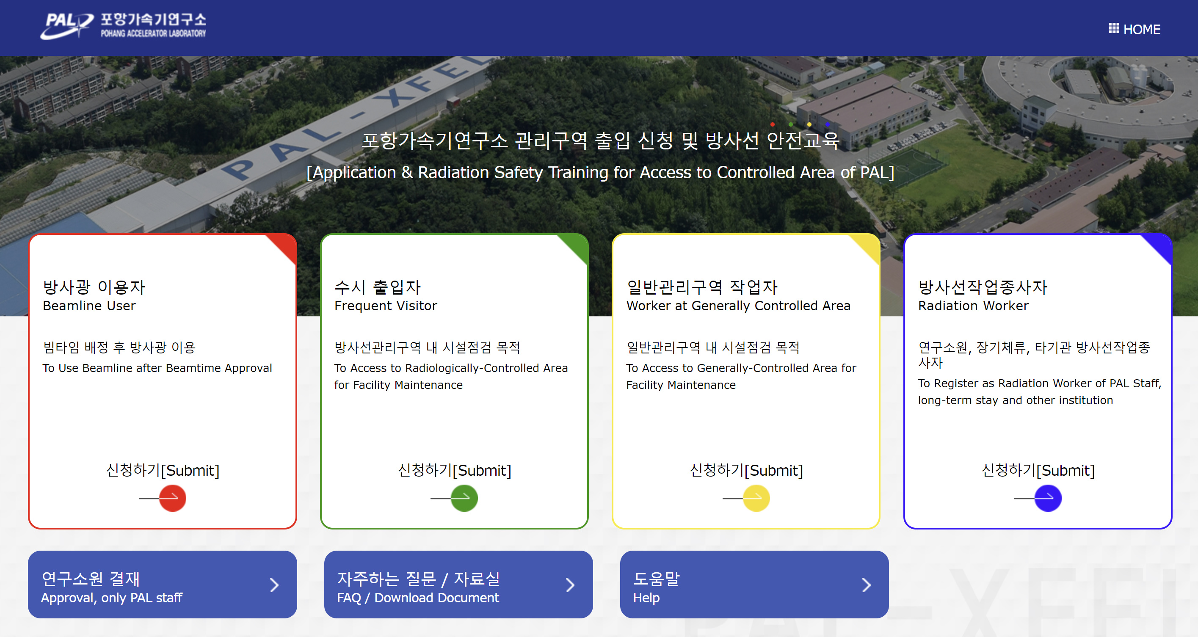
Registration for Radiation Worker in PAL
PAL registration/management for radiation worker system(https://rpt-pal.postech.ac.kr/)

Slide 18
Registration for Radiation Worker in PAL
Download the form: FAQ/Download Document>Download Document

Slide 19
Registration for Radiation Worker in PAL
Submit the certification to POSTECH safety management after filling it in>receive the certification after radiation safety supervisor and representative of safety management>send it by e-mail to Eunwoo Lee in PAL radiation protection team
Certification must be submitted 3 days before entrance to controlled area
You must submit your original certification when you receive the radiometer

Slide 20
Apply for Access to Controlled Area in PAL
PAL registration/management for radiation worker system(https://rpt-pal.postech.ac.kr/)

Slide 21
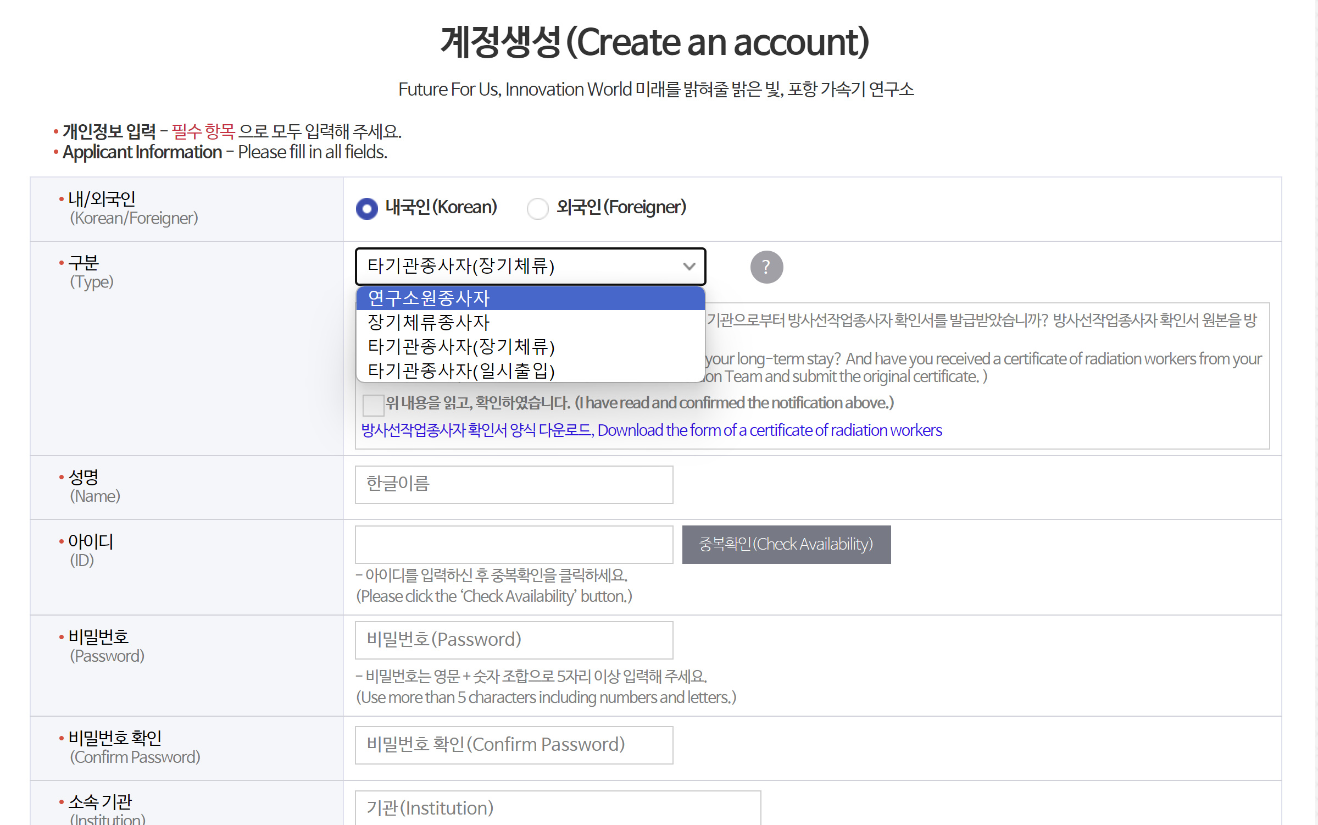
Apply for Access to Controlled Area in PAL
Choose “Worker from other institute(long-term stay) when creating your account

Slide 22
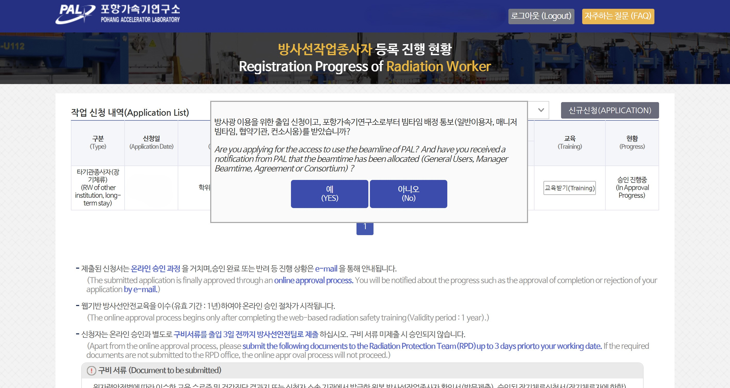
Apply for Access to Controlled Area in PAL
Apply for access to controlled area in PAL: Application>No

Slide 23
Apply for Access to Controlled Area in PAL

Slide 24
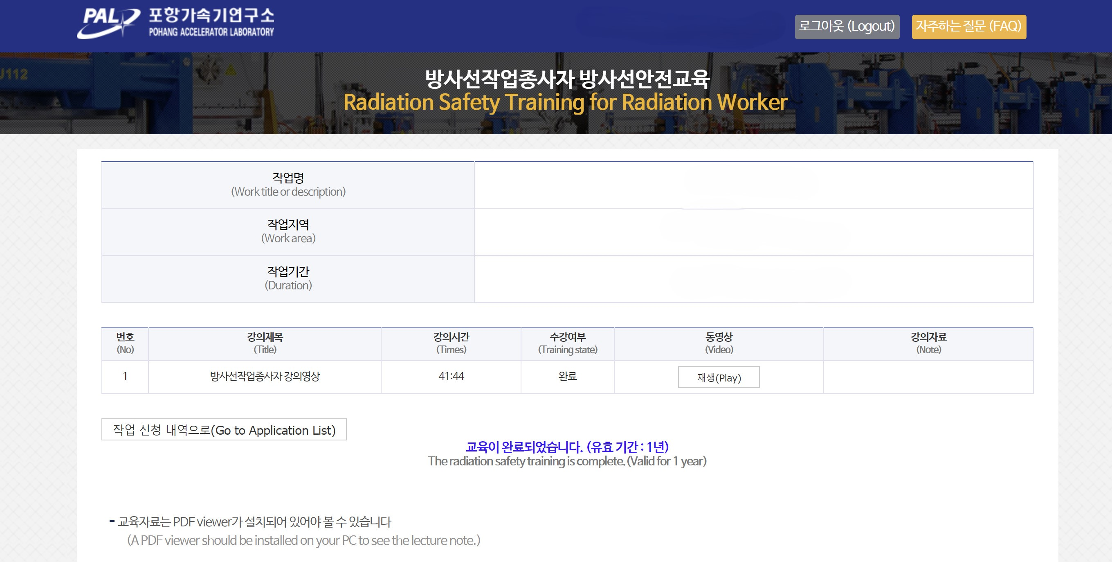
Apply for Access to Controlled Area in PAL
Application is finished after completing web-based radiation safety education

