Slide 1
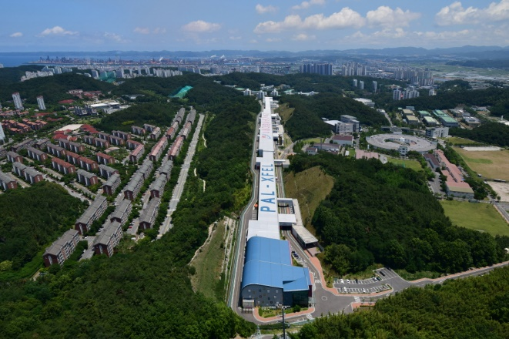
Collective effects in a diffraction-limited storage ring
Collective effects in a diffraction-limited storage ring
Jimin Seok
4GSR Beam Dynamics Group
Pohang Accelerator Laboratory, POSTECH
2024.10.25

Slide 2
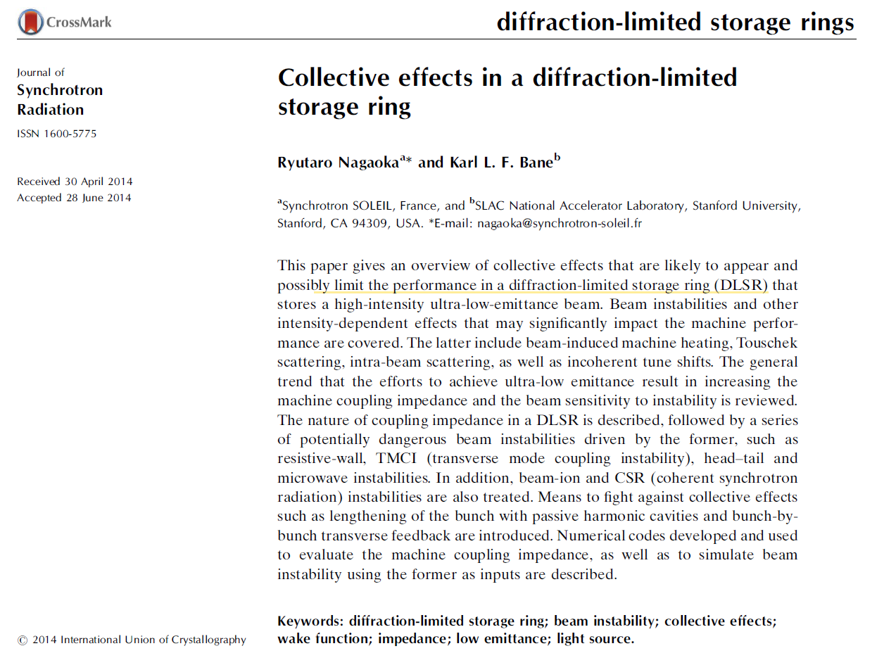
Collective effects in a diffraction-limited storage ring
Intro
Outline
Introduction
DLSRs and their links to collective effects
Coupling impedance in DLSRs
Beam instabilities in DLSRs
IBS and Touscheck scattering
Other collective effects
Cure of beam instabilities in a DLSR
Conclusions

Slide 3
Collective effects in a diffraction-limited storage ring
Diffraction-limited storage ring?
Approximate description of single-electron undulator radiation distribution (“intrinsic” or “diffraction” distribution)
$$∈_{r}=σ_{r}σ_{r′}≈\frac{λ}{2π}$$
$$β_{r}=\frac{σ_{r}}{σ_{r′}}≈\frac{L_{u}}{π}$$
Electron beam provides “diffraction-limited” radiation when
$$∈_{x,y}≤\frac{1}{2}∈_{r}≈\frac{λ}{4π}$$
$$β_{x,y} =β_{r}≈\frac{L_{u}}{π}$$
For an undulator filling a typical 5-m-long straight

Slide 4
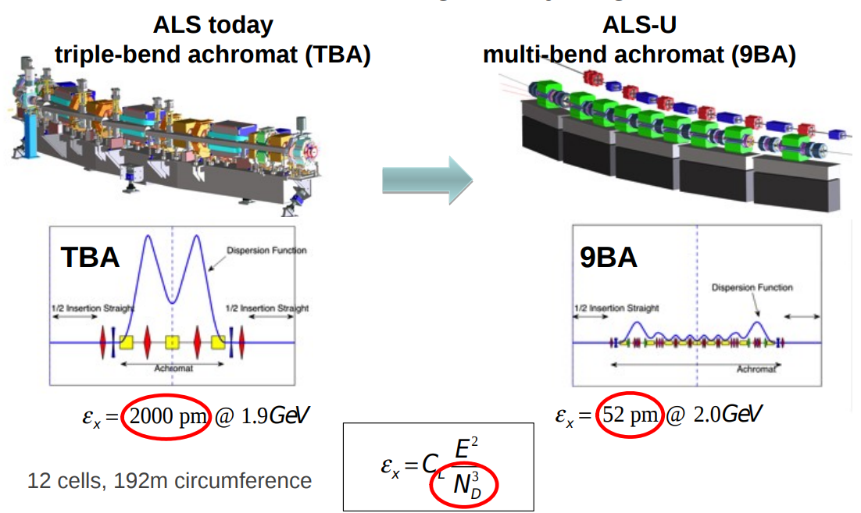
Collective effects in a diffraction-limited storage ring
Low emittance lattice

Slide 5
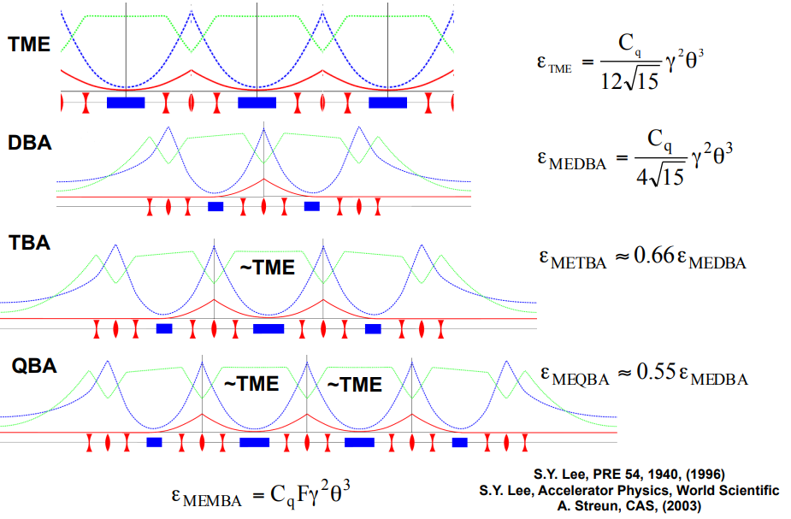
Collective effects in a diffraction-limited storage ring
Minimum emittance

Slide 6
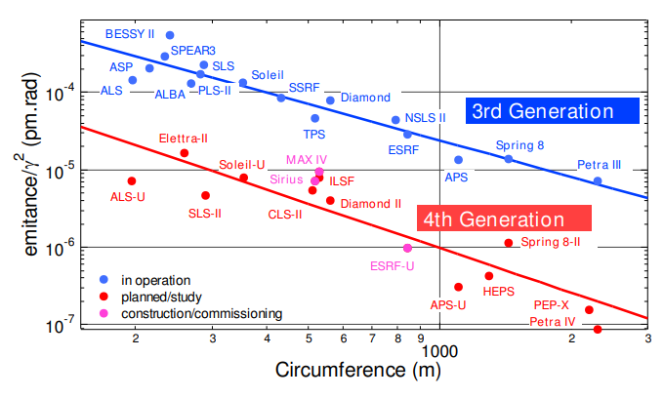
Collective effects in a diffraction-limited storage ring
Worldwide storage ring

Slide 7
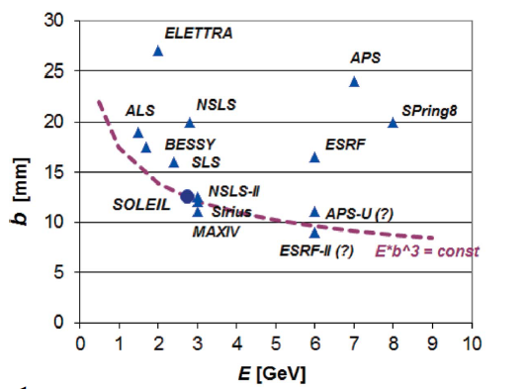
Collective effects in a diffraction-limited storage ring
Collective effect issues
1. Isochronicity
2. Small chamber aperture
3. Large chromaticity
MBA requires large magnet gradient -> small bore radius

Slide 8
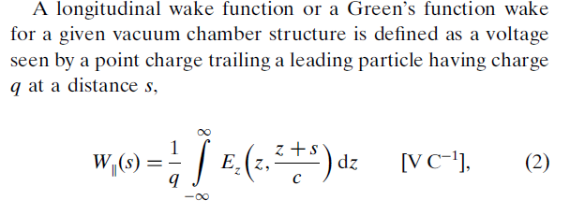
Collective effects in a diffraction-limited storage ring
Longitudinal coupling impedance
What is coupling impedance?
The impedance induced by interaction in between beam and components
Why wake function is also called Green’s function?
Wake potential is convolution of wake function and charge distribution

Slide 9
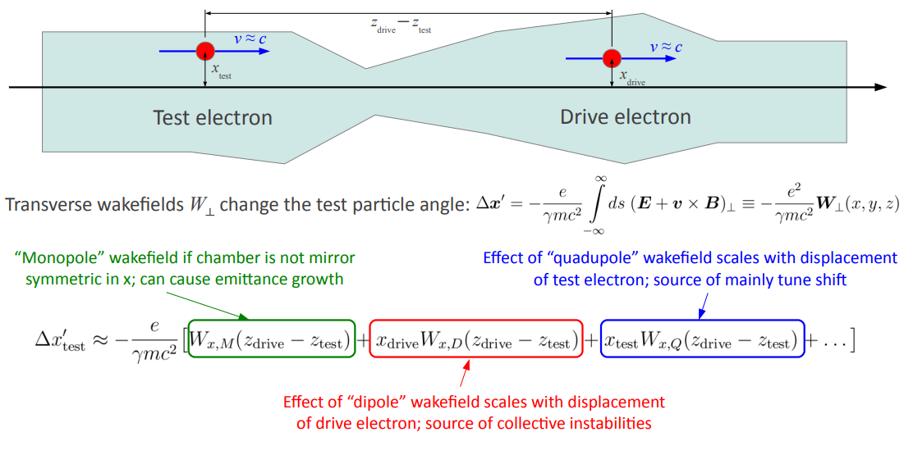
Collective effects in a diffraction-limited storage ring
Transverse coupling impedance

Slide 10
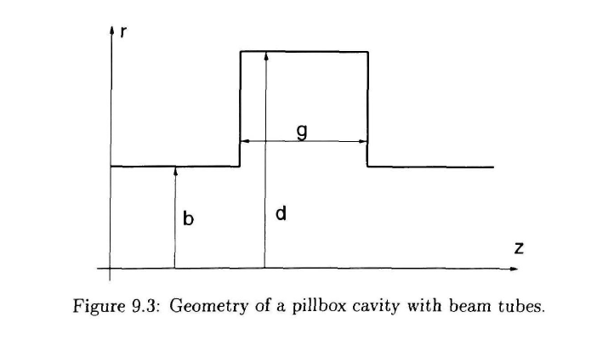
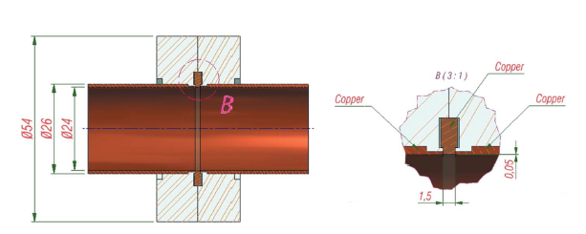
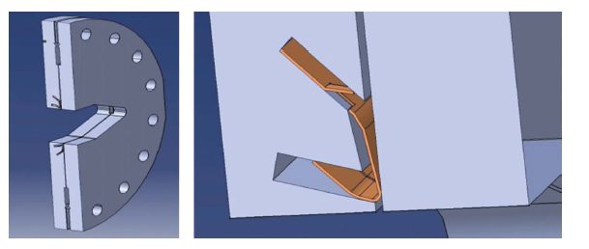
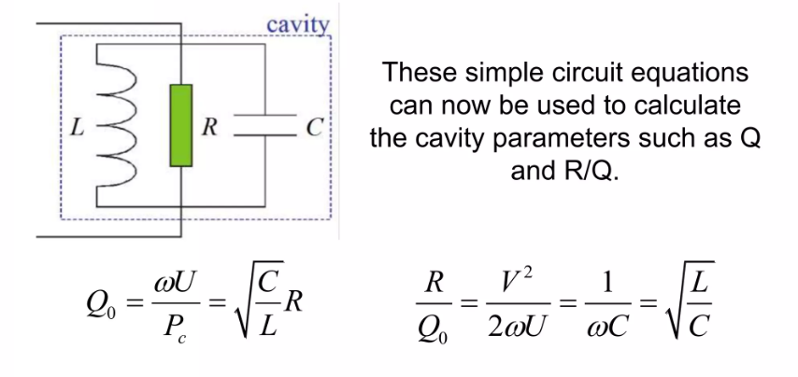
Collective effects in a diffraction-limited storage ring
Geometric impedance: flange

Slide 11
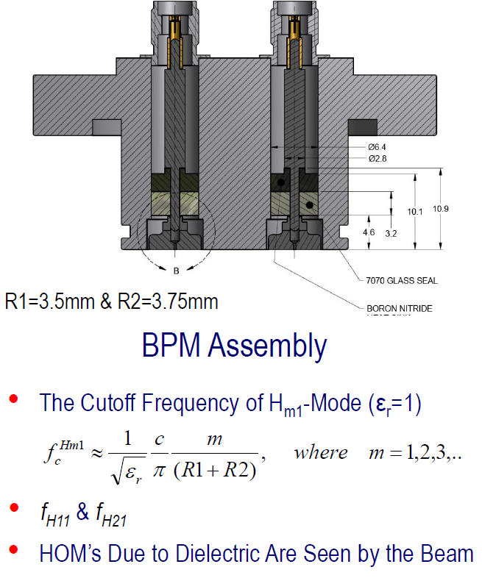
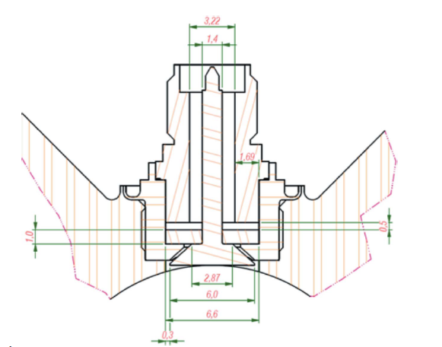
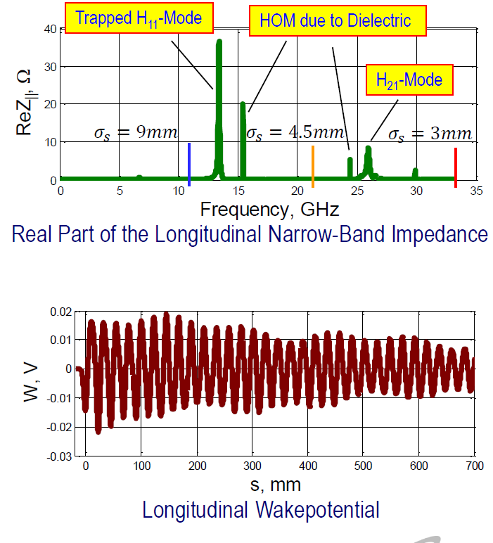
Collective effects in a diffraction-limited storage ring
Geometric impedance: BPM

Slide 12
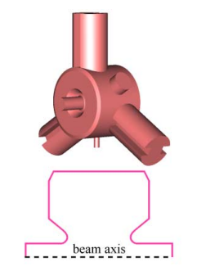
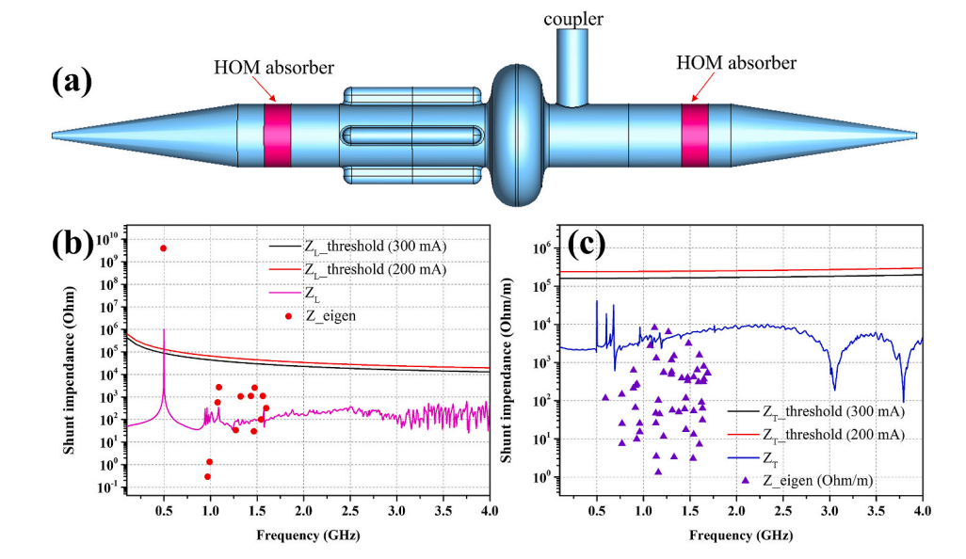
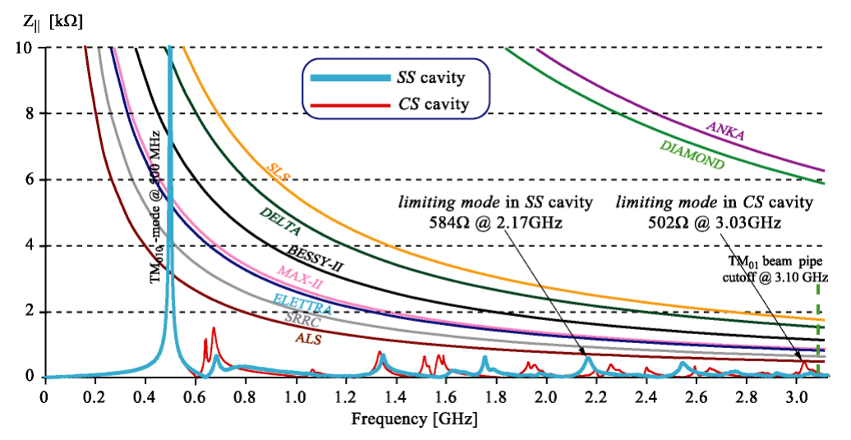
Collective effects in a diffraction-limited storage ring
Geometric impedance: RF cavity

Slide 13
Collective effects in a diffraction-limited storage ring
Resistive wall impedance
To be continued ….

