Slide 1
Deflecting cavity status & experimental plan at eLABs
Geunwoo Kim
24. 11. 08.

Slide 2
Contents
0. Review
How to design TCAV in ASTRA
Matching process for elabs TCAV.
Optimization elabs beamline
TCAV resolution calculation

Slide 3
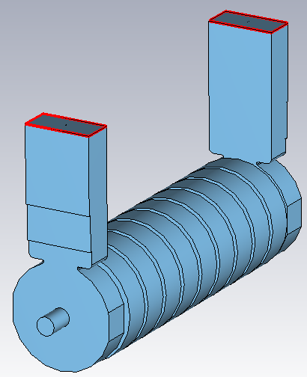
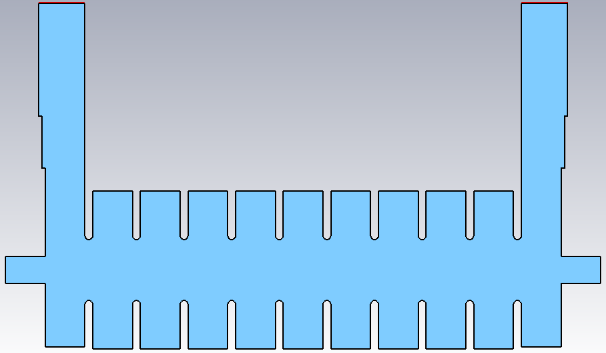
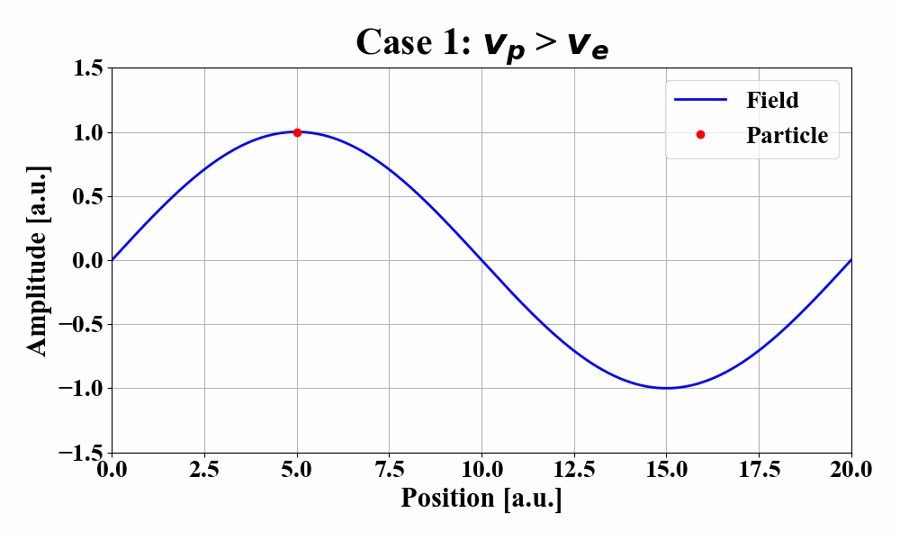
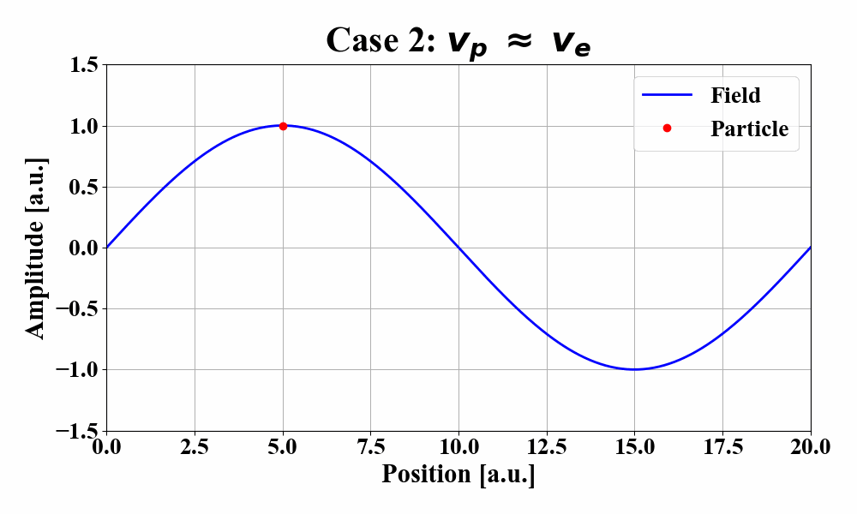
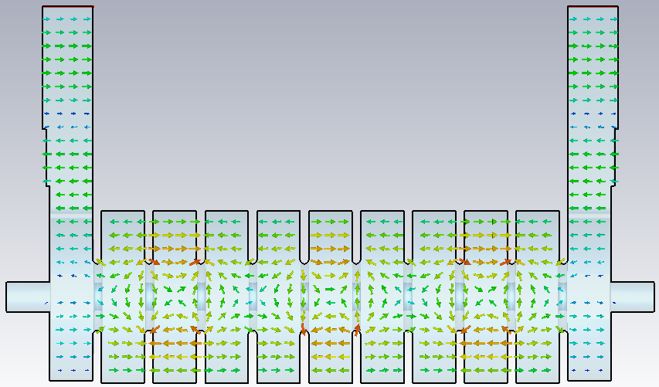
0. Review
Coupler cells
Active cells
Main feature
HEM₁₁ mode (similar to TM₁₁ mode; TE + TM)
Possible to get high deflecting component.
Iris-loaded structure (a.k.a slow-wave structure)
To deaccelerate phase velocity under $v_{ph}<c$.
2/3π mode (ΔΦ = 2π for three cells)
Increasing r_{sh} → V_{T} ↑ ($V_{T}∝\sqrt{r_{sh}}$)
<e-labs deflecting cavity shape>
y
z
<E-field distribution>
6 active cells (2/3π mode)
ΔΦ = 4π

Slide 4
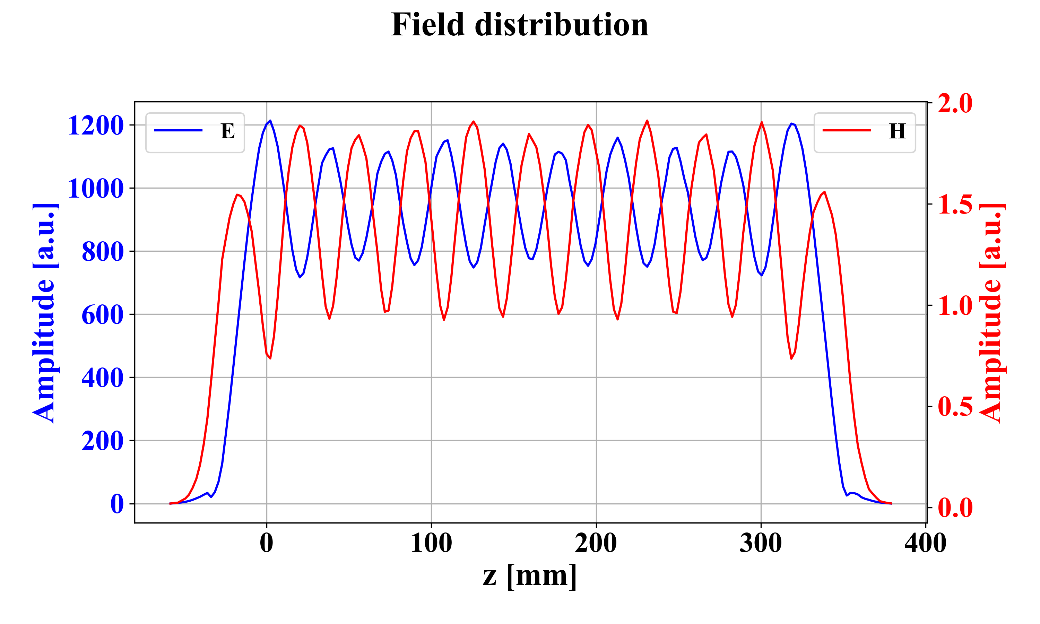
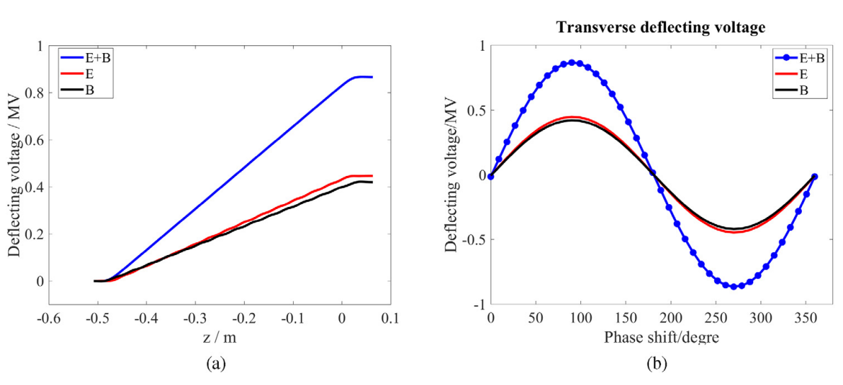
0. Review
Kick direction
$F=q(E+v×B)$
E_{y} and H_{x} were measured w.r.t z direction.
Beam will be kicked onto y direction. (E+B)
E_{y}
H_{x}
<Ref.>
To simulate TCAV into elabs beamline,
need to know how to define TCAV in ASTRA

Slide 5
1. Milestone to get resolution by simulation
Definition TCAV in ASTRA
Scaling TCAV to elabs
Simulation
(MAD-X, ASTRA)
Resolution
calculation
Notes:
하나 빠지면 파일 자체를 못찾아버림

Slide 6
1. How to design TCAV in ASTRA
3D field map components are required.
Transform CST data → 3D field map format
Store total 12 data
Both Re and Im field components.
If you are missing just single component….
x
y
z
#
of posi.
Position
data
x
Field data
Position
Field(F_{x}, F_{y}, F_{z})
y
N_{z}(1)
x y z
Data
Re
F_{x}
Im
F_{x}
Re
F_{y}
Im
F_{y}
Re
F_{z}
Im
F_{z}
N_{z}(2)
$$⋮$$
<CST 3D data format>
N_{z}(n)
<ASTRA 3D field map format>
Notes:
하나 빠지면 파일 자체를 못찾아버림

Slide 7
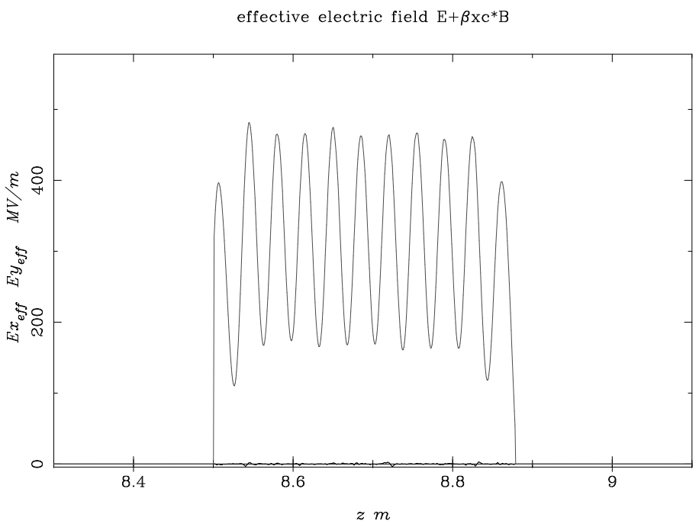
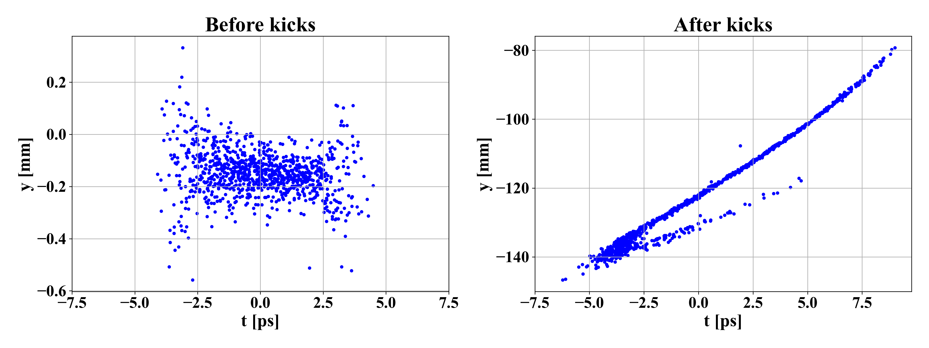
1. How to design TCAV in ASTRA
Assign 3D field map data into Astra code.
Re and Im fields should be distinguished.
Combine both cavities into a single module.
$V=A∙exp[i\left(\frac{ωz}{c}+α+φ\right)] ;A^{2}=Re^{2}+Im^{2}$
6. Run
Module 1
Cavity 1
Cavity 2
Re(field)
Im(field)
Control scaling, phase Φ
# of particles: 1,000

Slide 8
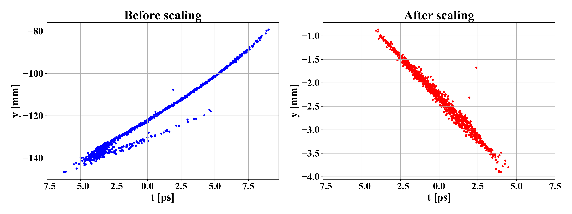
2. Scaling process for elabs TCAV
Initial V_{T} = 155.6 MV
PAL-XFEL TCAV V_{T} = 20 MV @ 21 MW
elabs TCAV V_{T} = 1 MV @ 0.137 MW
Scaling is required
 | E-labs TCAV
Beam energy | 70 MeV
Operating freq. | 2856 MHz
Freq. mode | HEM110
Phase shift a cell | 120 deg
Shunt Impedance | 28.7 MΩ/m
Input Power | 137 kW
Deflecting voltage | 1 MV
Cavity length | ~ 0.5 m
The design process for elabs's TCAV procedure is complete.

Slide 9
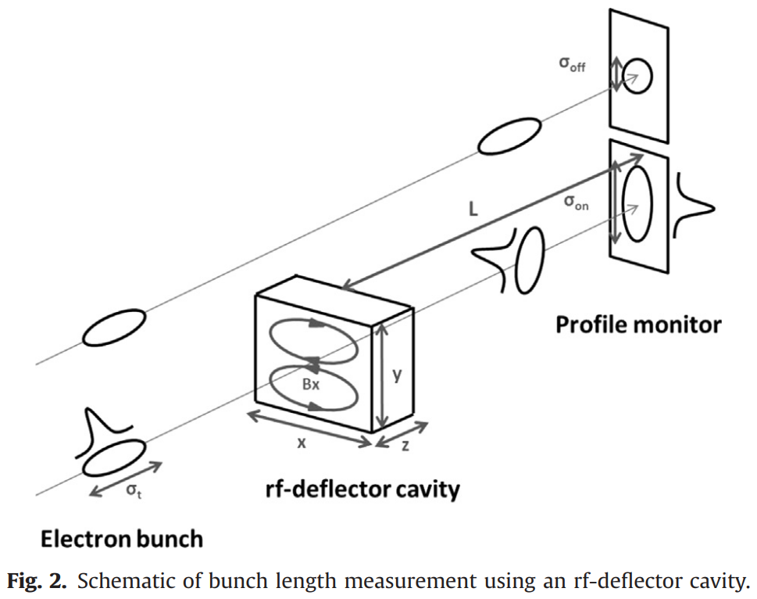
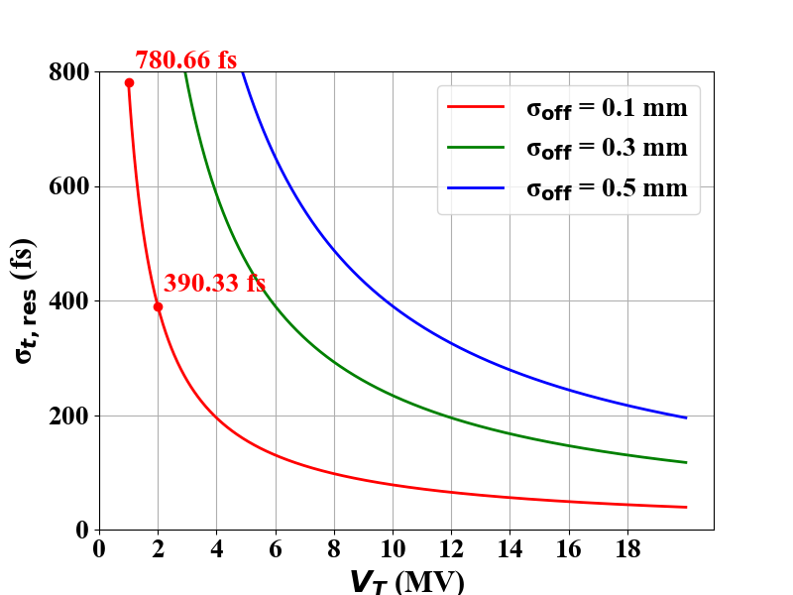
3. Optimization elabs beamline
② σ_{off}
* Temporal resolution
$$σ_{t,res}=\frac{p_{z}c}{e}∙σ_{off}∙\frac{1}{V_{T}ω_{RF}L}$$
① Beam energy
③ Deflection factor
TCAV OFF, drift region
Not
cavity length
Tunable parameters
② Beam size at screen without kick.
TCAV ON
More input power is required for high V_{T} ($V_{T}∝\sqrt{P}$)
V_{T} = 2 MV for P = 0.549 MW (∵ V_{T} = 2.7 MV/$\sqrt{MW}$)
2. Need beam size σ_{off} = 0.1 mm at the screen.
MAD-X and ASTRA are suitable for optimization.

Slide 10
3. Optimization elabs beamline
Screen
~ 0.5 m
Optimization point
9.7
<e-labs equipment layout, unit: m>
MAD-X simulation
Matching both beamlines
Definition method is different.
Optimization quadruple strengths
Obtain optimized β, α
Initial twiss parameters obtained from ASTRA.
β_{x0} = 16.10165;
β_{y0} = 15.87806;
α_{x0} = -2.508242;
α_{y0} = -2.470562;
D
Q1
D
Q2
MAD-X
ASTRA

Slide 11
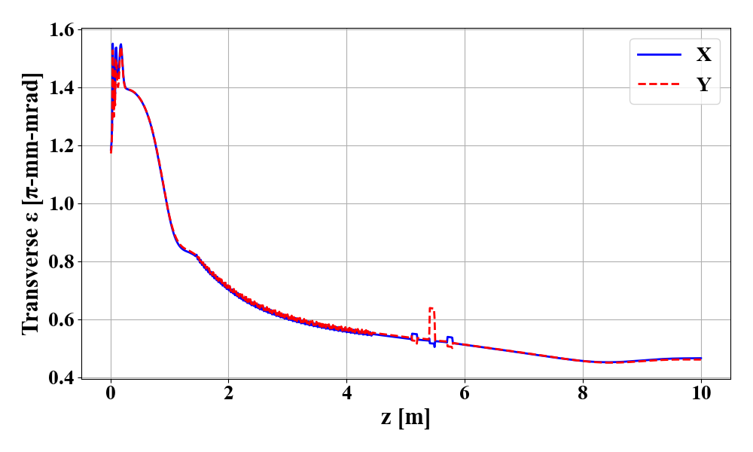
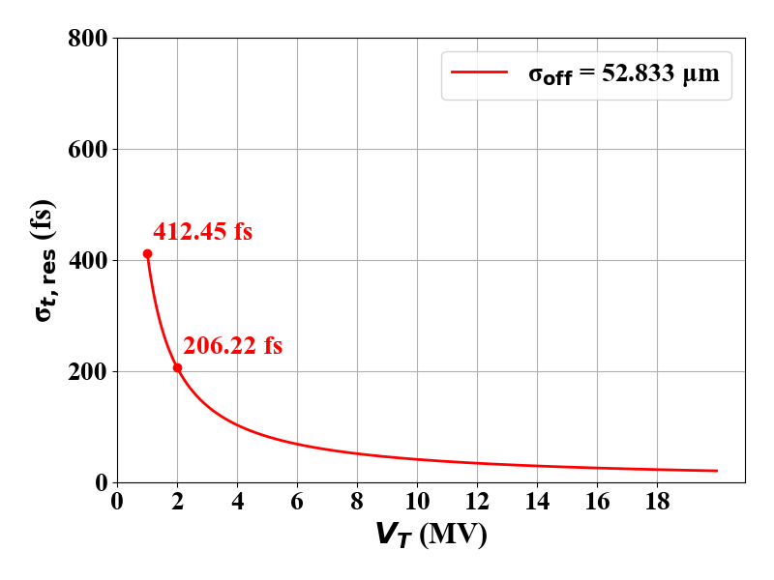
4. TCAV Resolution calculation
3. ASTRA simulation
Transverse emittance
ε_{x} = 0.4653, ε_{y} = 0.4614
σ_{rms,x} = 53.30 μm
σ_{rms,y} = 52.83 μm
Target: 100 um
Result: σ_{rms,y} = 52.83 μm
→ σ_{t,res} = 412.45 fs for V_{T} = 1 MV.
Quadruple region
Screen
$$σ_{t,res}=\frac{p_{z}c}{e}∙σ_{off}∙\frac{1}{V_{T}ω_{RF}L}$$

Slide 12
Summary and plans
0. Be sure to check example files in addition to the manuals.
Simulation(MAD-X, ASTRA) code for elabs including TCAV was completed.
Resolution calculation was done. (σ_{t,res}= 412.45 fs)
But, it needs to check the simulation results.
Considering the other simulation conditions.
Drawing deflecting voltage w.r.t phase.
Study on Longitudinal Phase Space (LPS)

