Slide 1
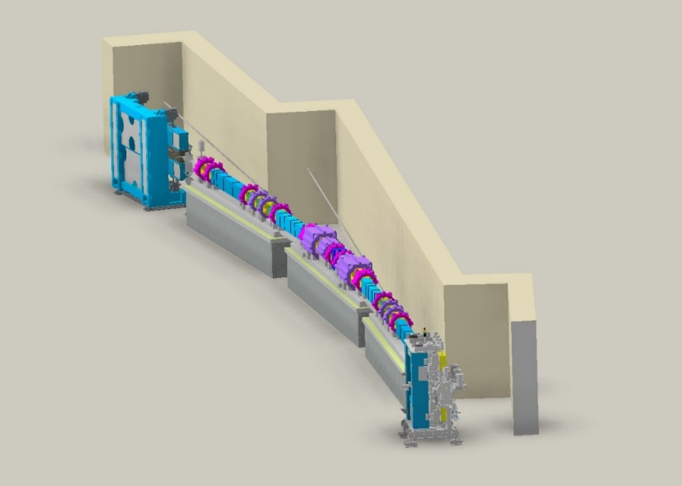
Beam physics group meeting
Study of the Beam lifetime
Junha Kim
Nov 7th, 2024

Slide 2
Various type of the lifetime
Beam lifetime is the characteristic time taken for the number of stored charged particles to decay under the situation that the storage ring operation is being well stabilized
Quantum emission in synchrotron
Elastic Coulomb scattering with residual gas
Bremsstrahlung effect with residual gas (inelastic scattering)
Intrabeam scattering (Touschek scattering)
Beam loss due to nonlinear effect of the magnet field and instabilities caused by collective effect does not consider because these effect are not stable situation.

Slide 3
Quantum lifetime($τ_{q}$)
The quantum emission in synchrotron radiation which is discrete and random process give the momentum change of the stored electron and lead to the fluctuation of the oscillation amplitude.
If the oscillation amplitude exceeds the aperture limit. We can call beam loss
Quantum lifetime due to synchrotron (longitudinal) oscillation
$$H\left(φ,ε\right)=\frac{hα}{2P_{0}R_{0}Ω_{0}}ε^{2}+\frac{ eV_{RF}}{2π}\left[cosφ−cosφ_{0}+\left(φ−φ_{0}\right)sinφ_{0}\right] → W_{ε}=\frac{1}{2}{\tilde{ε}}^{2}$$
Quantum lifetime due to betatron (transverse) oscillation
$$x=a\sqrt{β\left(s_{1}\right)}cosωt → W_{x}=a^{2}β(s_{1})$$
Symbol | meaning
$$h$$ | Harmonic number
$$α$$ | Momentum compaction factor
$$P_{0}$$ | Nominal momentum
$$R_{0}$$ | Radius of Ring
$$Ω_{0}$$ | Angular revolution frequency
$$ε$$ | Energy deviation
$$φ, φ_{0}$$ | RF phase, RF phase of synchronous electron
$$a$$ | Square of emittance

Slide 4
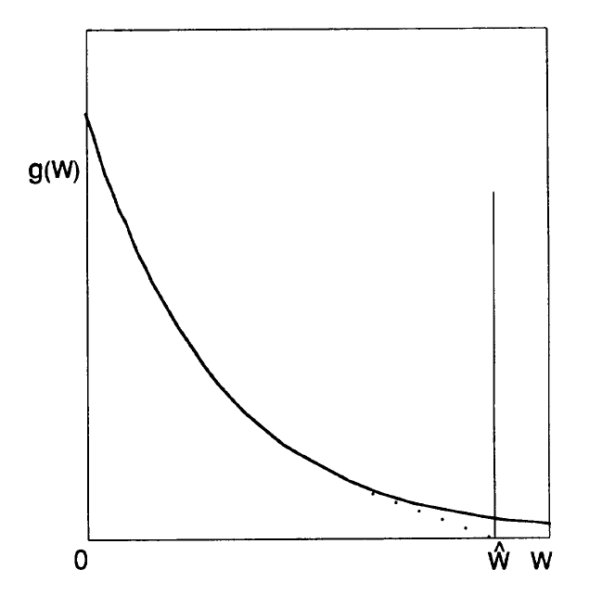
Quantum lifetime($τ_{q}$)
Let start consider quantum fluctuation and radiation damping, the invariant amplitude factor a and $ε$ of any particular electron are changed up and down in Gaussian distribution. So they produce $W_{x} and W_{ε}$ fluctuation.
In absence of aperture limit, $W$is follow exponential distribution. $g\left(W\right)dW=\frac{N}{<W>}\exp\left(−\frac{W}{<W>}>\right)dW$.
Where, $<W>$ is equal to 2$σ_{x or ε}^{2}.$ The function $g\left(W\right)$ is defined such that the number of electrons with ‘effective oscillation energy’ between W and W+dW is $g\left(W\right)dW$
The quantum effect are continually trying to fill in the ideal distribution by a ‘diffusion’ of electrons from the region of small W into the region of large W. But each time an electron reaches $\hat{W}.$ It is wiped off.
So we can think the loss particle is equal to N($W> \hat{W}$)
$$N\text{(}W>\hat{W}\text{) =} \int_{\hat{W}}^{∞}{g\left(W\right)dW} =Nexp(−\frac{\hat{W}}{<W>} )$$
The electron loss rate will be estimated by
$$−\frac{dN}{dt}≈\frac{N}{τ_{x or ε}}exp\left(−\frac{\hat{W}}{<W>}\right)={\left\{g(W)\frac{dW}{dt}\right\}}_{\hat{W}}$$
Aperture limit

Slide 5
Quantum lifetime($τ_{q}$)
$$−\frac{dN}{dt}=\frac{N}{τ_{x or ε}}exp\left(−\frac{\hat{W}}{<W>}\right)={\left\{g(W)\frac{dW}{dt}\right\}}_{\hat{W}}$$
Symbol | meaning
$$τ_{q_{x, ε}}$$ | Longit / trans. Qunatum lifetime
$$τ_{q}$$ | Quantum lifetime
$$ξ_{ε}$$ | $\frac{1}{2}(\frac{ΔE_{RF}}{σ_{ ε}})$
$$ξ_{x}$$ | $\frac{1}{2}\left(N_{ν}\right); N_{ν} =\frac{dynamic aperture}{beam size}$
$$Ω_{0}$$ | Angular revolution frequency
$$τ_{x, ε}$$ | Longit. / trans. Damping time
According to radiation damping,
$$\frac{dW}{dt}=−\frac{2W}{τ_{x}}$$
Therefore $−\frac{dN}{dt}=\frac{2N\hat{W}g(\hat{W})}{τ}$ and generally $\frac{1}{τ_{q}}=−\frac{1}{N}\frac{dN}{dt} →τ_{q}=\frac{τ_{x or ε} }{2}\frac{<W>}{\hat{W}}\exp\left(\frac{\hat{W}}{<W>}\right)$
Finally, it can be expressed by M. Sand SLAC report
$$τ_{q_{x, ε}} =\frac{τ_{x, ε}e^{ξ_{ε,x}}}{2ξ_{ε,x}} ;\frac{1}{τ_{q}} =\frac{1}{τ_{x}} +\frac{1}{τ_{ε}}$$
Practically, it can be ignored.

Slide 6
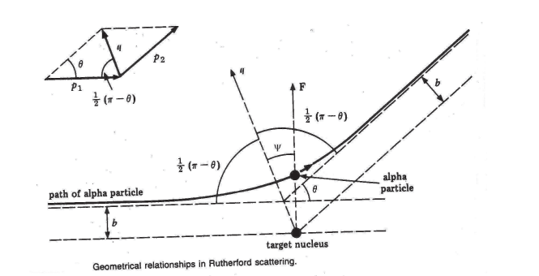
Elastic scattering lifetime($τ_{g}$)
Circulating electrons in storage ring can undergo elastic Coulomb scattering with nucleus of residual gas in the vacuum chamber. Therefore, the electron gets an angular kick in its betatron motion. If the resulting amplitude of the betatron motion exceeds the storage ring aperture, the electron gets lost from the beam. The lifetime determined by this phenomenon is called the gas scattering lifetime (or elastic scattering lifetime)
The differential scattering cross-section between electron and nucleus is
$$dσ_{g}≅\frac{4Z\left(Z+1\right)r_{e}^{2}}{γ^{2}}\frac{dθ}{θ^{3}}dφ$$
$$σ_{g} = \int_{−π}^{π}{dφ}\int_{θ_{1}(φ)}^{\frac{π}{2}}{\frac{4Z\left(Z+1\right)r_{e}^{2}}{γ^{2}}\frac{dθ}{θ^{3}}}$$
$θ_{1}is minimum value of θ$where scattered electrons escape from the beam.
Symbol | meaning
Z | Atomic number of residual gas
$$r_{e}$$ | Classical electron radius

Slide 7
Elastic scattering lifetime($τ_{g}$)
$$σ_{g} = \int_{−π}^{π}{dφ}\int_{θ_{1}(φ)}^{\frac{π}{2}}{\frac{4Z\left(Z+1\right)r_{e}^{2}}{γ^{2}}\frac{dθ}{θ^{3}}}$$
$$≅ \int_{−π}^{π}{\frac{2Z\left(Z+1\right)r_{e}^{2}}{γ^{2}}\frac{1}{θ_{1}^{2}(φ)}dφ}$$
To find $θ_{1}$ which is minimum value of $θ$ where scattered electrons escape from the beam, with some approximations.
Let incident electron move in design orbit. It get an angular kick $θ$ due to the scattering and it starts betatron oscillation with initial conditions where transverse displacement y=0, y’ = $θ$.
If $θ$ is $θ_{1}$, the oscillation amplitude becomes the minimum half minimum aperture $h_{m}$. Therefore, only if the transverse displacement has $h_{m}$as maximum value of betatron amplitude.
Symbol | meaning
Z | Atomic number of residual gas
$$r_{e}$$ | Classical electron radius

Slide 8
Elastic scattering lifetime($τ_{g}$)
According to Courant-Snyder invariant,
$$y^{2}+{\left(αy +βy′\right)}^{2}=βε$$
For y=0 and y’=$θ_{1}^{2}$,
$βθ_{1}^{2}$=$ε$
For y= $h_{m}$, $αy +βy$’ vanishes because $\sqrt{β_{m}ε}$ is circle of radius in two dimensional space
$h_{m}^{2}$=$β_{m}ε$
$$θ_{1}^{2 }=\frac{h_{m}^{2}}{β_{m}β}$$
To an approximation, we take $β$to be average value of $β$ function. $θ_{1}^{2 }=\frac{h_{m}^{2}}{β_{m}<β>}$
Therefore,
$σ_{g}$= $\frac{4Z\left(Z+1\right)r_{e}^{2}}{γ^{2}}\frac{β_{m}<β>}{h_{m}^{2}}$

Slide 9
Elastic scattering lifetime($τ_{g}$)
$σ_{g}$= $\frac{4Z\left(Z+1\right)r_{e}^{2}}{γ^{2}}\frac{β_{m}<β>}{h_{m}^{2}}$
From the A.Piwinski’s report
$$\frac{1}{τ_{g} } = {cn}_{g}σ_{g}$$
$n_{g}$(density of atoms of residual gas) is obtained from the ideal gas law:
$$\frac{N}{V} =\frac{N_{A}P}{RT}→n_{g}=\frac{ Nn}{V} =\frac{nN_{A}P}{RT}$$
$$n_{g} = nP × 3.2189 × {10}^{13} \left(\frac{atoms}{nano Torr ∙ m^{3}}\right)$$
$$\frac{1}{τ_{g} }=3.427× {10}^{−3}×nPZ\left(Z+1\right)\frac{β_{m}<β>}{γ^{2}h_{m}^{2}} {\left(nano Torr hrs\right)}^{−1}$$
Assumming that the residual gas is $N_{2}$ (Z=7 , n=2) gas, For PLS
$τ_{g}$ = $\frac{113.5}{P} \left(nano Torr hr\right) →$tens of order lifetime
Symbol | meaning
$n_{g}$ | the number of density of atoms of residual gas
$$τ_{g}$$ | Gas scattering lifetime
c | Speed of light
n | Number of atoms per residual gas molecule
$$N_{A}$$ | Avogadro constant
P | Vacuum pressure

Slide 10
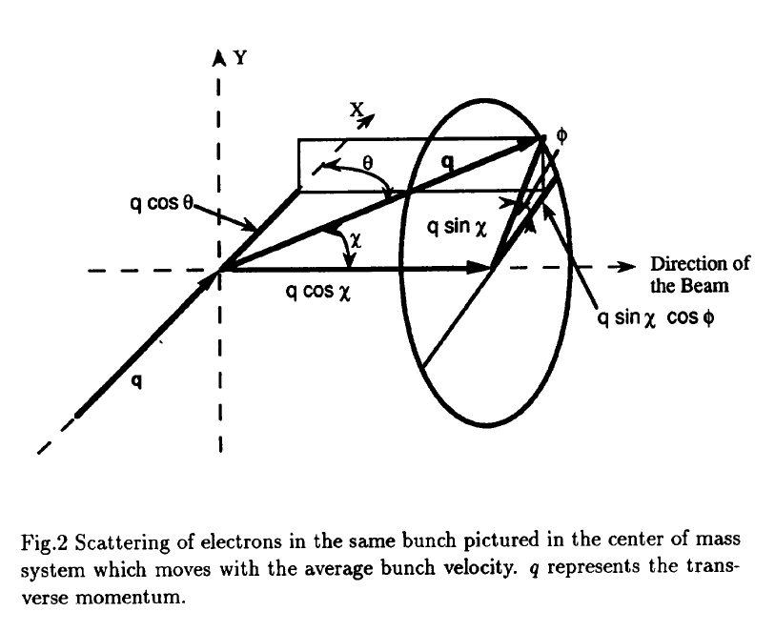
Touschek lifetime($τ_{b}$)
The intrabeam scattering via Coulomb interaction can change the longitudinal momentum due to the momentum transfer from horizontal to longitudinal direction. If the amount of the momentum transfer exceeds the storage ring momentum acceptance, the electron will escape from the beam.
Let consider the Coulomb scattering between two particles in the same bunch in their center of mass (CM) system. Each particle is scattered by an angle $θ$. The number of particles dN with velocity $v=\frac{dx}{dt}$ which is scattered into the differential solid angle d$Ω$ is expressed by
$$dN=\frac{dσ}{dΩ}Nndx$$
Where N is the total number of particles impinging on the target of density n and $\frac{dσ}{dΩ}$ is the differential scattering cross section.

Slide 11
Touschek lifetime($τ_{b}$)
The rate of collisions is given by
$$\frac{dN}{dt}=σvNn= \int_{V_{B}}{σvn^{2}dV} where N=ndV$$
Taking the mean of $σv$ and assuming that $\overline{σv}$ is independent of position inside the bunch. The loss rate for entire bunch in the moving system is
$\frac{dN}{dt}=−$ $\overline{σ_{T}v}$ $\int_{V_{B}}{n^{2}dV}$
$where σ_{T}$ is the total cross section through which electrons can escape from the beam (Note $σ_{T}$ < $σ$ )
Take the formula the non-relativistic M$φ$ller scattering cross section in CM system.
$\frac{dσ}{dΩ}=\frac{4r_{e}^{2}c^{4}}{v^{4}} [\frac{4}{\sin^{4}{θ}}−\frac{3}{\sin^{2}{θ}}]$
Where $dΩ=sinχdχdφ and cosθ=sinχcosφ$

Slide 12
Touschek lifetime($τ_{b}$)
The longitudinal momentum transfer is
$${\left(Δp\right)}_{CM}=q\left|cosχ\right|$$
Where q is the transverse momentum of each particle in CM system.
Transferring back to the LAB system, we get ${\left(Δp\right)}_{LAB}=γ$ ${\left(Δp\right)}_{CM}$. Therefore, the particle will be lost
if $\frac{γ{\left(Δp\right)}_{CM}}{p_{0}}>\frac{Δp_{RF}}{p_{0}}$. Where $\frac{Δp_{RF}}{p_{0}}$ is momentum acceptance.
So, the total scattering cross section for particle loss
$$σ_{T}= \int_{\left|cosχ\right|>μ}{\frac{dσ}{dΩ}}dΩ$$
Where $\left|cosχ\right|$ > $\frac{Δp_{RF}}{p_{0}}$ $≡μ$
$$σ_{T}=\frac{8πr_{e}^{2}c^{4}}{v^{4}}\left[\frac{1}{μ^{2}}−1+\ln{μ}\right] for q>\frac{Δp_{RF}}{γ}$$
$=0 for q< \frac{Δp_{RF}}{γ}$
This formula is valid in the CM system.

Slide 13
Touschek lifetime($τ_{b}$)
$\frac{dN}{dt}=−$ $\overline{σ_{T}v}$ $\int_{V_{B}}{n^{2}dV}$
$n=\frac{N}{{\left(2π\right)}^{\frac{3}{2}}σ_{x}σ_{y}σ_{z}} exp⁡(−(\frac{x^{2}}{2σ_{x}^{2}}+\frac{y^{2}}{2σ_{y}^{2}}+\frac{z^{2}}{2σ_{z}^{2}}))$in LAB frame
$$\int_{V_{B}}{n^{2}dV}=\frac{N^{2}}{V_{B}}$$
In the moving frame S,
$\frac{dN}{dt}=−\overline{σ_{T}v}\frac{N^{2}}{V_{B}} →moving with LAB frame \frac{dN}{dt}=−\overline{σ_{T}v}\frac{N^{2}}{{γ^{2}V}_{B}}$
It then follows that
$N\left(t\right)=\frac{N_{0}}{1+\frac{t}{τ_{t}}} →\frac{1}{τ_{t}}=−\frac{1}{N}\frac{dN}{dt}=\frac{N_{0}}{V_{B}}\frac{\sqrt{π} r_{e}^{2}c}{δp_{x}{\left(ΔP_{RF}\right)}^{2}}C(ξ)$= $\frac{\sqrt{π} r_{e}^{2}cN_{0}}{γ^{3}σ_{x}^{′}{\left(\frac{{ΔE}_{RF}}{E_{0}}\right)}^{2}V_{B}}C\left(ξ\right)$
$$\frac{1}{τ_{t}}=\frac{\sqrt{π} r_{e}^{2}cN_{0}}{γ^{3}σ_{x}^{′}{\left(\frac{{ΔE}_{RF}}{E_{0}}\right)}^{2}V_{B}}C\left(ξ\right)$$
Symbol | meaning
$$N_{0}$$ | Initial total number of electrons in a bunch
$$r_{e}$$ | Classical electron radius
$$V_{B}$$ | $${\left(4π\right)}^{\frac{3}{2}}σ_{x}σ_{y}σ_{z}$$
$$\frac{{ΔE}_{RF}}{E_{0}}$$ | RF acceptance
$$τ_{t}$$ | Touschek lifetime

Slide 14
Total lifetime or half lifetime
The overall beam lifetime in storage ring is determined by four loss mechanisms.
$$\frac{1}{τ}=Σ\frac{1}{τ_{i}}$$
Here, we must consider the fact that Touschek lifetime is the half lifetime while the others are exponential lifetimes, lt is convenient to treat the overall beam lifetime as half lifetime. The relation between exponential lifetime $τ_{i}$
$$\exp{(−\frac{τ_{\frac{1}{2},i }}{τ_{i}})}=\frac{1}{2} ; τ_{\frac{1}{2},i }=ln2 ×τ_{i}$$
The total half lifetime $τ_{\frac{1}{2}}$ of a beam in storage ring is given by
$$\frac{1}{τ_{\frac{1}{2}}}=\frac{1}{\ln{2}×τ_{q}}+\frac{1}{\ln{2}×τ_{g}}+\frac{1}{\ln{2}×τ_{b}} + \frac{1}{τ_{t}}$$

Slide 15
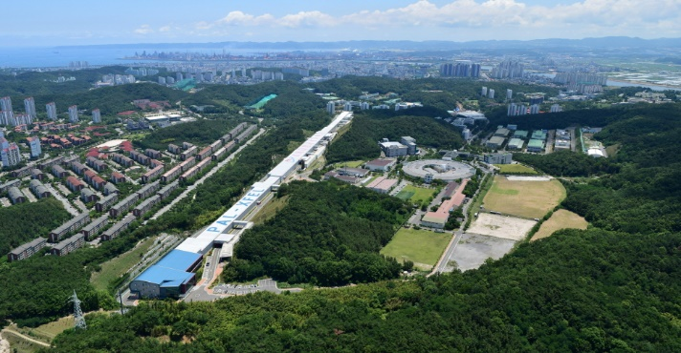
4GSR weekly meeting
Thank you!

Slide 16
Bremsstrahlung lifetime($τ_{b}$)
The scattering between a particle in the beam and the residual gas in storage ring vacuum chamber gives energy loss due to Bremsstrahlung radiation. If the energy loss due to Bremsstrahlung is larger than the storage ring energy acceptance, the electron will be lost

