Slide 1
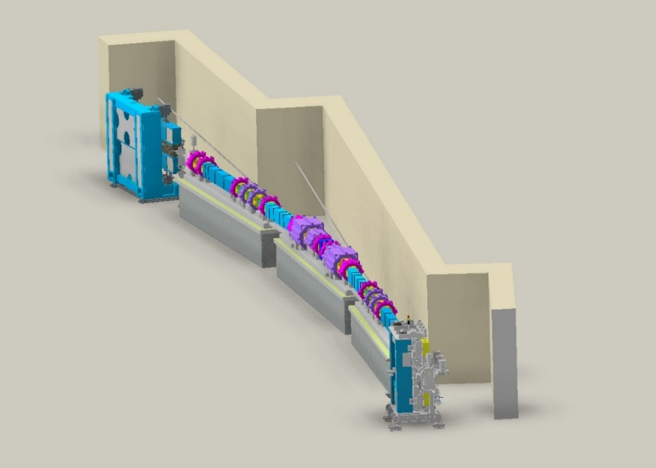
JKPS
Analysis of off-momentum nonlinear driving terms for enlarging off-momentum dynamic apertures
Junha Kim
Nov 29th, 2024

Slide 2
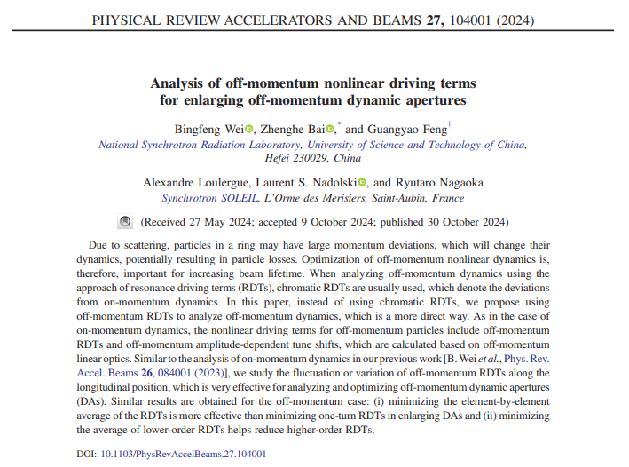
JKPS
Why I choose this paper?
My MOGA simulation works very well for booster lattice optimization.
However, it is still not effective for the storage ring case. While the ideal lattice performs well, the error cases are not promising for my MOGA solution.
One of my objectives in MOGA is to optimize the lifetime. The calculation of the lifetime takes too long, but the RDTs are much faster to compute compared to the lifetime calculation.
In my future work, I would like to try optimizing NDTs to increase the local MA or off-momentum DA, as suggested in this paper.

Slide 3
JKPS
Composition of the paper
Introduction
Discusses the significance of optimizing off-momentum nonlinear dynamics to enhance beam lifetime in storage rings.
Off-momentum NDTS
Introduces the concept of off-momentum NDTs and their role in analyzing off-momentum dynamics.
Control of off-momentum ADTS
Demonstrates methods to reduce off-momentum ADTS and their impact on enlarging dynamic apertures (DAs).
Control of off-momentum RDTS and Their fluctuations
Explores minimizing off-momentum resonance driving term (RDT) fluctuations to enhance DA performance.
Off-momentum DA analysis for a hybrid MBA lattice
Analyzes DA reduction causes and proposes optimization methods for a hybrid multi-bend achromat (MBA) lattice.
Conclusion

Slide 4
JKPS
I. Introduction
The nonlinear part of the Hamiltonian in the 5D phase space (x,x’,y,y’,$δ$) can be expanded into a series of nonlinear driving terms(NDTs)
Out of them, the geometric terms, including resonance driving terms(RDTs) and amplitude-dependent tune shifts(ADTSs) affect on-momentum nonlinear dynamics.
The chromatic terms affect off-momentum nonlinear dynamics
Particles in a ring can have different momentum deviations causing chromatic effect.
The resulting limitation on momentum deviation defines the momentum aperture(MA), which determines the beam lifetime.
$$τ_{touschek} ∝MA^{3}$$
In low-emittance rings, the major limitation to MA is the transverse nonlinear dynamics.
Therefore, it is essential to enlarge dynamic apertures(DA) of off-momentum particles.

Slide 5
JKPS
I. Introduction
The authors previously demonstrated that minimizing the fluctuations of RDTs along the longitudinal position (calculated as the element-by-element average of RDTs) is more effective for enlarging on-momentum dynamic apertures (DAs) than minimizing one-turn RDTs. Building on this finding, they propose to extend this approach to analyze and optimize off-momentum dynamics.

Slide 6
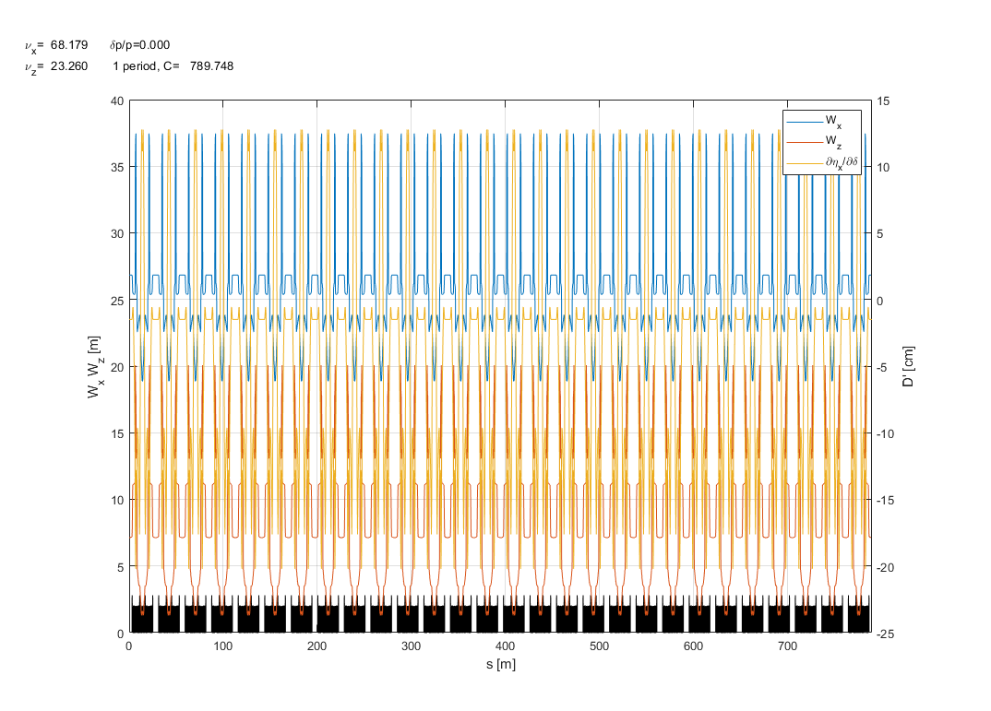
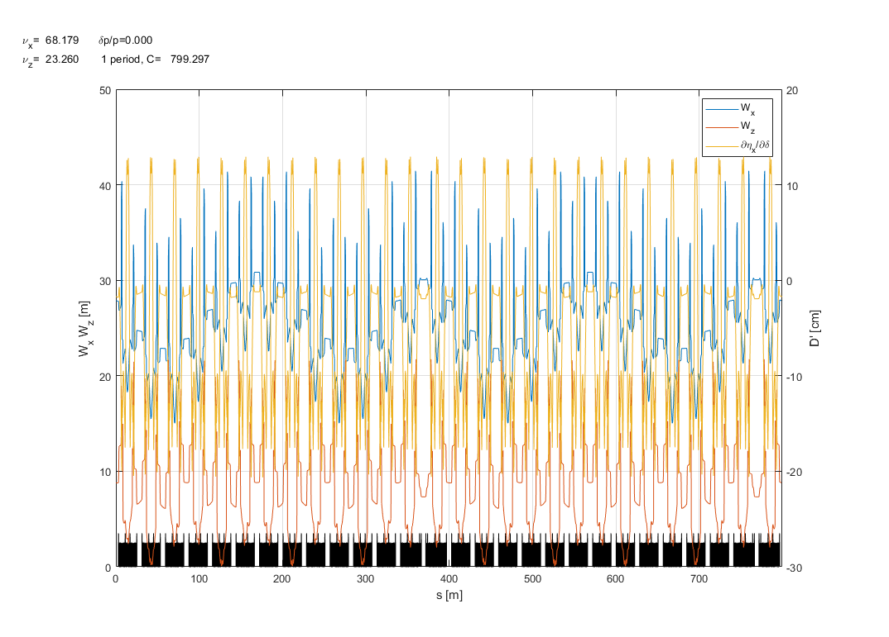
JKPS
I. Introduction
Nat. Chromaticity | $$ξ_{x0}$$ | $${ ξ}_{y0}$$
Unit cells | $$−3.9789$$ | $$−3.0683$$
Straight section | $$−4.1137$$ | $$−2.9467$$
The introduction of a high-beta injection cell. Restoring the periodicity of chromatic terms along the ring can effectively improve off-momentum dynamics performance.
The authors tried to optimize the fluctuation of chromatic term along the ring to find nonlinear lattice solution with larger off-momentum DA but found it to be ineffective
So, the instead of focusing on deviation from on-momentum dynamics, such as chromatic beta-beating, the author propose using off-momentum NDTs to analyze 4D off-momentum dynamics(include off-momentum RDTs/ADTSs)
W function plot when the ring is consisted with
28 unit cells
W function plot when the ring is consisted with
26 unit cells + 2 straight section

Slide 7
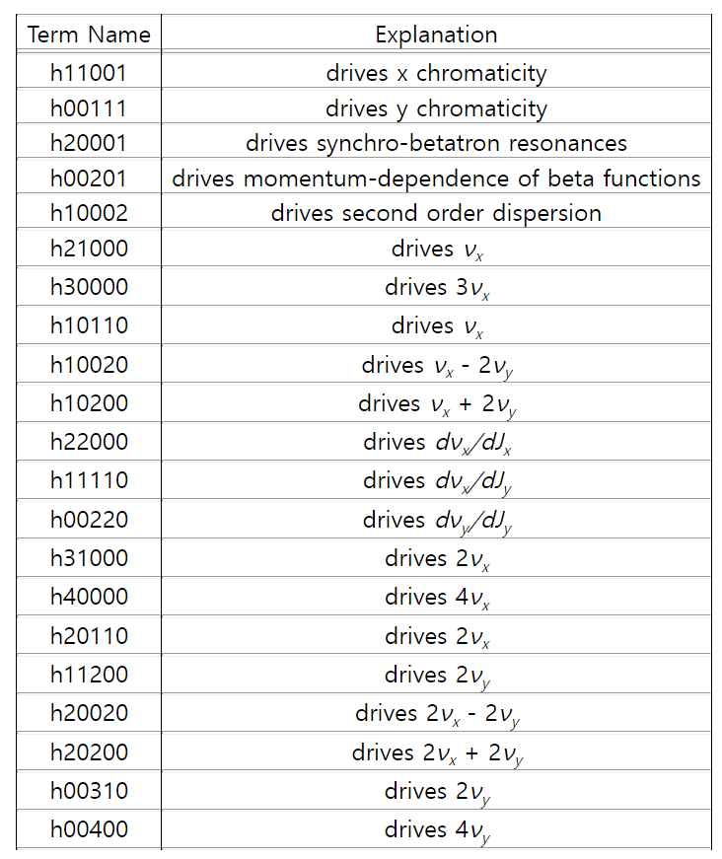
JKPS
II. Off-momentum NDTS
$h_{x}^{±}≡\sqrt{2J_{x}}e_{ }^{±iφ_{x}} ,h_{y}^{±}≡\sqrt{2J_{y}}e_{ }^{±iφ_{y}}$ with $\left(J,φ\right)$ being the action-angle variables, $δ$ is the relative momentum deviation
$h_{jklmp}$with p $≠0$ are chromatic terms driving chromatic effect and the ones with p=0 are geometric terms.
To calculate off-momentum NDTs, the nonlinear part of Hamiltonian needs to be normalized with off-momentum linear optics. Compared to the on-momentum case, there are two differences in the normalization.

Slide 8
JKPS
II. Off-momentum NDTS
To calculate off-momentum NDTs, the nonlinear part of Hamiltonian needs to be normalized with off-momentum linear optics. Compared to the on-momentum case, there are two differences in the normalization.
the scaled magnet strengths should be changed to $\frac{1}{1+δ}$ of their original values.
The off-momentum closed orbit is different from the ideal orbit. For particles on the off-momentum closed orbit, generally, they do not pass through the centers of multipole magnets, as if there are magnet misalignments.
The closed-orbit offset lead to introduce extra nonlinear kicks generated by feed-down effects on nth-order multipoles (n>=4)
Off-momentum NDTs, only the terms $h_{jklmp}$ with p=0 are considered. and the nonlinear invariant, an alternative definition of RDTs $f_{jklm}$can be obtained.

Slide 9
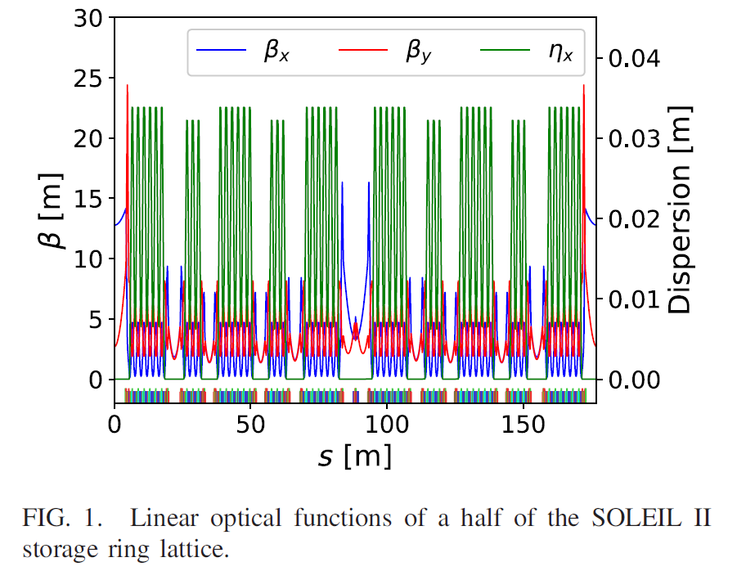
JKPS
III. Control of off-momentum ADTS
The authors use the SOLEIL II storage ring lattice. Its lattice is composed of 20 alternating 7BA and 4BA cells, which achieve an ultralow emittance of 84pm at the beam energy of 2.75 GeV.

Slide 10
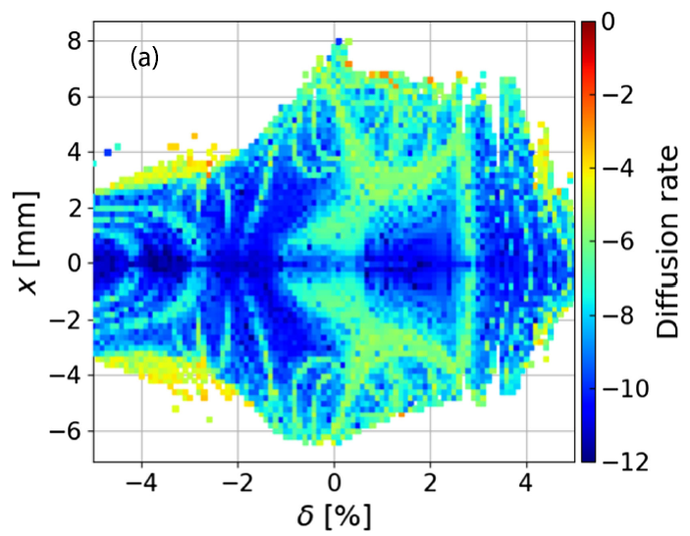
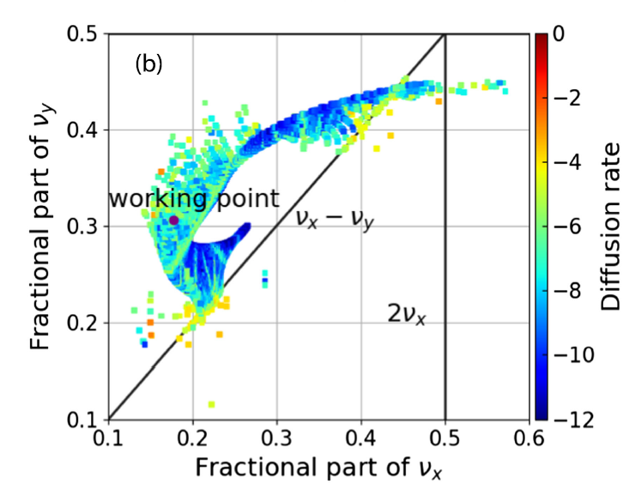
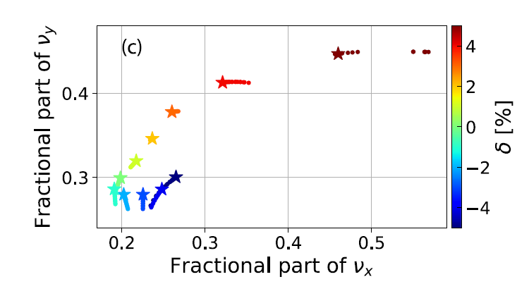
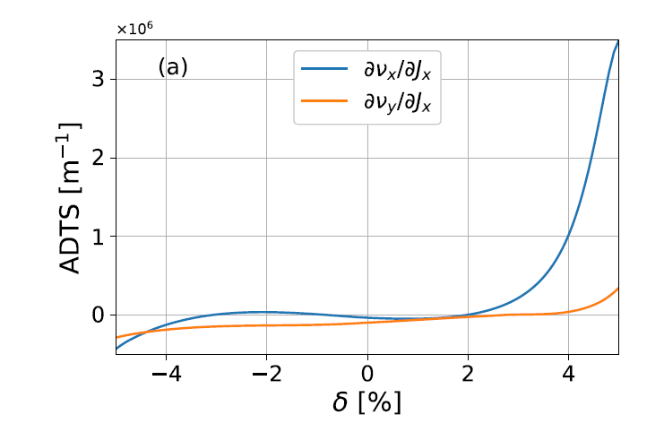
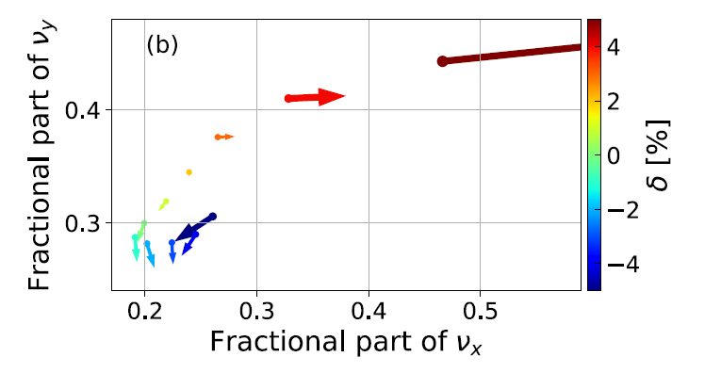
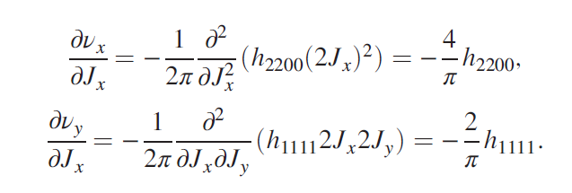
JKPS
III. Control of off-momentum ADTS
: x = 0
: |x| $≤$ 2
ELEGANT Tracking
Calculation from NDTs

Slide 11
JKPS
III. Control of off-momentum ADTS
To calculated result are below figures in the previous slide. It can be seen that $\frac{∂ν_{x}}{∂J_{x}}$ becomes very large as the momentum deviation approaches 5%.
The calculated result are closed to the tracked result with minor deviation
The starting points of these arrows below (b) are on off-momentum closed-orbits on on the ideal orbit as in the on-momentum case
The tracked result includes higher-order ADTSs, which are not considered in the calculated result.
Since the off-momentum ADTS term $\frac{∂ν_{x}}{∂J_{x}}$ is very large around the momentum deviation of 5%, we can try reducing this term to enlarge the off-momentum DA. To control this term, we did an optimization, where the NDTs of $δ=5\%$ were minimized and the off-momentum tunes were controlled to be away from the half-integer resonance.

Slide 12
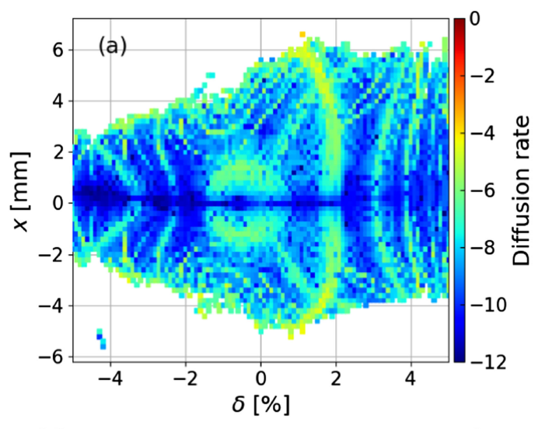
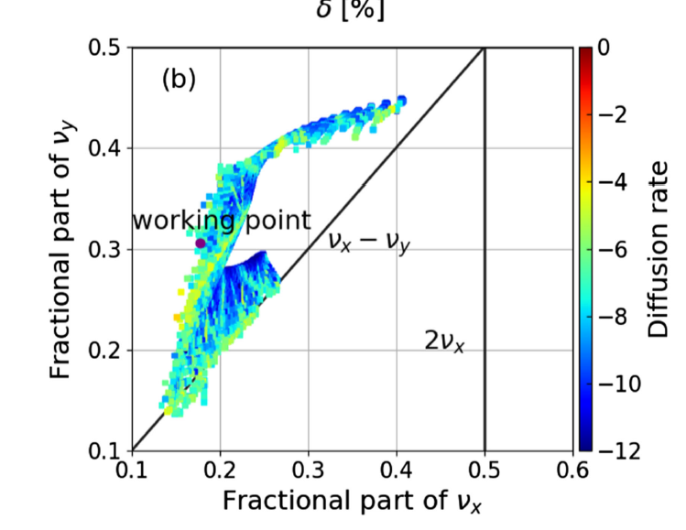
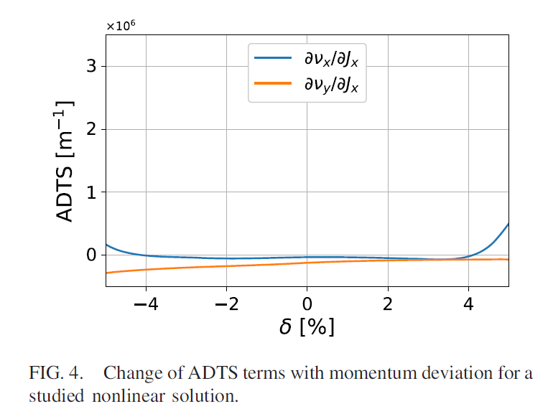
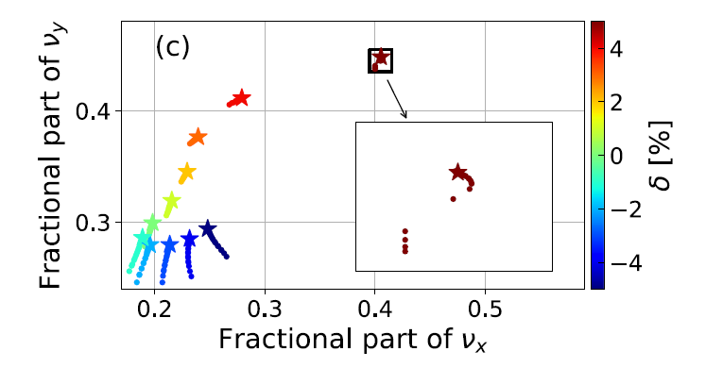
JKPS
III. Control of off-momentum ADTS
: x = 0
: |x| $≤$ 2
Calculation from NDTs
ELEGANT

Slide 13
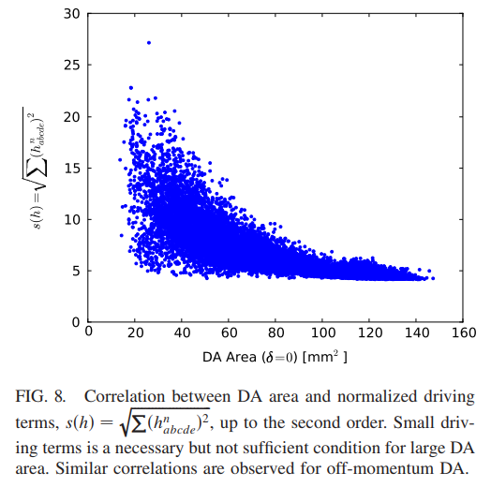
JKPS
IV. Control of off-momentum RDTS and THEIR FLUCTUATIONS
To demonstrate that controlling off-momentum ADTSs are effective for enlarging off-momentum DA
However, the shrinkage of horizontal DA around $δ=5\%$ is not main factor limiting the MA of SOLEIL II, which is more complex to optimize
The right figure shows that small one-turn RDTs is a necessary but not sufficient condition for large DA
But in recent work, it was found that minimizing RDT fluctuations is much more effective than minimizing one-turn RDTs in enlarging the DA.
The authors extend their work to off-momentum case based on fluctuation minimizing in on-momentum cases.
In here, they use SSRF storage ring.

Slide 14
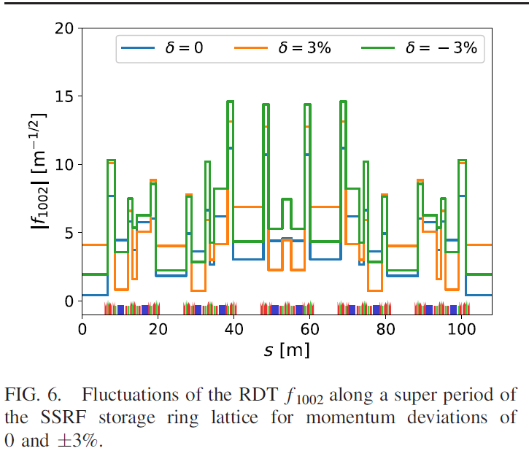
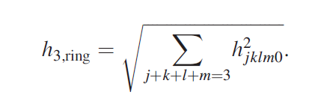
JKPS
IV. Control of off-momentum RDTS and THEIR FLUCTUATIONS
Mainly due to the change of linear optics with momentum, RDTs also change
The right figure shows the fluctuations of the RDT $f_{1002}$ along a super period of SSRF for three $δ$ values.
When $δ$=0, the RDT $f_{1002}$ is canceled well over a super period. But at $δ=±$3%, the fluctuations of $f_{1002}$ become large.
The fluctuation of an RDT is calculated as the average value:
$s_{i}$is the location of the $i$th nonlinear magnet, and N is the number of nonlinear magnets
The fluctuations of the nth order RDTs $f_{n,ave}$is calculated as
Similary, we define the third-order one turn RDTs, $h_{3,ring}$ as

Slide 15
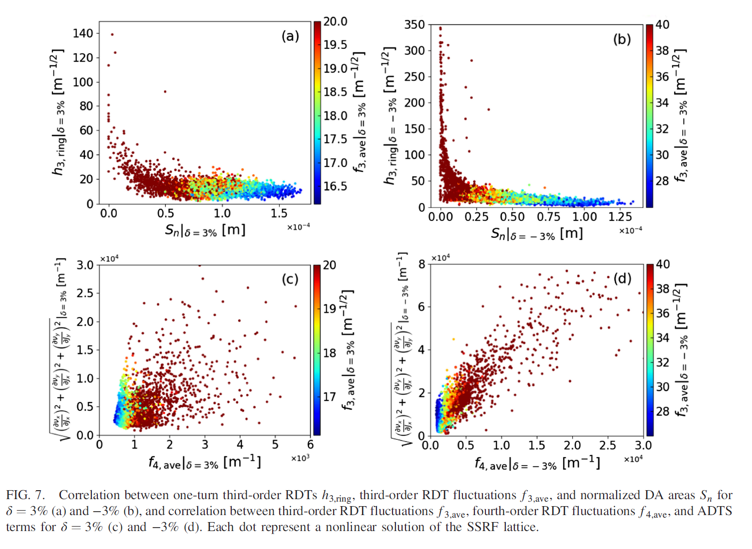
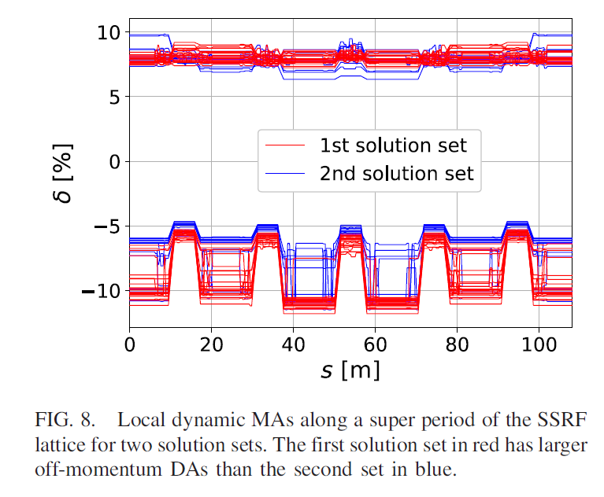
JKPS
IV. Control of off-momentum RDTS and THEIR FLUCTUATIONS

Slide 16
JKPS
IV. Control of off-momentum RDTS and THEIR FLUCTUATIONS
We can see that minimizing one-turn RDTs is a necessary but not sufficient condition for enlarging normalized DA, while minimizing RDT fluctuation is much more effective.
The two lower plots of Fig 7. show the correlation between third-order RDT fluctuations, forth-order RDT fluctuations and ADTSs for $δ=3\% and δ=−3\%$. It is seen that minimizing lower order RDT fluctuations helps reduce higher-order RDT fluctuations and ADTS, both of which come from the crossing terms of lower-order RDTS
Then, we selected two solution sets and tracked their local dynamic MAs using ELEGANT, which are limited by the transverse nonlinear dynamics. The two solution sets have similar on-momentum DA areas of about 10 cm2.
The first solution set has larger off-momentum DAs with Sn for δ = 3% greater than 1.4 × 10−4 m and Sn for δ =−3% greater than 1.0 × 10−4 m,
the second solution set has smaller off-momentum DAs with Sn for δ = 3% less than 1.2 × 10−4 m and Sn for δ = −3% less than 0.8 × 10−4 m.
From Fig 8, we can see that the overall local MAs of the first solution set are larger than those of the second set. This indicates that for the SSRF lattice, reducing off-momentum RDT fluctuations is effective in enlarging local MA.
For the two solution sets of the SSRF lattice, the effect of higher-order dispersion on local MA is small, But for the SOLEIL II lattice, higher-order dispersion needs to be seriously considered.

Slide 17
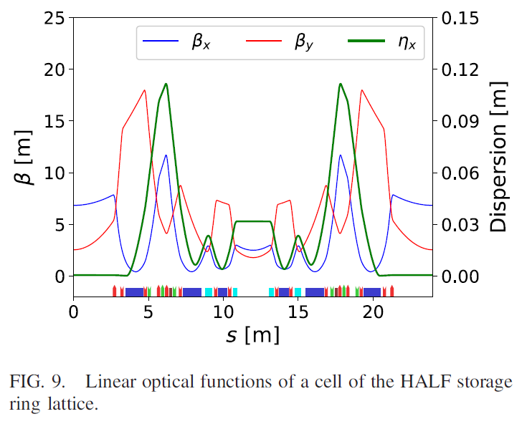
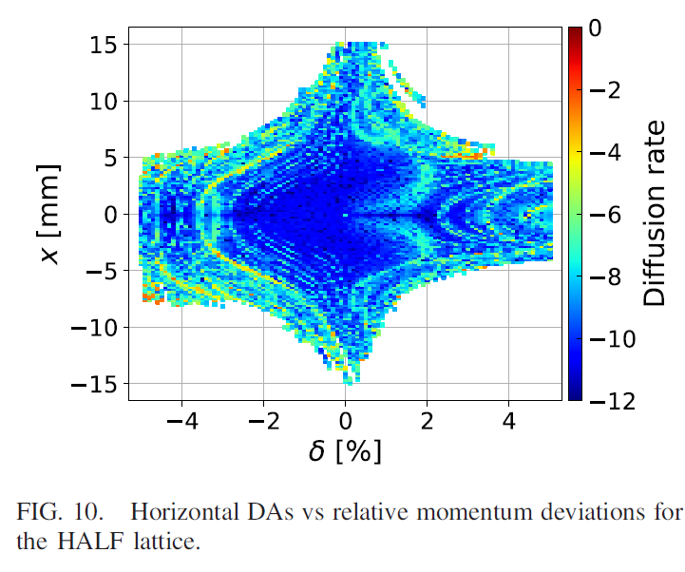
JKPS
V. Off-momentum DA analysis for a hybrid MBA lattice
We will further analyze the off-momentum DAs for hybrid MBA lattice. Hybrid MBA lattices are used in some designs of the fourth-generation storage ring light sources. The storage ring of Heifei Advanced Light Facility(HALF) uses a modified H-6BA lattice with a long and a short straight section in one cell
For the hybrid MBA lattice with $−Ι$ transformation between two dispersion bumps, the nonlinear cancellation is very effective in the on-momentum dynamics.
However, the cancellation can degrade in the off-momentum dynamics due to significant change of linear optics with momentum.

Slide 18
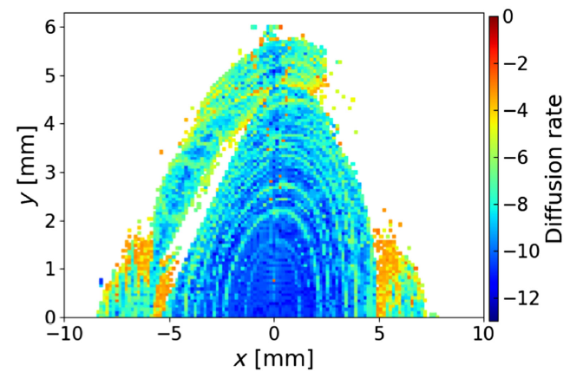
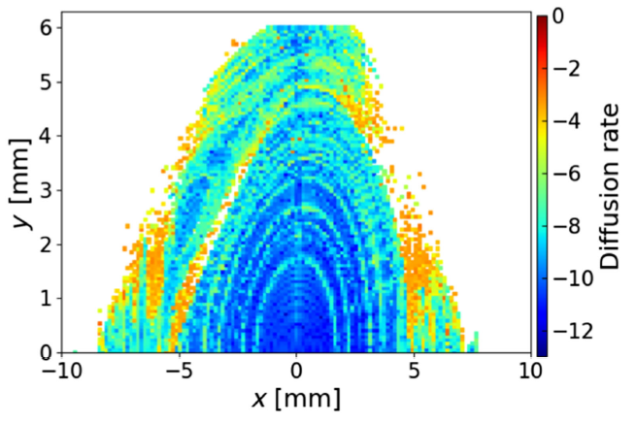
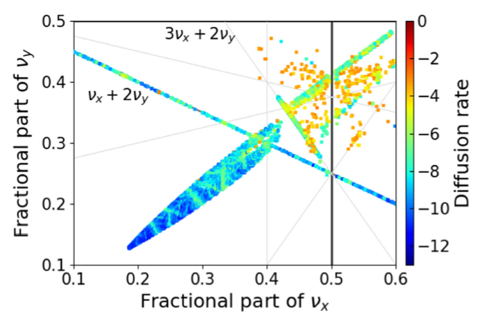
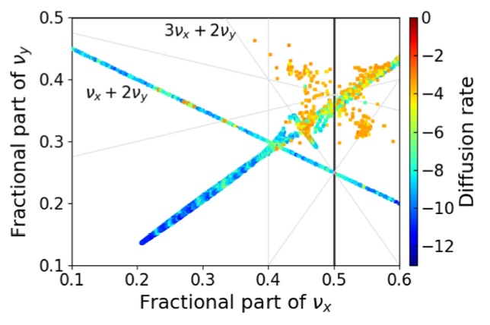
JKPS
V. Off-momentum DA analysis for a hybrid MBA lattice
For the HALF lattice, it was found that there can be a hole in the off-momentum DA with $δ around−2\%$, which may affect the MA if the hole becomes large when errors are included,
The right figure shows the off- momentum DAs and frequency maps with $δ around−2\%$for two nonlinear solutions of HALF. The DA hole of the solution on the left of the figure is larger than of the solution on the right.
It can be seen that hole involves multiple resonance lines in the tune space., including the third-order nonstructural resonance $ν_{x}+2ν_{y}$ and the fifth-order structural resonance $3ν_{x}+2ν_{y}.$
We found that the structural resonance $3ν_{x}+2ν_{y}$ has a significant effect of the DA hole. To reduce the DA hole, it is necessary to control fifth-order resonance.

Slide 19
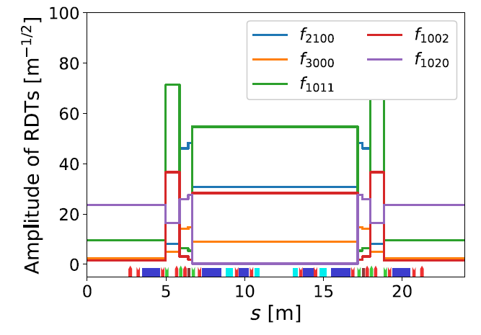
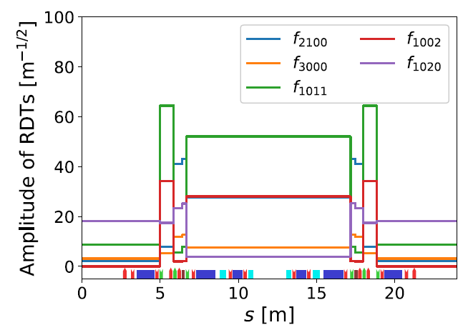
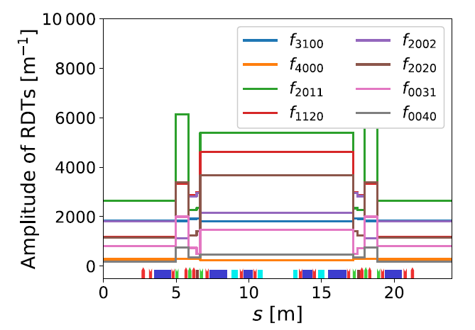
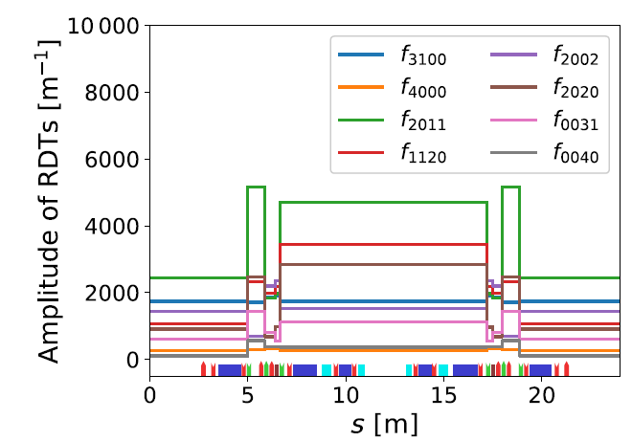
JKPS
V. Off-momentum DA analysis for a hybrid MBA lattice
In the HALF lattice, the fifth-order RDTs are contributed by the crossing terms of lower-order RDTs.
For the off-momentum case, the third- and fourth-order RDT fluctuations of the two solutions are also shown.
We see that the RDT fluctuations of the right solution are smaller than those of the left solution.
Therefore, in the off-momentum dynamics reducing lower-order RDT fluctuations also helps control the fifth-order resonance.

Slide 20
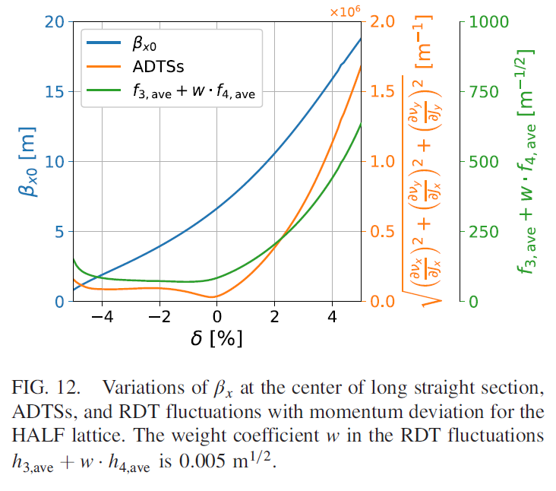
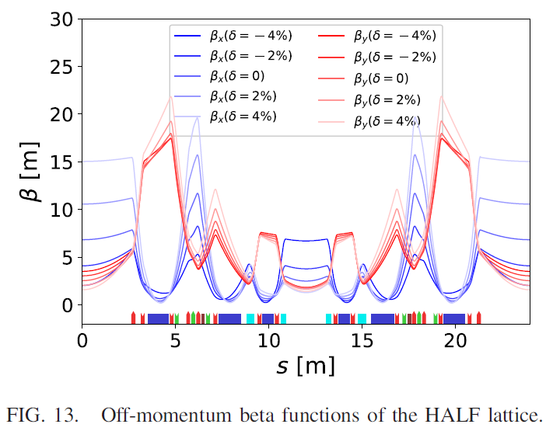
JKPS
V. Off-momentum DA analysis for a hybrid MBA lattice
In Fig 12, ADTSs RDT fluctuations and $β_{x}$ at the center of long straight section are plotted as functions of $δ$
We see that when $δ$>0 both off-momentum RDT fluctuations and ADTSs increase quickly, which is the reason for the decrease of DA, even though the increasing $β_{x}$ is beneficial for enlarging DA.
When $δ<0,$ the increase of RDT fluctuations and ADTSs is small, which is due to that the reduced $β$ functions at the positions of sextupoles, as shown in Fig 13, help to reduce the RDT fluctuations. However, $β_{x}$ decreases significantly.
Therefore, to enlarge off-momentum DAs, one needs to reduce RDT fluctuations and ADTSs and also increase $β_{x}.$Besides, from Fig 12, we can also see that the changing trends of RDT fluctuations and ADTSs are basically the same, demonstrating again that reducing RDT fluctuations helps reduce ADTSs

Slide 21
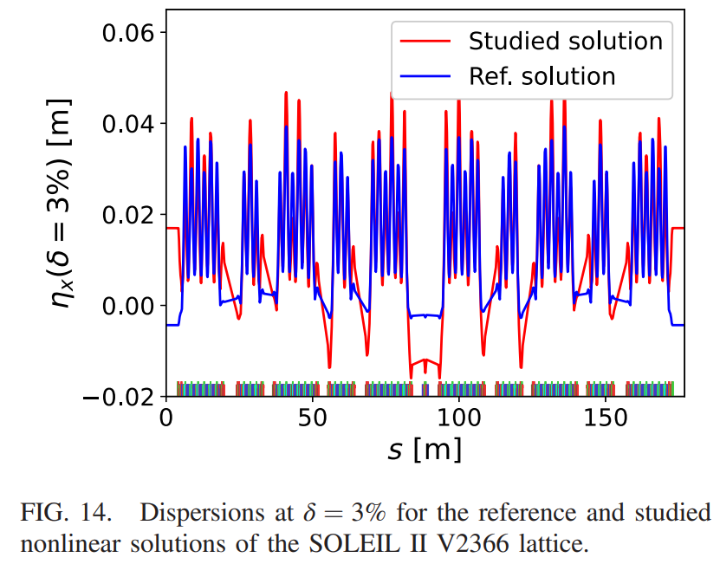
JKPS
VI. Conclusion and Outlook
Instead of using chromatic RDTs, we proposed using off-momentum NDTs, including off-momentum RDTs and off momentum ADTs, to analyze off-momentum DAs of a ring. Then the nonlinear analysis based on minimizing RDT fluctuations for enlarging on-momentum DA was extended to the off-momentum case.
As in the on-momentum case, reducing off-momentum RDT fluctuations turned out to be very effective in enlarging off-momentum DAs, and reducing lower-order RDT fluctuations is beneficial for controlling higher-order RDTs.
For the studied nonlinear solution shown in (Slide12) we found that the local MA in straight section are larger but the local MA in high-dispersion regions are lower than those o the reference nonlinear solution because of the larger higher-order dispersions as shown in Fig 14.
Therefore, enlarging off-momentum DA, it is also necessary to control higher-order dispersion to increase the MA. Actually, the higher-order dispersion had been considered in the nonlinear optimization of the SOLEIL II lattice.
Studied solution (Slide 12)

Slide 22
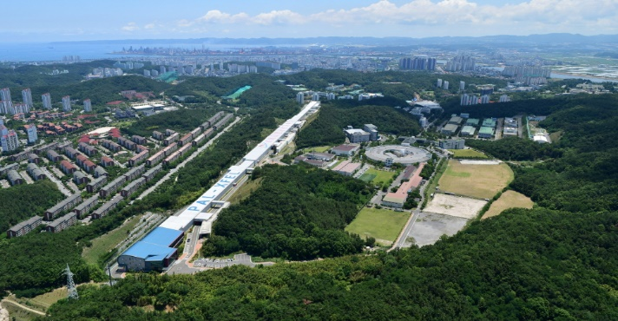
Thank you!

Slide 23
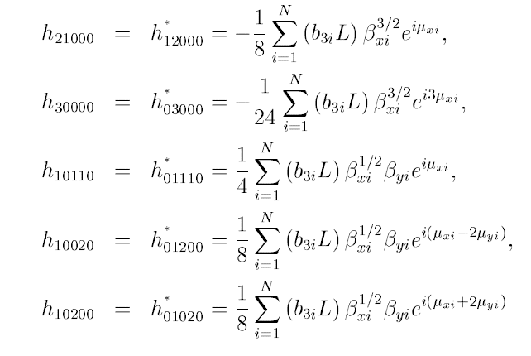
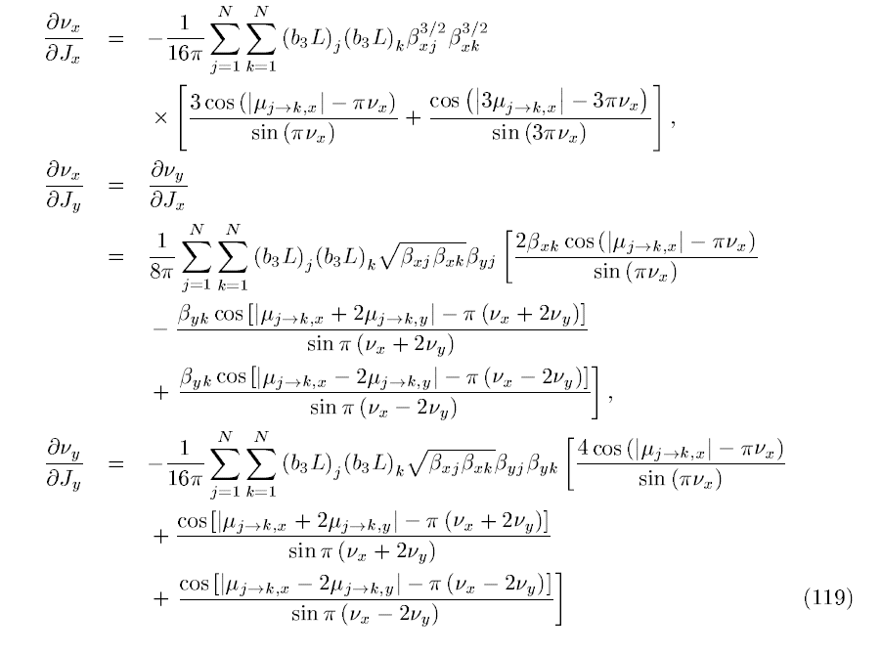
From. The Sextupole Scheme for the Swiss Light Source (SLS) An Analytic Approach, Johan Bengtsson (1997)

