Slide 1
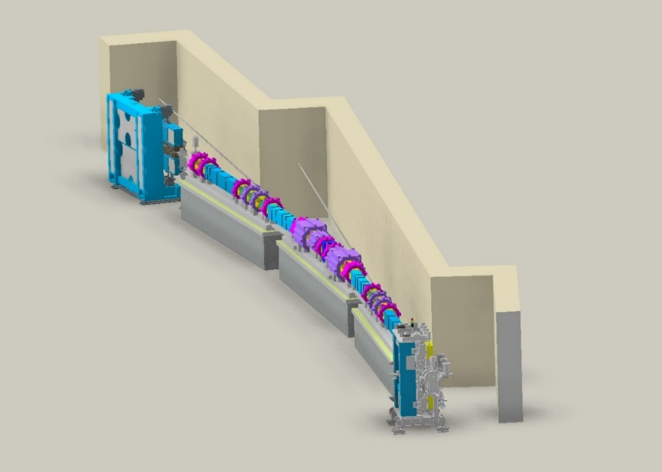
CAPHE group meeting
FODO Booster Ring Analysis
Junha Kim
Nov 8th, 2024

Slide 2
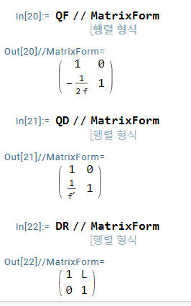
$$M_{cell}=QF∗DR∗QD∗DR∗QF$$
$$M_{cell}= \left(\begin{matrix}1+\frac{L}{f^{′}}−\frac{L}{f}−\frac{L^{2}}{2ff^{′}} & 2L+\frac{L^{2}}{f^{′}} \\ −\frac{1}{f}+\frac{1}{f^{′}}−\frac{L}{ff^{′}}+\frac{L}{2f^{2}}+\frac{L}{4f^{2}f^{′}} & 1+\frac{L}{f^{′}}−\frac{L}{f}−\frac{L^{2}}{2ff^{′}}\end{matrix}\right)$$
$$M_{1→2}= \left(\begin{matrix}\sqrt{\frac{β_{2}}{β_{1}}}(\cos{Δφ}+α_{1}sinΔφ) & \sqrt{β_{1}β_{2}}sinΔφ \\ \frac{\left(α_{1}−α_{2}\right)\cos{Δφ}−(1+α_{1}α_{2})sinΔφ}{\sqrt{β_{1}β_{2}}} & \sqrt{\frac{β_{1}}{β_{2}}}(\cos{Δφ}−α_{2}sinΔφ)\end{matrix}\right)$$
Thin-lens approximation
$$f =\frac{1}{K_{f}l_{f}}$$
$$f’ =\frac{1}{K_{d}l_{d}}$$
Assumptions : $β_{1}{=β}_{2} ,α_{1}=α_{2}=0$
$$M_{1→2}= \left(\begin{matrix} \cos{Δφ} & βsinΔφ \\ −\frac{1}{β}sinΔφ & \cos{Δφ}\end{matrix}\right)=M_{cell}$$
$\cos{Δφ}$ = $1+\frac{L}{f^{′}}−\frac{L}{f}−\frac{L^{2}}{2ff^{′}}$ ; $βsinΔφ$= $2L+\frac{L^{2}}{f^{′}}$
$$Δφ=\cos^{−1}{(1+\frac{L}{f^{′}}−\frac{L}{f}−\frac{L^{2}}{2ff^{′}})}$$
$β =\frac{2L+\frac{L^{2}}{f^{′}}}{sinΔφ}$
L
L

Slide 3
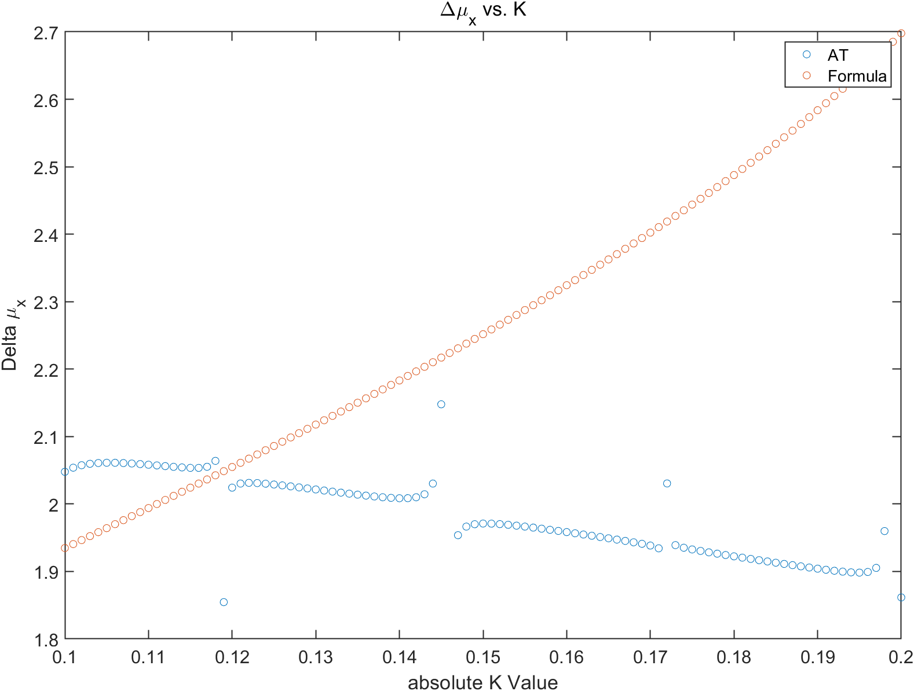
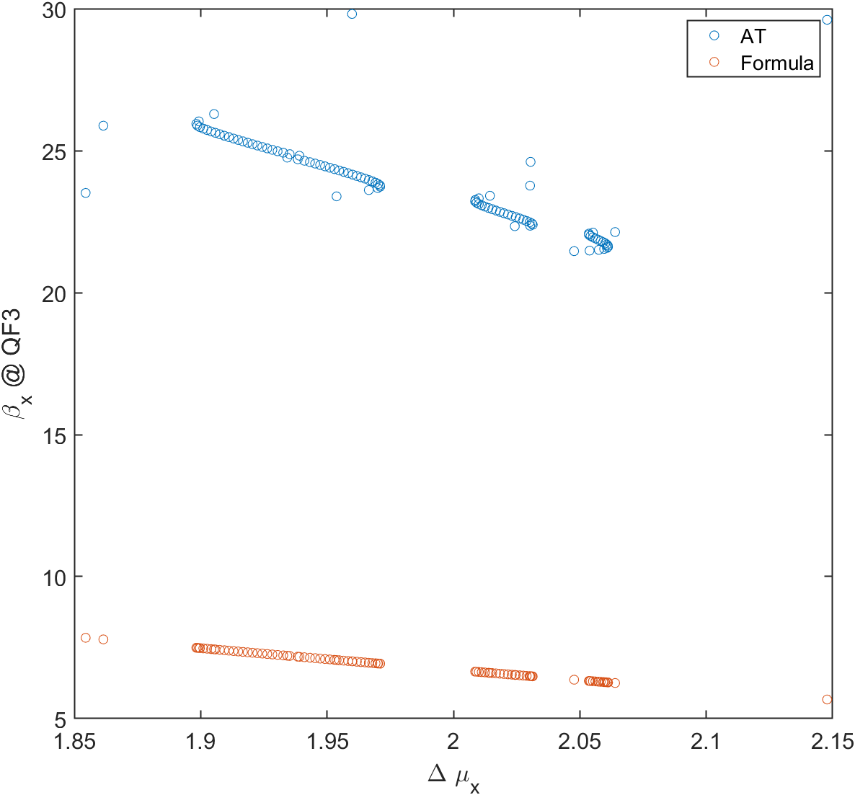
Bending magnet의 K값을 -0.2부터 -0.1까지 0.001씩 옮겨가면서 phase scan
$cosΔφ = 1+\frac{L}{f′} −\frac{L}{f} −\frac{L^{2}}{2ff’} = \left(1−\frac{L}{f} \right)+(1−\frac{L}{2f})\frac{L}{f′}$
$$\left(1−\frac{L}{f} \right)+\left(1−\frac{L}{2f}\right)\frac{L}{f^{′}} =1−2\sin^{2}\left(\frac{Δφ}{2}\right)$$
$\frac{L}{f^{′}} =\frac{\frac{L}{f} − 2\sin^{2}(\frac{Δφ}{2})}{1−\frac{L}{2f} }$
$β =\frac{2L+\frac{L^{2}}{f^{′}}}{sinΔφ} =\frac{L\{2+\frac{\frac{L}{f} − 2\sin^{2}(\frac{Δφ}{2})}{1−\frac{L}{2f} }\}}{sinΔφ}$

Slide 4
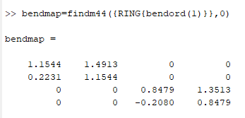
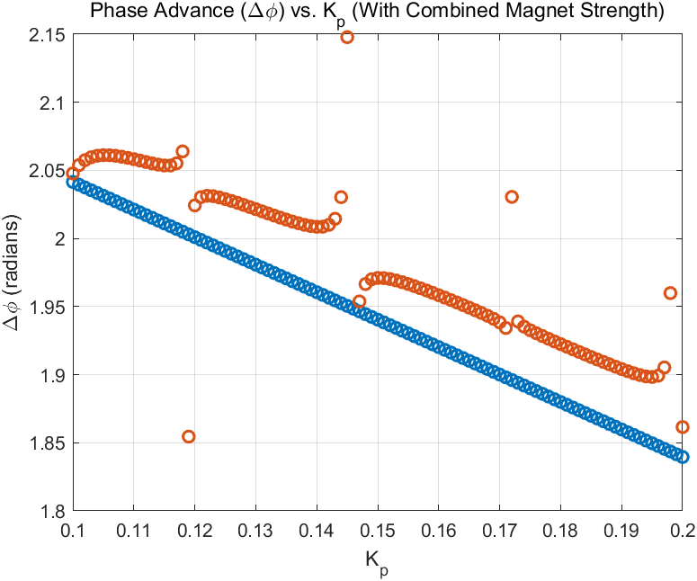
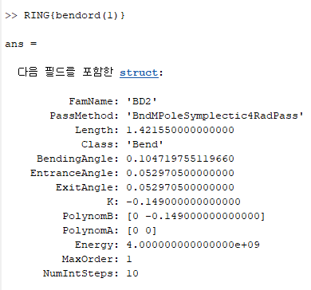
$K_{c}=\sqrt{K+\frac{1}{ρ^{2}}}=0.3929$
$K_{c}=K+\frac{1}{ρ^{2}}=0.1544$
$ρ =\frac{l}{θ} =\frac{1.42155}{0.1047}=13.557$
$cosh\left(\sqrt{K} L\right)=$1.1544
$\frac{1}{\sqrt{K}}\sinh\left(\sqrt{K} L\right)$ = 1.494
$\cos\left(\sqrt{K} L\right)=$0.8531
$${\left(\frac{\cos^{−1}\left(0.8479\right)}{L}\right)}^{2}=0.1545$$

Slide 5
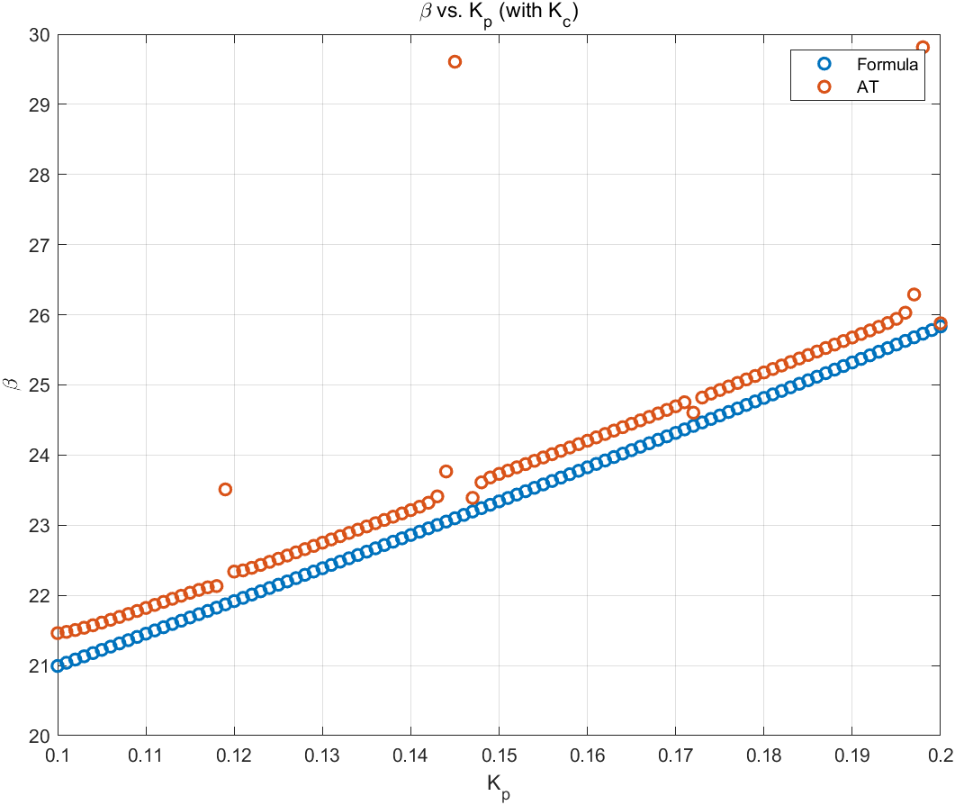
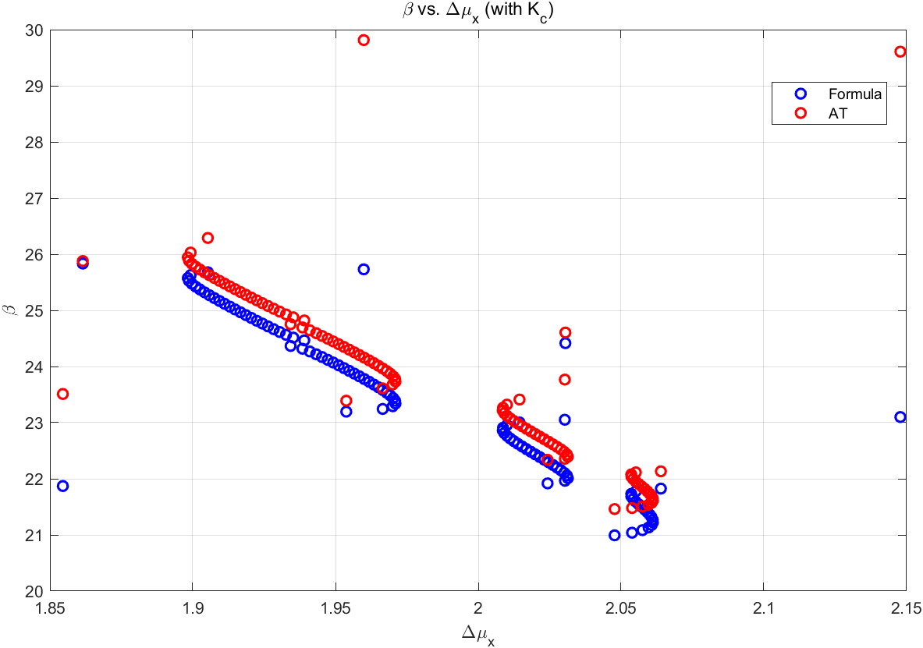
$$=\left(\begin{matrix}M_{11} & M_{12} \\ M_{21} & M_{22}\end{matrix}\right)=\left(\begin{matrix} \cos{Δφ} & βsinΔφ \\ −\frac{1}{β}sinΔφ & \cos{Δφ}\end{matrix}\right)$$
$\sin^{2}{Δφ}+\cos^{2}{Δφ}$ =1
$$\frac{M_{12}}{β^{2}}{+ cos}^{2}{Δφ}=1$$
$$β=\sqrt{\frac{M_{12}}{1−\cos^{2}{Δφ}}}$$

Slide 6
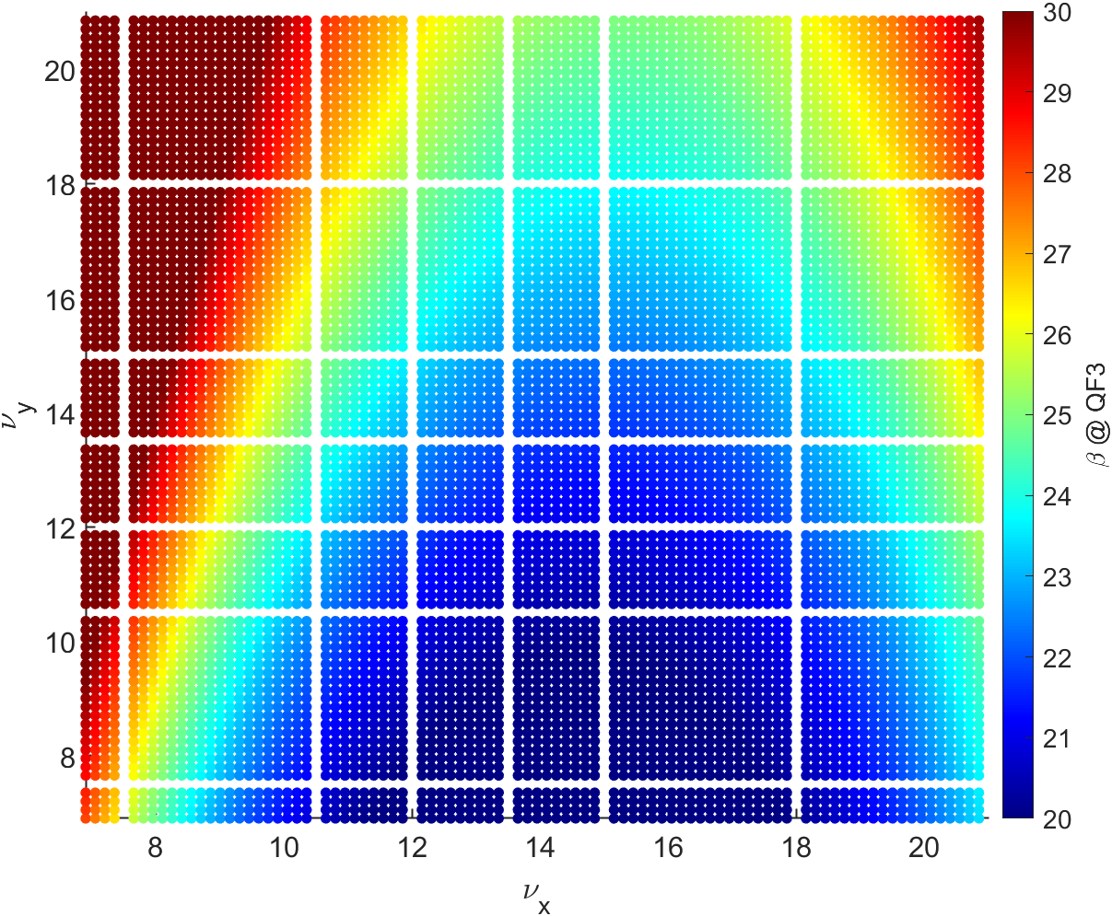
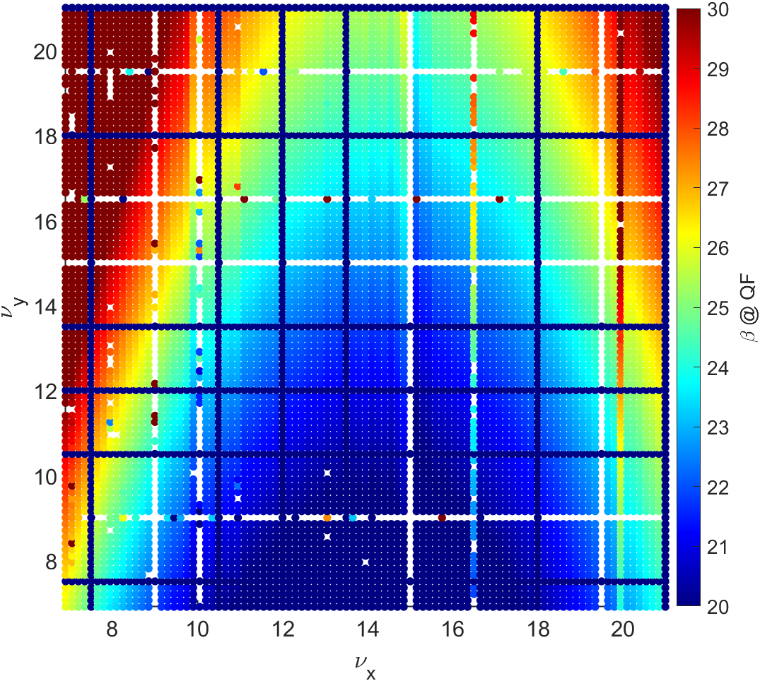
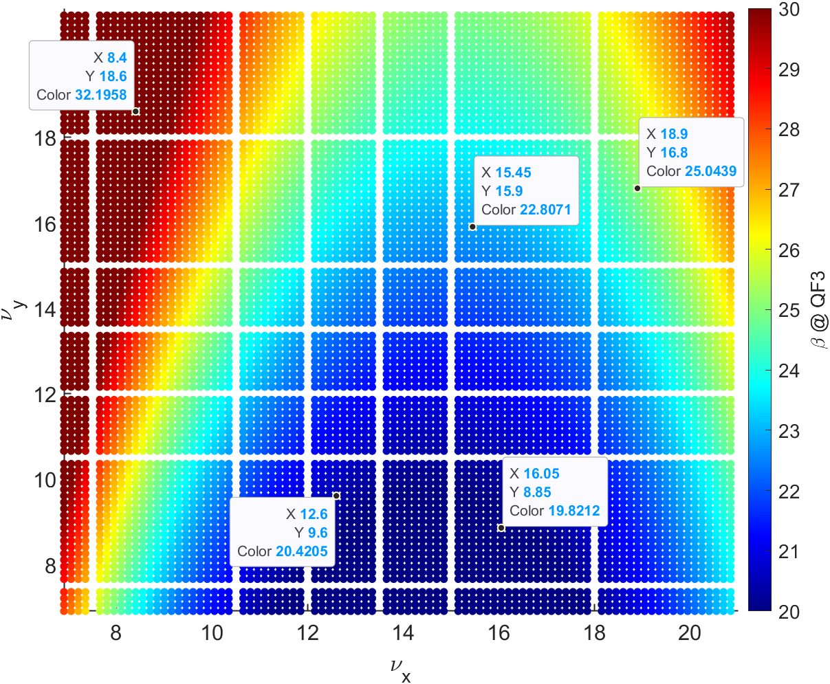
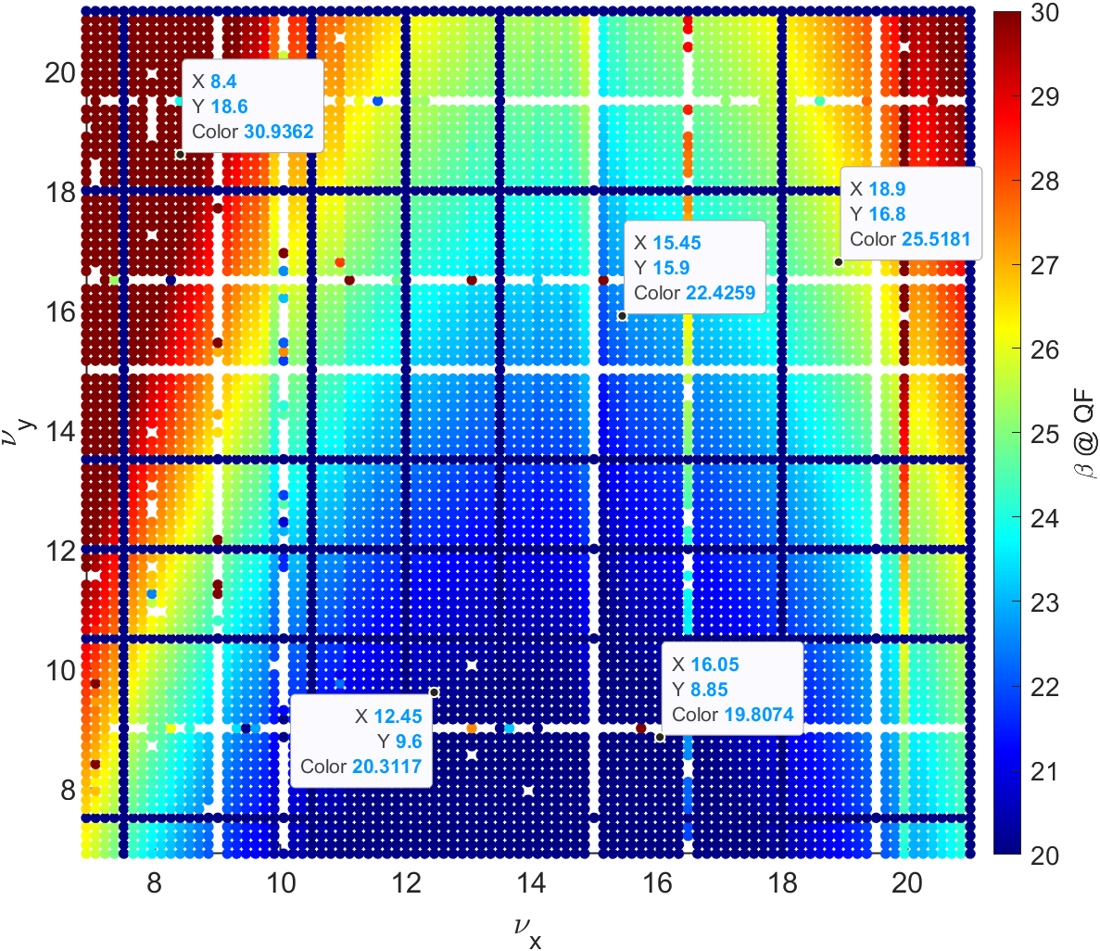
Calculation point of the beta function
L
L

Slide 7
$$\left(\begin{matrix}x \\ x′\end{matrix}\right)=M\left(\begin{matrix}x_{0} \\ x_{0}′\end{matrix}\right)$$
$$M=\left(\begin{matrix}C & S \\ C′ & S′\end{matrix}\right)$$
$\left(\begin{matrix}β \\ α \\ γ\end{matrix}\right)=\left(\begin{matrix}C^{2} & −2CS & S^{2} \\ −CC′ & SC^{′}+S^{′}C & −SS′ \\ C^{′2} & −2S^{′}C′ & S^{′2}\end{matrix}\right)$ $\left(\begin{matrix}β_{0} \\ α_{0} \\ γ_{0}\end{matrix}\right)$
Calculate beta function at sextupoles in Booster
$$\frac{∂ν_{x}}{∂J_{x}}=−\frac{1}{16π}\sum_{j=1}^{N}{\sum_{k=1}^{N}{{\left(b_{3}L\right)}_{j}{\left(b_{3}L\right)}_{k}β_{x,j}^{\frac{3}{2}}}β_{x,k}^{\frac{3}{2}}}[\frac{cos⁡(\left|μ_{j→k,x}\right|−πν_{x})}{sin⁡(πν_{x})}+\frac{cos⁡(\left|3μ_{j→k,x}\right|−3πν_{x})}{sin⁡(3πν_{x})}]$$

