Slide 1
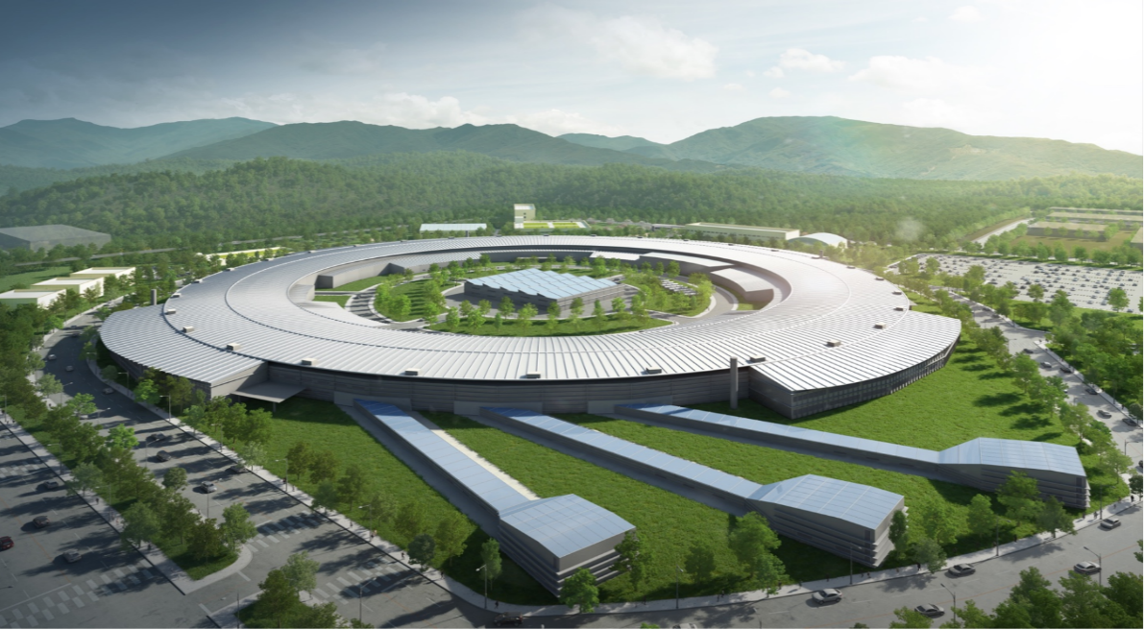
NSLS-II FOFB
NSLS-II Fast Orbit Feedback System
6th Speaker
Control group
Yeun-Chan Ryu
13, Dec 2024

Slide 2
NSLS-II FOFB
Outline
Background
What is Fast Orbit Feedback
Orbit Response Matrix(ORM) & Inverse Response Matrix(IRM)
2. Why this paper
3. Introduction
4. Two-Tier Communication
5. Compensation in eigenspace
What is Feedback Algorithm
6. Commissioning Result
2
Notes:
1,2번은 일반적인 FOFB를 말하는 경우. 가속기별로 상이하다
3번부터 그중 NSLS의 경우를 설명
4번에서 나올 어떤 아키텍쳐로 되어있는지 확인
5번은 시간안에 계산을 할 수 있게 만드는 수학적+회로적 트릭
병렬처리에 특화된 FPGA를 사용을 하였다.
그 전에 SVD에 대한 간단한 소개
6번은 간단하게 beam size가 줄어졌다

Slide 3
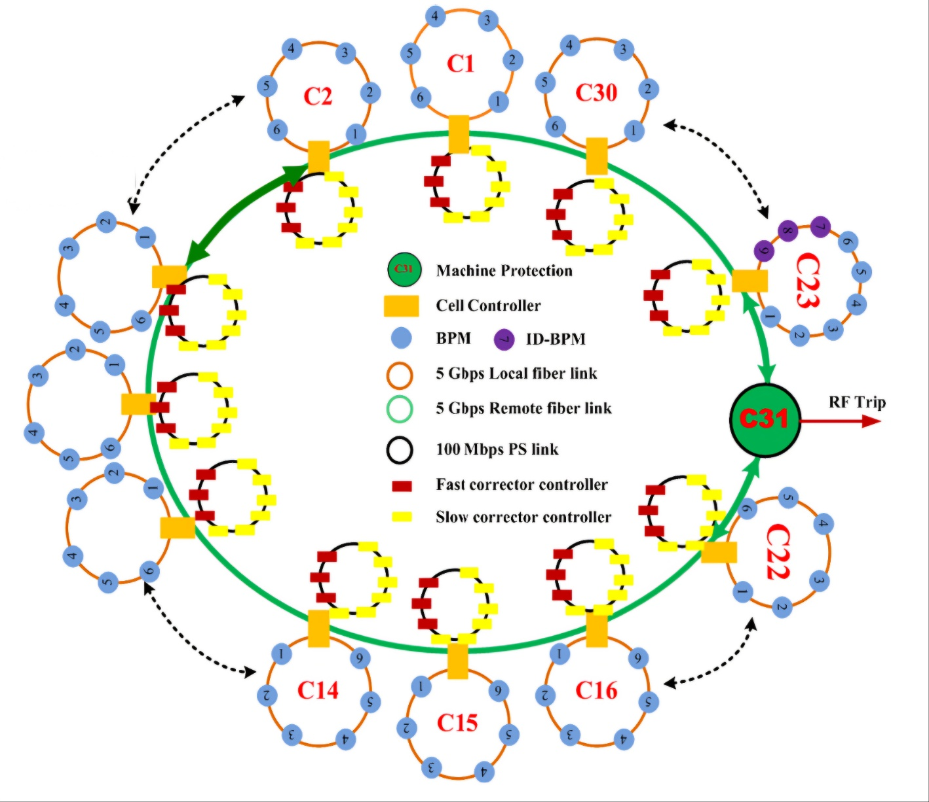
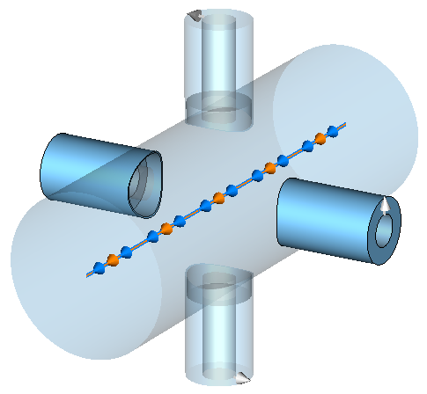
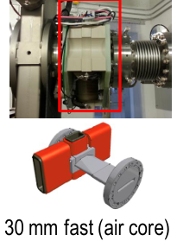
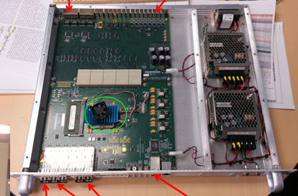
NSLS-II FOFB
Background
What is Fast Orbit Feedback(FOFB)
Suppress noise in the Storage ring or correct magnet errors
Read global beam position monitor data, and correction about beam error
Calculations must be performed within the ‘time budget’
Each Accelerator has different FOFB system
NSLS-II FOFB
(ICALEPCS 2015)
Corrector
Beam Position Monitor
Calculation about error
https://space.mit.edu/
ICALEPCS 2015
ICALEPCS 2015
FOFB 알고리즘 단순화
3

Slide 4
NSLS-II FOFB
Background
Orbit Response Matrix (ORM)
Linear matrix about relationship between beam position and corrector in the FOFB system
Preparatory function for Feedback
Mapping how beam positions change under influence of kick (applied by corrector)
$$\left(\begin{matrix}Δx_{1} \\ Δx_{2} \\ ⋮ \\ Δx_{m}\end{matrix}\right)=\left(\begin{matrix} & & \\ & ORM & \\ & & \end{matrix}\right)\left(\begin{matrix}θ_{1} \\ θ_{2} \\ ⋮ \\ θ_{n}\end{matrix}\right)$$
Inverse Response Matrix (IRM)
Measure orbit deviation (Reference - Detect) and calculate compensation value
IRM derived from ORM
$$\left(\begin{matrix}{Δθ}_{1} \\ {Δθ}_{2} \\ ⋮ \\ {Δθ}_{n}\end{matrix}\right)=\left(\begin{matrix} & & \\ & IRM & \\ & & \end{matrix}\right)\left(\begin{matrix}Ref−x_{1} \\ Ref−x_{2} \\ ⋮ \\ Ref−x_{m}\end{matrix}\right)$$
4
Notes:
FOFB의 아이디어는 다음과 같았습니다. BPM으로 틀어진 정도를 읽고, corrector로 틀어진 것을 잡아주는 역할. 이었습니다
하지만 실제 가속기 내에서 해당의 아이디어를 실제로 구현하기 위해, 디테일한 아키텍쳐 연결방식, BPM과 Corrector를 어떻게 연결할지. 와 알고리즘이 달라지게 됩니다.
그러니 가속기 별로 FOFB 시스템이 조금씩 달라지게 됩니다. 그 중! (다음슬라이드)

Slide 5
NSLS-II FOFB
Why this paper
[Abstract]
This paper Presents the NSLS-II fast orbit feedback(FOFB) system, including the architecture, the algorithm and the commissioning results. A two-tier communication architecture is used to distribute the 10kHz beam position data(BPM) around the storage ring. The FOFB calculation is carried out in field programmable gate arrays (FPGA). An individual eigenmode compensation algorithm is applied to allow different eigenmodes to have different compensation parameters. The system is used as a regular tool to maintain the beam stability at NSLS-II.
[Chosen reason]
The NSLS-II FOFB Architecture is similar with PLS-II & KOREA 4GSR (cell by cell)
Studying calculation algorithm in time budget
Parallel calculation using FPGA
5

Slide 6
NSLS-II FOFB
Introduction
Two-tier Communication
NSLS-II FOFB use 180 BPMs and 90 Fast correctors
To calculate in time budget(10kHz), use Cell Controller
6 BPM + 3 Fast Corrector / Cell Controller
Compensation in eigenmode
Multiple Input-Multiple Output(MIMO)
Traditional Singular Value Decomposition (SVD) : same compensation algorithm
Different compensation for each eigenmode
NSLS-II FOFB
(ICALEPCS 2015)
6

Slide 7
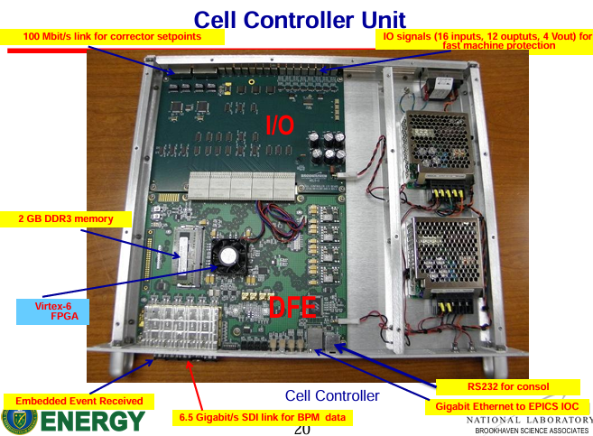
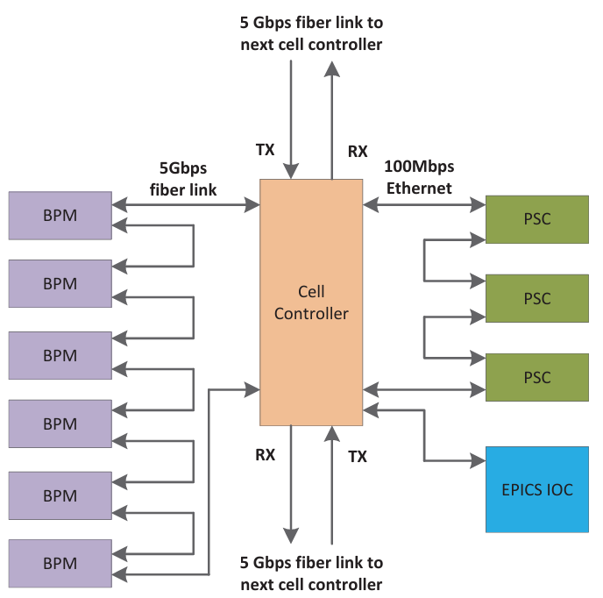
NSLS-II FOFB
Two-tier Communication
To read global BPM data in the storage ring
NSLS-II has 30 Cells
(6 BPM + 3 fast corrector) / cell
Two Tier communication
1st tier : BPM – Cell Controller
2nd tier : Cell Controller - Cell Controller
6 BPM are read by ring topology
EPICS Collaboration (2012)
E V R | 1st B P M | 6th B P M | N-1 C C | N+1 C C
ICALEPCS 2015
7

Slide 8
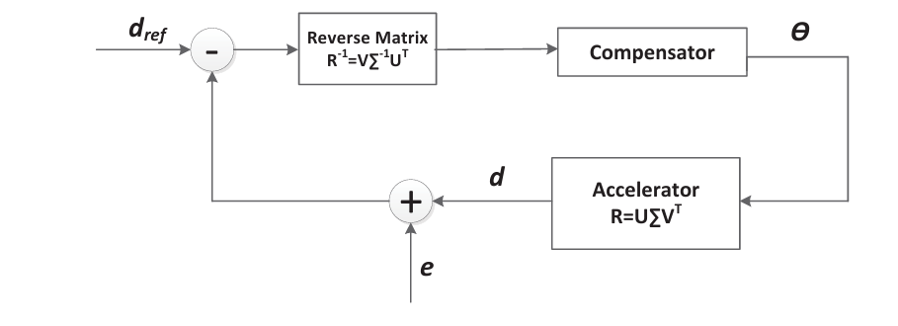
NSLS-II FOFB
Compensation in eigenspace
[Remind] Basic fomula
dCOR=IRM*(Ref-Detect)
Traditional compensator algorithm
$θ_{act}=Q\left(z\right)θ$ Q(z) is compensator controller (≒ PID)
$$\left(\begin{matrix}θ_{1} \\ θ_{2} \\ ⋮ \\ θ_{n}\end{matrix}\right)=\left(\begin{matrix} & & \\ & IRM & \\ & & \end{matrix}\right)\left(\begin{matrix}Ref−x_{1} \\ Ref−x_{2} \\ ⋮ \\ Ref−x_{m}\end{matrix}\right)$$
<dCOR 계산 방법>
$$Q(z)$$
=> Same controller to all eigenmodes
$$θ$$
$$θ_{act}$$
8
Notes:
해당 다이어그램은 일반적인 Feedback 알고리즘 다이어그램입니다. 센서 값에서 값을 읽고, 목표치와의 차이값 만큼의 변화할 값을 controller에서 게산후 Plant에서 적용을 한다
FOFB의 경우에는 Sensor가 BPM이 될 것이며, C.C.가 Controller내 계산과정이며, corrector에서 보충값을 인가합니다.

Slide 9
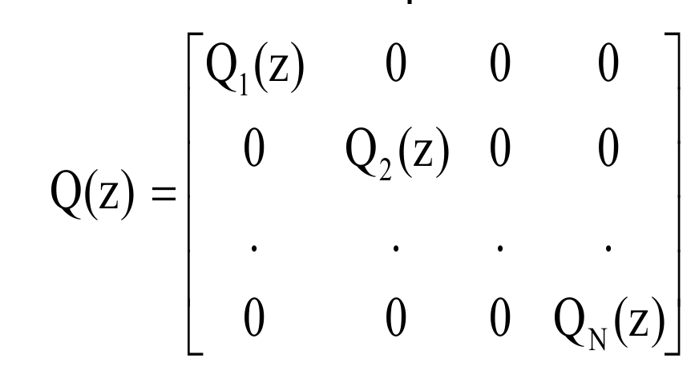
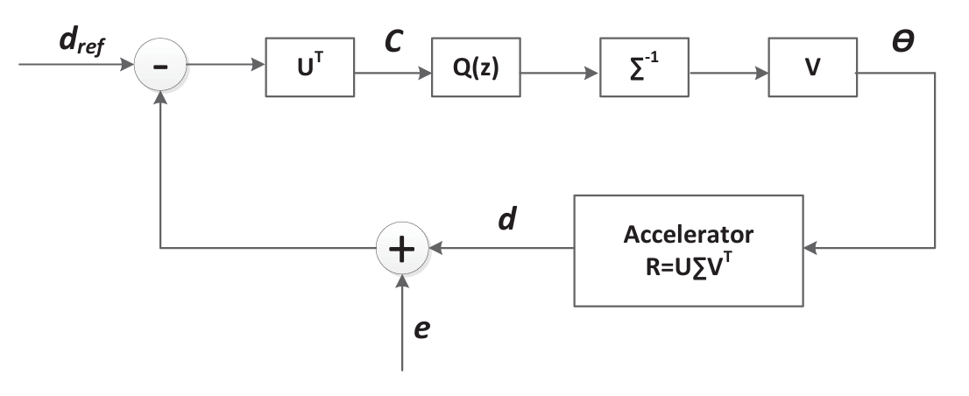
NSLS-II FOFB
Compensation in eigenspace
Singular Value Decompose
Any matrix decompose to 3 matrix
$ORM=UΣV^{T}$ / $IRM=VΣ^{−1}U^{T}$
Individual Eigenmode Compensation
Q(z) is compensation value
$U^{T}ΣV$ is known value by IRM
$$\left[\begin{matrix} & & \\ & IRM & \\ & & \end{matrix}\right]=\left[\begin{matrix}| & | & | \\ e & e & e \\ | & | & |\end{matrix}\right]\left[\begin{matrix}σ^{−1} & 0 & 0 \\ 0 & σ^{−1} & 0 \\ 0 & 0 & σ^{−1}\end{matrix}\right]\left[\begin{matrix}− & e & − \\ − & e & − \\ − & e & −\end{matrix}\right]$$
Eigen vector
Eigen value
Eigen vector
Q(z) is can be individual by diagonal
MxN
NxN
NxN
NxN
=> Large number of calculation need in time
9
Notes:
IRM을 사전에 계산한 값이므로, U $Σ$ V 또한 사전에 계산된 값입니다.
Q(z)는 diagonal matrix이므로 서로의 eigenspace에 영향을 주지 않습니다

Slide 10
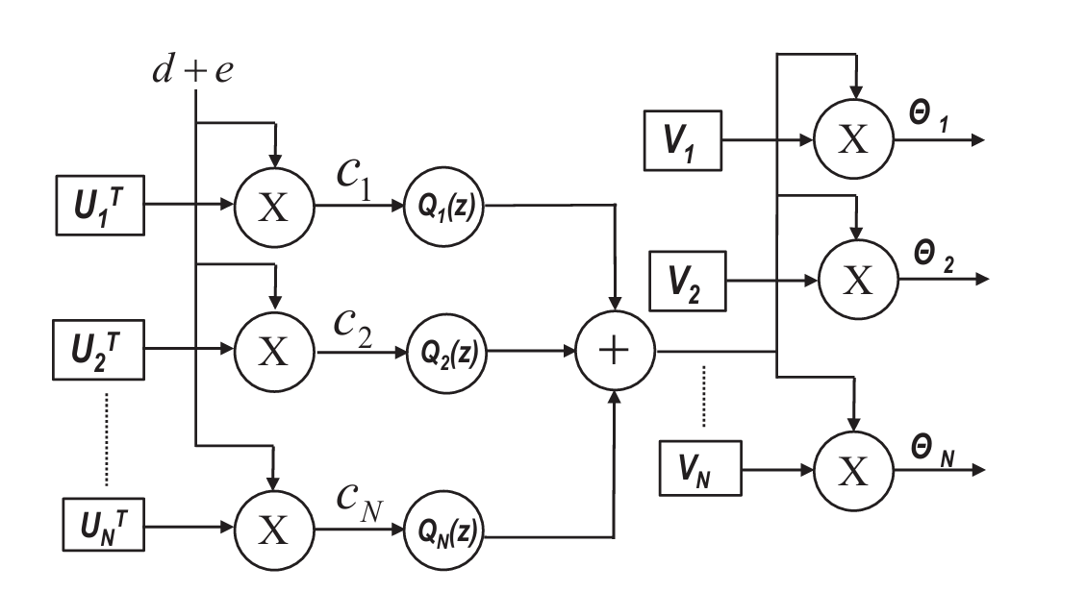
NSLS-II FOFB
Compensation in eigenspace
FOFB calculation with FPGA
Field Programmable Gate Array(FPGA) is gate array
Gate array has capability to parallel computation
$U_{i}, Q_{i}\left(z\right), V_{i}$ setting on correspond Cell Controller
$$⋯$$
$$U_{1}$$
BPM1
$$U_{2}$$
BPM2
$$U_{3}$$
BPM3
$$⋯$$
$$N_{180}$$
BPM180
10

Slide 11
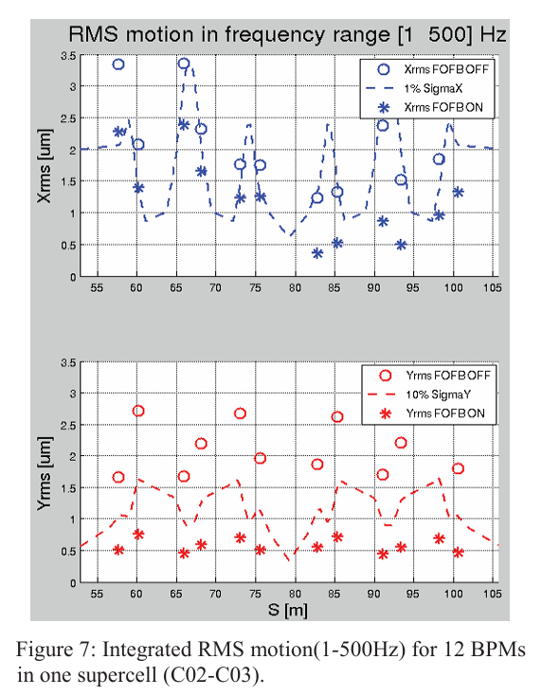
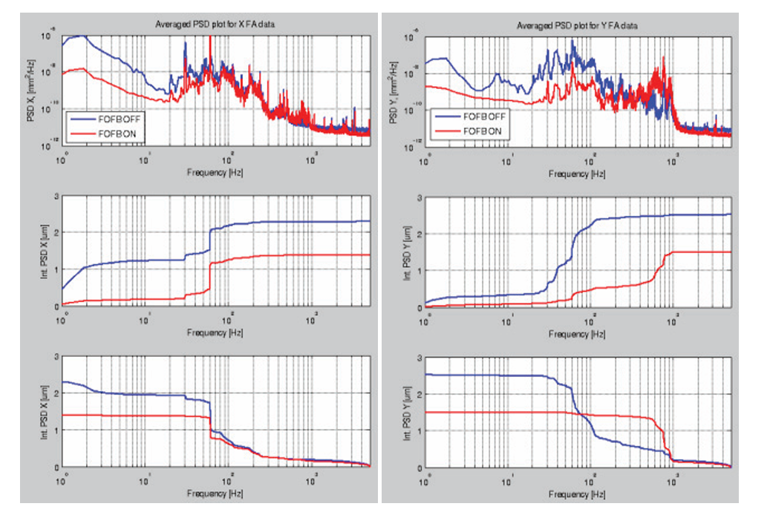
NSLS-II FOFB
Commissioning Result
Beam Stability Achievement
RMS motion
11

Slide 12
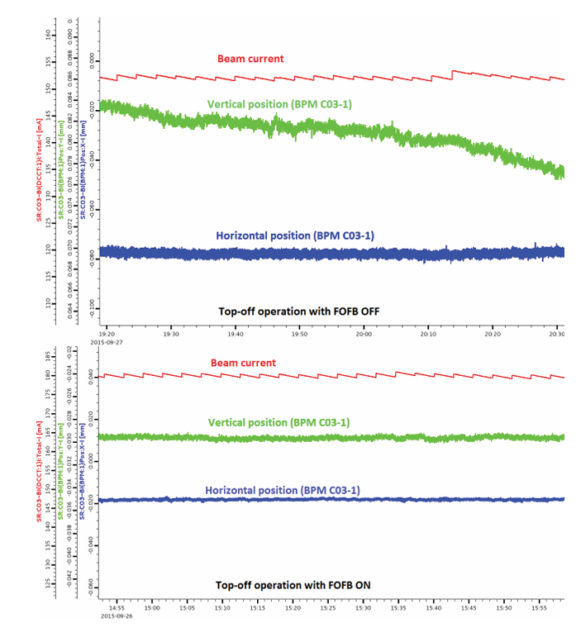
NSLS-II FOFB
Commissioning Result
Beam Stability Achievement
Injection
12

Slide 13
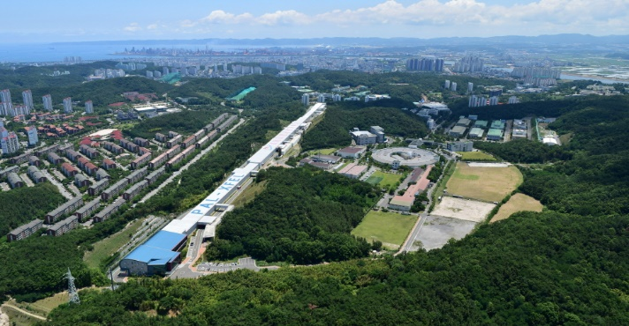
NSLS-II FOFB
Thank you!

Slide 14
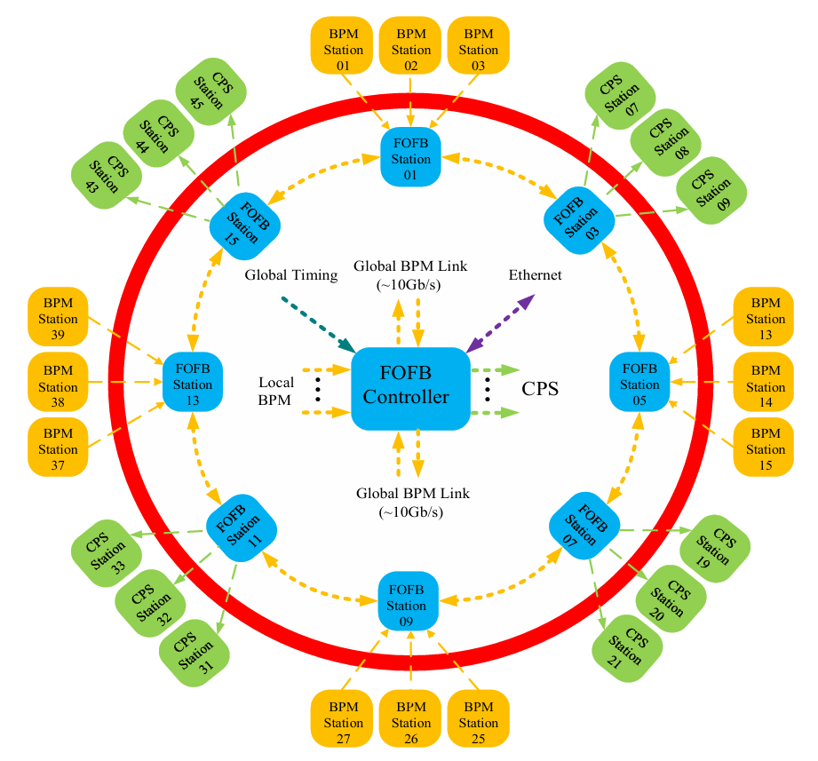
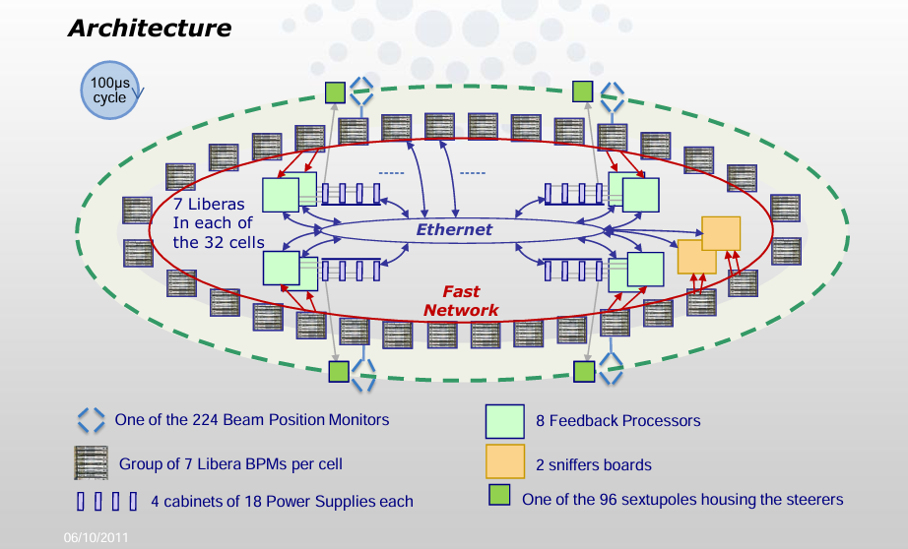
NSLS-II FOFB
Background
Other Accelerator Lab FOFB system
Each Accelerator has different FOFB system
NSLS-II control FOFB to cell by cell (same as KOREA 4GSR)
HEPS FOFB
(ICALEPCS 2023)
NSLS-II FOFB
(ICALEPCS 2015)
ESRF FOFB
(E. Plouviez JM Koch 2011)
4

Slide 15
NSLS-II FOFB
Compensation in eigenspace
FOFB calculation with FPGA
Field Programmable Gate Array(FPGA) is gate array
Gate array has capability to parallel computation
1X90
1X180
90X1
1X90
1X180
90X1
1X90
1X180
90X1
10

