Slide 1
고반복율 컴팩트 플라즈마 기반 방사광원
개발을 위한 캐필러리 구조 최적화
2024.12.19
Junyeong Jeong, Inhyuk Nam, Min Sup Hur, Moses Chung

Slide 2
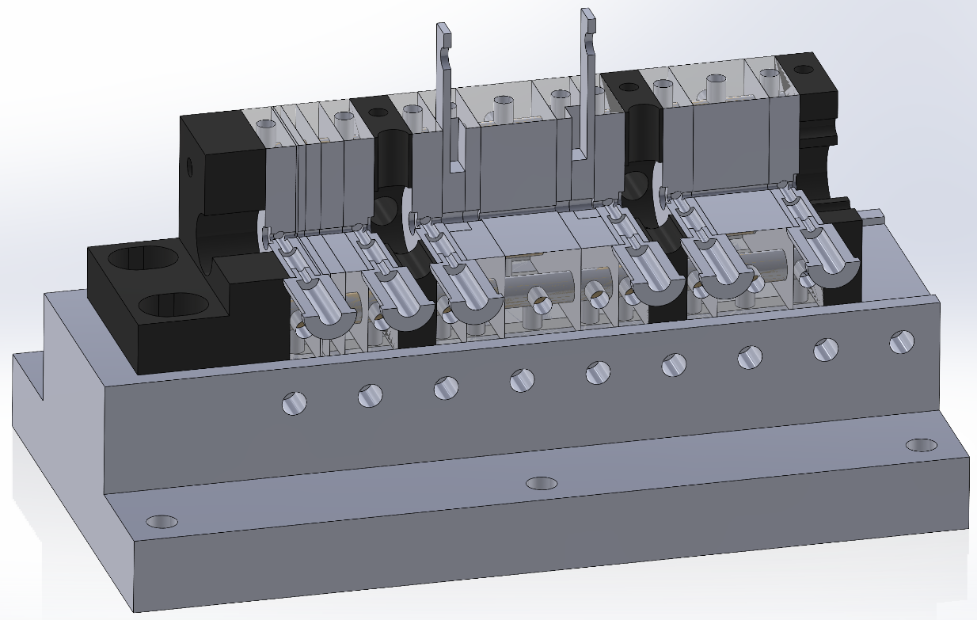
Research start from
Segmented capillary and Tapered plasma density

Slide 3
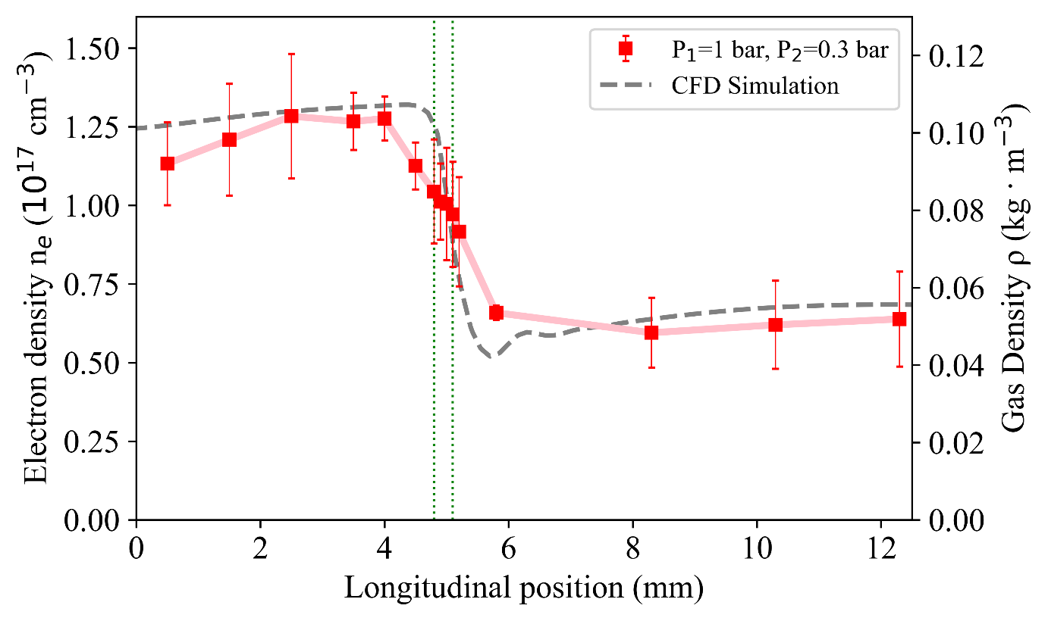
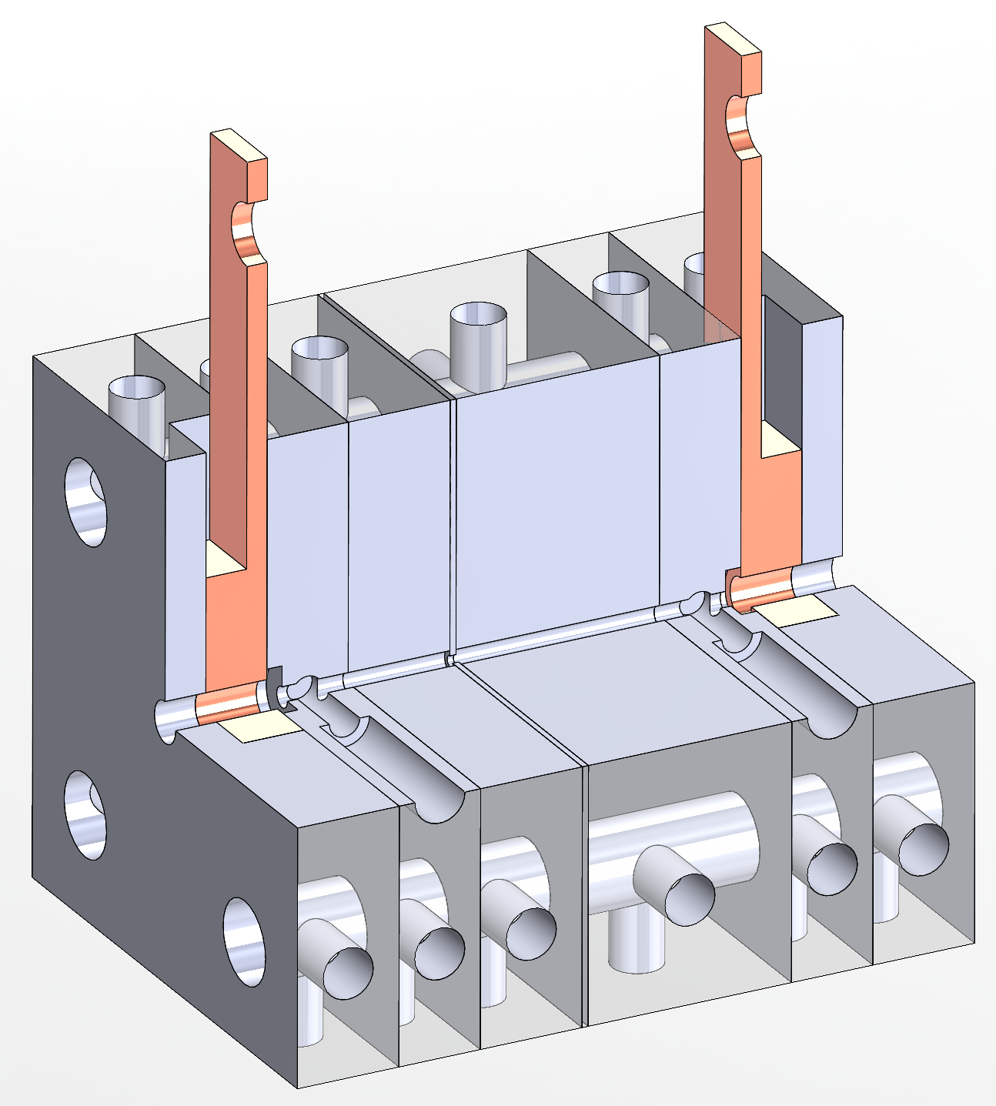
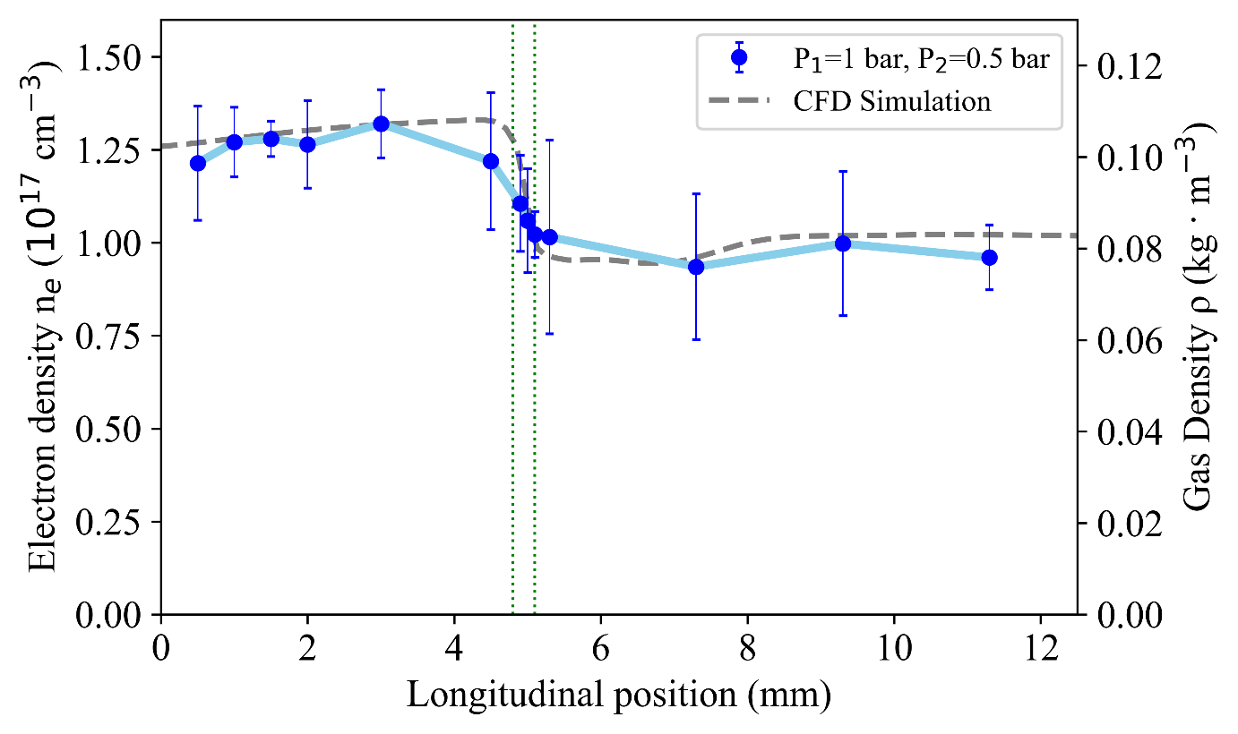
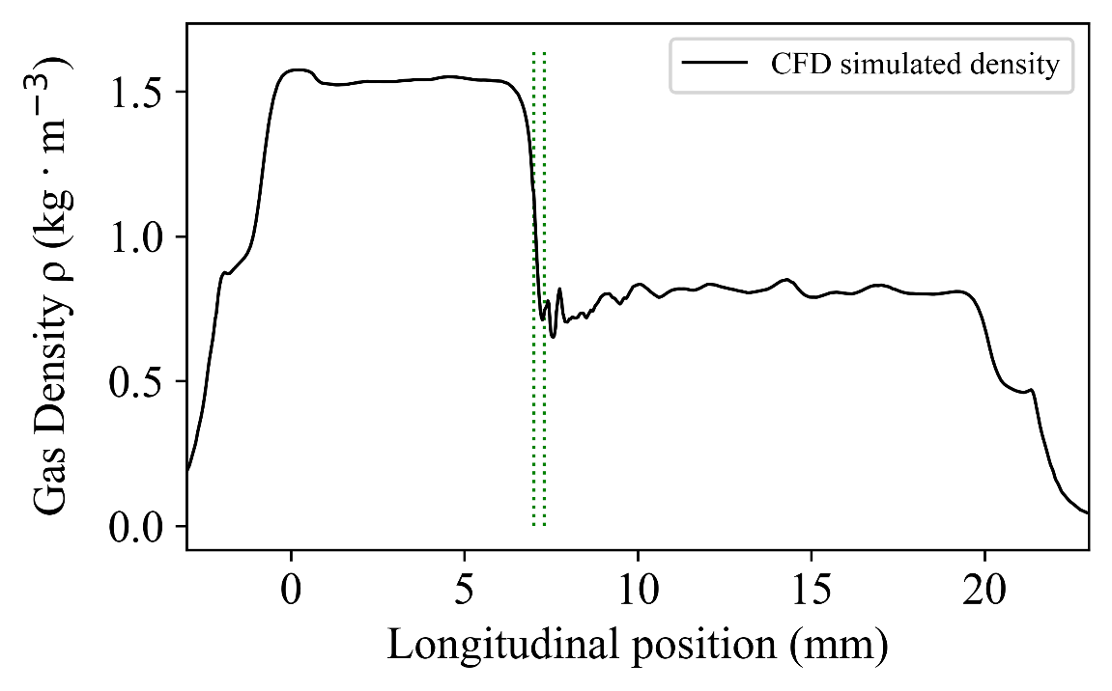
Research start from
Segmented capillary and Tapered plasma density

Slide 4
Tapered density for what?
Plasma density : $5×{10}^{18} {cm}^{−3}$ / $3×{10}^{18} {cm}^{−3}$
Laser parameters:
$a_{0}=1.7$
duration$=25 fs$ FWHM
spot size$=23 μm$ FWHM
target focus$=5 mm$ → density transition position
Electron beam :
energy $=334 MeV$
energy spread $:σ_{E}=23 MeV$
total charge = 48 pC

Slide 5
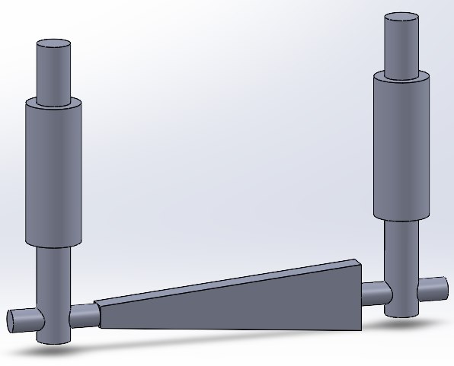
Follow-up Research
Design other modules for special purpose
Continuous gas flow
Differential pumping with Cavity module
Different sort of tapered density
Capillary radius variation

Slide 6
Follow-up Research
Done
Plan
Result
Model design
CFD simulation (Molflow, ANSYS)
Good
Make model
Result
Experiment
Bad
Bad
Succeed!
Good

Slide 7
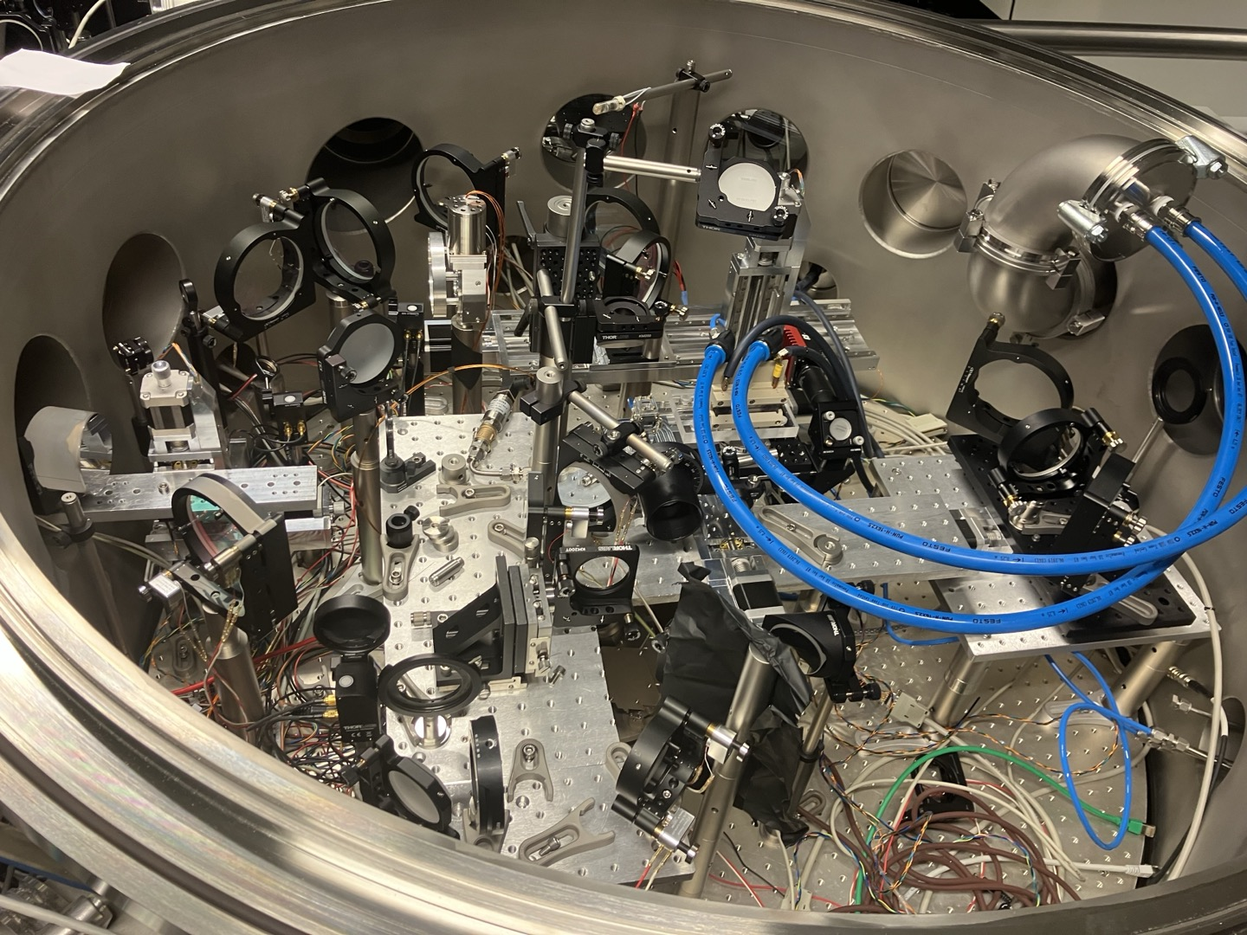
Chamber example
DESY Hamburg, MPL group
Gas jet + Capillary source
Differential pumping around capillary source

Slide 8
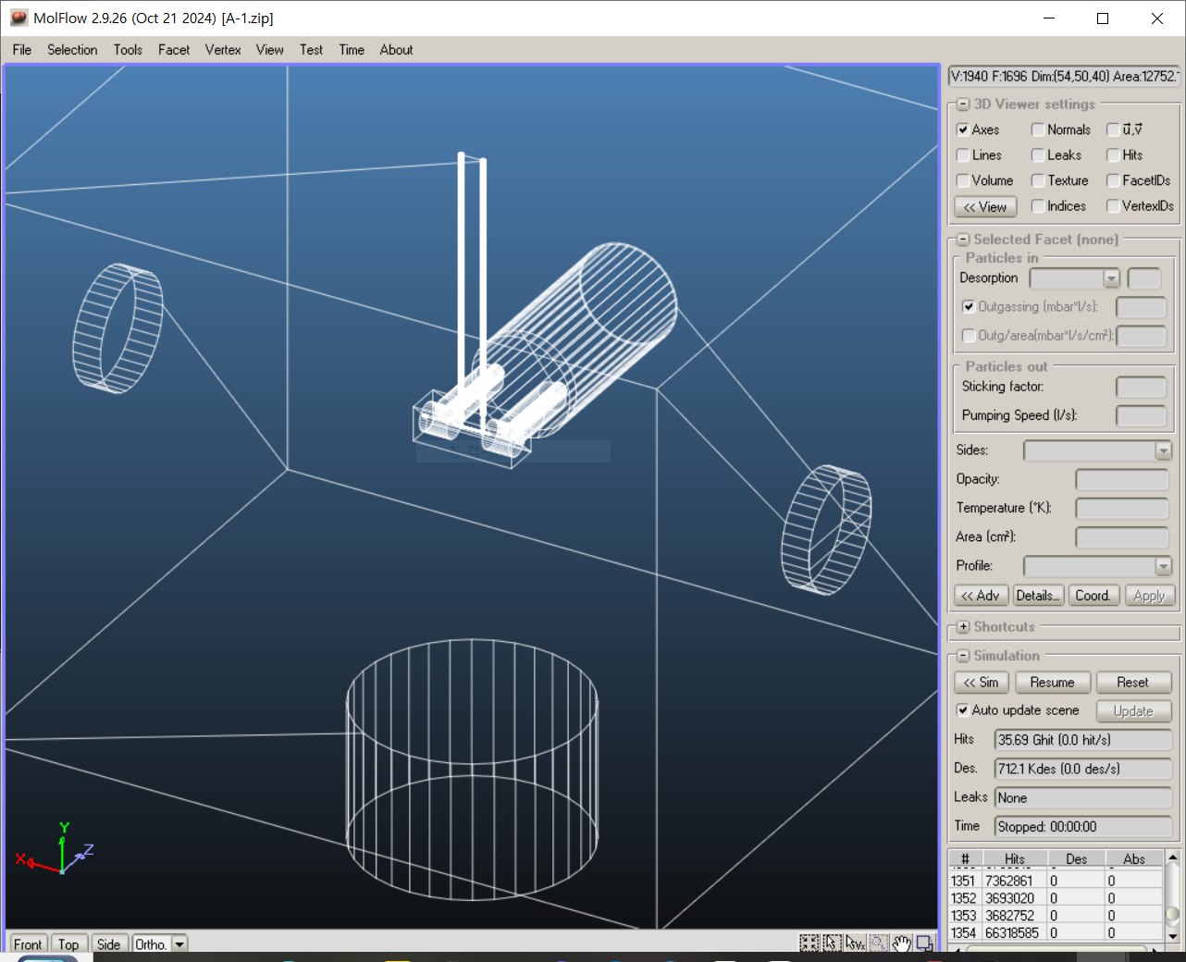
CFD(MolFlow)
Test-particle Monte-Carlo simulators for ultra-high-vacuum and synchrotron radiation, developed at CERN
Start from simple cube chamber
Structure dimension
Chamber: 500*400*400
Capillary: 20mm length, 2 inlets
Main pump below (DN 100 CF)
Beam path (DN 40 CF)

Slide 9
CFD(MolFlow)
Gas: He (4g/mol)
Desorption type → Cosine
[Outgassing/Area]
Capillary: 1E-14 (Sapphire crystal)
Chamber: 1E-12 (SUS304)
Gas line: 1E-10 (Plastic)
[Gas injection]
Inlet:
$$Q=P×A×v=P×A×\sqrt{\frac{8RT}{πM}}$$
Control this parameter and see the Capillary center pressure

Slide 10
Continuous gas flow [A]
Differential pumping
Without (0)
Pumping from side cavity module
One module (1)
Two modules (2)
Side pump – pumping speed
70 L/s (1)
0 – Only with structure (3)
350 L/s (4)

Slide 11
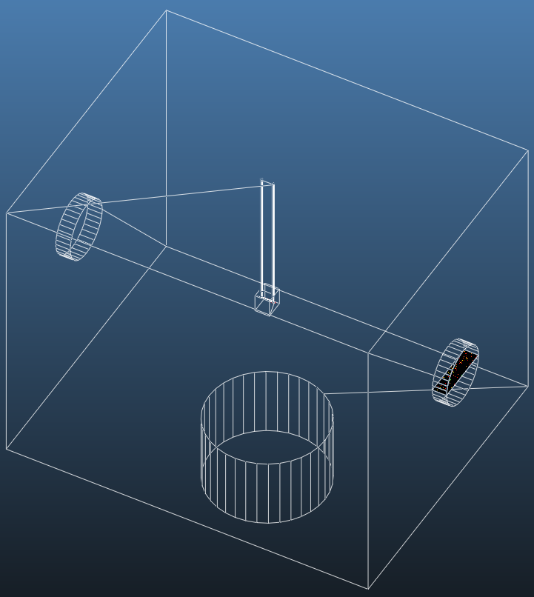
A-0 (capillary only)
Outgassing parameter at the chamber feedthrough
Cosine, 15 mbar*L/s
Pressure inside the capillary
150 mbar
Pressure at the wall(beam path direction)
4.7E-2 mbar

Slide 12
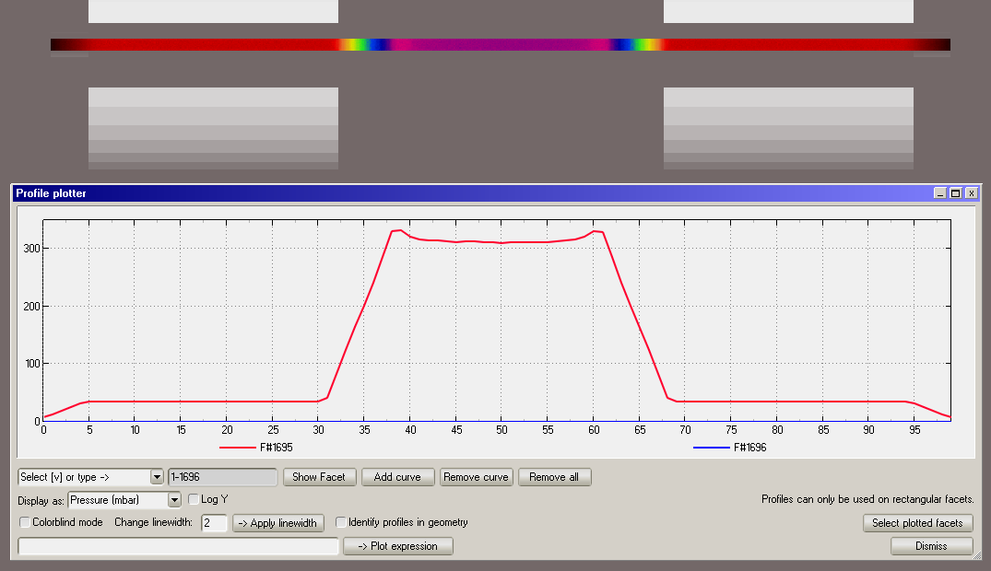
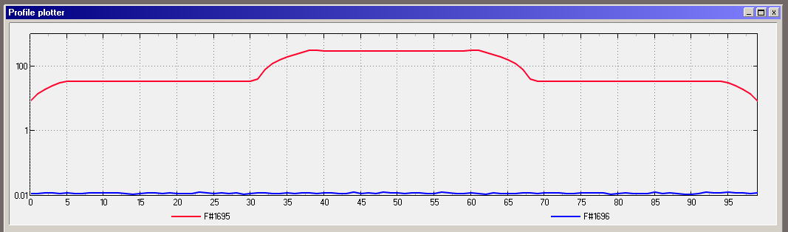
A-1 single cavity module
Pressure inside the capillary
320 mbar
1st cavity module
30 mbar
Pressure at the wall(beam path direction)
1.54E-2 mbar

Slide 13
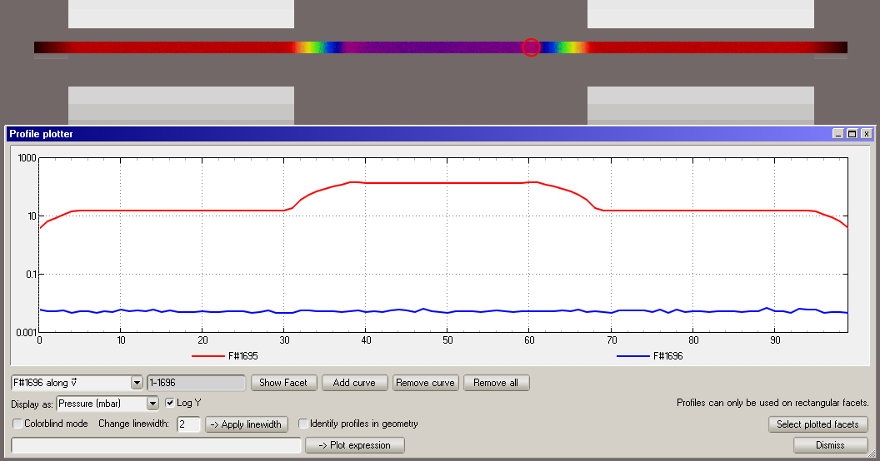
A-1 Pressure normalization
Fit the capillary pressure to 150 mbar
1st cavity pressure 15 mbar
Wall pressure 6.25E-3 mbar

Slide 14
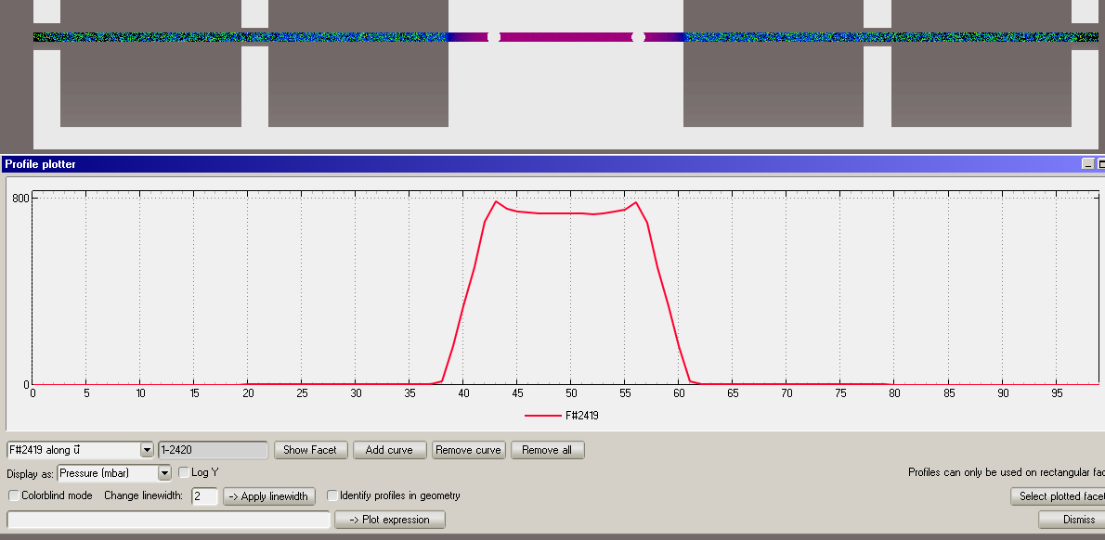
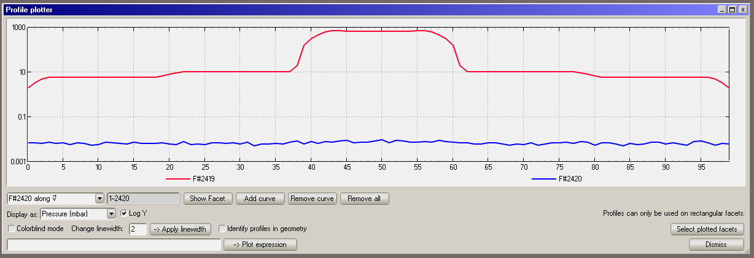
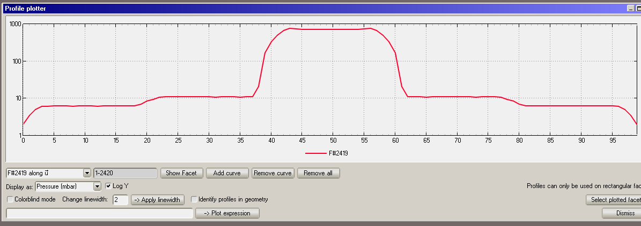
A-2 double cavity module
Pressure inside the capillary
740 mbar
1st cavity pressure 11 mbar
2nd cavity pressure 6 mbar
Pressure at the wall(beam path direction)
1.51E-3 mbar

Slide 15
A-2 Pressure normalization
Fit the capillary pressure to 150 mbar
1st cavity pressure 2.3 mbar
2nd cavity pressure 1.25 mbar
Wall pressure 1.01E-2 mbar

Slide 16
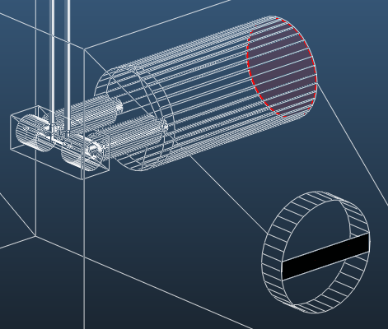
Pump speed (Side)
Side pump speed (single cavity)
Capillary / Wall Pressure
0L/s
340 mbar / 3.14E-2 mbar
70L/s(A-1)
320 mbar / 1.24E-2 mbar
140L/s
300 mbar / 5.16E-3 mbar
210L/s
280 mbar / 2.5E-3 mbar
350L/s
260 mbar / 1.25E-3 mbar

Slide 17
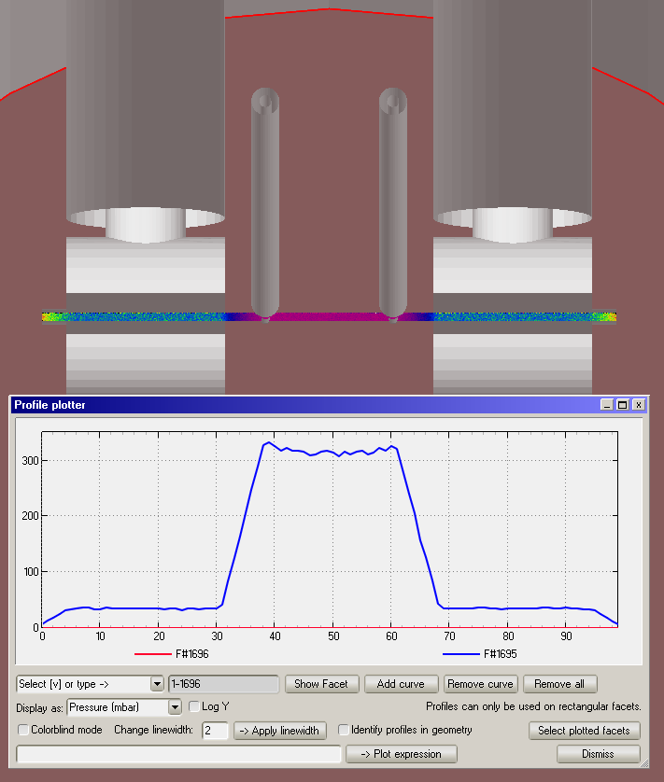
Pump speed (Main)
Main pump speed (double cavity)
Capillary / Wall Pressure
700L/s
320 mbar / 1.44E-2 mbar
1400L/s
310 mbar / 4.3E-3 mbar
2100L/s
310 mbar / 1.01E-3 mbar

Slide 18
Result [A]
(Unit: mbar) | No Cavity | 1 cavity |  | 2 cavities
 |  | Orig. | Norm. | Orig. | Norm.
P_in | 150 | 300 | 150 | 740 | 150
P_wall | 4.7E-2 | 1.44E-2 | 6.25E-3 | 1.01E-2 | 1.51E-3
Cavity module
Reduce main pump effect to the capillary pressure (rising)
Structure itself affects the wall pressure
Side pump
Very effective to reduce wall pressure
Only few effect about capillary pressure
Main pump
Effective to reduce wall pressure, but not much as side pump
Almost zero-effect about capillary pressure
To reach the target pressure(<1E-4 mbar)
Use strong side pump (main → too expensive)
Add more cavity module
Side pump speed (L/s) | Capillary pressure (mbar) | Wall pressure (mbar)
0 | 340 | 3.14E-2
70 | 320 | 1.44E-2
140 | 300 | 5.16E-3
210 | 280 | 2.5E-3
350 | 260 | 1.25E-3
Side pump speed (L/s) | Capillary pressure (mbar) | Wall pressure (mbar)
700 | 320 | 1.44E-2
1400 | 310 | 4.3E-3
2100 | 300 | 1.01E-3

Slide 19
Tapered density [B]/[C]
Done
Target [B]
ne
Tapered plasma density to increase electron energy by phased locked LWFA
ne
Down gradient plasma density for controlled injection
- High quality electron beam
- Narrow energy spread electron beam
x
x
H. Suk, et. al. Phys. Rev. Lett. 86 1011 (2001)
E. Guillaume, et. al. Phys. Rev. Lett. 115, 155002 (2015) – shock front in gas jet
J. Kim et al. JINST 14 C12015 (2019) – down gradient in capillary gas-cell
W. Rittershofer, et. al. Phys. Plasmas 17, 063104 (2010)
M.S Hur, et. al. Phys. Plasmas 18, 033102 (2011)
M.S Kim, et. al. Appl. Phys. Lett. 102, 204103 (2013)
Target [C]
Done
ne
ne
Long up-ramp density plasma to enhance electron beam energy
Variable acceleration length to optimize beam quality according to the dephasing/depletion length
x
x
C. Aniculaesei et al. Sci. Rep. 9, 11249 (2019)
Inhyuk Nam et al. Phys. Scr. 99 015603 (2024)
A.E. Hussein et al. Sci. Rep. 9, 3249 (2019)

Slide 20
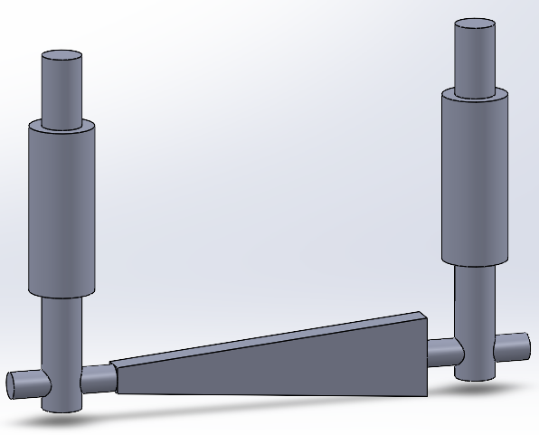
Slope on the center [B]
Slope structure (12mm)
Linear plate(1)
Exponential plate (2)
Linear cone (3)
Exponential cone (4)
Inlet pressure 1:3
Left side: 5 mbar*L/s
Right side: 15 mbar*L/s
Without Differential pump
ne
x

Slide 21
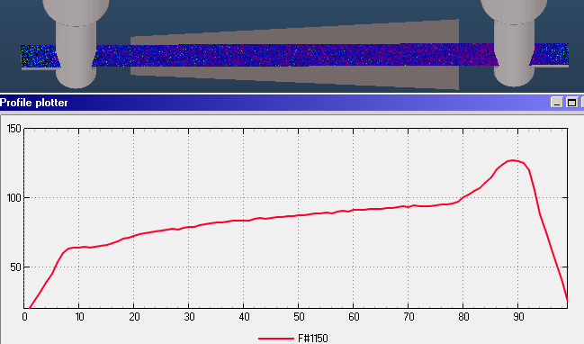
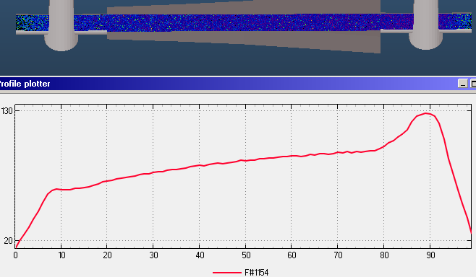
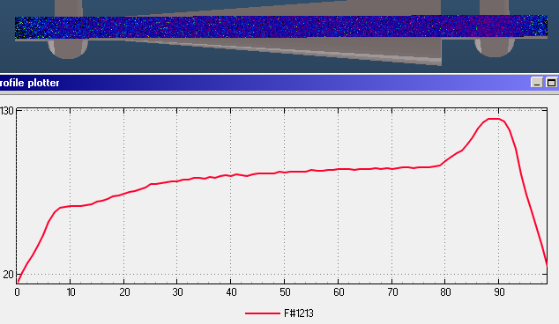
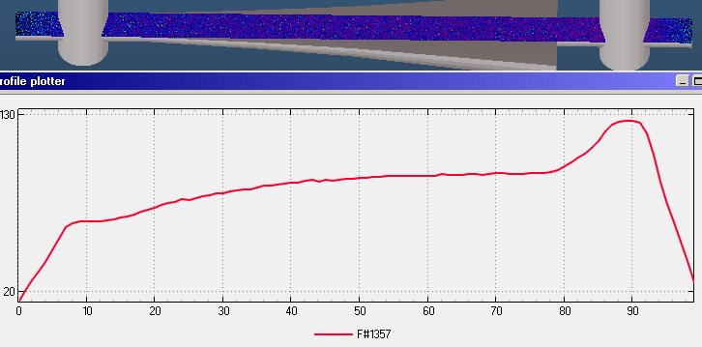
Result [B]

Slide 22
Plot

Slide 23
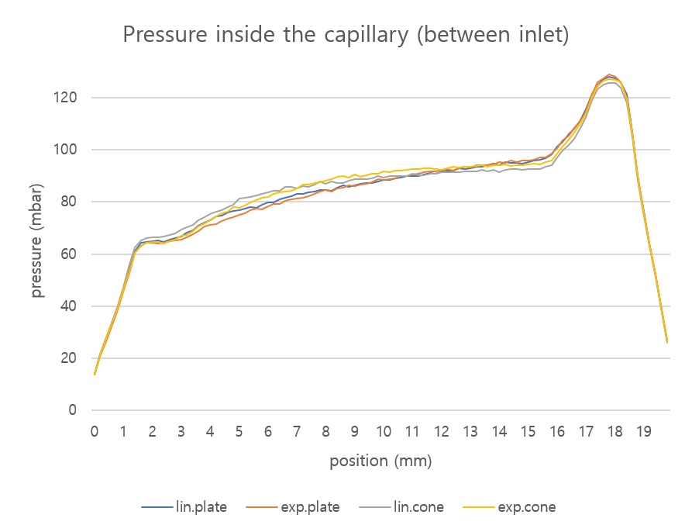
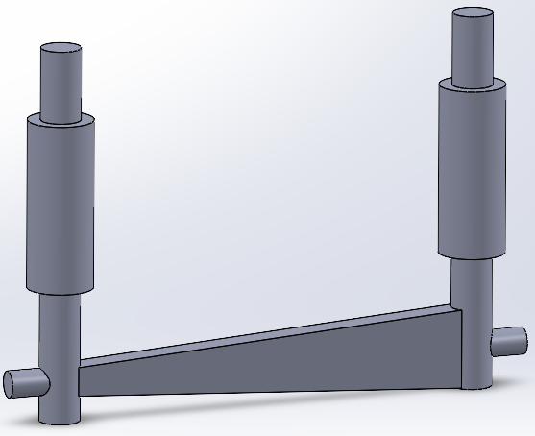
Modifying the design [B]
Plate makes more linear slope, compared to cone
Path between inlet and center structure makes different slope with center

Slide 24
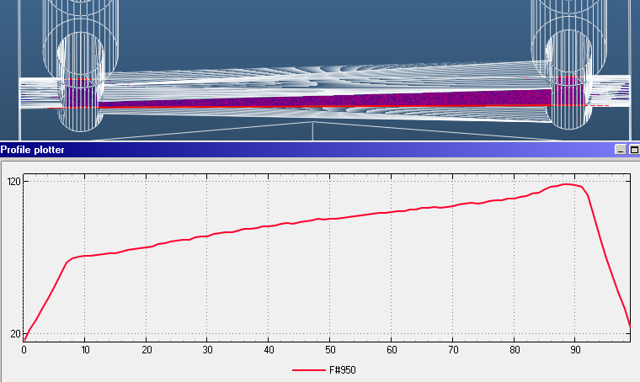
Result [B]

Slide 25
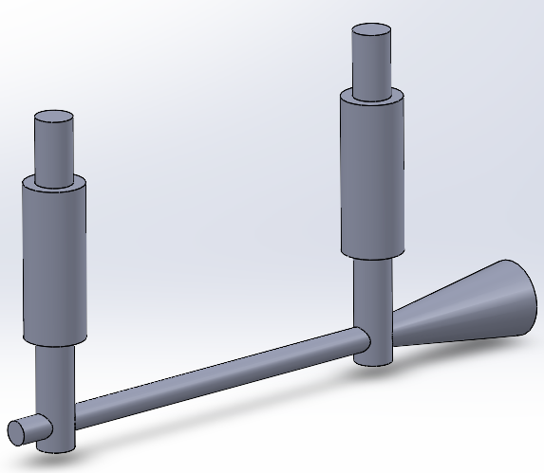
Outlet Design [C]
Outlet modifying
Longer cylinder
Cone
Wider cylinder
ne
x

Slide 26
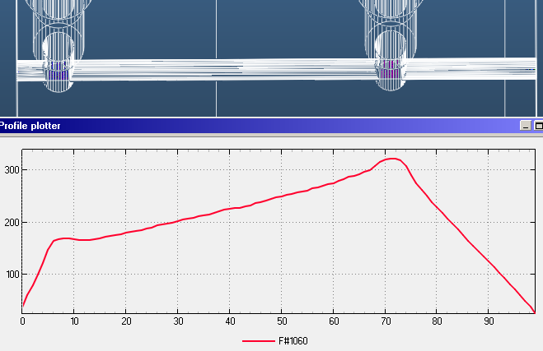
Longer outlet
Linear slope on the right outlet side
Long path makes pressure rising on the right inlet side
But it can be used for [B] cases
→ Let’s make wide outlet → Cone

Slide 27
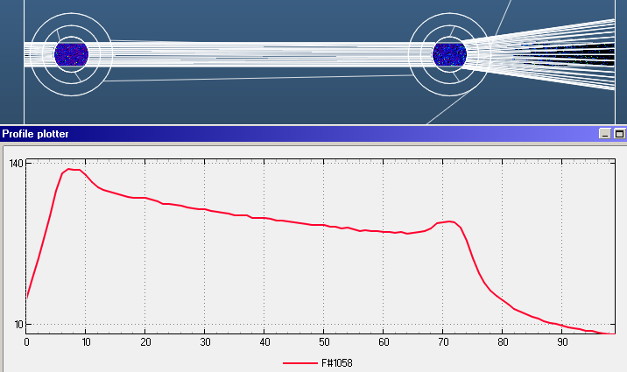
Cone outlet
Cone makes exponential slope
Pressure on the right inlet side is decreased too much
→ Increasing right inlet pressure and change the cone to wider cylinder

Slide 28
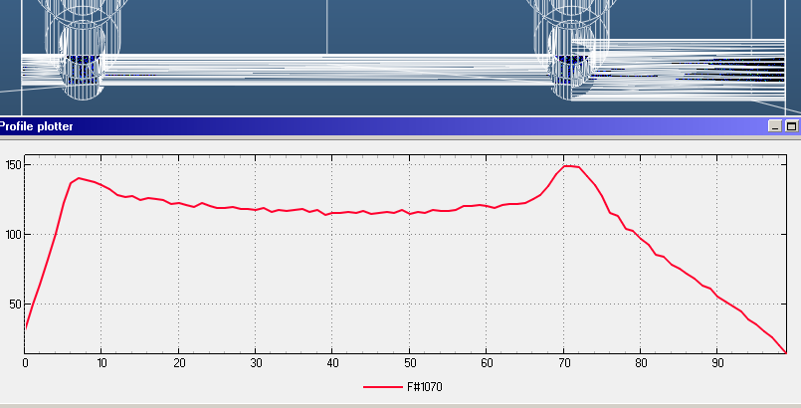
Wider cylinder
Inlet outgassing parameter:
L: 15 mbar*L/s
R: 35 mbar*L/s
Can make linear slope
Center pressure is flat, except for the inlet position

Slide 29
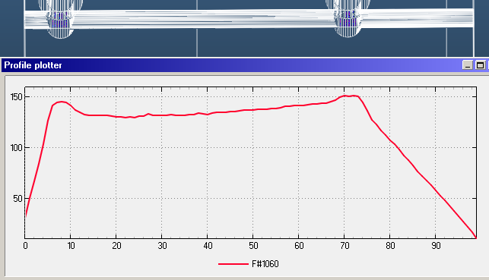
Conclusion [C]
ne
Longer/Wider outlet with inlet pressure control can make Longer linear slope
Long outlet → Long slope + Pressure increasing
Wide outlet → Long slope + Pressure decreasing
ex) Long outlet with inlet outgassing parameter (L:15, R:6)
x
Limitation
We don’t know exact gas pressure until we generate the plasma and measure its density

Slide 30
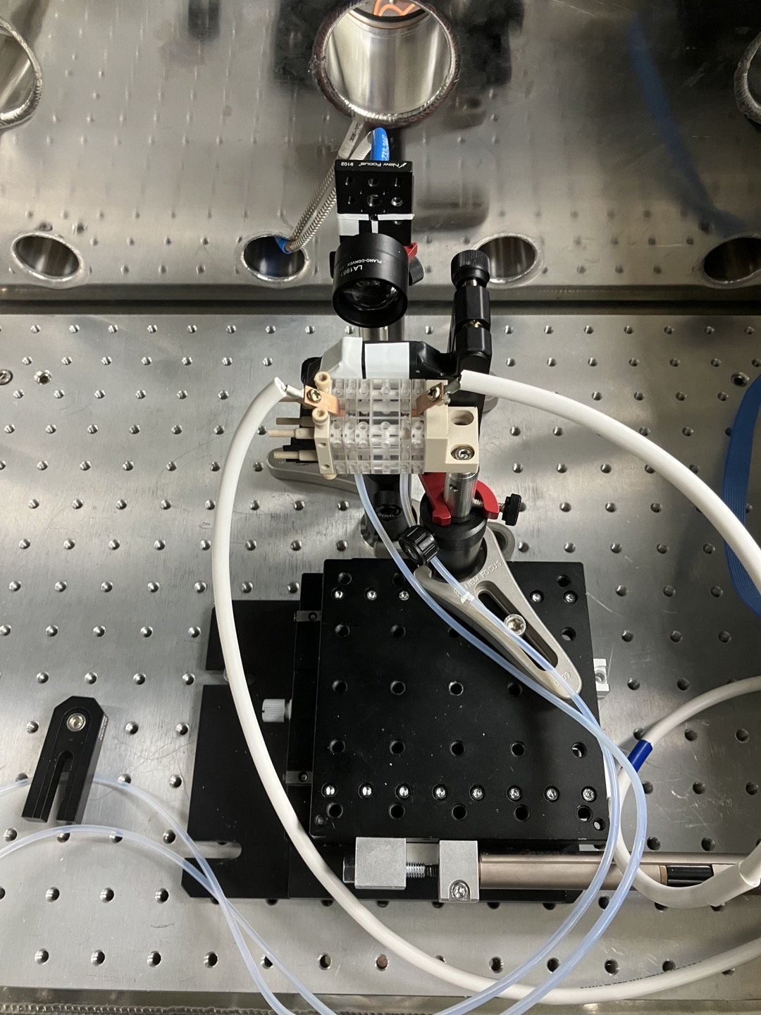
Overall
Conclusion
Specialized module for SC:
→ Proven effective via CFD
Experimental plan
Continuous flow:
3D-printed differential pump cavity module
Chamber & Feedthrough: Outsourced
Tapered plasma density
→ Modules: discharge-safe materials (Diamond / Sapphire)
→ Discharge circuit & Spectrometer fabrication
LWFA experiment

Slide 31
THANK YOU!
jjy6330@unist.ac.kr
ihnam@unist.ac.kr

