Slide 1
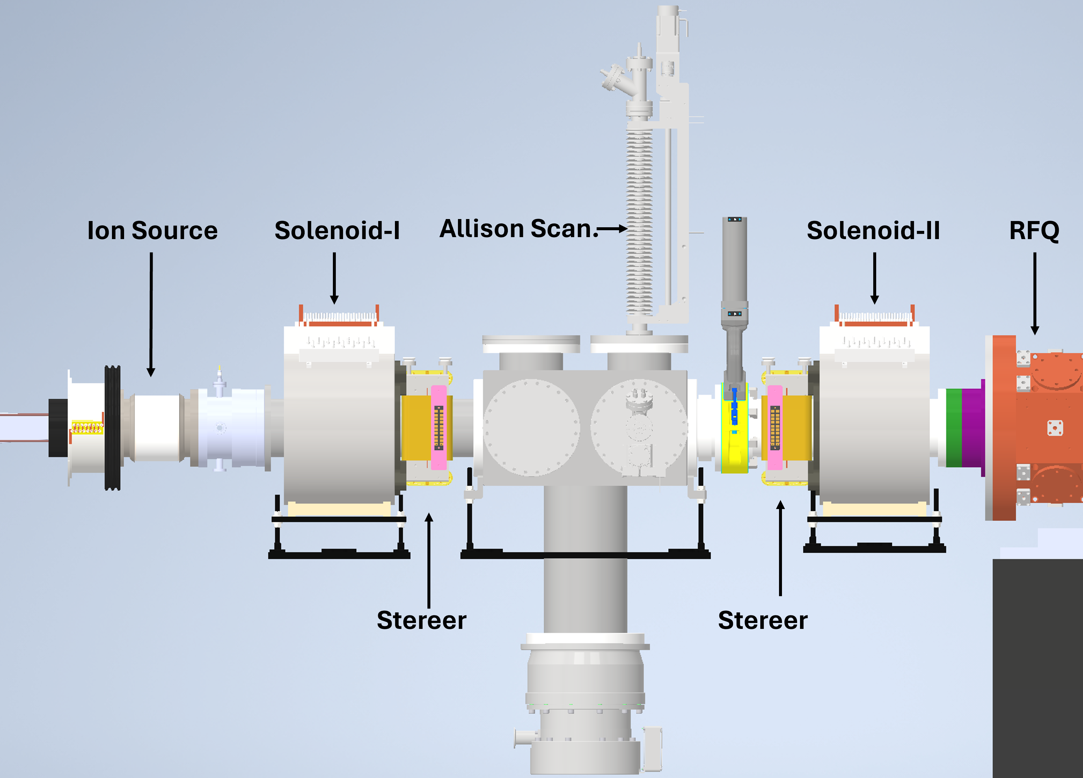
SCC Experiment
Isolated
Horizontal and vertical phase space measurement
Current measurement → Beam losses
Gauge→ Injected gas pressure control
Phase space measurement
Gas injection point
Time resolved measurement
Measure build-up time..
ACCT-1
Gauge
ACCT-2

Slide 2
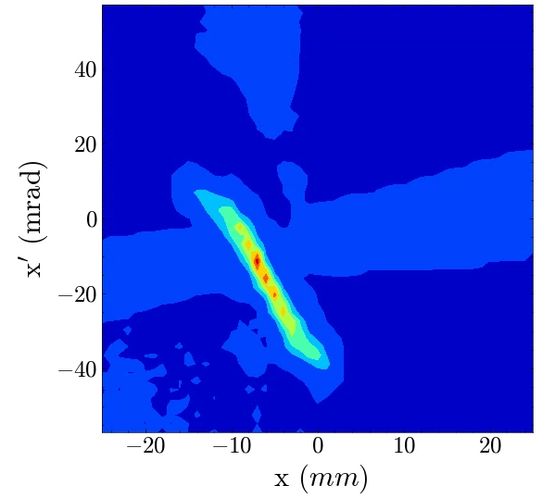
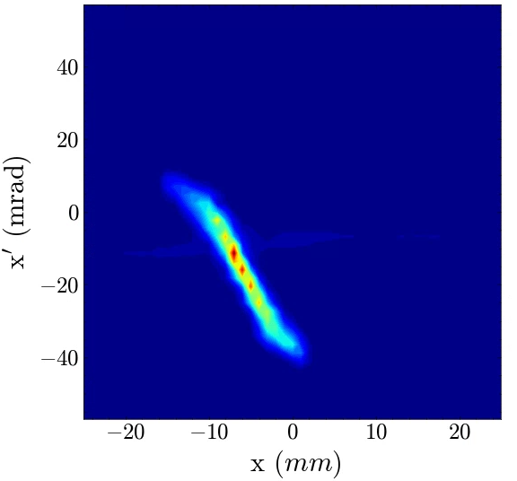
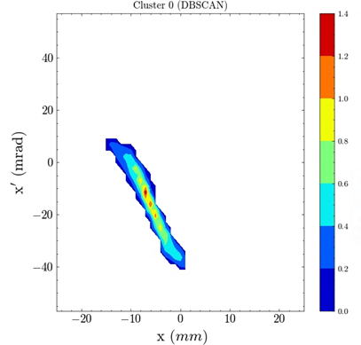
Measurement - Data analysis
Original
Filtered
Baseline → $p=2.6x{10}^{−5} mbar$
Energy=25keV
Current=15 ~17 mA
Pulse length = 500 us
Repetition = 4 Hz
Sol1=90 A
Allison step size=1 mm
Allison step angle=1.6 mrad
Vplasma=26.4 kV
Vsupp. = -3 kV
DBSCAN

Slide 3
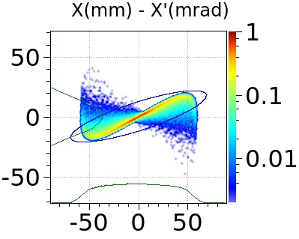
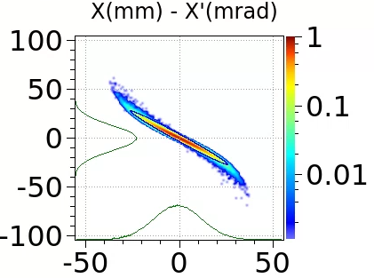
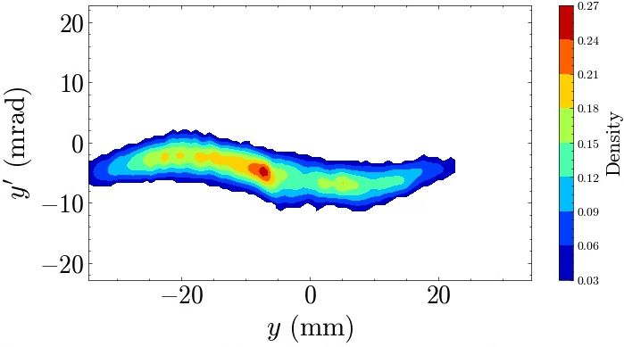
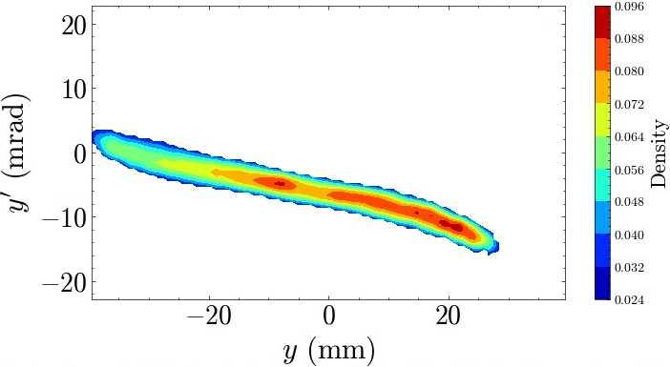
Phase Space
Simulation
No gas injection
Kr gas injection
Nonlinearity is removed
Beam become more convergent
Experiment

Slide 4
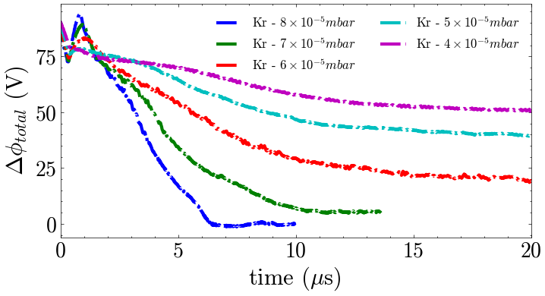
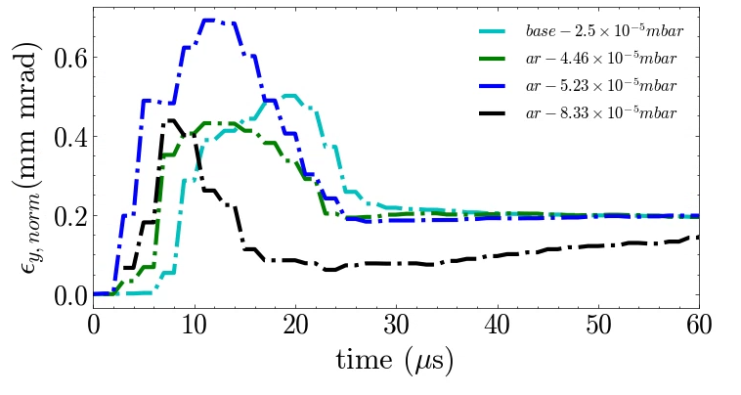
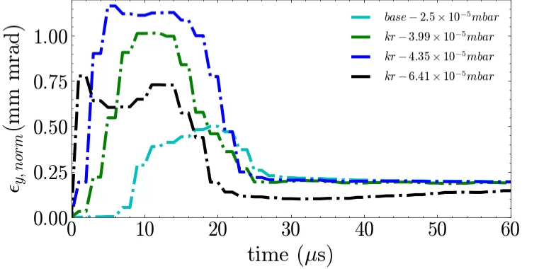
Build-up time – pressure dependence
Simulation
Experiment
Increasing pressure → reducing build-up time.

Slide 5
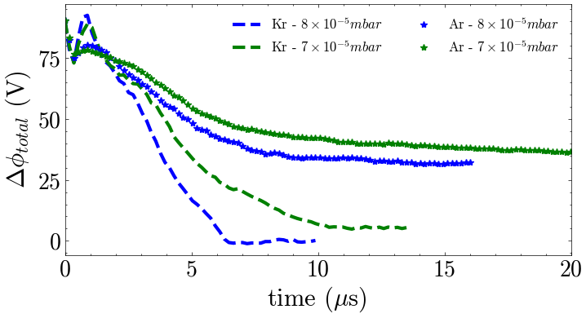
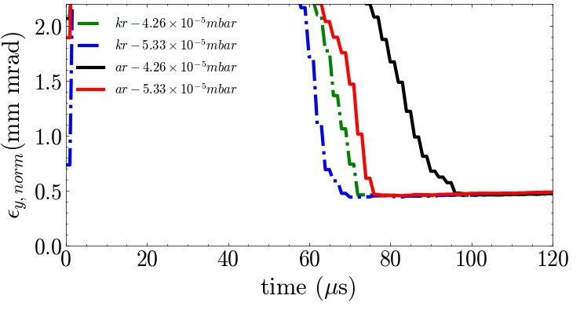
Injected gas type
Simulation
Experiment
Krypton is much effective than Argon gas
Long build-up time
Crucial for pulsed beam operation

Slide 6
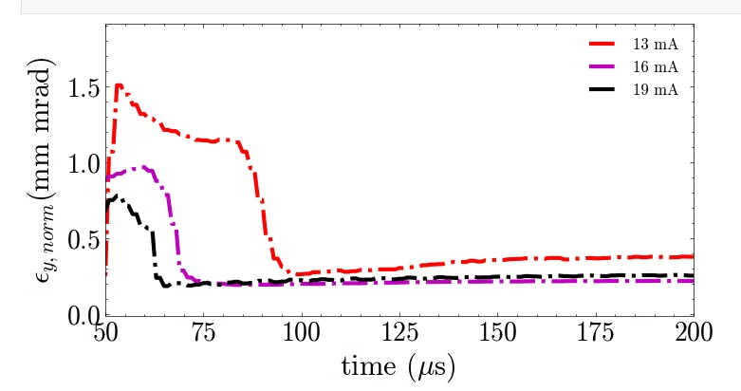
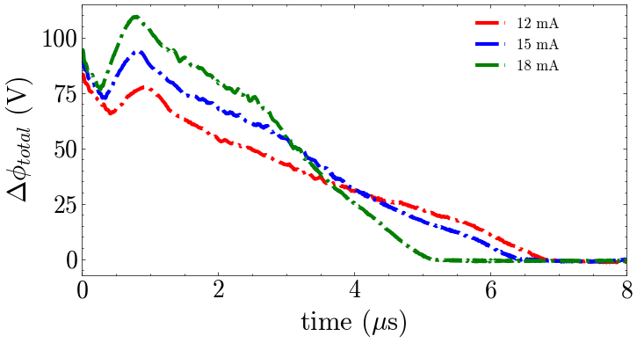
Beam Current effect
Simulation
Experiment
Reducing beam current → increasing build-up time

Slide 7
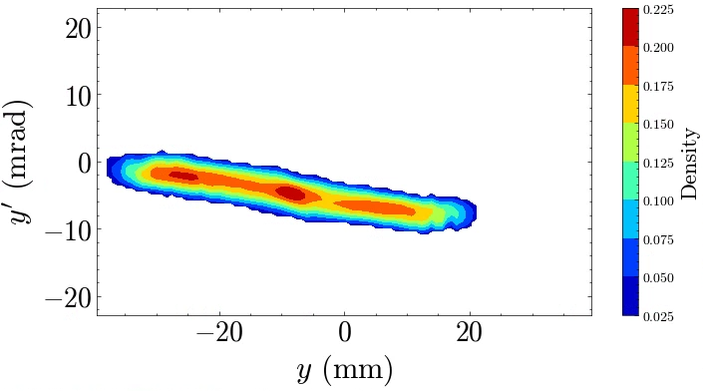
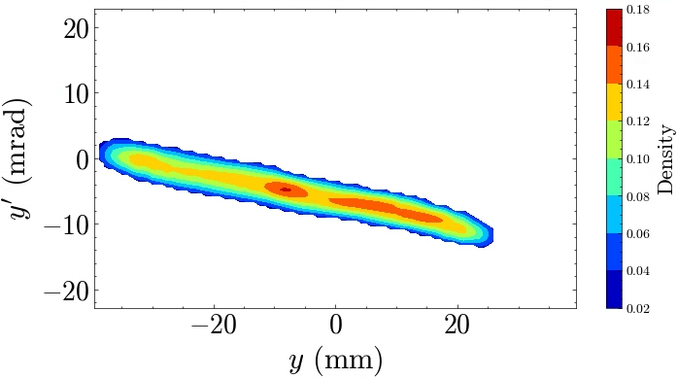
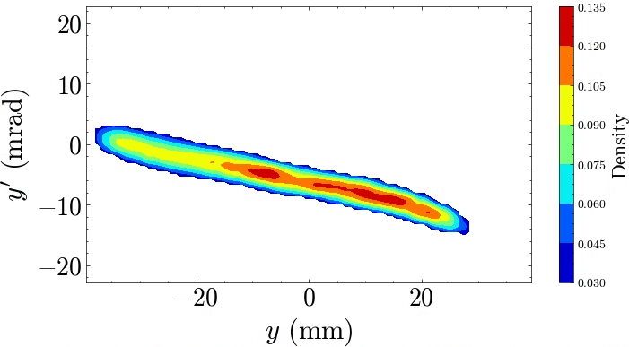
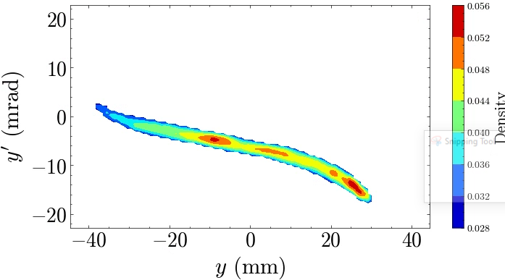
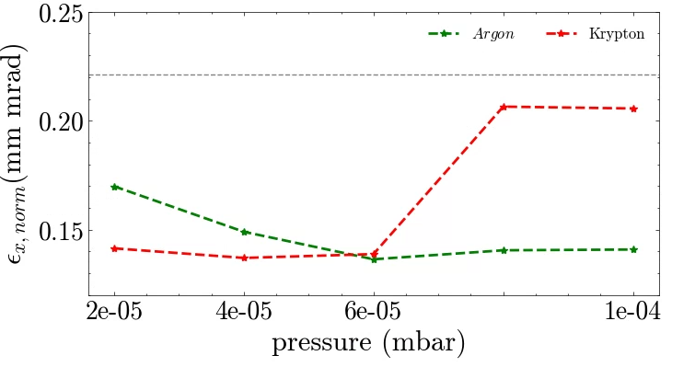
Emittance growth
Experiment
Argon gas is injected with different gauge pressures
Baseline- $2.5x{10}^{−5}$ mbar
$3.38x{10}^{−5}$ mbar
$5.07x{10}^{−5}$mbar
$6.04x{10}^{−5}$mbar
$7.96x{10}^{−5}$mbar
$10.46x{10}^{−5}$mbar
$$ε_{y,norm}=0. 216 mm mrad$$
$$RMS size=13.50 mm$$
$$RMS angle=2.54 mrad$$
Ibeam=15.8mA
$$ε_{y,norm}=0. 168 mm mrad$$
$$RMS size=14.98 mm$$
$$RMS angle=2.56 mrad$$
Ibeam=15.8 mA
$$ε_{y,norm}=0. 184 mm mrad$$
$$RMS size=17.19 mm$$
$$RMS angle=3.54 mrad$$
Ibeam=14.4mA
$$ε_{y,norm}=0. 189 mm mrad$$
$$RMS size=17.83 mm$$
$$RMS angle=3.91 mrad$$
Ibeam=13.8 mA
$$ε_{y,norm}=0. 192 mm mrad$$
$$RMS size=18.67 mm$$
$$RMS angle=4.17 mrad$$
Ibeam=11.8mA
$$ε_{y,norm}=0. 183 mm mrad$$
$$RMS size=18.93 mm$$
$$RMS angle=4.49 mrad$$
Ibeam=8 mA
Simulation
Emittance growth is observed in high injected gas pressures
Gas injection level needs to be tuned carefully.

Slide 8
Conclusion
Phase space measurement and time resolved phase space measurement is conducted.
Beam build-up time is crucial for short pulse beam operation.
In some cases, rising time (build-up time) exceeds 100 us is measured.
Rising time is dependent to gas pressures level (proven experimentally and simulation).
Rising time is dependent to gas type (proven experimentally and simulation).
Rising time is dependent to beam current (proven experimentally and simulation).
Nonlinearity effects may be eliminated (proven experimentally and simulation).
Emittance growth may be observed (proven experimentally and simulation).

Slide 9
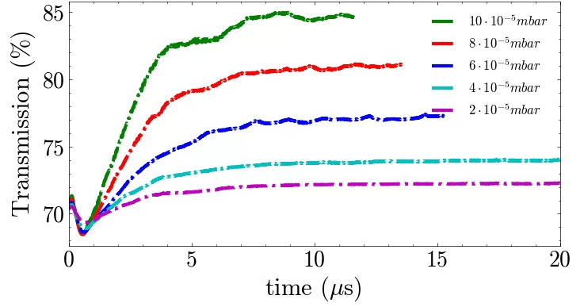
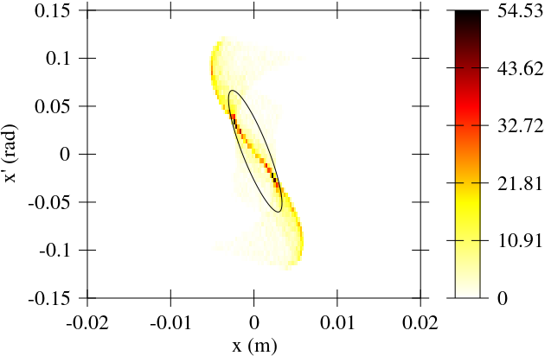
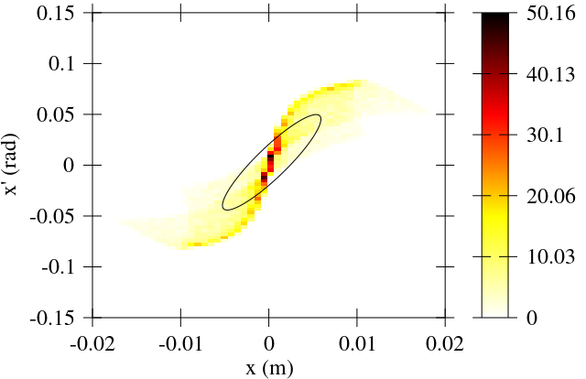
Next plan →RFQ
How SCC affect the beam matching and transmission.
Simulation
LEBT Transmission
Before SCC
After SCC
Include RFQ and Solenoid scan.. → today
Complete the paper …

Slide 10
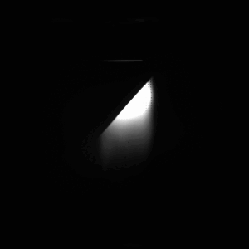
Beamline
Pepper pot
Virtual pepper pot

