Slide 1
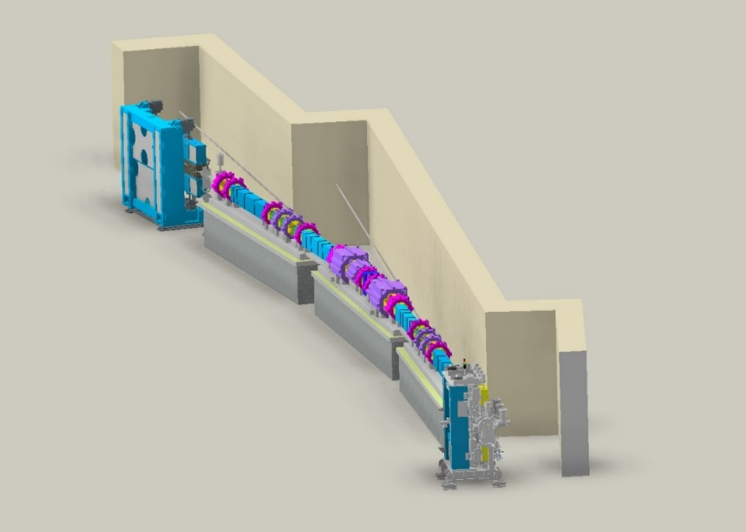
CAPHE group meeting
FODO Analysis & Booster Injection efficiency investigation
Junha Kim
Jan 17th, 2025

Slide 2
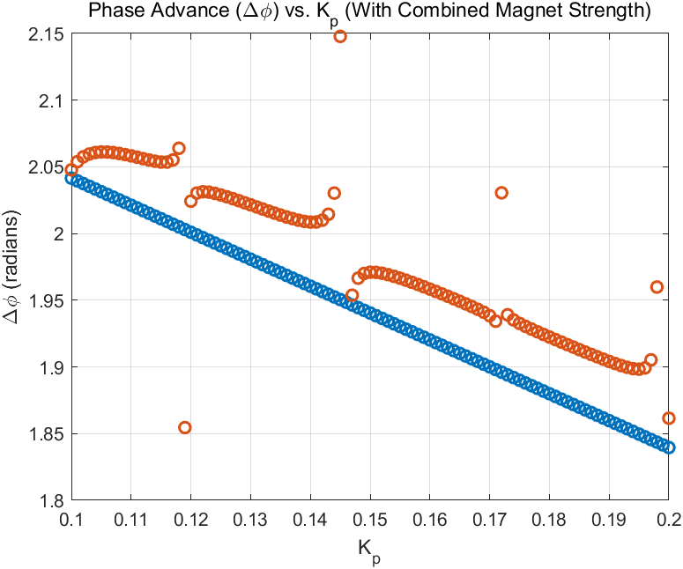
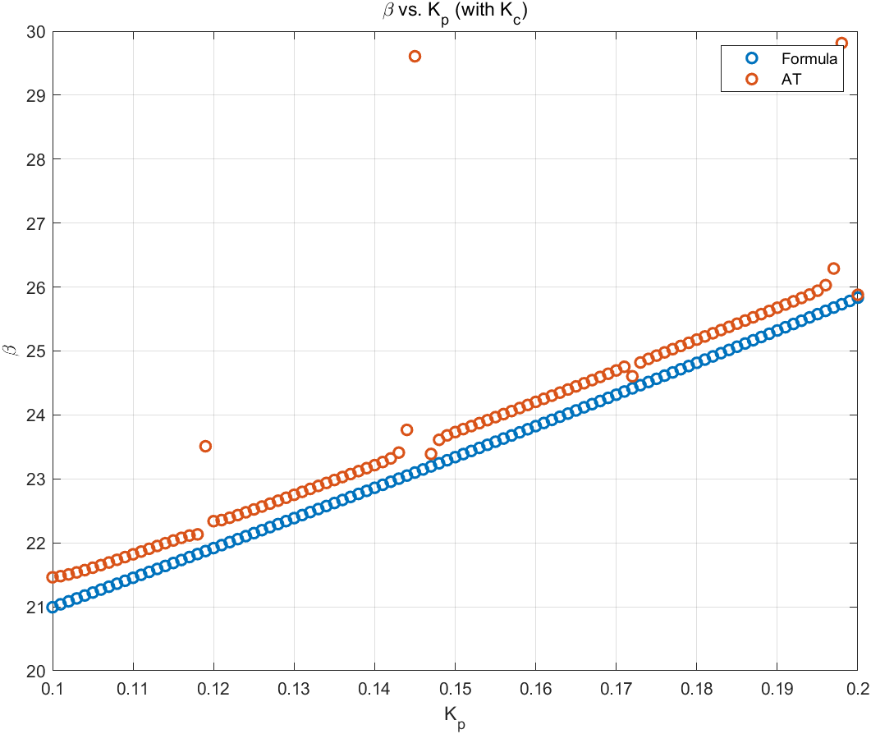
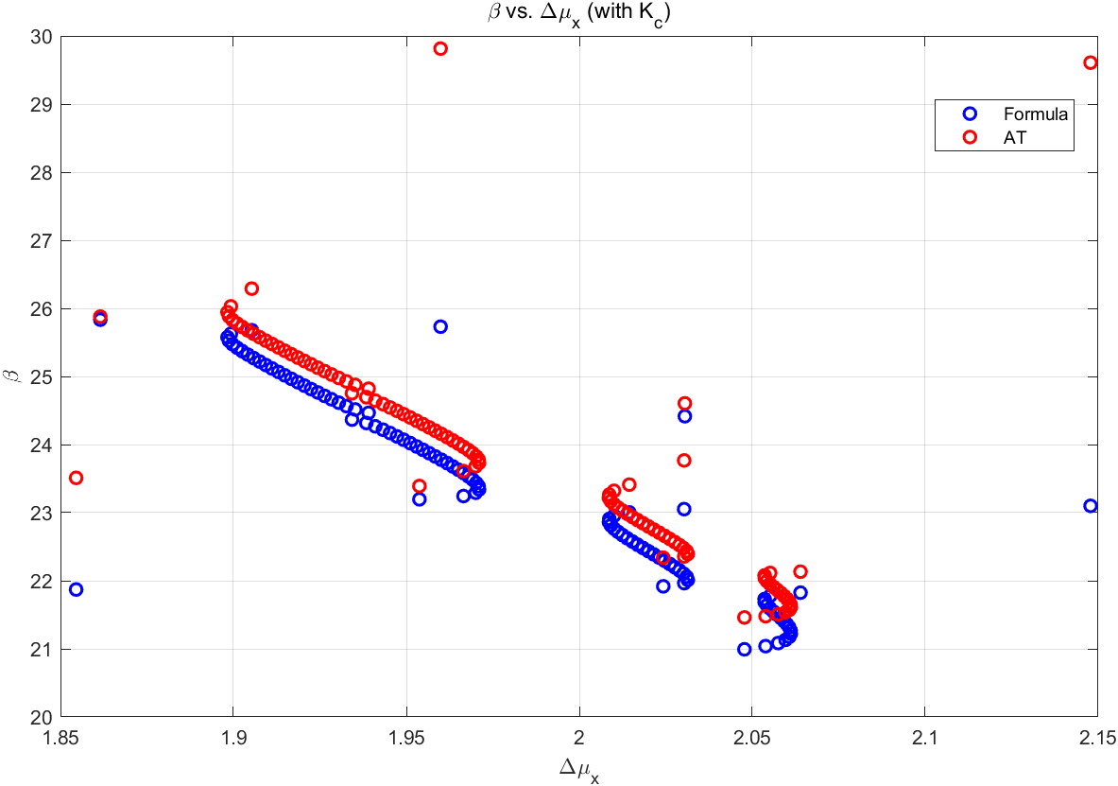
CAPHE group meeting
Mismatch result between analytic formula & AT

Slide 3
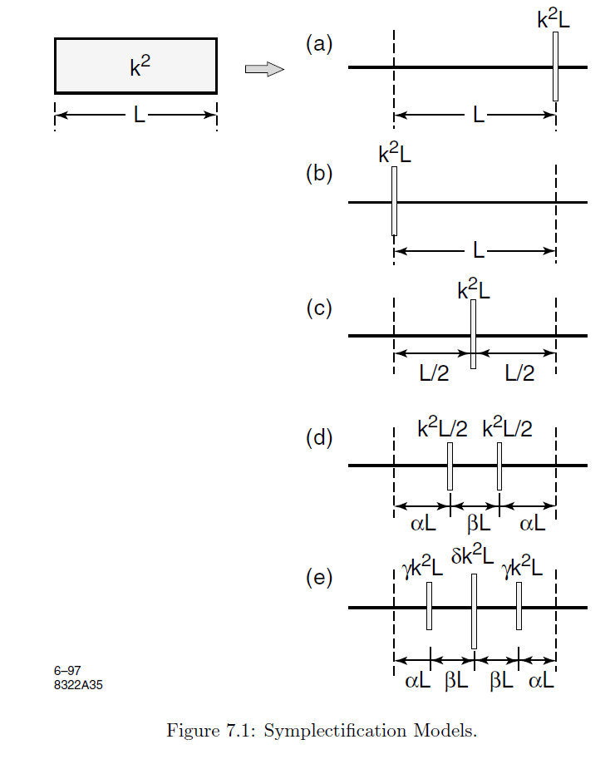
CAPHE group meeting
Symplectic Approximation of Maps
$$M=\left(\begin{matrix}1 & 0 \\ −k^{2}L & 1\end{matrix}\right) \left(\begin{matrix}1 & L \\ 0 & 1\end{matrix}\right)$$
$M= \left(\begin{matrix}1 & L \\ 0 & 1\end{matrix}\right)$ $\left(\begin{matrix}1 & 0 \\ −k^{2}L & 1\end{matrix}\right)$
$M= \left(\begin{matrix}1 & \frac{1}{2}L \\ 0 & 1\end{matrix}\right)$ $\left(\begin{matrix}1 & 0 \\ −k^{2}L & 1\end{matrix}\right)$ $\left(\begin{matrix}1 & \frac{1}{2}L \\ 0 & 1\end{matrix}\right)$
$M= \left(\begin{matrix}1 & αL \\ 0 & 1\end{matrix}\right)$ $\left(\begin{matrix}1 & 0 \\ −{\frac{1}{2}k}^{2}L & 1\end{matrix}\right)$ $\left(\begin{matrix}1 & βL \\ 0 & 1\end{matrix}\right)$ $\left(\begin{matrix}1 & 0 \\ −{\frac{1}{2}k}^{2}L & 1\end{matrix}\right)$ $\left(\begin{matrix}1 & αL \\ 0 & 1\end{matrix}\right)$
$M= \left(\begin{matrix}1 & αL \\ 0 & 1\end{matrix}\right)$ $\left(\begin{matrix}1 & 0 \\ −{γk}^{2}L & 1\end{matrix}\right)$ $\left(\begin{matrix}1 & βL \\ 0 & 1\end{matrix}\right)$ $\left(\begin{matrix}1 & 0 \\ −{δk}^{2}L & 1\end{matrix}\right)$ $\left(\begin{matrix}1 & βL \\ 0 & 1\end{matrix}\right)$ $\left(\begin{matrix}1 & 0 \\ −{γk}^{2}L & 1\end{matrix}\right)$ $\left(\begin{matrix}1 & αL \\ 0 & 1\end{matrix}\right)$

Slide 4
CAPHE group meeting
Symplectic Approximation of Maps
$M= \left(\begin{matrix}1 & αL \\ 0 & 1\end{matrix}\right)$ $\left(\begin{matrix}1 & 0 \\ −{γk}^{2}L & 1\end{matrix}\right)$ $\left(\begin{matrix}1 & βL \\ 0 & 1\end{matrix}\right)$ $\left(\begin{matrix}1 & 0 \\ −{δk}^{2}L & 1\end{matrix}\right)$ $\left(\begin{matrix}1 & βL \\ 0 & 1\end{matrix}\right)$ $\left(\begin{matrix}1 & 0 \\ −{γk}^{2}L & 1\end{matrix}\right)$ $\left(\begin{matrix}1 & αL \\ 0 & 1\end{matrix}\right)$
$$=\left(\begin{matrix}1−\frac{1}{2}kL^{2}+βγ\left(α+\frac{1}{2}δ\right)k^{2}L^{4}−αβ^{2}γ^{2}δk^{3}L^{6} & L−\left(\frac{1}{4}δ+αγ+2αβγ\right)kL^{3}+2αβγ\left(αγ+\frac{1}{2}δ\right)k^{2}L^{5}−α^{2}β^{2}γ^{2}δk^{3}L^{7} \\ −kL+βγ\left(1+δ\right)k^{2}L^{3}−β^{2}γ^{2}δk^{3}L^{5} & 1−\frac{1}{2}kL^{2}+βγ\left(α+\frac{1}{2}δ\right)k^{2}L^{4}−αβ^{2}γ^{2}δk^{3}L^{6}\end{matrix}\right)$$
$$βγ\left(α+\frac{1}{2}δ\right)=\frac{1}{24}, βγ\left(1+δ\right)=\frac{1}{6}, \frac{1}{4}δ+αγ+2αβγ=\frac{1}{6}$$
$$2α+2β=1, 2γ+δ=1$$
4 unknowns, 5 equations.
$$β≈−0.1756, α≈0.6756, γ≈1.3512, δ≈−1.7024$$

Slide 5
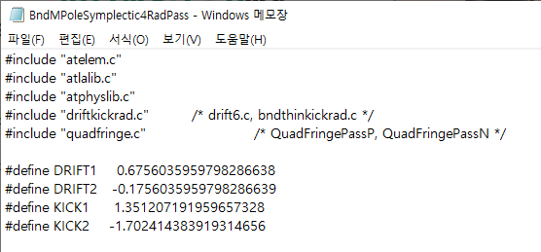
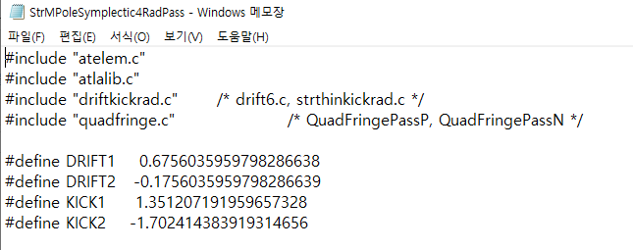
CAPHE group meeting
Symplectic Approximation of Maps in AT
$$α≈0.6756,$$
$$β≈−0.1756,$$
$$γ≈1.3512,$$
$$δ≈−1.7024$$
In AT, the magnet divide N parts first. Then each part calculated by symplectic approximation of maps

Slide 6
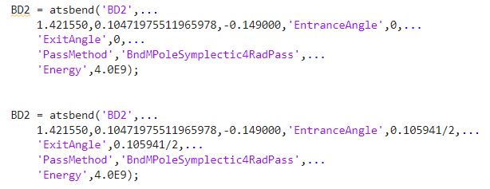
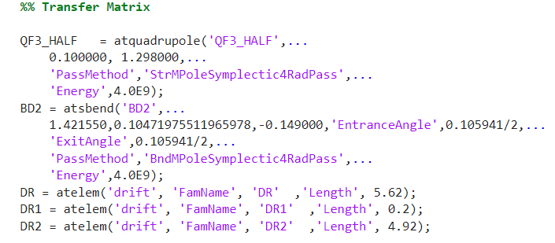
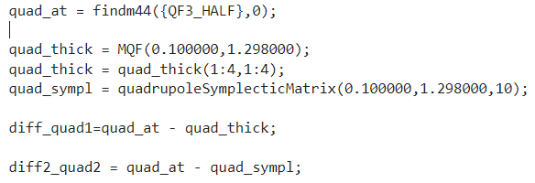
CAPHE group meeting
Symplectic Approximation of Maps in AT

Slide 7
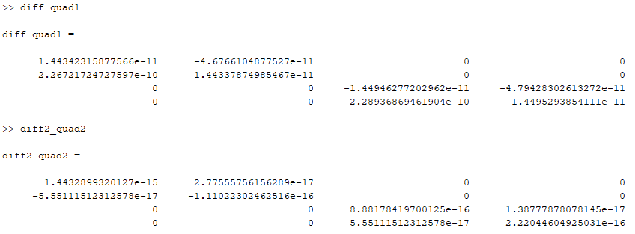
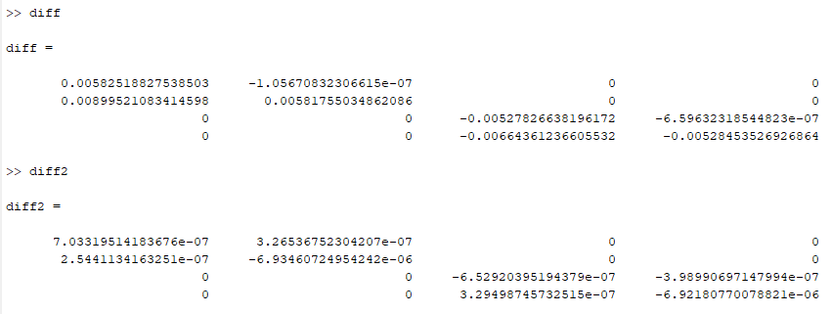
CAPHE group meeting
Quad & Bending comparison
Quad
AT vs Analytic
AT vs Symplectic
Bending
AT vs Analytic
AT vs Symplectic

Slide 8
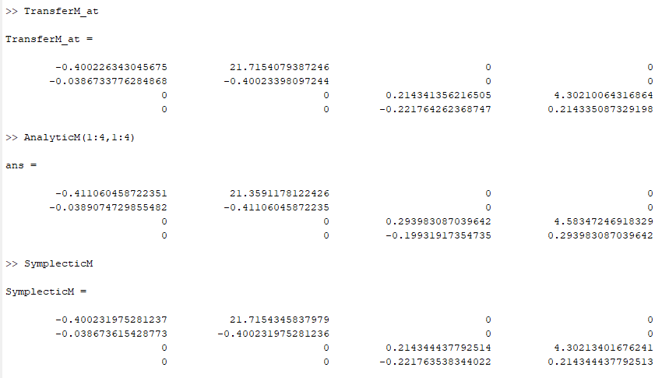
CAPHE group meeting
Transfer matrix comparison

Slide 9
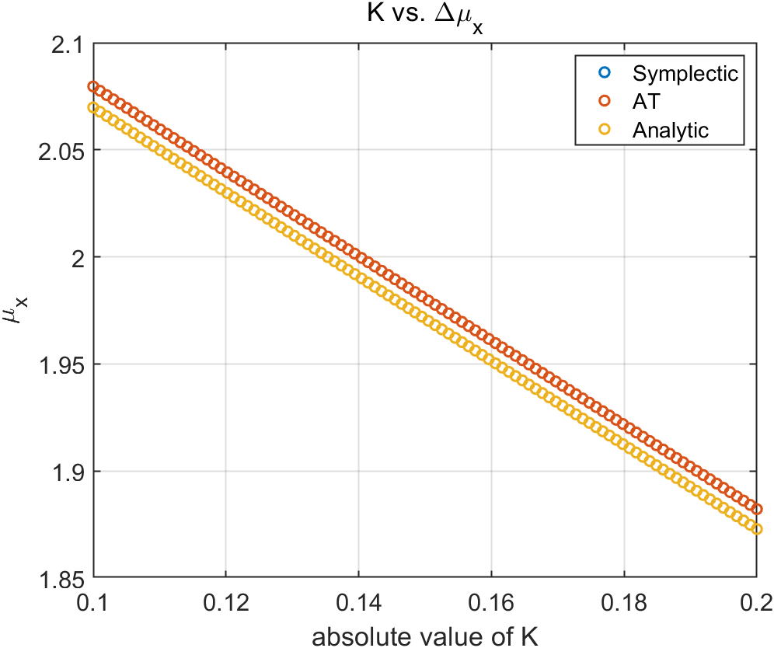
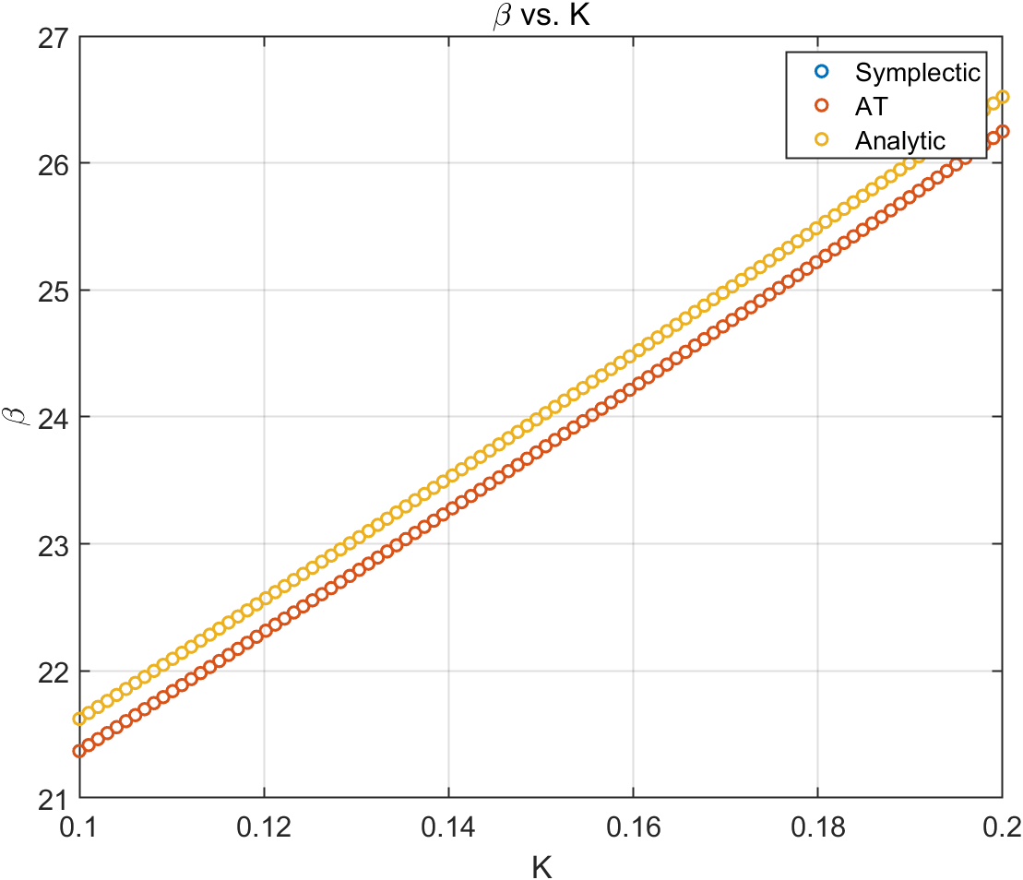
CAPHE group meeting
Phase space & beta function

Slide 10
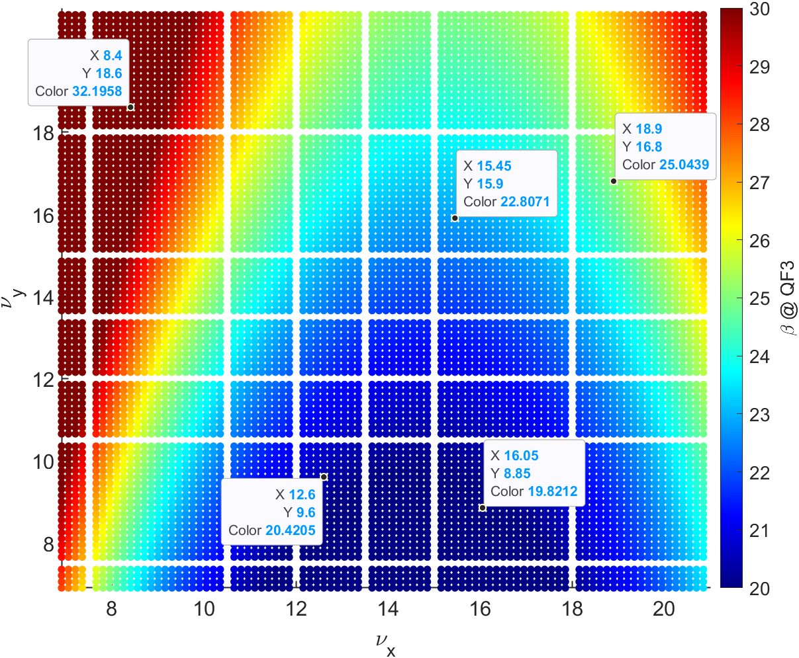
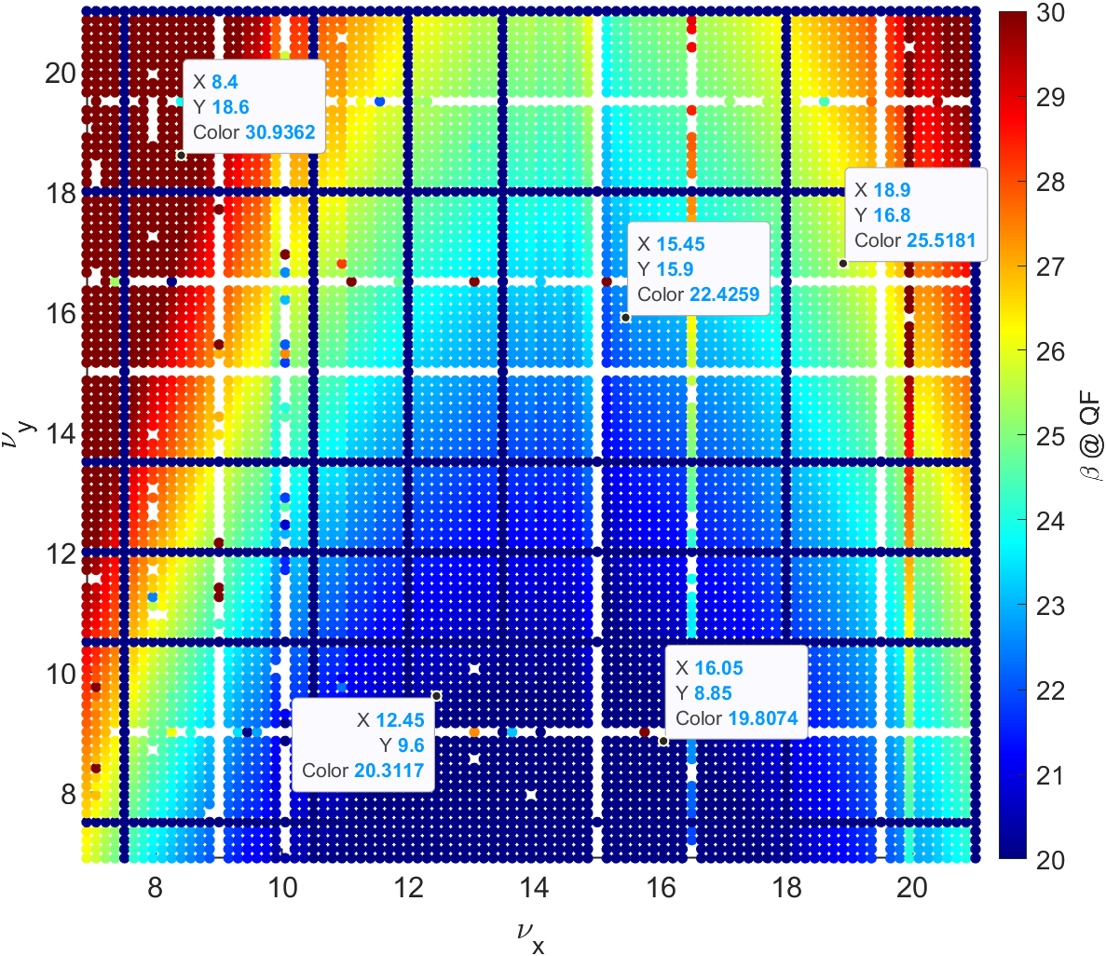
CAPHE group meeting
Beta function calculation across various tunes
Beta calculation using Analytic calculation
Beta calculation using AT Function

Slide 11
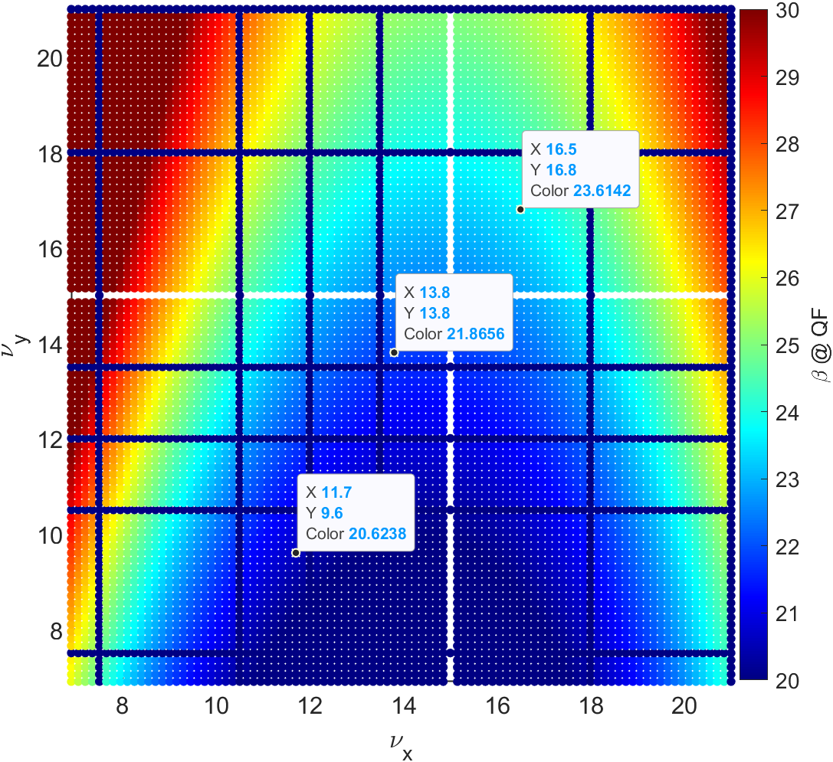
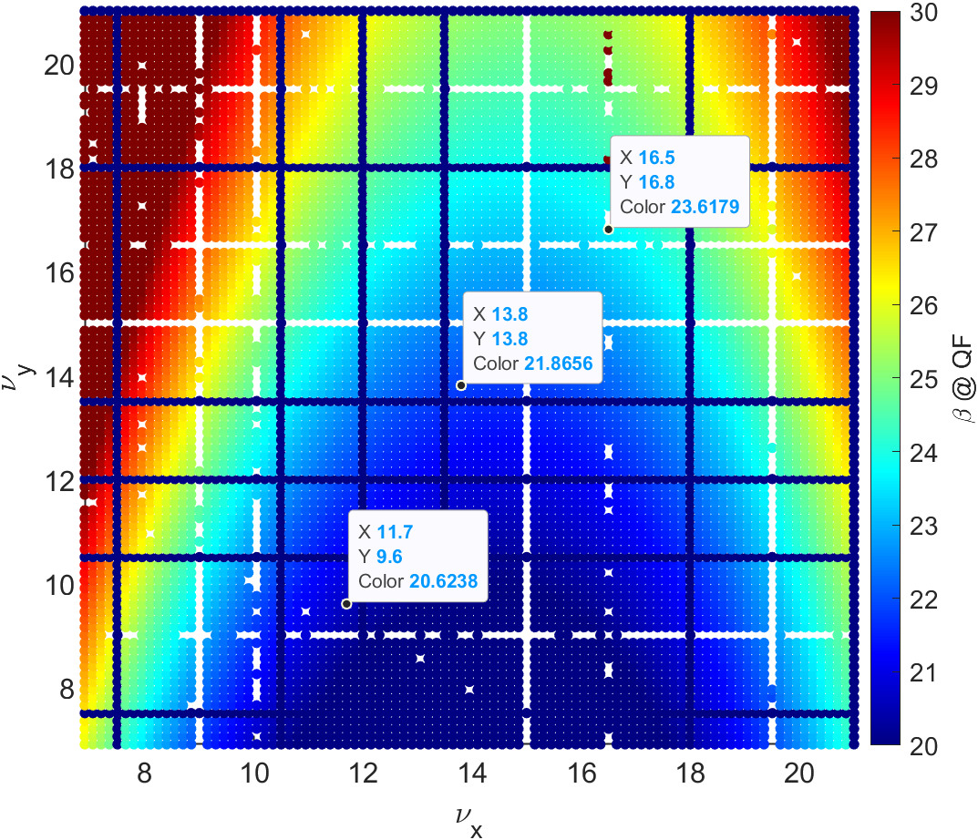
CAPHE group meeting
Beta function calculation across various tunes
Beta calculation using Symplectic Approximation
Beta calculation using AT Function

Slide 12
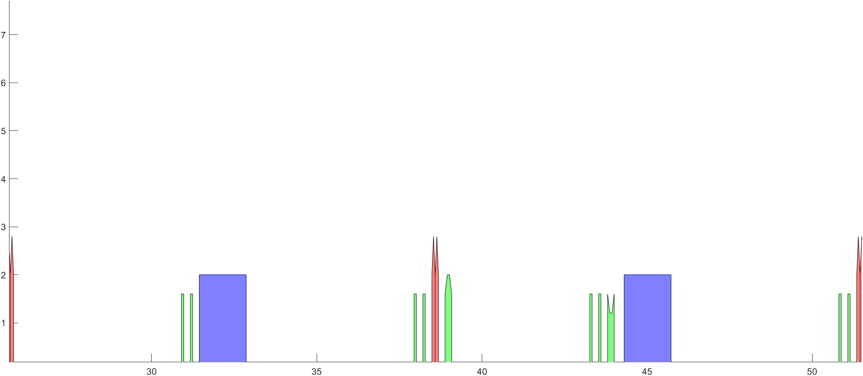
CAPHE group meeting
Beta function calculation at Sextupoles
Symbol | meaning
$$\frac{∂ν_{x}}{∂J_{x}}$$ | Horizontal Amplitude tune shift
$$b_{3}$$ | Sextupole strength
$$β_{j}$$ | The j-th sextupole
$$L$$ | Sextupole’s Length
$$μ_{j→k,x}$$ | The phase advance between the j-th sextupole and the k-th sextupole
$$ν_{x}$$ | Horizontal tune
$$\frac{∂ν_{x}}{∂J_{x}}=−\frac{1}{16π}\sum_{j=1}^{N}{\sum_{k=1}^{N}{{\left(b_{3}L\right)}_{j}{\left(b_{3}L\right)}_{k}β_{x,j}^{\frac{3}{2}}}β_{x,k}^{\frac{3}{2}}}[\frac{cos⁡(\left|μ_{j→k,x}\right|−πν_{x})}{sin⁡(πν_{x})}+\frac{cos⁡(\left|3μ_{j→k,x}\right|−3πν_{x})}{sin⁡(3πν_{x})}]$$
Calculation point of the beta function shown in the previous slide
SF
SD
Corrector
Corrector
Corrector
Corrector
QF
BD(QD)
QF
BD(QD)
QF
$$\left(\begin{matrix}x \\ x′\end{matrix}\right)=M\left(\begin{matrix}x_{0} \\ x_{0}′\end{matrix}\right)$$
$$M=\left(\begin{matrix}C & S \\ C′ & S′\end{matrix}\right)$$
$\left(\begin{matrix}β \\ α \\ γ\end{matrix}\right)=\left(\begin{matrix}C^{2} & −2CS & S^{2} \\ −CC′ & SC^{′}+S^{′}C & −SS′ \\ C^{′2} & −2S^{′}C′ & S^{′2}\end{matrix}\right)$ $\left(\begin{matrix}β_{0} \\ α_{0} \\ γ_{0}\end{matrix}\right)$

Slide 13
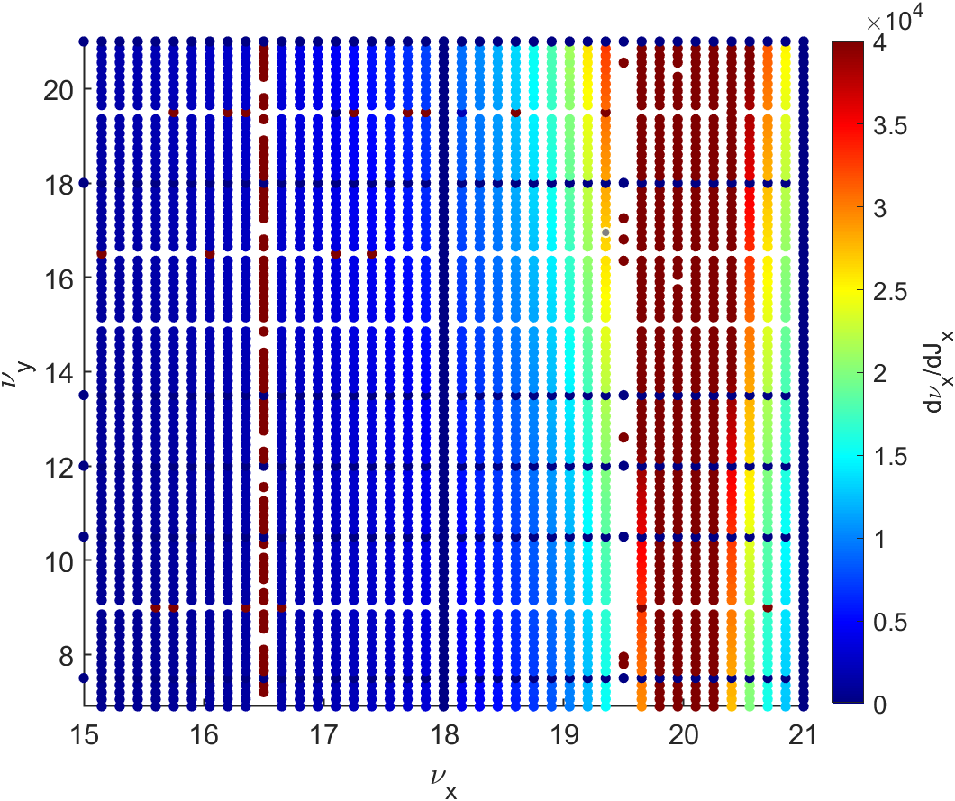
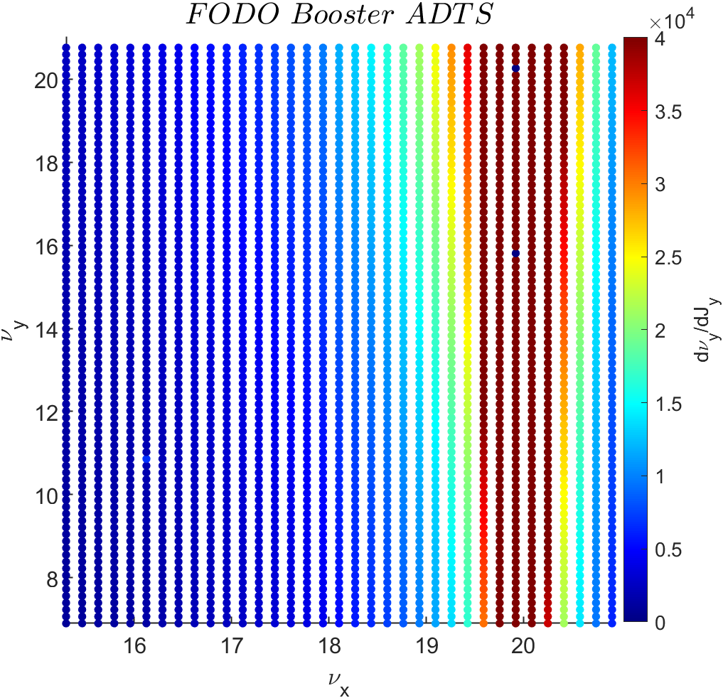
CAPHE group meeting
Horizontal amplitude tuneshift across various tunes
Calculation using Symplectic Approximation
Calculation using AT Function

Slide 14
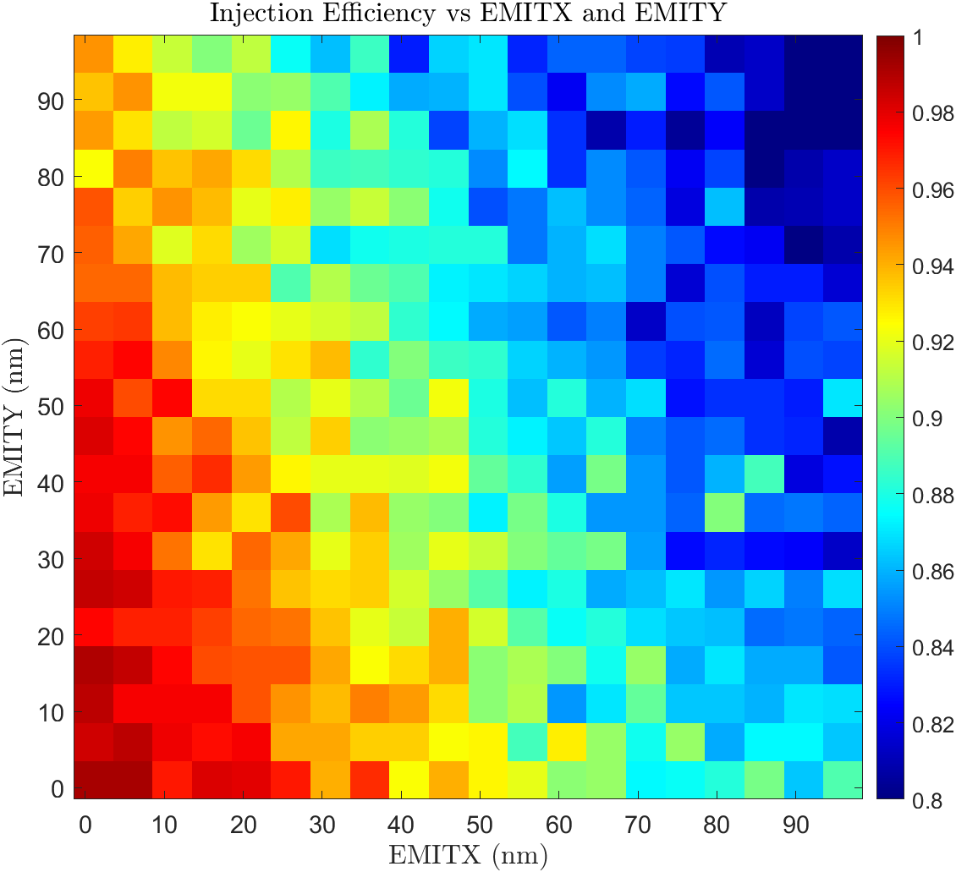
CAPHE group meeting
Injection Efficiency VS Injected Beam Emittance
Choosing average value of DA areas from DAs of 56 error seeds
Injection point is fixed.
X = -6mm
X’ = 0.0 rad
The horizontal/vertical (H/V) emittance varies from 0 to 100 nm.
The horizontal and vertical emittance achieves an injection efficiency of over 98% around 10 nm

Slide 15
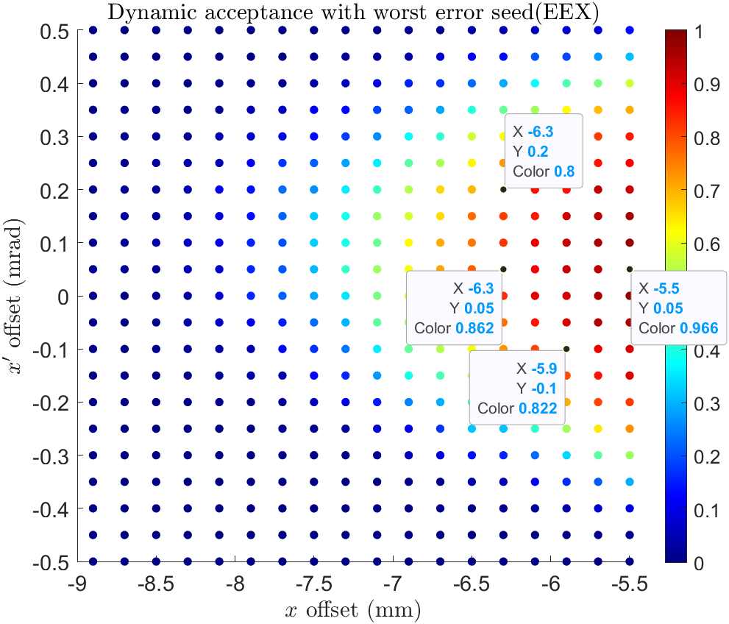
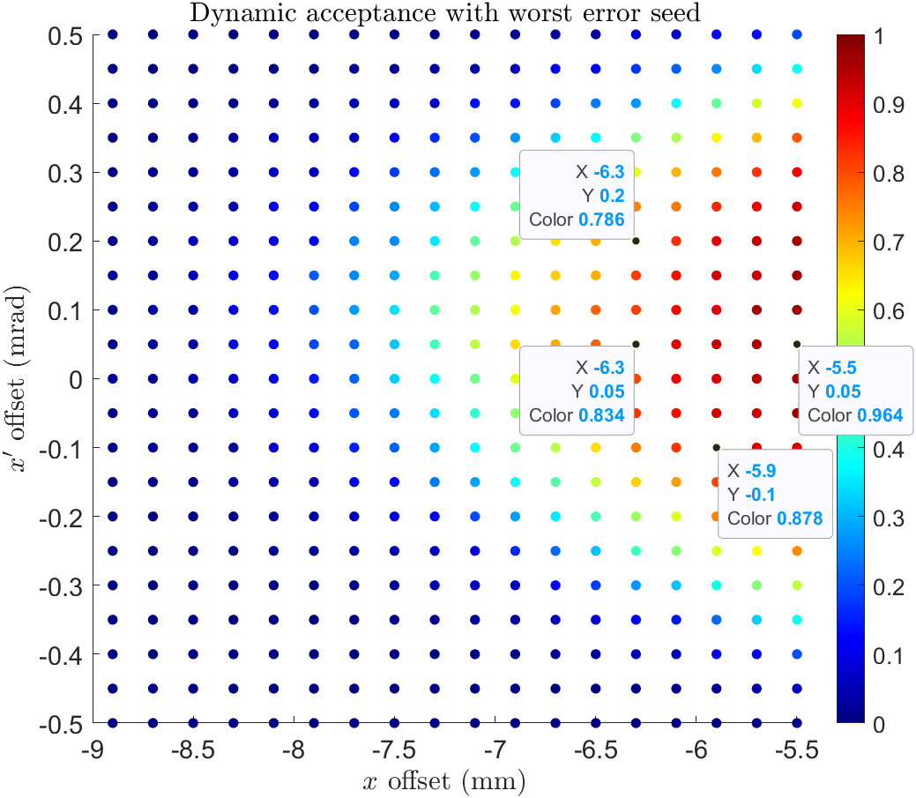
CAPHE group meeting
Injection Efficiency with Emittance Exchange (DA area 하위 20% seed)
Choosing one error lattice along the 56 error seed. And calculate the Injection efficiency with original case and emittance exchange(EEX) injection case.
Original : $ε_{x}=10.8nm , ε_{y}=ε_{x}∗0.01$ , EEX : $ε_{y}=10.8nm , ε_{x}=ε_{y}∗0.01$

Slide 16
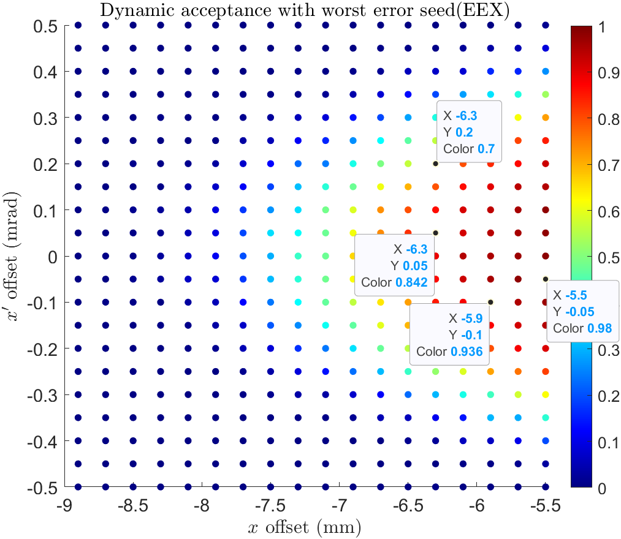
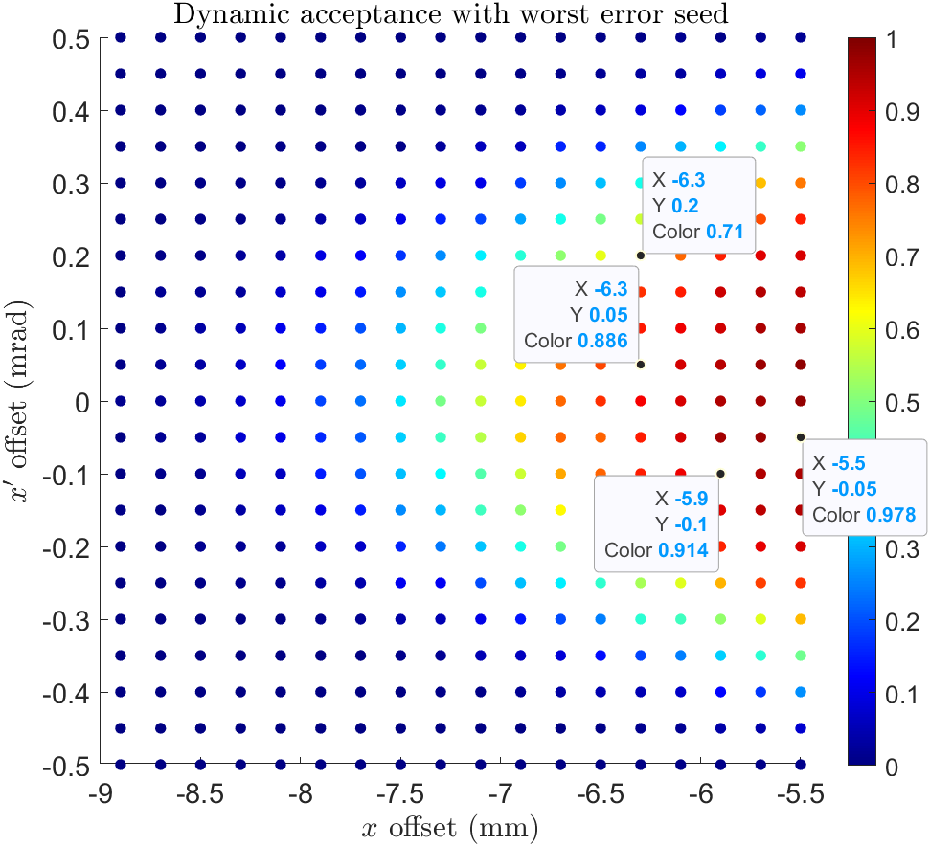
CAPHE group meeting
Injection Efficiency with Emittance Exchange (DA area worst seed)
Choosing worst error lattice along the 56 error seed. And calculate the Injection efficiency with original case and emittance exchange(EEX) injection case.
Original : $ε_{x}=10.8nm , ε_{y}=ε_{x}∗0.01$ , EEX : $ε_{y}=10.8nm , ε_{x}=ε_{y}∗0.01$

Slide 17
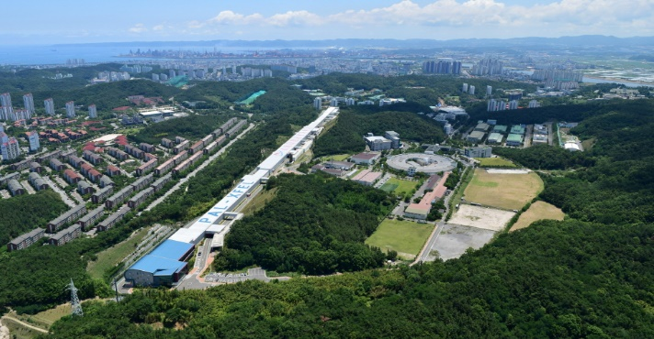
Thank you!

