Slide 1
Research Progress
Feb. 14. 2025
송우진

Slide 2
Summary of White PBPM Development
Experimental plan (Nov 01, 24 )
Experimental goal and contents
Preliminary preparations
Detailed experimental procedure
Set-up
1 – 장비심의위원회 (Feb 05, 25)
2 – Order
Fabrication
Test
XFEL SX test plan (Jan 03, 25)
3 – PAL-XFEL Soft X-ray beamline
Data processing
Data analysis
Results (in progress)
PLS-II BL6C
1. Background Study
2. Conceptual Design
3. Detailed Design
4. Experiment
5. Resolution (Dec 06, 24)
Expected signal strength
4 – Exposure time estimation
Transverse spread
Systematic error

Slide 3
Time table
Jan 06 – XIBPM upgrade, replacement of internal structures.
Jan 08 – Discuss plans for measuring profile.
Jan 13 – Vertical displacement measurement @ pink-beam
– Chamber rotation and flange re-assemble
Jan 20 – Horizontal displacement measurement @ pink- & mono-beam
Feb 05 – 4GSR 가속기연구단 장비검토위원회
Feb 10 – Start of major component procurement
(Plan)
March – Profile measurement at PAL-XFEL SX beamline (Replace mesh and electrode with an upgraded version)
April – Complete the draft of the paper works (Thesis, Journal)
May – Experimental chamber set-up and test

Slide 4
장비심의위원회

Slide 5
Procurement item list

Slide 6
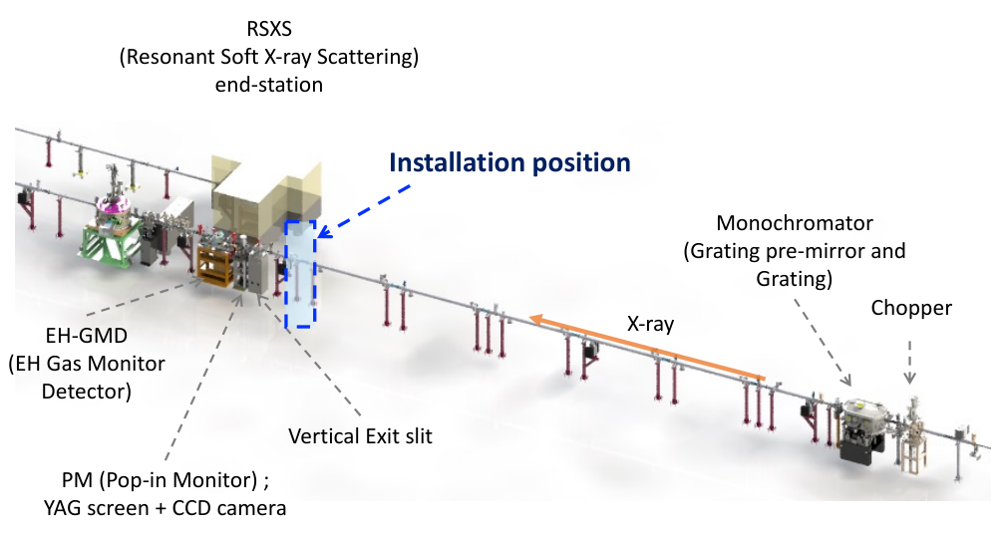
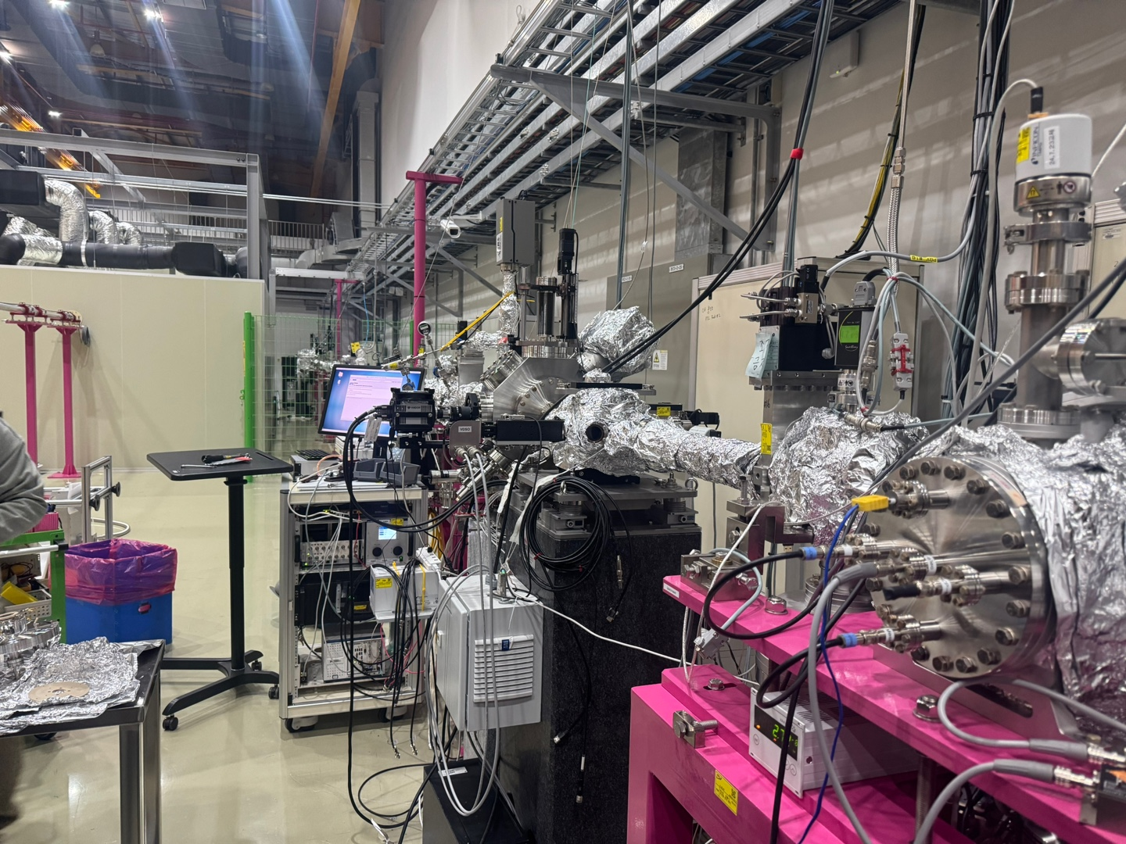
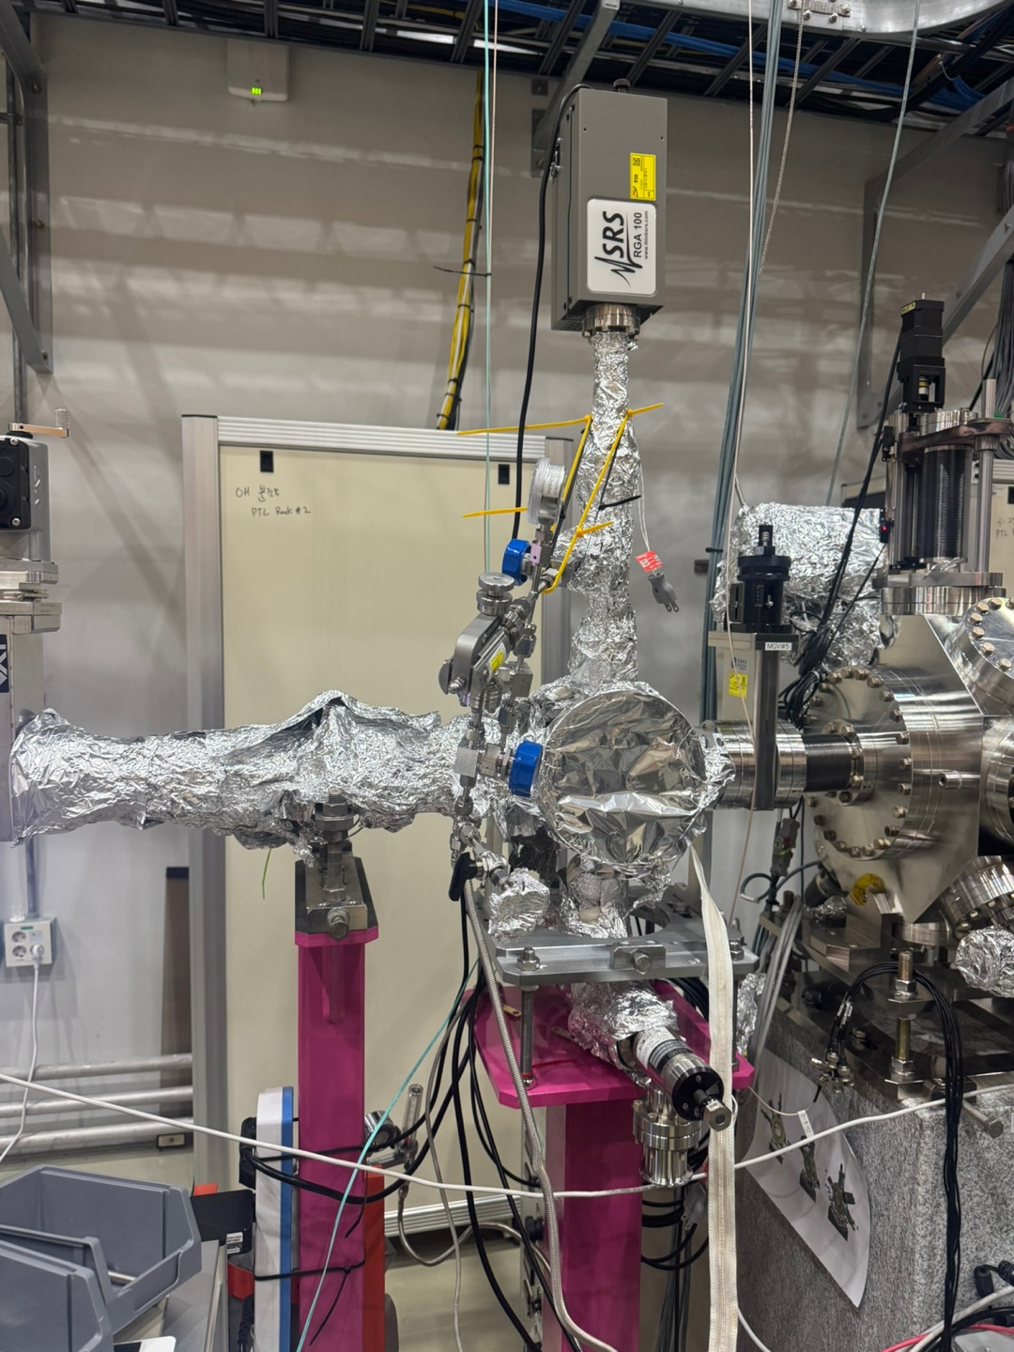
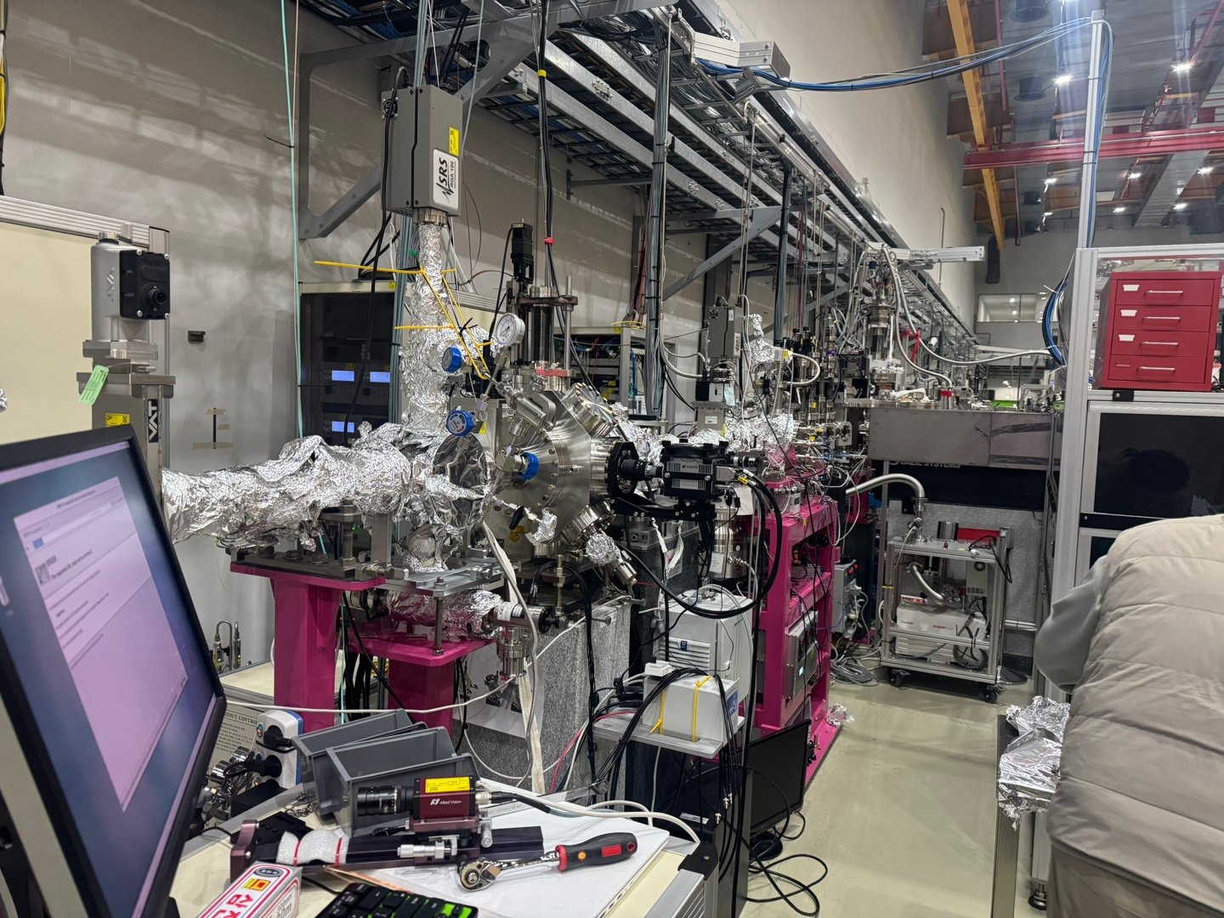
PAL-XFEL Soft X-ray beamline experiment overview
From H. Hyun’s presentation
X-ray

Slide 7
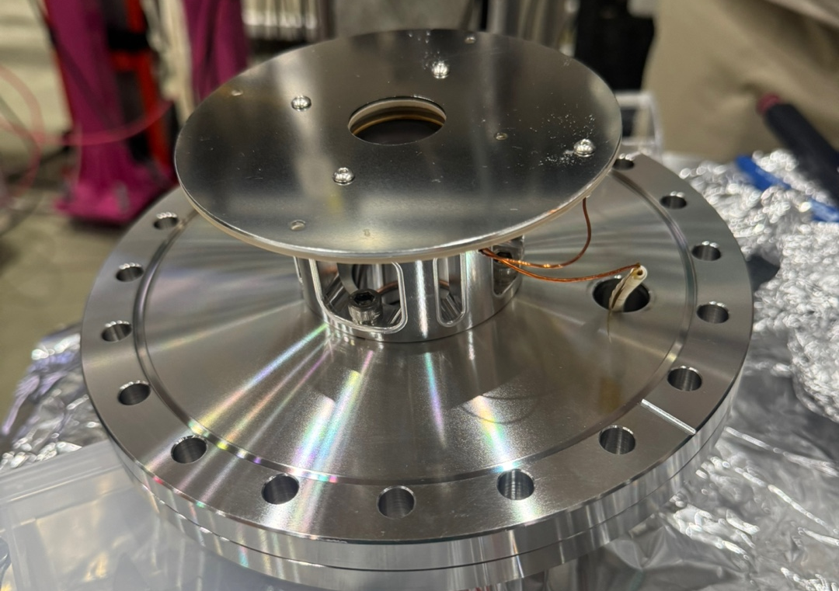
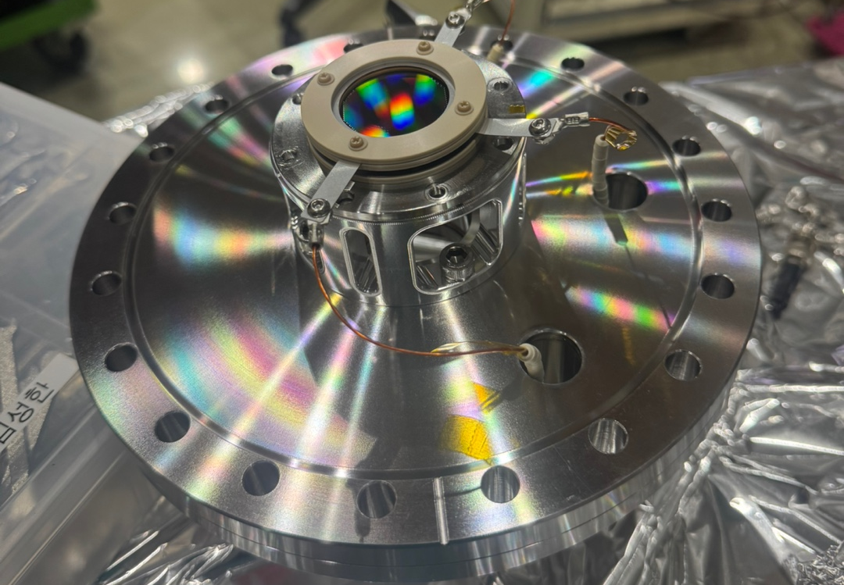
PAL-XFEL Soft X-ray beamline experiment overview
Jan 06 – XIBPM upgrade, replacement of internal structures.
Jan 08 – Discuss plans for measuring profile.
Jan 13 – Vertical displacement measurement @ pink-beam
– Chamber rotation and flange re-assemble
Jan 20 – Horizontal displacement measurement @ pink- & mono-beam
→ In this experiment, Keep the mesh, only Install the shield plate.

Slide 8
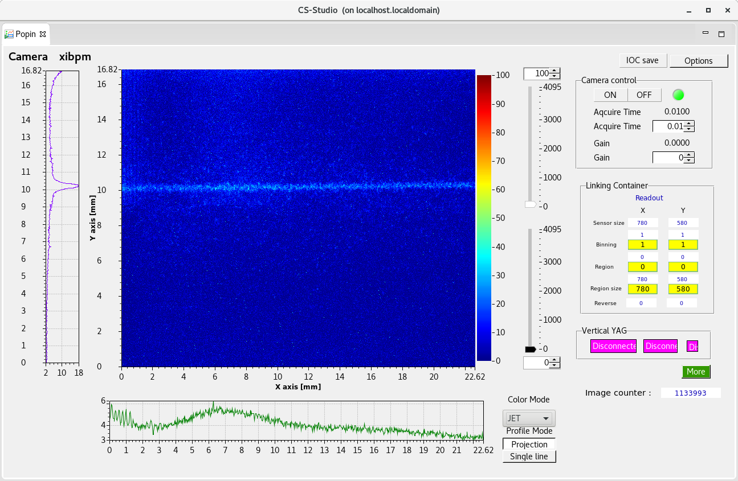
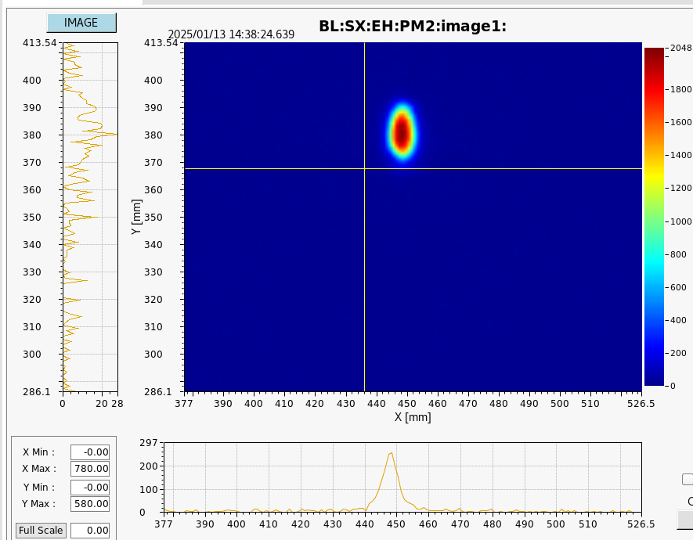
PAL-XFEL Soft X-ray beamline experiment overview
Image ration: 1.766
19.04 m
14.58 m
Pop-in Monitor (PM)
YAG → Reference
Grating mirror
XIBPM

Slide 9
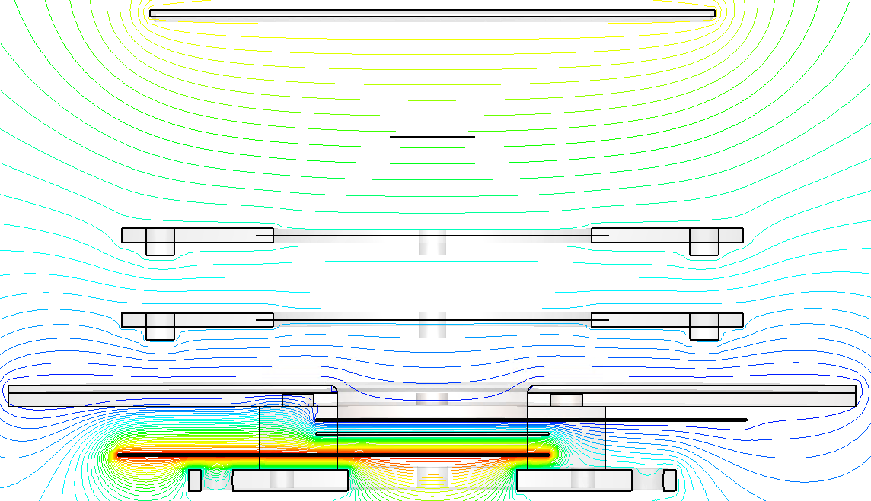
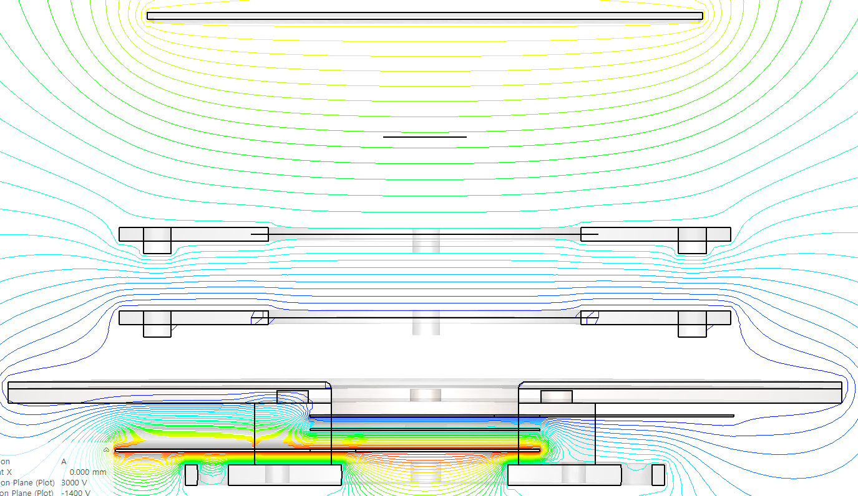
PAL-XFEL Soft X-ray beamline experiment overview
Experimental target
Vertical / Horizontal displacement
→ Beam path change
Point spread function (Beam size)
Applied voltage change
Photon beam energy change, Pink / Mono beam
Set A
Set B
1. Repller, electrode size
→ About 4% increased
2. Shield plate position
→ About 4% increased
By applying the same voltage to Mesh 1 as MCP-in, it is possible to mitigate the magnification increase (M=1.04).

Slide 10
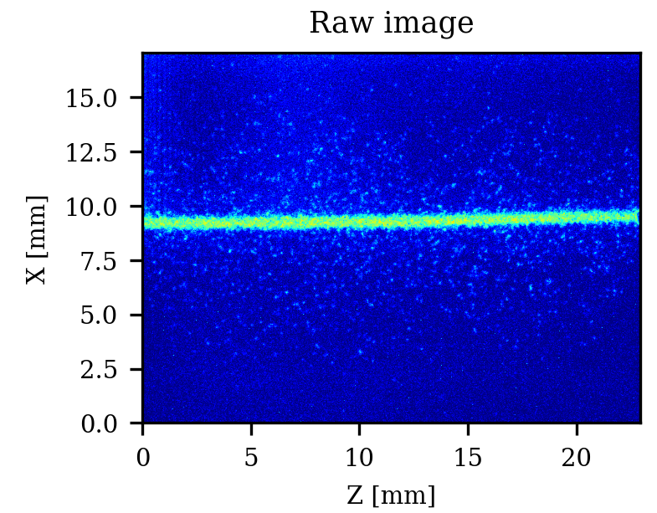
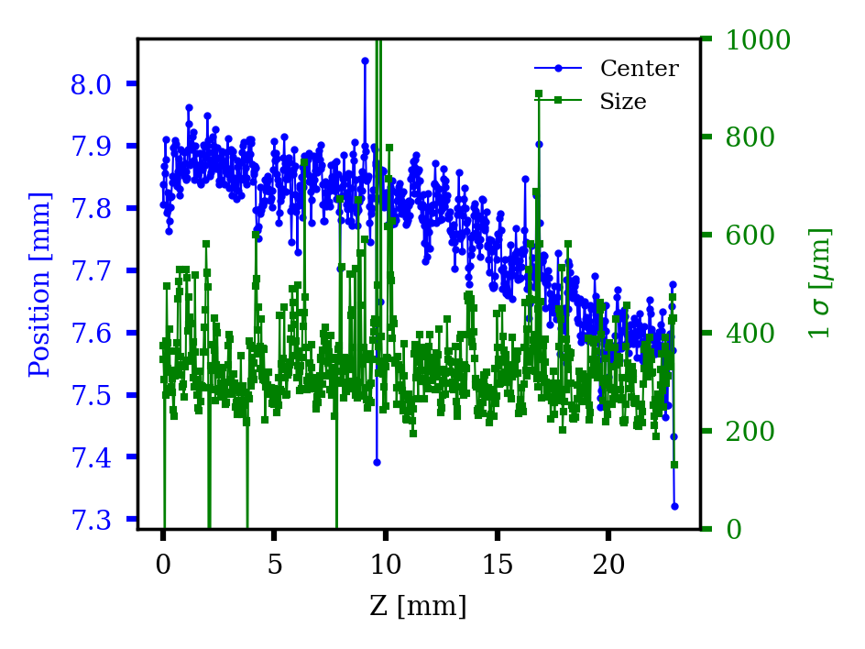
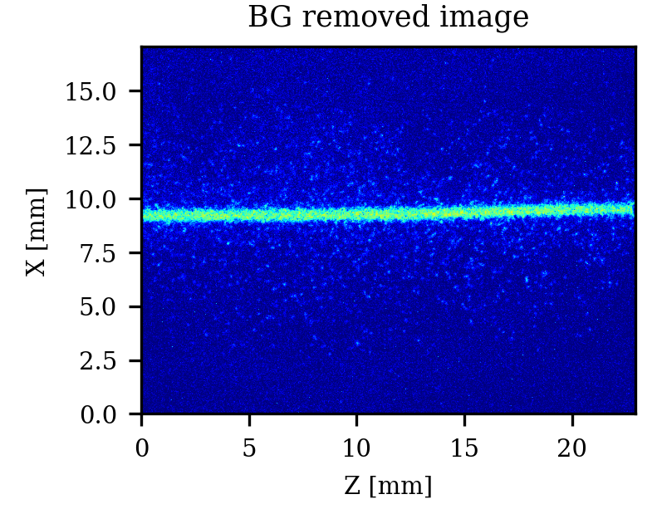
PAL-XFEL Soft X-ray beamline experiment results (Vertical, in progress)
1. Data processing
Center position and size of each column
500 eV, position 0, shot 1

Slide 11
PAL-XFEL Soft X-ray beamline experiment results (Vertical, in progress)
1. Data processing
Center shifted image

Slide 12
PAL-XFEL Soft X-ray beamline experiment results (Vertical, in progress)
2. Data analysis (Voltage set A/B)
Set A
Set B

Slide 13
PAL-XFEL Soft X-ray beamline experiment results (Vertical, in progress)
2. Data analysis (Photon energy)
Kr binding energy → M (293 eV), L (1678 eV)
500 eV
700 eV
900 eV
1100 eV

Slide 14
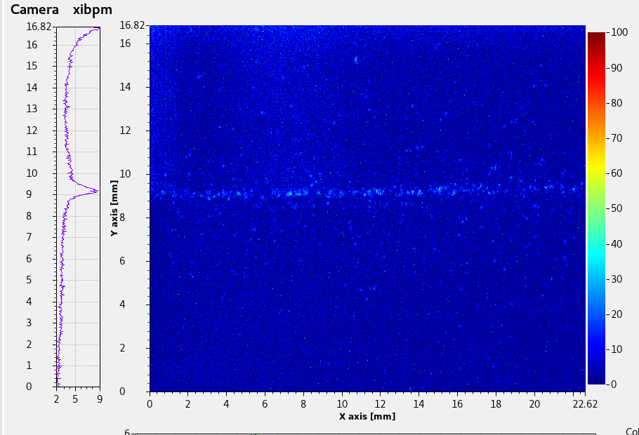
PAL-XFEL Soft X-ray beamline experiment results (Vertical, in progress)
2. Data analysis (Photon energy)
500 eV
700 eV
900 eV
1100 eV

Slide 15
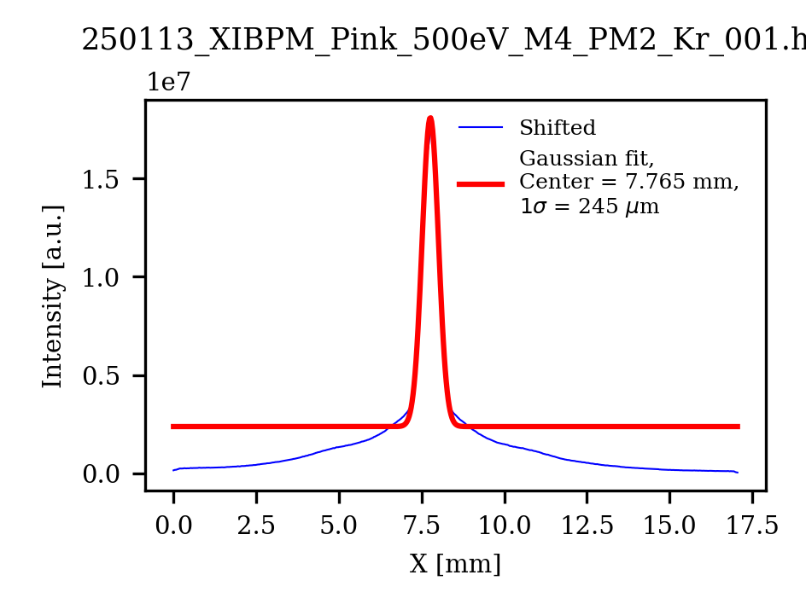
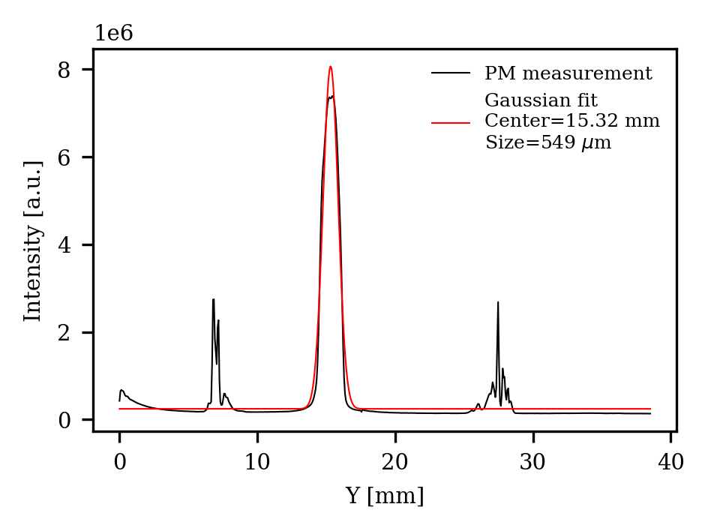
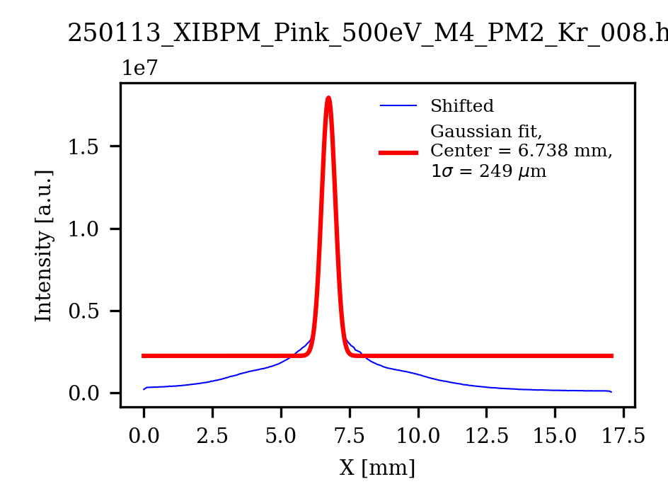
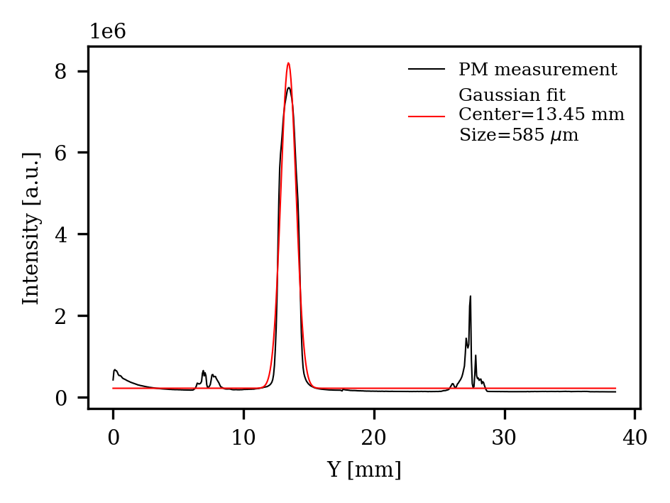
PAL-XFEL Soft X-ray beamline experiment results (Vertical, in progress)
2. Data analysis (Position) - M4 Mirror’s GR motor adjusted (8 steps)
Pop-in Monitor
XIBPM displacement
= 1.027
PM displacement
= 1.87
(1.87/1.766=1.059)

Slide 16
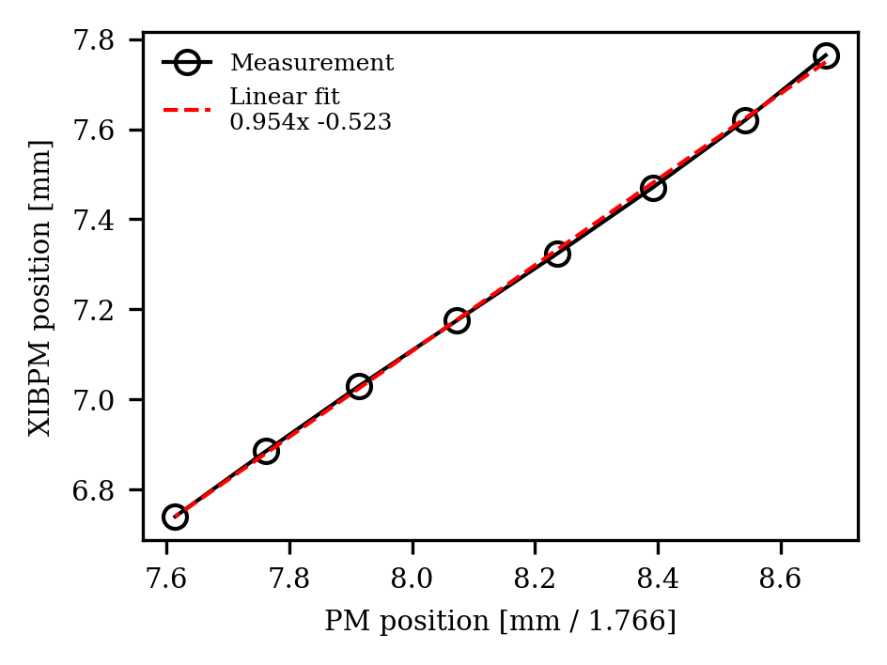
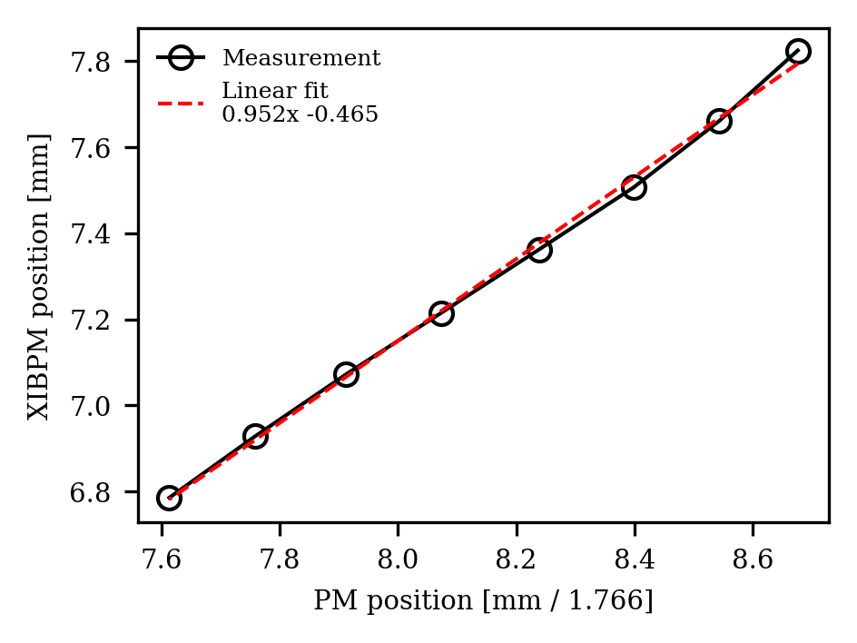
PAL-XFEL Soft X-ray beamline experiment results (Vertical, in progress)
2. Data analysis (Position) - M4 Mirror’s GR motor adjusted (8 steps)
Image ration: 1.766
19.04 m
14.58 m
Pop-in Monitor (PM)
YAG → Reference
Grating mirror
XIBPM
Set A
Set B
Fit err = 8.9e-3, 7.2e-2
Fit err = 1.76e-2, 1.44e-1

Slide 17
PAL-XFEL Soft X-ray beamline experiment results (Vertical, in progress)
2. Data analysis (Applied voltage)
Repeller
voltage
2000 V
3000 V
4000 V
MCP-in voltage
-1600 V
-1400 V

Slide 18
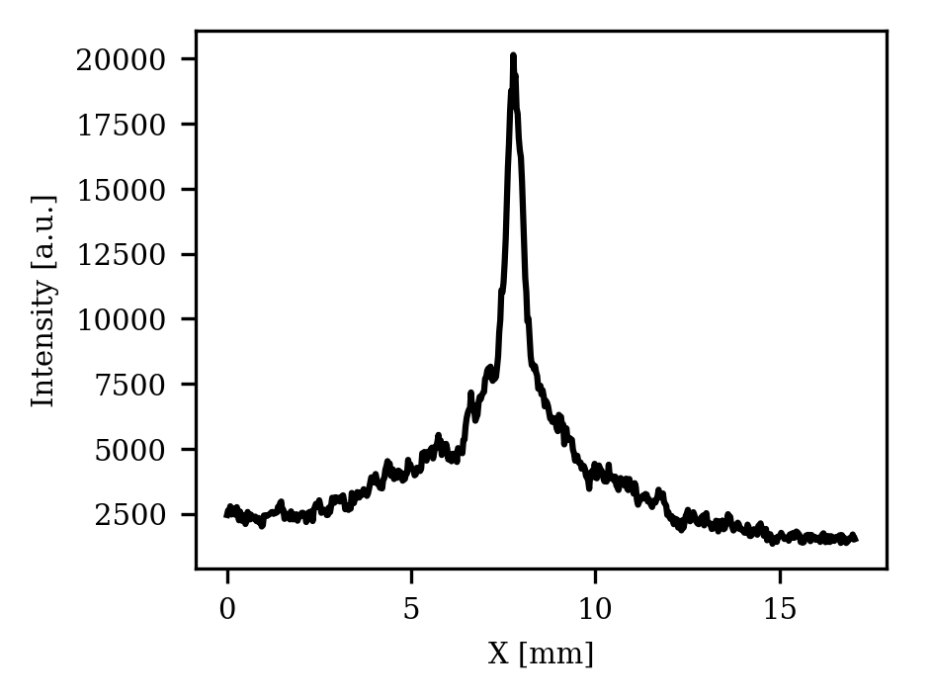
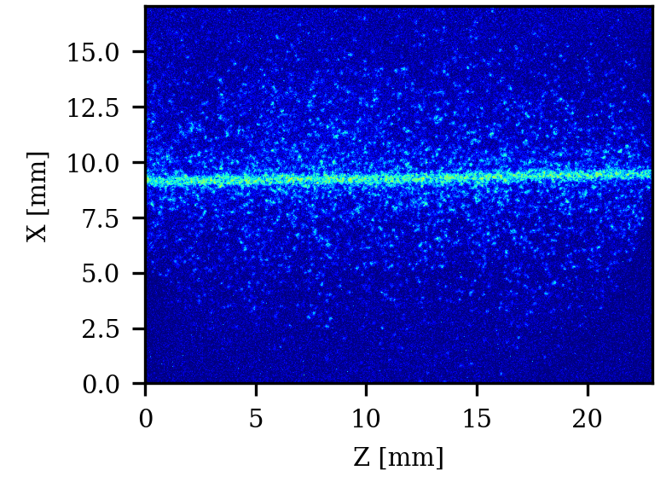
Exposure time estimation
Measured by XIBPM at SX beamline (Kr injected)
900 eV pink beam single shot, SNR~4
PAL-XFEL SX beamline, photons per pulse → 2e+12 (pink beam)*
Xenon ionization cross section at 900 eV (Kr was used, but since the cross-section is similar, Xe data will be utilized for a consistent comparison.) → 2.1 Mbarn
Photo-ion generation (event number) per pulse → 2.24e+5 [event/pulse]
* S. H. Park, RSI 89, 055105 (2018)

Slide 19
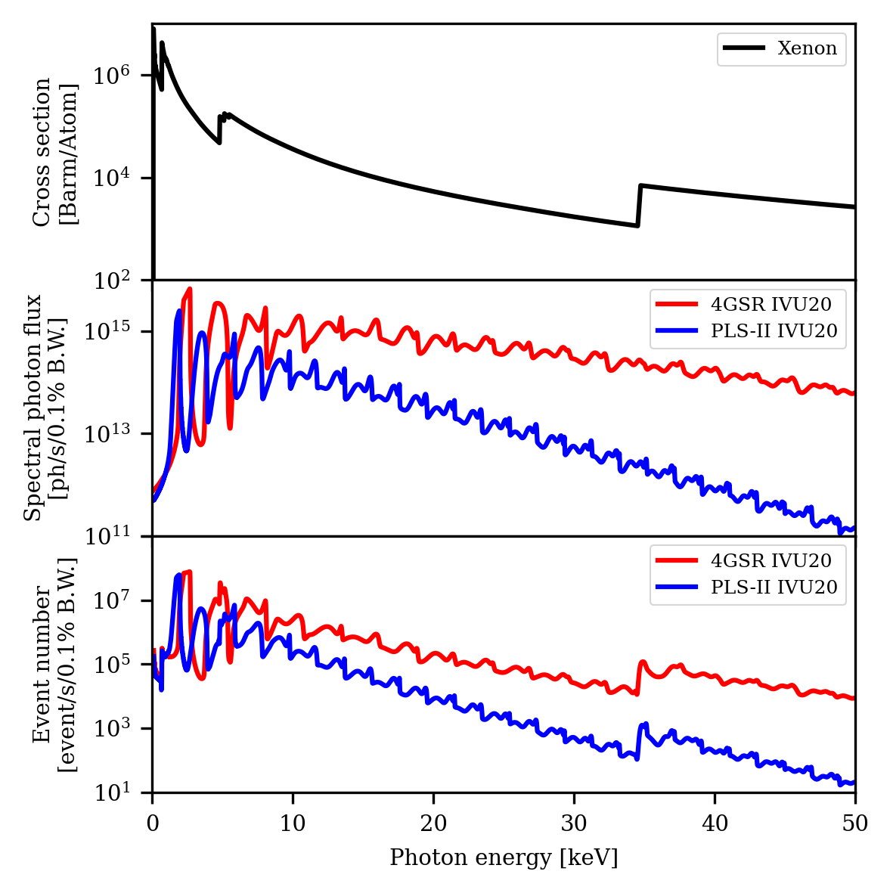
Exposure time estimation
Pressure = 1e-6 torr
# of event = Photon flux * Cross-section (Xe) * Loschmidt constant * Pressure * Drift length [event/s/0.1% B.W.]
Photon beam | Beamline | Total event number | Exposure time
900 eV pink beam | PAL-XFEL SX | 2.24e+5 | Single pulse
White beam | PLS-II | 3e+9 | Dep. on data processing time
 | 4GSR | 8e+9
10 keV beam (0.1% bW) | PLS-II | 1.85e+5 | 1.21 sec (0.83 Hz)
 | 4GSR | 2.50e+6 | 0.09 sec (11 Hz)
30 keV beam (0.1% bW) | PLS-II | 5.09e+2 | 440 sec
 | 4GSR | 2.59e+4 | 8.7 sec (0.12 Hz)

Slide 20
Exposure time estimation
Residual gas composition (High vacuum, require reference check)
Gas | Percentage contribution
H2O | 48%
H2 | 27
N2 | 15
O2 | 5
CO | 2.5
CO2 | 2.5
Total | 100%
Photon beam | Beamline | Total event number |  | Exposure time (Residual gas)
 |  | Xenon | Residual Gas
900 eV pink beam | PAL-XFEL SX | 2.24e+5 (Kr) |  | Single pulse
White beam | PLS-II | 3e+9 | 9.2e+7 | 2.4 ms (410 Hz)
 | 4GSR | 8e+9 | 1.76e+8 | 1.2 ms (785 Hz)
10 keV beam (0.1% bW) | PLS-II | 1.85e+5 | 6.07e+2 | Too long
 | 4GSR | 2.50e+6 | 8.19e+3 | 274 sec
30 keV beam (0.1% bW) | PLS-II | 5.09e+2 | 1.03e+0 | Too long
 | 4GSR | 2.59e+4 | 5.24e+1 | Too long

Slide 21
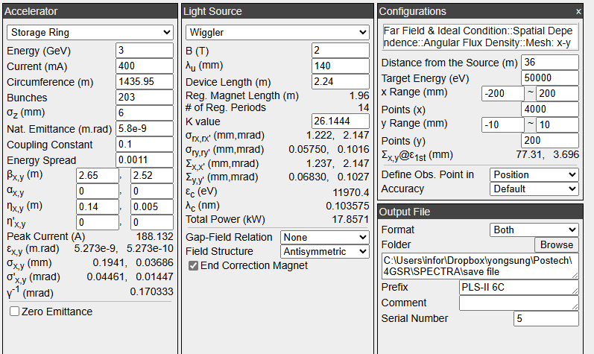
Future plan
Spectra → BL6C Beam Calculation (Previously Calculated with IVU20)
Simulate the expected experimental results for BL6C, including the event number.

Slide 22
Summary
White PBPM is currently in the procurement process.
XIBPM displacement experiment at the PAL-XFEL SX beamline has been completed.
- Data analysis is in progress.
Expected signal intensity has been calculated.
- Simulation for the PLS-II experiment is planned.

Slide 23
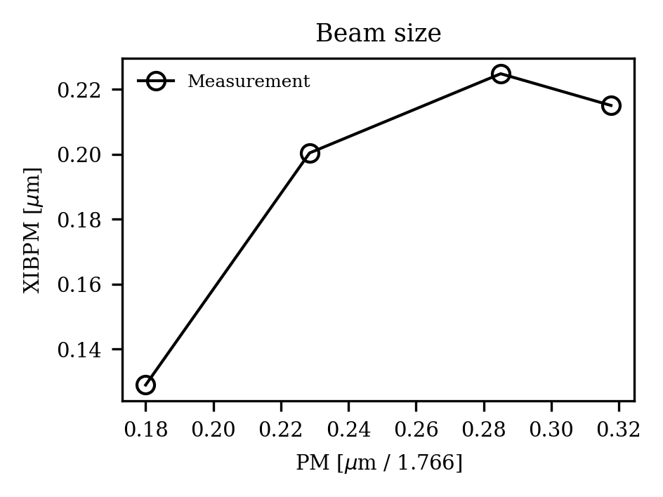
700 eV
500 eV
900 eV
1100 eV

Slide 25
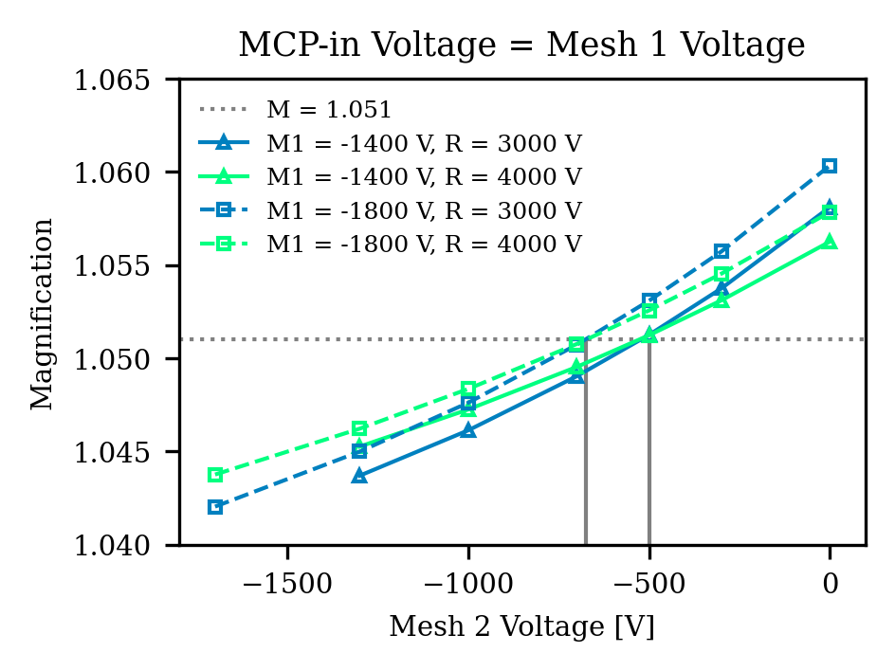
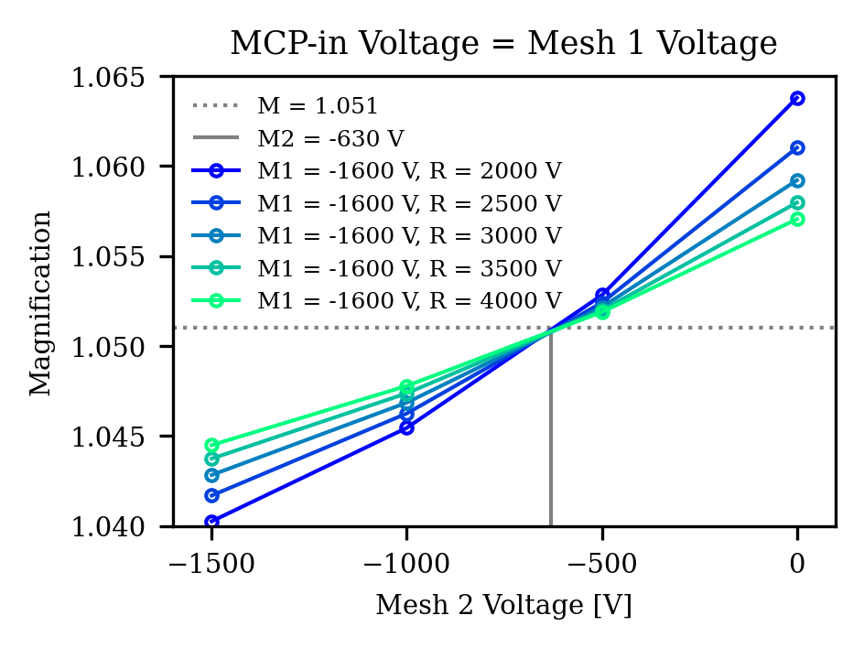

Slide 26
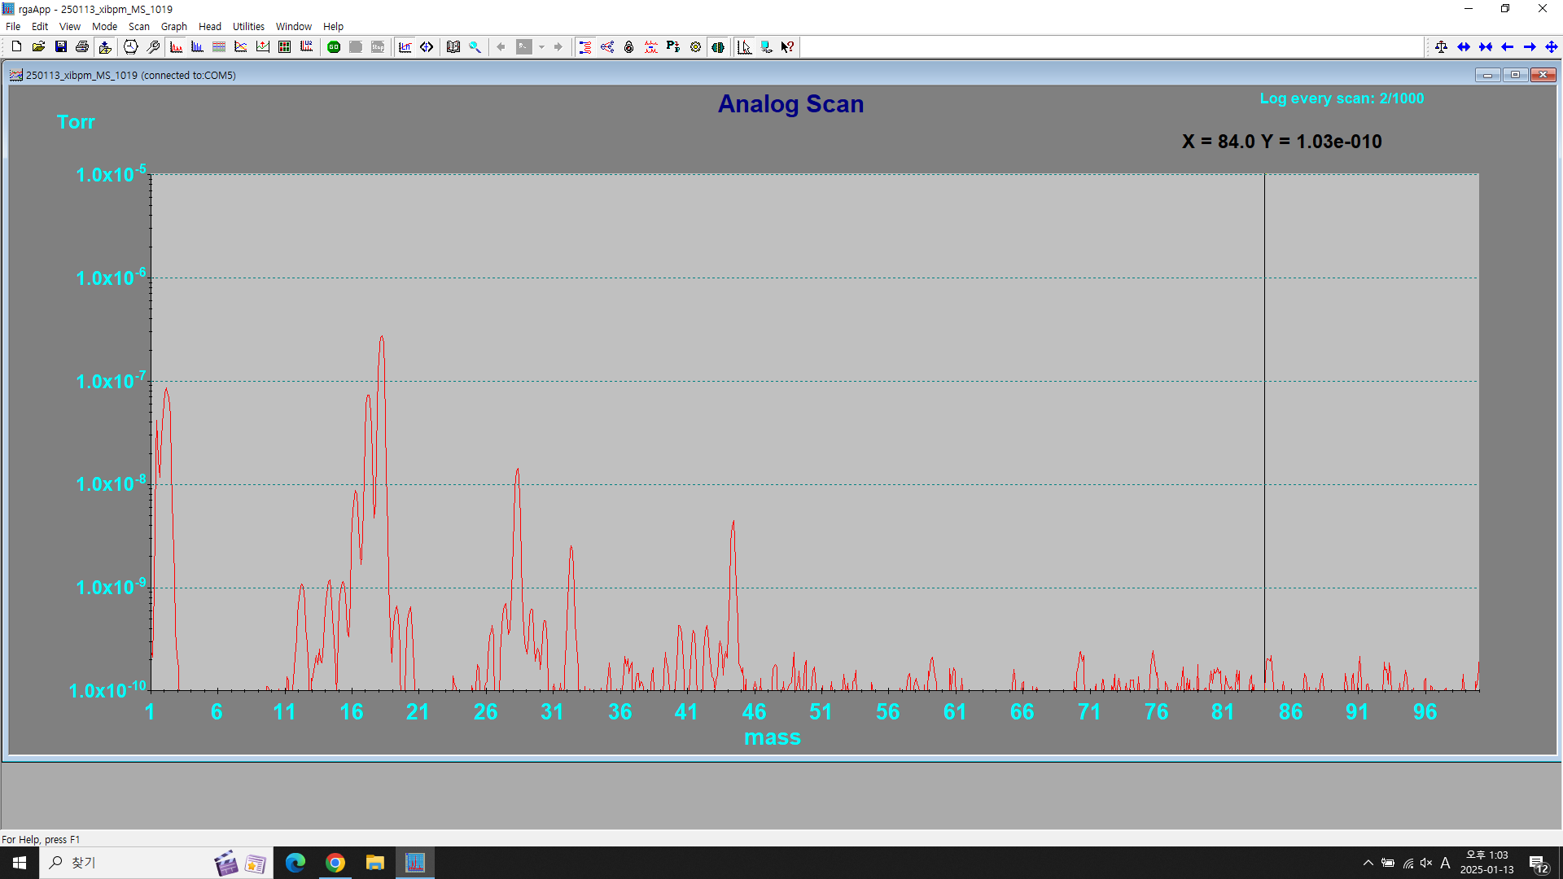
진공도 : 6.9E-7 Torr
250113_XIBPM - RGA 측정
H2O
H2
N2, O2
CO2?

