Slide 1
Experiment Plan for Development of an Absolute Coordinate Calibration Device for Beam Profile Monitor
Feb. 24. 2025
윤주환

Slide 2
1. Research Background
BPRM by scintillator and its limitation
Research purpose
Numerical model
3. Experiment
BPRM stage alignment test
Motor performance test
Original 2D profile image setting
Distorted image measurement
2. Experiment Design
Process of experiment
Device setup & spec
Device component test
4. Result Analysis
Comparison of Original & Measured
1D (x, y axis) intensity graph plotting
RMS Error

Slide 3
Time Table
~25.02.21
실험 장비 완비 여부 확인
논문 Perspective Calibration 부분 작성
PC 설정 및 자리 옮기기
(선형가속기 105호)
~25.03.03
연습용 스크린으로 프로파일 찍어보기
논문 Experimental Setup 부분 작성
피규어 초본 제작
~25.03.10
YAG 설치 및 프로파일 데이터 추출
논문 초고 작성 완료 후 피드백
(늦어도) 3월 둘째주까지 논문 서브미션

Slide 4
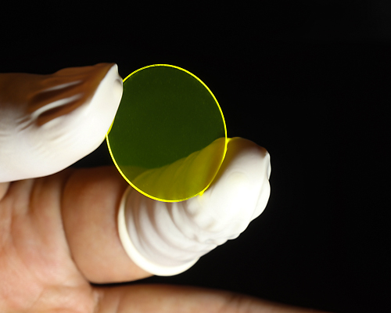
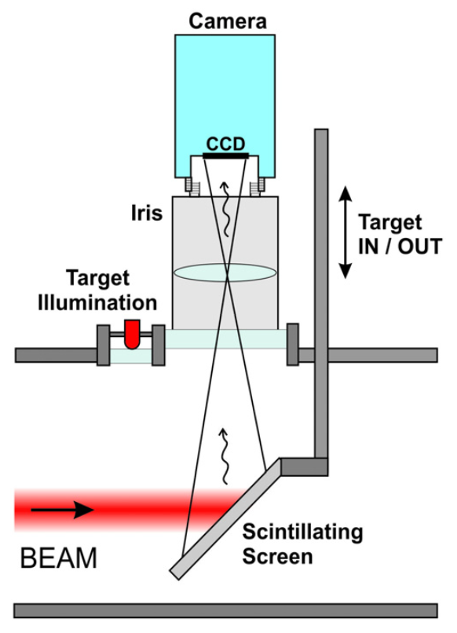
Research Background
y
2D beam profile
x
Beam Profile Monitor (BPRM) based on the scintillator is well adopted due to its convenient structure.
Scintillator oblique against the beamline → Beam profile image is distorted.
BPRM device alignment & assembly tolerance → Inaccurate position coordinates.

Slide 5
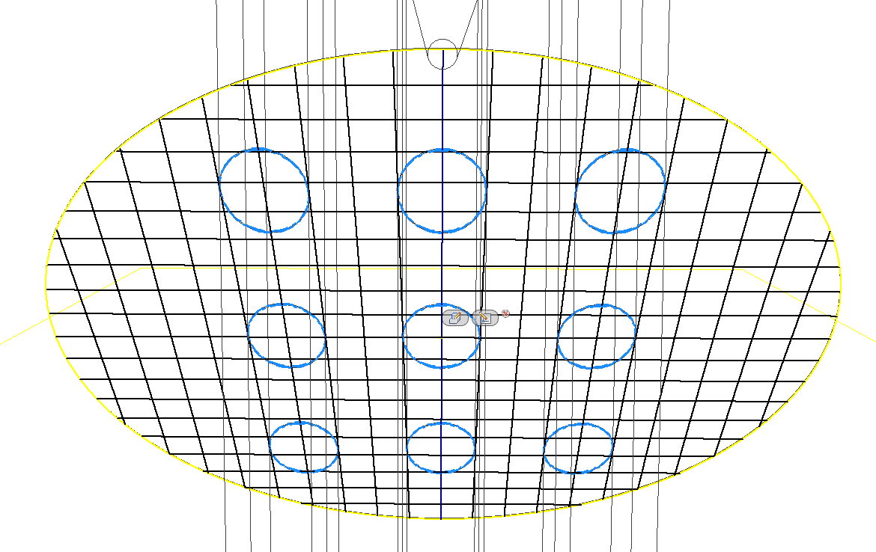
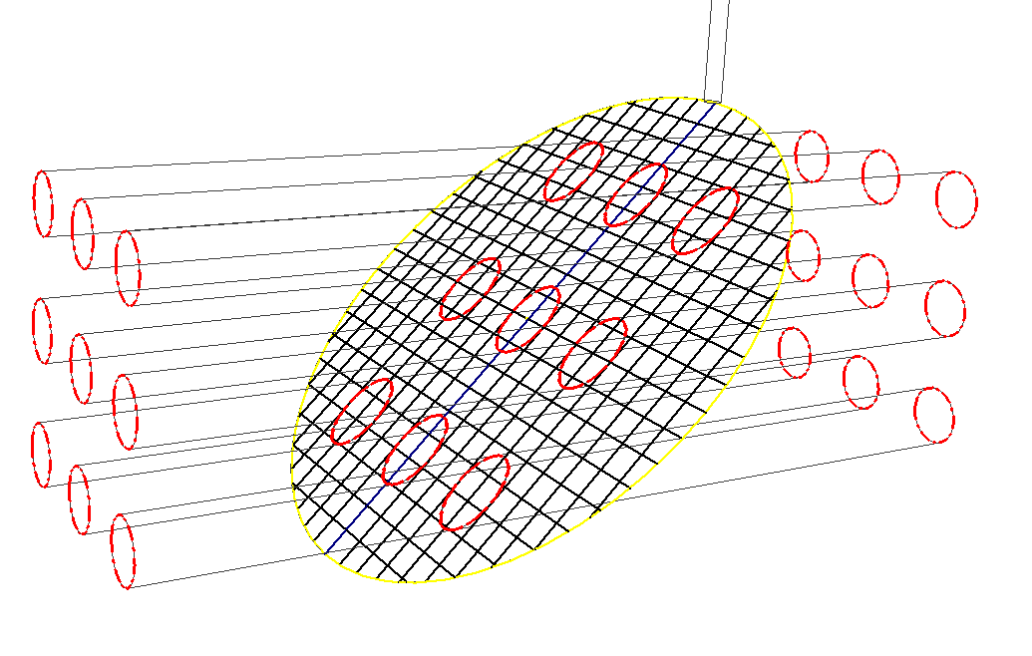
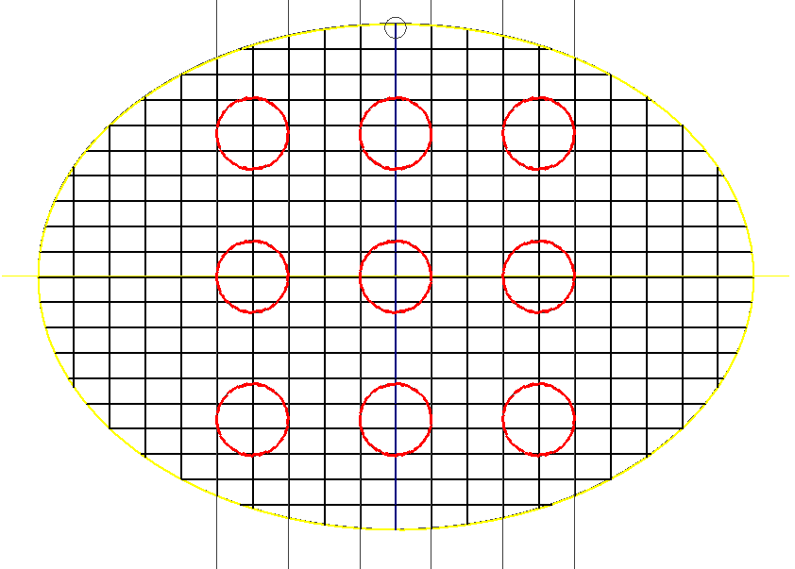
Perspective Calibration
Goal
Flattening the distorted coordinate space
Restoring original space regardless of the distorted angle
Method
Identify the relation between the original and distorted coordinate space
Transform all the coordinates → extract whole image
Application
Get 2D flat beam image of the tilted screen
a) RAW DATA
Readout
9-circular beam
b) DESIRED IMAGE
tilting screen

Slide 6
Perspective Calibration
Coordinates are changed when the original point projects to distorted plane.
Each coordinates is related by transformation matrix, 3x3.
j=1 in scaling factor → The rest of matrix can be obtained by 4 pairs of coordinates.
Transform the remaining distorted coordinates into plane ones → Single flat image

Slide 7
Overview of An Experiment
BPRM Stage Set up
Alignment test
Camera area confirmation
Two-axis Motor Examination
Position & velocity consistency in straight path → Linearity
Position accuracy after repeating motion → Repeatability
Camera Origin Point Setting
Set camera’s origin position to target the central part of YAG screen

Slide 8
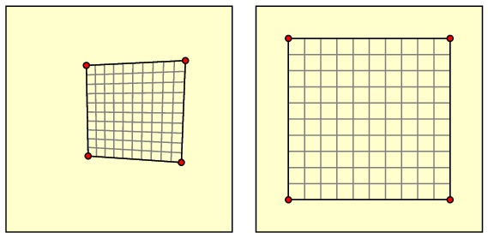
Overview of An Experiment
2D Beam Profile Image Production
Criterial image (Transform 45˚ tilted seen to horizontal plane)
Distorted image (Arbitrary angle)
Image Calibration
Perspective transformation
Acquire 1D gray scale of beam profile

Slide 9
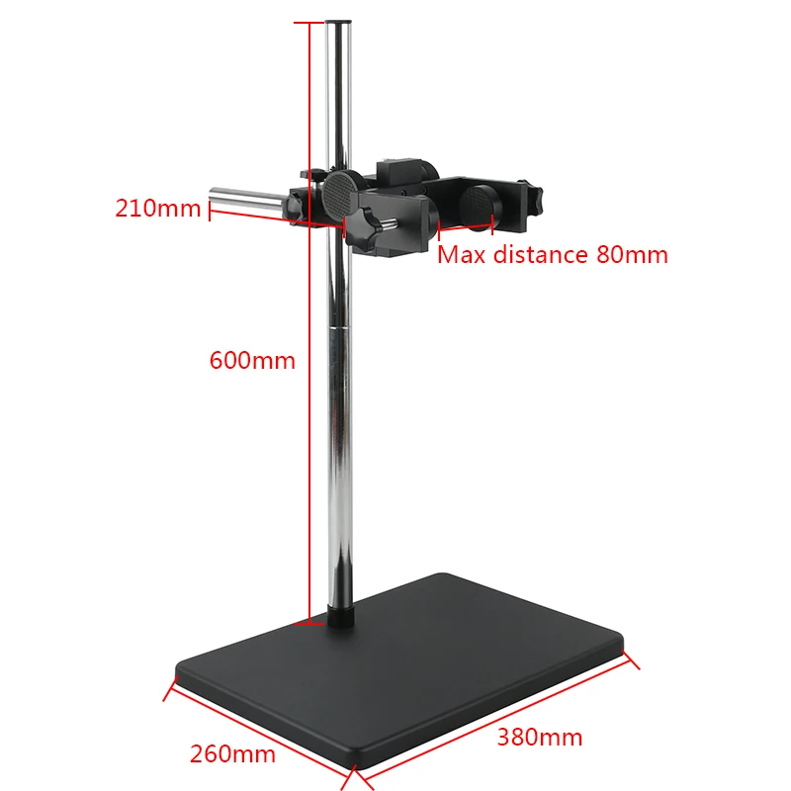
Device Setup
https://ko.aliexpress.com/item/1005002587524203.html
What needs
CMOS Camera & Two-axis motorized stage
Grid glass plate (To check the alignment of a stage and set the coordinates of moving motor position)
YAG Screen & Supporter
Laser & holder
Level meter

Slide 10
Device Set up (Specification)
Grid plate
한 칸에 5mm
중심점(원점) 기준으로 25mm 지점까지 사용 가능
Ce:YAG single crystals
Size: 10x10x0.1mm
Thermal resistance: 790 W/m
Melting point: 2243 K
Polished surface with marking grid
Laser
YAG
Wavelength: 532 nm
Power: 500 mW
Diameter: 6.0 mm
* 슬릿 구멍으로 빔 크기 줄이기
Grid plate
Fixed focal length: 25 mm (Wide Angle)
Working distance: 100mm - ∞
Maximum distortion: 0.22 %
Lens
Ethernet control
Resolution: 10000 ppr
BK Brake (Axis-mounted)
Holding torque: 1.0 Nm
Camera
2–axis
Motor
Type: CMOS
Resolution: 1.6 Megapixels
Sensor Size (FxV): 4.97 mm × 3.73 mm
Mono (Colorless)

Slide 11
Device Setup
부품 | 기능 및 역할
Two axis motorized cam | Camera centre indicates position coordinates, moving horizontally and vertically in um unit. Verify motor linearity and repeatability.
Grid plates | Define the coordinate plane, calibrating the camera position. Both plates overlap → Camera-Grid plates alignment is straight ahead.
YAG screen | Obliquely installed YAG image is taken and flattened. Installed within the calibrated coordinate range.
Laser & holer | Collect laser beam profile and check that BPRM image is calibrated into 2D. Mounted vertically to camera viewpoint and irradiate YAG surface.

Slide 12
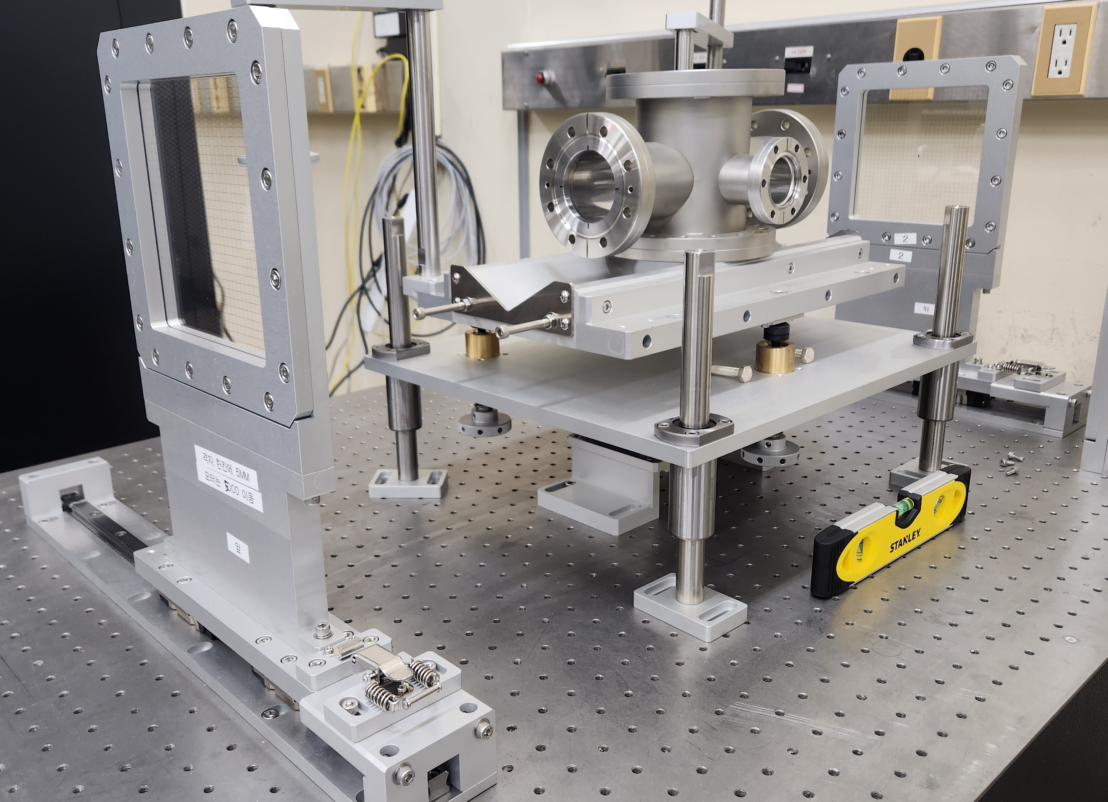
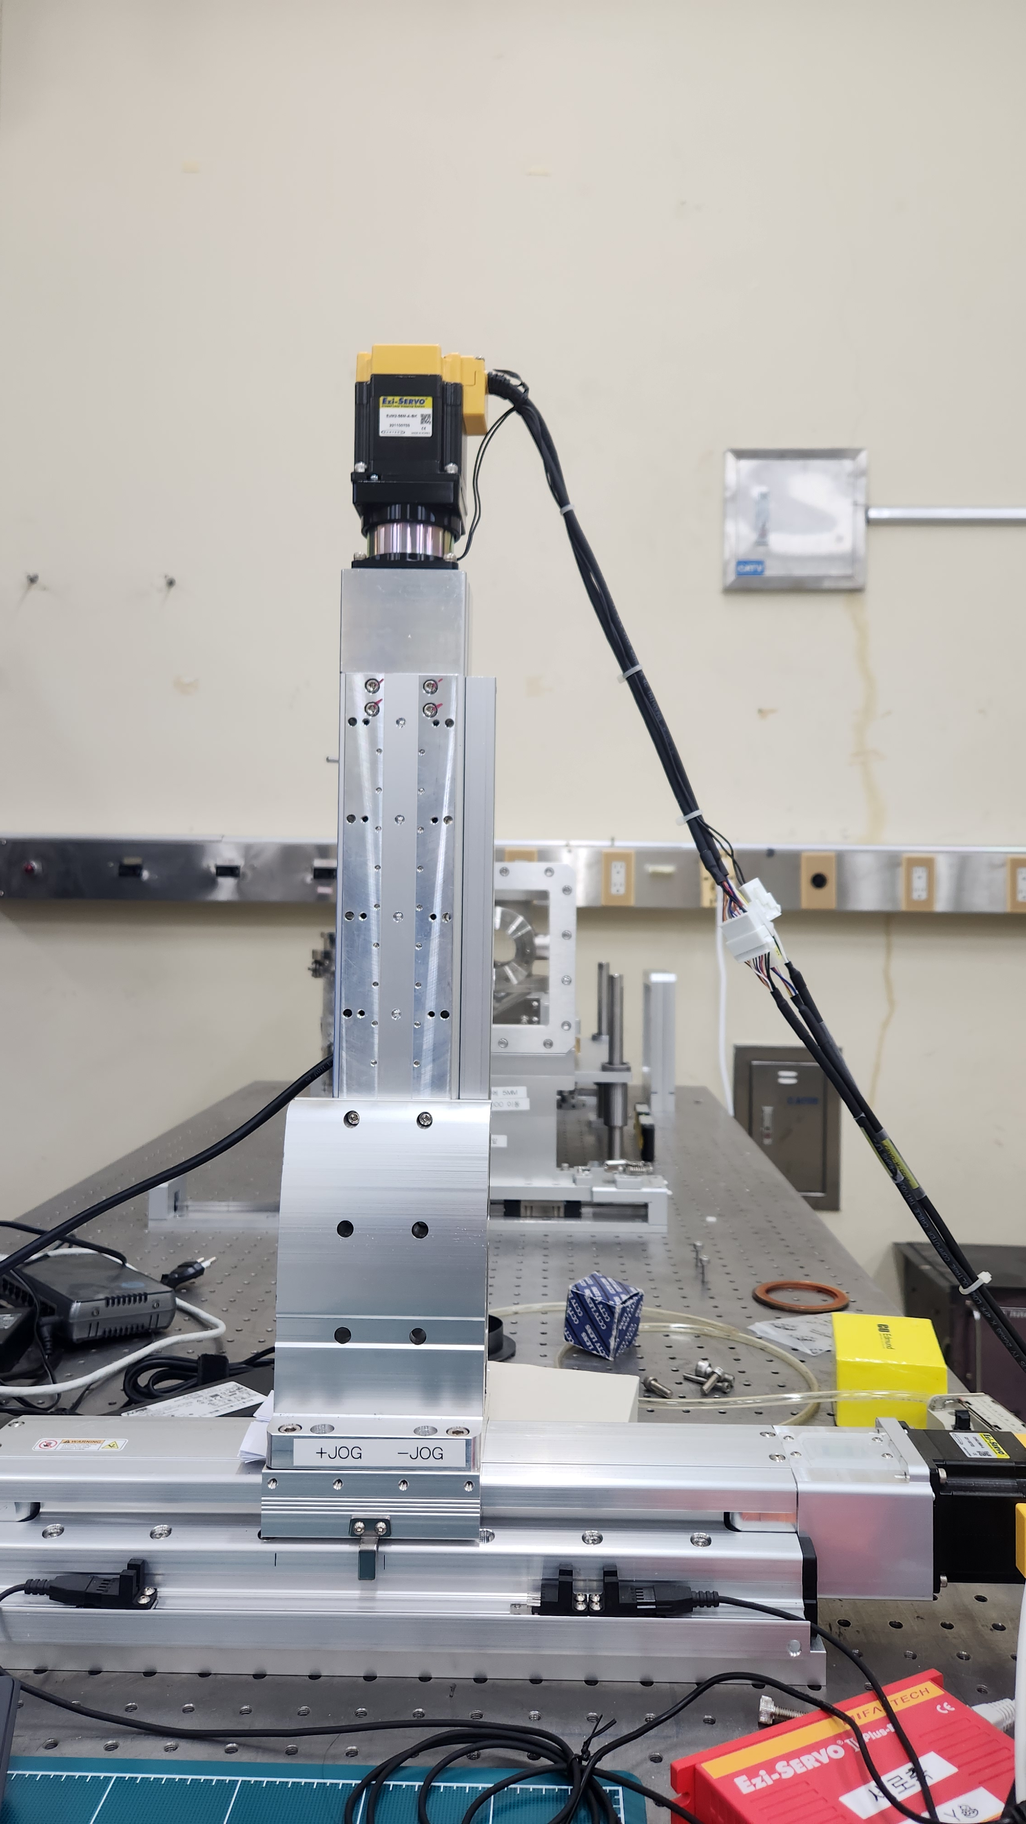
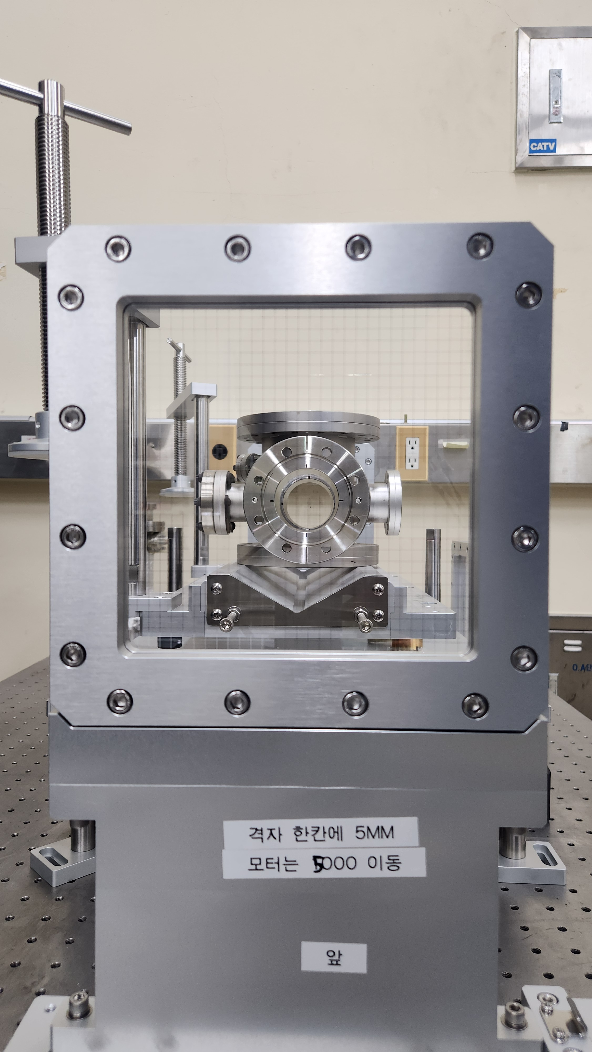
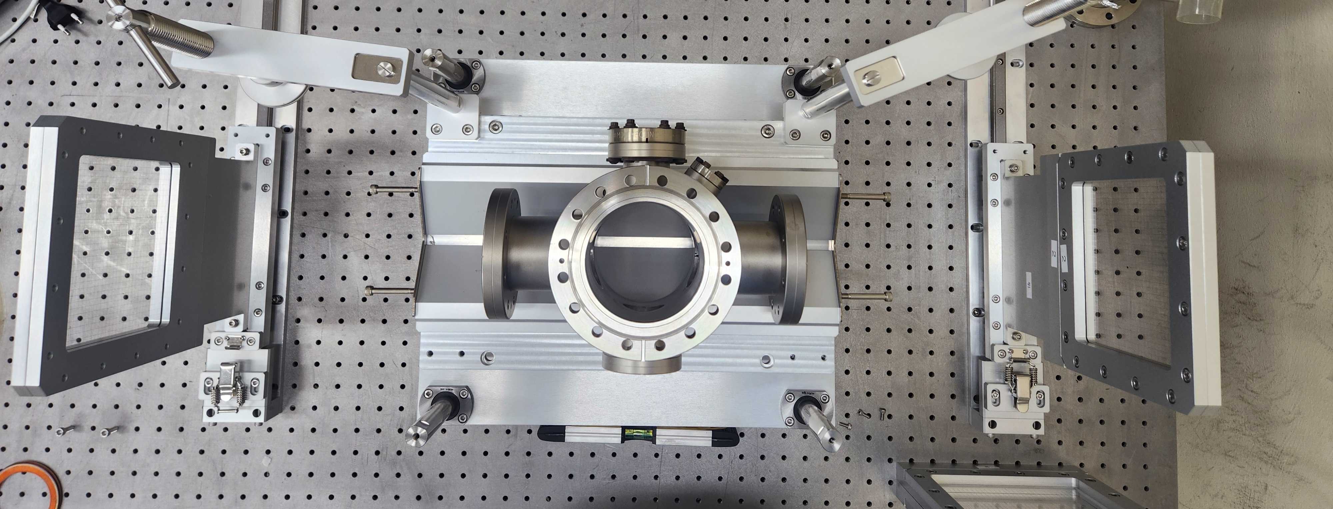
Plate to plate: 0.875 m
Table to grid center: 0.290m

Slide 13
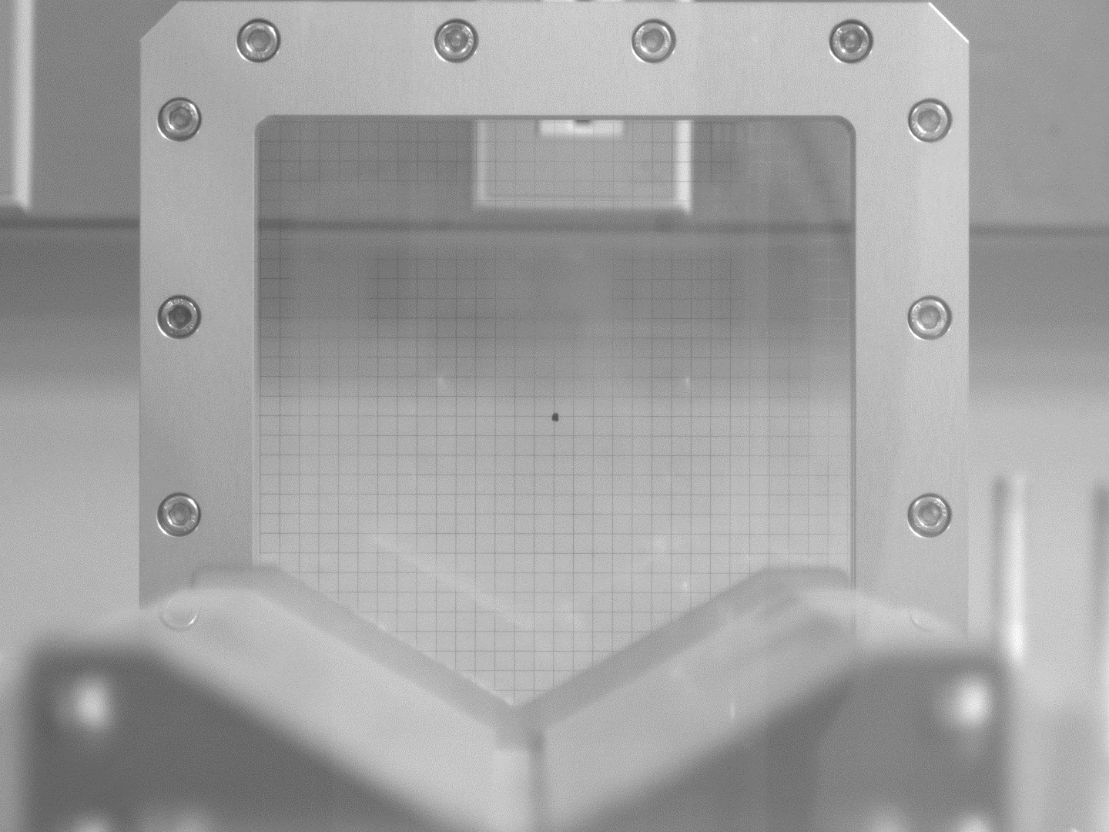
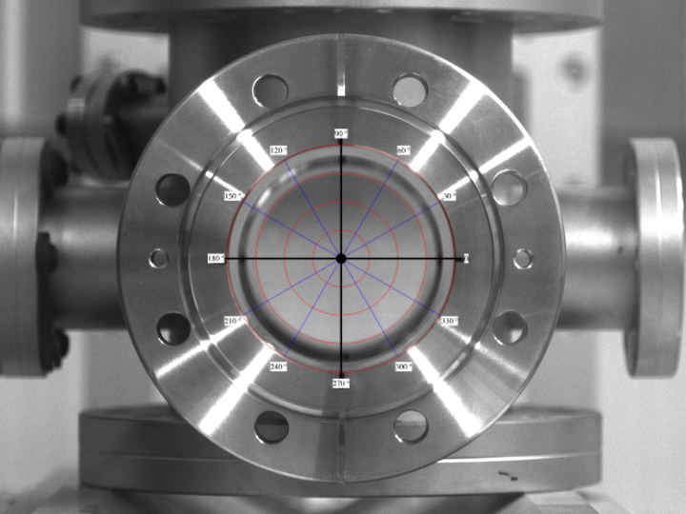
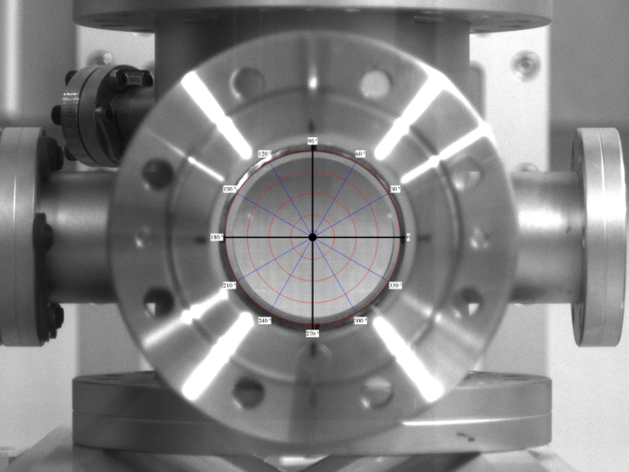
Alignment Test
두 격자판의 촬영 범위 지정 및 평행 여부 점검
스크린 대신 더미 챔버로 일직선 정렬 시험해 봄
Verify the range of linearly printed grid on each plate.
Each coordinates are overlapped. → Determine whether camera gazes at the front.
If the camera moves 5000um when the coordinate moves one space (5mm) → Camera can move without grid plate.
Eliminate the grid plate after setting origin point.
Control the motor to move the camera to the desired position.

Slide 14
Motor Test
Repeatability
Return to initial position(Origin) after the repetitive motion, in micro-unit.
In experiment without grid plate, motor position is reference coordinates. → Deviation not allowed.
During 100 times repetitive motion on each axis (Origin ~ $±$25mm), check actual position.
Linearity
Motor moves along straight orbit which is grid plate line.
If the camera center deviates the grid line, YAG cannot be installed on that area.
Two grids should be overlapped to verify the linear motion of motor.

Slide 15
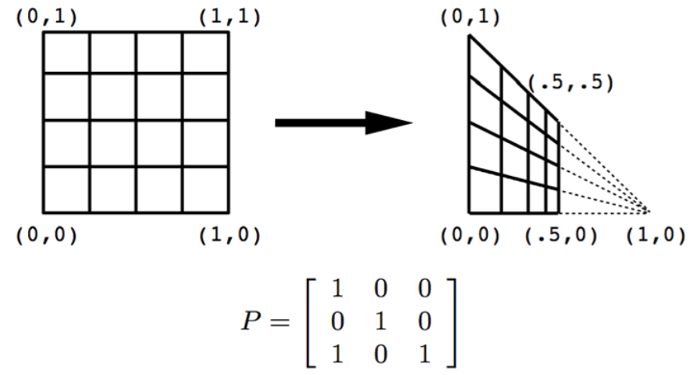
Experiment
BPRM image calibration by perspective transformation
Irradiate YAG with a laser → Laser beam 2D profile image.
Flatten the tilted screen image using a transformation matrix and compare it with the original 2D image.
Verify stage alignment and motor repeatability/linearity before experiment to ensure same images.
대조군 (2D transverse beam image) | 실험군 (distorted screen image)
Perfectly flat image can be equipped by installing YAG at exact 45°. Convert it to 0° image, that is 2D transverse image. Reference image → each coordinate point has to be equally spaced from the origin. Coordinates of source space are determined by moving camera to each ones. | Image of the arbitrary tilted screen is transformed into 2D beam profile image. Capture the point indicating the source coordinate. Distance the camera moved is the coordinates of the target space. Comprise the transformation matrix by 4 pairs of coordinates. → Flattening the image using Python.

Slide 16
Experiment
Source image
(2D Flat profile)
Target image
(Tilted screen)
Transformed image
(Perspective calibration)
Comparison

Slide 17
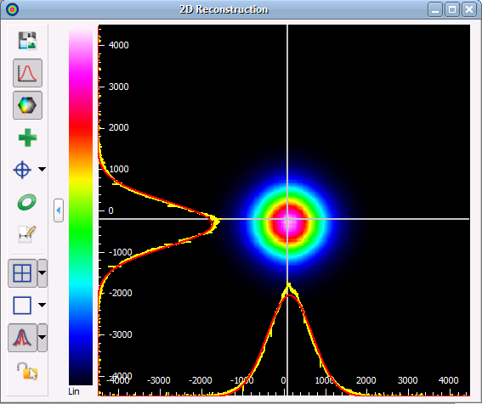
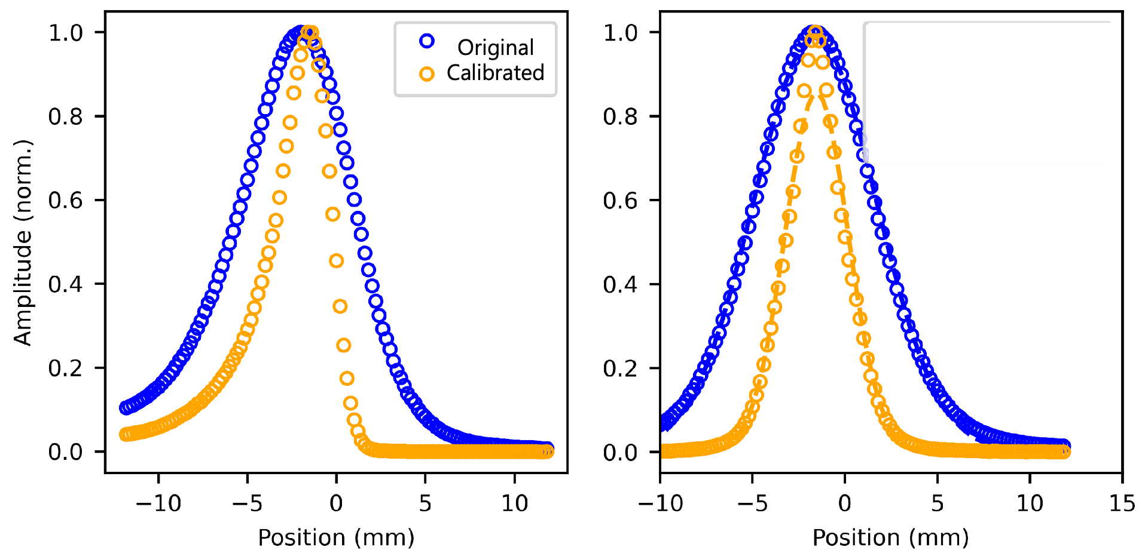
BPRM Measurement & Analysis
Comparison of original 2D profile and calibrated image by transformation matrix
Plotting the gray scale graph of each profile’s horizontal & vertical axis.
Compare error rates with RMSE for graphs in each axis.
Describe beam spread, shape (eccentricity) qualitatively.
Analyse error cause.

Slide 18
THANK YOU

Slide 19
Appendix
What to be equipped
YAG Screen (안 깨지게 설치)
Laser pointer mounting (스크린 중심부를 정확히 targeting)
Laser hole slit (빔 사이즈 줄이기 위해)
BPRM Analysis Program (프로파일 그래프 도화)

Slide 20
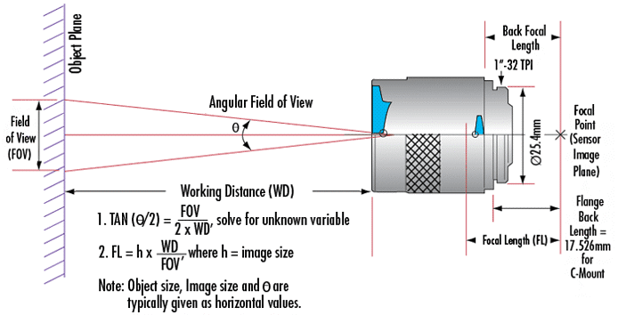
Appendix
Camera Information
Focal length
Field of View
Lens Magnification
​$Field of View=\frac{Working Distance x Sensor Size}{Focal Length}$
https://www.edmundoptics.co.kr/knowledge-center/application-notes/imaging/6-fundamental-parameters-of-an-imaging-system/

Slide 21
