Slide 1
Efficient continuous wave accelerating structure for ion beams
Feb. 21, 2025
Woojin Song

Slide 2
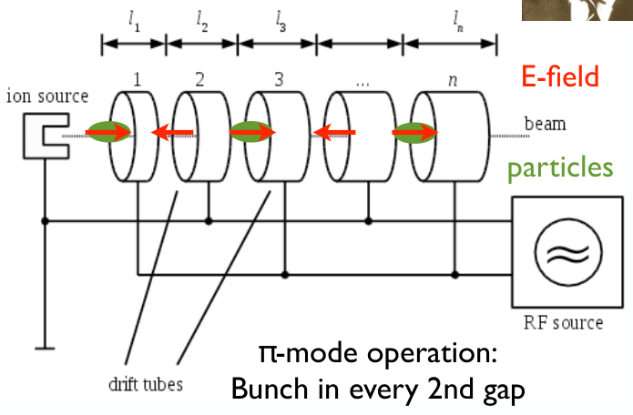
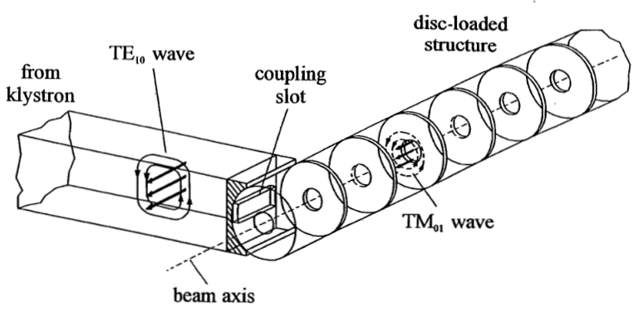
Drift Tube Linac (DTL)
The Wideroe Linac (1927)
Composed of a series of metal drift tubes.
High-frequency AC is applied
However, at higher energy levels, it becomes excessively long. (For 10 MeV proton, ~2 m tube)
W. W. Hansen (1947) - Disk-loaded structure linac
RF technology advanced through WW2, and based on this progress, it was proposed.
Primarily used for accelerating relativistic particles in the high-frequency range.

Slide 3
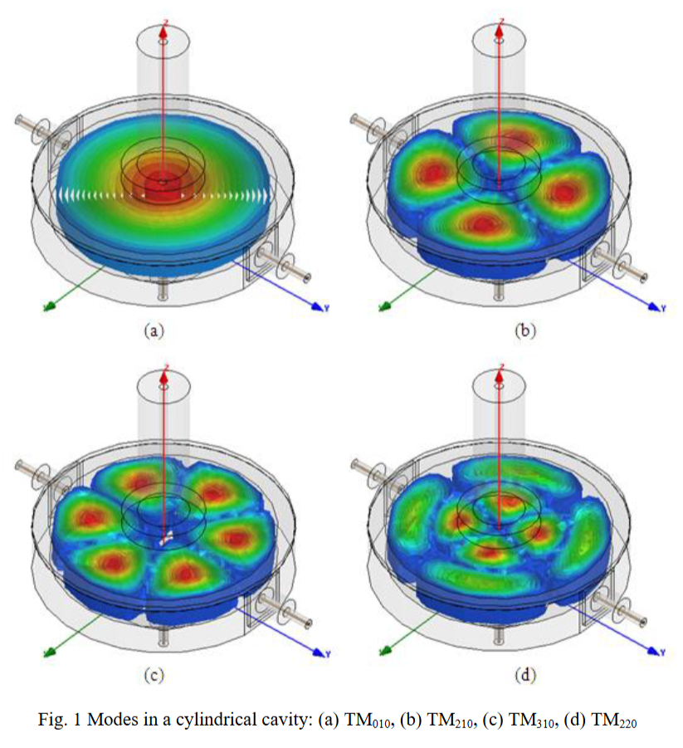
Drift Tube Linac (DTL)
1. Alvarez type – Regular acceleration, Strong periodic transverse focusing
CERN Linac-4, 1st DTL
28 gaps
Peak V < 0.31 MV/gap

Slide 4
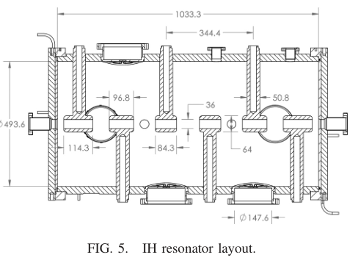
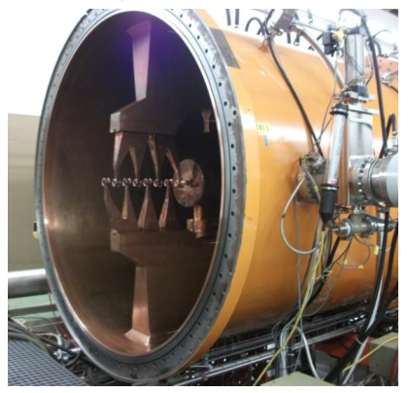
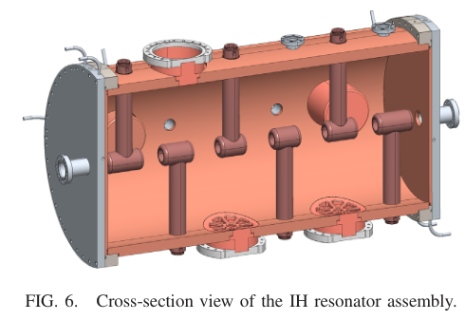
Drift Tube Linac (DTL)
2. Inter-digital H-mode (IH-DTL)
- High voltage, Transverse focusing, Few drift tubes with Quad.
GSI Darmstadt, 1st HIS cavity
53 gaps
Peak V < 0.75 MV/gap
35 MHz

Slide 5
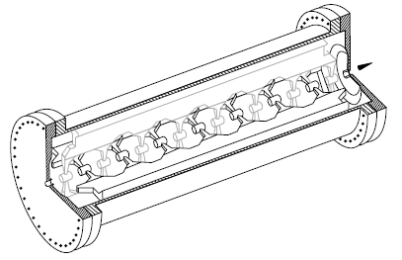
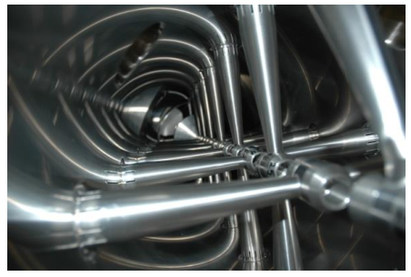
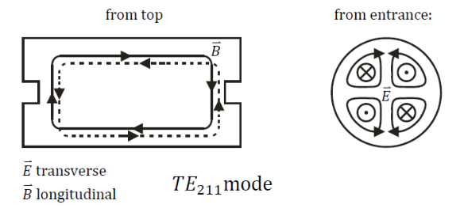
Drift Tube Linac (DTL)
3. Crossed-bar H-mode (CH-DTL, spoke)
- High voltage, No transverse focusing
- Higher mode ↔ IH-DTL
GSI Darmstadt, 1st p-Linac
21 gaps
Peak V < 0.33 MV/gap
352 MHz

Slide 6
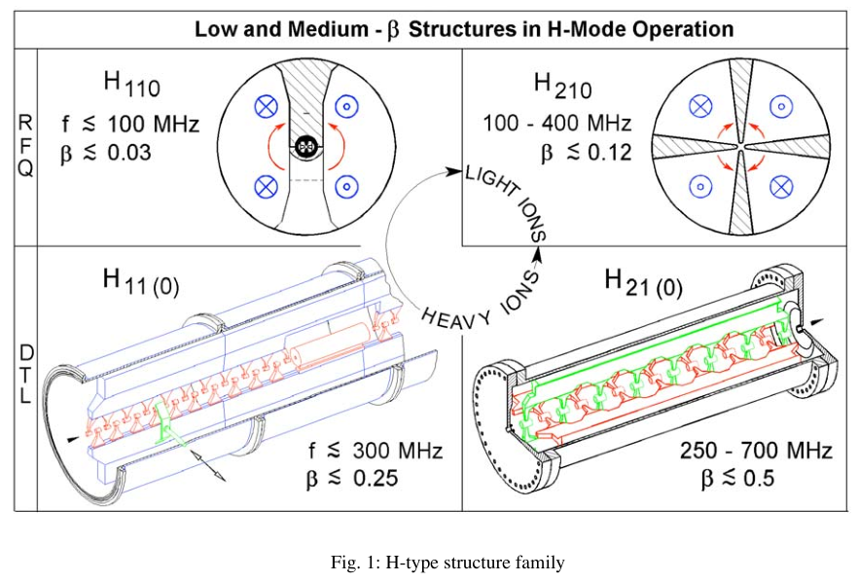
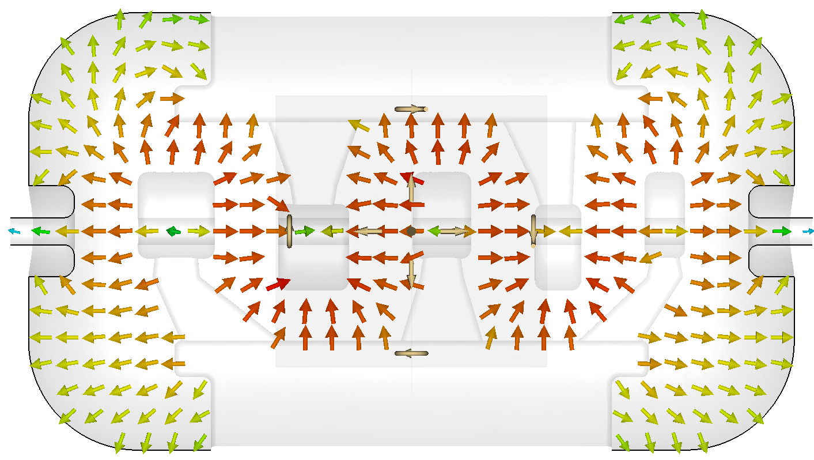
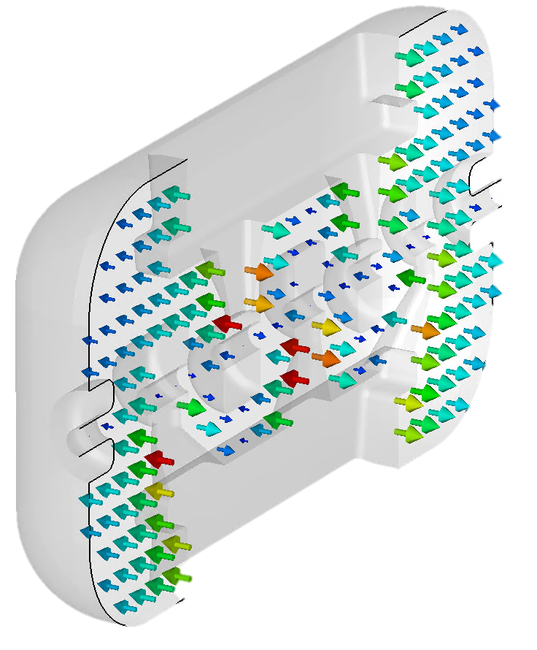
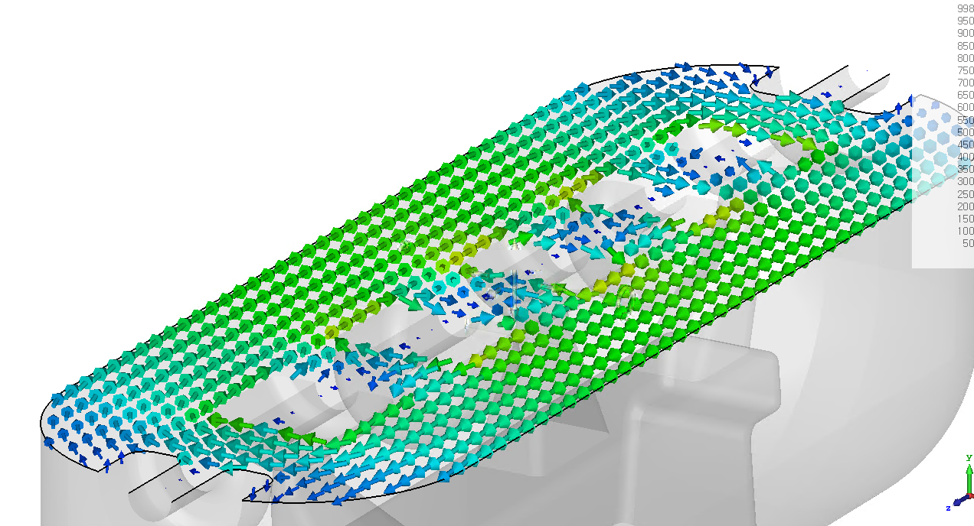
Drift Tube Linac (DTL)
E-field
H-field

Slide 7
Drift Tube Linac (DTL)

Slide 8
Drift Tube Linac (DTL)

Slide 9
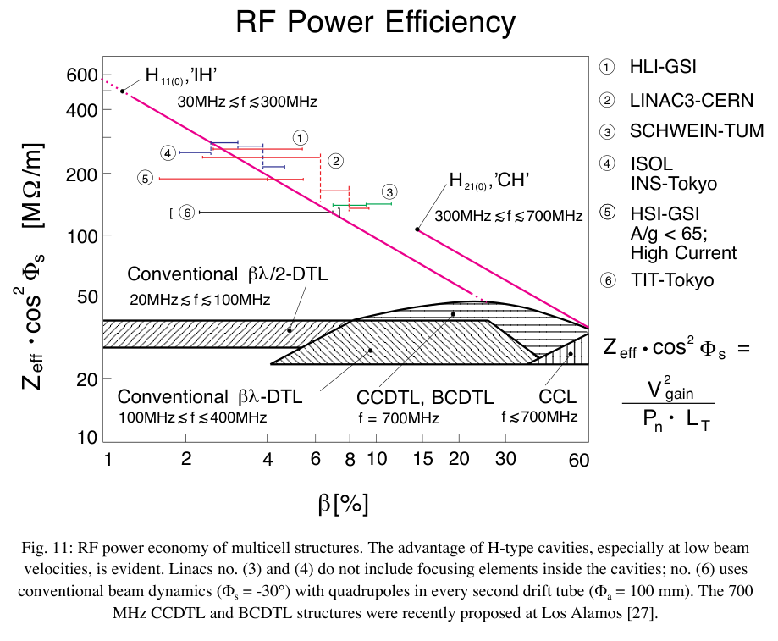
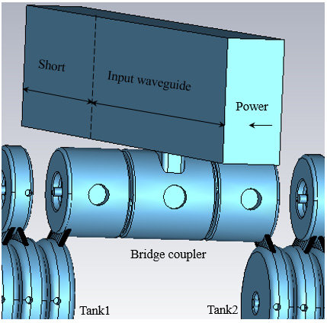
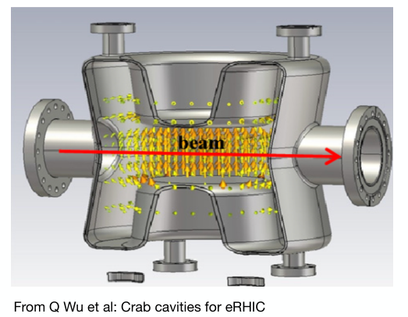
Drift Tube Linac (DTL)

Slide 10
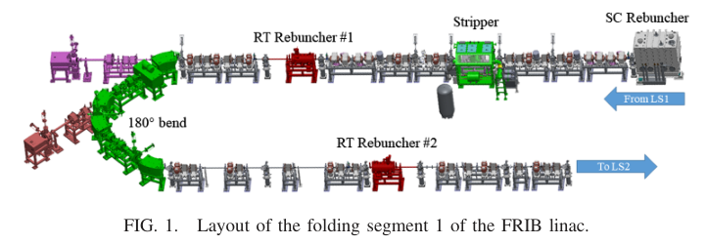
Beam Dynamics Requirements in the FS1

Slide 11
Beam Dynamics Requirements in the FS1
Consists of three rebunchers:
Superconducting (SC) rebunvcher (QWR)
Performs time focusing (shortening) at the stripper.
Room temperature (RT) rebuncher
Addresses concerns of uncontrolled losses of contaminant ions (q/A is smaller than the normal beam) after passing through the stripper.
The first RT rebuncher is used to reduce the increase in momentum spread at the 180° bend.
The second RT rebuncher is used for injection into LS2.

Slide 12
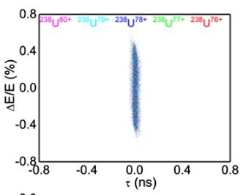
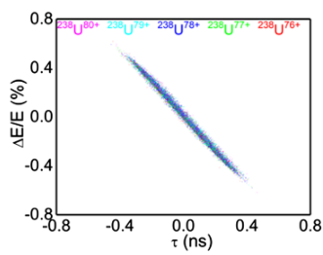
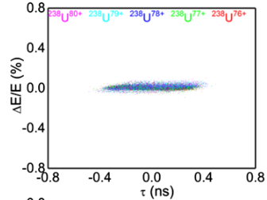
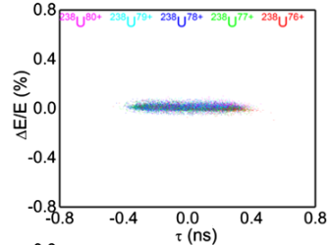
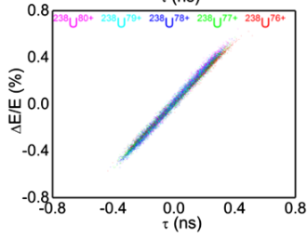
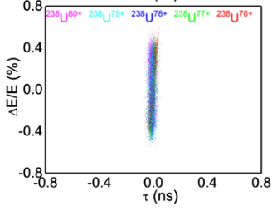
Beam Dynamics Requirements in the FS1
Drift
<15 ps
Accelerate
Drift
Accelerate

Slide 13
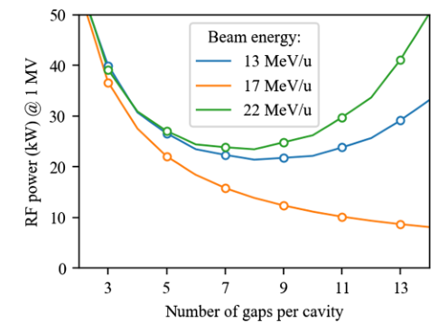
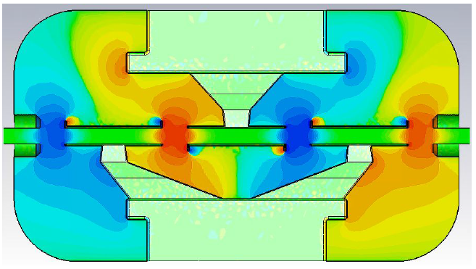
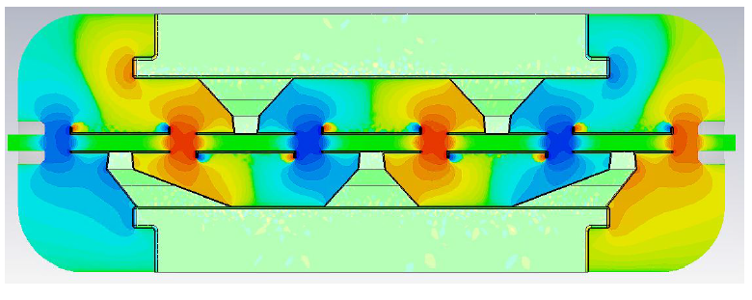
Multiphysics Design of the Accelerating Structure
Has high shunt impedance at low beta, making it suitable for CW operation.
Requires velocity acceptance and shunt impedance optimization.
→ Utilizes 7 gaps.
Number of gaps = 4
Q factor = 17577
Shunt impedence = 38 MΩ
Number of gaps = 6
Q factor = 19235
Shunt impedence = 65 MΩ

Slide 14
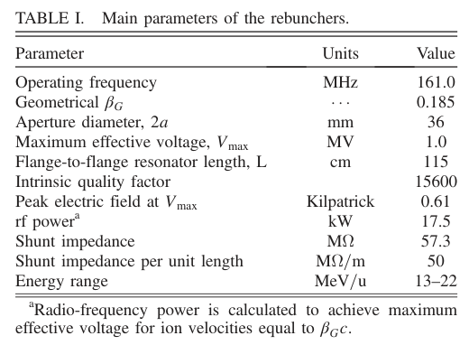
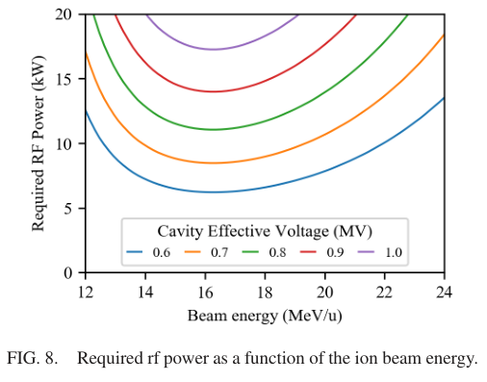
Multiphysics Design of the Accelerating Structure
The rf power of 17.5 kW is sufficient to provide the required voltages for the ion species in the energy range from 13 to 22 MeV/u.

Slide 15
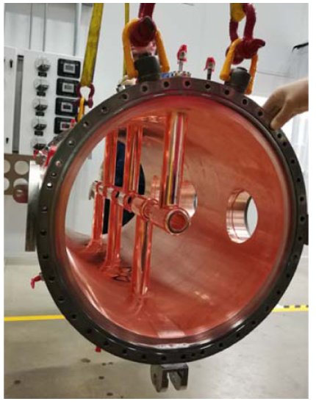
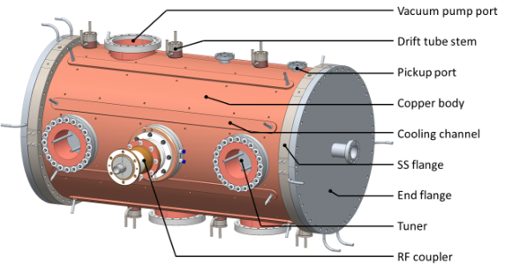
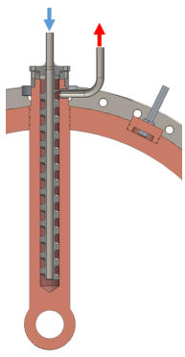
Mechanical Design and Fabrication
Cooling water channels are installed throughout the resonator body, stems, couplers, and tuners.
The motorized tuner is in the feedback with a LLRF system.

Slide 16
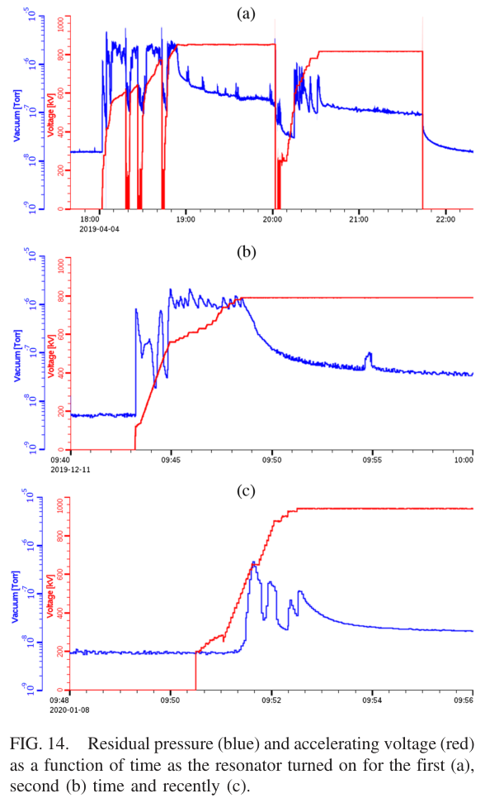
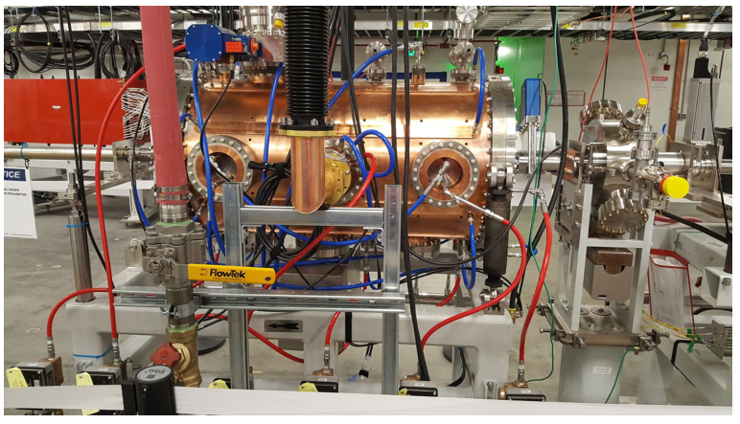
RF and Beam Testing
Both fabricated rebunchers were installed in the FRIB beamline, followed by RF commissioning.

Slide 17
Summary
The rebuncher was well-designed, closely matching the design specifications.
At low energies below 20 MeV/u, RT-DTL has a higher shunt impedance than SC rebuncher.
Considering cooling and contamination issues, RT-DTL may be more advantageous than SC rebuncher.

Slide 18
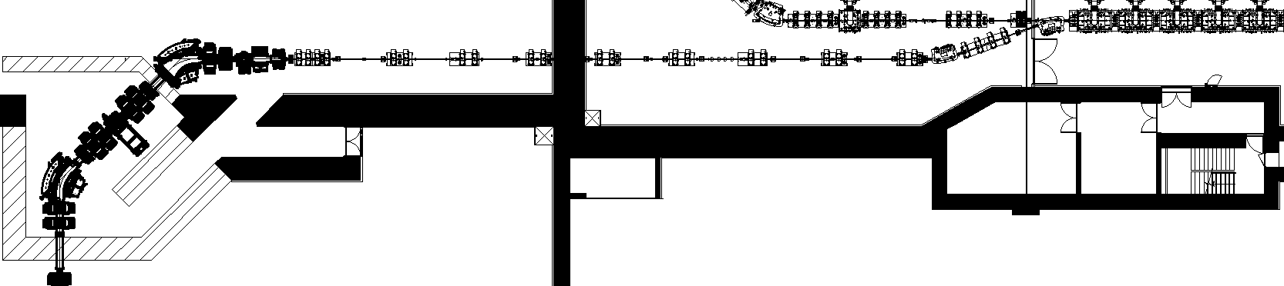
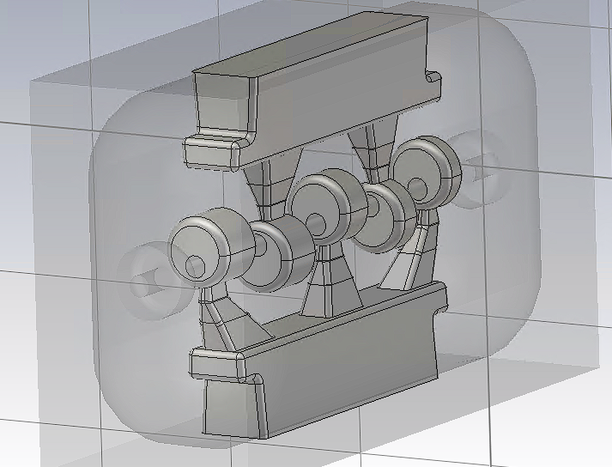
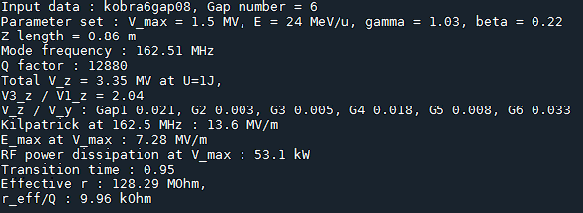
Rebuncher at SCL3-KoBRA Beamline (RAON)
KoBRA target
End of SCL3
SCL3
Beam
Rebuncher

Slide 19
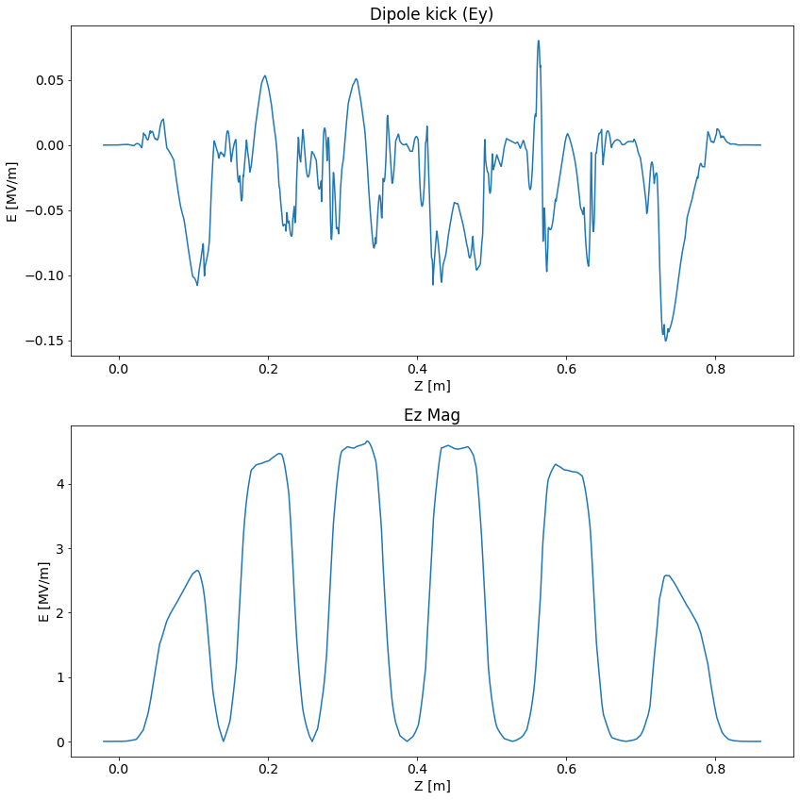
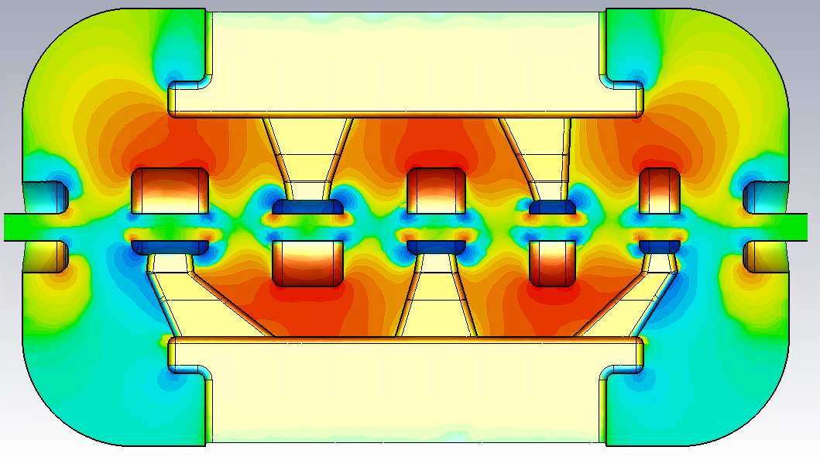
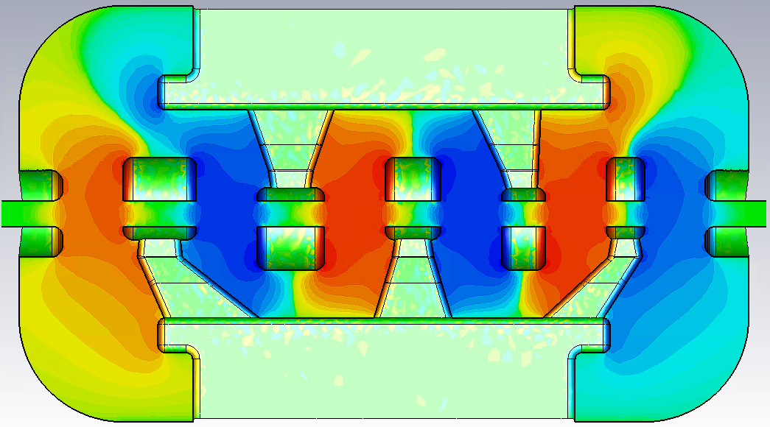
Rebuncher at SCL3-KoBRA Beamline (RAON)
Ey
Ez

