Slide 1
Experimental Demonstration of Energy-Chirp Control in Relativistic Electron Bunches Using a Corrugated Pipe
2025-02-28, Pohang, South Korea
Young Min Park
Division of Advanced Nuclear Engineering (DANE), POSTECH

Slide 2
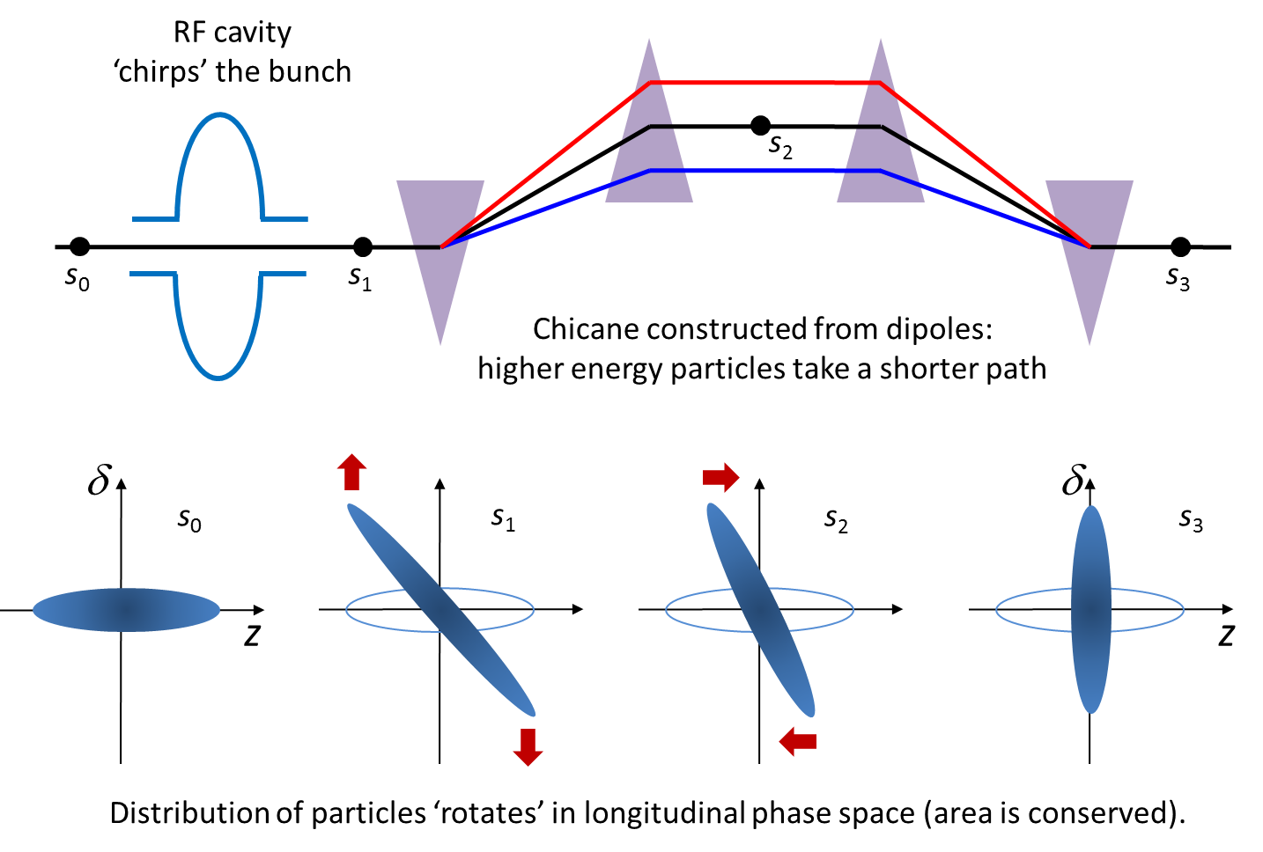
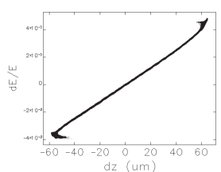
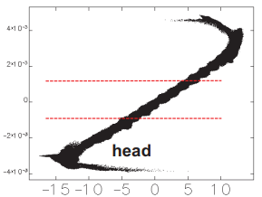
Basic structure in FEL
Energy chirp
Correlation between $t$ and $δ$ in the longitudinal direction.
In a typical free-electron laser (FEL), RF phase of linac can induce energy chirp
Bunch compressor
Reduces bunch length through a magnet structure (e.g. Chicane)
Energy deviation remains unchanged during passage $→$ Chirp remain
Chirp
2

Slide 3
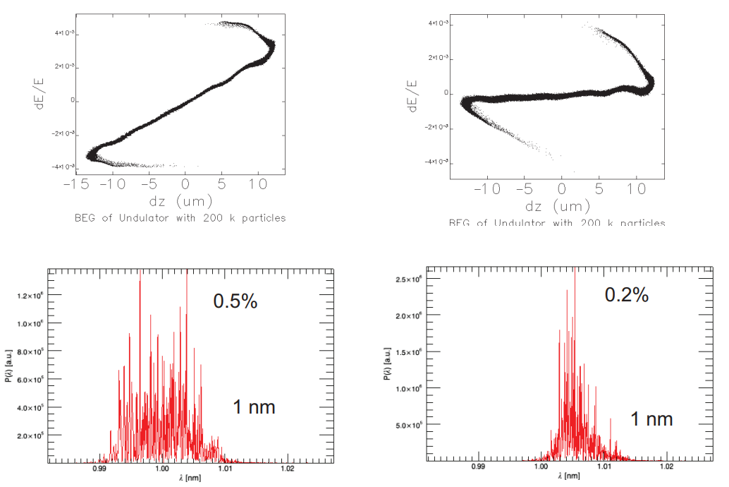
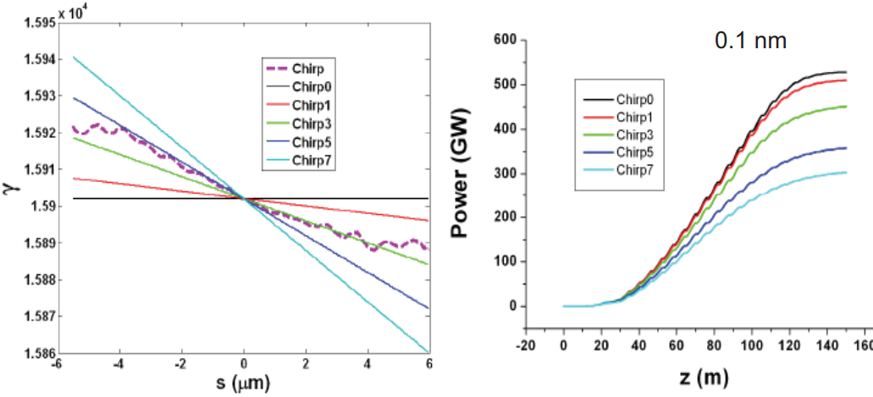
Basic structure in FEL
Energy chirp vs FEL efficienty
Energy chirp can broaden the FEL bandwidth and reduced FEL power
3

Slide 4
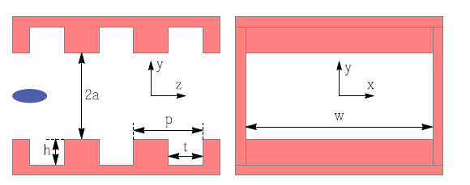
Basic structure in FEL
Previous method to remove chirp
Construct additional linac section and adjust RF phase to remove energy chirp
Solution can be costly or impractical in next-generation FELs.
Requires additional space for RF cavities.
Dechirper
Dechirp : Remove energy chirp
Dechirper : structure to generate strong longitudinal wakefields to dechirp the beam
Solution can be costly or impractical in next-generation FELs.
$$dE/E$$
$$dE/E$$
$$z$$
4

Slide 5
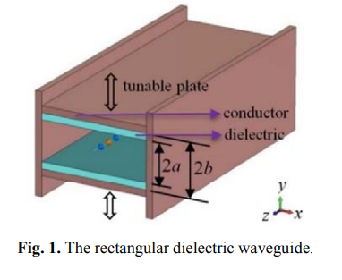
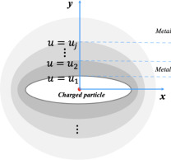
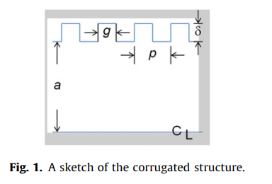
Dechirper
Dielectric-lined waveguide
Rectangular corrugated wall
Smooth pipe shows non-linearity, while corrugated pipe shows linear.
Flat geometry (Rectangular geometry) has better controllability.
Effective for variable bunch charge and bunch length
Unwanted transverse wakefields can increases beam emittance and deterioration of FEL performance
Small radius resistive pipe
Measurements of both longitudinal and transverse wake effects was needed.
Metallic corrugated wall
5

Slide 6
Dechirper
$$W_{d}$$
$$W_{q}$$
Parameter | Value (mm)
g | $$5\sim 28$$
p | $$0.5$$
h | $$0.6$$
t | $$0.3$$
w | $$50$$
$$W_{z}\left(s\right)≈\frac{Z_{0}cπ}{4g^{2}}⋅\cos\left(ks\right), k=\frac{1}{0.22\sqrt{\frac{ght}{2p}}}$$
$$W_{y}\left(s\right)=W_{d}\left(s\right)y_{1}+W_{q}\left(s\right)y_{t}$$
$$W_{x}\left(s\right)=W_{q}\left(s\right)\left(x_{1}−x_{t}\right), for w≫g$$
Let we assume $y_{1}=y_{t}, x_{1}=x_{t}$
$$W_{d}, W_{q}∝\frac{1}{g^{4}}$$
Maxwell numerical solution
6

Slide 7
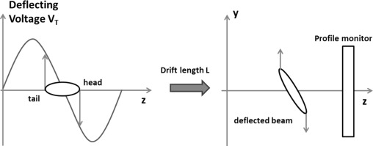
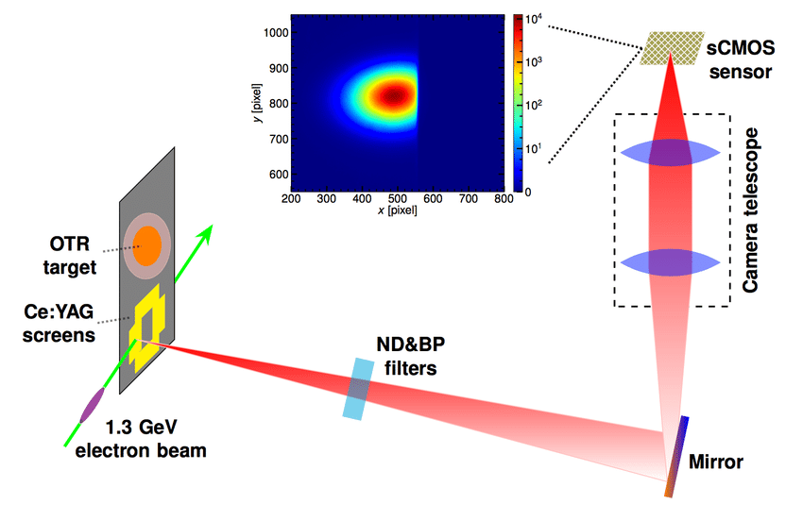
PAL-ITF
S-band accelerating structures
Photo-cathode gun
PAL-ITF(Injection Test Facility)
2856 MHz rf photocathode gun (beam charge $Q=200 pC$)
3-m long S-band accelerating structures (beam energy $70 MeV$)
1-m long rf deflector ($0.5 MV$)
Spectrometer ($30 °$)
4 YAG:Ce screens and CCD camera (9 $μm/pixel$ resolution)
Screen 3-4 $→$ Beam size measure
Screen 5-6 $→$ Time resolved measurements of longitudinal and transverse wake effects
7

Slide 8
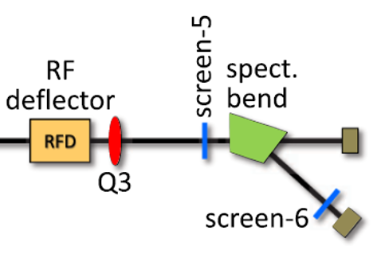
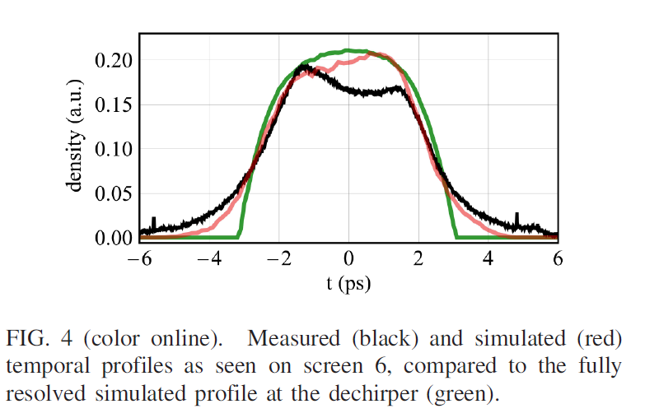
Measurements method
Time resolved measurements of longitudinal and transverse wake effects
$y−$axis deflector on (Calibration by varying rf degrees)
$$y$$
$$y$$
Time
$$z$$
$$z$$
Bending on (Calibration by bend’s magnetic field)
$$\frac{dE}{E}$$
$$\frac{dE}{E}$$
Screen-6
$$\frac{dE}{E}$$
$$x$$
$$x$$
8

Slide 9
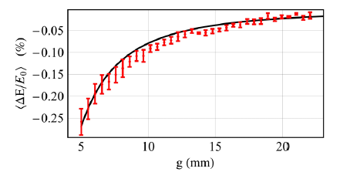
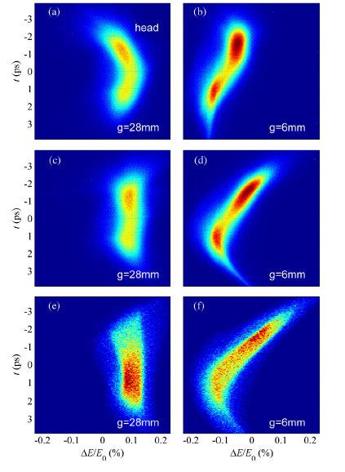
Measure and Simulation
$w/o$ wake
$with$ wake
Measured
Energy loss measurements
Measure beam centroid horizontal position as the dechirper gap is varied from 5 to 28 mm.
Error bar : N=4 rms variation (~ 2 days)
RF deflector is switched off for centroid measurements.
Measured and correction
Simulation (ASTRA to L0b, ELEGANT)
9

Slide 10
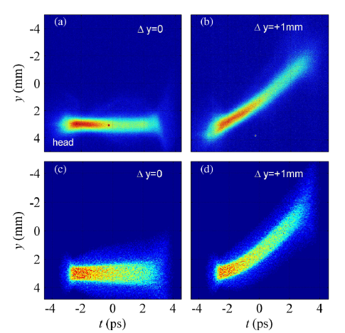
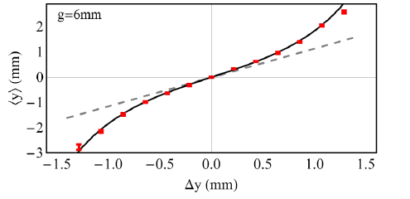
Measure and Simulation
on axis
off axis
Turn off rf deflector and adjust L0a rf phase to make strong energy chirp.
Better to measure through screen 5 without time coordinates.
Measured
$$x axis→\frac{dE}{E}→time$$
$$y axis→y$$
Simulation
10

Slide 11
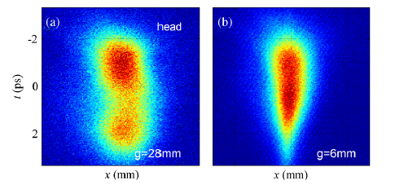
Measure and Simulation
Extra focusing $→$ Can lead emittance growth (10 %)
Turn on rf deflector to measure by $x$ vs $t$
$y−$axis deflector on (Calibration by varying rf degrees)
$$y$$
$$y$$
Time
$$z$$
$$z$$
$$x$$
Screen-5
11

Slide 12
Summary
By using time-resolved measurements, they confirm both the linearity and the approximate scale of the wake-induced chirp of the corrugated chamber.
This results give on confidence in the practicality of including a corrugated-wall dechirper in the design of next-generation FELs.
12

Slide 13
Thank you for your attention!
13

