Slide 1
Study of non-linear effects of TDC and tomography of phase space
25. 03. 10
Geunwoo Kim

Slide 2
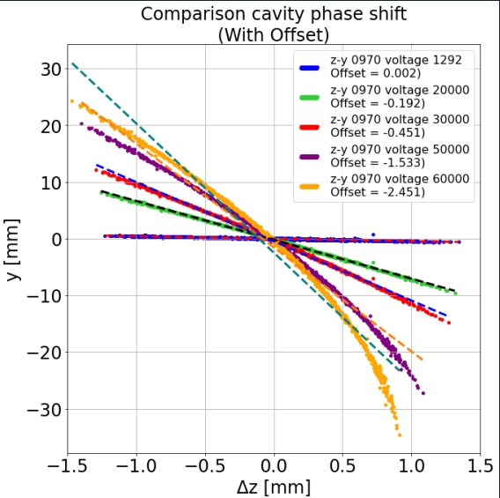
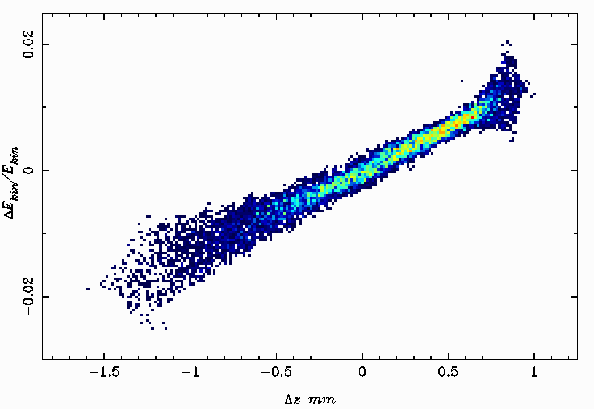
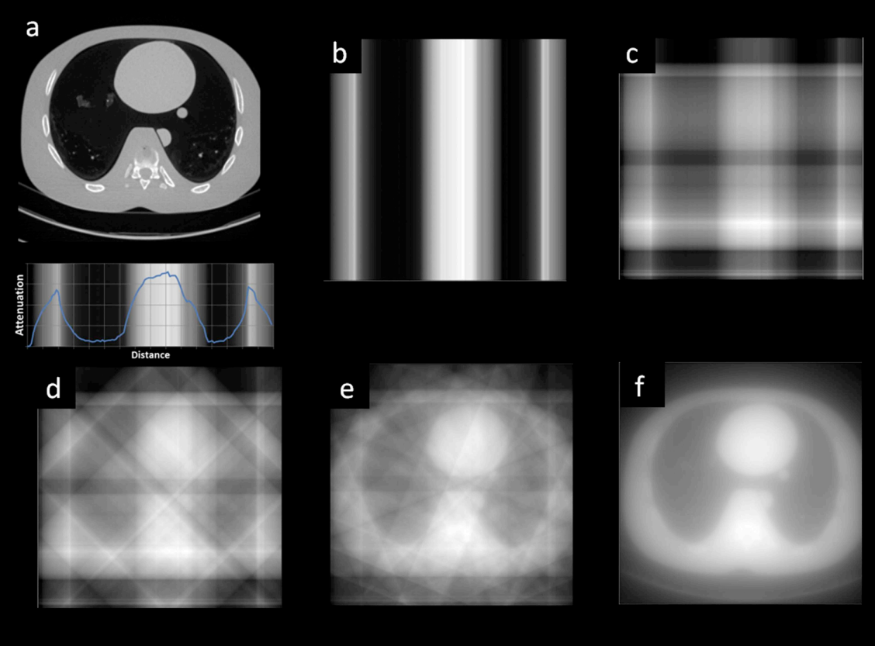
Outline: Current progress
TDS non-linear effects
Non-linear kick at higher V in Z-Y space
Flip energy chirp in Z-δ longitudinal space
Tomography of Phase Space
Principle of reconstruction procedure
Transform-based
Algebraic-based
Maximum Entropy
Z-Y space
Z-δ space
2

Slide 3
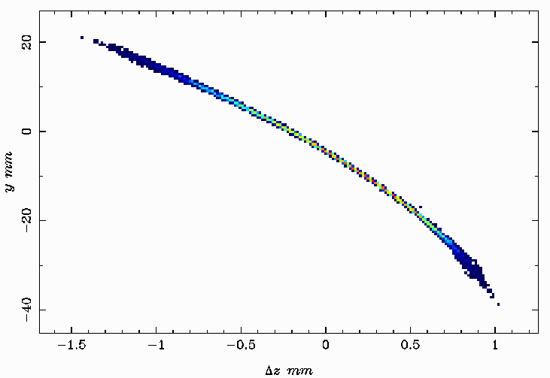
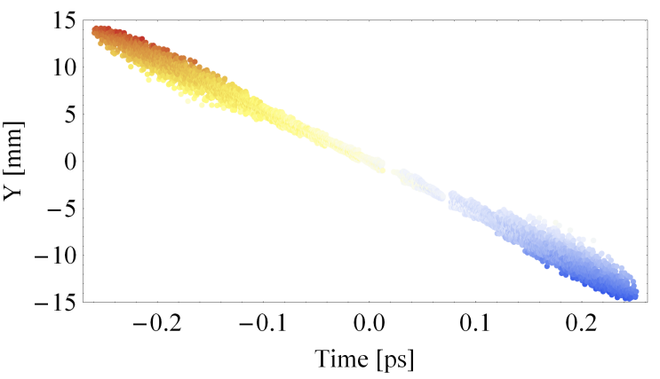
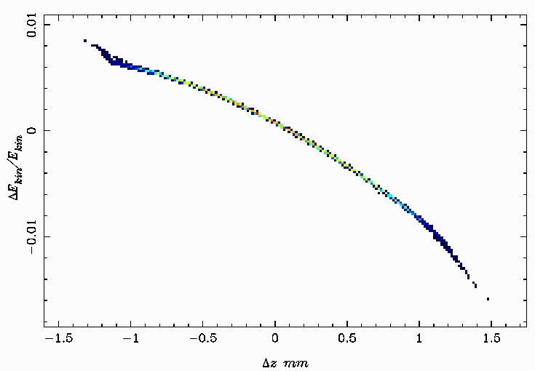
TDC non-linear effects
In general, ΔE_{tail}>ΔE_{head} for phase stability.
Tail
Head
RF
deflecting
cavity
Acquired results
for V⊥ > 10 MV
Expected Output
ΔE_{tail}
?
E_{head}
ΔE_{head}
E_{tail}
3

Slide 4
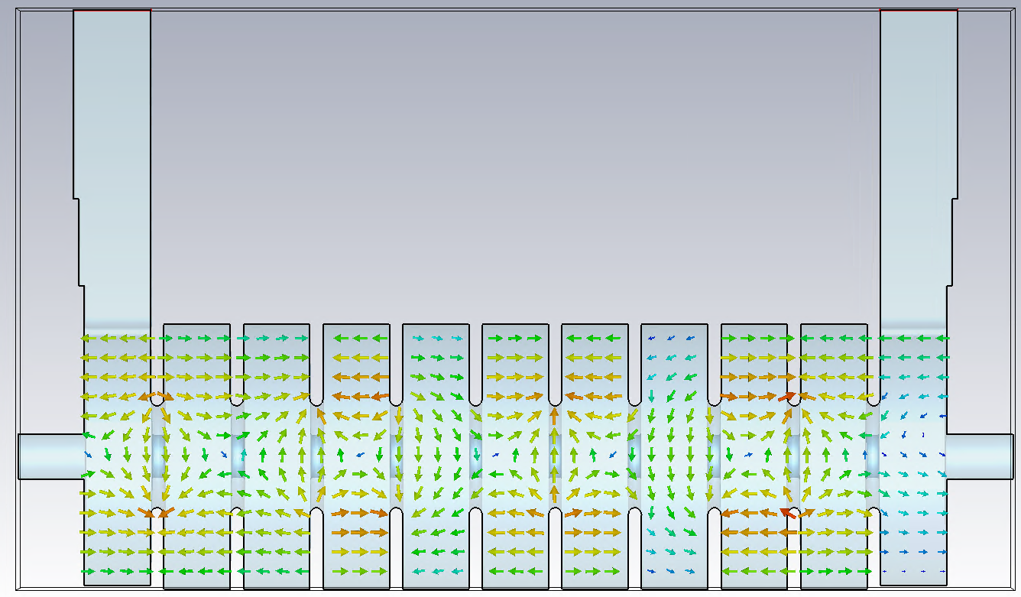
TDC non-linear effects
PIC simulation
- To monitor the motion of bunch inside TDS.
E field
H field
4

Slide 5
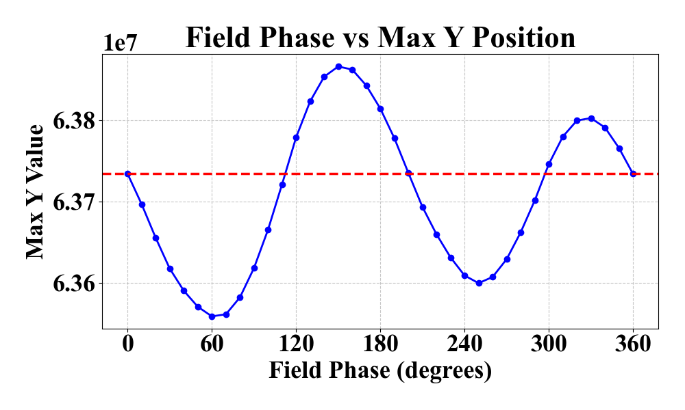
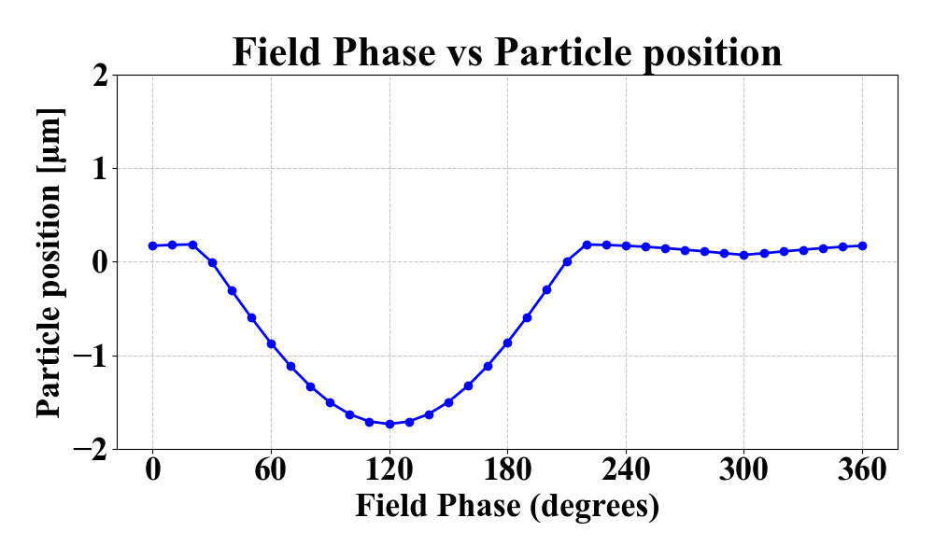
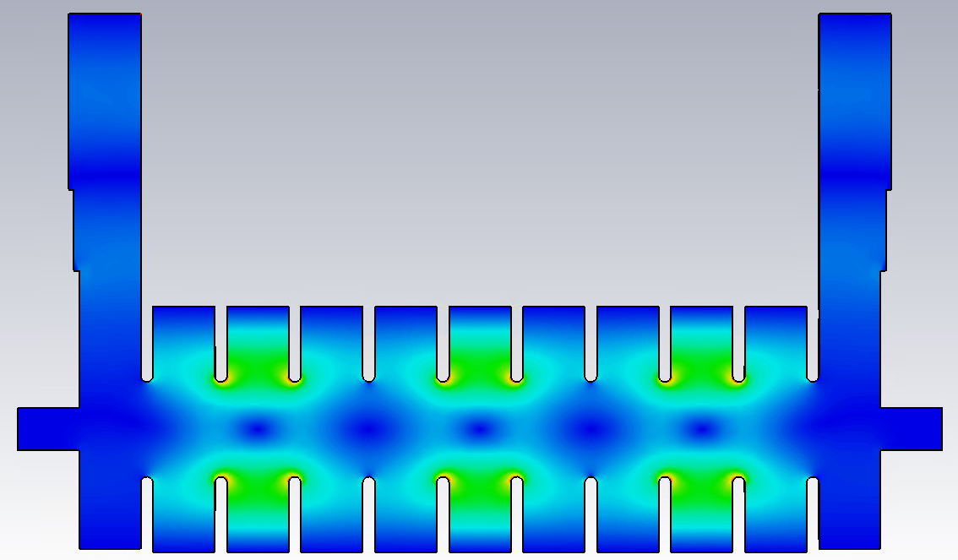
TDC non-linear effects
Some issues in PIC simulation
Non-uniform field distribution
Difficult to synchronize the beam and field
Use only active cell range
30 deg
210 deg
30 deg
210 deg
5

Slide 6
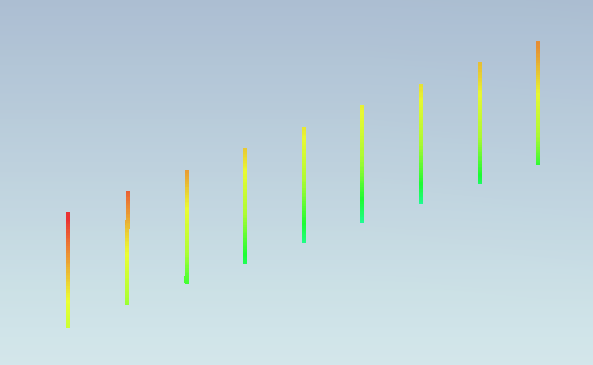
TDC non-linear effects
Particle tracking at 30 deg
Tail
E_{z, head}
E_{z, tail}
Head
→ Still, non-flipped(Negative) chirp
6

Slide 7
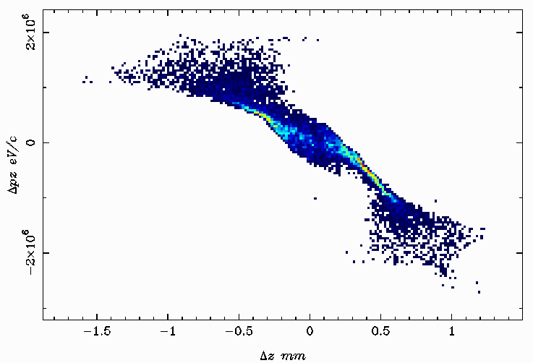
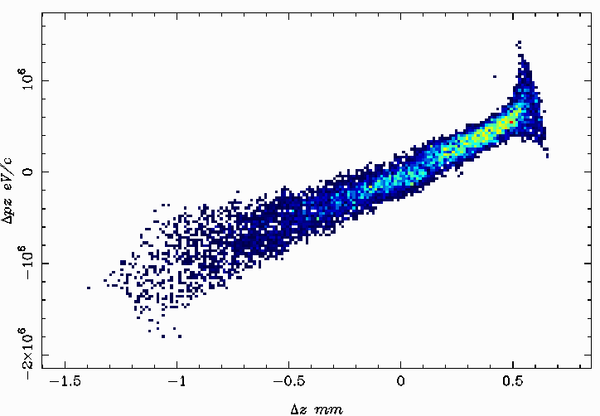
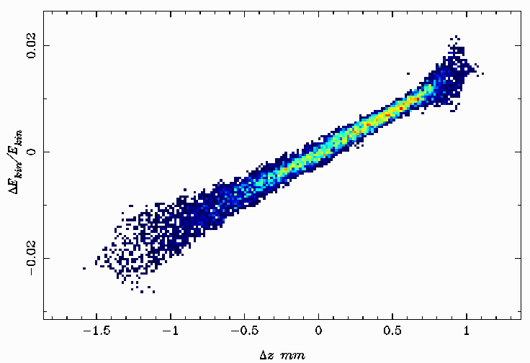
TDC non-linear effects
ASTRA simulation
Field offsets of TDC.
Longitudinal energy dispersion effects via TDC.
Space charge effects
Field offsets of TDC.
<Field offset -5 mm>
< Field offset 2.5 mm>
< Field offset -2.5 mm>
7

Slide 8
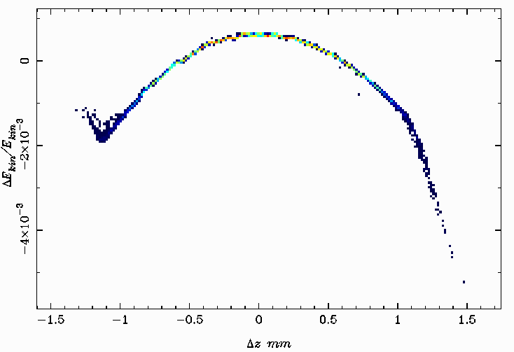
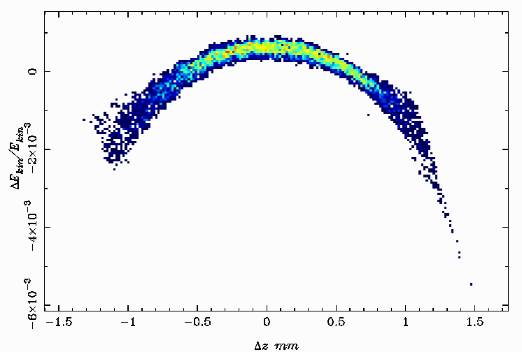
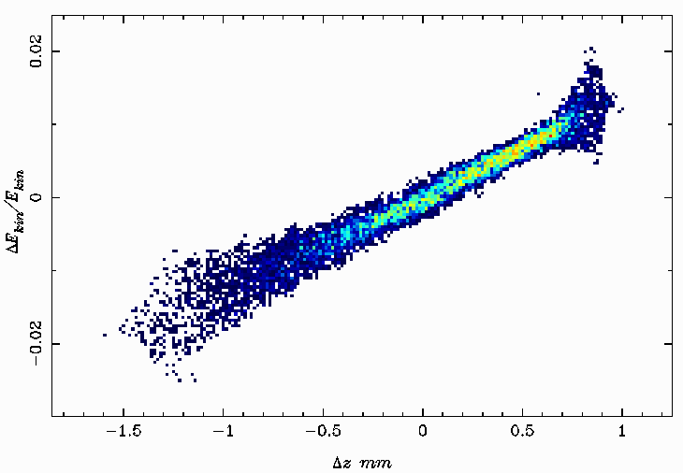
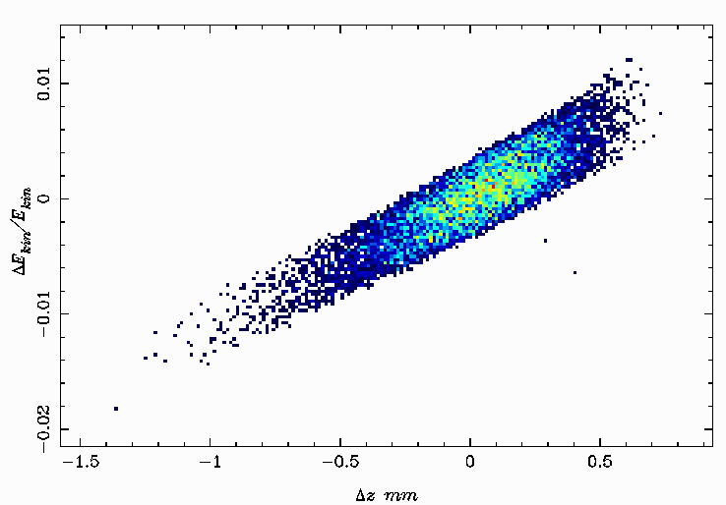
TDC non-linear effects
2 & 3. TDC dispersion effects and space charge effects
<I. Entrance at TDC>
<II. Exit at TDC>
<III. w/ space charge effects>
<IV. w/o space charge effects>
8

Slide 9
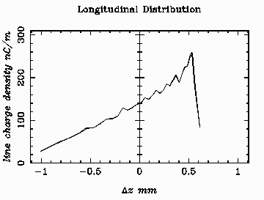
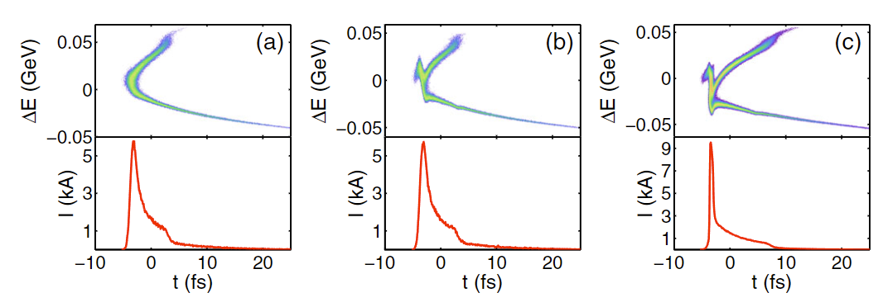
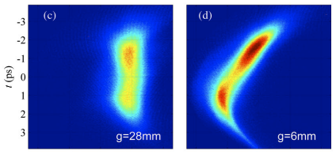
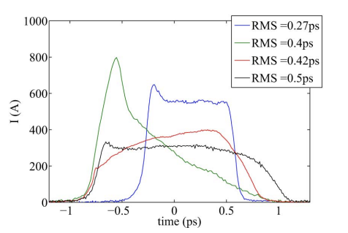
TDS non-linear effects
ASTRA simulation
It looks like the bunch distribution after bunch compressor
Head
Optimization booster cavity settings to mitigate current spikes
Removing rf curvature of booster cavity
Tail
9

Slide 10
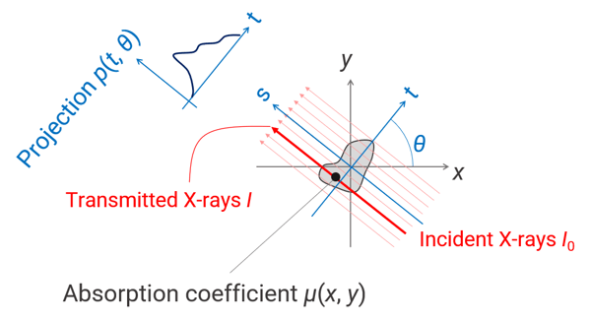
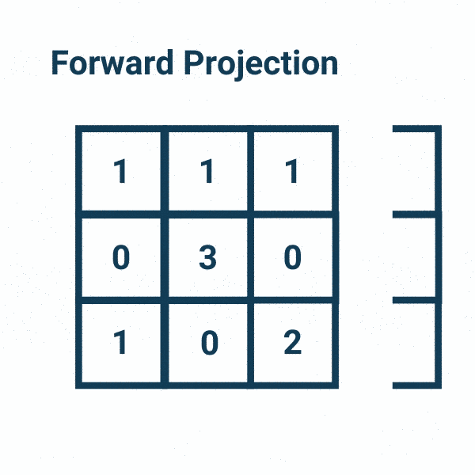
Tomography of Phase Space
Principle of tomography (Radon transformation)
How to obtain the projection data?
<Radon transformation>
10

Slide 11
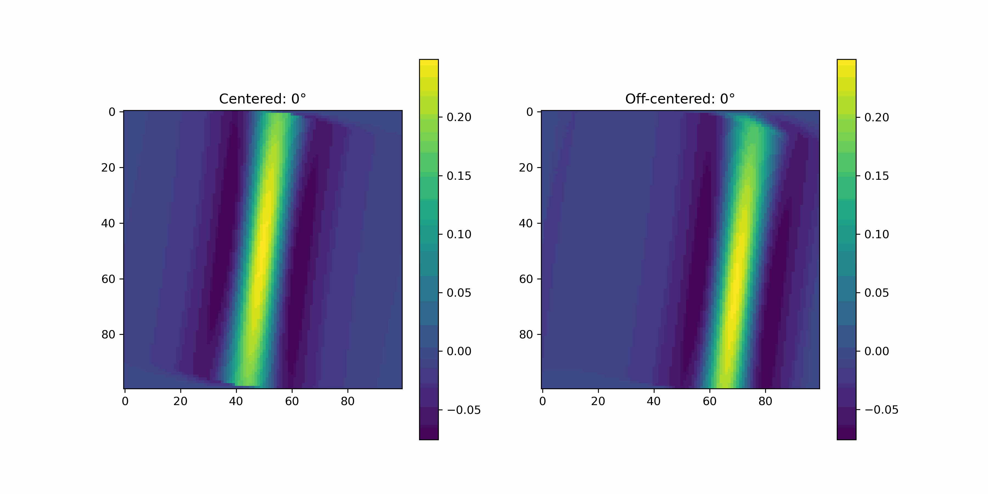
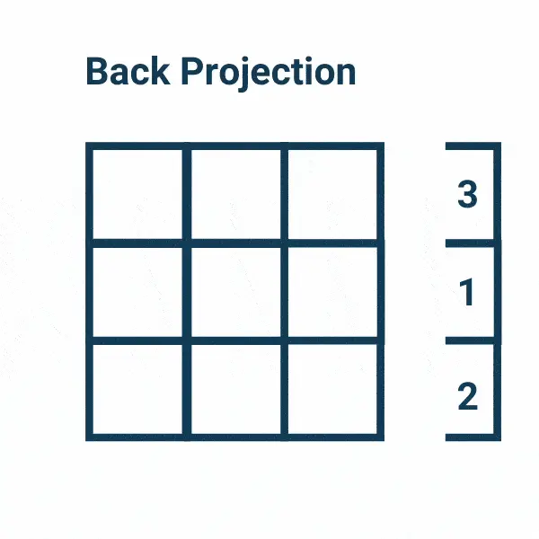
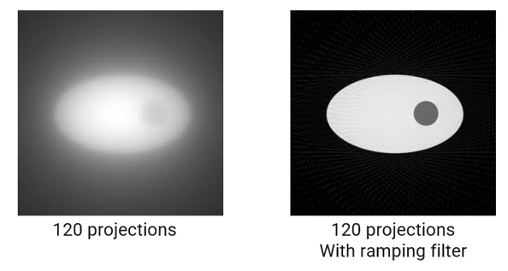
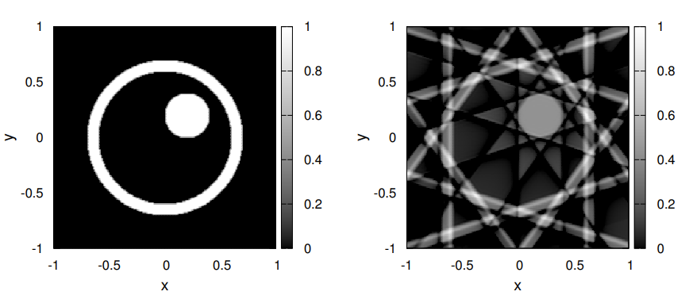
Tomography of Phase Space
Filtered Back Projection (FBP)
<Inverse Radon transformation>
But, FBP strongly depends on…
1. spaced angle
2. # the projection data
11

Slide 12
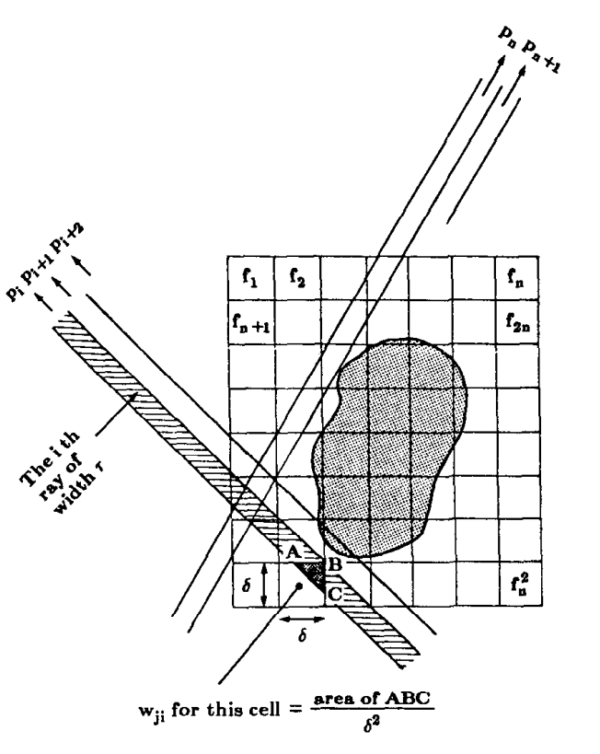
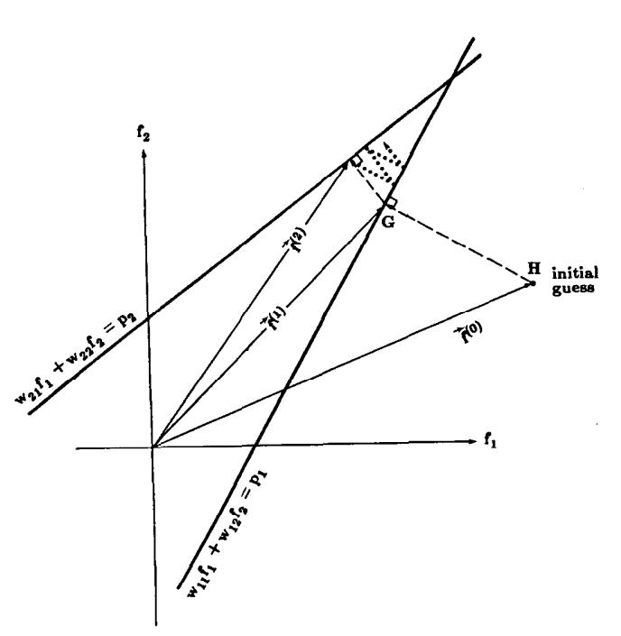
Tomography of Phase Space
Algebraic Reconstruction Technology (ART)
Solve linear system $Ax=b$ via iterative methods.
$Σ_{j=1}^{N}w_{ij}f_{j}=p_{i} i=1,2,⋯,M$ where p_{i} is a hyperplane
Simple case for 2 by 2 image
$w_{11}f_{1}+w_{12}f_{2}=p_{1}$
$w_{21}f_{1}+w_{22}f_{2}=p_{2}$
Advantages of ART
1. Less dependency on measurement angles
2. Effective reconstruction with incomplete data
12

Slide 13
Summary & Next steps
TDC nonlinear effects study
PIC simulation
ASTRA
Field offsets of cavity
Dispersion via TDC
Space charge effects
Understand of phase space tomography
Filtered back projection (FBP)
Algebraic reconstruction technology (ART)
Booster cavity optimization
Organize required components for transverse or longitudinal phase space
13

